Slide 1
β-decay of ⁶⁸Mn: Probing the N = 40 Island of Inversion
Rashmi Umashankar
UBC/TRIUMF

Slide 2
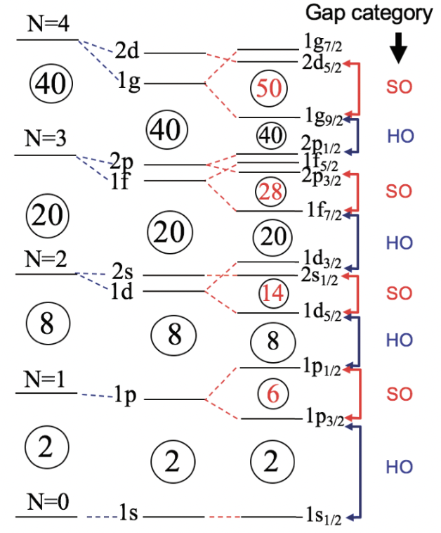
Nuclear Shell Model
Winter Nuclear & Particle Physics Conference, Feb 13-16, 2025
Notes:
- well-known divergence from the independent-particle shell model description
the single particle energies are modified and strong quadrupole correlations overcome the spherical mean-field gaps
deformed intruder configurations being more energetically favorable to the extent that they often become the ground state
some of the features that you would normally expect from a shell or a subshell closure disappear in these regions.

Slide 3
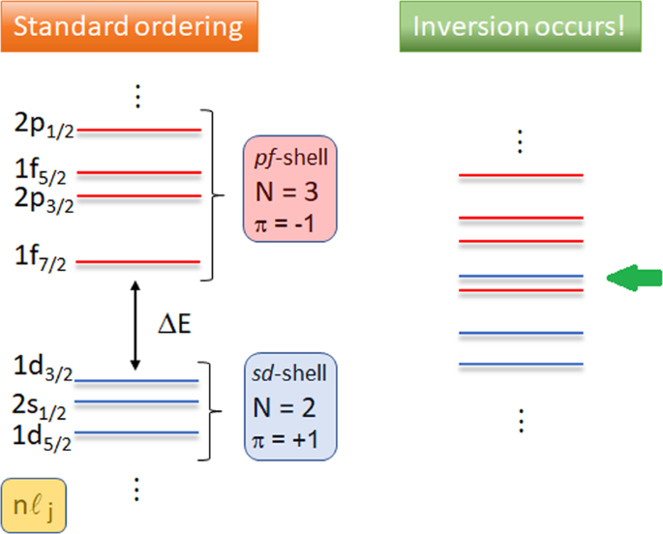
Island of Inversion
pf shell
sd shell
Winter Nuclear & Particle Physics Conference, Feb 13-16, 2025
Fortunato, L., Casal, J., Horiuchi, W. et al. Commun Phys 3, 132 (2020)
Notes:
- well-known divergence from the independent-particle shell model description
the single particle energies are modified and strong quadrupole correlations overcome the spherical mean-field gaps
deformed intruder configurations being more energetically favorable to the extent that they often become the ground state
some of the features that you would normally expect from a shell or a subshell closure disappear in these regions.

Slide 4
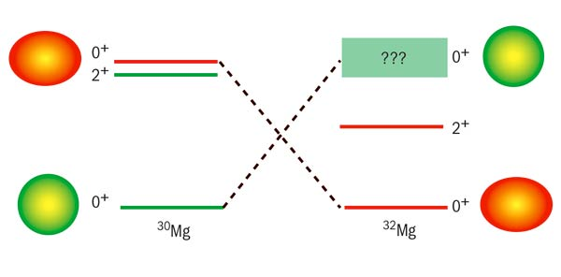
Island of Inversion
pf shell
sd shell
Winter Nuclear & Particle Physics Conference, Feb 13-16, 2025
Fortunato, L., Casal, J., Horiuchi, W. et al. Commun Phys 3, 132 (2020)
K. Wimmer et al. Phys. Rev. Lett. 105 (2010)
Notes:
- well-known divergence from the independent-particle shell model description
the single particle energies are modified and strong quadrupole correlations overcome the spherical mean-field gaps
deformed intruder configurations being more energetically favorable to the extent that they often become the ground state
some of the features that you would normally expect from a shell or a subshell closure disappear in these regions.

Slide 5
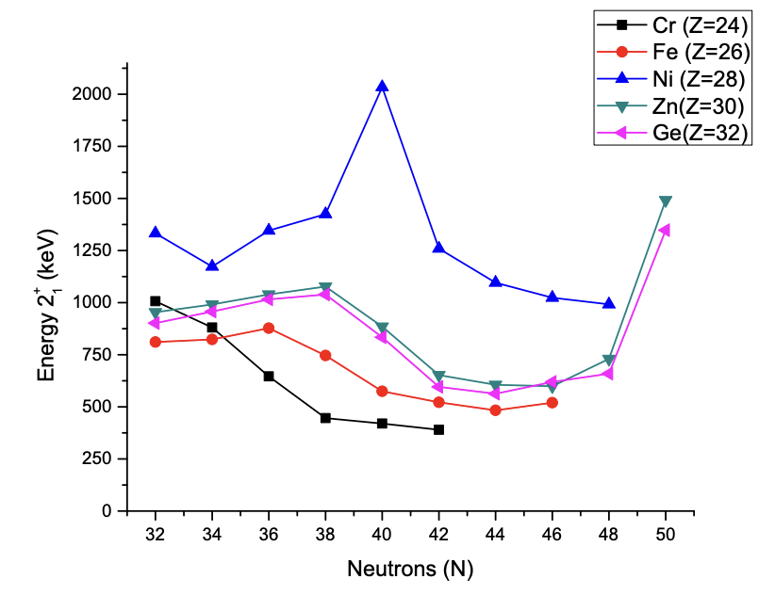
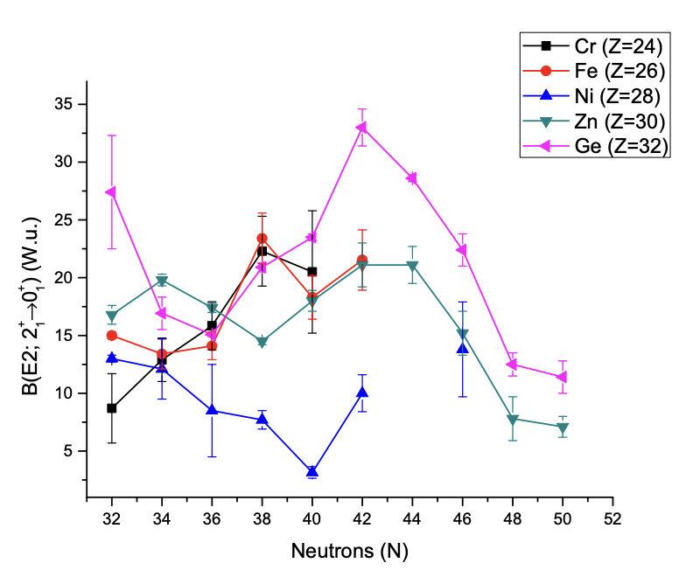
Suggested magicity of N = 40
Large energy gap between the pf shell and neutron 0g_{9/2} shell
Sub-shell closure at N=40
Evidenced by ⁶⁸Ni (Z = 28):
Doubly magic behavior
Large E(2⁺) = 2.033 MeV
Small B(E2; 0⁺→ 2⁺) = 3.2 (7) W.u
O. Sorlin et al., Phys. Rev. Lett. 88, 092501 (2002).
T. Otsuka, Physics 4(1), 258-285 (2022)
Winter Nuclear & Particle Physics Conference, Feb 13-16, 2025
Notes:
N=40 is not a standard magic number.
the existence of the sub-shell closure at N = 40 was proposed since a relatively large gap separates the pf shell from the neutron g9/2 orbital. This picture was initially confirmed by the measurements done in 68Ni. 68Ni has 28 protons and 40 neutrons and Z=28 is an already established magic number. If N=40 was indeed magic, then 68Ni would exhibit doubly magic behavior and this is exactly what we observe from measuring the 2+ energy and E2 transition strength. The excitation energy of the 2+ state is measured at 2035 keV which is higher than neighbouring Ni isotopes. The corresponding electromagnetic transition probability / reduced transition rate of the 2+ to 0+ transition was also measured to be relatively low.
However, this alone cannot be a conclusive argument in favor of shell closure since there have been studies (including mass measurements) that refute this proposed idea.

Slide 6
N = 40 Island of Inversion
Fe isotopes: Energy of the 2₁⁺ state changes from 2033 keV in ⁶⁸Ni to 573 and 521 keV in ⁶⁶Fe and ⁶⁸Fe, respectively
Systematics indicate a sudden increase in collectivity around N = 40 and Z < 28
Successfully described by LNPS interaction – pf shell for protons, 1p_{3/2}0f_{5/2}1p_{1/2}0g_{9/2}1d_{5/2} orbitals for neutrons
Cr isotopes: 2₁⁺ energies decrease gradually beyond N = 32 with lowest E(2₁⁺) measured at 390 keV for ⁶⁶Cr
Winter Nuclear & Particle Physics Conference, Feb 13-16, 2025
Notes:
The large energy gap between the pf and 0g9/2 orbitals which suggests the magic nature of N=40 reduces or even disappears with the removal of protons.
Consider the case of Fe. It has 26 protons which is not a magic number. However, if N=40 were indeed magic, then 66Fe would expect semi magic tendencies. But that is not to be seen.
The removal of only two protons from the f7/2 orbital has a drastic effect on the collectivity in Fe isotopes and changes the energy of the 2+state from 2033 keV in 68Ni to 573 and 517 keV in 66Fe and 68Fe, respectively. A similar behavior is observed in the Cr isotopes with Z=24, where the 2+ energies decrease gradually beyond N = 32 with the lowest 2+ energy measured in 64Cr. This sudden onset of deformation along the Fe and Cr chains has also been inferred from B(E2) systematics.

Slide 7
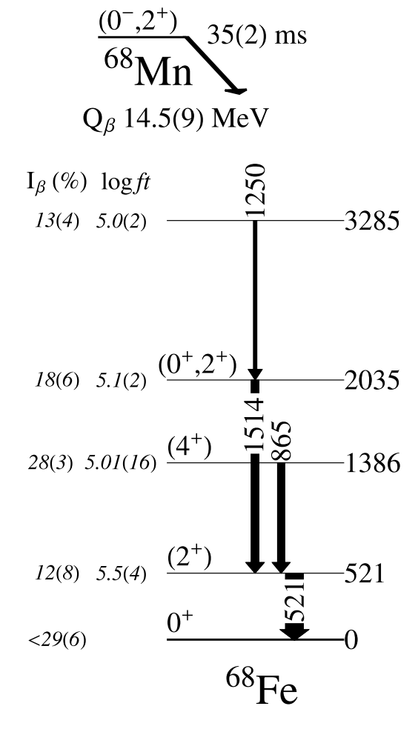
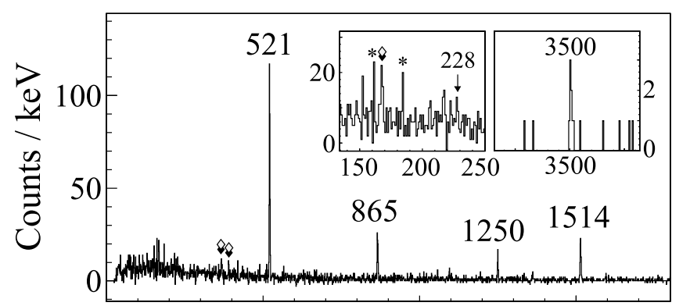
Measurement goals in ⁶⁸Fe
Previous Work – G.Benzoni et. al. (2015)
G. Benzoni, et al. Physics Letters B, 751:107–112 (2015).
Winter Nuclear & Particle Physics Conference, Feb 13-16, 2025

Slide 8
Measurement goals in ⁶⁸Fe
Expand the level scheme through 𝛾𝛾 coincidence analysis
Measure branching ratios with high precision
G. Benzoni, et al. Physics Letters B, 751:107–112 (2015).
Winter Nuclear & Particle Physics Conference, Feb 13-16, 2025

Slide 9
Measurement goals in ⁶⁸Fe
Expand the level scheme through 𝛾𝛾 coincidence analysis
Measure branching ratios with high precision
Clarify shape coexistence interpretation
Deformed band built on g.s
Spherical band built on the 0⁺ 2035 keV level?
G. Benzoni, et al. Physics Letters B, 751:107–112 (2015).
Winter Nuclear & Particle Physics Conference, Feb 13-16, 2025

Slide 10
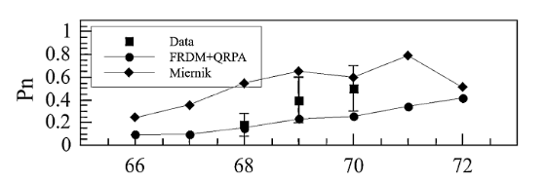
Measurement goals in ⁶⁸Fe
Expand the level scheme through 𝛾𝛾 coincidence analysis
Measure branching ratios with high precision
Clarify shape coexistence interpretation
Deformed band built on g.s
Spherical band built on the 0⁺ 2035 keV level?
Re-measure β-delayed neutron emission probability
Currently Benzoni et. al. report
Structure of ⁶⁷Fe
G. Benzoni, et al. Physics Letters B, 751:107–112 (2015).
Winter Nuclear & Particle Physics Conference, Feb 13-16, 2025

Slide 11
Measurement goals in ⁶⁸Fe
Expand the level scheme through 𝛾𝛾 coincidence analysis
Measure branching ratios with high precision
Clarify shape coexistence interpretation
Deformed band built on g.s
Spherical band built on the 0⁺ 2035 keV level?
Re-measure β-delayed neutron emission probability
Currently Benzoni et. al. report
Structure of ⁶⁷Fe
Compare against theoretical calculations
G. Benzoni, et al. Physics Letters B, 751:107–112 (2015).
Winter Nuclear & Particle Physics Conference, Feb 13-16, 2025

Slide 12
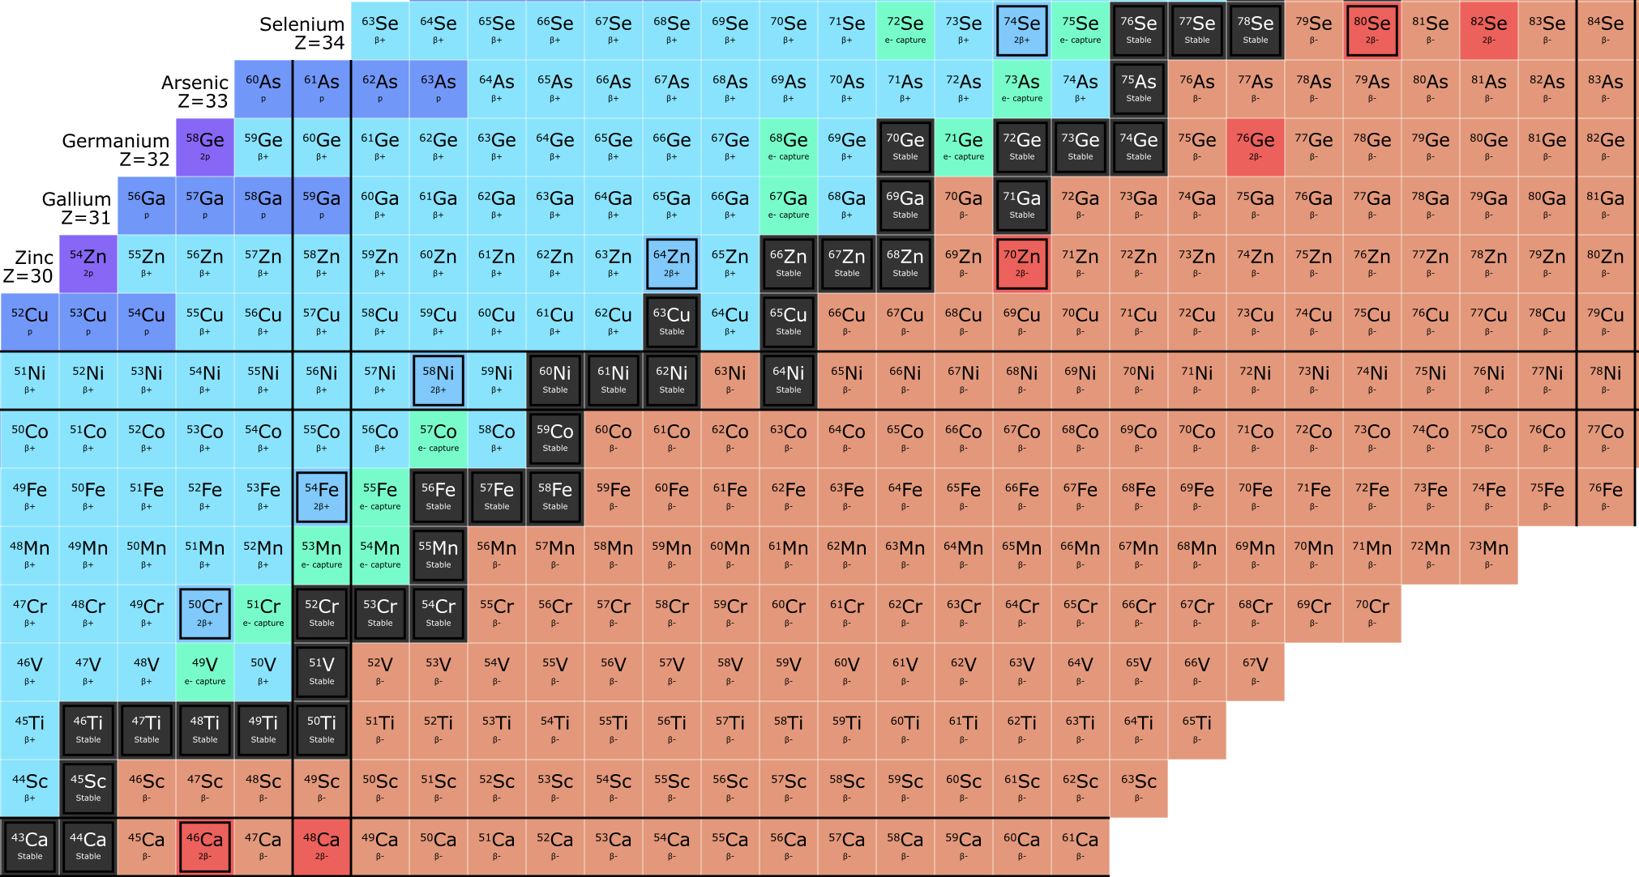
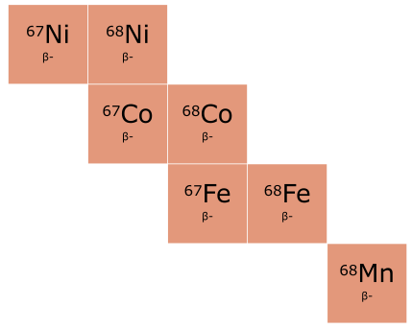
S1723: β decay of ⁶⁸Mn at GRIFFIN
N = 40
Z
S1723 campaign in 2021
Over 50 hours of data collection at ~ 15 pps
β decay
N
β-n decay
Winter Nuclear & Particle Physics Conference, Feb 13-16, 2025
Notes:
68Mn beams produced at TRIUMF

Slide 13
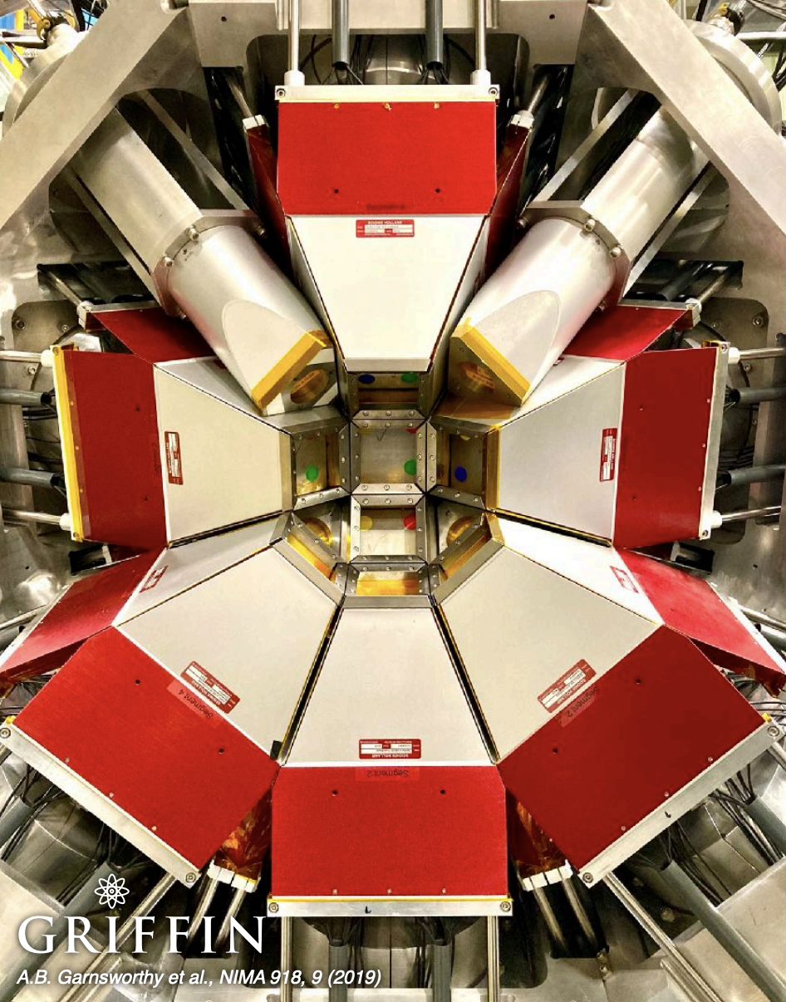
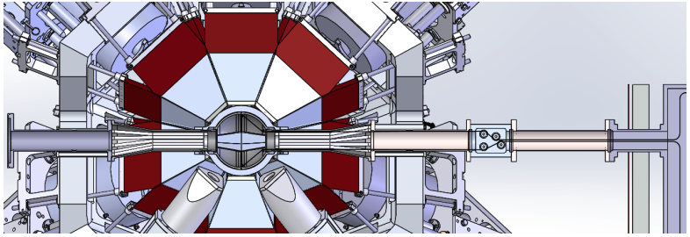
Beam
Implantation
★
Gamma-ray Infrastructure for Fundamental Investigations of Nuclei
A close-packed array of 16 Compton-suppressed large-volume HPGe clover detectors, 64 crystals
Winter Nuclear & Particle Physics Conference, Feb 13-16, 2025

Slide 14
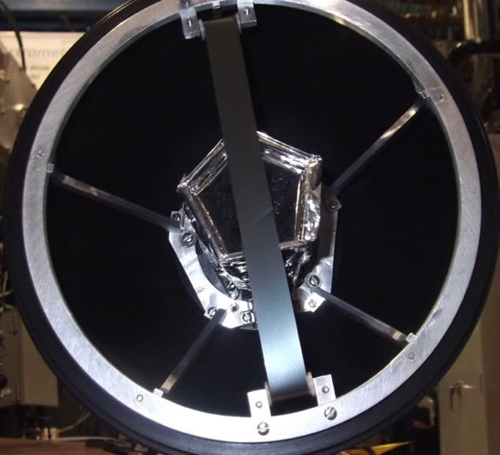
Beam
Implantation
★
Gamma-ray Infrastructure for Fundamental Investigations of Nuclei
SCEPTAR
Winter Nuclear & Particle Physics Conference, Feb 13-16, 2025

Slide 15
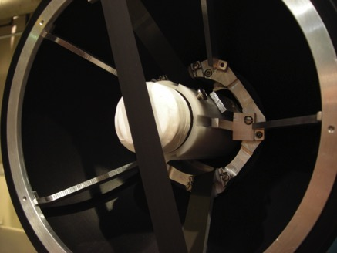
Beam
Implantation
★
Gamma-ray Infrastructure for Fundamental Investigations of Nuclei
SCEPTAR
Zero Degree Scintillator
Winter Nuclear & Particle Physics Conference, Feb 13-16, 2025

Slide 16
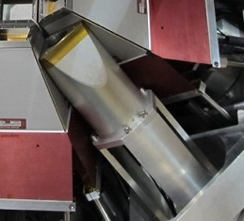
Beam
Implantation
★
Gamma-ray Infrastructure for Fundamental Investigations of Nuclei
SCEPTAR
Zero Degree Scintillator
LaBr₃(Ce)
Winter Nuclear & Particle Physics Conference, Feb 13-16, 2025

Slide 17
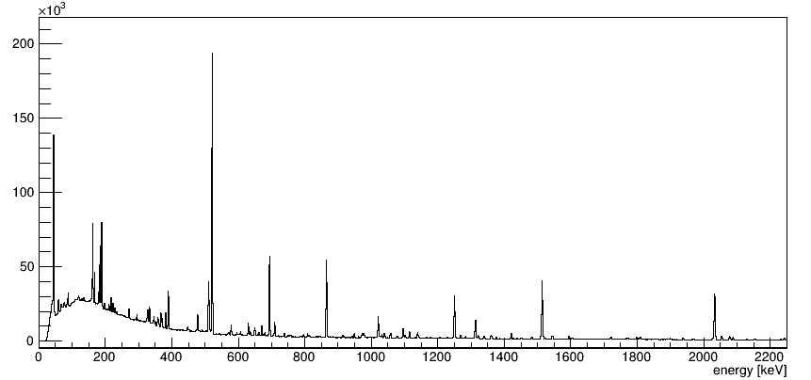
S1723: β decay of ⁶⁸Mn at GRIFFIN
Benzoni et al.
Benzoni et al.
x 10⁴ higher statistics
This work
521
⁶⁸Fe
⁶⁸Co
⁶⁸Ni
865
1514
Counts / keV
1250
Winter Nuclear & Particle Physics Conference, Feb 13-16, 2025
G. Benzoni, et al. Physics Letters B, 751:107–112 (2015).

Slide 18
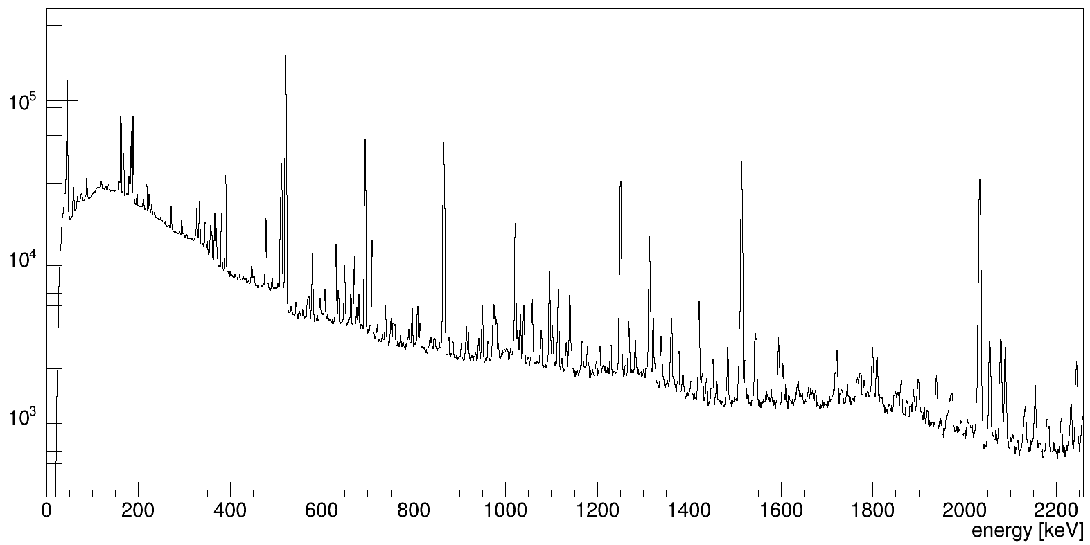
S1723: β decay of ⁶⁸Mn at GRIFFIN
Benzoni et al.
Benzoni et al.
521
865
1250
1514
⁶⁸Fe
⁶⁸Co
⁶⁸Ni
Counts / keV
Winter Nuclear & Particle Physics Conference, Feb 13-16, 2025
G. Benzoni, et al. Physics Letters B, 751:107–112 (2015).

Slide 19
18 new transitions
10 new excited states
Structure of ⁶⁸Fe
G. Benzoni, et al. Physics Letters B, 751:107–112 (2015).
Winter Nuclear & Particle Physics Conference, Feb 13-16, 2025
Notes:
Greatly expanded the level scheme with 18 new transitions and 10 new excited states

Slide 20
𝛾𝛾 angular correlations
Angular correlation: Measure the coincidence frequency of two successive decays at different angles (𝛾₂ with respect to 𝛾₁)
𝛳
Both gamma rays have an isotropic distribution in the laboratory frame
but have a well-defined correlation between them when measured
in coincidence!
Winter Nuclear & Particle Physics Conference, Feb 13-16, 2025
Schematic courtesy of M. Bowry

Slide 21
𝛾𝛾 angular correlations
Angular correlation: Measure the coincidence frequency of two successive decays at different angles (𝛾₂ with respect to 𝛾₁)
𝛳
Rate provides angular correlation
Winter Nuclear & Particle Physics Conference, Feb 13-16, 2025
Schematic courtesy of M. Bowry

Slide 22
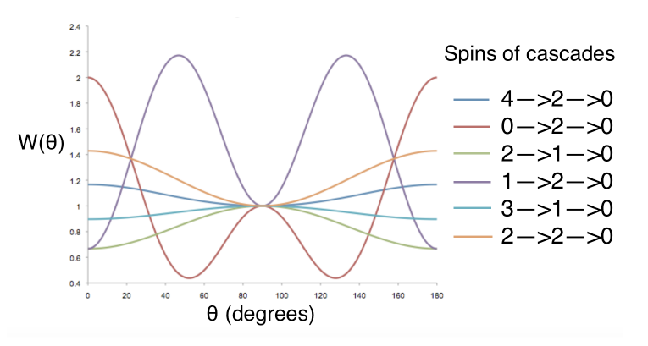
𝛾𝛾 angular correlations using GRIFFIN
Angular correlation: Measure the coincidence frequency of two successive decays at different angles (𝛾₂ with respect to 𝛾₁)
Contains nuclear structure information
Winter Nuclear & Particle Physics Conference, Feb 13-16, 2025
Figure courtesy of A. Maclean

Slide 23
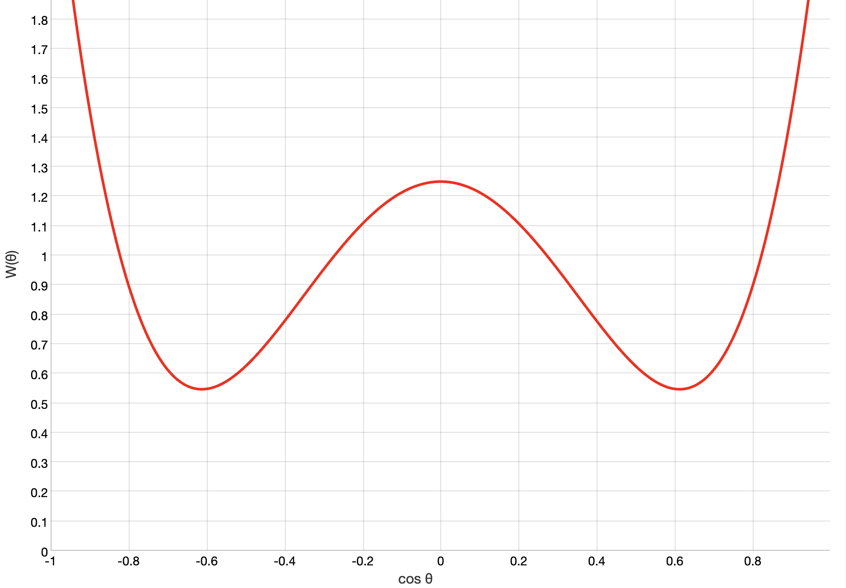
𝛾𝛾 angular correlations using GRIFFIN
Angular correlation: Measure the coincidence frequency of two successive decays at different angles (𝛾₂ with respect to 𝛾₁)
Contains nuclear structure information
Winter Nuclear & Particle Physics Conference, Feb 13-16, 2025
Figure courtesy of A. Maclean

Slide 24
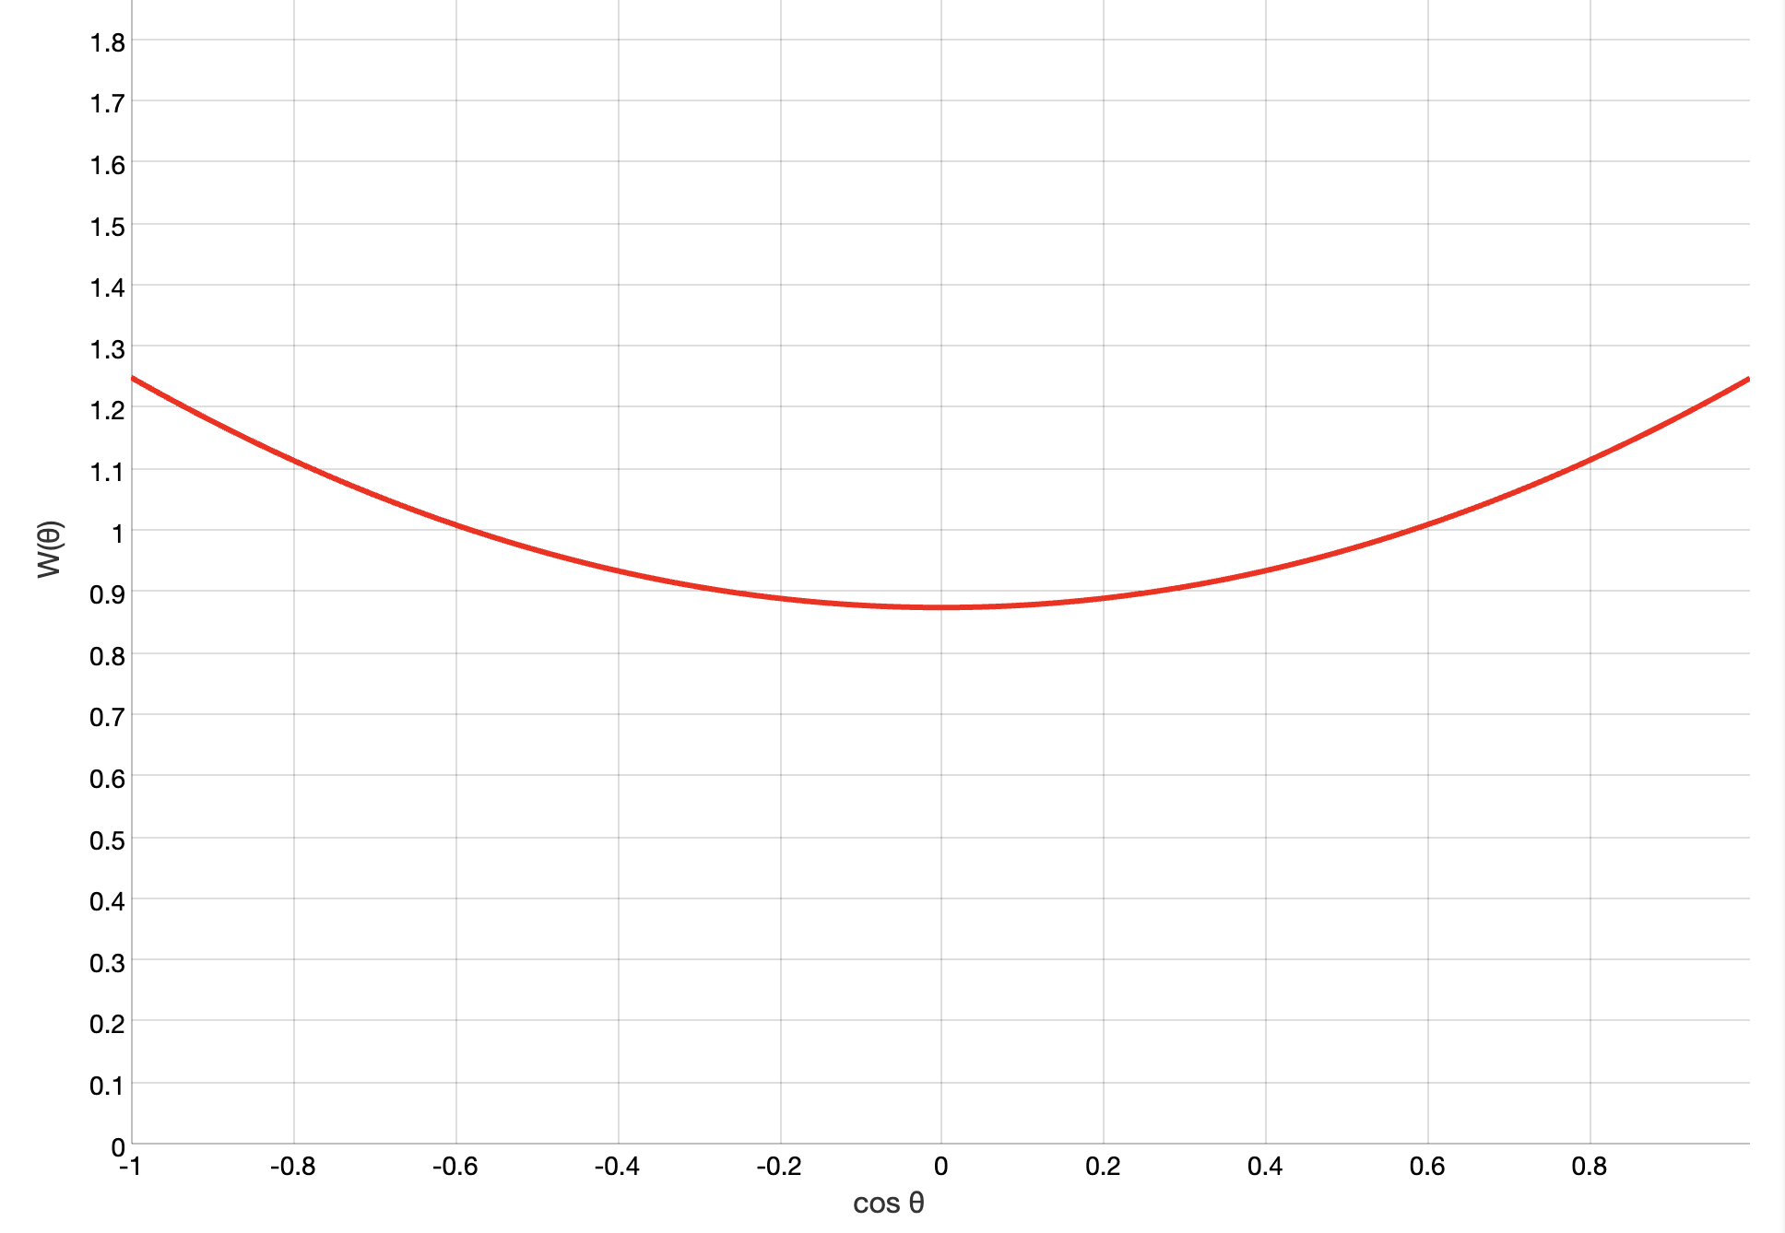
𝛾𝛾 angular correlations using GRIFFIN
Angular correlation: Measure the coincidence frequency of two successive decays at different angles (𝛾₂ with respect to 𝛾₁)
Contains nuclear structure information
Winter Nuclear & Particle Physics Conference, Feb 13-16, 2025
Figure courtesy of A. Maclean

Slide 25
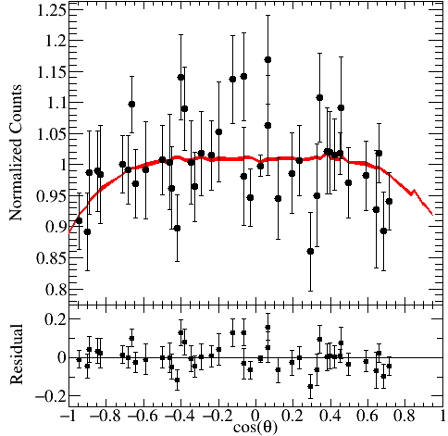
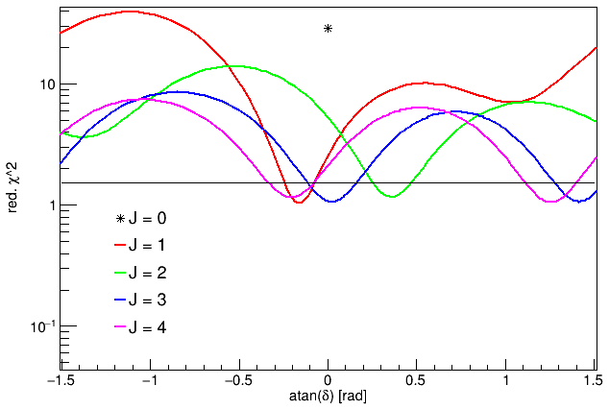
Angular correlation analysis for the (0⁺,2⁺) → (2⁺) → (0⁺) cascade
99% confidence limit
a₂ = -0.068 (26)
a₄ =-0.039 (33)
𝜒²/NDF= 1.1
Can disqualify J = 0 assignment
Winter Nuclear & Particle Physics Conference, Feb 13-16, 2025

Slide 26
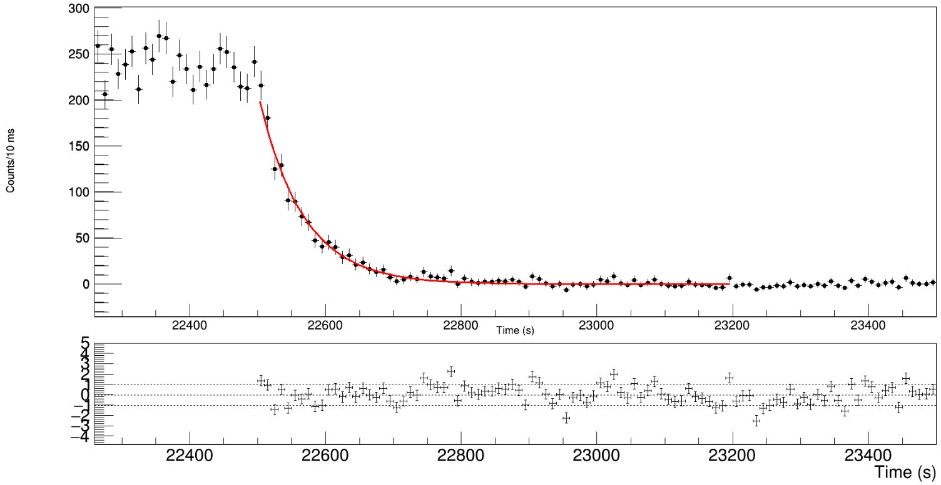
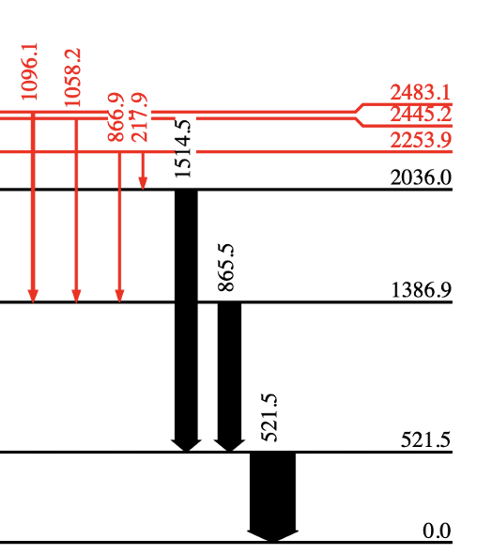
⁶⁸Mn ground state half-life
Gating on the 521 keV 𝛾
PRELIMINARY
Counts/10 ms
Beam on
Beam off
Winter Nuclear & Particle Physics Conference, Feb 13-16, 2025

Slide 27
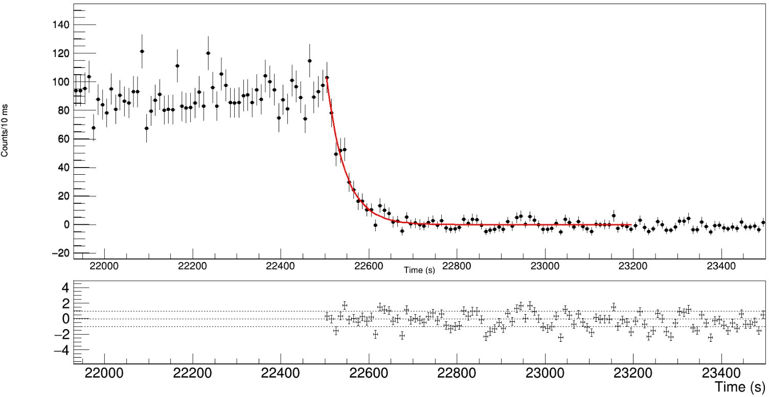
⁶⁸Mn ground state half-life
Gating on the 865 keV 𝛾 – Note that it is a doublet!
PRELIMINARY
Counts/10 ms
Beam on
Beam off
Winter Nuclear & Particle Physics Conference, Feb 13-16, 2025

Slide 28
⁶⁸Mn ground state half-life
Gating on the 865 keV 𝛾
PRELIMINARY
Discrepancy in measured value
Counts/10 ms
Beam on
Beam off
Winter Nuclear & Particle Physics Conference, Feb 13-16, 2025

Slide 29
Potential isomer in ⁶⁸Mn
In literature so far,
J. Daugus et al. (2011) | β-decay, fragmentation | 29 (4) ms
O. Sorlin et al. (2003) | β-decay, fragmentation | 28 (8) ms
M. Hannawald et. al (1999) | β-decay, ISOL | 28 (4) ms
S.N. Liddick et al. (2013) | β-decay, fragmentation | 40 (7) ms
G. Benzoni et al. (2015) | β-decay, fragmentation | 35.2 (20) ms
(4⁺)
(2⁺)
This work
Gating on the 521 keV | β-decay, ISOL | 45 (2) ms
Gating on the 865 keV |  | 29 (2) ms
Winter Nuclear & Particle Physics Conference, Feb 13-16, 2025

Slide 30
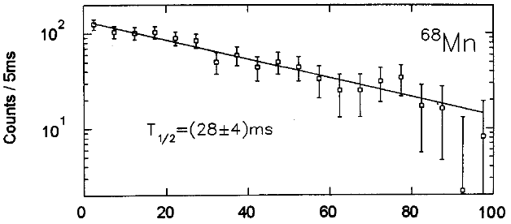
Potential isomer in ⁶⁸Mn
In literature so far,
J. Daugus et al. (2011) | β-decay, fragmentation | 29 (4) ms
O. Sorlin et al. (2003) | β-decay, fragmentation | 28 (8) ms
M. Hannawald et. al (1999) | β-decay, ISOL | 28 (4) ms
S.N. Liddick et al. (2013) | β-decay, fragmentation | 40 (7) ms
G. Benzoni et al. (2015) | β-decay, fragmentation | 35.2 (20) ms
(4⁺)
(2⁺)
This work
Gating on the 521 keV | β-decay, ISOL | 45 (2) ms
Gating on the 865 keV |  | 29 (2) ms
Winter Nuclear & Particle Physics Conference, Feb 13-16, 2025

Slide 31
Potential isomer in ⁶⁸Mn
In literature so far,
x
J. Daugus et al. (2011) | 29 (4) ms
O. Sorlin et al. (2003) | 28 (8) ms
M. Hannawald et. al (1999) | 28 (4) ms
S.N. Liddick et al. (2013) | 40 (7) ms
G. Benzoni et al. (2015) | 35.2 (20) ms
0.0
β⁻
β⁻
(4⁺)
(2⁺)
This work
Gating on the 521 keV | 45 (2) ms
Gating on the 865 keV | 29 (2) ms
One possible explanation is a high-spin isomer in ⁶⁸Mn that populates the (4⁺) state
Winter Nuclear & Particle Physics Conference, Feb 13-16, 2025

Slide 32
Summary
Expanded the level scheme of ⁶⁸Fe through 𝛾𝛾 coincidence analysis
Clarify shape coexistence interpretation
2035 keV level not J = 0
0₂⁺ candidate to be identified
Discovered hints of an isomeric state in ⁶⁸Mn
Also done but not shown here,
Re-measured β-delayed neutron emission probability in ⁶⁸Mn
Expanded the level scheme of ⁶⁷Fe
Measured the g.s half-life of ⁶⁸Fe
Discovered 7 new transitions and 3 new excited states in ⁶⁸Ni
Future work
Compare against theoretical calculations
Winter Nuclear & Particle Physics Conference, Feb 13-16, 2025

Slide 33
Thank you Merci
R. Umashankar^{1,2}, B. Olaizola³, V. Vedia¹, A.B. Garnsworthy¹,
C. Andreoiu⁴, G.C. Ball¹, S.S. Bhattacharjee¹, S. Buck⁶, R. Caballero-Folch¹, I. Dillmann¹, E. Dunling¹, E.G. Fuakye⁴, F.H. Garcia⁴, P.E. Garrett⁶, S. Georges¹, C. Griffin¹, G. Grinyer⁷, G. Hackman¹, K. Kapoor⁷, G. Leckenby^{1,2}, R.S. Lubna¹, M. Martin⁴, C. Natzke⁸, M. Rocchini⁶, N. Saei⁷, Y. Saito^{1,2}, M. Satrazani⁹, D. Shah⁷, J. Smallcombe⁹, P. Spagnoletti⁴, C.E. Svensson⁶, D. Yates^{1,2}, T. Zidar⁶
TRIUMF
UBC
IEM
SFU
UoGuelph
UoRegina
Colorado School of Mines
UoLiverpool
www.triumf.ca
Follow us @TRIUMFLab

Slide 34
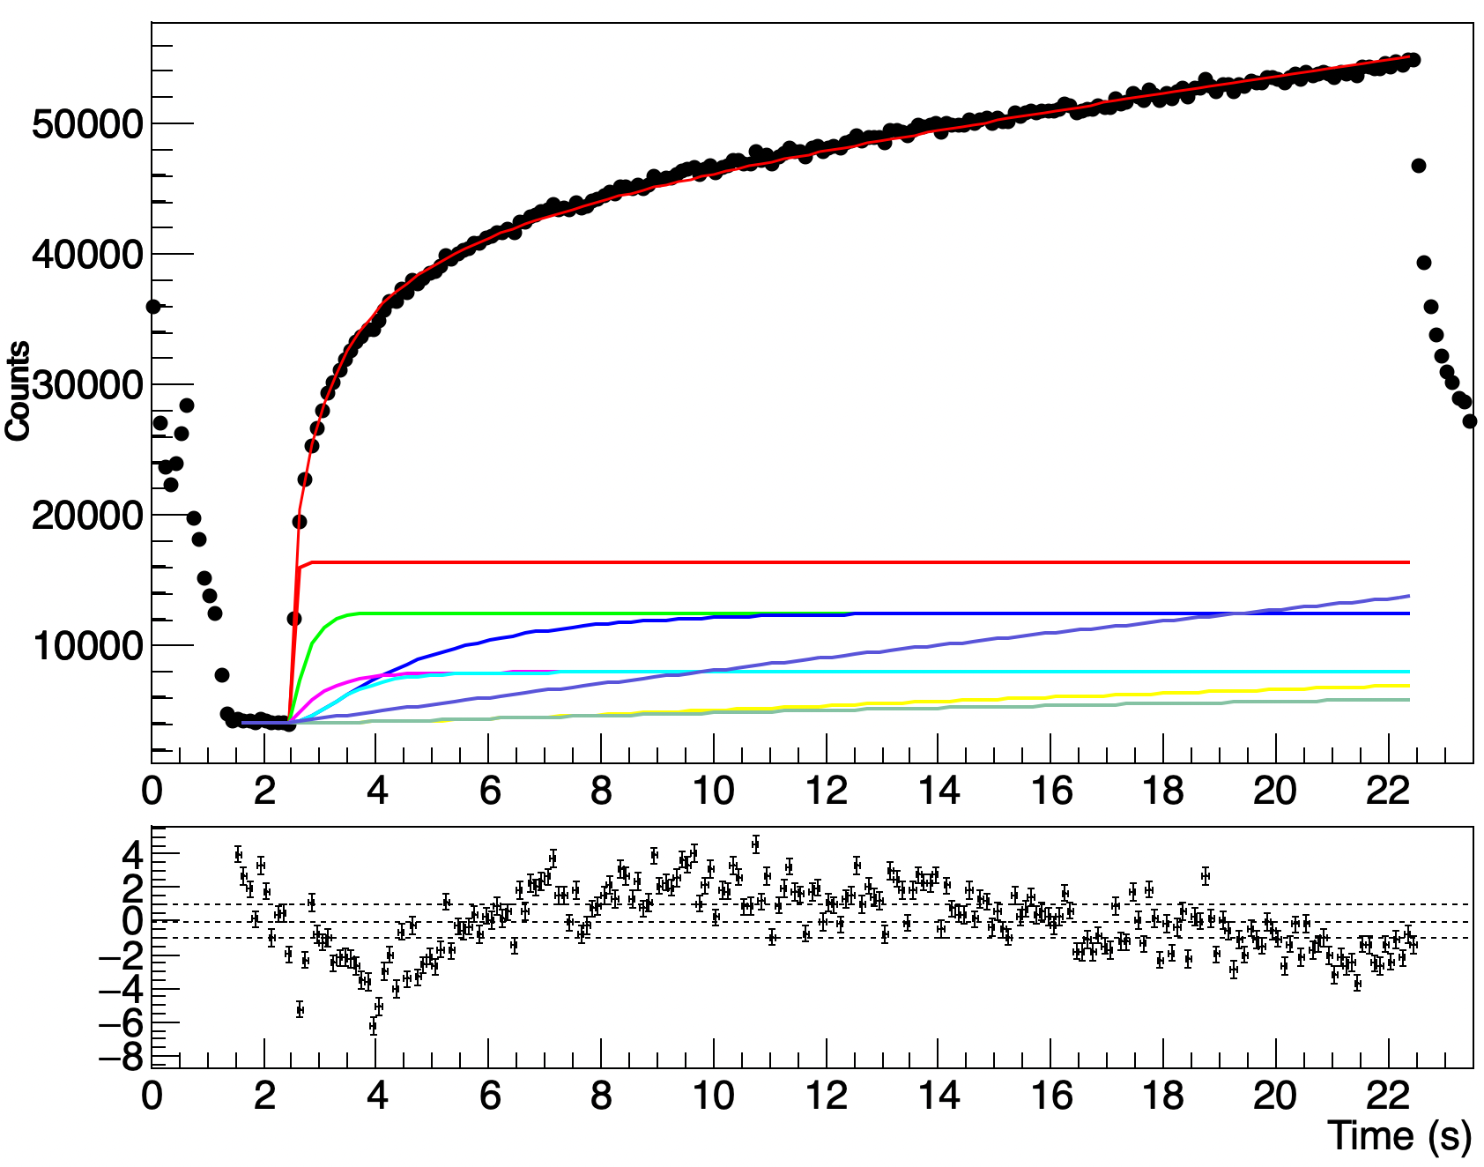
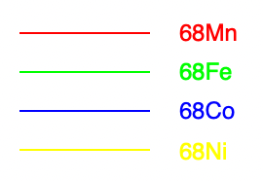
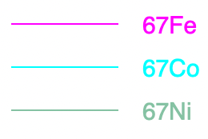
Measuring β-delayed neutron emission probability
PRELIMINARY
Performed a fit of Bateman equations which included both the A=68 and A=67 decay chains along with contaminants.
P_{n} was left as a free parameter
Previously measured by Benzoni et al.
We obtain a preliminary value of
Next step: Fit full cycle (beam on + off) and obtain N_{β} → Calculate log ft values
Winter Nuclear & Particle Physics Conference, Feb 13-16, 2025

Slide 35
𝛾𝛾 angular correlations
Angular correlation: Measure the coincidence frequency of two successive decays at different angles (𝛾₂ with respect to 𝛾₁)
Winter Nuclear & Particle Physics Conference, Feb 13-16, 2025
Schematic courtesy of M. Bowry

Slide 36
𝛾𝛾 angular correlations
Angular correlation: Measure the coincidence frequency of two successive decays at different angles (𝛾₂ with respect to 𝛾₁)
Both gamma rays have an isotropic distribution in the laboratory frame
Winter Nuclear & Particle Physics Conference, Feb 13-16, 2025
Schematic courtesy of M. Bowry

Slide 37
𝛾𝛾 angular correlations
Angular distribution of radiation emitted in radioactive decay experiments
Ensemble of radioactive nuclei with no preferred orientation and no alignment relative to the experiment
Rate per crystal is isotropic
Winter Nuclear & Particle Physics Conference, Feb 13-16, 2025
Schematic courtesy of M. Bowry

Slide 38
𝛾𝛾 angular correlations
Angular correlation: Measure the coincidence frequency of two successive decays at different angles (𝛾₂ with respect to 𝛾₁)
𝛳
Rate provides angular correlation
Winter Nuclear & Particle Physics Conference, Feb 13-16, 2025
Schematic courtesy of M. Bowry

Slide 39
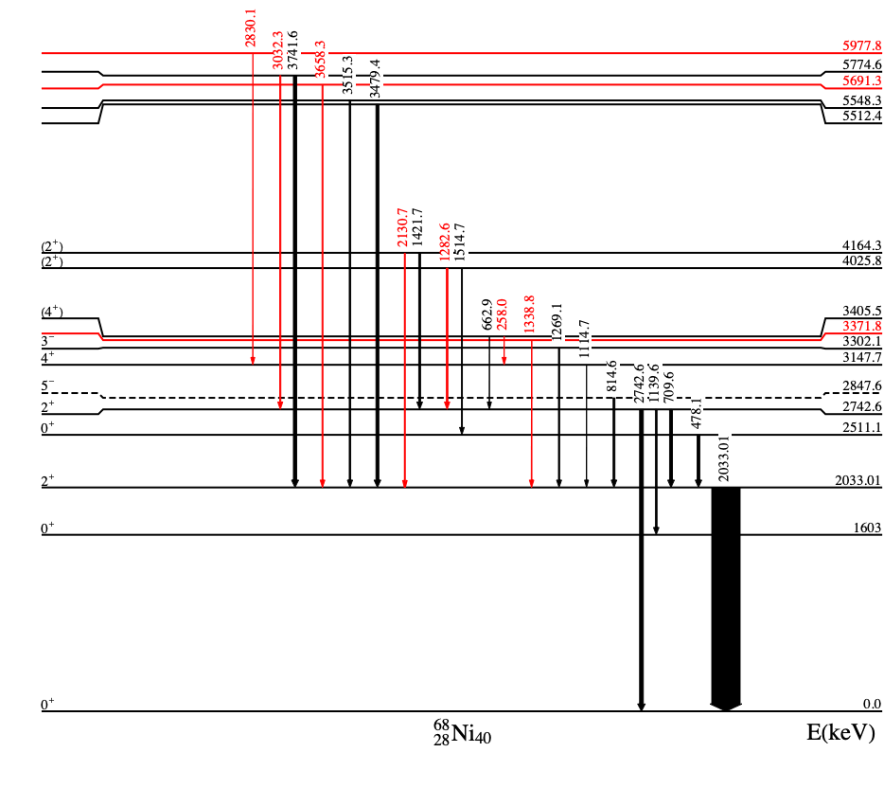
68Ni
Future Work
Prioritize 68Fe
Log ft calculations and theoretical interpretations
Grouping/Folding
Beta-n branch
Full decay chain analysis eventually
7 new transitions
3 new excited states
Winter Nuclear & Particle Physics Conference, Feb 13-16, 2025

Slide 40
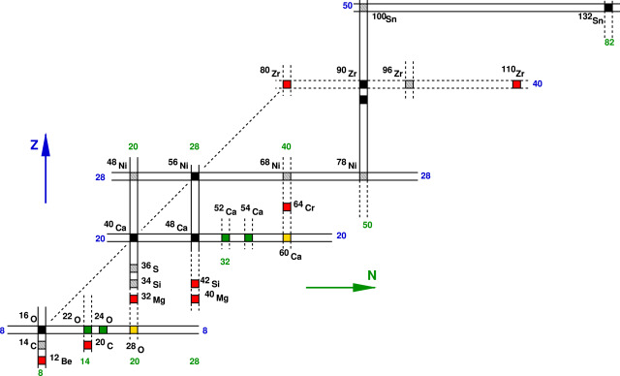
Islands of Inversion
β-decay of 68Mn: Probing the N=40 Island of Inversion
Energy gained through correlations offset the spherical mean field gaps
Ground states dominated by deformed npnh configurations instead of 0p0h
Shell and subshell closure features disappear
E(2⁺)
B(E2): Transition probability
Experimentally identified IoIs at N = 8, 20, 28, 40
Expected semi-magic turned deformed
Classic doubly-magic nuclei
New doubly-magic isotopes
New local doubly-magic
N=40
Very neutron-rich nuclei whose structure is under debate
F. Nowacki, A. Obertelli, A. Poves. Progress in Particle and Nuclear Physics 120, 103866 (2021)
Winter Nuclear & Particle Physics Conference, Feb 13-16, 2025

Slide 41
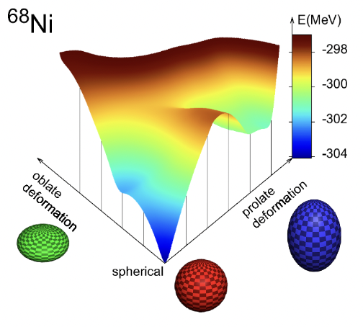
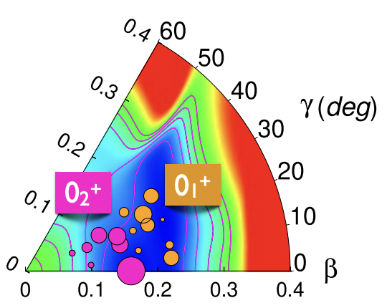
Shape coexistence in the vicinity
Shape Coexistence is often observed at IoIs, with inversions of “normal” and intruder configurations
The northern border of the IOI at N = 40 has so far been thought to occur in the Z = 26 Fe nuclei
Suggested extension of the northern limit of N = 40 IoI above Z = 26
Triaxial ground state (0₁⁺) and prolate 0₂⁺
M. Rocchini et al. Phys. Rev. Lett. 130 (2023)
T. Otsuka, Y. Tsunoda, J. Phys. G. 43 (2016)
Winter Nuclear & Particle Physics Conference, Feb 13-16, 2025
Notes:
-Islands of Inversion are also regions where shape coexistence phenomena occur
- There are numerous studies looking at this but I'm going to highlight one
-The northern border of the IOI at N=40 has so far been thought to occur in the Z=26 Fe nuclei
- provide evidence for an unexpected enhanced triaxial deformation of 74Zn
Mention Marco’s paper came out of a TRIUMF experiment

Slide 42
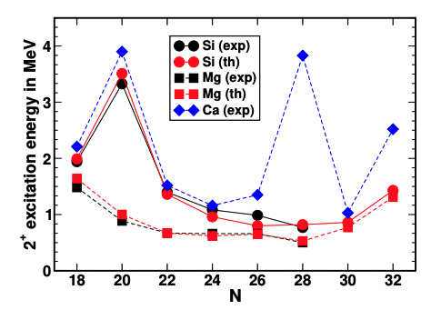
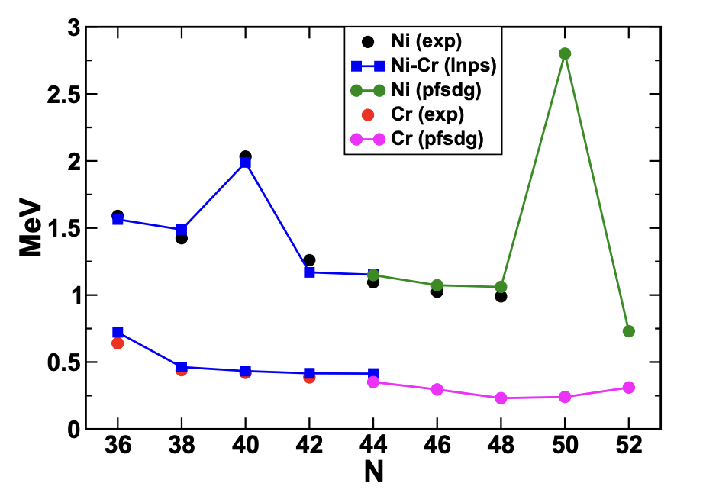
Merging the N = 40 and N = 50 IoI
New theorized IoI at N = 50 by F. Nowacki et al.
Suggested extension of the island of inversion at N = 40 for more neutron-rich isotopes towards N = 50
Supported by large-scale shell-model calculations using the PFSDG-U interaction
Spectroscopic information required to understand this bridge
Santamaria, et al., PRL 115, 192501 (2015)
Nowacki, et al., PRL 117, 272501 (2016)
Taniuchi, R., Santamaria, C., Doornenbal, P. et al. Nature 569, 53–58 (2019)
Winter Nuclear & Particle Physics Conference, Feb 13-16, 2025
Notes:
. The first spectroscopy at RIKEN placed the first 2+ excited state at 2.6 MeV pointing towards a shell closure at N=50.
However, some theoretical results looking at Cr chain do not support this suggestion and point towards another IoI at N=50.
On top of that, some shell model interpretations also suggest the possible merging of these two islands of inversion. This has a precedent in the proposed merging of the N=20 and N=28 where you can see the persistence of the shell closures in Ca and Si. But the Mg isotopes near n=20 do not show any decrease in collectivity and merge with the N=28 region.
Similarly, in Ni we observe two clear peaks at N=40 and N=50 but in the Cr isotopes, the 2+ energies are not affected by the neutron closures. The Iron results are not depicted here but it’s behaviour is also identical to that of Cr.
To understand a similar bridge between the N=40 and N=50 islands of inversion, it is crucial to obtain spectroscopic information of Fe, Co and Ni isotopes.

Slide 43
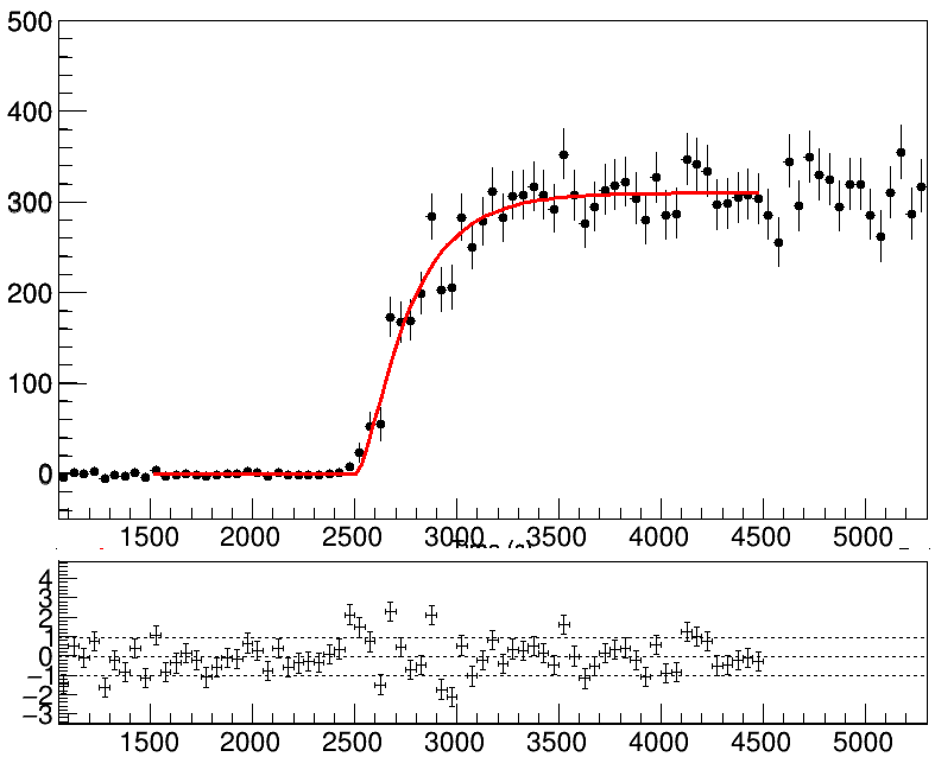
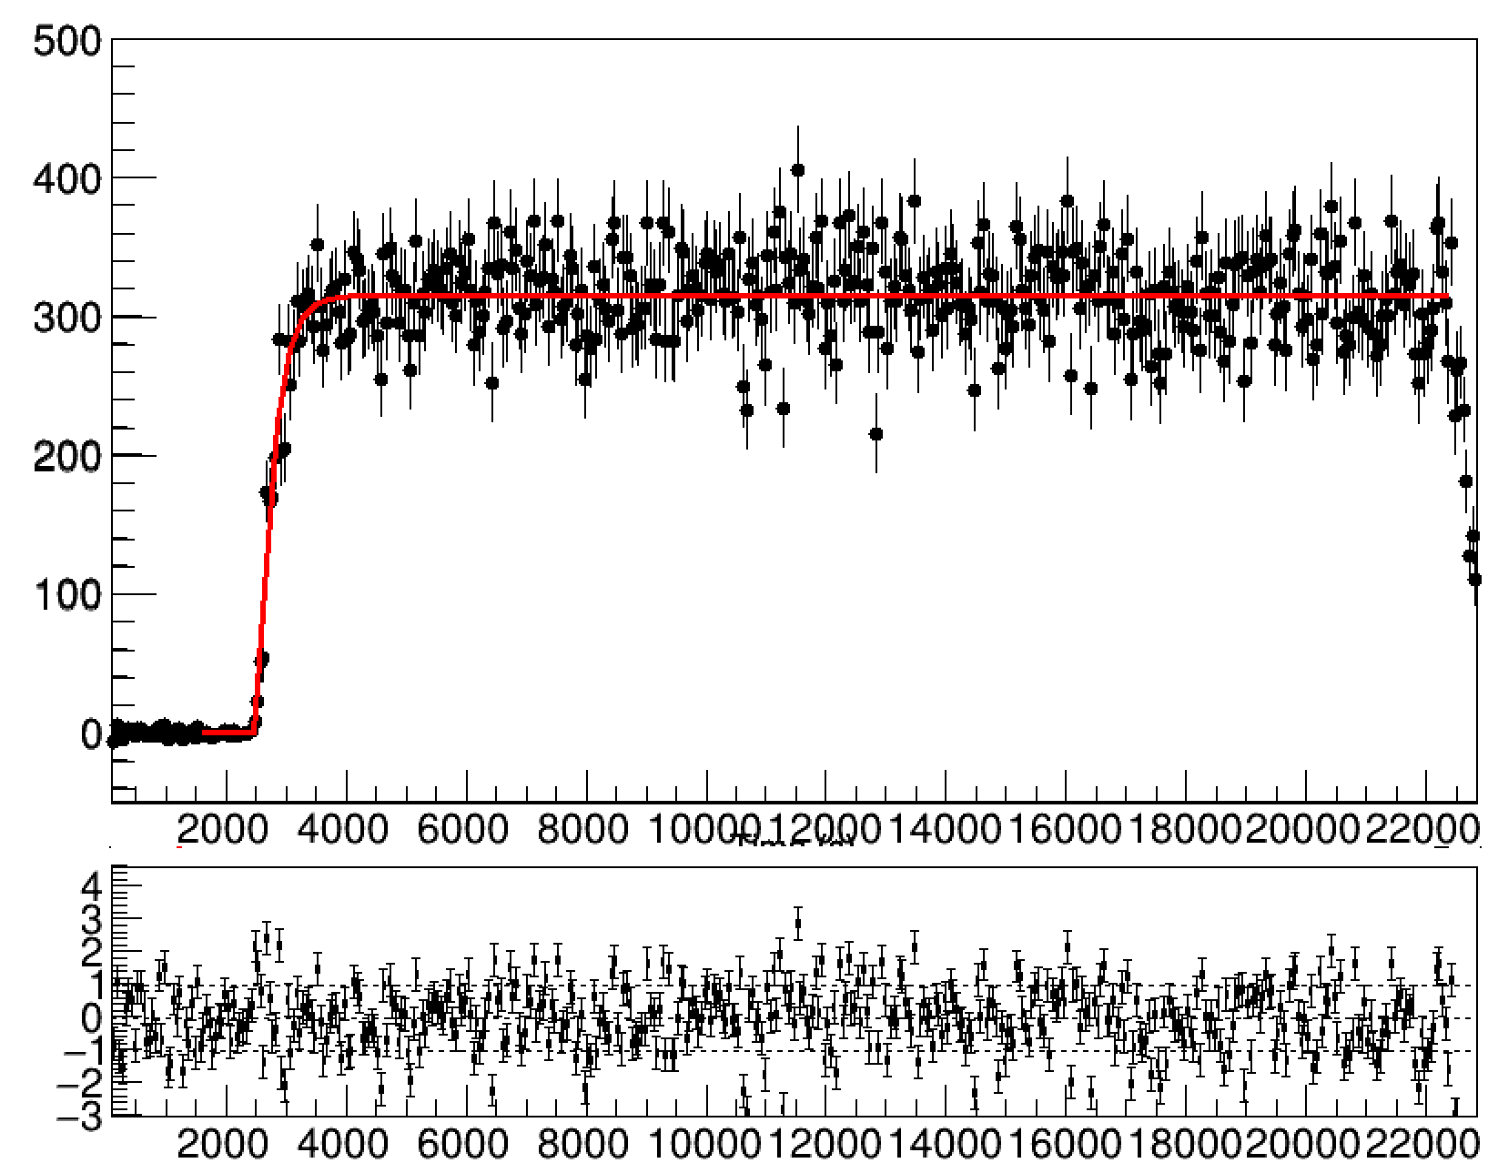
⁶⁸Fe ground state half-life
PRELIMINARY
Counts/10 ms
Time (ms)
T_{1/2} (NNDC) = 188 (4) ms
Time (ms)
Winter Nuclear & Particle Physics Conference, Feb 13-16, 2025

Slide 44
⁶⁸Ni
7 new transitions
3 new excited states
Winter Nuclear & Particle Physics Conference, Feb 13-16, 2025

