Slide 1
Highly-Charged Radioactive Molecules: Amplifying Sensitivity for New Physics
Rane Simpson
University of British Columbia (UBC) / TRIUMF
Notes:
Talking Points:
-Introduction
-Talk will concern the use of radioactive molecules as a tool in the search for a permanent EDM
-Experiment is quite early, will touch on some accomplished goals, and then how the experiment will proceed

Slide 2
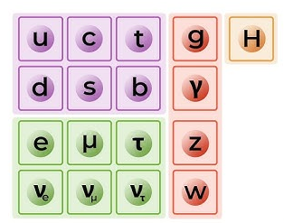
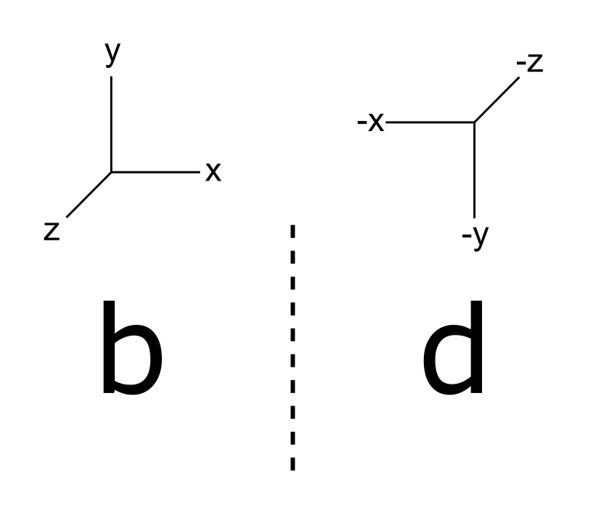
New Physics Searches
incredibly successful
Standard Model
matter-antimatter
asymmetry
Solution?
CP
violation!
Sakharov A.D., Pisma Zh.Eksp.Teor.Fiz. (1967)
Notes:
Talking Points:
-Standard model has successfully predicted particles such as W, Z, Higgs boson
-There are still remaining gaps that it doesn’t account for
-Namely: Matter-Antimatter asymmetry

Slide 3
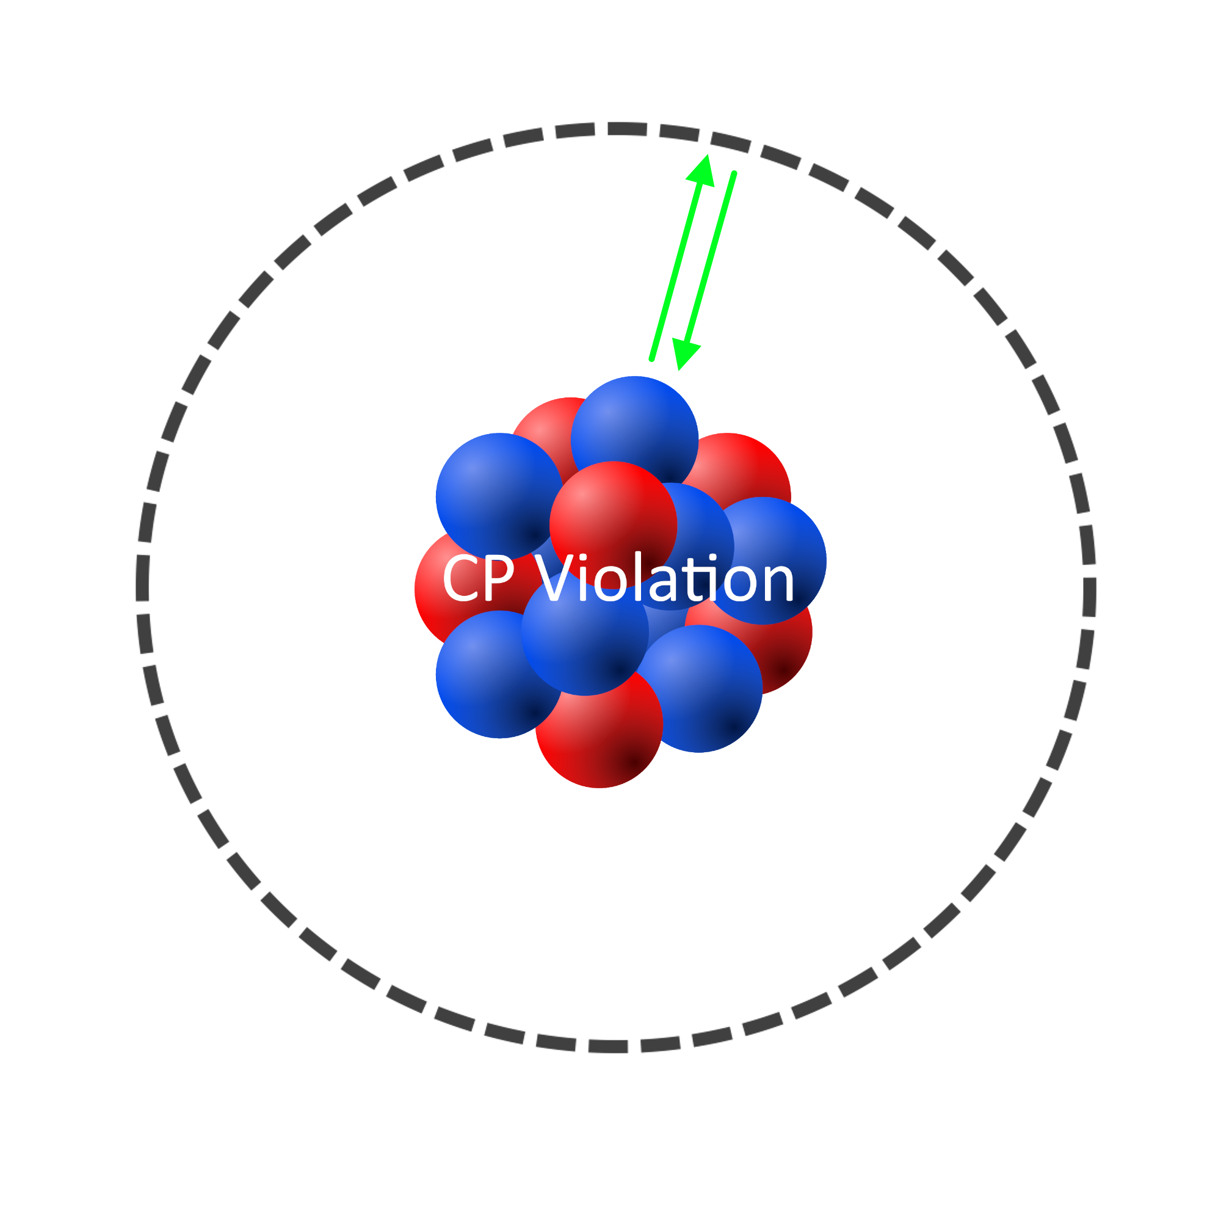
Nuclear CP Violation – Atomic Systems
Present upper limit held by ¹⁹⁹Hg:
|d_{Hg}| < 7.4 x 10⁻³⁰ e cm
[B. Graner et al., 2016]
Notes:
Talking Points:
-The effective fields present in the polar molecules provide another 3-4 orders of magnitude
-Trapping drastically improves coherence time and therefore statistics and provides yet another ~3 orders of magnitude of improvement

Slide 4
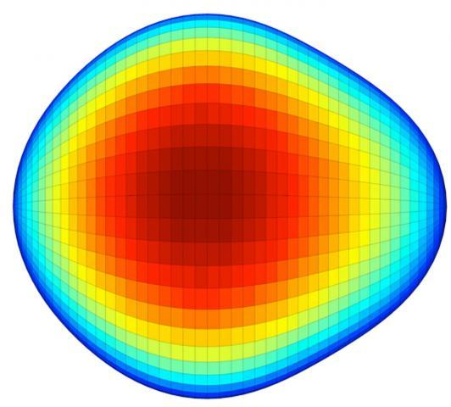
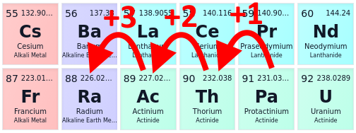
Enhanced Sensitivity – Radioactive Molecules
Enhancement factors in our approach:
octupole deformed nuclide x 100-1,000
in polar molecule x 1,000-10,000
in ion trap x 1,000 compared to beam experiments
Compared to spherical atomic nuclei (Hg)
+
3
Laser coolable!
Molecule | Predicted | Experimentally observed
UF³⁺
ThF³⁺ |  | -
AcF³⁺ |  | -
PaF³⁺ |  | -
All known cases are radioactive
Fluorine
Protactinium
https://doi.org/10.48550/arXiv.2203.10333
Notes:
Talking Points:
-The effective fields present in the polar molecules provide another 3-4 orders of magnitude
-Trapping drastically improves coherence time and therefore statistics and provides yet another ~3 orders of magnitude of improvement

Slide 5
Enhanced Sensitivity
Radioactive molecules
+3
Fluorine
Protactinium
Notes:
Talking Points:
-The effective fields present in the polar molecules provide another 3-4 orders of magnitude
-Trapping drastically improves coherence time and therefore statistics and provides yet another ~3 orders of magnitude of improvement

Slide 6
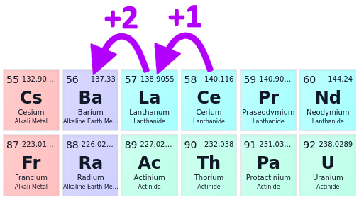
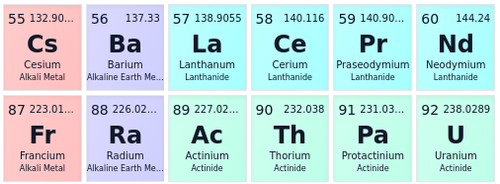
Enhanced Sensitivity
Radioactive molecules
+3
Fluorine
Stable surrogate
+2
Protactinium
Fluorine
Cerium
Notes:
-Using CeF2+ as a surrogate due to the nature of Pa being difficult to produce/obtain/work with
-CeF2+ if isoelectronic to PaF3+ and have the same valence electron configuration
-Ce is stable and much more easily produced
-But is it actually relevant?

Slide 7
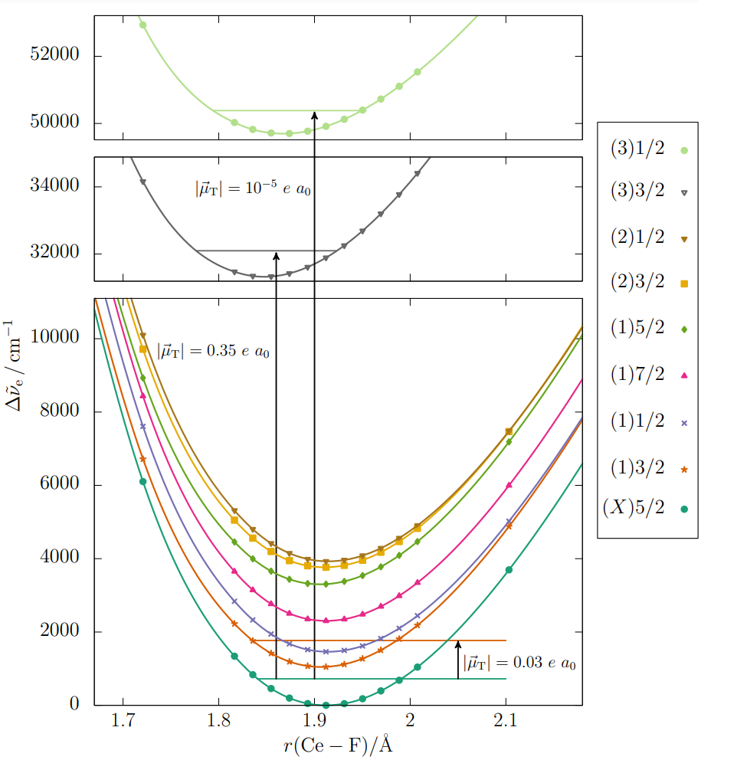
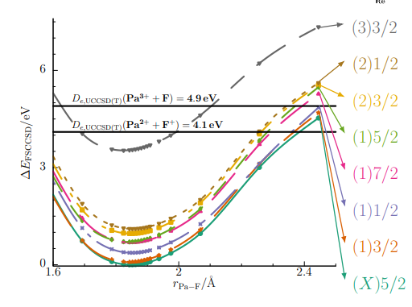
CeF²⁺ - Electronic Structure
Credit: Carsten Zülch, Robert Berger
CeF²⁺
PaF³⁺
Same ground state
Seven lowest lying states show well-ordered, quasi-parallel, compressed structure
Notes:
-Electronic structure of CeF2+ is shown to be the same as PaF3+ for the 7 lowest lying states
-Most importantly, the ground state is the same, meaning the hyperfine structure will look similar and can be used as a parallel to PaF3+

Slide 8
CeF²⁺ - PaF³⁺ Comparison
Credit: Carsten Zülch, Robert Berger
CeF²⁺
PaF³⁺
Ground State: X(5/2) X(5/2)
Prospects for
Quantum Control:
Notes:
-Electronic structure of CeF2+ is shown to be the same as PaF3+ for the 7 lowest lying states
-Most importantly, the ground state is the same, meaning the hyperfine structure will look similar and can be used as a parallel to PaF3+

Slide 9
CeF²⁺ - Brief Look at Quantum Control
Ce¹⁴⁰
I = 0
Not sensitive nuclear to P, T Odd effects
Ce¹⁴¹
I ≠ 0
Sensitive to nuclear P, T Odd effects
Leads to larger δm_{f} and additional hyperfine structures
Higher complexity leads to more challenges in the development of a measurement scheme but also provides more opportunities
Notes:
-Electronic structure of CeF2+ is shown to be the same as PaF3+ for the 7 lowest lying states
-Most importantly, the ground state is the same, meaning the hyperfine structure will look similar and can be used as a parallel to PaF3+

Slide 10
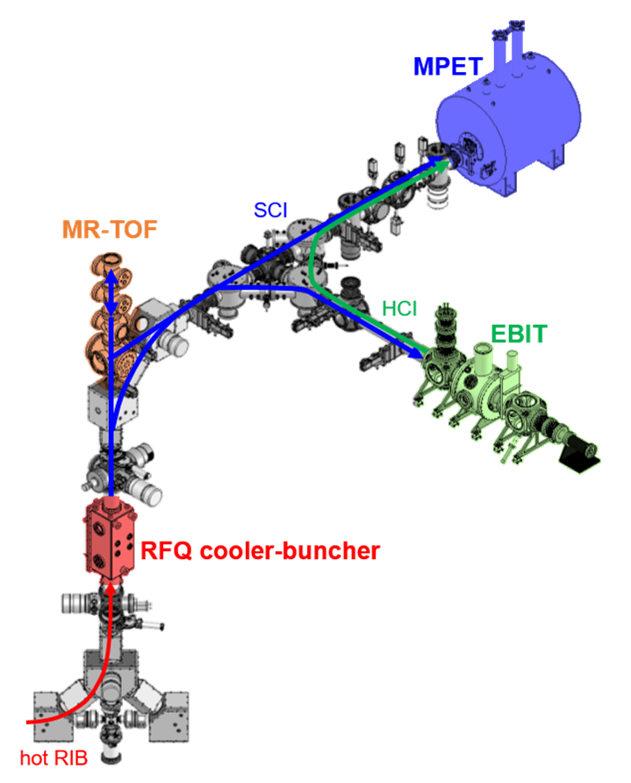
The TITAN Experiment
Molecule Formation
Identification
Notes:
-Now that we know CeF2+ is valuable as a surrogate, lets look at the experimental section
-Since RadMol is newly established at TRIUMF, we are still working towards setting up our own hardware
-In order to pursue science in the meantime, we have collaborated with TITAN in order to take advantage of their trapping and detection systems

Slide 11
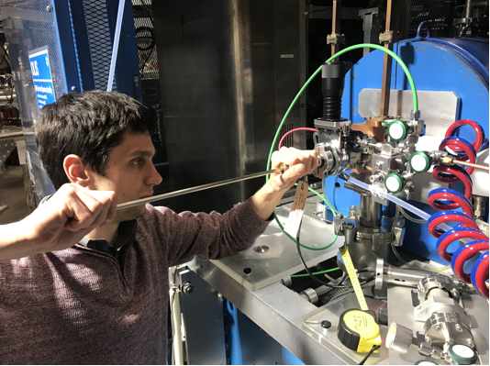
Experimental Outline
Ion production
Molecule Formation
Species Identification
Credit: Chris Charles, Phillip Justus
Notes:
Talking Points:
-The first step in forming UF³⁺ is to form the molecule in the first place
-This was done by sending U⁺ into the TITAN experiment while injecting trace amounts of SF₆ into the RFQ
-The result was the successful formation of UF⁺, UF₂₋₄⁺

Slide 12
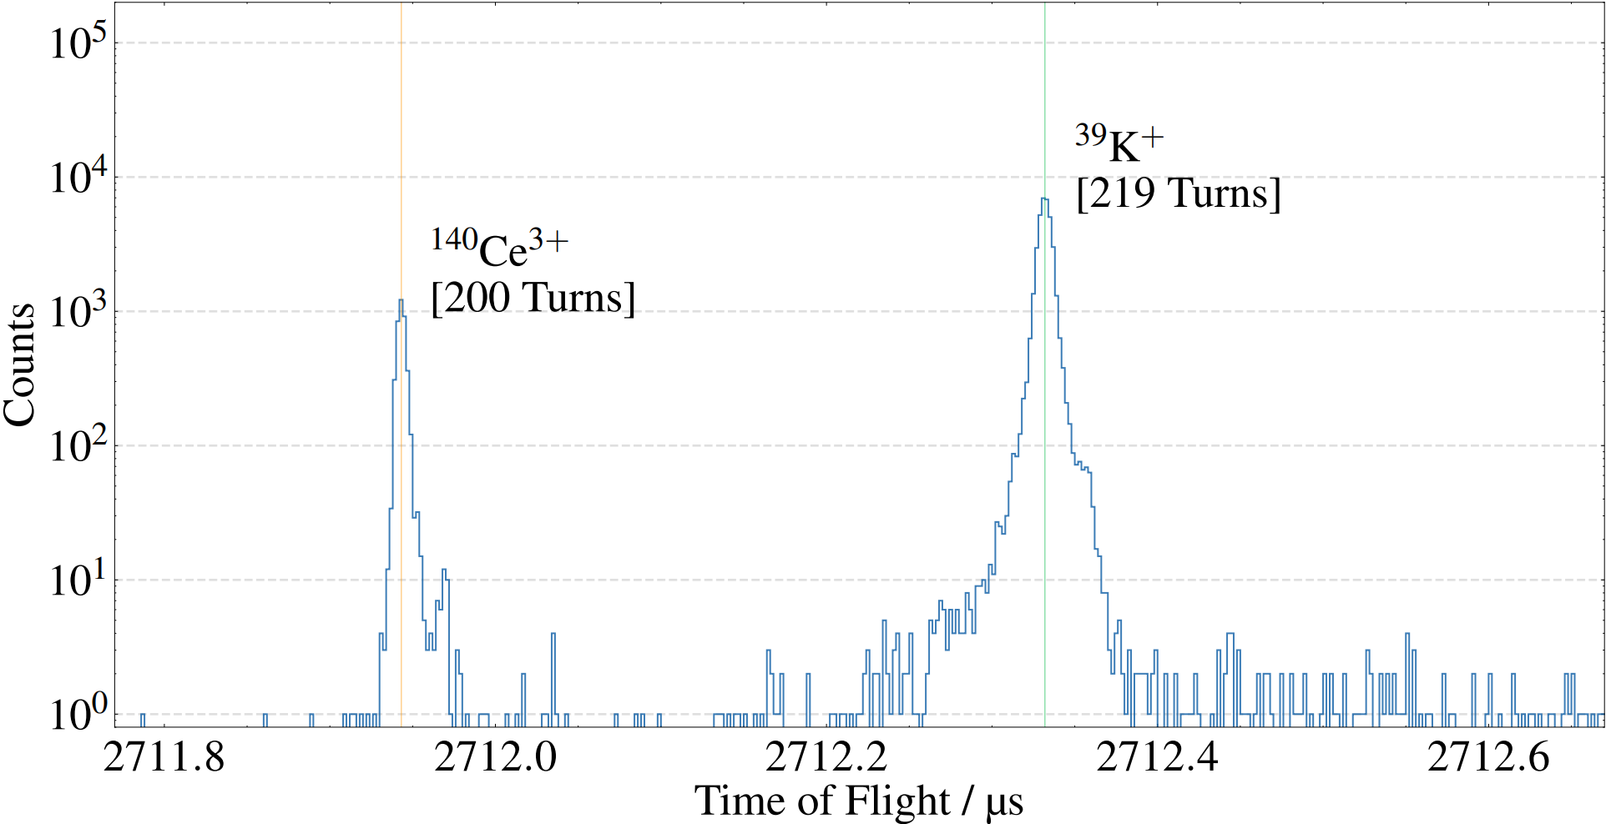
Triply Charged Cerium – No SF₆ Injection
Ion of interest
Calibrant
Notes:
Talking points:
-238k resolution on Ce3+ high turn scan
-This confirmed that the RFQ was clean enough to permit transport of the Ce³⁺ atomic ions

Slide 13
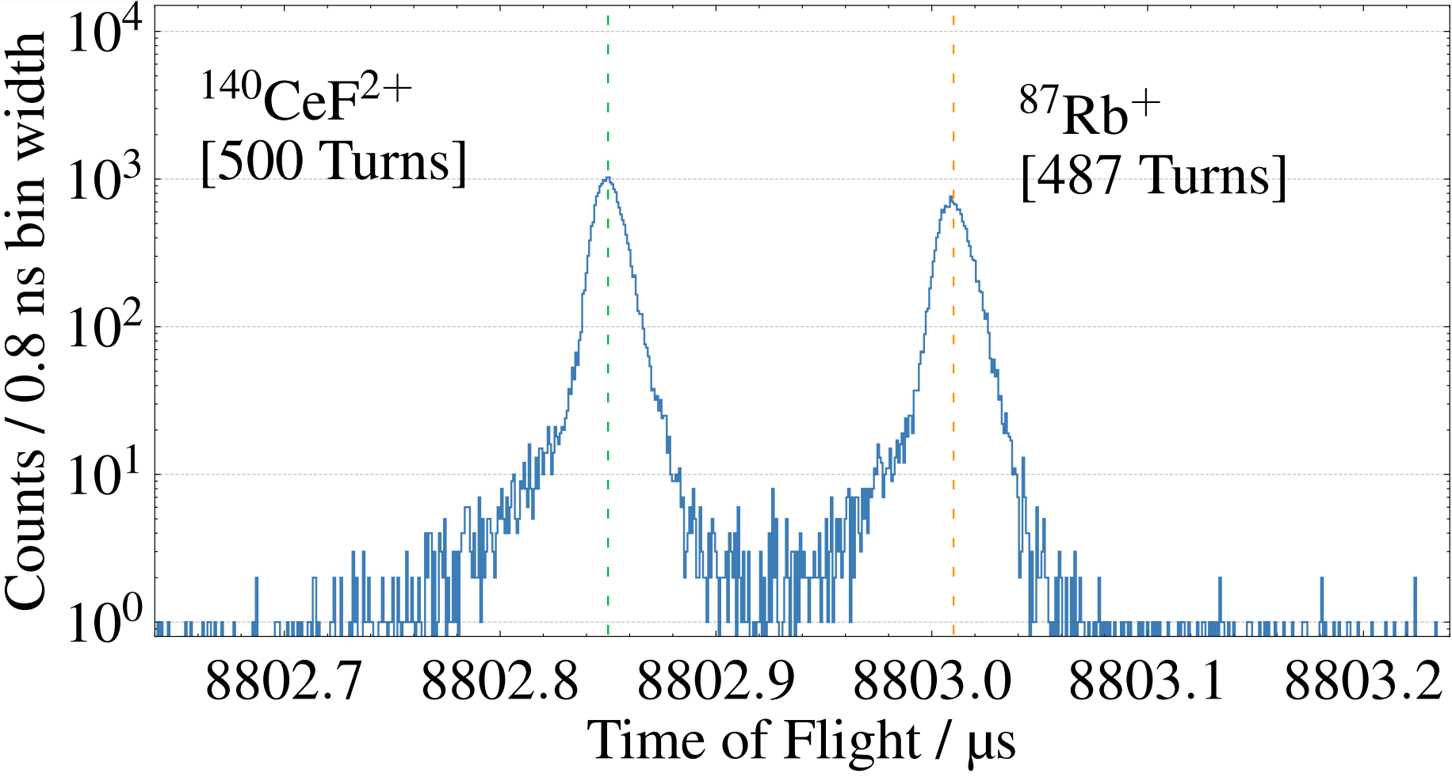
Doubly Charged Cerium Fluoride – w/ SF₆ Injection
Notes:
Talking points:
-238k resolution on Ce3+ high turn scan
-This confirmed that the RFQ was clean enough to permit transport of the Ce³⁺ atomic ions

Slide 14
Outlook
1) Further development of charge breeding techniques to increase the charge state further
2) Commissioning of an offline setup is ongoing in which spectroscopy can realistically be employed

Slide 15
Summary
The observation of an EDM of any kind would indicate CP violation and possibly lead to BSM physics
PaF³⁺ represents a system which is expected to exhibit extreme sensitivity to P, T - odd effects inside the nucleus
Due to the difficulty in producing protactinium beams, CeF²⁺ was chosen as a surrogate in order to develop production techniques and measurement schemes
Using ab initio methods, the electronic structure of CeF²⁺ has been shown to have many similarities to that of PaF³⁺, confirming the value of the more stable molecule
CeF²⁺ has been produced at the TITAN facility at TRIUMF, representing the first step to exploiting the opportunities present in this system
Next Steps
Continue developing techniques for various CeF²⁺ and PaF³⁺ production mechanisms
Port these techniques over to an offline set up in which laser spectroscopy is more feasible

Slide 16
Summary
The observation of an EDM of any kind would indicate CP violation and possibly lead to BSM physics
PaF³⁺ represents a system which is expected to exhibit extreme sensitivity to P, T - odd effects inside the nucleus
Due to the difficulty in producing protactinium beams, CeF²⁺ was chosen as a surrogate in order to develop production techniques and measurement schemes
Using ab initio methods, the electronic structure of CeF²⁺ has been shown to have many similarities to that of PaF³⁺, confirming the value of the more stable molecule
CeF²⁺ has been produced at the TITAN facility at TRIUMF, representing the first step to exploiting the opportunities present in this system
Next Steps
Continue developing techniques for various CeF²⁺ and PaF³⁺ production mechanisms
Port these techniques over to an offline set up in which laser spectroscopy is more feasible

Slide 17
Thank You
Also many thanks to the Targets and Ion Sources group (T&IS) as well as the TITAN Collaboration for their significant efforts in the advancement of this research!
Notes:
Thanks!

Slide 18
Backup Slides

Slide 19
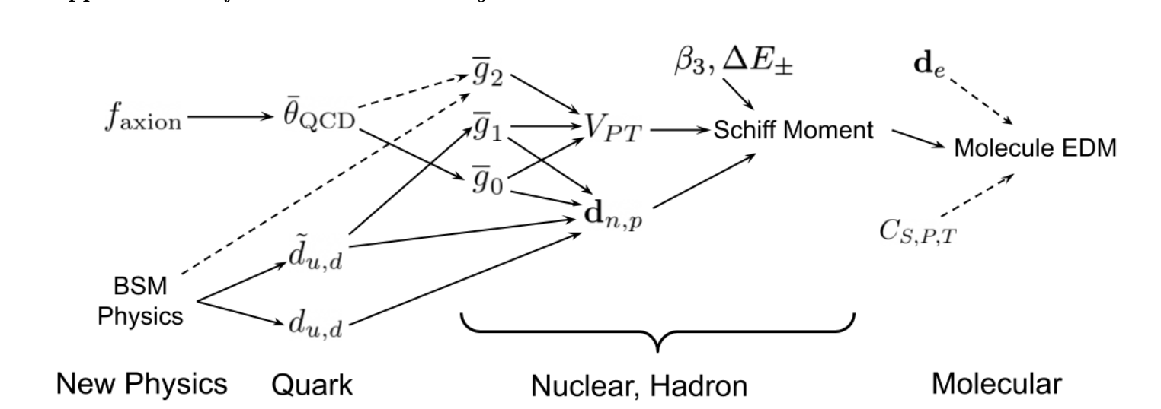
Relevant BSM Framework
Notes:
Talking Points:
-These CP violating effects can originate from different forms, but if detected, 2 things are true:
-This is a result of BSM physics, current models do not account for this
-These effects will lead to a molecular EDM

Slide 20
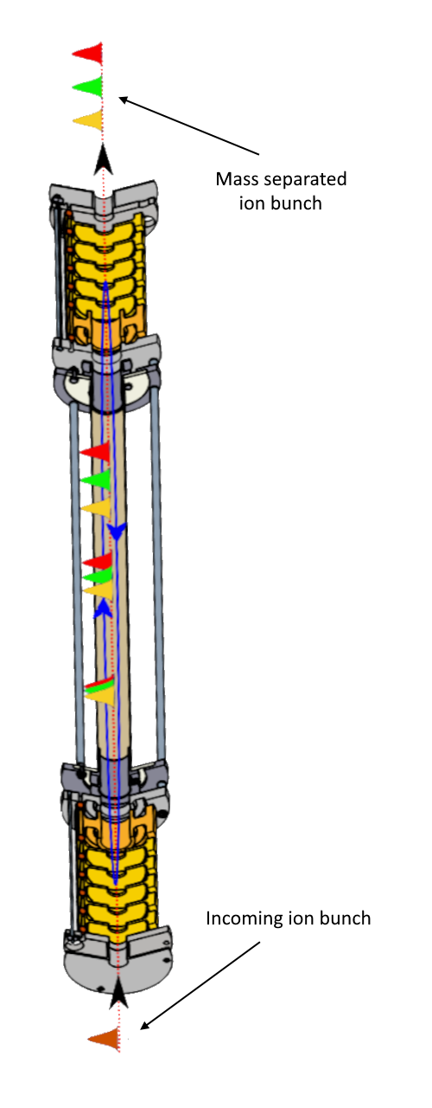
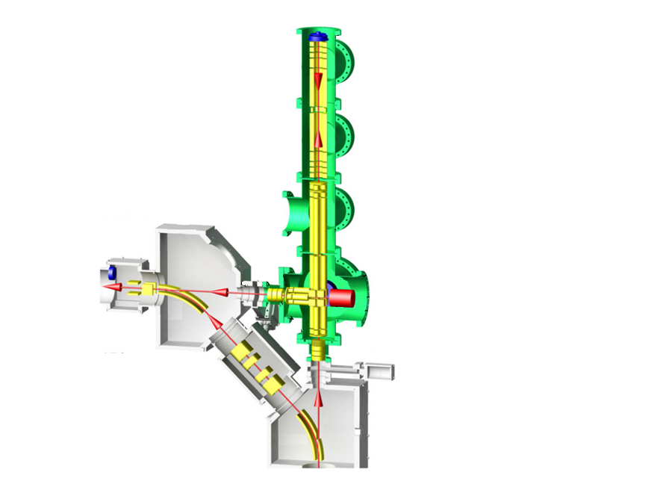
TITAN’s MRTOF
Analyzer Section
Notes:
Talking Points:
-The MRTOF, being of pivotal importance to some of our current results, merits further discussion
-The analyzer sits atop a set of traps
-Once the ion bunch is in the trap, it traverses a number of revolutions, from 1 to hundreds
-This path length gives the ion bunch ample time to separate spatially
-This separation is measured in TOF when the upper gate is opened and the ions are released onto the detector

Slide 21
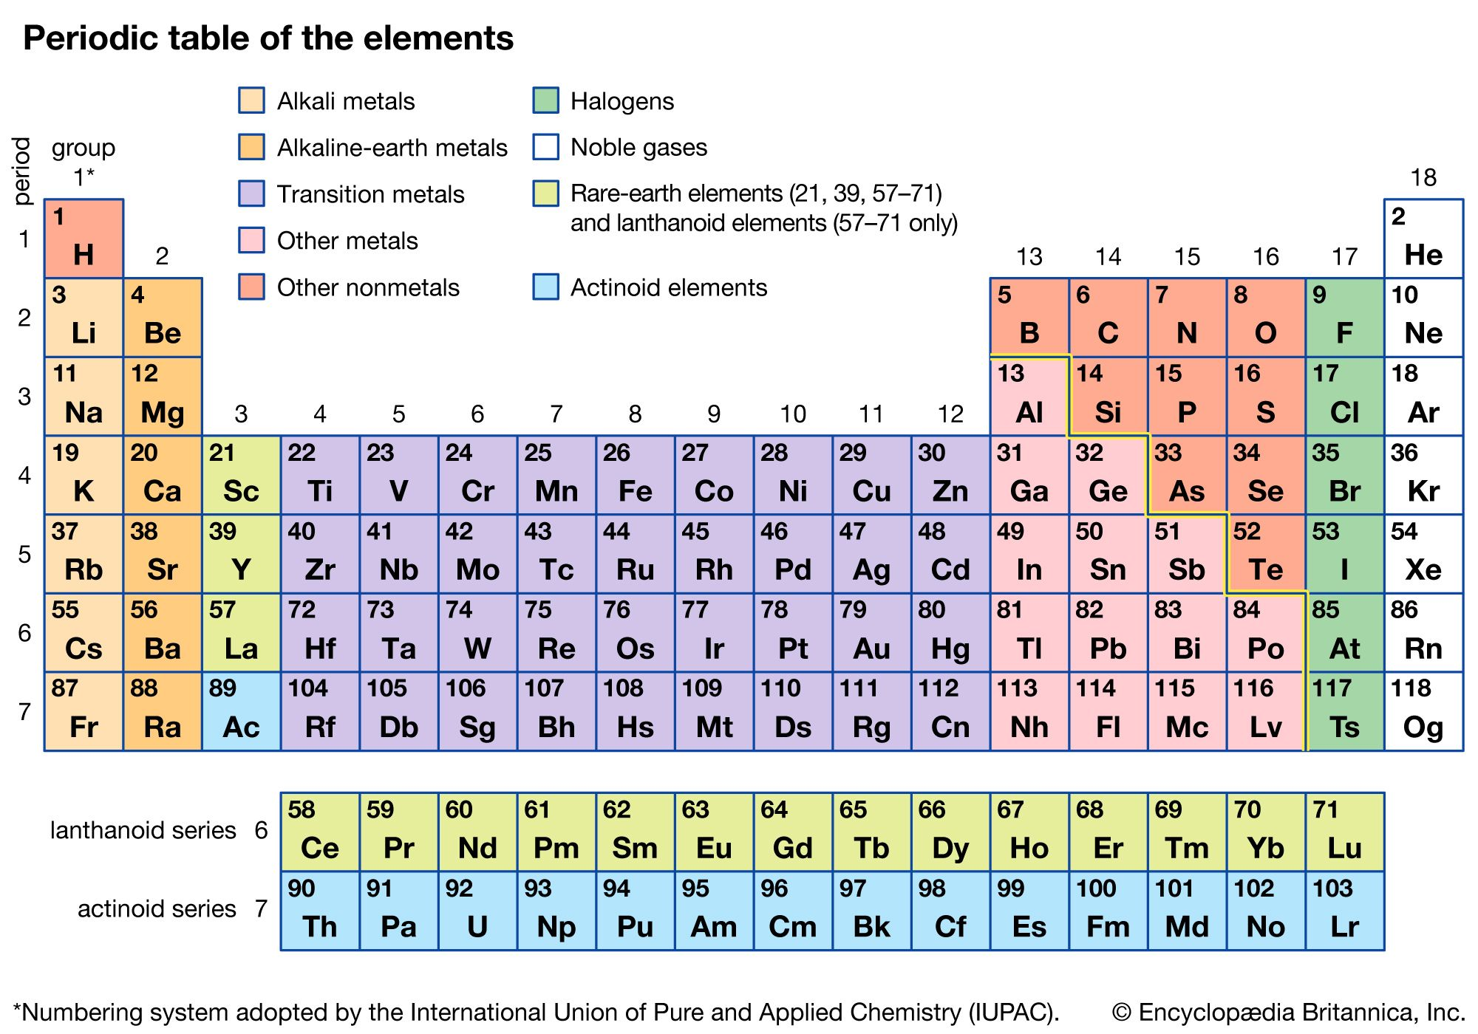
Which Molecule is Most Suitable?
Species of Interest
Actinide | Schiff Scaling Factor (relative to ²²⁵Ra)
²²⁵Ra | := 1 (~200x larger than 199Hg)
²²⁹Th | 2
²²⁷Ac | 6
²²⁹Pa | 40
Fluorine
Protactinium
Notes:
Talking Points:
-So, now that we know what we want to measure, we need to know what our target molecule will be
-Provided is a list of enhanced Schiff moments, with the well studied 225Ra being the baseline.
-We see that 229Pa appears to be the candidate with the most extreme sensitivity
-Fluorides have the highest ionization energy of the periodic table, and this improves the reliability of HCMs

Slide 22
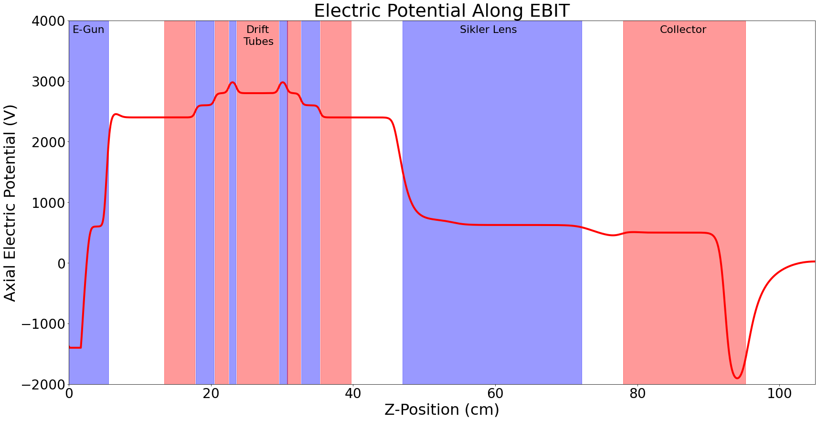
Experimental Development
Notes:
Talking Points:
-So, what are the plans and goals of this thesis?
-First, form the easiest HCM that is theoretically available, and the only one which has been experimentally confirmed: UF³⁺

Slide 23
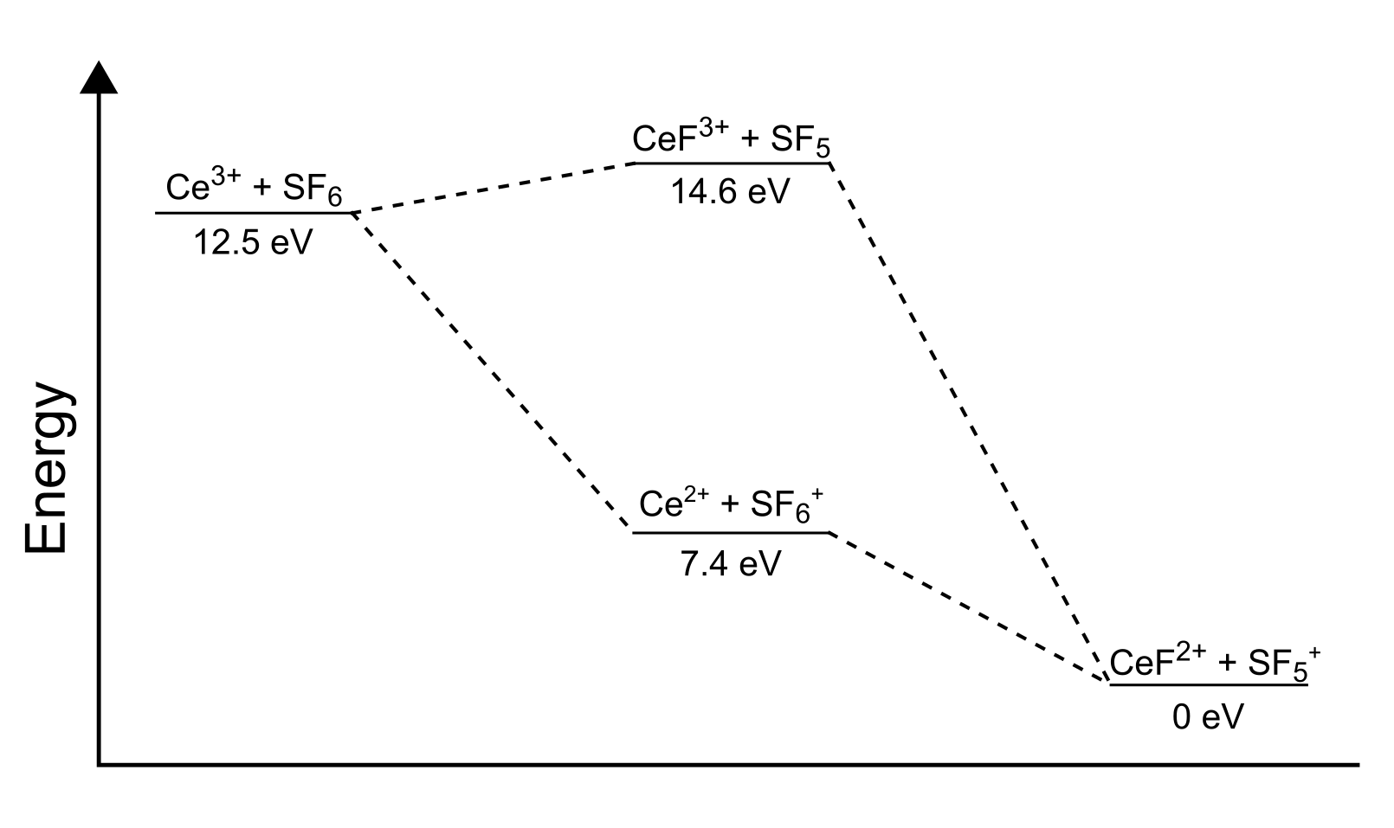
CeF²⁺ - Formation and Stability
Notes:
-Electronic structure of CeF2+ is shown to be the same as PaF3+ for the 7 lowest lying states
-Most importantly, the ground state is the same, meaning the hyperfine structure will look similar and can be used as a parallel to PaF3+

Slide 24
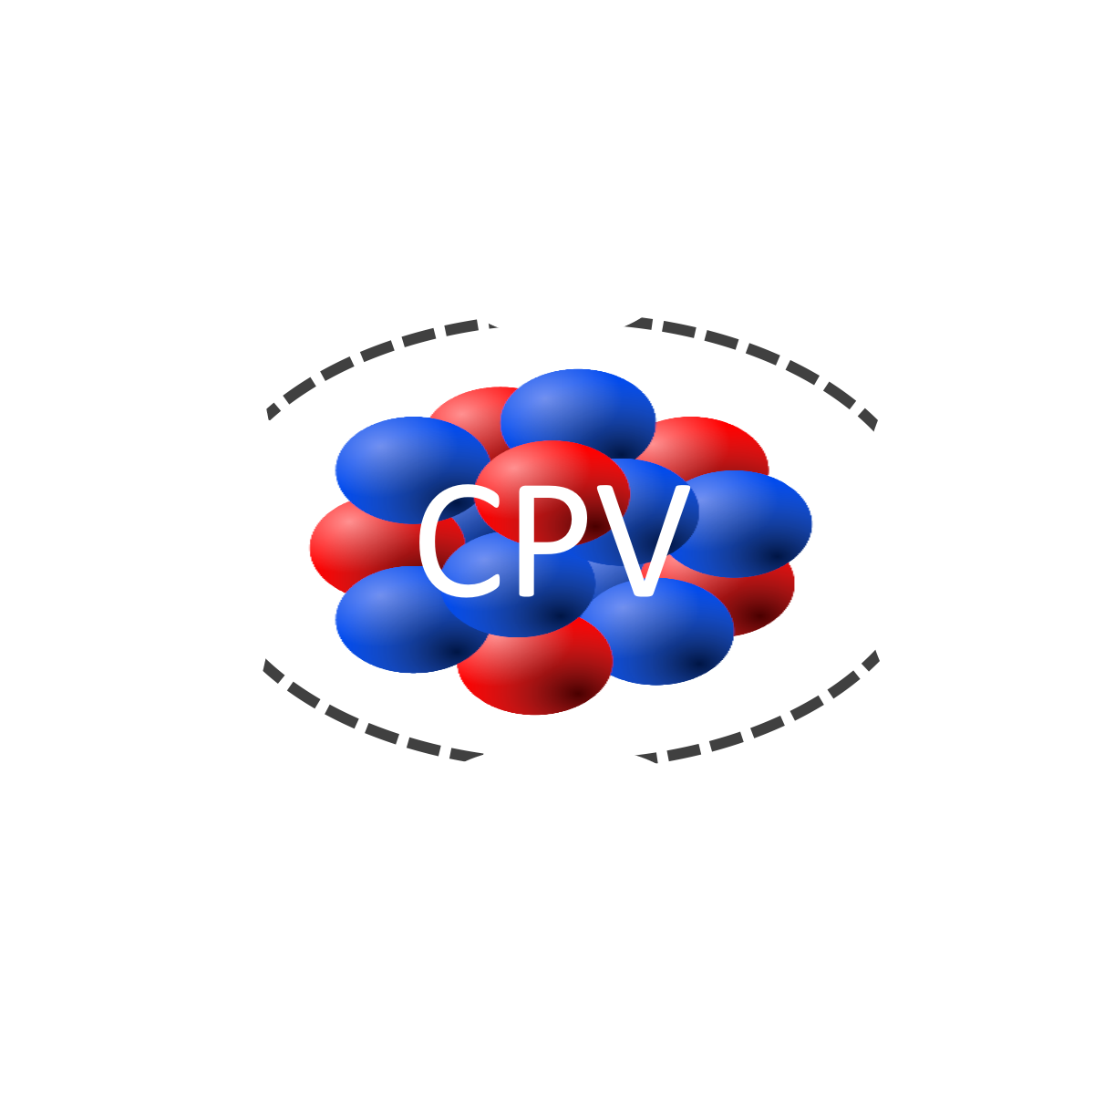
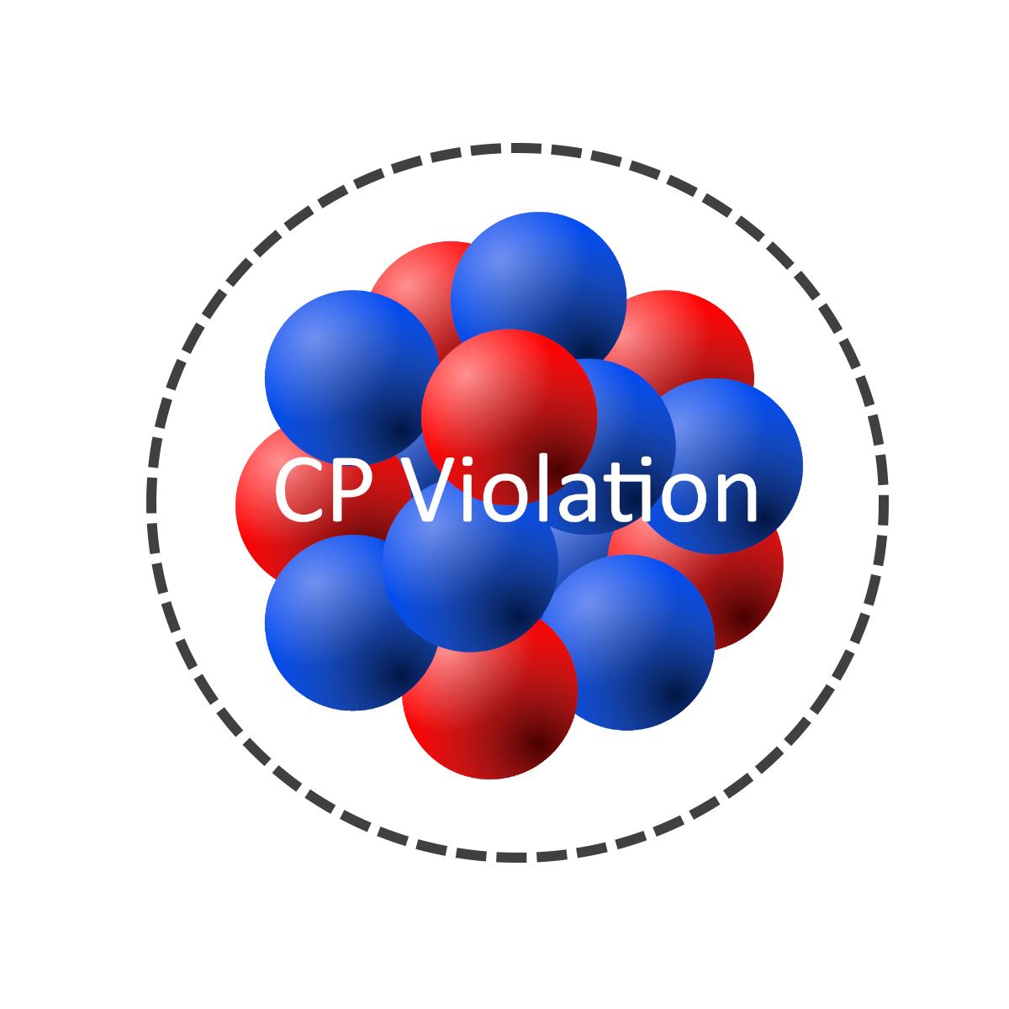
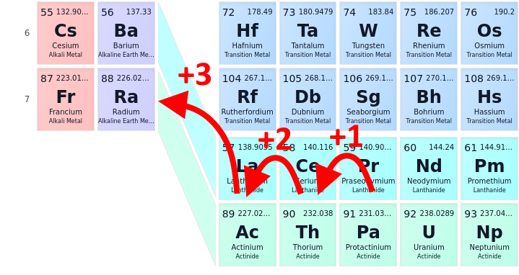
Enhanced Sensitivity
Radioactive molecules
Enhanced Schiff Moment
Enhancement factors in our approach:
octupole deformed nuclide x 100-1,000
in polar molecule x 1,000-10,000
in atom or ion trap x 1,000 compared to beam experiments
Compared to spherical atomic nuclei (Hg)
+3
Molecule | Predicted | Experimentally observed
UF³⁺
ThF³⁺ |  | -
AcF³⁺ |  | -
PaF³⁺ |  | -
All known cases are radioactive
Fluorine
Laser coolable!
Protactinium
https://doi.org/10.48550/arXiv.2203.10333
Notes:
Talking Points:
-The effective fields present in the polar molecules provide another 3-4 orders of magnitude
-Trapping drastically improves coherence time and therefore statistics and provides yet another ~3 orders of magnitude of improvement

