Slide 1
Application of DeepSets Machine Learning in FPGA to Improve ATLAS L0 Global Trigger for HL-LHC
WNPPC-2025
2025-02-15
Kelvin Leong, Maximilian Swiatlowski, Colin Gay, Wotjtek Fedorko

Slide 2
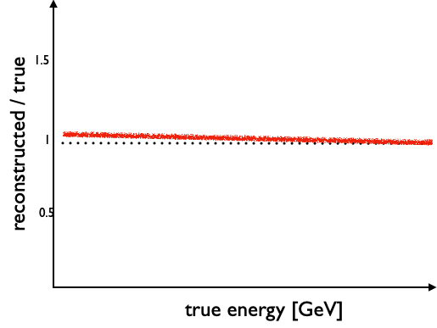
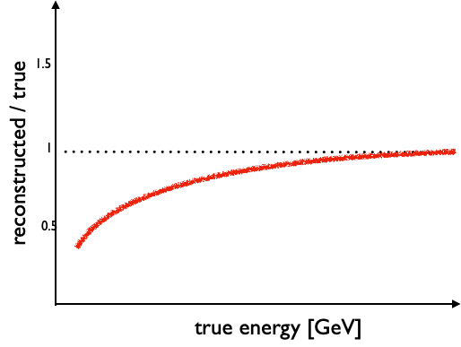
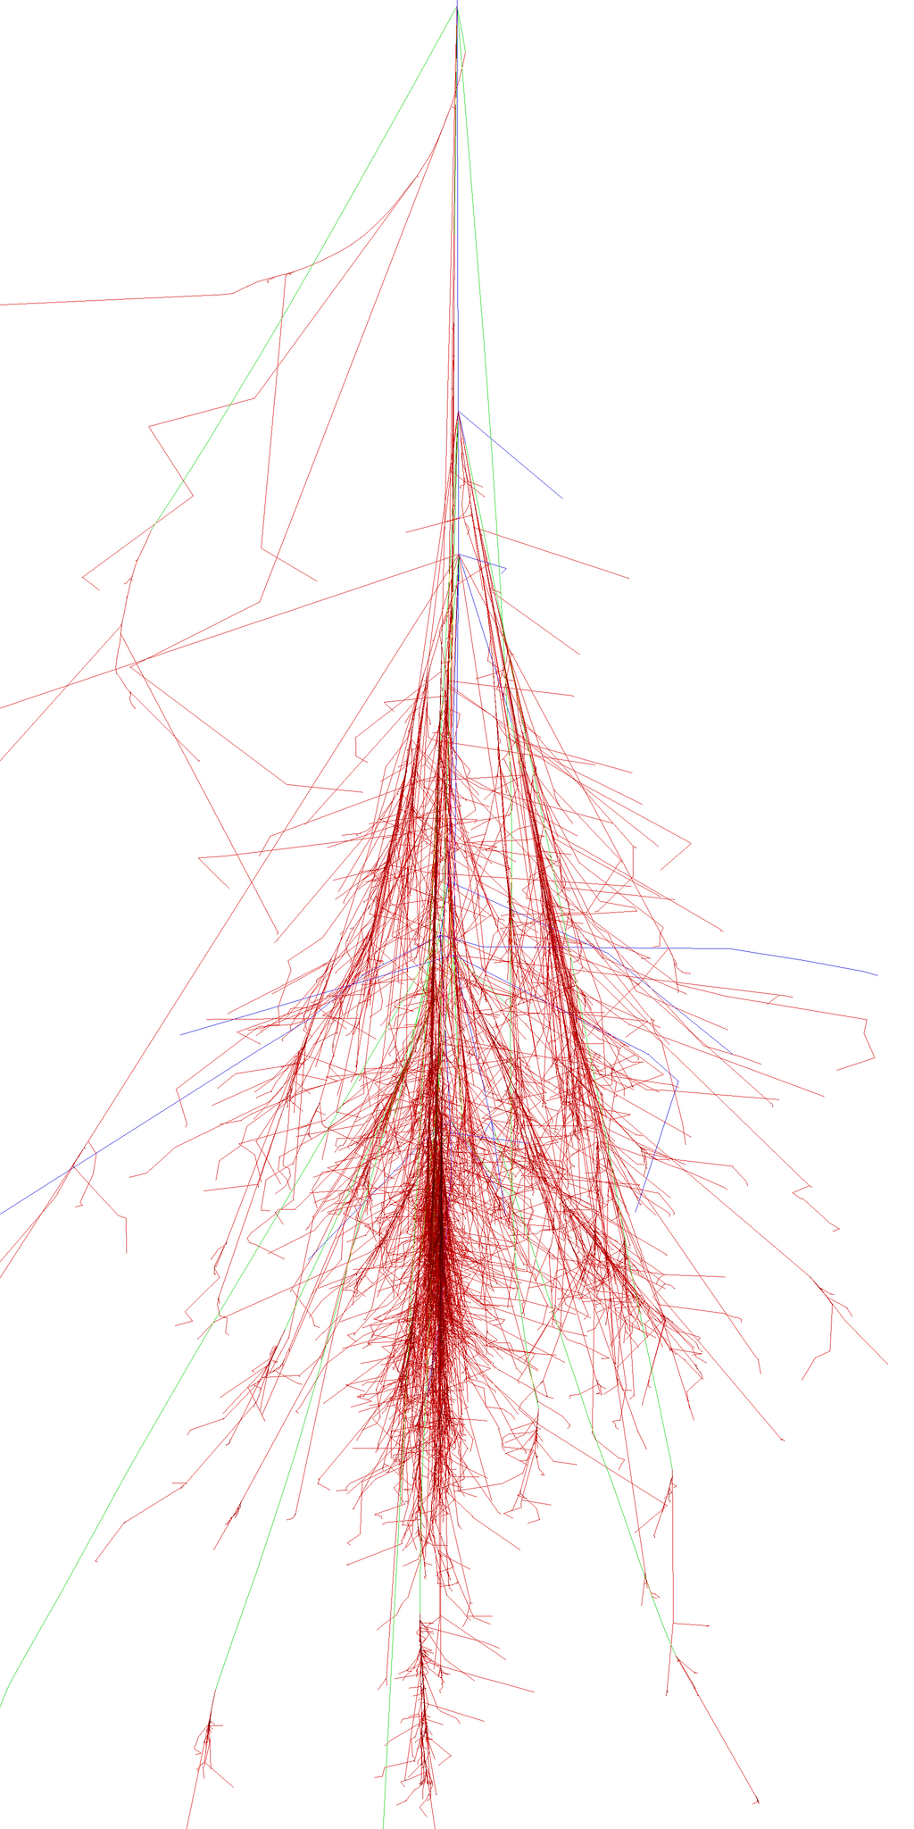
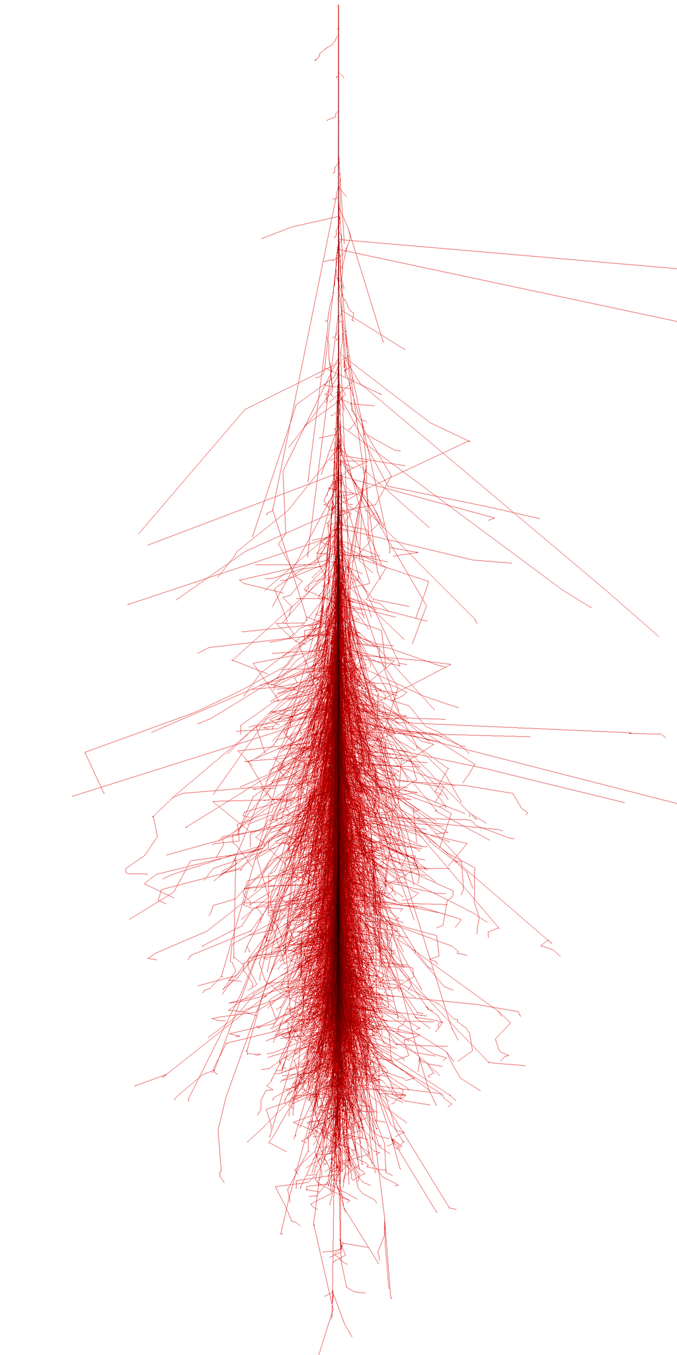
Calorimeters & Showers
Simulations from CORSIKA
EM Showers
Hadronic Showers
EM showers (e, γ, 𝜋⁰→2γ) are well-calibrated, measured “correctly”.
All showers are similar, resolution is good.
Hadronic showers (p, n, 𝜋±) are more difficult to calibrate
Each shower is unique, huge resolution penalty from variations.

Slide 3
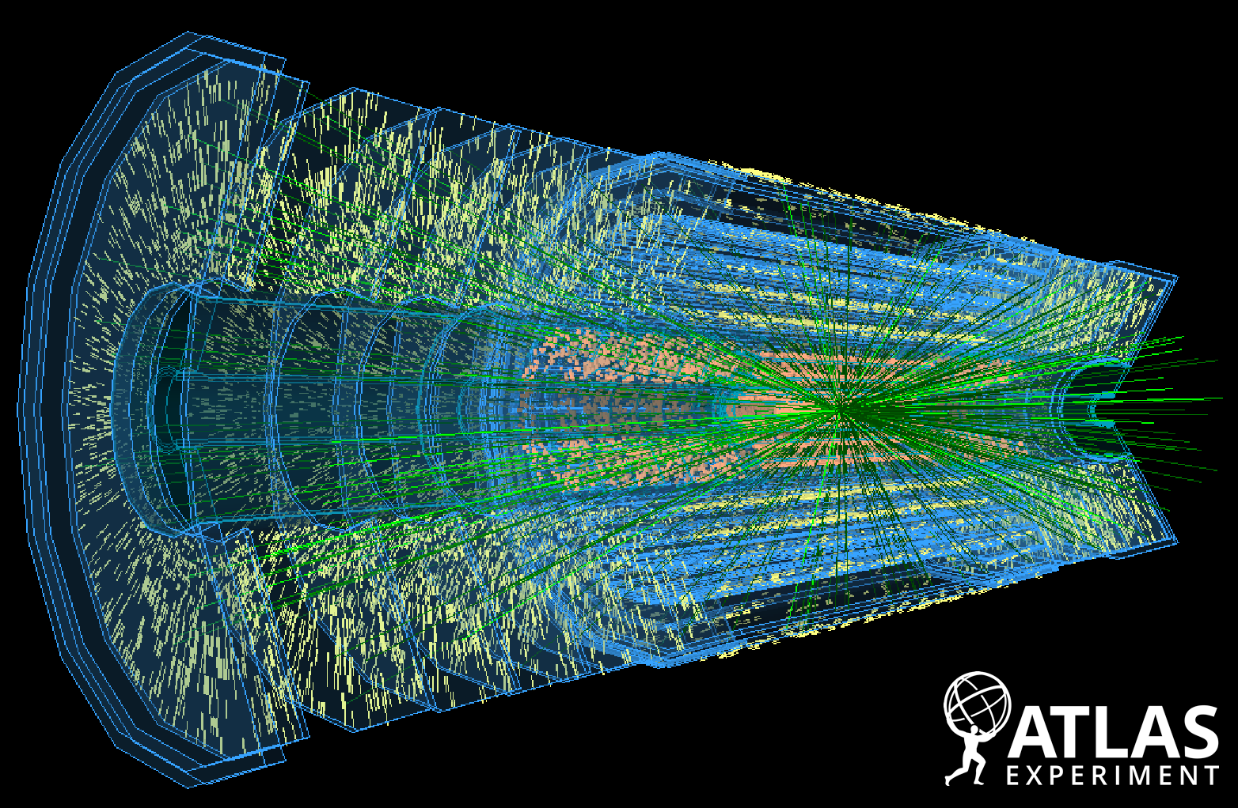
ATLAS Upgrade
LHC will be upgraded to High-Luminosity LHC in ~2026-2030
Subsequent run periods will expect an environment to 200 events per pp-collision bunch crossing (pileup), ~4x more than current run
HL-LHC simulated event in tracker
ATLAS-PHOTO-2023-042-1
Need a more efficient trigger system in ATLAS in the high-pileup environment
Interesting events could be inaccurately recorded, or missed by trigger and lost forever

Slide 4
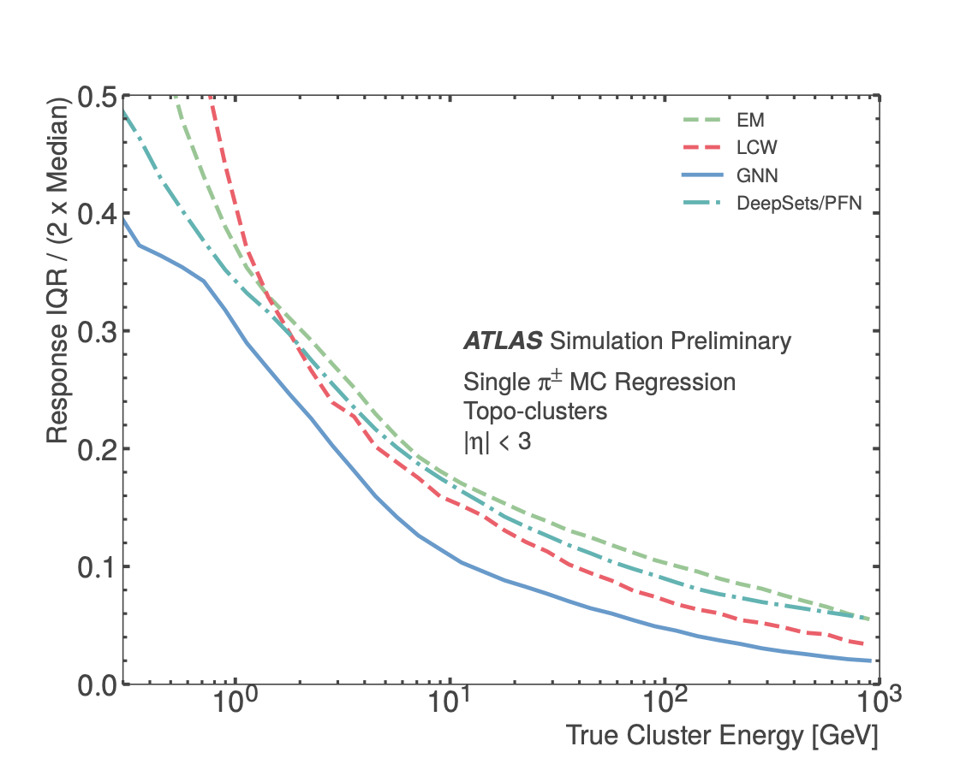
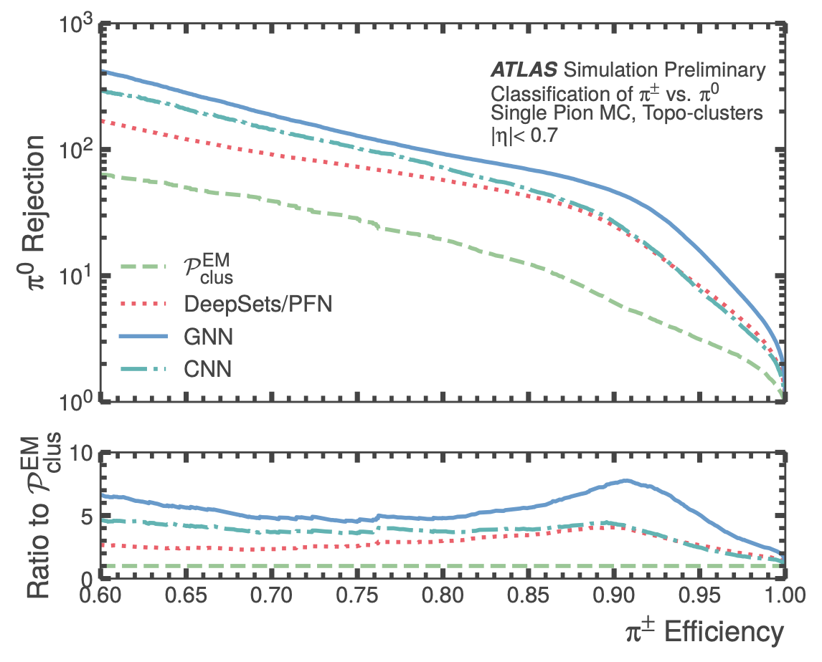
Machine Learning for Offline Shower Types Identification & Calorimeter Calibration
Pions (𝜋⁰, 𝜋±) are most abundant particle produced in collisions in LHC
Previous studies showed ML methods (e.g. GNN, DeepSets, …) outperforms the current algorithms for identifying shower types and calibrating energy in the calorimeter in offline.
ATL-PHYS-PUB-2020-018
ATL-PHYS-PUB-2022-040

Slide 5
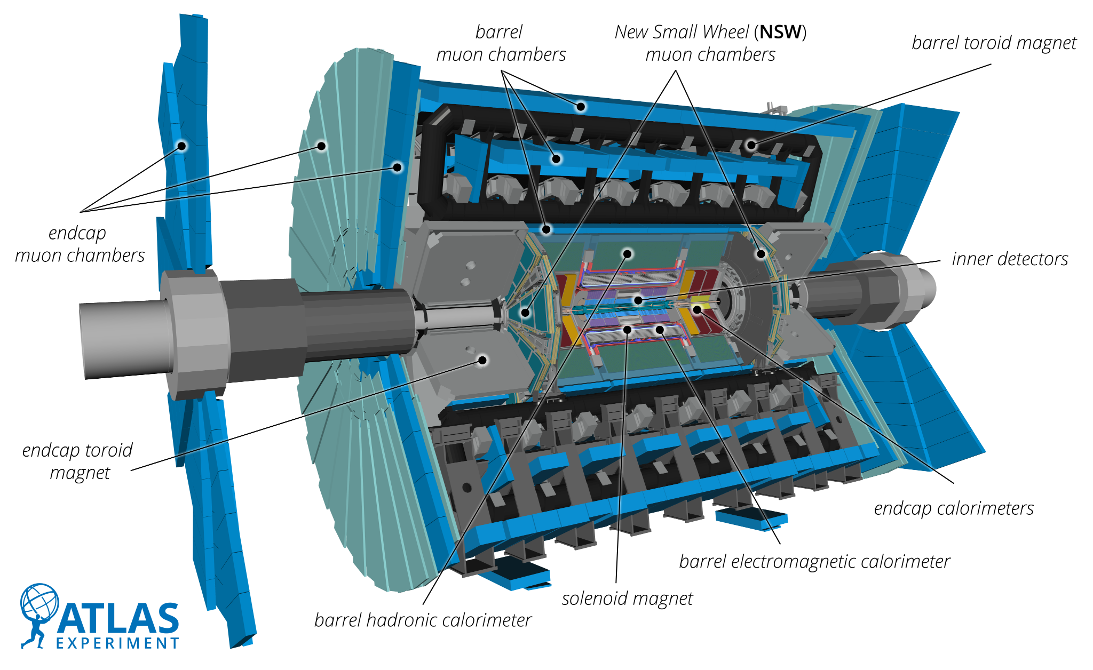
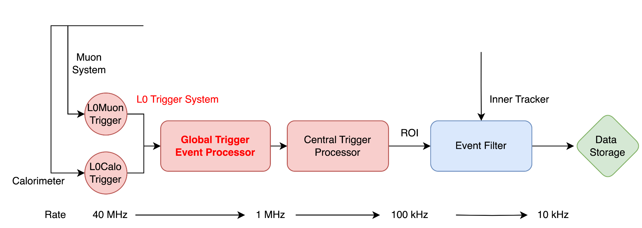
Can we apply ML to online trigger?
Can ML be applied in the L0 global trigger event processor for pion calibration?
L0 Event Selection:
Topo-clustering, calibration possible
Identify target items (leptons, jets)
Reduces data rate 40MHz → 1MHz, in total latency of 10 μs
FPGA in the event processor
Each algorithm in global trigger aims for ~5% resources in FPGA, algorithms to be improved / added over time
Requires conversion of NN to hardware code

Slide 6
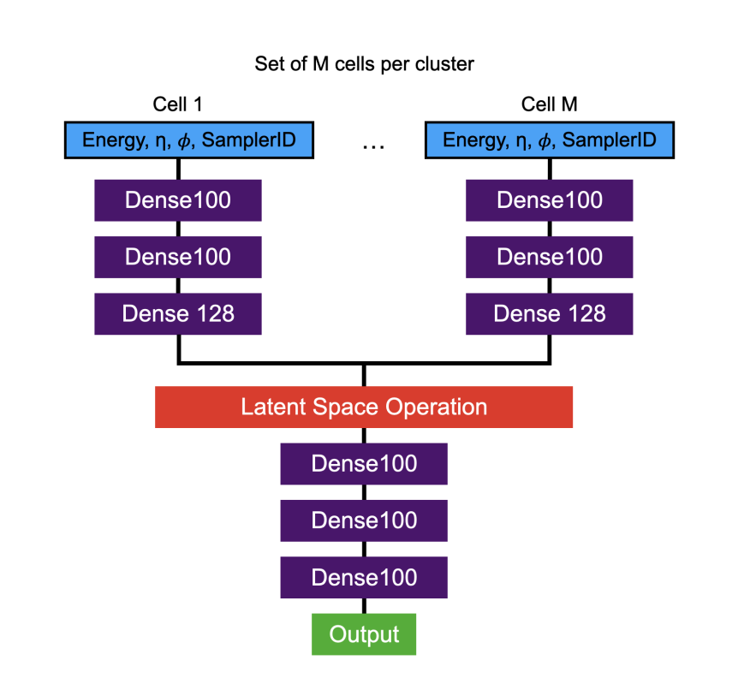
DeepSets Neural Network
DeepSets: (3 stage model)
Run a 𝚽 function (standard NN) on every cell
Sum all the results to “latent space”
Run a final F network, get outputs (classification & regression)
Relationships of cells are encoded in latent space
𝚽 function
# nodes
F function

Slide 7
Topo-Clustering for HL-LHC
arXiv:1603.02934
❸
Apply neighbouring clusters splitting
❶
Initial seed collection
❷
Cells above growth control threshold collection
All cells above seed threshold
Cells potentially contributing to cluster growth

Slide 8
Proposal:
DeepSets under the shadow of Topo-Clustering

Slide 9
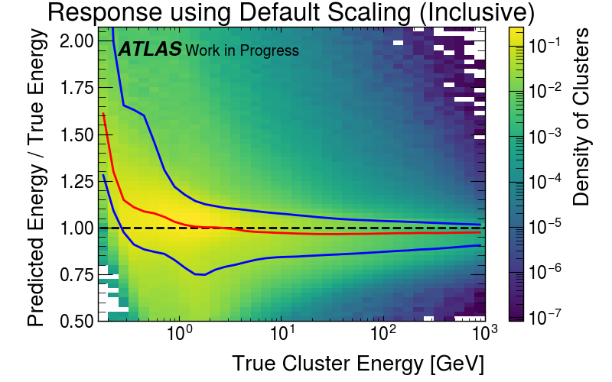
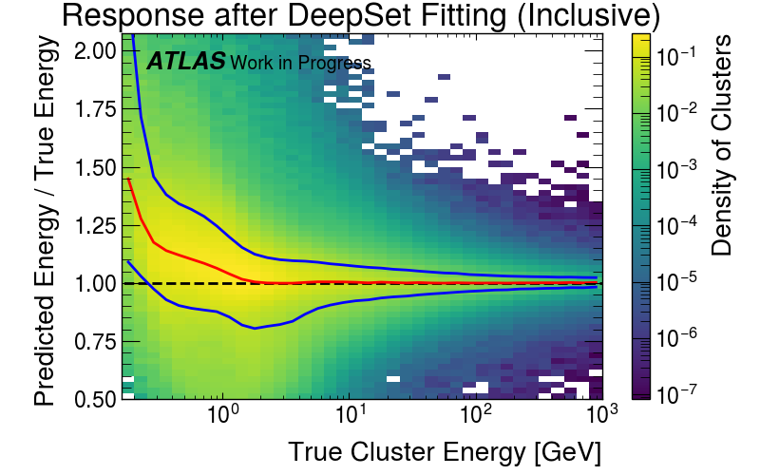
Neural network Performance
Trade-off studies with MC simulation
To work within the shadow of topo-clustering algorithm, we want small # of nodes (especially in 𝚽 function), while balancing # of hidden layers
Best candidate so far:
Training details:
~14M clusters with 𝝅⁰ & 𝝅± labels (mc21)
Epochs: 100
Learning rate: 0.001
Loss weights:
Regression: 99%
Classification: 1%
Model details:
𝚽 nodes: 96
𝚽 layers: 5
𝑭 nodes: 192
𝑭 layers: 5
Red line=Median response of test samples; blue line=1𝝈 response

Slide 10
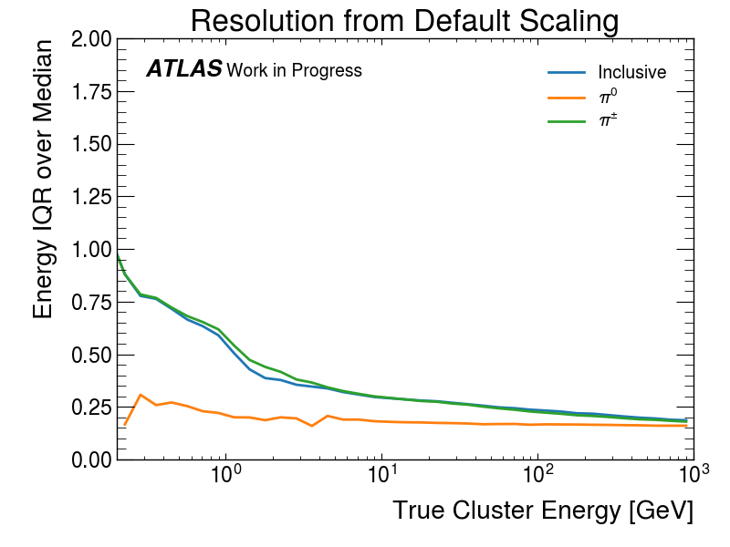
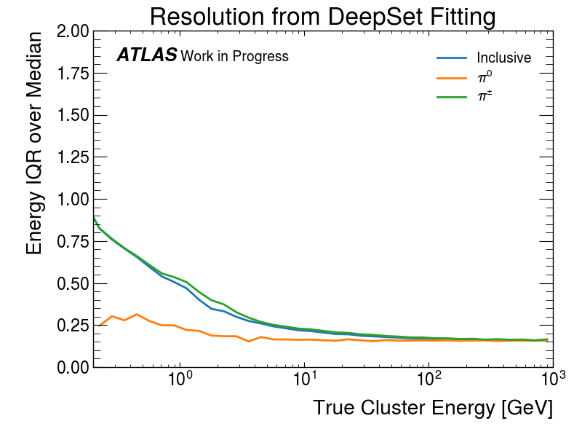
Neural network Performance
Trade-off studies with MC simulation
To work within the shadow of topo-clustering algorithm, we want small # of nodes (especially in 𝚽 function), while balancing # of hidden layers
Best candidate so far:
Training details:
~14M clusters with 𝝅⁰ & 𝝅± labels (mc21)
Epochs: 100
Learning rate: 0.001
Loss weights:
Regression: 99%
Classification: 1%
Model details:
𝚽 nodes: 96
𝚽 layers: 5
𝑭 nodes: 192
𝑭 layers: 5

Slide 11
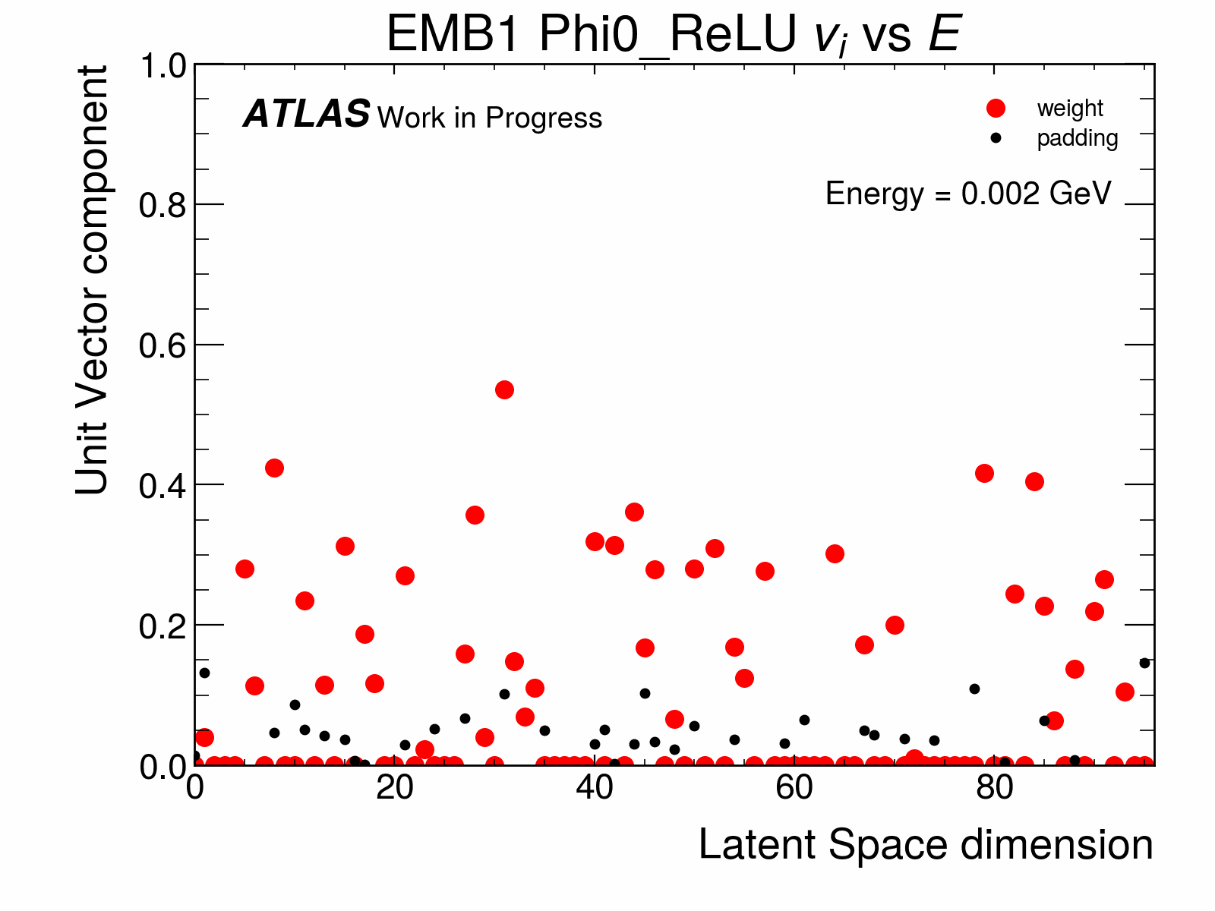
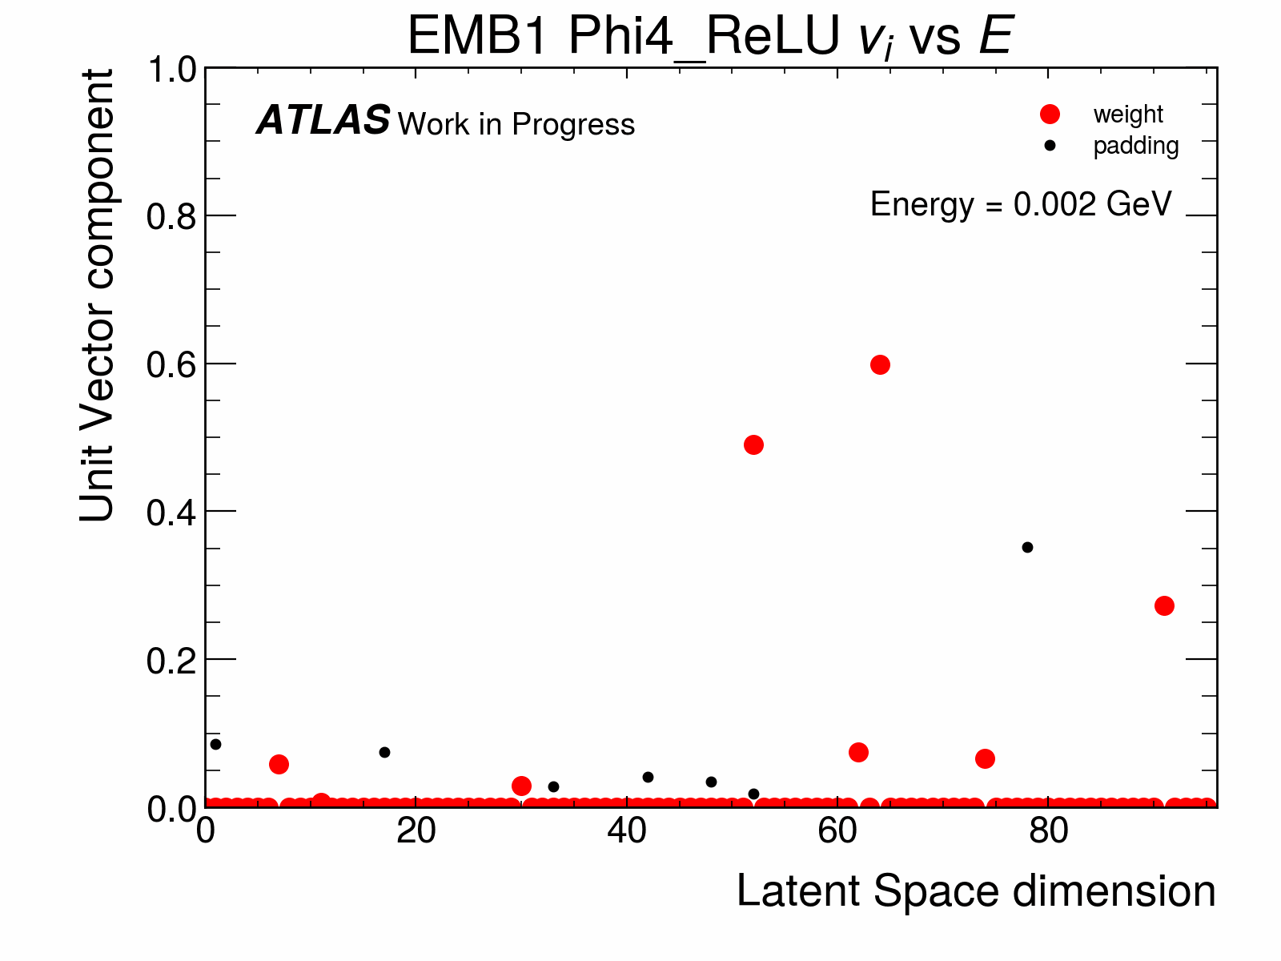
Possible Improvement for NN
Probe trained model with 1-cell-cluster, and varying cell energy
(First hidden layer)
(Final output)
(Last hidden layer)
≈300 MeV
Information are encoded in a few vector components in later hidden layers, rather than using all vectors
Possible to further reduce resource usage in 𝚽-layers
Plateau at <300 MeV could be electronic noise
Possible explanation for over-prediction for <300 MeV in NN fitting

Slide 12
Conclusion
Problem trying to solve:
Improve calorimeter calibration for online trigger during the HL-LHC
Why ML?
ML performs better than current algorithms in pion classification and energy calibration
Challenges ahead:
To be run in FPGA in the L0 global trigger under the shadow of the current topocluster algorithm
Strict requirement on latency and limitation of resource to implement the DeepSets neural network
Need DeepSets to recognize electronic noise to prevent over-prediction at low energy
Integration to future data flow and format with other trigger processes in hardware

Slide 13
Backup

Slide 14
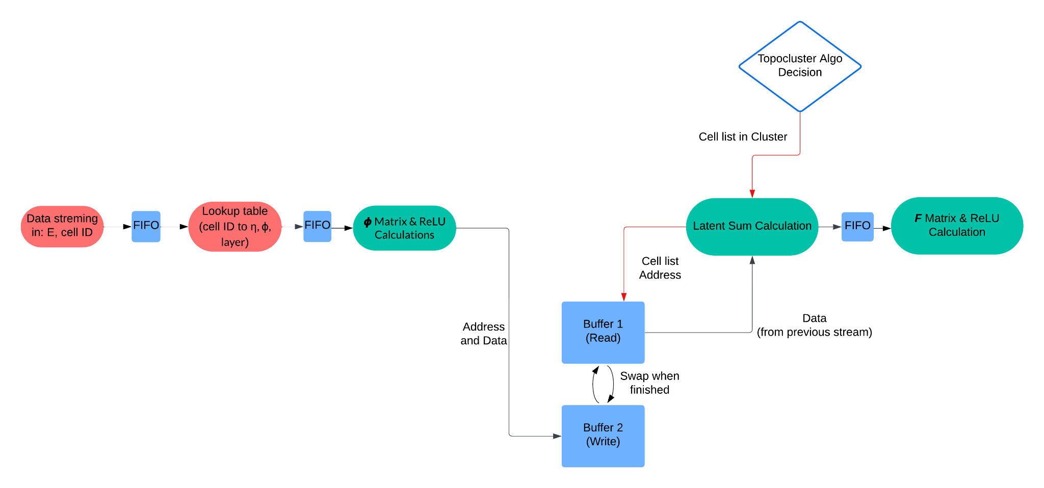
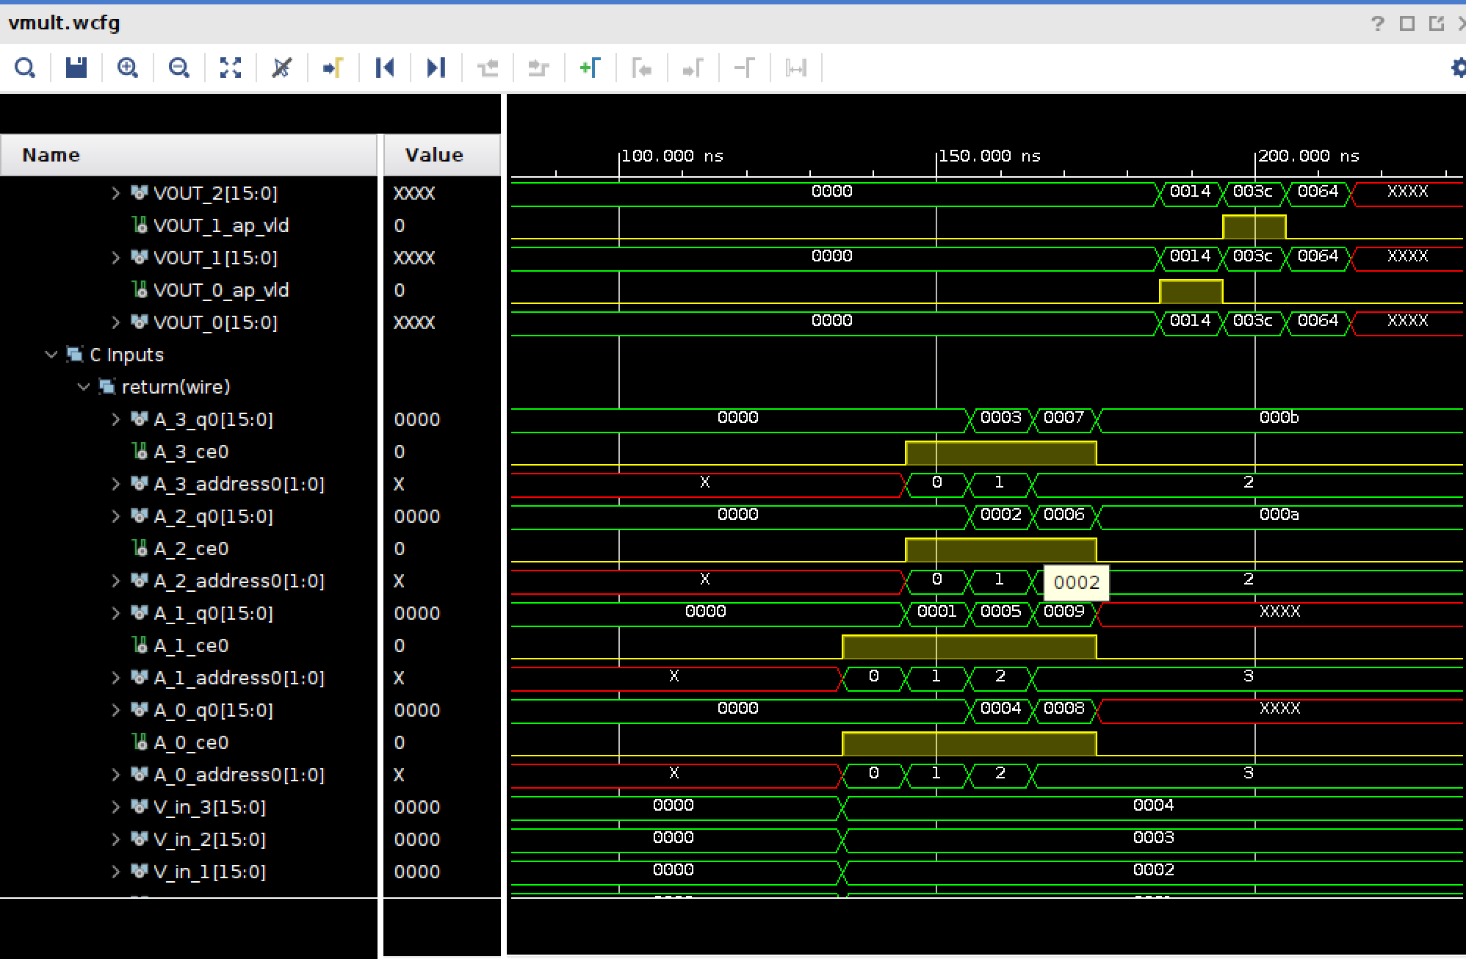
Implementation in FPGA
Prototyping using AMD Vitis HLS tools (written in C → generate RTL for FPGA)
Xilinx waveform for a matrix calculation

Slide 15
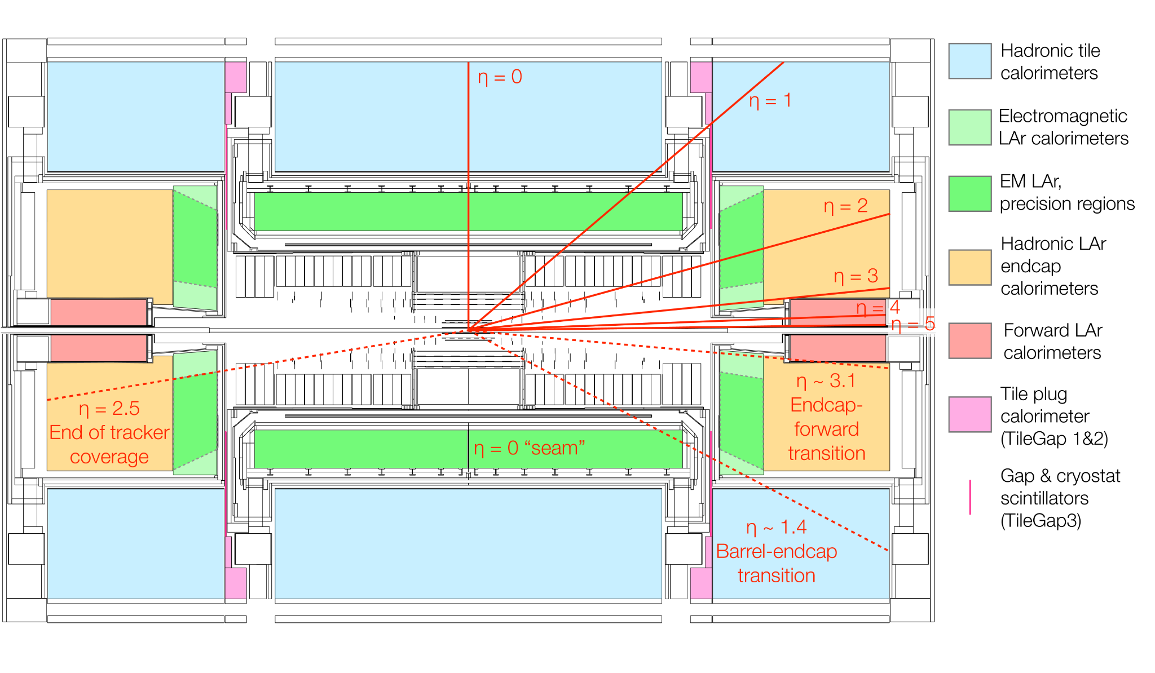
Geometry Reference
arXiv:2007.02645

Slide 16
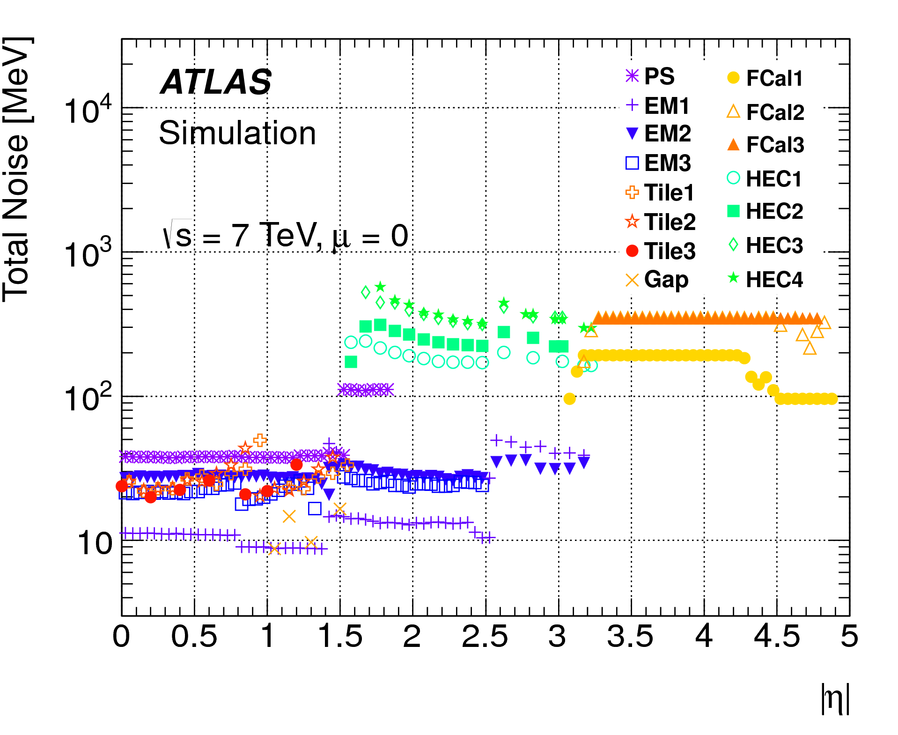
Electronic Noise in Calorimeter
Electronic noises in the detectors are similar across all runs
arXiv:1603.02934

Slide 17
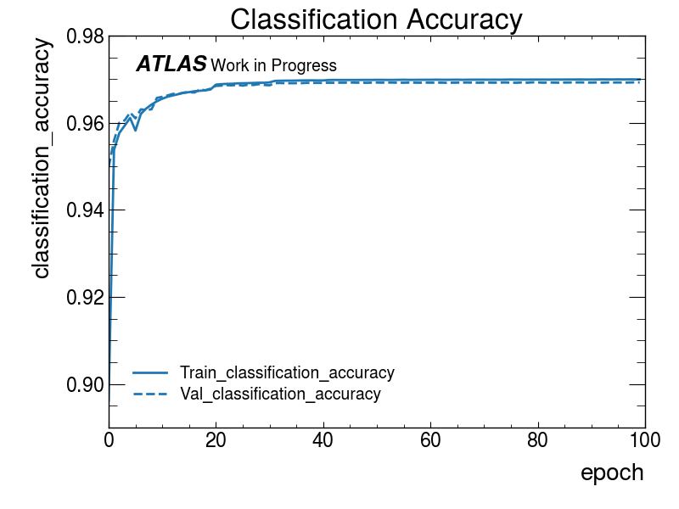
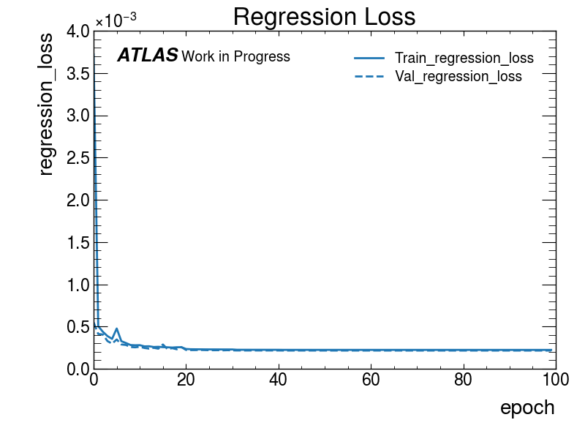
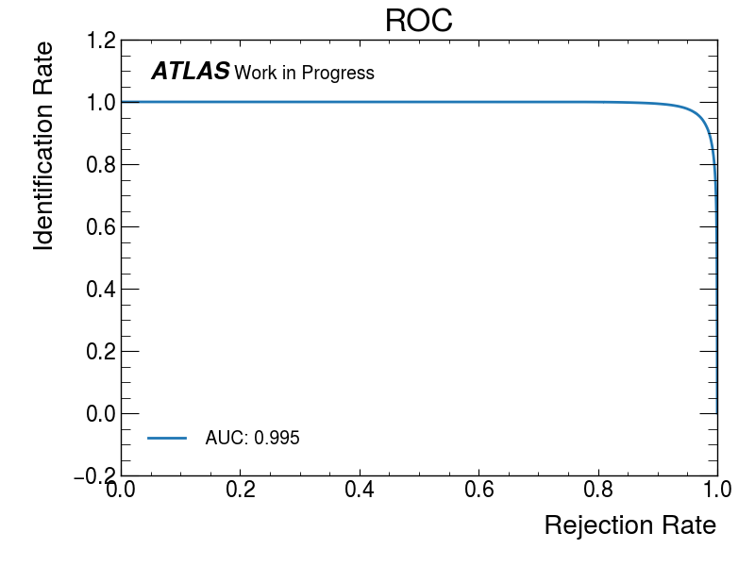
Accuracy, losses, ROC plots

Slide 18
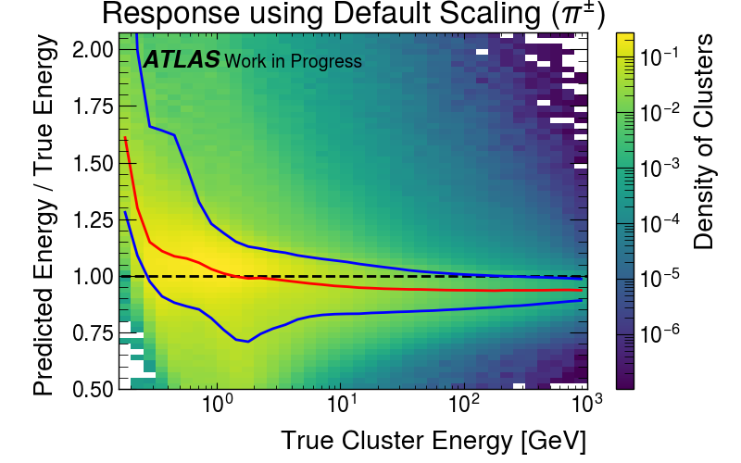
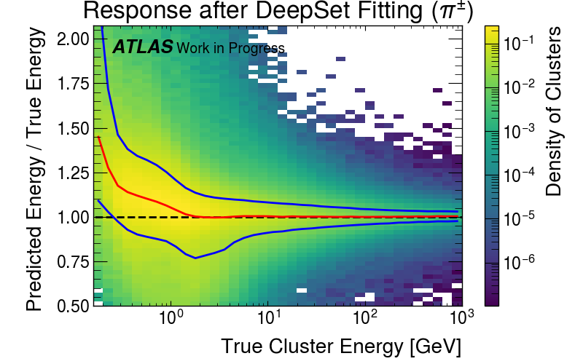
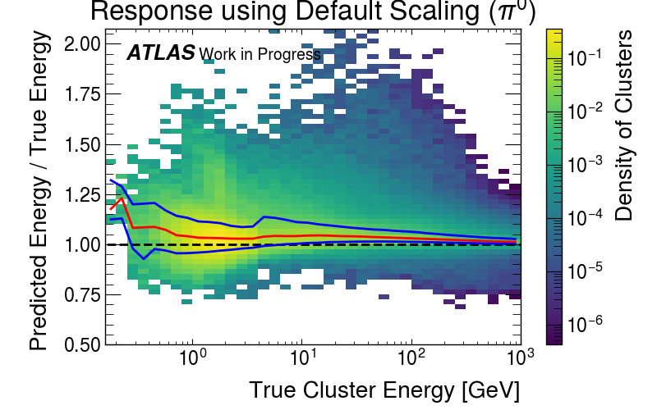
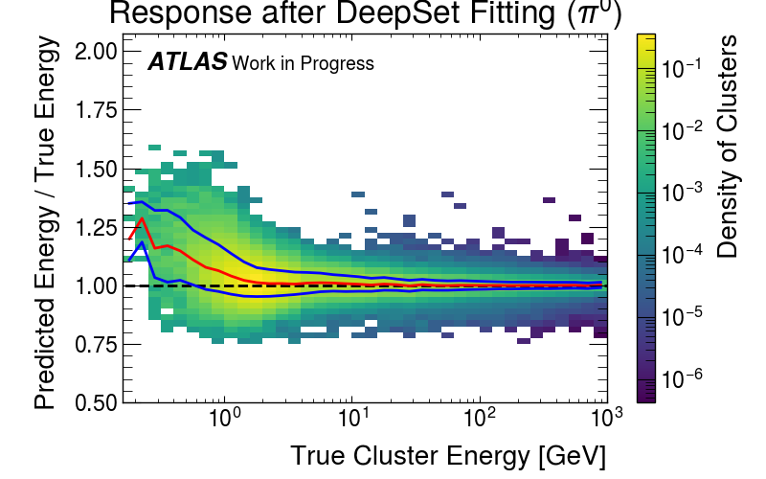
Regional Plots from Fitting

Slide 19
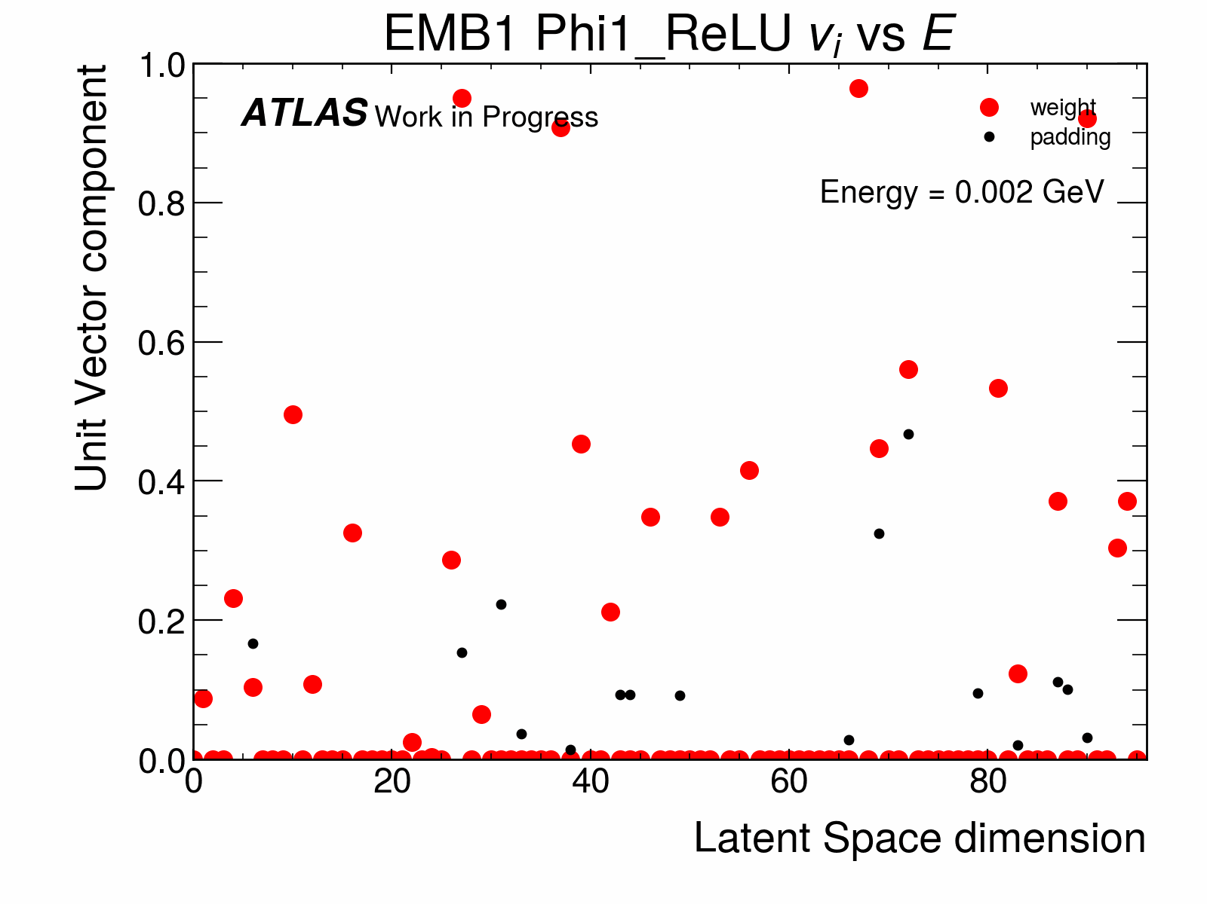
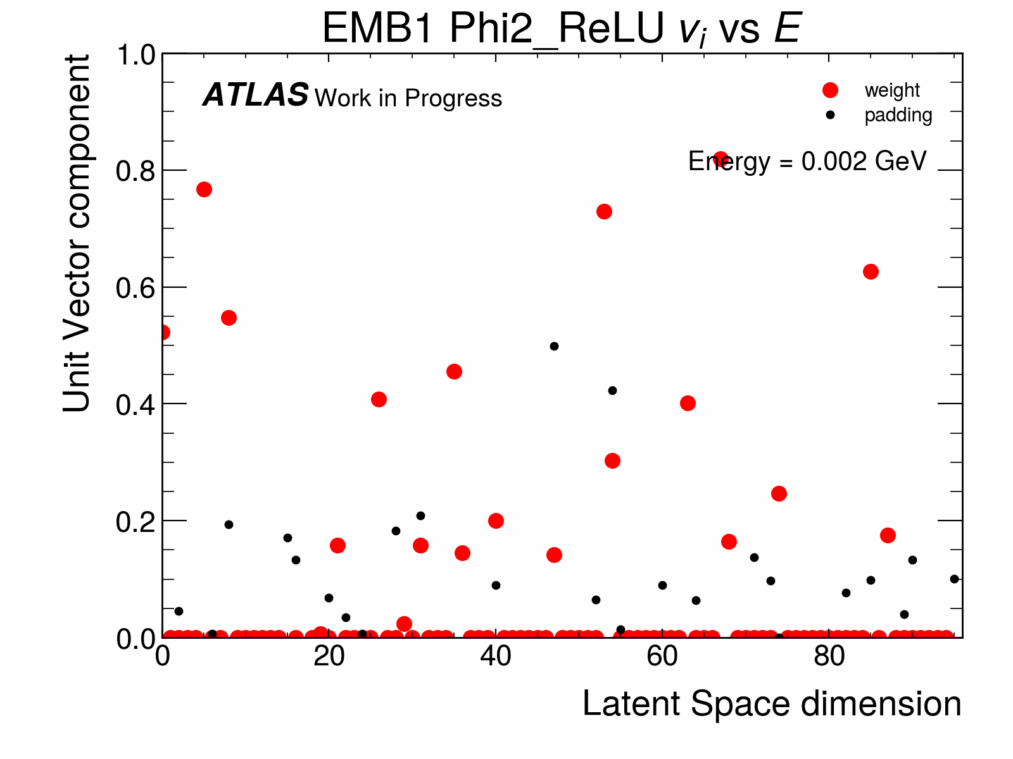
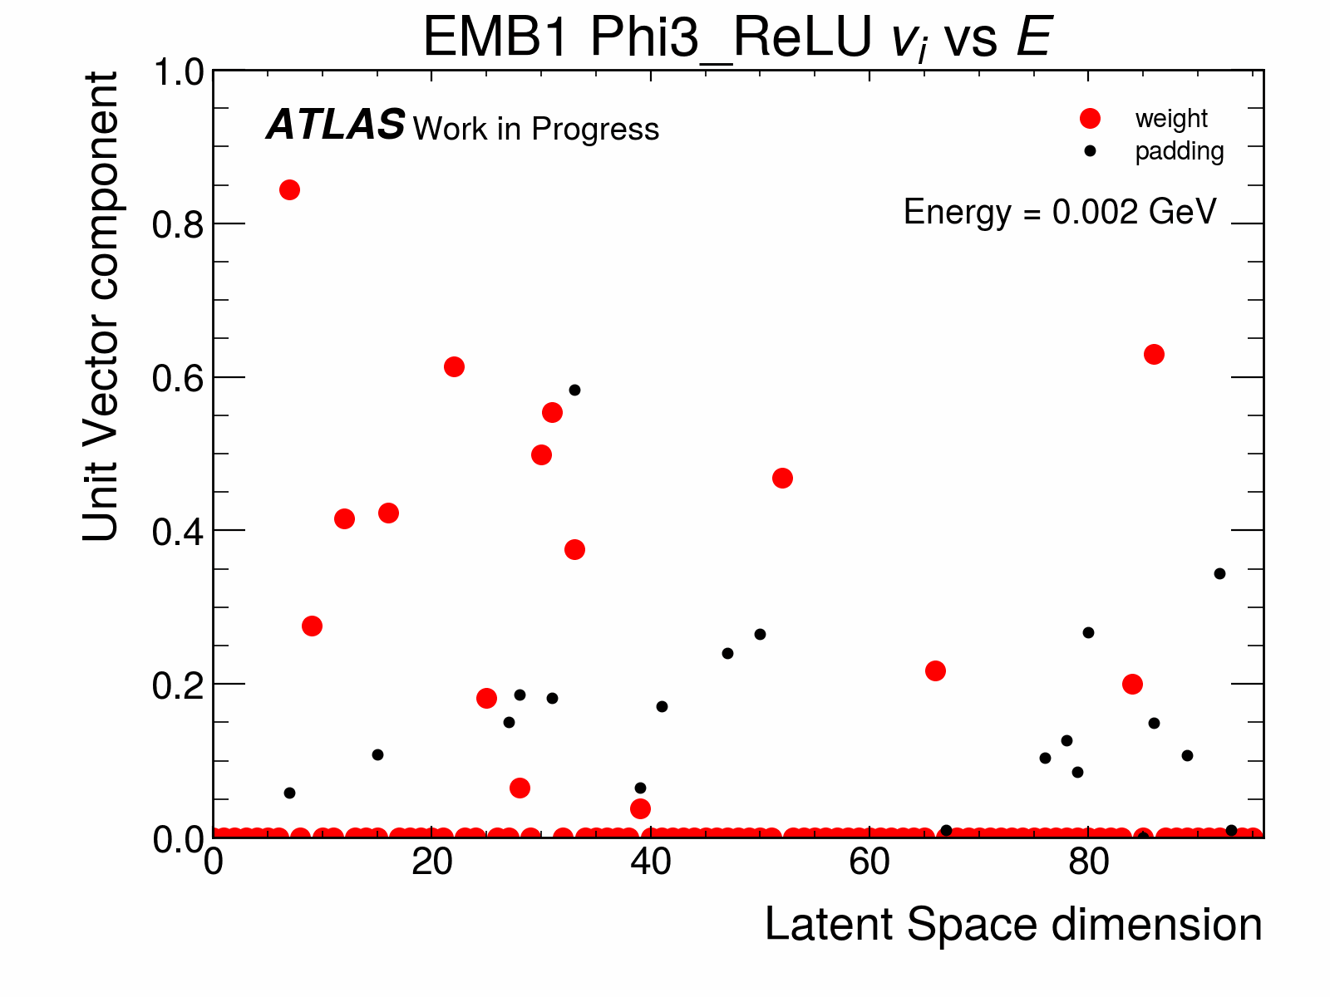
Comparison of 𝚽-layers unit vectors

Slide 20
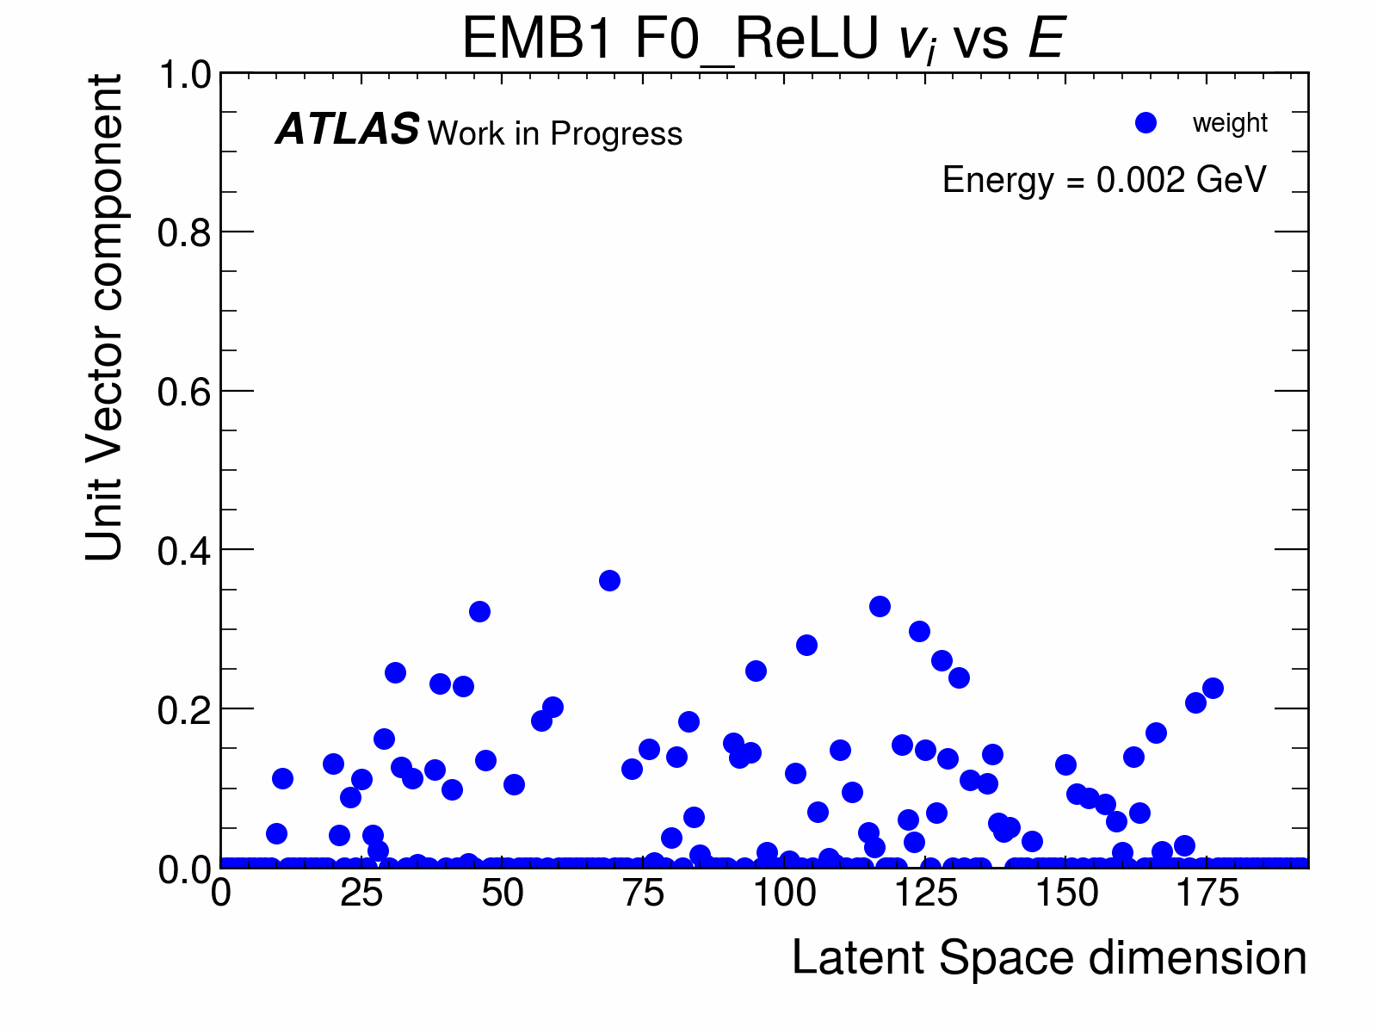
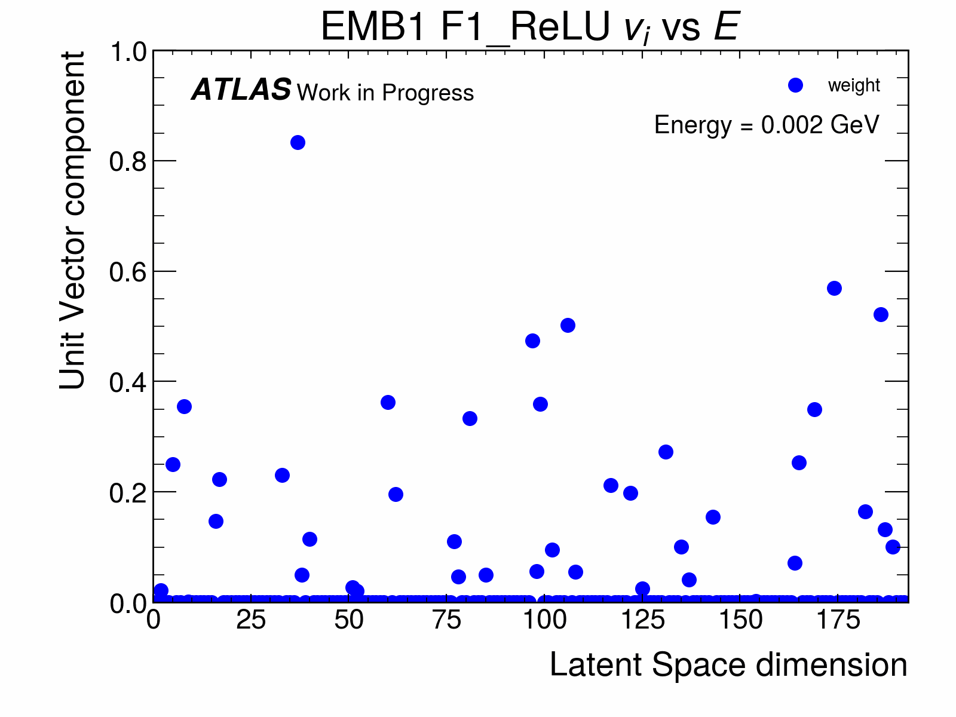
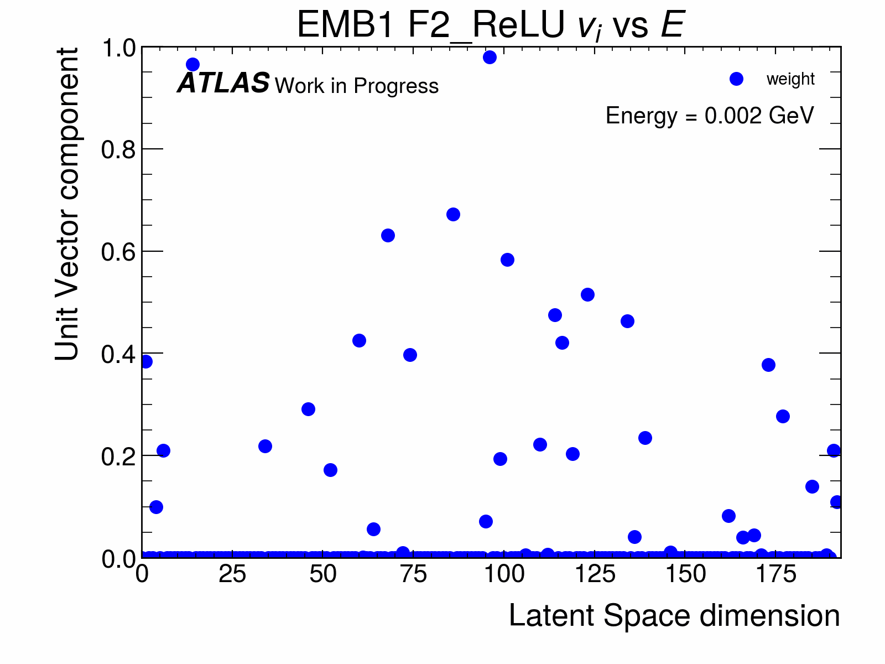
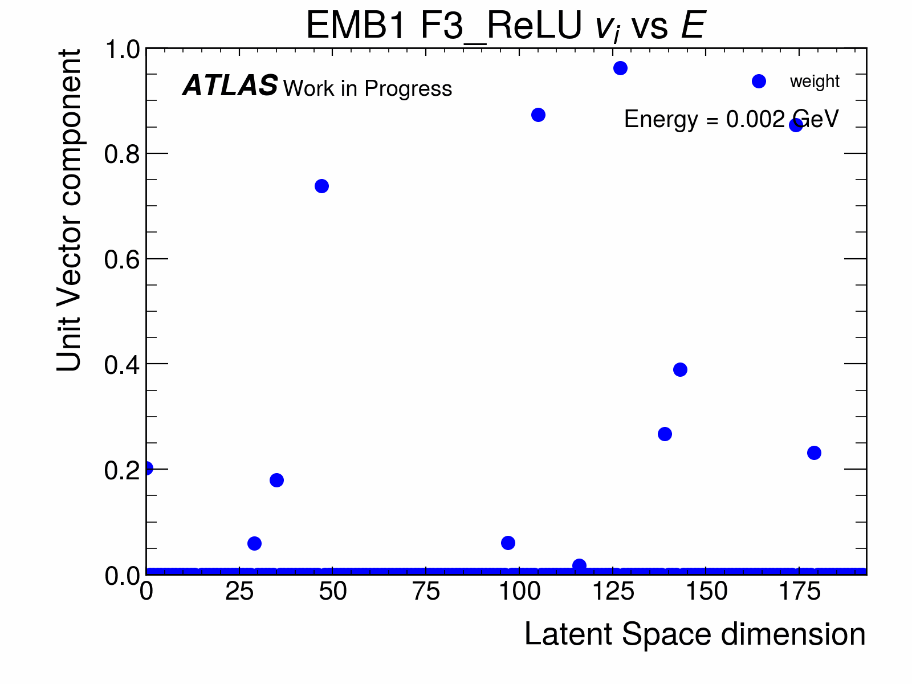
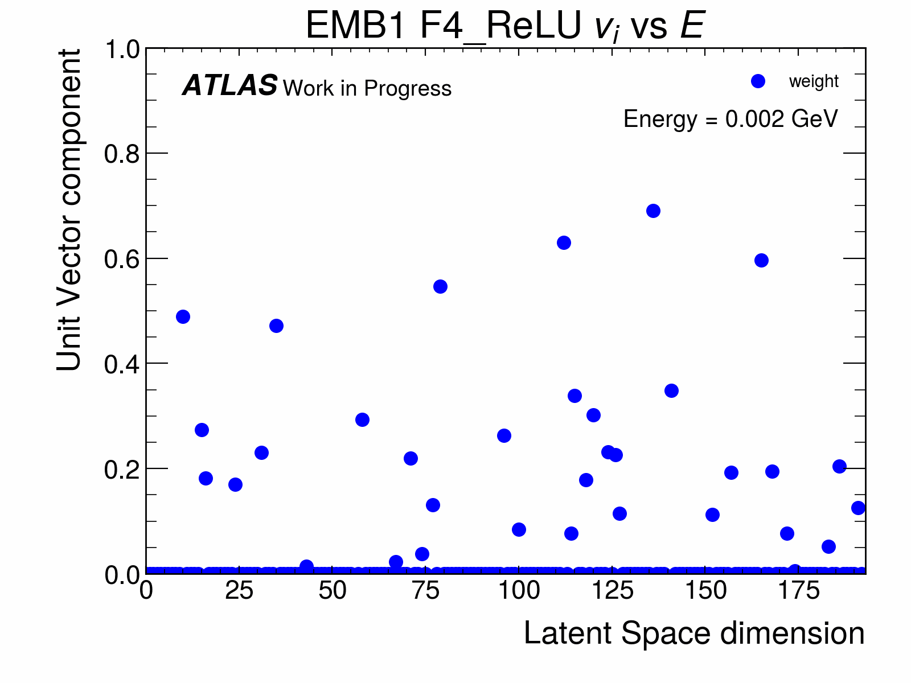
Comparison of F-layers unit vectors

