Slide 1

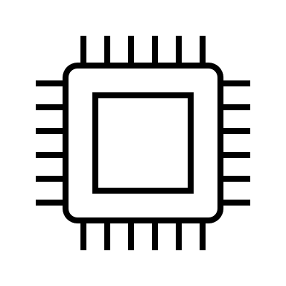

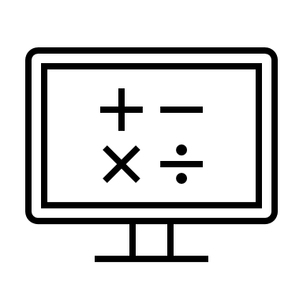

Equity, Diversity, and Inclusion (EDI) in STEM Research
STEM = Science , Technology, Engineering and Mathematics
Dr. Claudia Gomes da Rocha
Faculty of Science, Department of Physics and Astronomy
WNPPC2025, 13 February 2025
claudia.gomesdarocha@ucalgary.ca

Slide 2

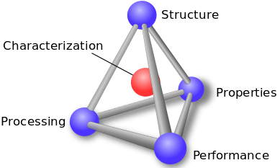
My research group: Complex (Nano) Materials Lab
Theoretical condensed matter physics
Complex systems, emergent phenomena
Computational nanoscience
Modelling Quantum Materials
Brain-inspired Computing Systems
Low dimensional systems
Nanoscale-mesoscopic
materials
Engineered/ functional materials

Slide 3









Complex (Nano) Materials Lab
Ghazaleh Gholizadeh
(MSc Student)
Marcus Kasdorf
(MSc Student)
Ciara Chisholm
(MSc Student, co-supervision with Dr. Brown)
Diego Simpson-Ochoa
(MSc Student, co-supervision with Dr. Nicola)
Gabe Komo
(Undergraduate final year physics thesis)

Slide 4
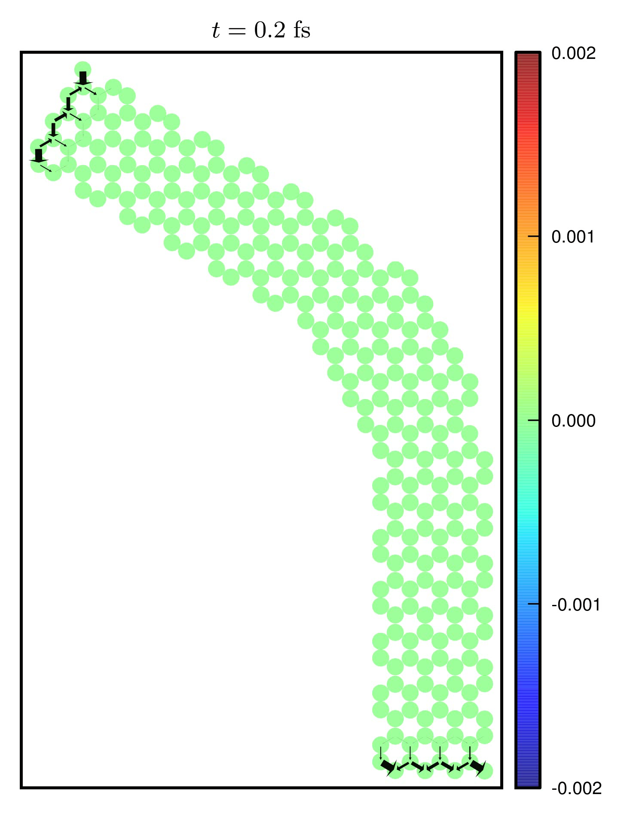
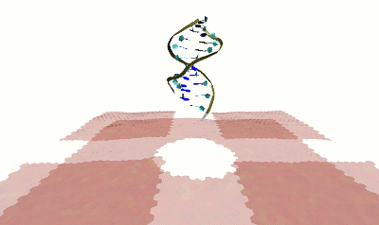
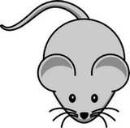
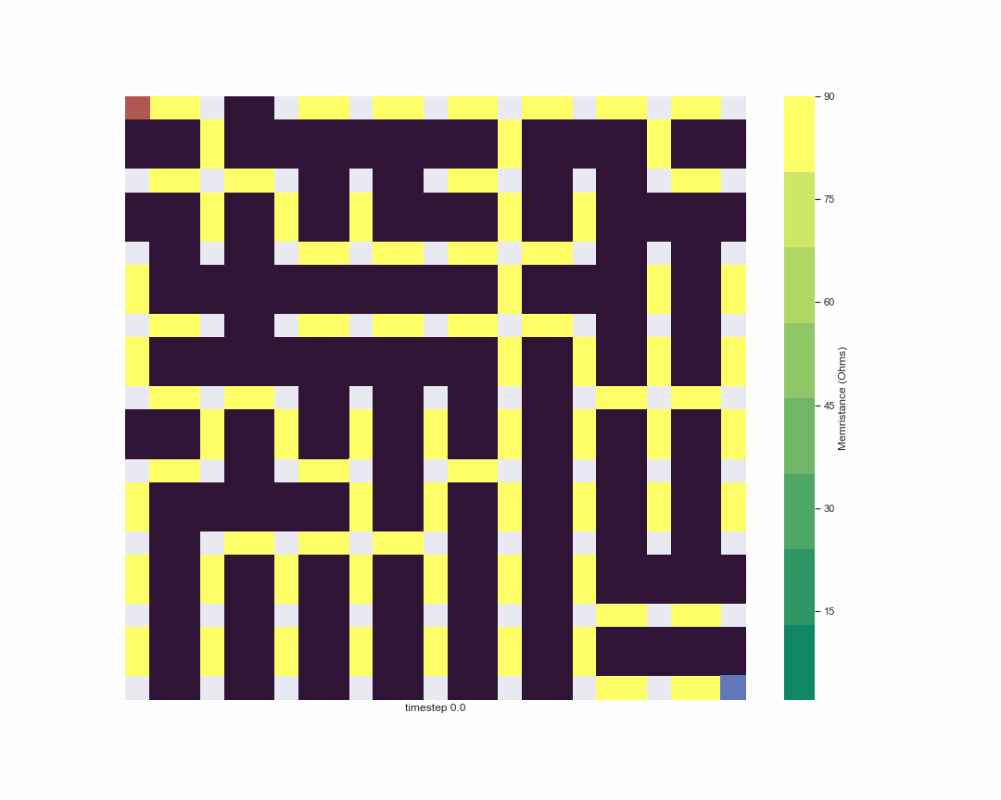
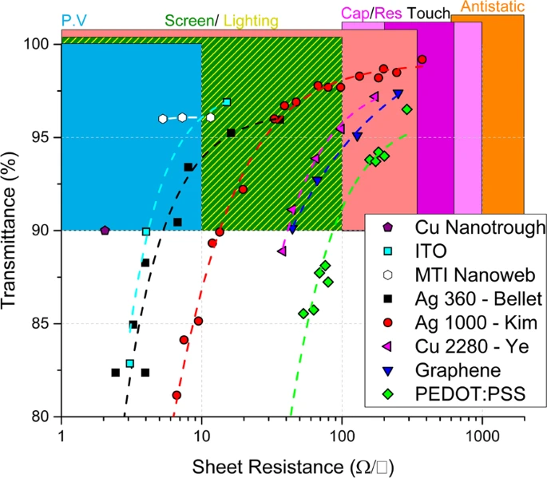
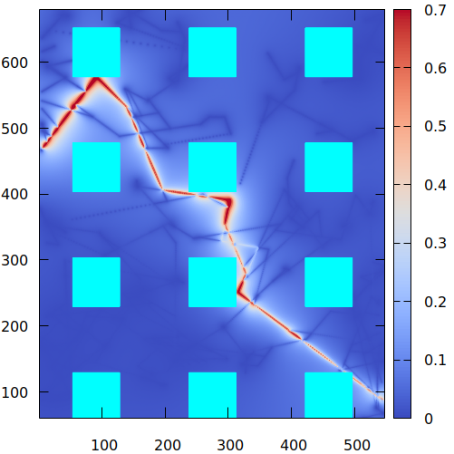
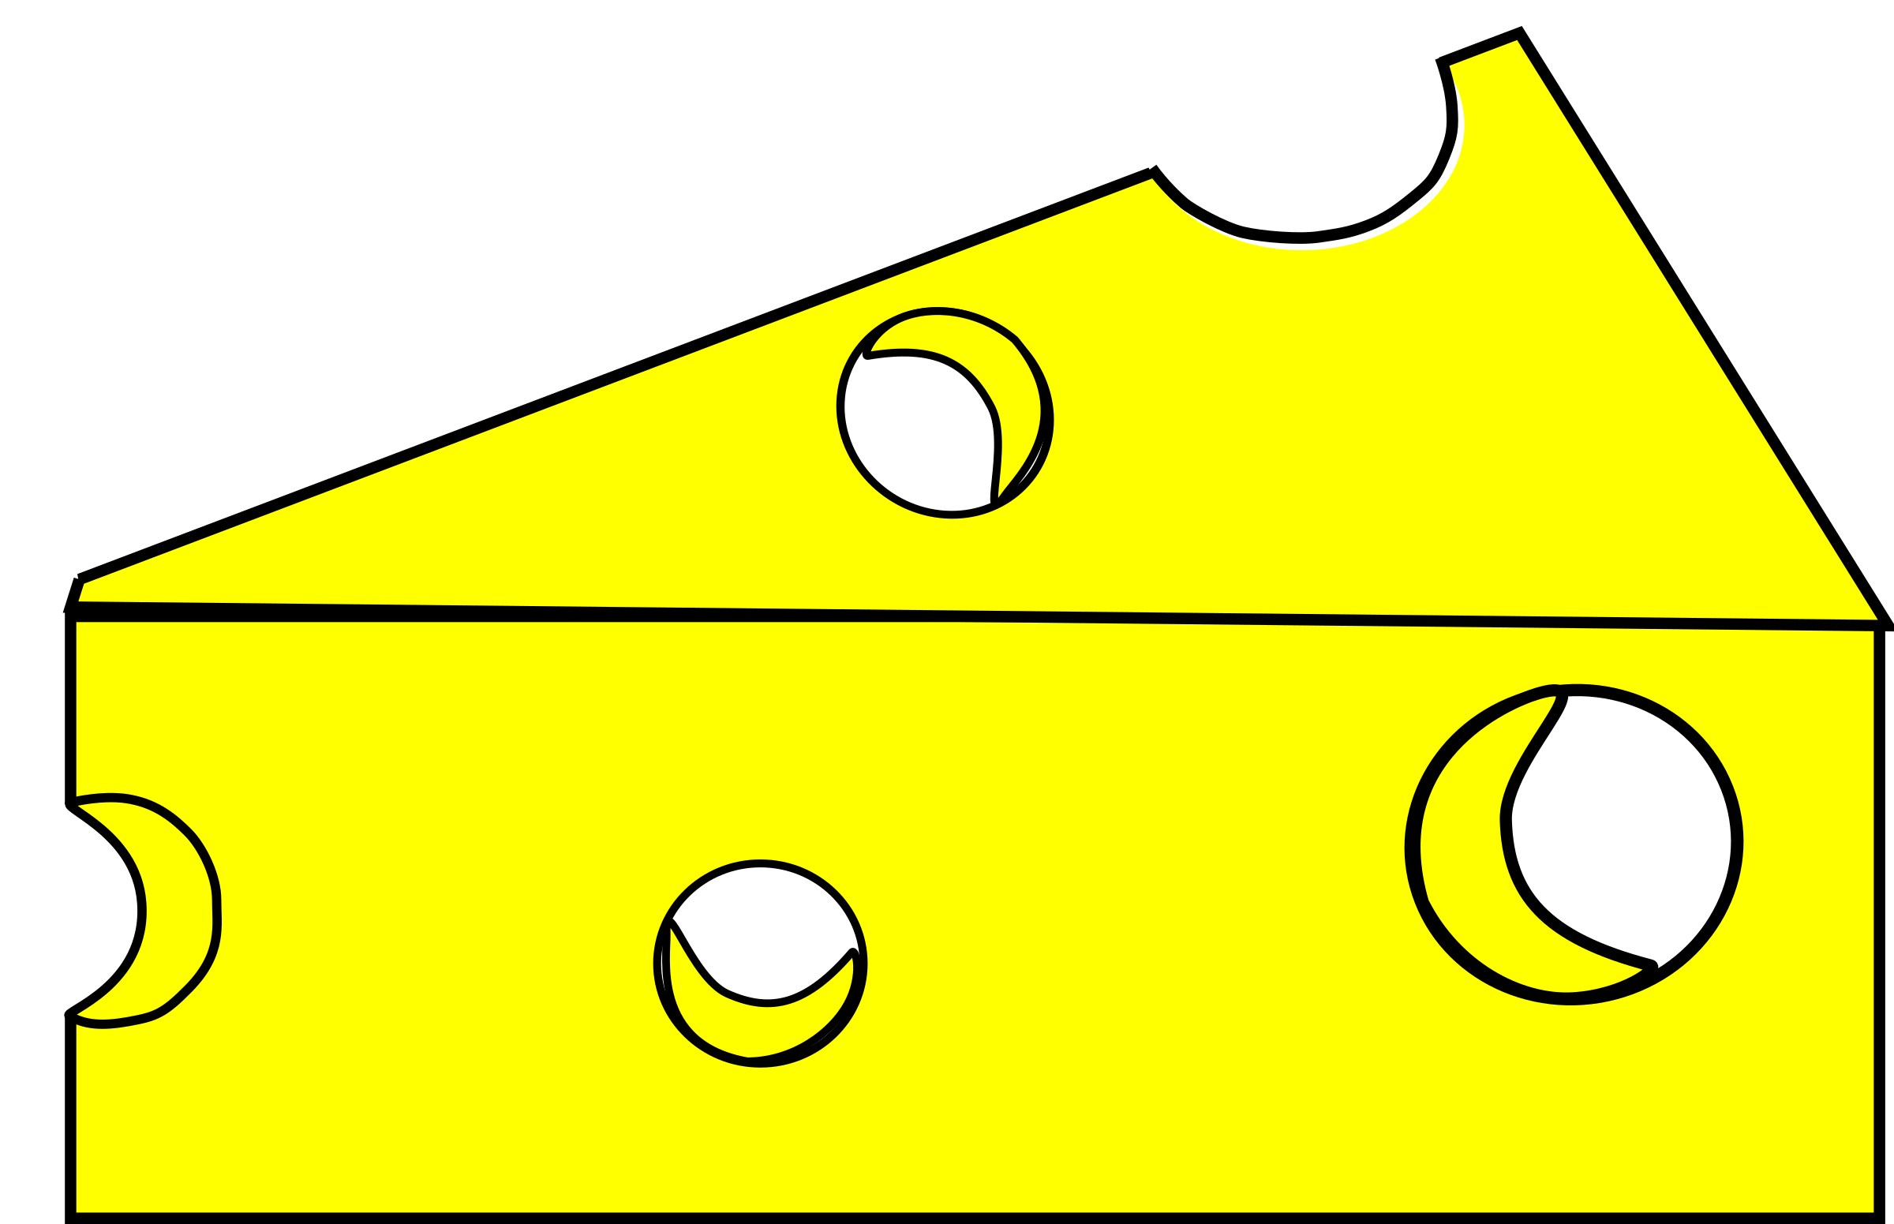
Complex (Nano) Materials Lab
Δq (e)
Transient currents in nanoswitches
Theoretical condensed matter physics
Complex systems, emergent phenomena
Computational nanoscience
Modelling Quantum Materials
Brain-inspired Computing Systems
Nanoscale 7, 8627 (2015)
Nanoscale 11, 12296 (2019)
Space-time mapping of currents at the nanoscale
Conductive sensors
5.0 V
J. Phys. Condens. Matter 28, 235001 (2016)
PCCP 16, 3558 (2014)
Nano Lett. 13, 1969 (2013)
Memristive systems and intelligent materials
Transparent conductors and flexible display simulations
Nanoscale 13, 15369 (2021)
Sci. Rep. 9, 11550 (2019)
Appl. Phys. Lett. 116, 251902 (2020)

Slide 5
Service
2020 – 2022: PHAS Undergraduate Liaison Chair of the Undergraduate Liaison Committee with participation in the Undergraduate Affairs Committee.
Since 2022: Associate Head EDI for the Department of Physics and Astronomy and member of the Faculty of Science EDI Committee. I have been taking various EDI-related training:
  (Full year training) Women in Science and Engineering (WISE) Planet Program; leadership training on personal leadership, systems and cultures, design for disruptions, regenerative design, and experiential learning through self-defined Leadership Equity Action Plan (LEAP) projects.
  (Winter 2025) NSERC Webinar - Equity, Diversity and Inclusion Considerations in the Alliance Training Plan.
  (Spring 2024) Equity, Diversity, Inclusion & Accessibility in Teaching and Learning, Taylor Institute.
  (Workshop) Danger of Burnout and Anxiety: What are the social stressors and what to do about them? By Dr. Gregor Wolbring, UCalgary.
  (Workshop) Allies and Allyship; particular focus on disabled people/people with disabilities. By Dr. Gregor Wolbring, Ucalgary.
  (Workshop) EDI through an ability studies lens. By Dr. Gregor Wolbring, UCalgary.

Slide 6
Service
2020 – 2022: PHAS Undergraduate Liaison Chair of the Undergraduate Liaison Committee with participation in the Undergraduate Affairs Committee.
Since 2022: Associate Head EDI for the Department of Physics and Astronomy and member of the Faculty of Science EDI Committee. I have been taking various EDI-related training:
  (Workshop) Responding to Students in Distress for Faculty & Staff.
  Equitable and Inclusive Hiring for Academic Selection.
  Unconscious bias training, UCalgary Office of EDI.
  Indigenous Canada online, University of Alberta.
  Indigenous Relations Training Program, University of Calgary.
  Identifying & Mitigating Bias in Reference Letters.
  Workshop on the meaningful inclusion of EDI into research programs.
  …

Slide 7
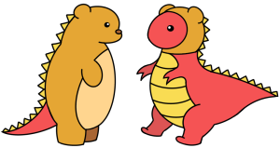

Canadian Conference for Undergraduate Women and Gender Minorities in Physics
About 100 participants registered (about 20 from UCalgary and remaining across Canada).
The organizing committee managed to raise almost $40,000 in funds!
The event counted vastly on student and faculty volunteering (community building).
Various UCalgary staff members have been helping the organizers in putting this event together.
Student-led organization with faculty mentorship.
https://cap.ca/congress-conference/ccuwip/
First time in which the conference name and its acronym include gender minorities.

Slide 8
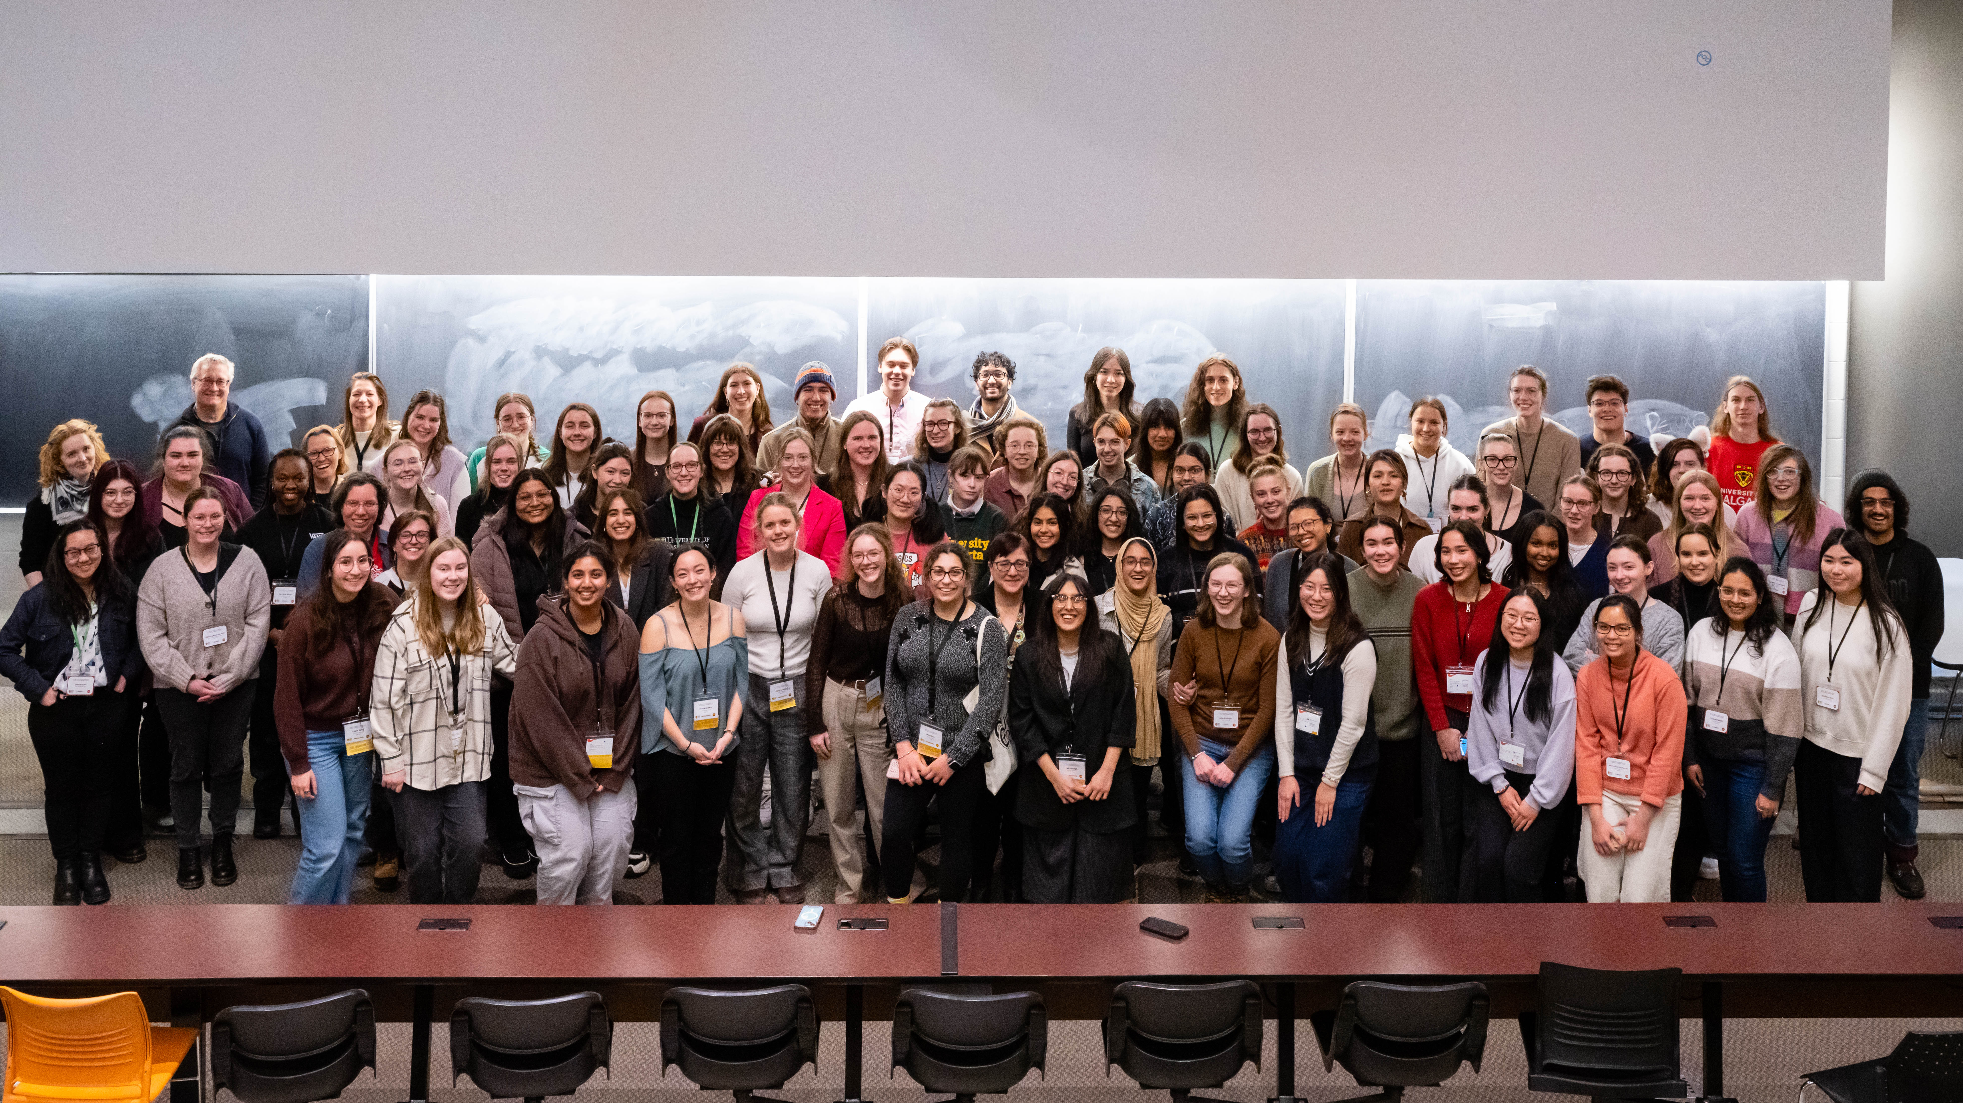
CCUW*iP 2025, 2 February 2025

Slide 9
Main Sources
NSERC guide on integrating equity, diversity and inclusion considerations in research.
Government of Canada’s Guide on Equity, Diversity and Inclusion Terminology.
There will be other sources cited during the presentation…
The slides will contain lots of information and text. This is because they also serve as notes for study and reflection.
The Natural Sciences and Engineering Research Council of Canada (NSERC; French: Conseil de recherches en sciences naturelles et en génie du Canada, CRSNG) is Canada’s federal funding agency for university-based research and student training; it is the major federal agency responsible for funding natural sciences and engineering research in Canada. https://www.nserc-crsng.gc.ca/index_eng.asp

Slide 10
EDI – Equity, Diversity, and Inclusion
Equity: The principle of considering people’s unique experiences and differing situations, and ensuring they have access to the resources and opportunities that are necessary for them to attain just outcomes.
Equity means fairness; people of all identities being treated fairly. It means ensuring that the processes for allocating resources and decision-making are fair to all and do not discriminate on the basis of identity. Equity aims to eliminate disparities and disproportions that are rooted in historical and contemporary injustices and oppression.
What about Equality?
Notes:
This Photo by Unknown Author is licensed under CC BY-NC-ND

Slide 11
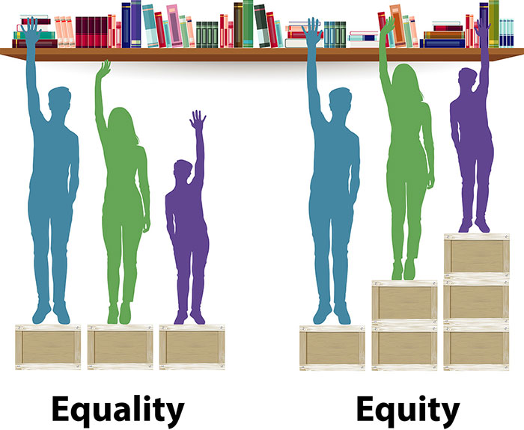
EDI – Equity, Diversity, and Inclusion
Notes:
This Photo by Unknown Author is licensed under CC BY-NC-ND

Slide 12
EDI – Equity, Diversity, and Inclusion
Equity: The principle of considering people’s unique experiences and differing situations, and ensuring they have access to the resources and opportunities that are necessary for them to attain just outcomes.
Equity means fairness; people of all identities being treated fairly. It means ensuring that the processes for allocating resources and decision-making are fair to all and do not discriminate on the basis of identity. Equity aims to eliminate disparities and disproportions that are rooted in historical and contemporary injustices and oppression.
Equality: The principle of treating everyone in the same manner by ensuring they have access to the same resources and opportunities.
Equality does not necessarily lead to fair outcomes since it does not consider people’s unique experiences and differing situations.

Slide 13
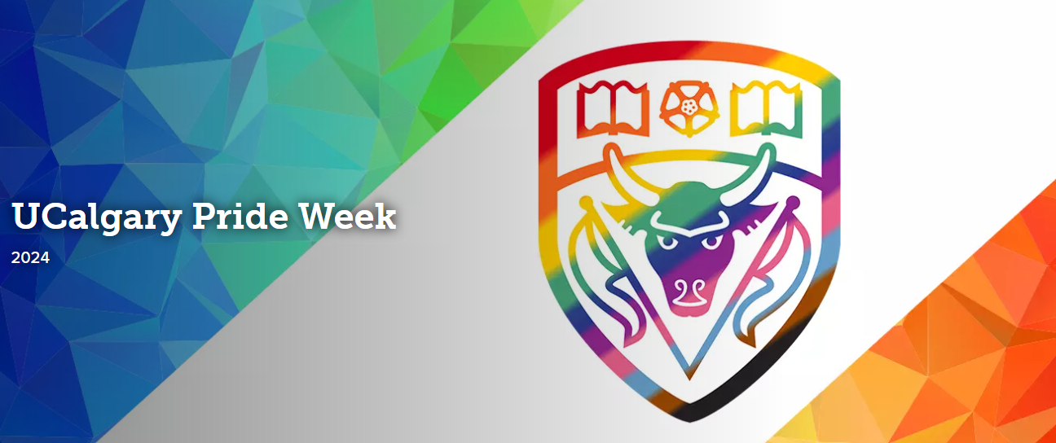
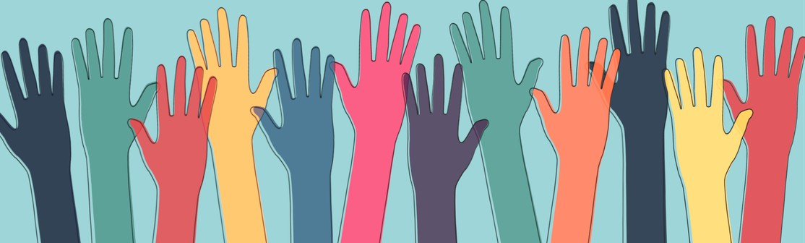
EDI – Equity, Diversity, and Inclusion
Diversity: Term used to describe the presence of a wide range of human qualities and attributes within a group, organization or society.
Diversity encompasses acceptance and respect of individual identities, which include, but are not limited to, the dimensions of race, language, ethnicity, gender identity and expression, sex, sexual orientation, socio-economic status, age, disability, neurodivergence, physical appearance, religious beliefs, political beliefs or other ideologies, ancestry, culture, geographic background.
26 August – 4 September 2024
https://www.ucalgary.ca/equity-diversity-inclusion/literacy-education/lgbtq2s-equity-diversity-and-inclusion/ucalgary-pride-week-2024
Notes:
This Photo by Unknown Author is licensed under CC BY

Slide 14
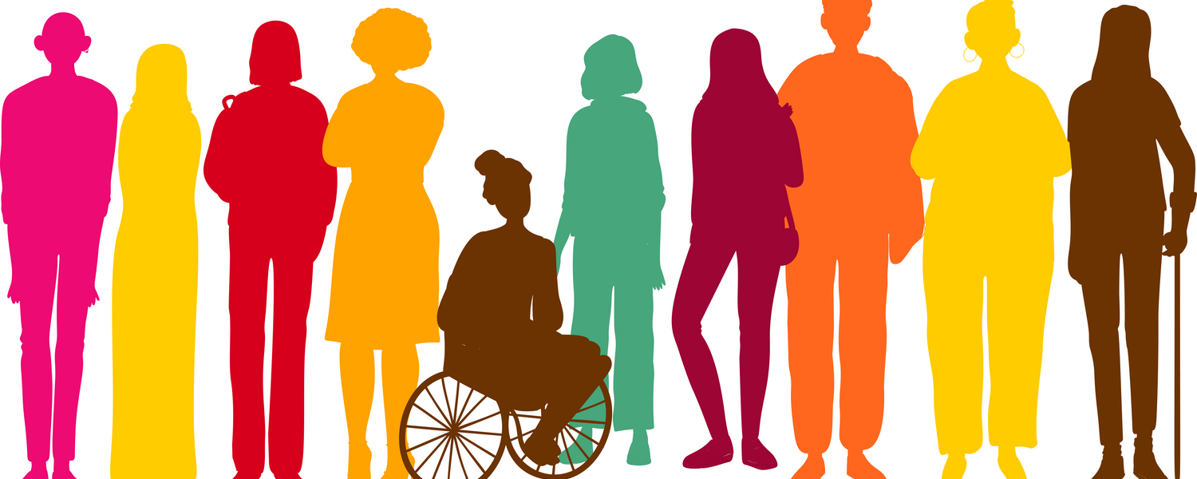
EDI – Equity, Diversity, and Inclusion
Inclusion: The practice of using proactive measures to create an environment where people feel welcomed, respected and valued, and to foster a sense of belonging and engagement.
This practice involves changing the environment by removing barriers so that each person has equal access to opportunities and resources and can achieve their full potential.
Office of Equity, Diversity, and Inclusion | University of Calgary
https://www.ucalgary.ca/equity-diversity-inclusion
https://www.ucalgary.ca/equity-diversity-inclusion/presidential-task-force-edia/presidential-task-force-edia
Notes:
This Photo by Unknown Author is licensed under CC BY
This Photo by Unknown Author is licensed under CC BY-SA-NC

Slide 15
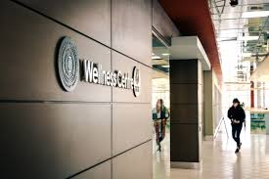
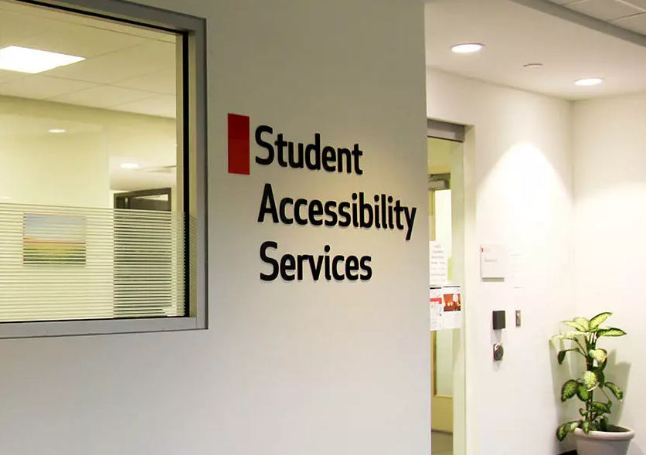


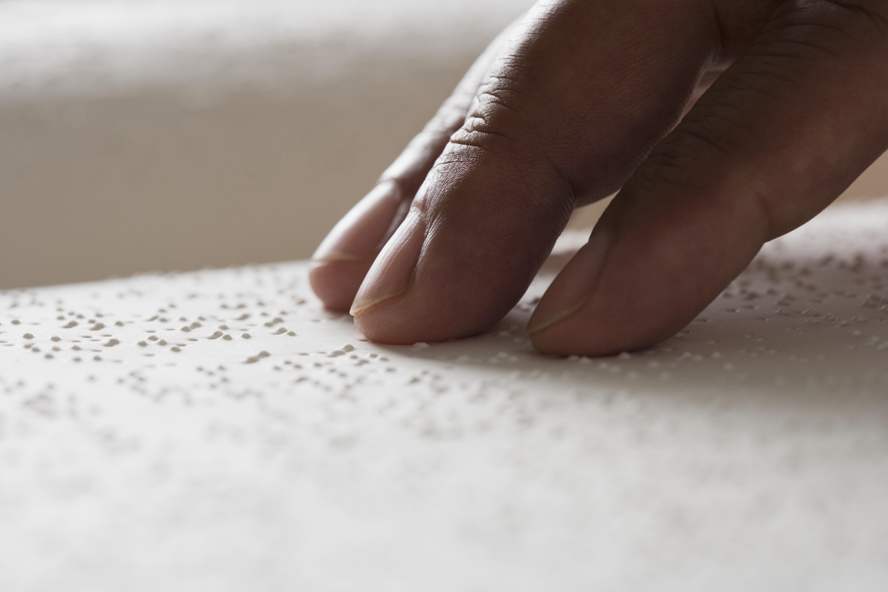
EDI + A + W
Accessibility: The combination of aspects that influence a person’s ability to function within an environment.
Wellness: Initiatives to develop and foster a culture that is positive, collegial, and respectful of all members, and in which wellness and a healthy work-life balance are valued along with (and indeed, contribute to) excellence in the study/workplace.
Source: The Gauntlet, August 10, 2020, photo by Mariah Wilson
Source: UCalgary SAS website
Student Wellness Services: https://www.ucalgary.ca/wellness-services/home
Student Accessibility Services (SAS): https://ucalgary.ca/student-services/access
Notes:
This Photo by Unknown Author is licensed under CC BY
This Photo by Unknown Author is licensed under CC BY-SA-NC
https://www.uoguelph.ca/ib/system/files/IB_EDI%20Hiring%20Strategies_July2020.pdf

Slide 16
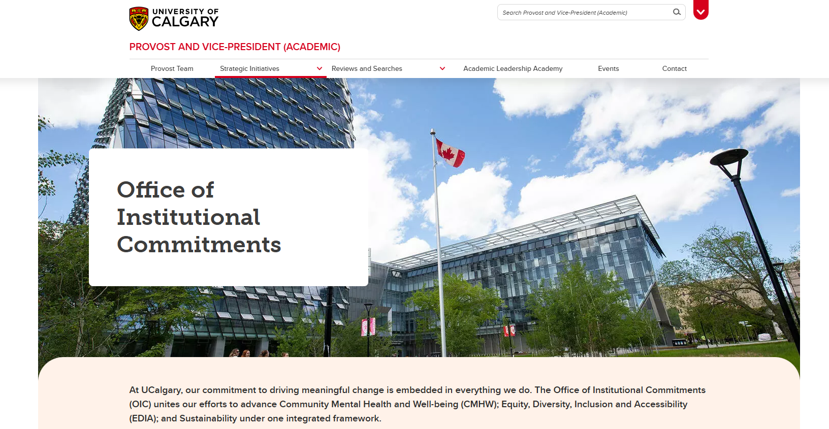
Office of Institutional Commitments
Oversees “community mental health and well-being; equity, diversity, inclusion, and accessibility (EDIA); and sustainability under one integrated framework.”
https://www.ucalgary.ca/provost/strategic-initiatives/office-institutional-commitments

Slide 17
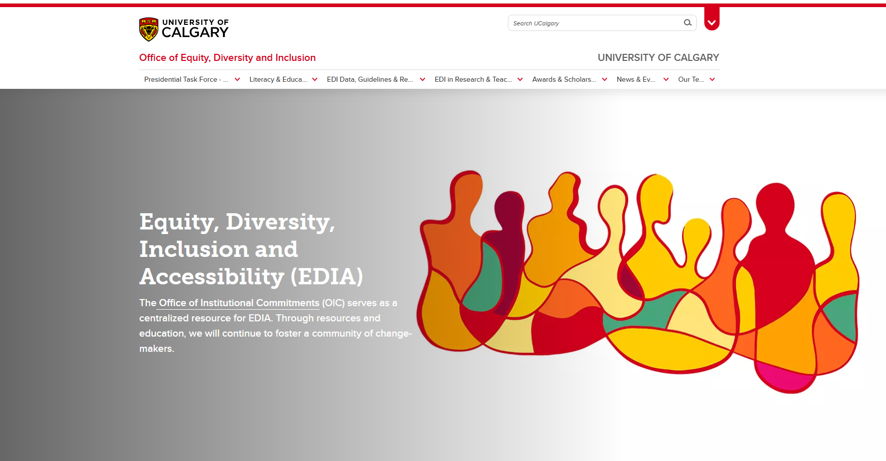
Office of Institutional Commitments
https://www.ucalgary.ca/equity-diversity-inclusion

Slide 18
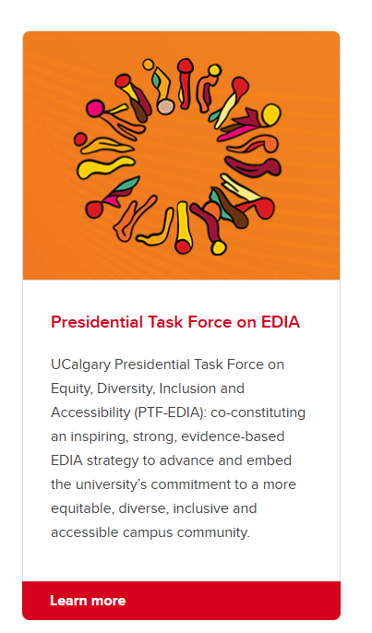
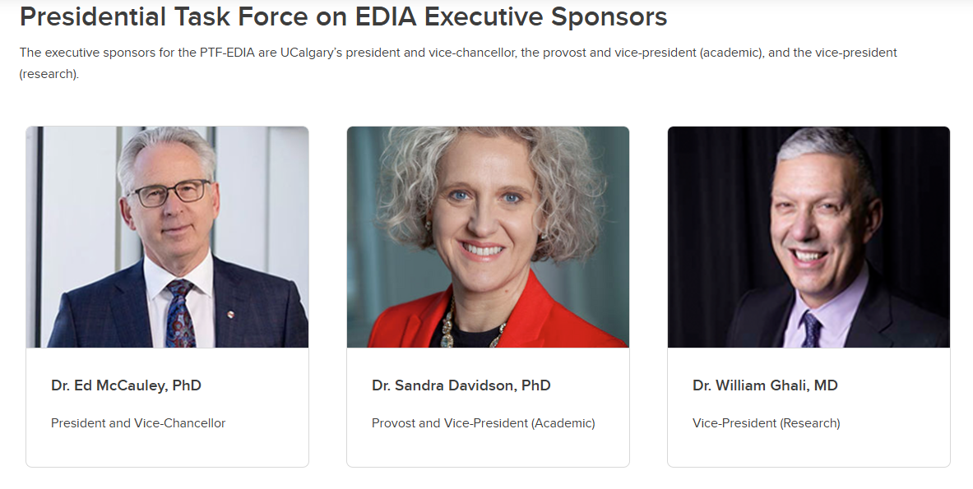
Office of Institutional Commitments
https://www.ucalgary.ca/equity-diversity-inclusion

Slide 19
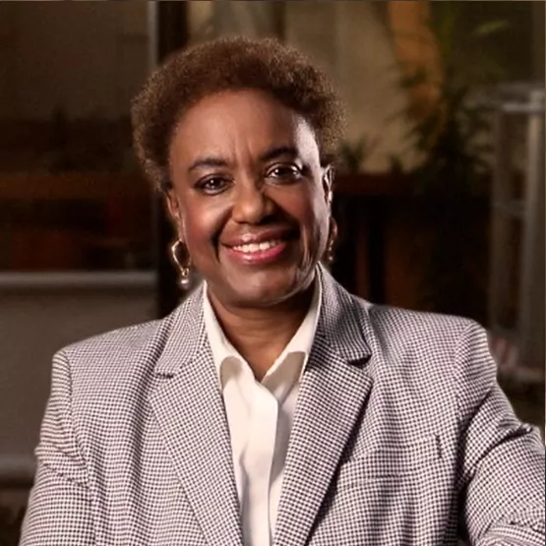
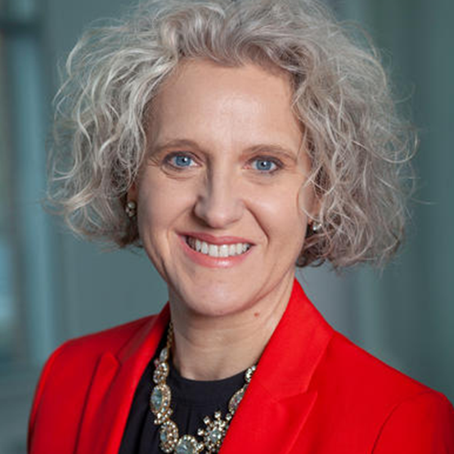
How is EDI structured in our university?
Physics
Presidential Task Force on EDIA
EDI Network
(University level)
Biological Sciences
Chemistry
Dr. Malinda S. Smith, PhD, Co-Chair
Associate Vice President Research (EDI)
Office of Equity, Diversity and Inclusion
Faculty of Science EDI Committee (Faculty level)
Computer Science
Math
PHAS EDI Committee (Departmental level)
Earth, Energy, and Environment
Dr. Sandra Davidson, ​​​​​​​Co-Chair
Provost and Vice-President (Academic)
Source: https://www.ucalgary.ca/equity-diversity-inclusion/presidential-task-force-edia/presidential-task-force-edia

Slide 20
PHAS EDI Committee = PHAS IDEA Committee
AH EDI and Faculty of Science EDI committee member:
Dr. Claudia Gomes da Rocha
Faculty representatives:
Dr. Matthew Taylor (Chair)
Dr. David Feder
Research Associate/Postdoctoral representative:
Vahdi Salari
Graduate representatives:
Becky Booth
Pooja Woosaree
Undergraduate representatives:
Stefan Sura
Kasey Walters
The goal of the PHAS IDEA Committee is to promote and advance EDIA projects and initiatives, when possible, and improve EDIA awareness, aiming to integrate EDIA principles into the culture of the Department of Physics and Astronomy (PHAS). The committee also advises the departmental leadership team on IDEA-related actions whenever challenges are identified.
Our mission aligns with the Faculty of Science and University of Calgary strategic plan (2023-2030) Ahead of Tomorrow: “This Strategic Plan shapes our journey toward 2030, considered through long-term, foundational commitments to: Equity, Diversity, Inclusion and Accessibility; Indigenous Engagement; Mental Health; Global Engagement; and Sustainability.”

Slide 21
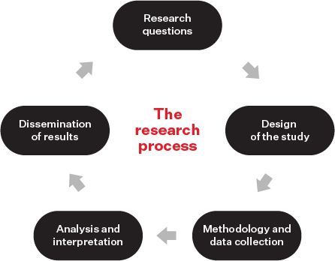
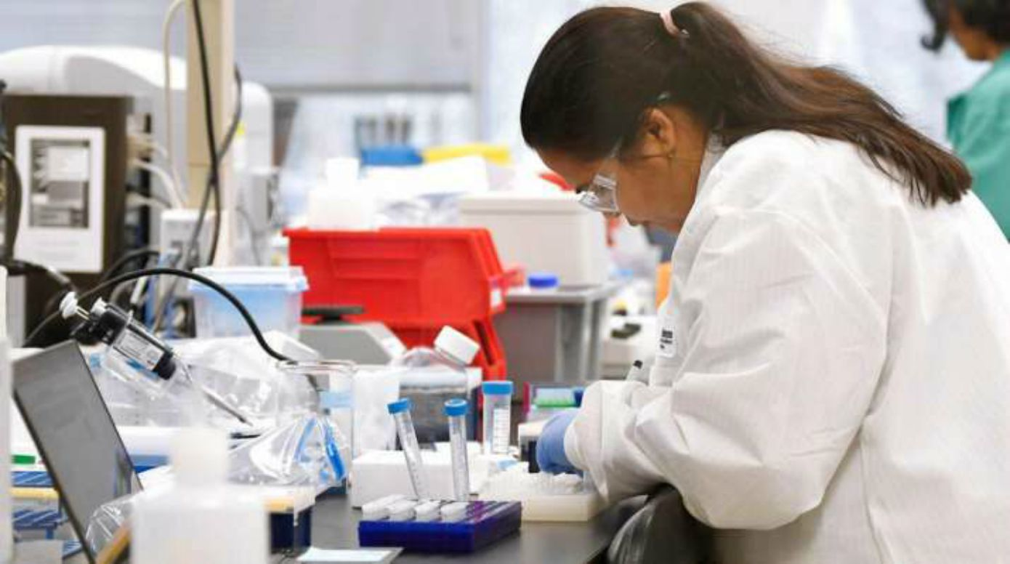
Why is EDI important for research?
“Considering EDI in the research process, where relevant, promotes research excellence by making it more relevant to society as a whole, ethically sound, rigorous, reproducible, and useful. It also fuels innovation through scientific discovery and by opening up new areas of research.”
Tannenbaum, C., et al. (2019). Sex and gender analysis improves science and engineering. Nature, 575, 137 – 146
https://www.nserc-crsng.gc.ca/NSERC-CRSNG/Policies-Politiques/EDI_guidance-Conseils_EDI_eng.asp
Notes:
This Photo by Unknown Author is licensed under CC BY

Slide 22
Why is EDI important for research?
Expanding the applicability of research findings and new technologies across a wider segment of society;
Helping to reveal implicit assumptions related to research that may otherwise go unnoticed and unchallenged;
Helping to mitigate biases by conducting inclusive research and improving technologies;
Supporting research outcomes that fairly benefit communities most impacted by the research;
Questioning biased norms and stereotypes;
Preventing overgeneralizations of findings that can be harmful or misleading;
Improving reproducibility of research findings, which can be more difficult when diversity-related variables are relevant to research but are not reported.

Slide 23
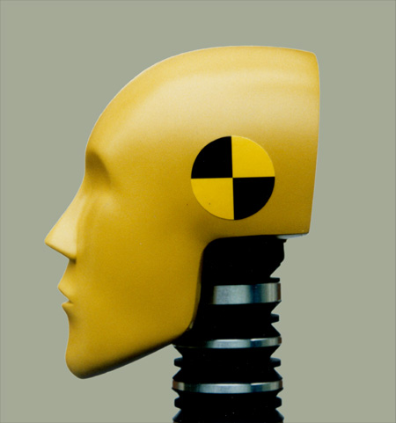
Example: The trouble with assuming a standard body size and type in auto safety testing
Crash test dummies used in auto safety testing commonly use what is assumed to be a standard adult male model that is simply scaled for varying heights and weights to account for people of all sizes. However, female bodies are not just a smaller version of a male body.
An analysis of automotive crash data from 1998 to 2008 in the United States revealed that, even after controlling for weight and body mass, the odds of being severely injured were 47% higher in belt-restrained female drivers than in belt-restrained male drivers involved in a comparable crash (Bose and Segui-Gomez, 2011).
The same is true for individuals of other body shapes and the elderly, who are at a greater risk of serious injuries in car crashes, as well as pregnant individuals who have a high risk of fetal injuries even in minor crashes (Schiebinger et al. 2011–2020).
Bose, D., and Segui-Gomez, M. (2011). Vulnerability of female drivers involved in motor vehicle crashes: an analysis of US population at risk. American Journal of Public Health, 101(12), 2368–2373.
Schiebinger, et al., M. (Eds.). (2011-2020). Gendered Innovations in Science, Health & Medicine, Engineering, and Environment.
Notes:
This Photo by Unknown Author is licensed under CC BY-SA

Slide 24
Example: The trouble with assuming a standard body size and type in auto safety testing
Inadequate critical reflection on implicit assumptions embedded in auto-safety testing—the tendency to assume a “standard” male body adequately represents all human bodies—has resulted in inequities for the majority of car users.
Missing from research are crash-test dummies that accurately model a diversity of bodies, in terms of their respective geometry, muscle and ligament strength, spinal alignment, dynamic response to trauma and mass distribution.
“One shoe does NOT fit all!”
Notes:
“One size fits all”

Slide 25

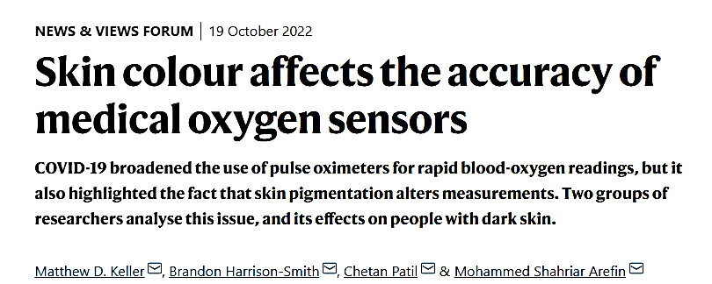
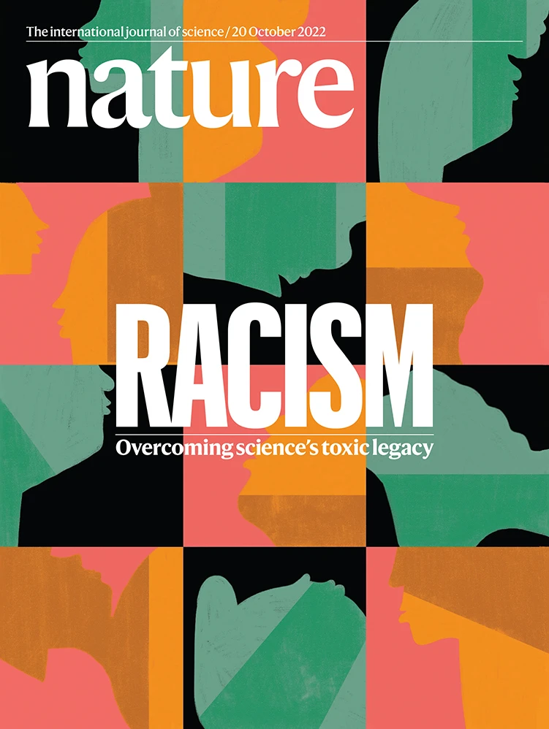
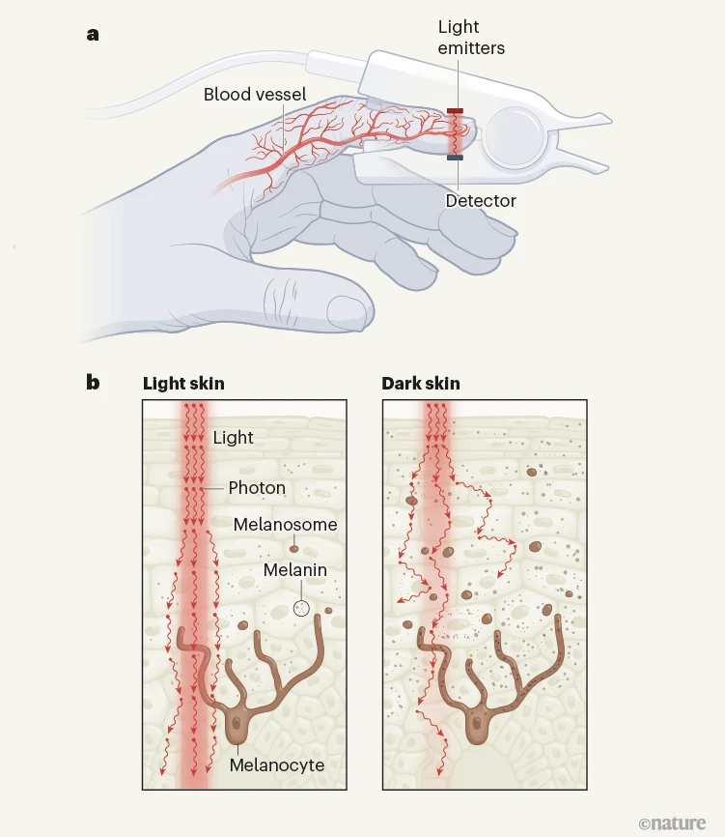
Example:
The pulse oximeter is a device that estimates a person’s oxygen saturation level, a measure of the oxygen concentration in their blood, by shining light through their tissue, typically a fingertip or an earlobe.
Accurate pulse-oximeter readings can be crucial for clinical decisions, especially when arterial blood-gas tests — the gold standard for determining oxygen saturation levels — are not available.
These devices give readings that are often less accurate for people who have dark skin, and this shortcoming has led to medical practices that only exacerbate the problem, making pulse oximetry emblematic of the broader issue of racial bias in medicine.
Sjoding, M. W., Dickson, R. P., Iwashyna, T. J., Gay, S. E. & Valley, T. S. N. Engl. J. Med. 383, 2477–2478 (2020).

Slide 26
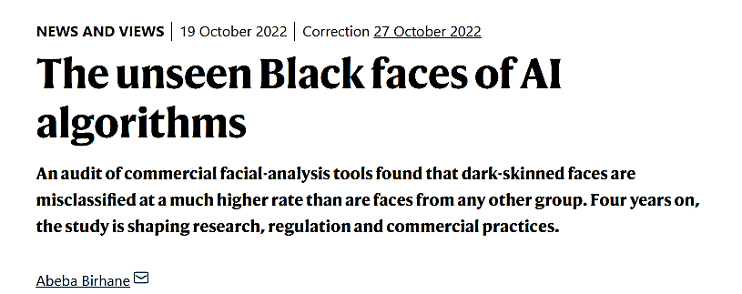
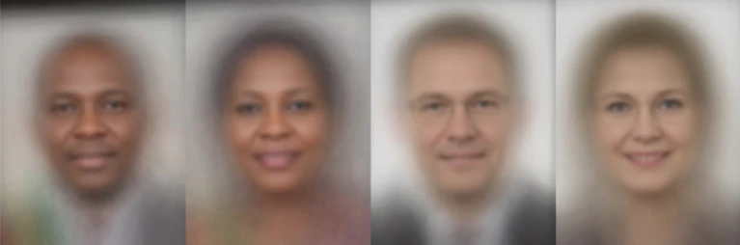
Example:
Buolamwini, J. & Gebru, T. Proc. Mach. Learn. Res. 81, 77–91 (2018).
Figure 1 | A gender-balanced facial image bank with a range of skin tones. On realizing that dark-skinned faces were under-represented in the data sets of images that are used to train facial-recognition software, Buolamwini and Gebru compiled their own data set using photographs of politicians from countries with gender parity in their national parliaments. This is a subset of ‘average’ faces made by blending many images from the full data set, which contains photographs of 1,270 individuals from Rwanda, Senegal, South Africa, Iceland, Finland and Sweden. Buolamwini and Gebru used their data set to show that three commercial gender-classification systems misclassified women with darker skin with an error rate that was much higher than that for men with lighter skin. Credit: Dr Joy Buolamwini (CC BY 4.0)

Slide 27
Example:
“As a graduate student in computer science, Buolamwini was frustrated that commercial facial-recognition systems failed to identify her face in photographs and video footage. She hypothesized that this was due, in part, to the fact that dark-skinned faces were not represented in the data sets that were used to train the computer programs she was studying.”
“This insight led Buolamwini and her collaborator Gebru to undertake a systematic audit of commercial facial-analysis systems, and to demonstrate that such systems perform differently depending on the skin colour and gender of the person in the image. The work became known as the Gender Shades audit.”
“The authors began by using a skin-type classification system, approved by dermatologists, to assess the composition of two image banks, known as IJB-A and Adience, that were widely used at the time to train facial-recognition software. They found that individuals with light-coloured skin were the subject of 79.6% of the images in IJB-A and of 86.2% of those in Adience.”
http://www.gendershades.org
Buolamwini, J. & Gebru, T. Proc. Mach. Learn. Res. 81, 77–91 (2018).

Slide 28
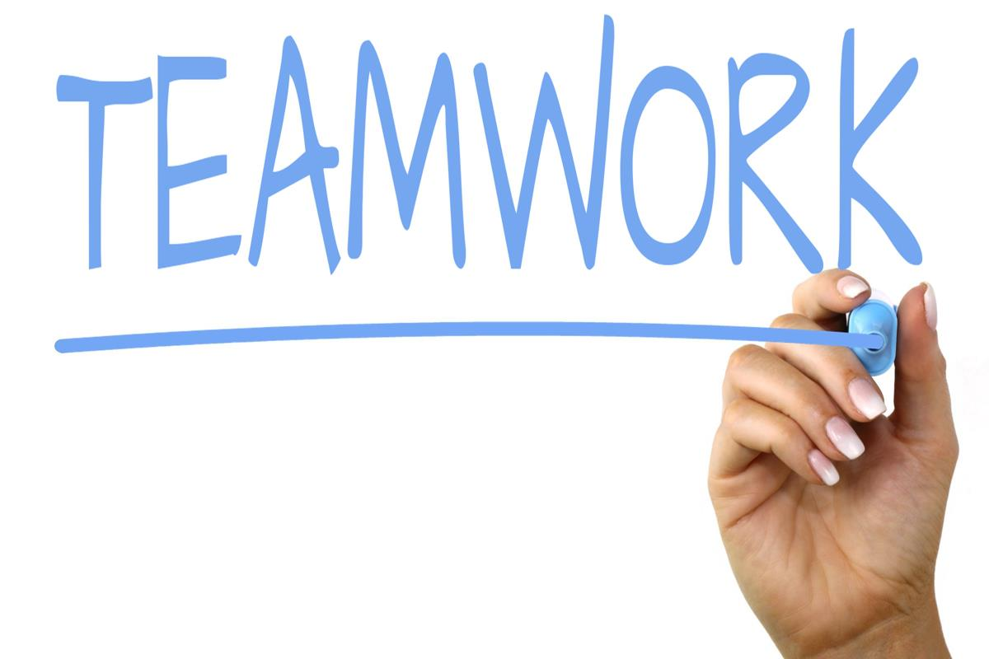
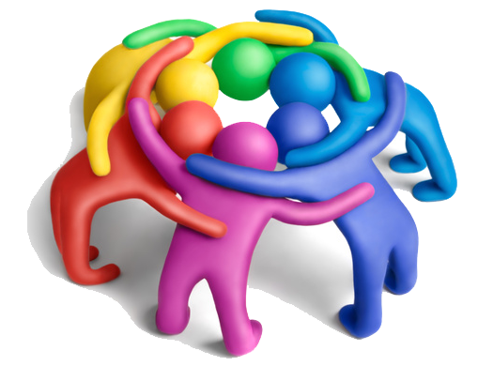
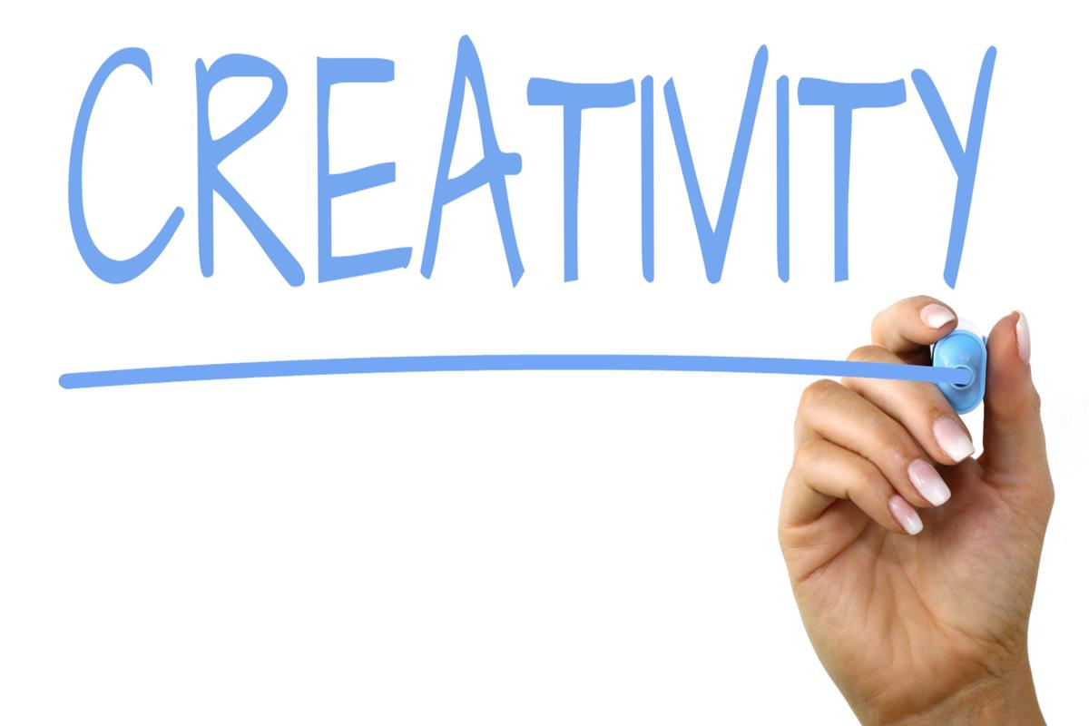
Diversity in research teams can enhance the effectiveness of team science
The inclusion of individuals with diverse knowledge, perspectives and research methods will lead to scientific or translational breakthroughs that might not be achieved by a more homogeneous group of individuals.
Source: National Research Council (United States of America, 2015)
Notes:
This Photo by Unknown Author is licensed under CC BY-SA
This Photo by Unknown Author is licensed under CC BY-NC
This Photo by Unknown Author is licensed under CC BY-SA

Slide 29
Diversity in research teams can enhance the effectiveness of team science
Considering EDI in the context of research teams promotes research excellence by:
increasing research teams’ effectiveness through improved collaborative processes, collective intelligence and the ability of the team to perform a variety of tasks;
increasing performance and collaboration within diverse groups;
driving radical innovation within diverse research teams;
promoting equity and inclusion through effective mentorship, thus enhancing recruitment and retention in teams;
allowing collective input from different points of view during problem-solving, leading to improved performance;
creating an inclusive climate through leadership that helps to realize the potential benefits of diversity.

Slide 30
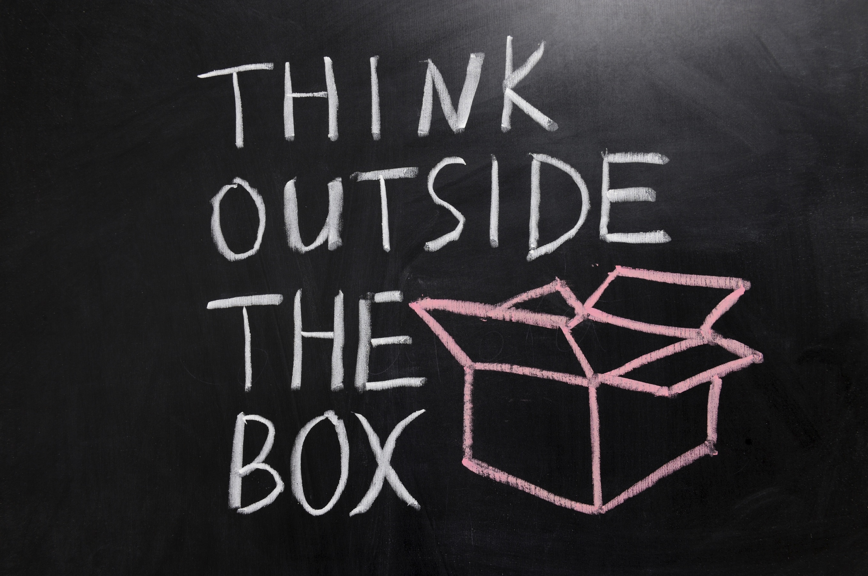
How diversity can drive innovation
This research examined a nationally representative survey of 1,800 professionals, 40 case studies, and numerous focus groups and interviews, and it revealed two kinds of diversity: inherent and acquired.
Inherent diversity involves traits you are born with, such as gender, ethnicity, and sexual orientation.
Acquired diversity involves traits you gain from experience: e.g., working in another country can help you appreciate cultural differences.
However new research provides compelling evidence that diversity unlocks innovation and drives market growth—a finding that should intensify efforts to ensure that executive ranks both embody and embrace the power of differences.
Diversity in management and leadership unlocks innovation by creating an environment where “outside the box” ideas are heard. When minorities form a critical mass and leaders value differences, all employees can find senior people to go to bat for compelling ideas and can persuade those in charge of budgets to deploy resources to develop those ideas.
Hewlett, S. A., Marshall, M., and Sherbin, L. (2013, December). “How Diversity Can Drive Innovation.” Harvard Business Review. https://hbr.org/2013/12/how-diversity-can-drive-innovation
Notes:
This Photo by Unknown Author is licensed under CC BY-SA-NC

Slide 31

Tokenism
The practice of doing something (such as hiring a person who belongs to a minority group) only to prevent criticism and give the appearance that people are being treated fairly (via Merriam Webster).
Intent is important in deciding whether or not a workplace is engaging in tokenism. If there’s only one candidate from an underrepresented minority within a group, that could be an instance of tokenism — or maybe the company or institution is only just beginning its diversity efforts. Or perhaps the company or institution genuinely wants to improve diversity among staff, but past initiatives have been lacking.
Source: https://business.vanderbilt.edu/news/2018/02/26/tokenism-in-the-workplace/ by Kara Sherrer

Slide 32
Tokenism
One critical step in combating tokenism is ensuring that employees aren’t called upon to be the lone representative for their entire group.
A panelist in an event hosted in the Vanderbilt Business and Vanderbilt University, Kia Jarmon, Founder of MEPR Agency, recalled getting separated from the only other African-American student in the fourth grade; they were placed in separate classrooms to give the appearance of “diversity,” and this has continued to happen to her throughout her career.
Workplaces can help forestall tokenism by making sure there’s more than one person from each demographic in a group.
Source: https://business.vanderbilt.edu/news/2018/02/26/tokenism-in-the-workplace/ by Kara Sherrer

Slide 33
Tokenism
BEYOND INCLUSION: The Importance of Avoiding Tokenism to Dismantle Systemic Inequity
BY PHIL NEUFFER
“There is no quick fix to racial inequity in the workplace. For companies to avoid performative actions and tokenism, they must acknowledge and understand how their systems are influenced by the history of systemic racism and commit to the long-term, organization-wide efforts it takes to build new standards.”
Cardozie Jones, the founder and principal of True North EDI, a consulting firm that works with organizations to improve in the areas of equity, diversity and interdependence, provides an even simpler definition: “Tokenism is when you are making a choice about inclusion that is for the sake of performance,” Jones says, describing the action as transactional. “A person’s identity serves a purpose rather than realizing that your space is incomplete without the perspectives of people who are not like you.”
https://magazine.abfjournal.com/20221/beyond-inclusion-the-importance-of-avoiding-tokenism-to-dismantle-systemic-inequity
Further resources: https://www.chairs-chaires.gc.ca/program-programme/equity-equite/best_practices-pratiques_examplaires-eng.aspx

Slide 34
Representation, recognition, resource allocation
Is everything in Science objective and fair? Are merit, excellence, and academic accomplishment the only indicators of success in academia and are they always fair?
Not always and not without changing the culture and without EDI!

Slide 35
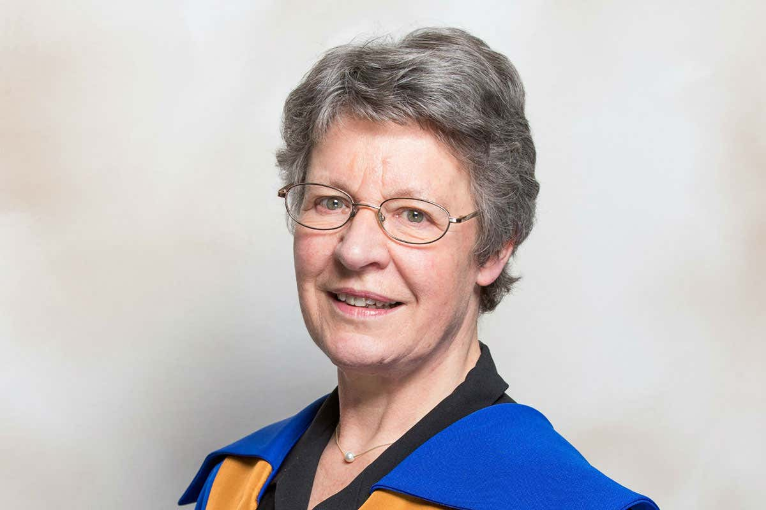
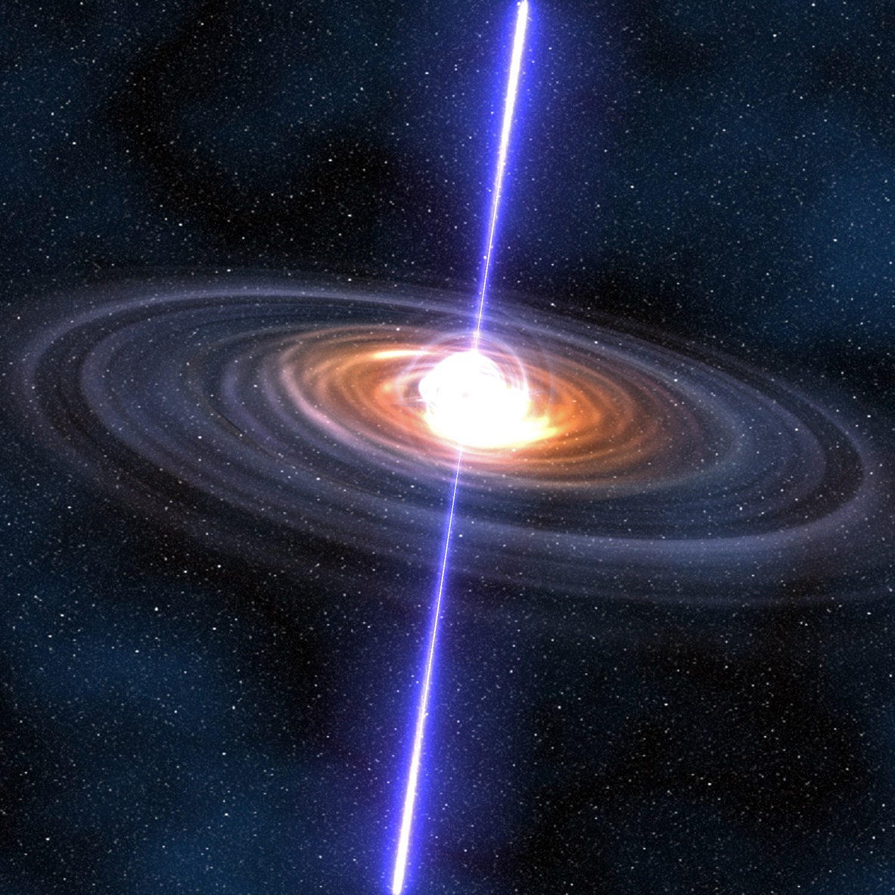
Representation, recognition, resource allocation
Dame Jocelyn Bell Burnell found the first pulsar while she was a graduate student at the University of Cambridge in 1967.
Bell and Anthony Hewish (her supervisor) published a paper describing their discovery in February 1968.
In 1974 the Nobel Prize committee awarded Hewish and his collaborator Sir Martin Ryle a Nobel Prize in physics for their (and Bell Burnell’s) discovery.
In 2018, Bell was awarded the Special Breakthrough Prize in Fundamental Physics; the prize committee not only cites her “detection of radio signals from rapidly spinning, super-dense neutron stars” but also her “lifetime of inspiring scientific leadership.”
She has donated the £2.3-million prize which is now being administered by the Institute of Physics as the Bell Burnell Graduate Scholarship Fund whose mission is to support physics graduate students from under-represented groups.
Sources:
National Geographic, SCIENCE | WOMEN OF IMPACT by Nadia Drake, September 6, 2018
https://www.cam.ac.uk/stories/journeysofdiscovery-pulsars
https://www.iop.org/about/news/bell-burnell-awarded-copley-medal-donates-gift#gref
Notes:
This Photo by Unknown Author is licensed under CC BY-SA
This Photo by Unknown Author is licensed under CC BY-ND

Slide 36
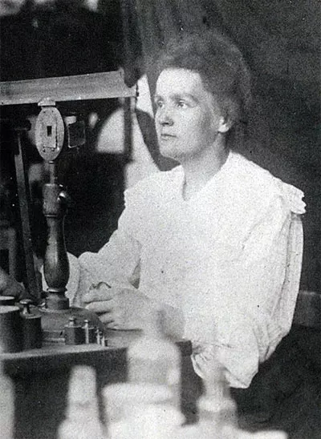
Representation, recognition, resource allocation
We could be losing diverse talents due to a lack of opportunities!
Dr. Marie Curie was unable to attend a university because she was a woman. She then attended “Flying University” an underground college.
Marie moved to Paris in 1891, in order to pursue a degree in physics and mathematics; she enrolled at the Sorbonne University.
From the Nobel Prize website: “She could not attend the University of Warsaw, as her brother had: the Russian government prohibited women from attending university anywhere in its empire. In Paris, she felt unprepared but exhilarated.”
“It was like a new world opened to me, the world of science, which I was at last permitted to know in all liberty.”
MARIE CURIE
Sources: https://www.nobelprize.org/womenwhochangedscience/stories/marie-curie
Manhattan Project National Historical Park website
https://history.aip.org/exhibits/curie/stud1.htm
Notes:
We could be losing talents too due to lack of opportunities!

Slide 37
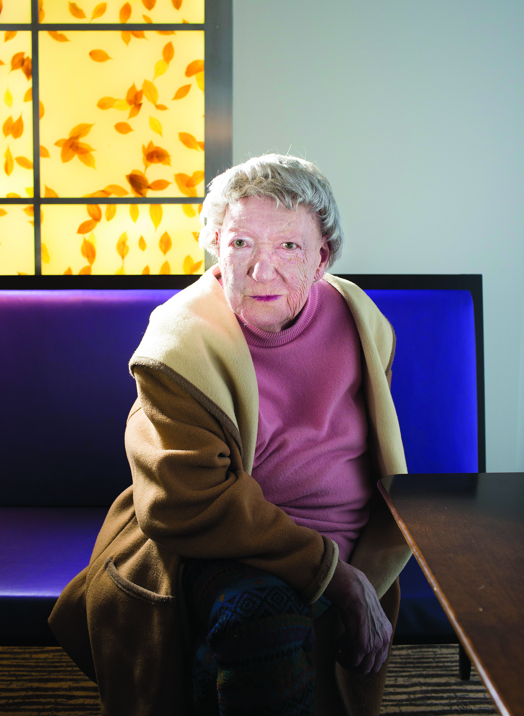
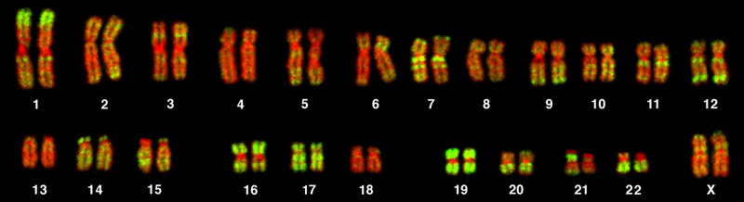
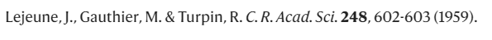
Representation, recognition, resource allocation
Access to resources does make a difference!
Marthe Gautier discovered that people with Down’s syndrome had an extra copy of chromosome 21 in 1958.
But when she was unable to identify the exact chromosome with her lower-power microscope, she “naively” lent her slides to geneticist Jerome Lejeune, she told the Science journal in 2014.
She was then “shocked” to see the discovery of the extra chromosome 21 published six months later, with Lejeune’s name first, hers second, and Raymond Turpin, Lejeune’s boss as third author.
Notes:
We could be losing talents too due to lack of opportunities!
This Photo by Unknown Author is licensed under CC BY

Slide 38
Representation, recognition, resource allocation
Access to resources does make a difference!
Marthe Gautier discovered that people with Down’s syndrome had an extra copy of chromosome 21 in 1958.
But when she was unable to identify the exact chromosome with her lower-power microscope, she “naively” lent her slides to geneticist Jerome Lejeune, she told the Science journal in 2014.
She was then “shocked” to see the discovery of the extra chromosome 21 published six months later, with Lejeune’s name first, hers second, and Raymond Turpin, Lejeune’s boss as third author.
Misspelt!
Notes:
We could be losing talents too due to lack of opportunities!
This Photo by Unknown Author is licensed under CC BY

Slide 39
Representation, recognition, resource allocation
https://phys.org/news/2022-05-women-scientists-forgotten-history.html
https://www.nature.com/articles/nature.2014.14690
https://www.science.org/content/article/after-more-50-years-dispute-over-down-syndrome-discovery
Notes:
We could be losing talents too due to lack of opportunities!
This Photo by Unknown Author is licensed under CC BY

Slide 40
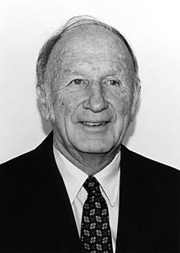
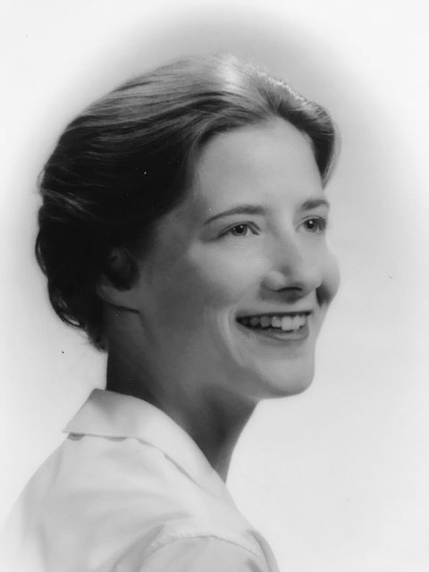
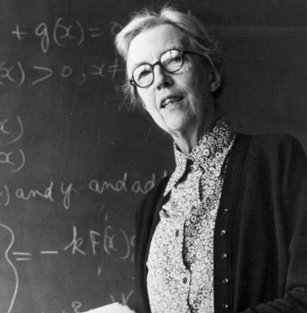

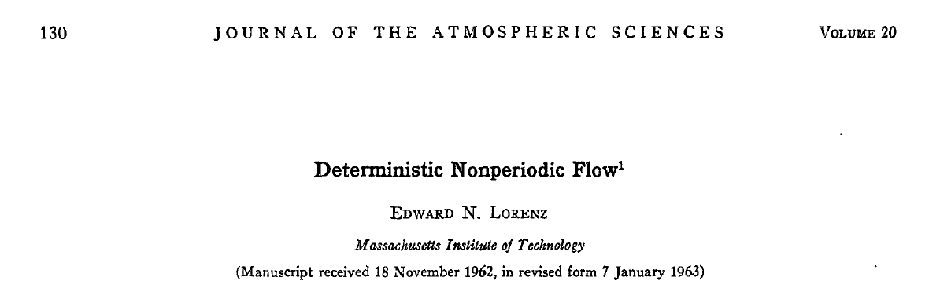
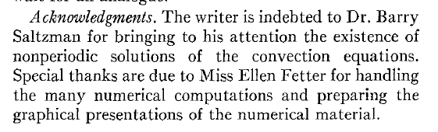
Dame Cartwright is one of the pioneers that led to Chaos theory. Anticipated key aspects that are fundamental to chaotic dynamics.
Edward Norton Lorenz (May 23, 1917 – April 16, 2008)
Ellen Fetter, American computer scientist.
Dame Mary Cartwright, British mathematician (17 December 1900 – 3 April 1998).

Slide 41
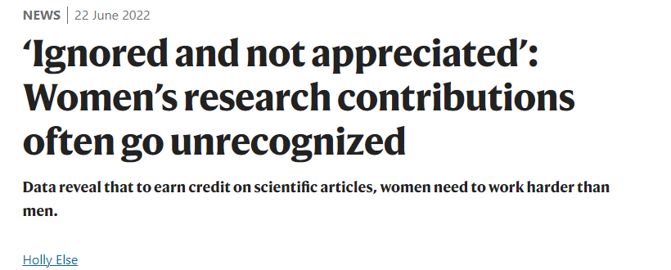
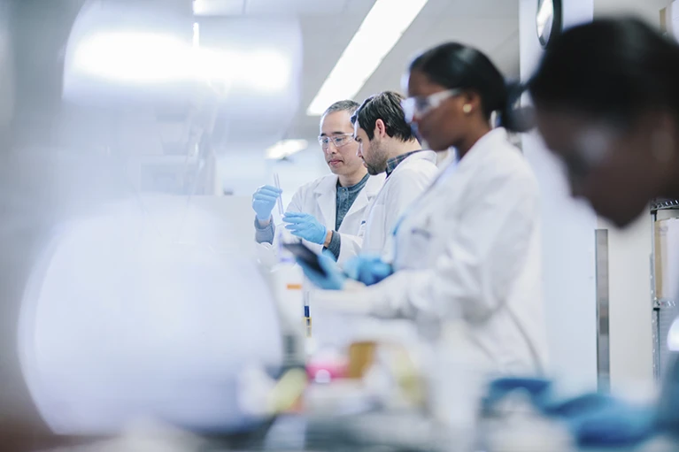

Representation, recognition, resource allocation
Notes:
We could be losing talents too due to lack of opportunities!
This Photo by Unknown Author is licensed under CC BY

Slide 42
Intersectional inequalities in science
Diego Kozlowski, Vincent Larivière, Cassidy R. Sugimoto, and Thema Monroe-White
https://doi.org/10.1073/pnas.2113067119
The US scientific workforce is not representative of the population. Barriers to entry and participation have been well-studied; however, few have examined the effect of these disparities on the advancement of science. Furthermore, most studies have looked at either race or gender, failing to account for the intersection of these variables. Our analysis utilizes millions of scientific papers to study the relationship between scientists and the science they produce. We find a strong relationship between the characteristics of scientists and their research topics, suggesting that diversity changes the scientific portfolio with consequences for career advancement for minoritized individuals. Science policies should consider this relationship to increase equitable participation in the scientific workforce and thereby improve the robustness of science.
Note: Originally developed for capturing the living realities of black women (Crenshaw 1989), the concept of intersectionality emphasizes the interaction of gender and race as markers of structural inequalities on and across each other. The approach has been opened up to further categories of social differentiation and discrimination such as migration histories, class, disability, sexual orientation, age, and others.
Source: Is Science for Everyone? Exploring Intersectional Inequalities in Connecting With Science
https://doi.org/10.3389/feduc.2021.673850
Notes:
We could be losing talents too due to lack of opportunities!
This Photo by Unknown Author is licensed under CC BY

Slide 43
EDI – Equity, Diversity, and Inclusion
Positionality and Intersectionality
Positionality refers to the personal values, views, and location in time and space that influence how one engages with and understands the world. It is wrapped up in the dynamics of power and privilege. For example, your gender, race, class, and other aspects of your social identities influence and inform how you move through the world, what knowledge you produce and value, and the biases through which everything you say, think, and do, is filtered, intentionally or otherwise. Moreover, positionality is experienced differently in different contexts and can dictate how much access you have (to resources, support, etc.) in society.
Intersectionality acknowledges the complex relationship between social identities and systems of power and oppression. Given the fluid, relational, and social construction of identities, intersectional paradigms recognize that every person has multiple and diverse identities (e.g., race, gender, sexual orientation, socio-economic status, dis/ability, beliefs, and worldview) that combine in unique ways to shape our perspectives, and experiences with oppression and privilege (Ontario Human Rights Commission, 2001).
Universal Design for Learning (UDL) for Inclusion, Diversity, Equity, and Accessibility (IDEA) 2022 by Darla Benton Kearney
https://opentextbooks.uregina.ca/universaldesign/chapter/positionality-intersectionality/
Notes:
This Photo by Unknown Author is licensed under CC BY-NC-ND

Slide 44

EDI – Equity, Diversity, and Inclusion
Positionality and Intersectionality
Individuals have multiple identities based not only on gender, but other dimensions such as race, ethnicity, sexuality, age, education, etc.
This graphic entitled “Intersectionality” visually displays how social identities intersect with one another and are wrapped in systems of power. For example, using the imagery of a spirograph, Duckworth (2020) colour-codes various social identities including race, ethnicity, gender identity, class, language, religion, ability, sexuality, mental health, age, education, and body size.
Universal Design for Learning (UDL) for Inclusion, Diversity, Equity, and Accessibility (IDEA) 2022 by Darla Benton Kearney
https://opentextbooks.uregina.ca/universaldesign/chapter/positionality-intersectionality/
Notes:
This Photo by Unknown Author is licensed under CC BY-NC-ND

Slide 45

EDI – Equity, Diversity, and Inclusion
Positionality and Intersectionality
Define yourself:
How close or far away from the centre are you?
How does your level of power shift as you place yourself in different identity categories?
Thinking about your institution, where do students, staff, administrators, and/or faculty reside?
Duckworth, S. (2020, Oct 18). Wheel of power/privilege [Infographic].
Universal Design for Learning (UDL) for Inclusion, Diversity, Equity, and Accessibility (IDEA) 2022 by Darla Benton Kearney
https://opentextbooks.uregina.ca/universaldesign/chapter/positionality-intersectionality/
Notes:
This Photo by Unknown Author is licensed under CC BY-NC-ND

Slide 46
Guided discussion
The guided questions in the following are based on the article “HOW DIVERSITY WORKS” by Katherine W. Phillips, October 2014, ScientificAmerican.com and the EDI Coffee Chat activity created by the Faculty of Science EDI Leadership team.

Slide 47
Guided discussion
1) How did you feel before about this topic of EDI in STEM? Did you learn anything new from this class? What is your opinion now about the importance of EDI for research and science in general?
2) “For groups that VALUE innovation and new ideas, diversity helps”.
What happens if a group does not value innovation?
3) What research questions and data are missed when one studies things from a particular cultural lens or gender perspective?

Slide 48

4) Science and research still lack diversity. Where would the benefits of EDI be most meaningful?
5) What could we do as researchers and scientists to promote the benefits of EDI principles?
48

