Slide 1
Beam Safety Shut-Off System for TRIUMF’s ARIEL e-Linac based on Cherenkov Fiber
Richard Hermann
TRIUMF Accelerator Development Group

Slide 2
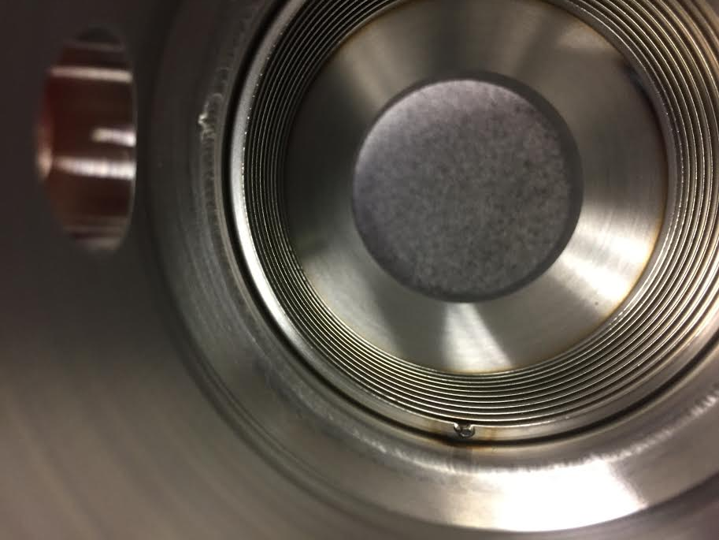
Machine Protection System
Beam Safety Shut-Off System
There to detect beam malfunction and stop it in < 10 μs
200 W beam (660 uA, 300 keV) went through a bellow and vented the entire beamline
Notes:
Malfunctions: hole burning, activation, heating, outgasing (-> vacuum new, cryos dirty), ….
Bellow - elastic tube of rubber, plastic or leather which folds together in a "concertina-like manner" and which is attached for mechanical parts which push each other mechanically into one another in order to protect them against foreign influences, in particular contamination, and to seal them against the environment

Slide 3
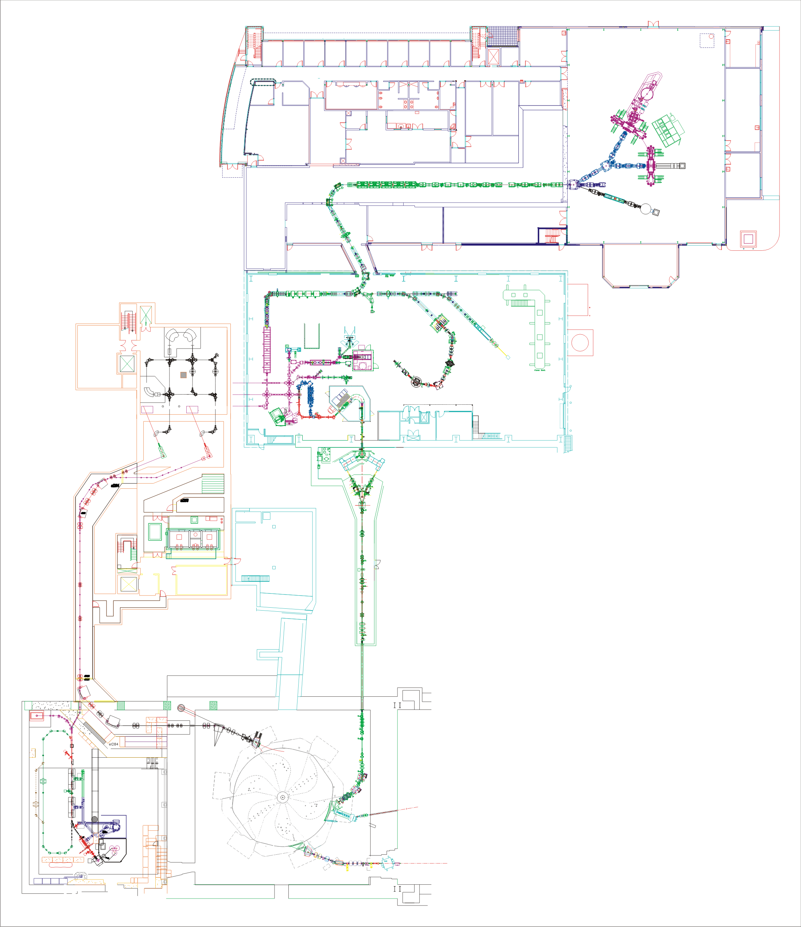
Machine Protection System
Beam Safety Shut-Off System
There to detect beam malfunction and stop it in < 10 μs
for TRIUMF’s ARIEL e-Linac
TRIUMF: Canada’s particle accelerator center TRI-University Meson Facility
ARIEL: Advanced Rare Isotope Laboratory
e-Linac: Electron Linear accelerator
Isotope Separator
and Accelerator
ARIEL e-
ARIEL H-
Cyclotron 520 MeV
e-Linac 30MeV
Notes:
TRIUMF → Aveen Mahon
Ariel – (not there yet) main purpose, complementary more specific way to create radioactive beams (uranium trarget) – photo fission as opposed to spallation/fragemetation

Slide 4
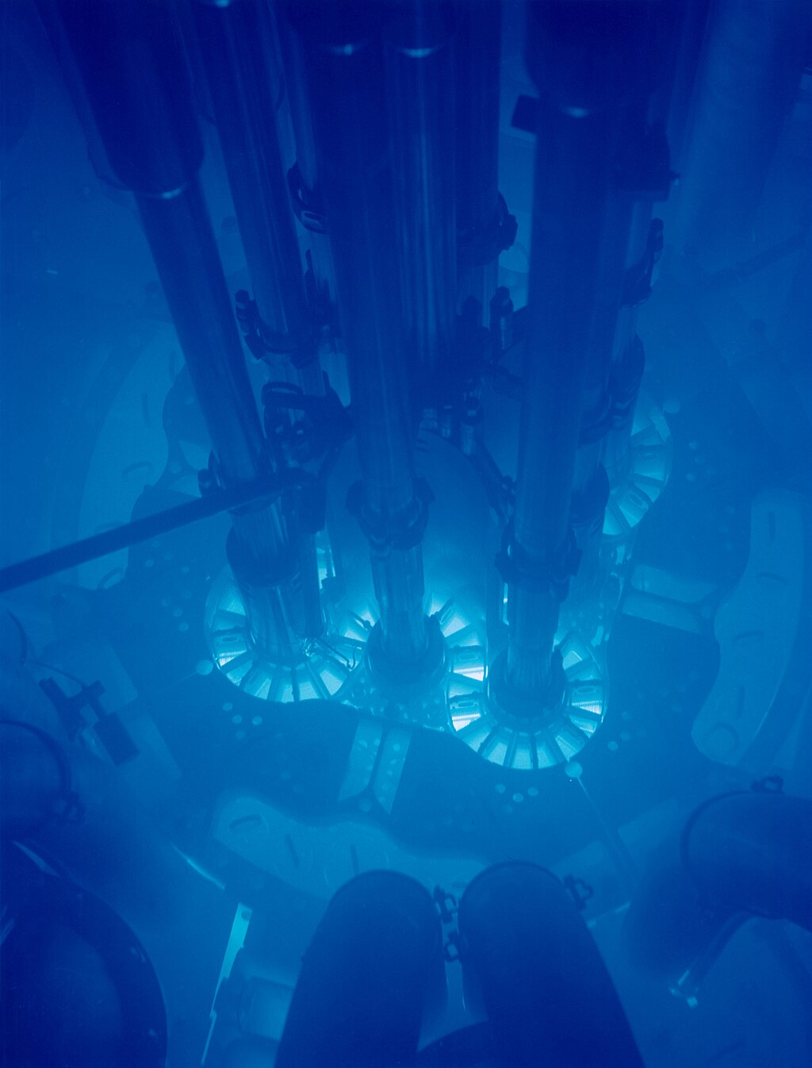
Machine Protection System
Beam Safety Shut-Off System
There to detect beam malfunction and stop it in < 10 μs
for TRIUMF’s ARIEL e-Linac
TRIUMF: Canada’s particle accelerator center TRI-University Meson Facility
ARIEL: Advanced Rare Isotope Laboratory
e-Linac: Electron Linear accelerator
based on Cherenkov Fiber
optical fiber emitting Cherenkov radiation (photons) if particles travel faster than light in the material
Cherenkov radiation – Wikipedia Advanced test reactor Idaho National Laboratory
Notes:
That’s topic and motivation – no damage ;)

Slide 5
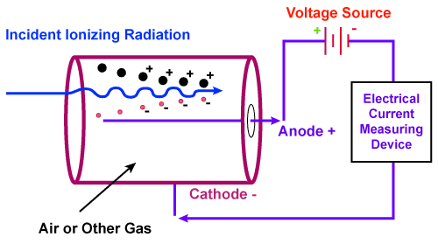
Beam Loss Monitors
Long Ionization Chamber (LIC)
+ Variable continuous coverage (1.5m, 2m, 3m)
+ Robust, proven technology (Response of 1m: 22 μC/Gy)
- Bulky
- Slowest response
- Maintenance intensive
https://electricalvoice.com/ionization-chamber-working/
Notes:
Motivation is clear, what are the options?
Ar gas for prompt collection of electrons Positive HV outer conductor, signal inner conductor

Slide 6
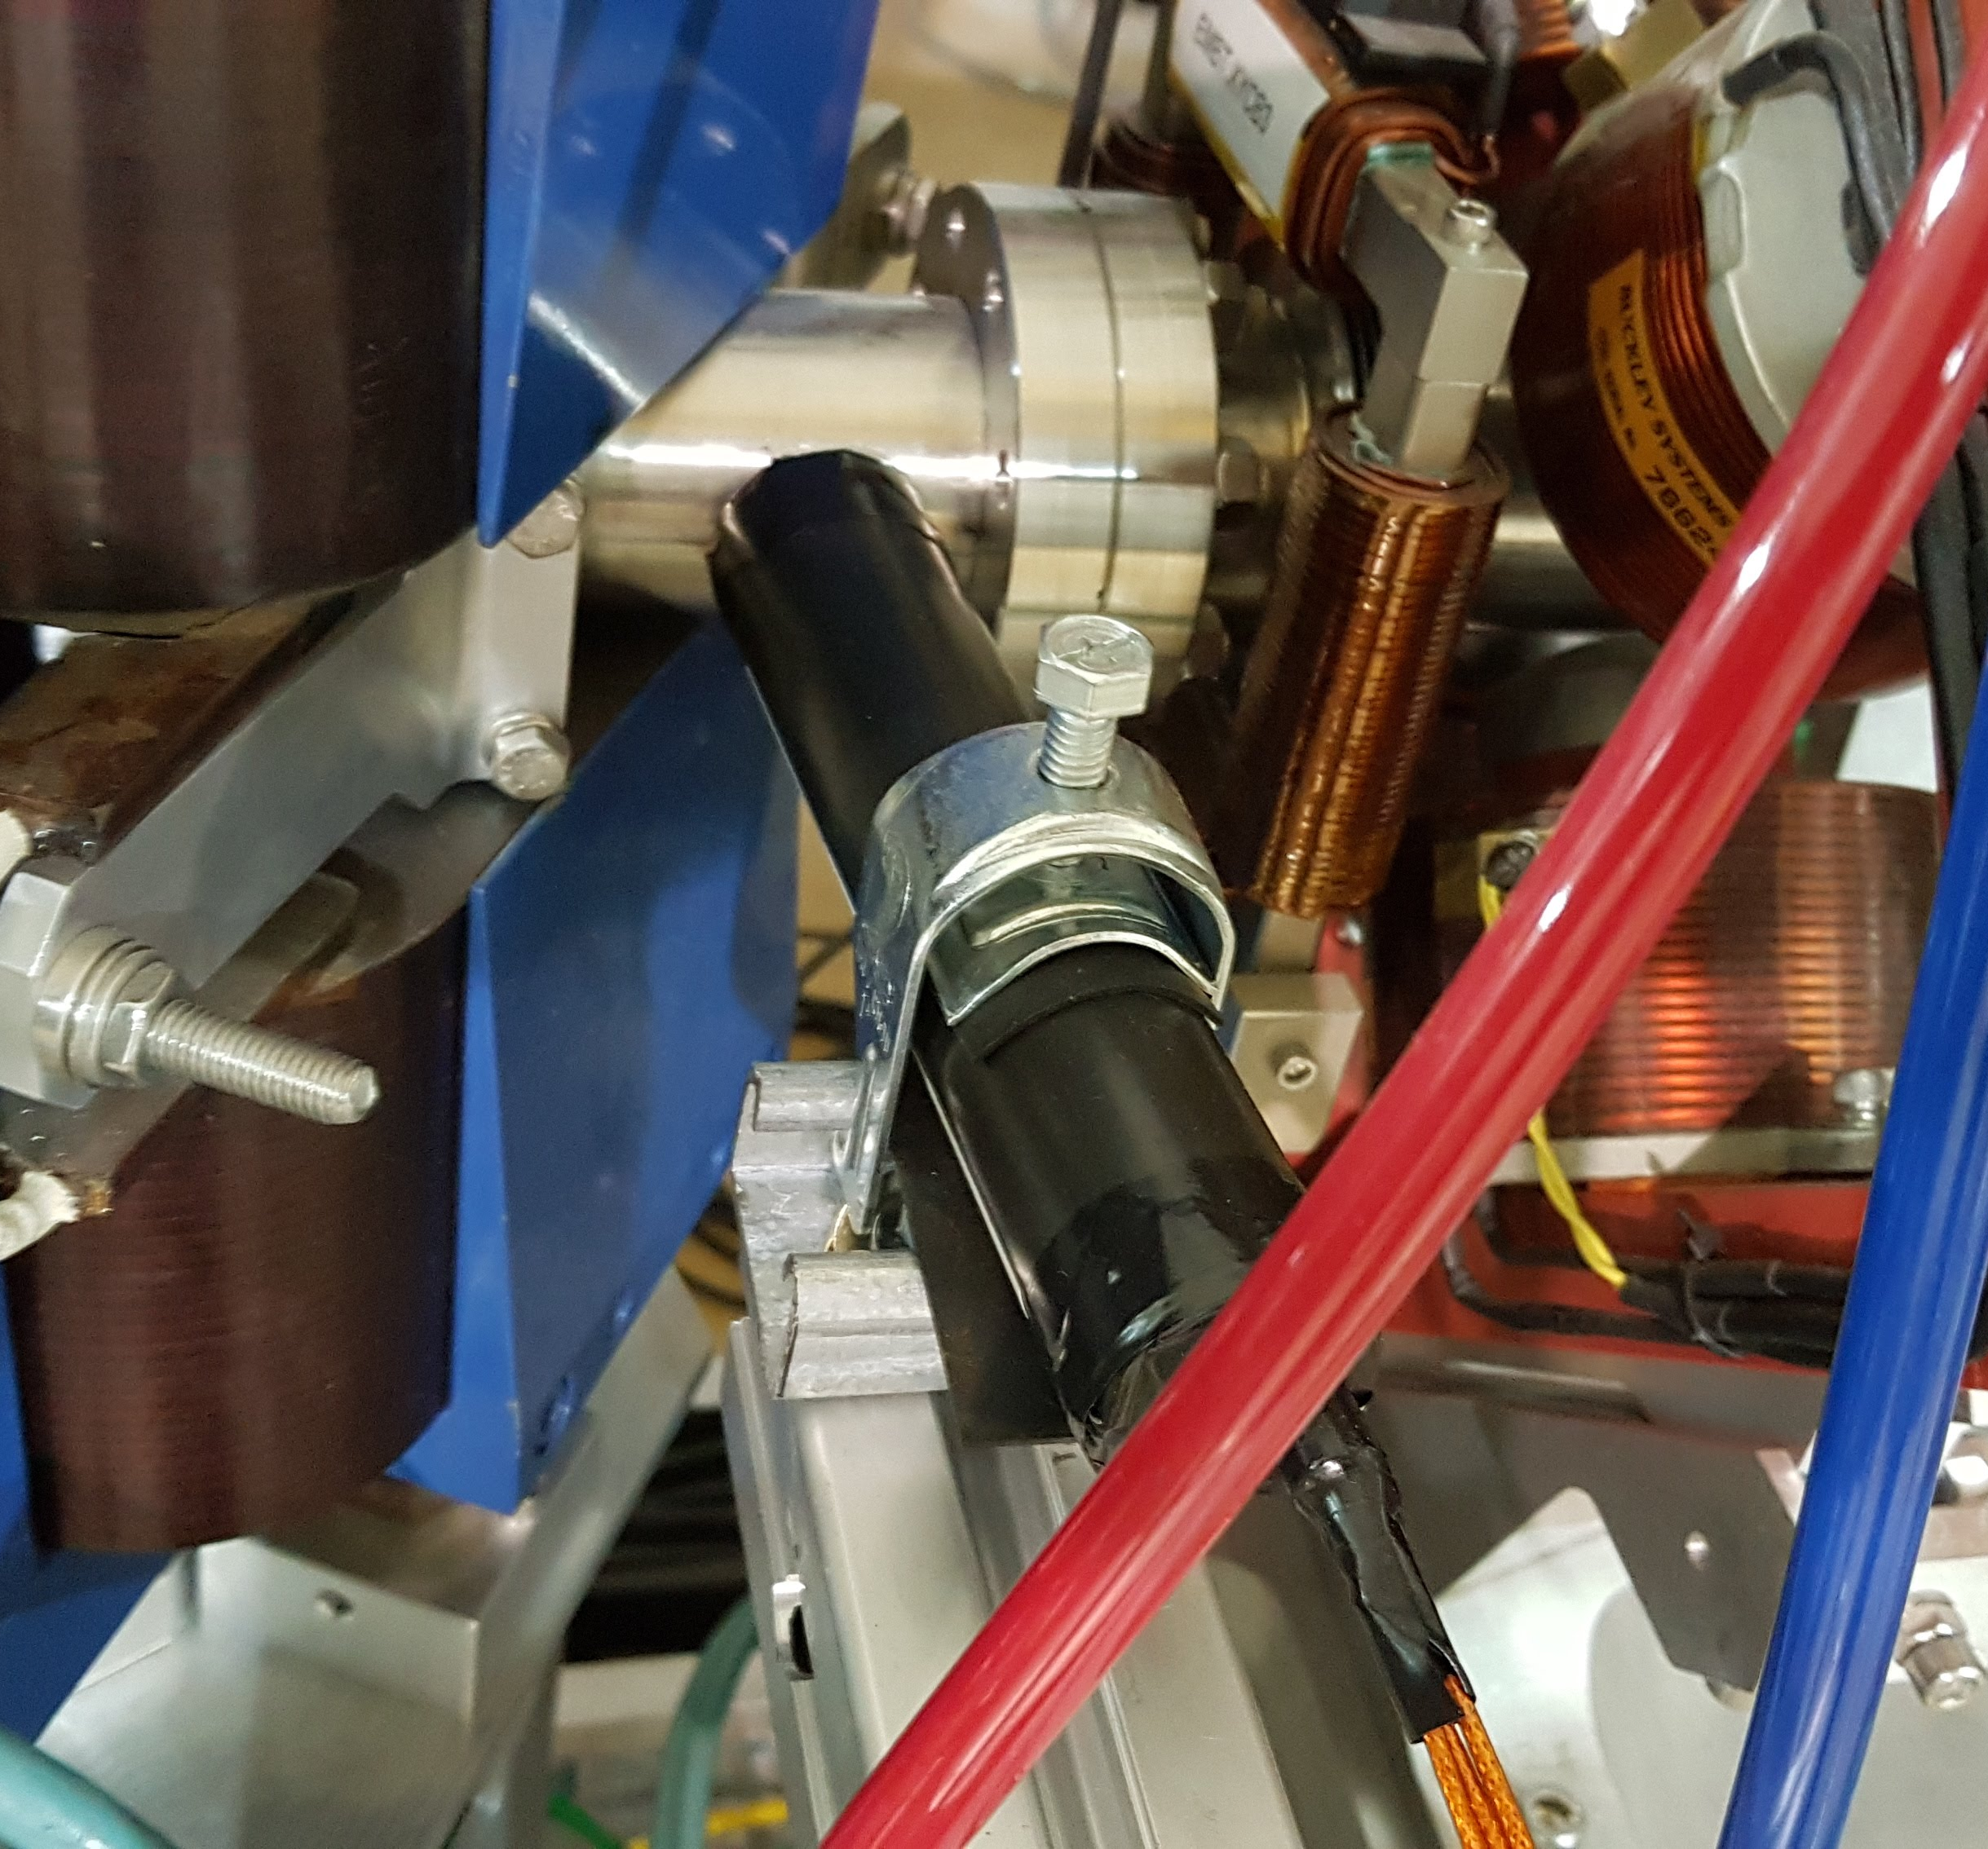
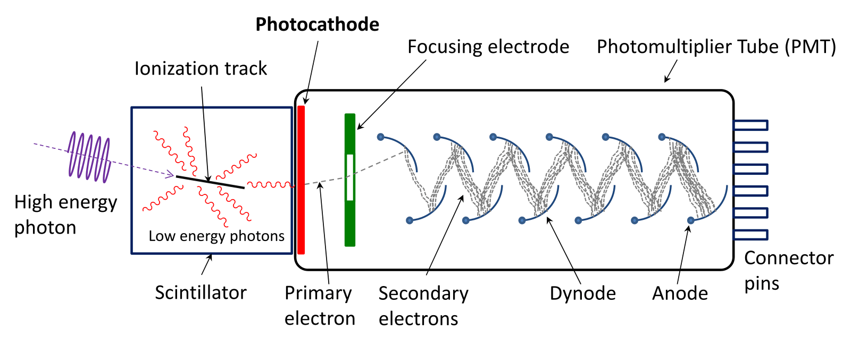
Beam Loss Monitors
Bi₄Ge₃O₁₂ scintillator coupled to Photo-multiplier tube
+ High sensitivity/precision (~35 μC/Gy) for chronic beam loss
+ Fast response (readout is limit)
- Very local information (multiple needed → costly)
- Electronics close to beam (aging)
- Long cables necessary (= capacitor, signal degradation)
Test-
LED
BGO
Custom base
https://instrumentationtools.com/scintillation-counter-principle/
IBIC 2019 - September 10, 2019
Notes:
1 cm³ BGO crystal (Bismuth germanate)
Remember the PMT
Chronic beam loss: long term activation / unnecessary losses

Slide 7
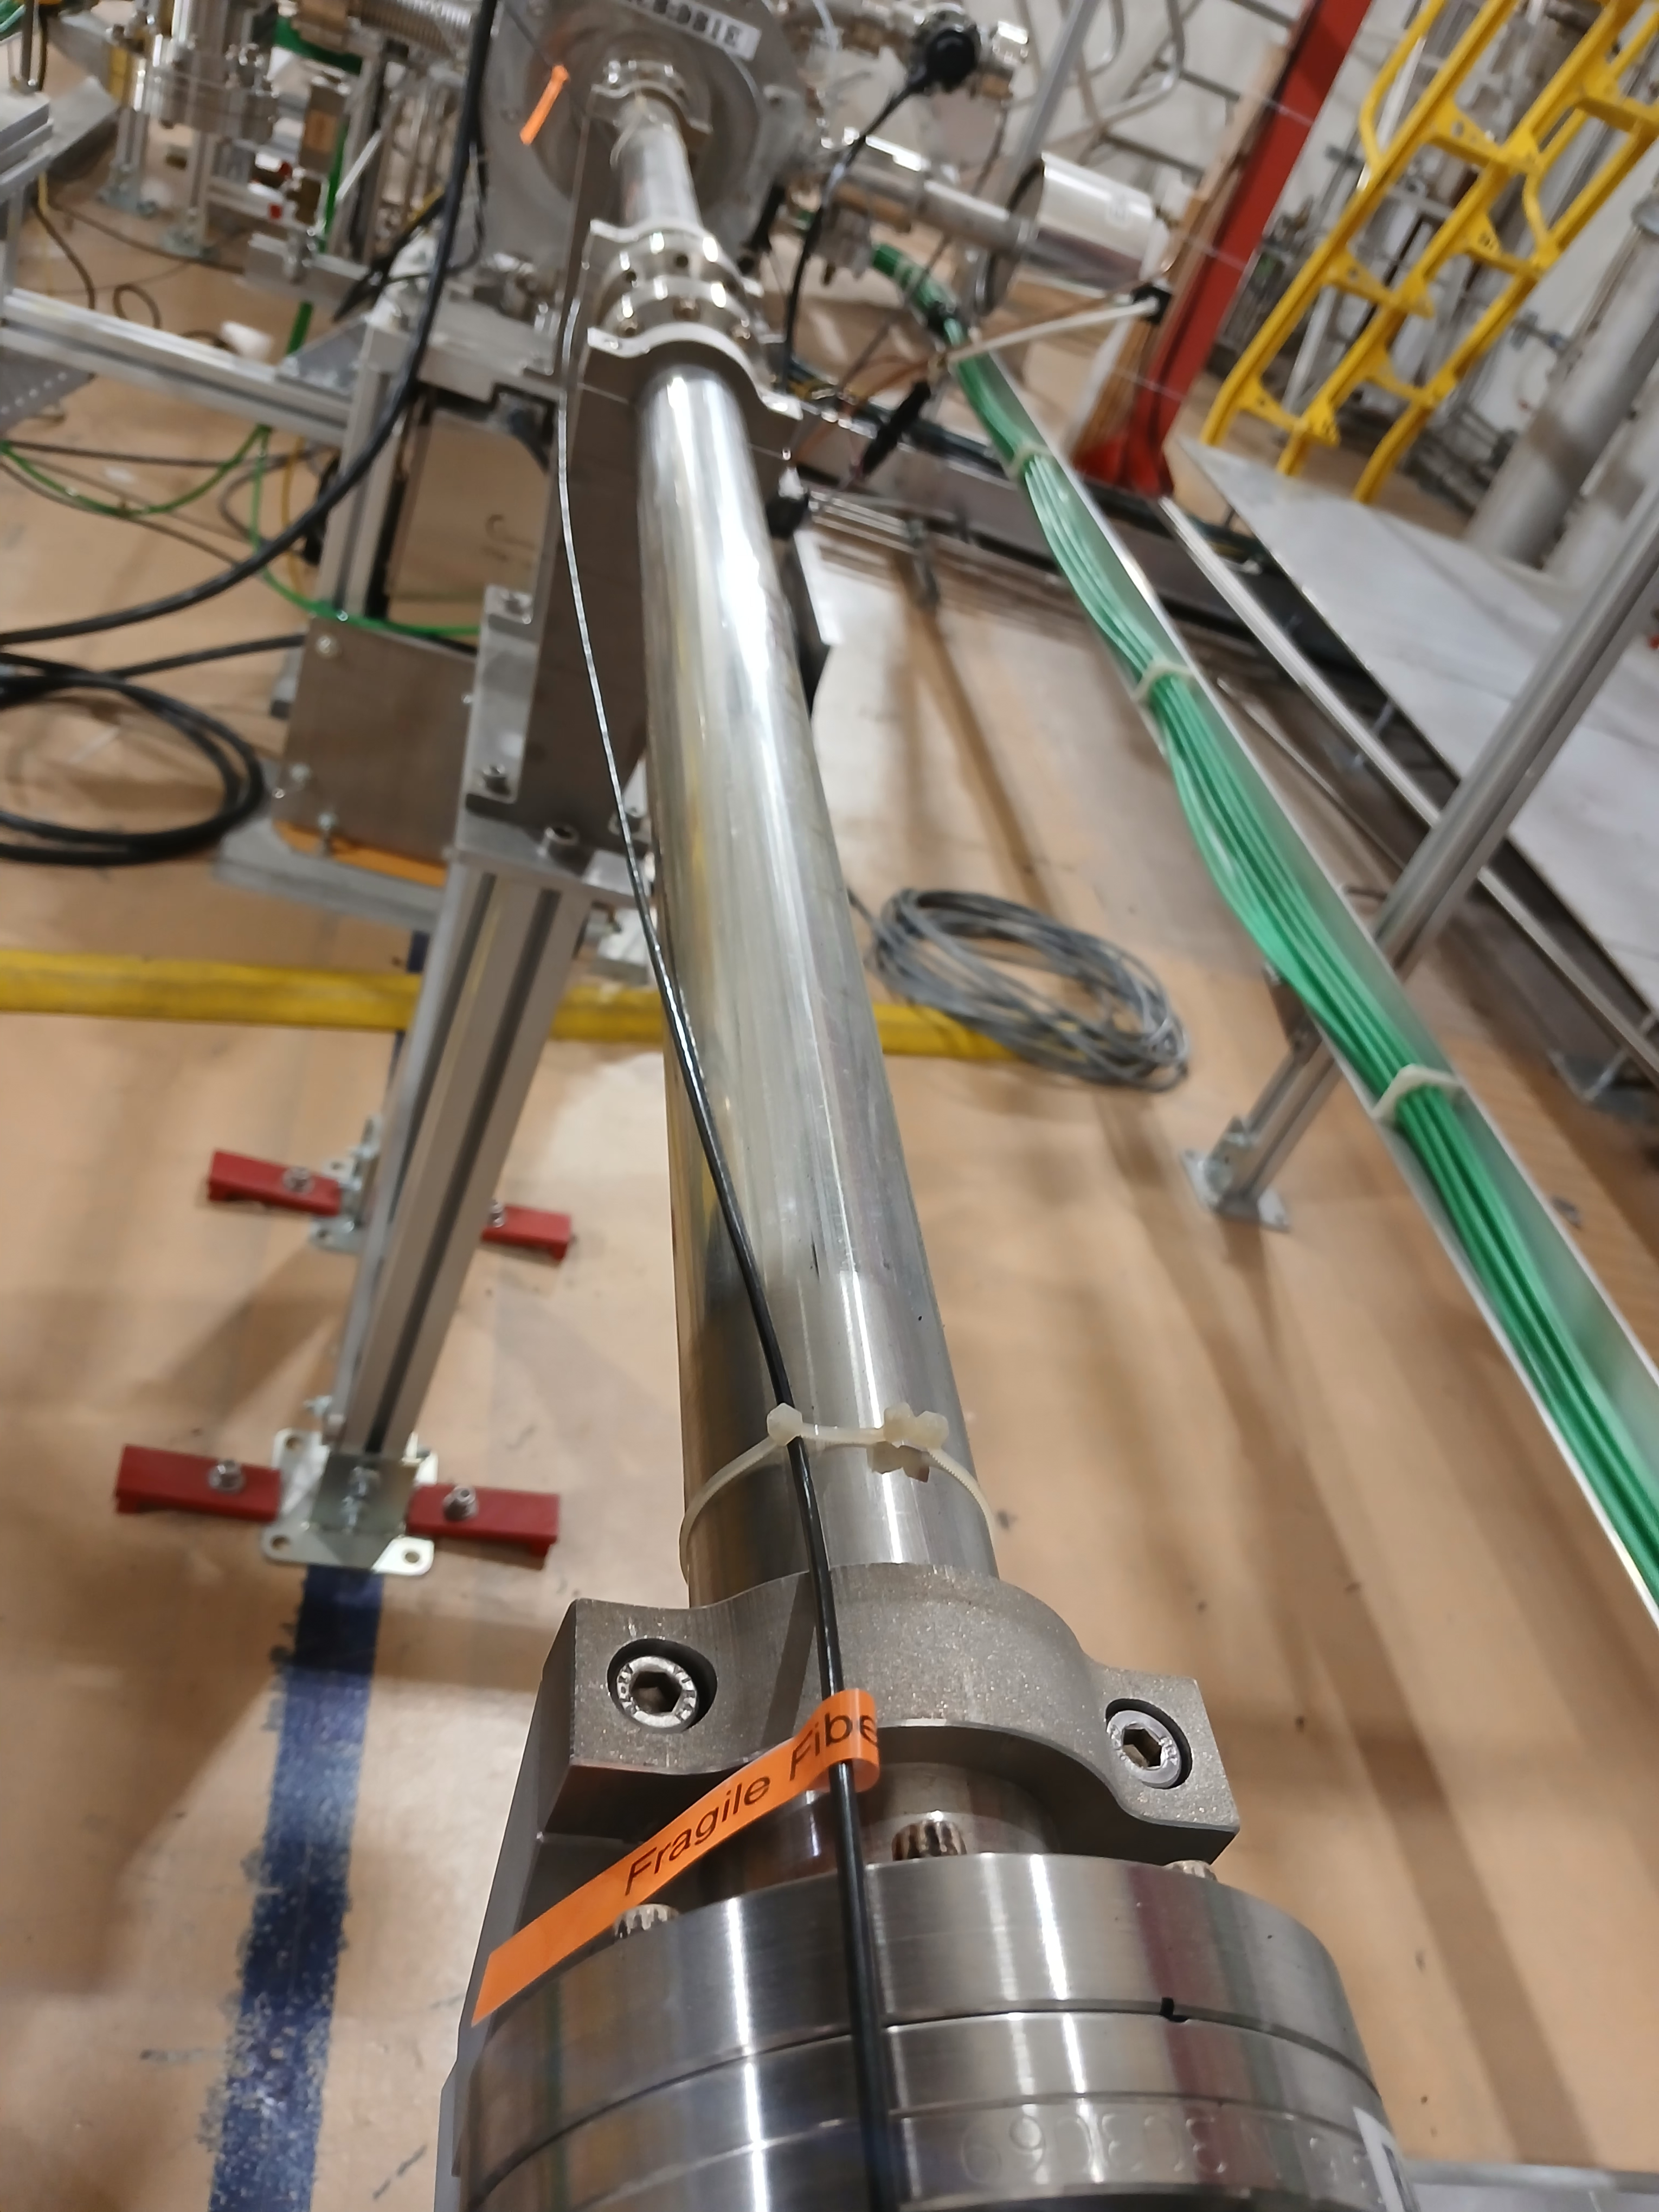
Beam Loss Monitors
Cherenkov Fiber with PMTs
+ High flexibility (complete beamline, close to beam)
+ Fast response (readout is limit)
+ Simple (only two channels)
+ Electronics outside of hall (easy development/exchange)
- Lower sensitivity (x2-x3 smaller then LIC)
- Signal loss (attenuation)
beam line
PMT 1
time diff.
e-
PMT 2
Notes:
105 μm diameter radiation-hard fluorinated silicate
Time difference in PMT Signal tells position of loss
Response: factor 2-3 smaller then LIC (=22 μC/Gy) https://doi.org/10.48550/arXiv.2005.06522

Slide 8
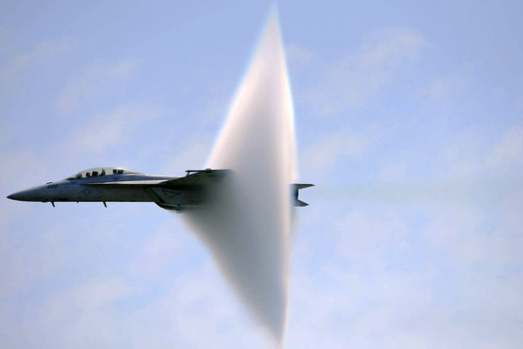
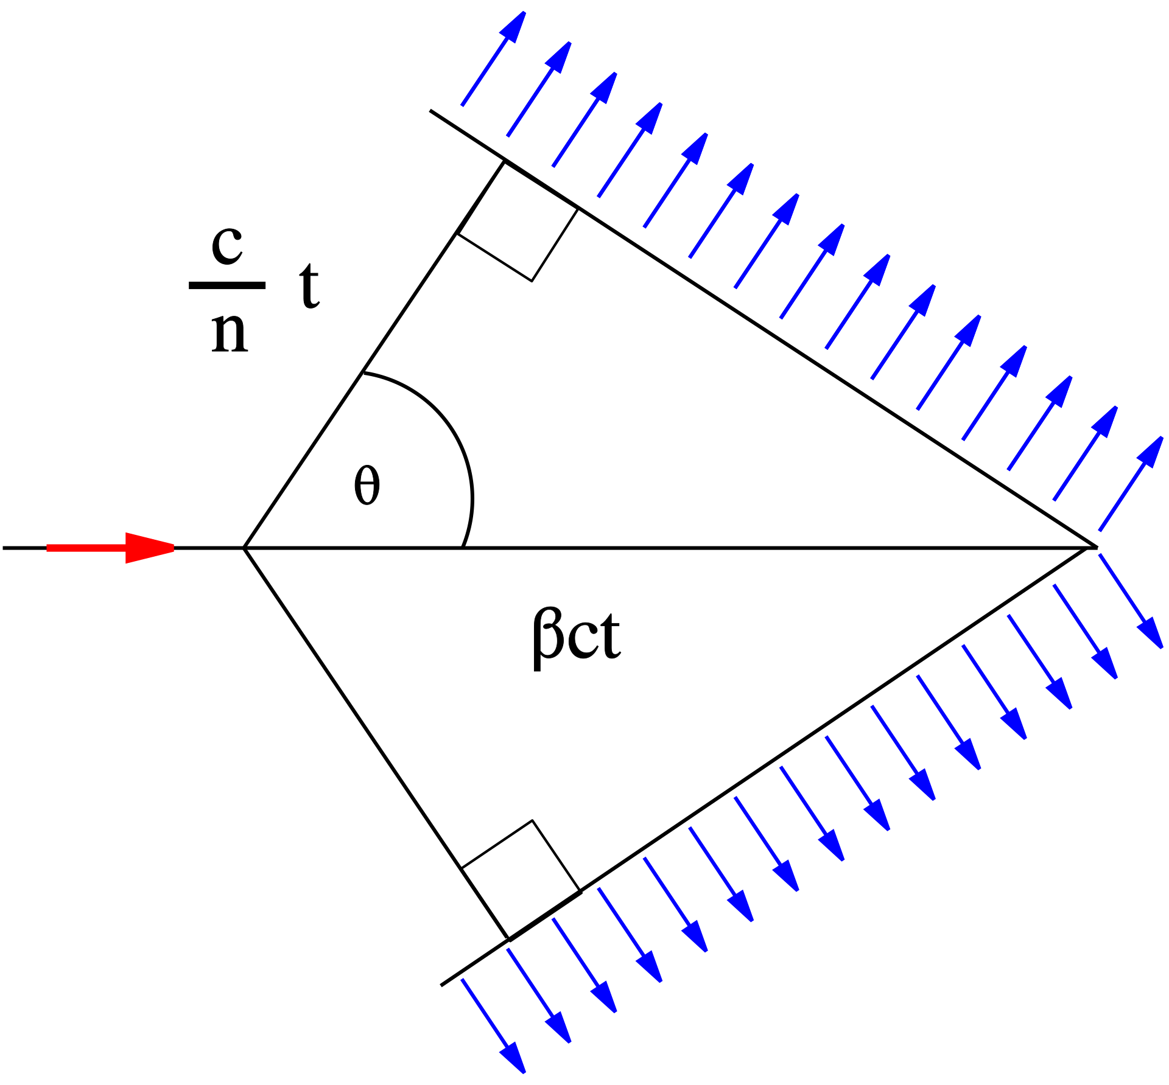
Cherenkov Fiber Principle
Like a in aircrafts.
If a charged particle passes through a medium with a speed larger than the phase velocity of light in that medium then photons are emitted.
wavelength of Cherenkov radiation: particle’s speed (β=v/c) and refractive index (n) of the material not on the entry angle
https://sciencefocus.hkust.edu.hk/sonic-booms
BEAM LOSS POSITION MONITOR USING CERENKOV RADIATION, DIPAC 2005 proceedings, M. Koerfer
Notes:
Not sponsored by Sonic3, I promise.
Emitted spectral range remains unchanged
Spatial and directional distribution of the emitted photons can vary with the angle.
May be used to distinguish different particles via the different emission spectra (e.g. protons and electrons)
Intensity within the fiber will vary

Slide 9
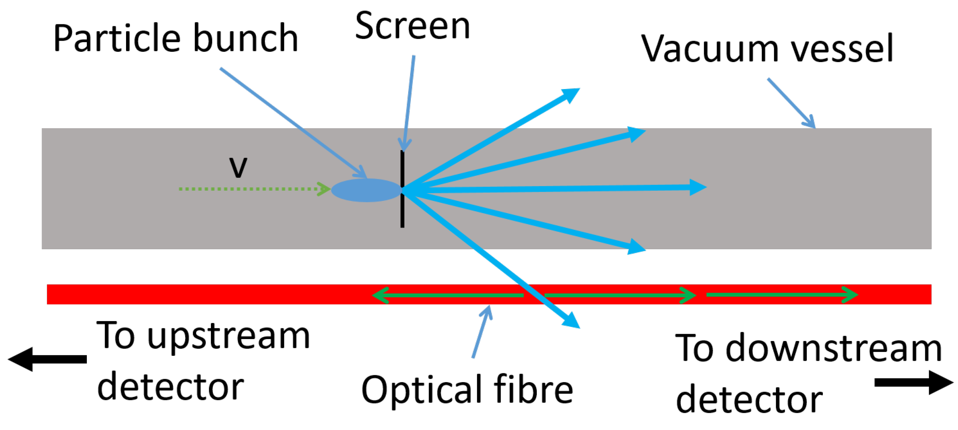
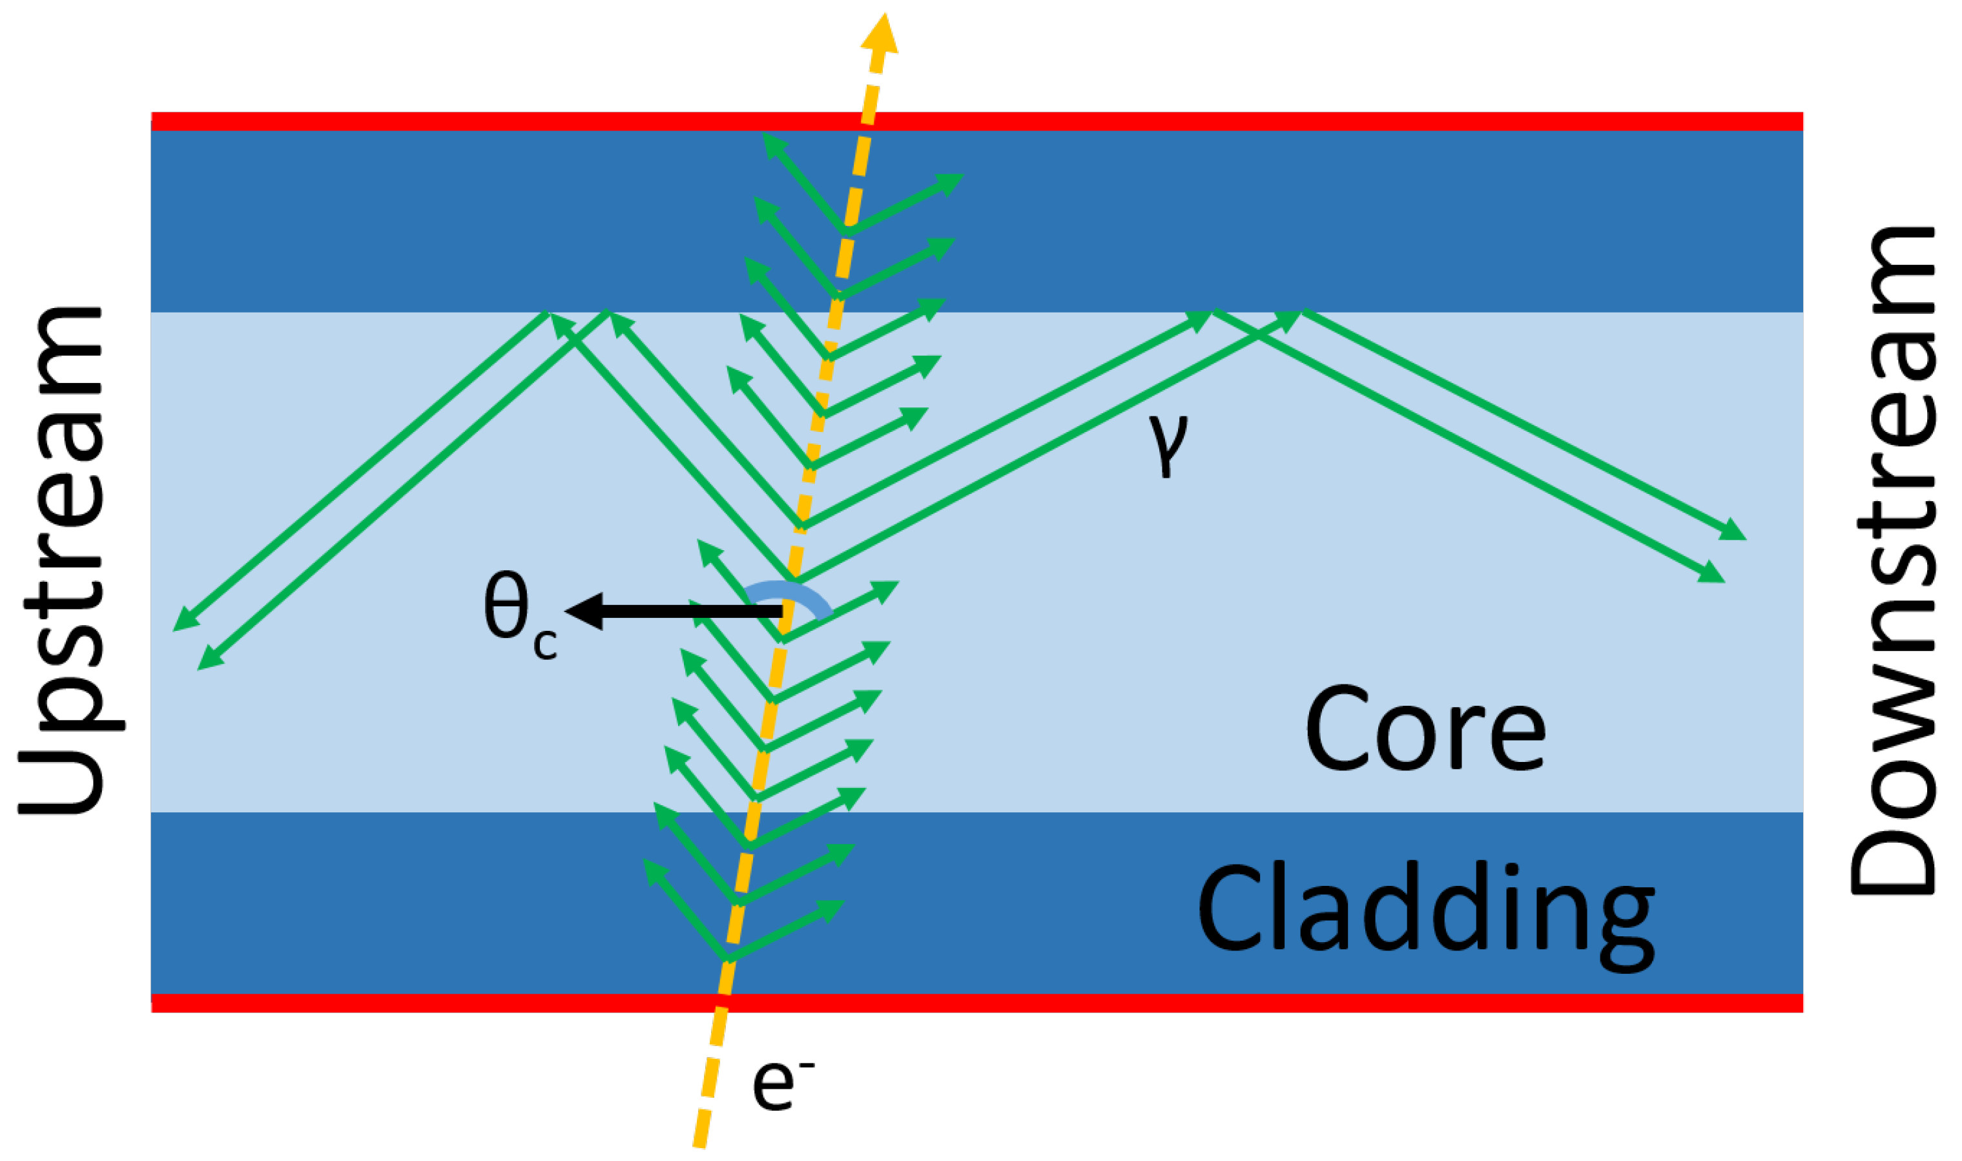
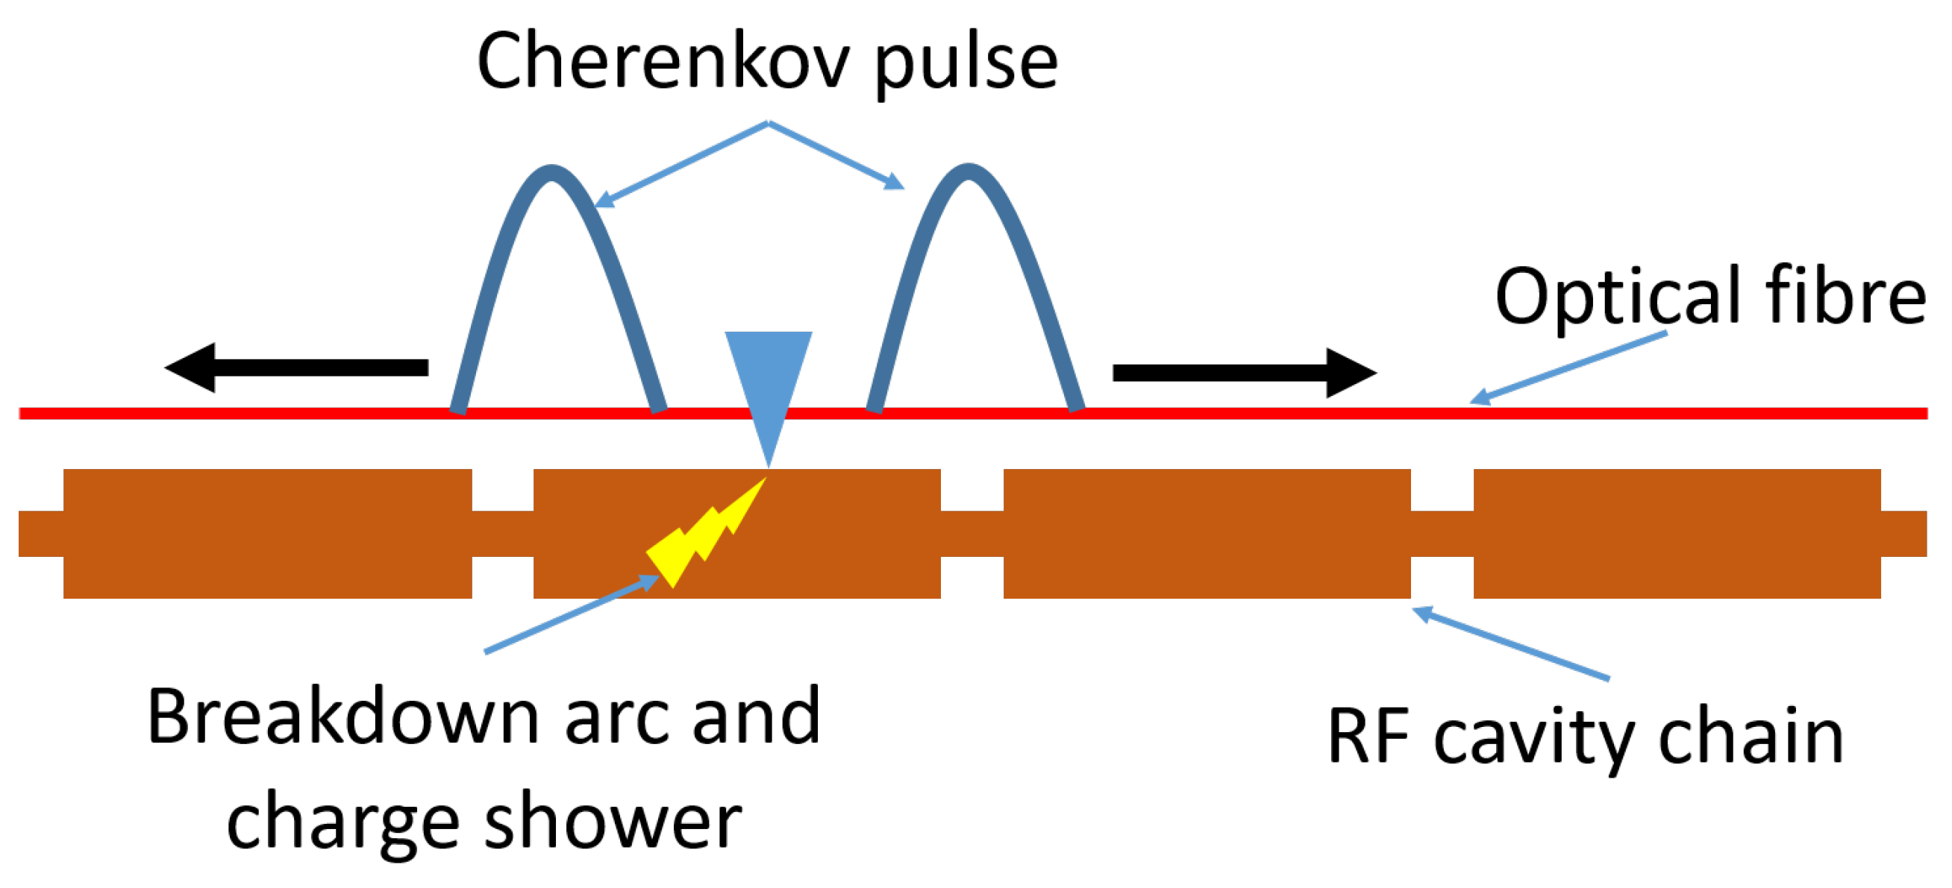
Cherenkov Fiber Principle
Cherenkov Radiation in Optical Fibres as a Versatile Machine Protection System in Particle Accelerators, 16.02.2023, J. Wolfenden et al., Sensors 2023, https://doi.org/10.3390/s23042248
Notes:
Here for our usecase. a screen too create artificial loss
For bunched beam, easy, for cw tricky positioning wise
The angular variation of Cherenkov radiation transmitted along optical fibers depends only on the refractive index difference Δ n between the core and the cladding, and that the peak intensity is proportional to the cube of the fiber core radius (DOI: 10.1364/OL.32.001205)

Slide 10
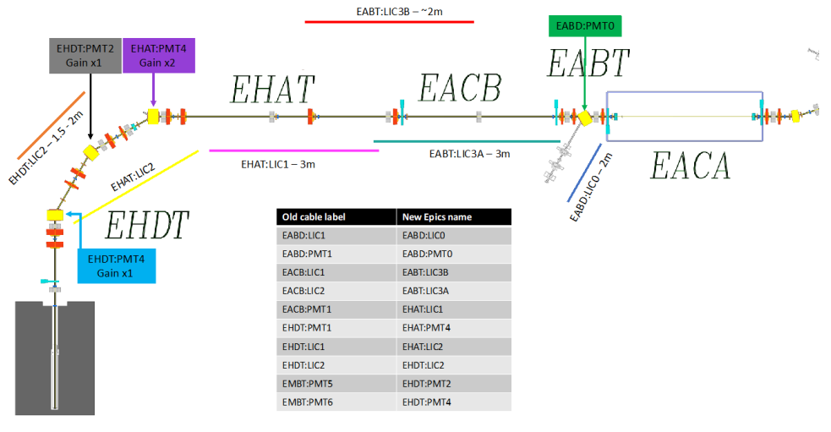
e-Linac Machine Protection Systems
Existing beam loss monitors:
LICs
BGOs & PMTs
PMT
PMT 3
PMT
PMT
e-
PMT
dump
Notes:
Why better for DarkLight/Flash? - Maybe physical/space constraints

Slide 11
e-Linac Machine Protection Systems
Existing beam loss monitors:
LICs
BGOs & PMTs
Cherenkov Fiber:
1x 100m Fiber + 2x PMT
roof
PMT
PMT 1
PMT 3
PMT 2
PMT
PMT
e-
PMT 4
PMT
dump
Notes:
Why better for DarkLight/Flash? - Maybe physical/space constraints

Slide 12
Results so far?
Sweep Measurement
PMT 1
PMT 2
roof
PMT 1
MB0 sweep
PMT 3
PMT 2
e-
main beamline
PMT 4
beam dump
dump
Notes:
roof

Slide 13
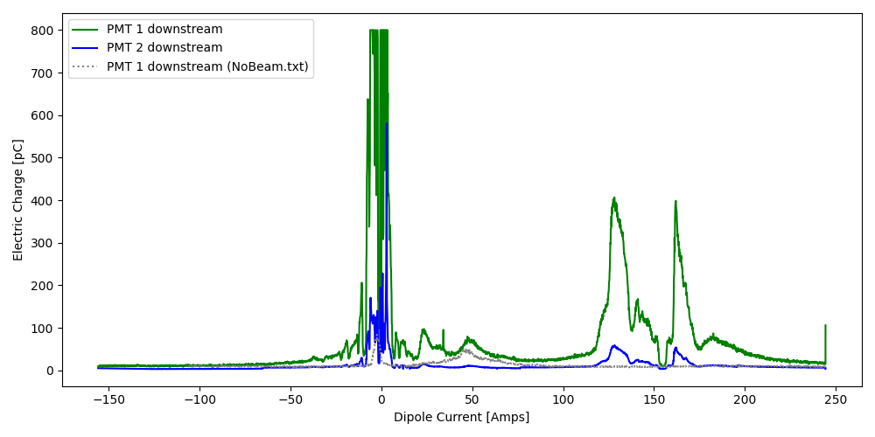
Sweep Measurement
Shut off: as simple as setting an electric charge threshold (basically plug&play)
main beamline
beam dump

Slide 14
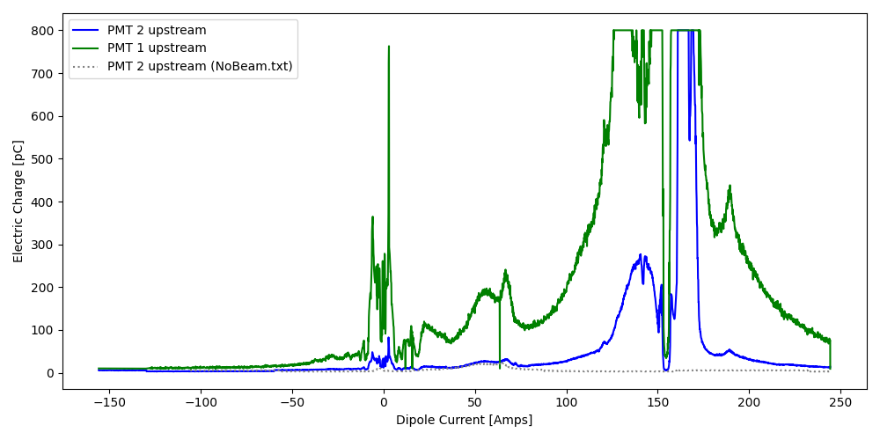
Sweep Measurement
Shut off: as simple as setting an electric charge threshold (basically plug&play)
Signal is different up- and downstream (as expected)
Notes:
With setting a threshold already a safe protection covering the whole system. Already now doable, positioning next
(Possible Interpretation: 0Amps hits are downstream, while 150Amps hits are upstream)

Slide 15
Conclusion
Proof of Concept (=could work already) ✔
Advantages of Cherenkov Fiber over current system (LICs or BGO&PMTs):
Adjustable: just a fiber, hardly any space consumption, can be fed through magnets or placed very close.
Scalable: one system with two PMTs for whole beamline
Cost effective: only two channels necessary
Less complex: great for development, change/test electronics on the fly
Up next:
Proof and improve time delay measurement for position measurement
Better materials: replace old PMT, change to double cladding fiber, implement RedPitaya
Extra fiber with windings only close to Cryo to subtract background
Test if protons give distinguishable signal to electrons
Notes:
Only Disadvantage: lower sensitivity due to signal loss
RedPitaya: as more accessible digital online spectrometer

Slide 16
Thank you Merci Contact: Richard Hermann rhermann2@triumf.ca
www.triumf.ca
Follow us @TRIUMFLab

Slide 17
Appendix
Extra Slides

Slide 18
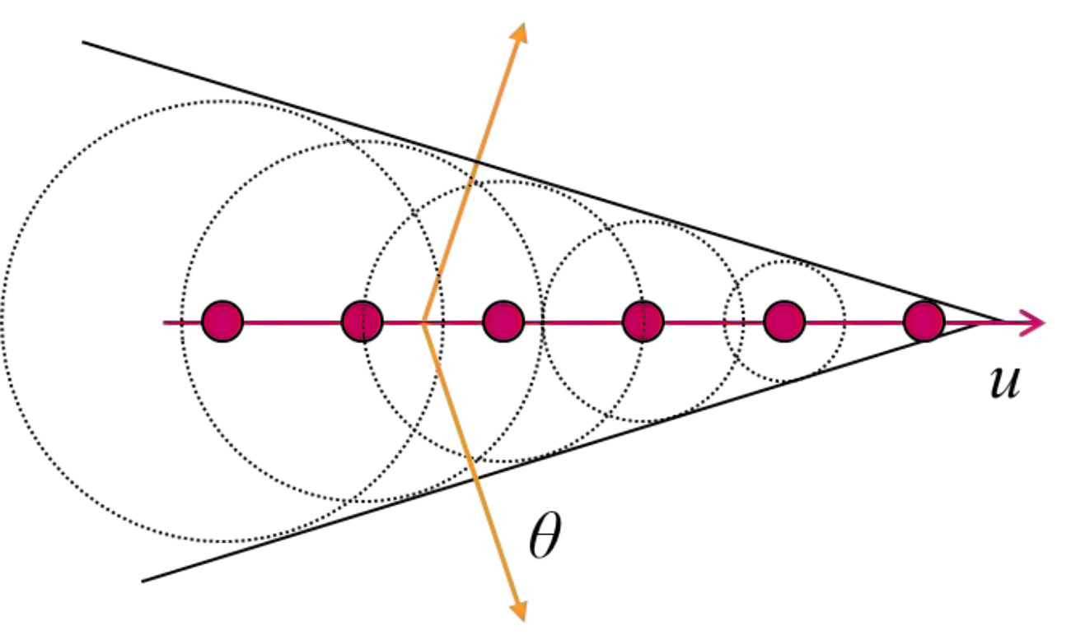
Machine Protection System
Beam Safety Shut-Off System
There to detect beam malfunction and stop it in < 10 μs
for TRIUMF’s ARIEL e-Linac
TRIUMF: Canada’s particle accelerator center TRI-University Meson Facility
ARIEL: Advanced Rare Isotope Laboratory
e-Linac: Electron Linear accelerator
based on Cherenkov Fiber
optical fiber emitting Cherenkov radiation (photons) if particles travel faster than light in the material
Cherenkov radiation – Wikipedia Advanced test reactor Idaho National Laboratory
Stanford 2014, lecture H. Alaeian
Notes:
TRIUMF → Aveen Mahon
Ariel – main purpose, complementary more specific way to create radioactive beams (uranium trarget) – photo fission as opposed to spallation/fragemetation

Slide 19
Comparison
 | Advantages | Disadvantages
LIC | Proven technology, sensitive, robust | Slowest response, bulky, maintenance-intensive Individual channels – more expensive
BGO&PMT | Fast response, flexible, high precision, very sensitive | very local information, many needed → costly, electronics close to beam (aging), long cables necessary – basically large capacitor, degradation of signal, Individual channels – more expensive
Cherenkov | Fast, flexible, simple, suitable for large setups, accessibility to hall, test different pmts on the fly, great for development, …, cheaper as for two channel | lower sensitivity, signal loss
Individual channels
More expensive, …

Slide 20
Cherenkov Fiber Principle
Like a in aircrafts.
If a charged particle passes through a medium with a speed larger than the phase velocity of light in that medium then photons are emitted
wavelength of Cherenkov radiation: particle’s speed (β=v/c) and refractive index (n) of the material not on the entry angle
Emitted spectral range remains unchanged
Spatial and directional distribution of the emitted photons can vary with the angle.
May be used to distinguish different particles via the different emission spectra (e.g. protons and electrons)
https://sciencefocus.hkust.edu.hk/sonic-booms
BEAM LOSS POSITION MONITOR USING CERENKOV RADIATION, DIPAC 2005 proceedings, M. Koerfer
Notes:
Not sponsored by Sonic3, I promise.
Intensity within the fiber will vary

Slide 21
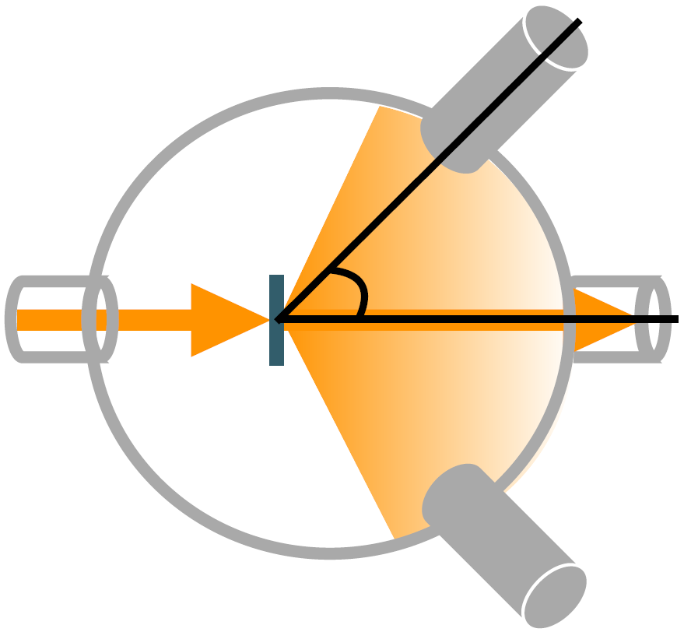
e-Linac use cases (high intensity electron beam)
DarkLight
ATOMKI experiment with Beryllium 8 observed hypothetical X17 Boson (mass 17 MeV/c2)
Electrons on thin target (Tantalum, C12-foil, Be8) shall create γ and X17
Min. 30MeV, 300uA, 10kW, 1000h cw
FLASH
THz
Electron Beam
K. Pachal: “The DarkLight experiment at TRIUMF and the hunt for a new boson”
Notes:
An experiment to secondary proof a measurement of a hypothetical particle, which could be linked to dark matter.
Interesting as an Angle anomalies in e+e- *positron electron decay* was measured on Be8 (unexpected peak at 140 degrees)

Slide 22
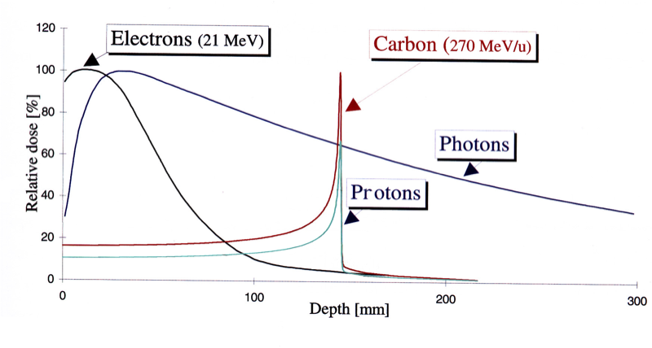
e-Linac use cases (high intensity electron beam)
DarkLight
FLASH
Ultra high dose rate (UHDR) radiotherapy
Reduced damage in healthy tissue (L.Egoriti 2022)
Higher patient security (movement)
THz
Dose rate
~ 40 Gy/s
FLASH
Dose ~ 40 Gy
~ 0.05 Gy/s
Conventional
Dose ~ 40 Gy
0
1 sec
minutes
t
https://www.quantumdiaries.org/.../bragg-peak-3/
S. D. Rädel, “Status and Future Perspective of the TRIUMF E-Linac”, 2019

Slide 23
e-Linac use cases (high intensity electron beam)
DarkLight
FLASH
THz
Sub mm high charge electron bunches (THz wavelengths are 100μm – 1mm)
Extents the Spectroscopy range
For now, used for beam tuning
Pre-requisite for energy recovery
Bunch compressor for high intensity
S. D. Rädel, “Status and Future Perspective of the TRIUMF E-Linac”, 2019
Notes:
Extension to the spectral range – on the long run to observe certain biologic processes, for now a tool to improve beam tuning

Slide 24
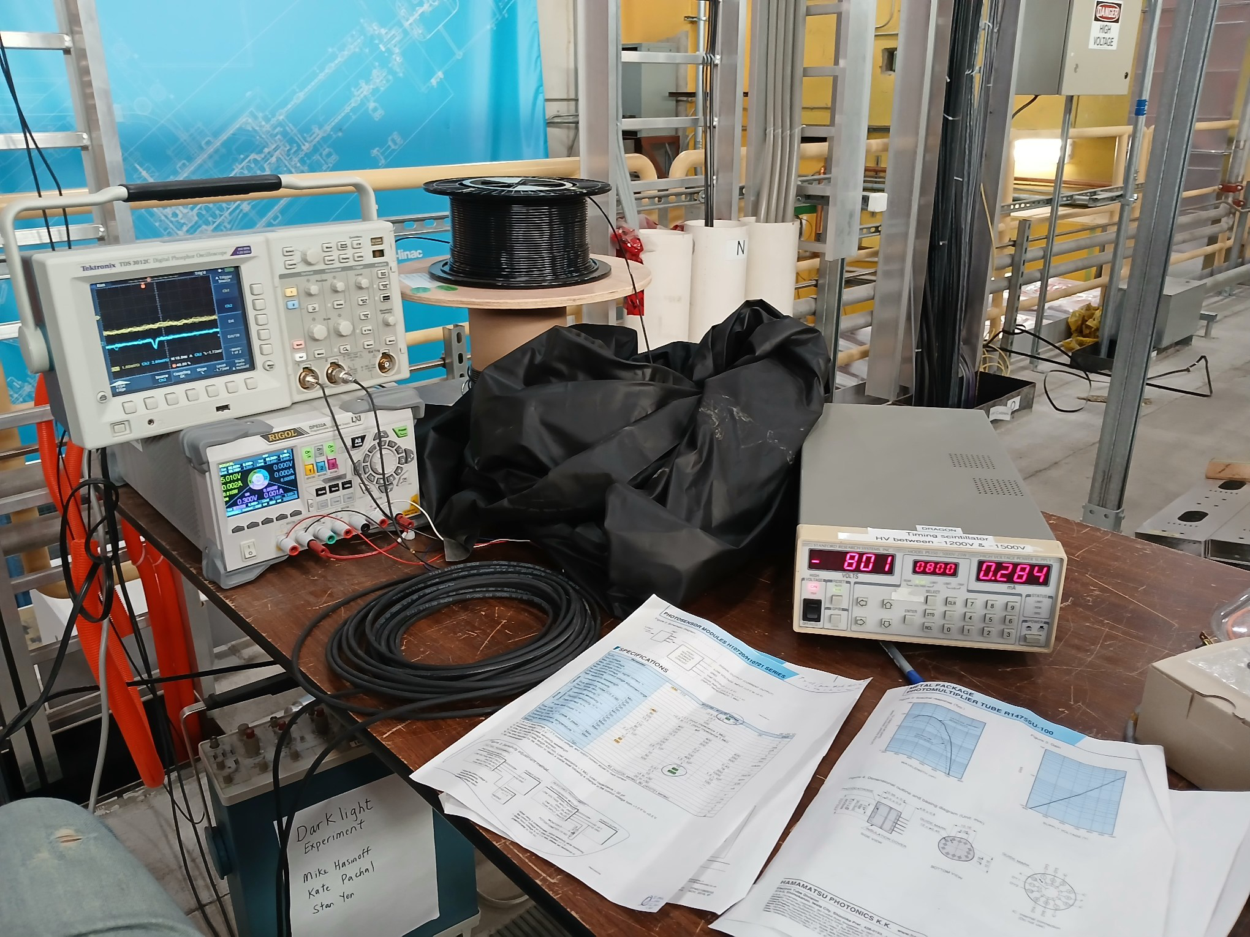
Pathway
Setup
Quartz-fiber
PMTs:
“New” (designed 2016) H10720 series ~0.7V with 5V bias
“Old” (designed 2000) R14755U-100 ~800V

Slide 25
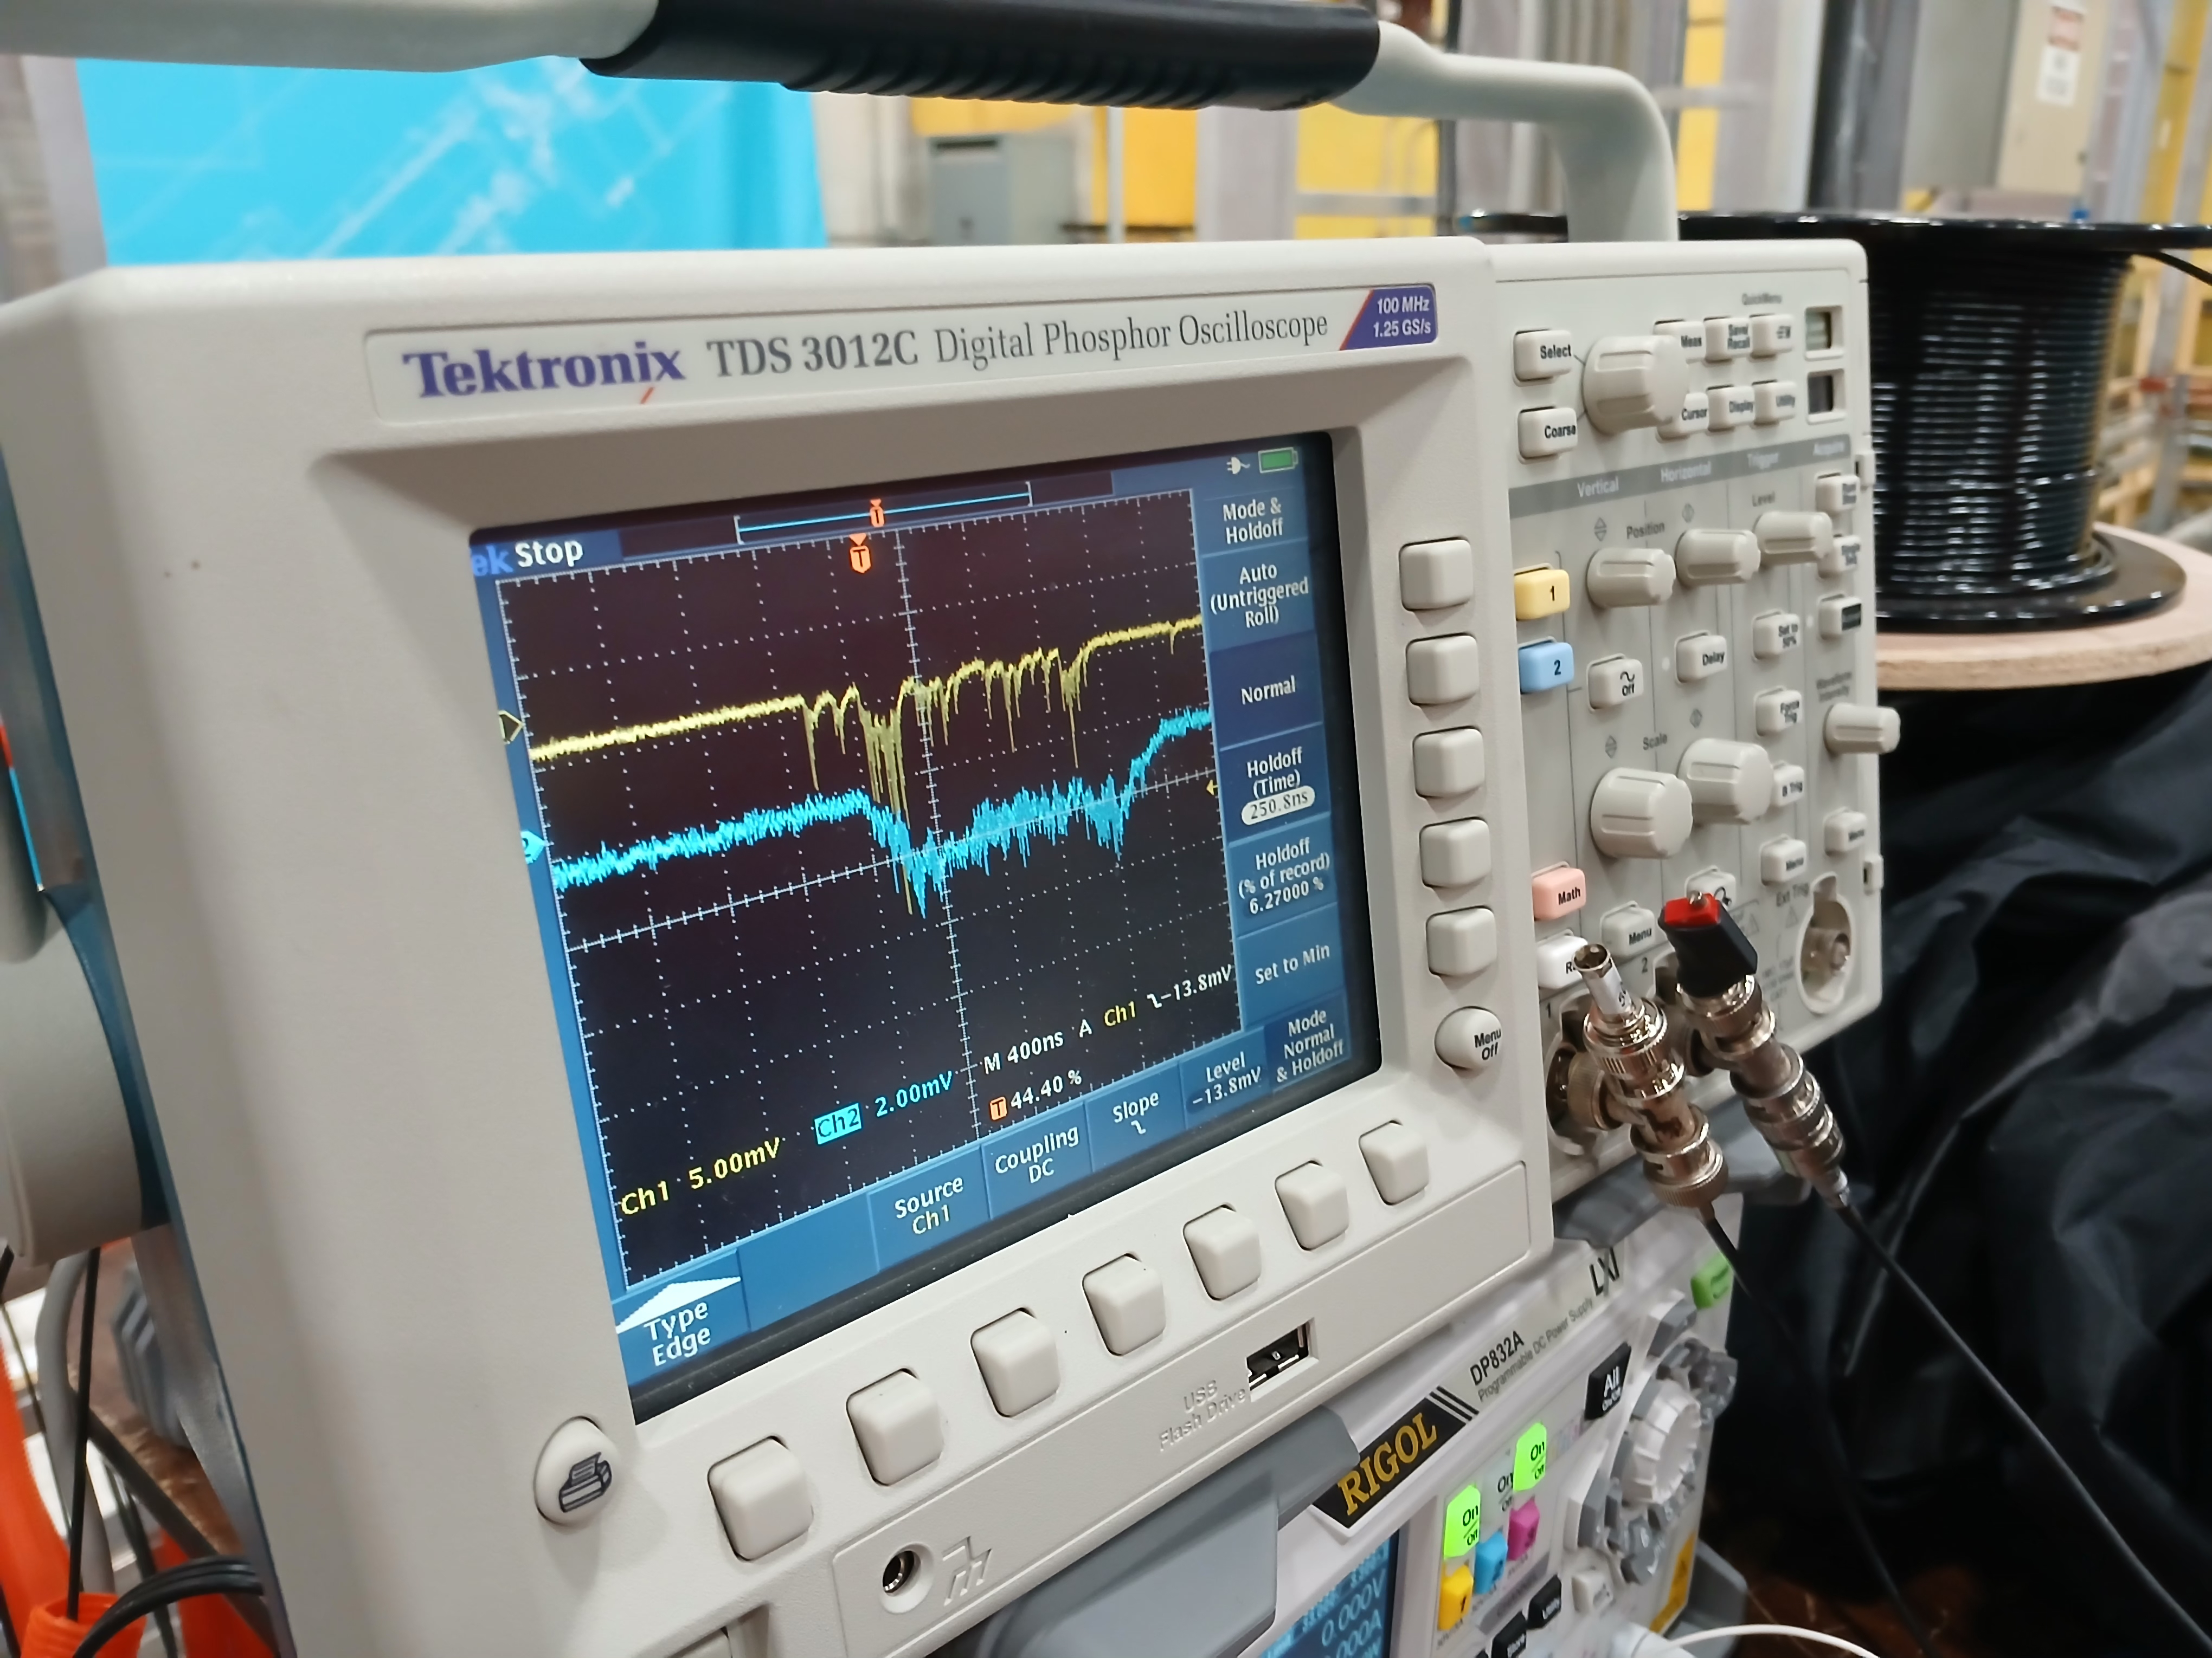
2024-12-05 Results
Viewscreen in the beam upstream EABT:VS1
Signal for both channels, even with visible time shift
→ ~300ns

