Slide 1
The Scientific Goal
Perform antimatter/matter comparison at highest attainable precision
E.g., Determine 1S-2S transition frequency in antihydrogen with the same precision of hydrogen
Test the fundamental symmetries that underlie Standard Model and General Relativity

Slide 2
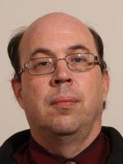
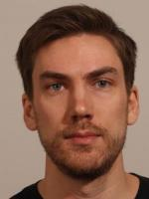
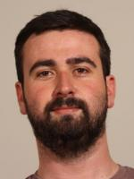
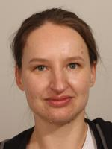
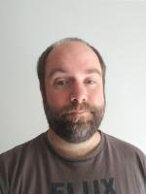
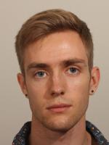
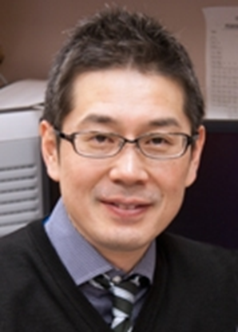
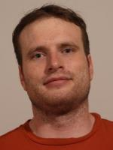
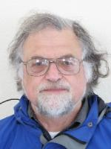
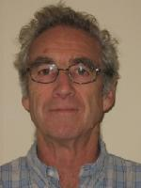
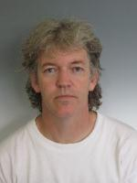
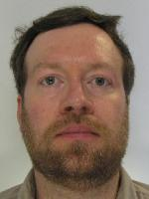
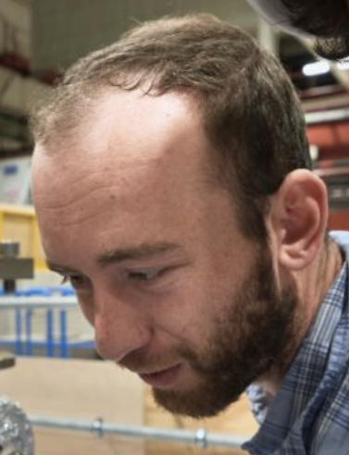
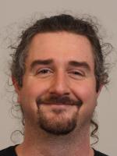
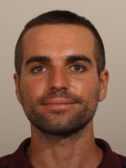
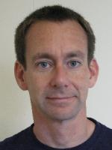
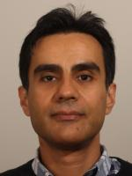
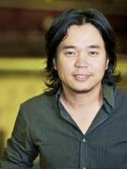
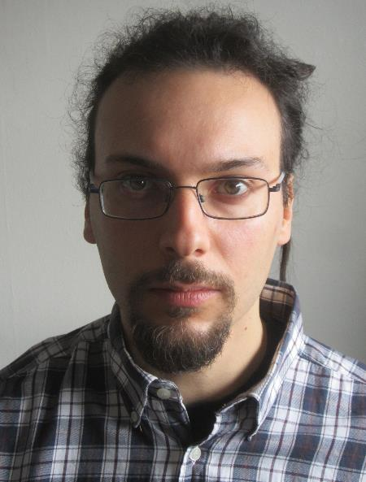
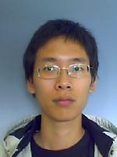
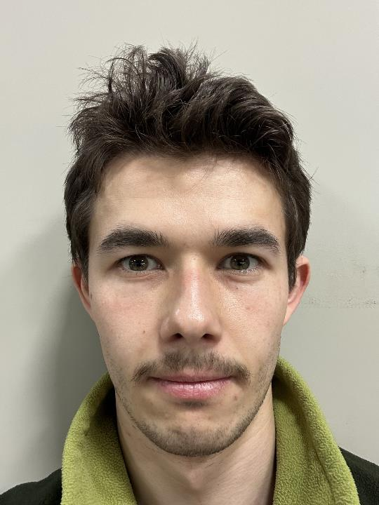
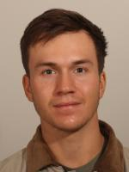
The Team (ALPHA-Canada)
* Denotes HPQ
*
*
*
*
*
*
Detectors, DAQ & Data Analysis
Laser Cooling
Microwave Spectroscopy, Magnetometry and Penning Traps
*
*
Apologies to newest grad students, co-op students and past members.
PI
me
HAICU

Slide 3
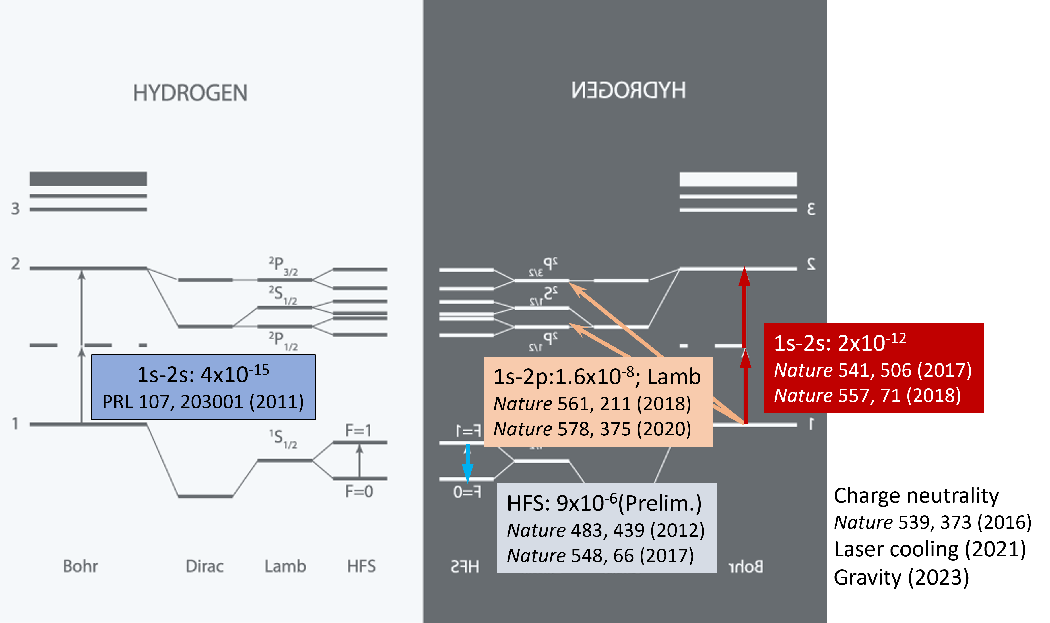
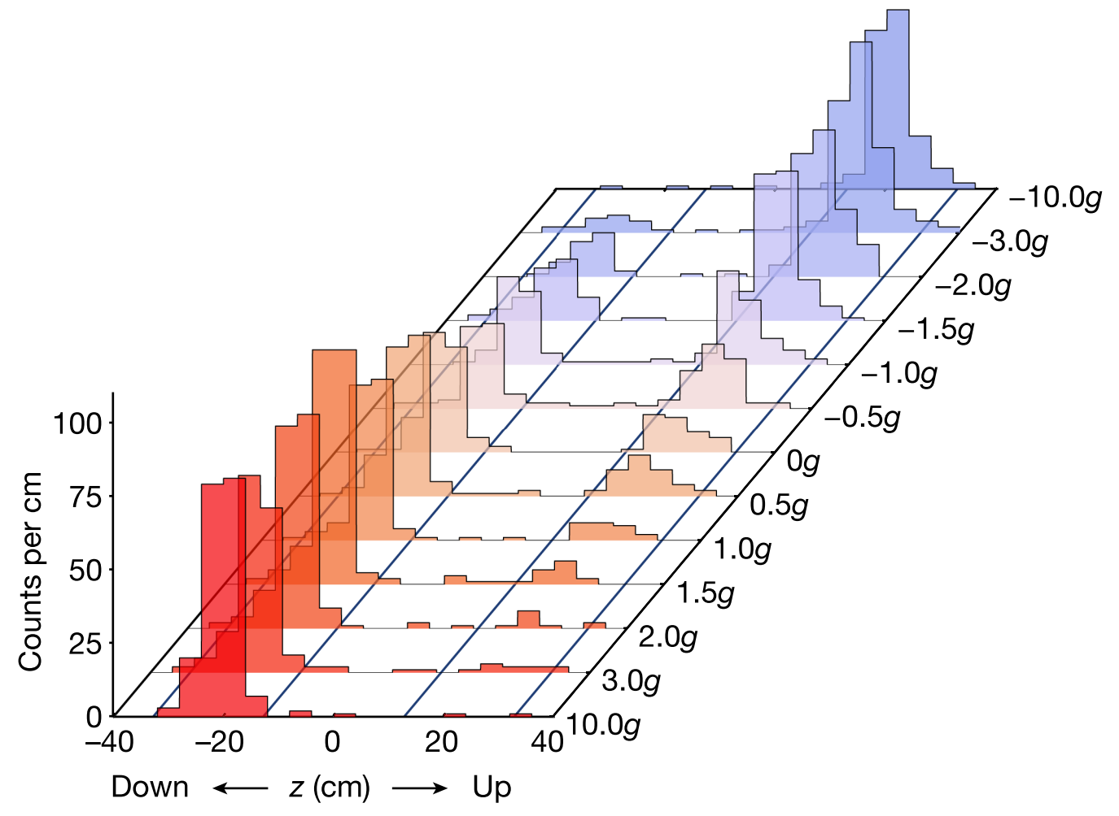
The Current Status
ALPHA-2: trapping antihydrogen for 12 years and counting
1S-2S, microwave spectroscopy
Laser cooling
Indirect determination of Lamb shift
New transition being probed, e.g., 2S-4P
Record breaking number of antiatoms stores: >10⁴
ALPHA-g: dropping trapped antihydrogen
First experiment in 2022 (~20% error on first measurement)
Currently trapping and dropping unprecedented number of antiatoms

Slide 4
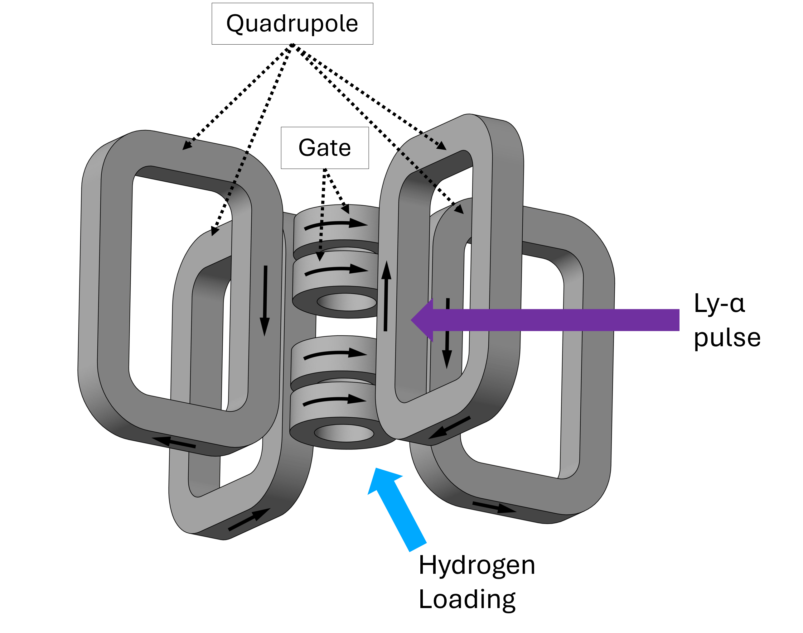
HAICU (now – 2031?)
Hydrogen-Antihydrogen Infrastructure of Canadian Universities
Platform to develop quantum sensing techniques on H & pathfinder for next generation of H experiments
Long-term goal: Make the first hydrogen fountain
Phase 1: Construction is ongoing at TRIUMF and UBC – first trapped atoms expected early next year
HAICU does not depend on the cyclotron
If infrastructure is ready, no additional resources required
Gate coils assembly at TRIUMF (Oct. 2024)

Slide 5
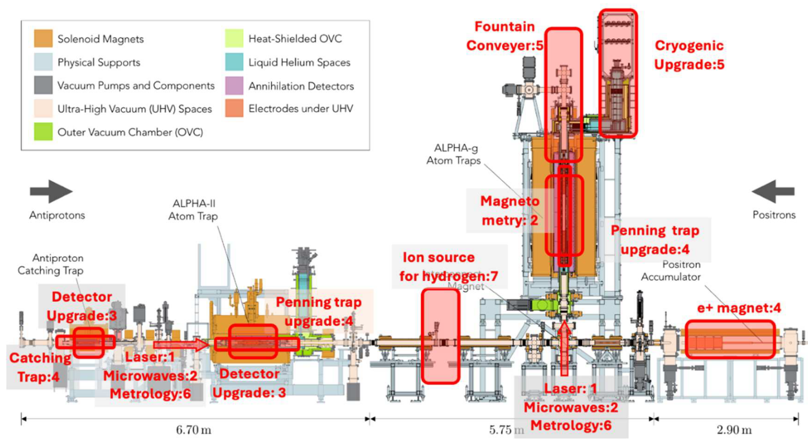
ALPHA Next Generation (2027-?)
Reach hydrogen-level precision
Microwave and laser (1S-2S) spectroscopy
Precision gravitational studies
Application to be submitted to CFI IF2025
Timely with CERN LS3 (injectors)
Modernization of decades-old facilities and tools
To name a few: DAQ, trap CS
Increase automation and sustainability (e.g., liquid helium consumption)
Direct antihydrogen-hydrogen comparison
Hydrogen loading and detection

