Slide 1
Particle Physics
Oliver Stelzer-Chilton
ACOT Meeting, November 2024

Slide 2
Particle Physics within the Physical Sciences Division
The departments of Particle Physics, Science & Technology and Scientific Computing address the areas:
High Energy Frontier
Neutrinos and Dark Matter
Precision Tests of Fundamental Interactions
Lead in Scientific Discovery through focus projects
Projects where we are involved in all areas
detector design/construction, operations, data analysis
Ensure critical mass is established
Maintain leadership in all areas
Current experiments
ATLAS, T2K/Hyper-K, ALPHA, TUCAN, SuperCDMS
New experiments expected to reach that point in the future
DarkLight, nEXO, PIONEER

Slide 3
Enable Particle Physics in Canada and Abroad
TRIUMF is part of a network of laboratories and partner institutions
Leverage TRIUMF key expertise in accelerator, computing, detector and DAQ technologies
Unique expertise in e.g. cryomodules, SiPM, TPC, gaseous detectors, DAQ, etc…
Support for Accelerator and Engineering, Science Technology and Computing are crucial
SNOLAB: detector, facility and DAQ systems through Science and Technology involvement
-> SuperCDMS, nEXO, ARGO, DEAP, SNO+
CERN: In kind contributions to LHC and HL-LHC, share in detector upgrades -> ATLAS, ALPHA
-> global detector R&D organization (DRD)
KEK/J-PARC: beam monitoring accelerator contributions
share in detector upgrades -> T2K/Hyper-K
PSI: PIONEER
Gran Sasso: DAQ systems, SiPM -> DarkSide
Future involvement
Ocean Networks Canada: -> P-One
Future Collider

Slide 4
Particle Physics Department
Particle Physics – O. Stelzer-Chilton
Deputy – C. Malbrunot
I. Trigger M. Vetterli (SFU)
O. Stelzer-Chilton D. Gingrich (UofA)
M. Swiatlowski P. Savard (UofT)
B. Stelzer (SFU) G. Azuelos (UdeM, emeritus)
A. Konaka D. Karlen (UVic)
M. Hartz (with IPMU) X. Li
W. Rau (with MI). J-M. Poutissou (emeritus)
K. Clark (with Queens, MI) T. Brunner (McGill)
S. Yen (emeritus)
M. Fujiwara A. Capra
R. Picker D. Gill (emeritus)
C. Malbrunot R. Helmer (emeritus)
A. Olin (emeritus) T. Numao (emeritus)
Monthly meetings inclusive to
Particle Physics,
Theory,
Science Technology
and Scientific Computing
department members
Dark Matter Forum Meetings
Science and Technology Seminars
Quantum Forum Seminars
Affiliated Scientists
S. Bhadra (YorkU)
D. Bryman (UBC)
M. Hasinoff (UBC)
R. McPherson (UVic)
S. Oser (UBC)
T. Momose (UBC)
W. Van Oers (Manitoba)
R. Thompson (Calgary)
B. Pointon (BCIT)
M. Danninger (SFU)
P. De Perio (IPMU/Tokyo)
A. Khramov (BCIT)

Slide 5
UCN Search
Completed five candidates shortlist interviews – feedback collected by end of last week
Efrain Segarra, PSI Villigen
Marie Blatnik, Los Alamos
Skyler Degenkolb, U Heidelberg
Wolfgang Schreyer, Oak Ridge NL
Noah Yazdandoost, PSI Villigen
Search committee
Chen-Yu Liu (chair), University of Illinois Urbana-Champaign
Brad Plaster, University of Kentucky
Jeff Martin, University of Winnipeg
Isabel Trigger, TRIUMF
Ruediger Picker, TRIUMF

Slide 6
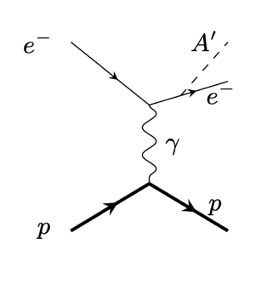
Particle Physics - EEC
Interest in carrying out more Particle Physics experiments onsite lead to the creation of the Particle Physics – Experiment Evaluation Committee (PP-EEC)
Fifth PP-EEC to take place Thursday, January 13th
EEC Committee:
Deborah Harris (York/FNAL) chair
Concettina Sfienti (Mainz)
Jan Friedrich (TU Munich)
Elise Novitski (UW)
Makoto Fujiwara (TRIUMF)
Dave McKeen (secretary)
OSC (ex officio)

Slide 7
CFI Proposals
Successful in IF 2022/23:
Hyper-K $6.4M
200 mPMTs, photogrammetry calibration and
water quality monitoring equipment
P-ONE $5.9M (total project $14.8M)
Six instrumented mooring lines for neutrino telescope at Ocean Network Canada (OCN)
nEXO $12M
Liquid Xenon detectors (TRIUMF part SiPM characterization)
IF 2025 Competition (university envelopes allocated and total)
ATLAS-Tier-1: 9 ATLAS-Canada universities, $5.3M request from CFI, $13.2M total
ALPHA-Next Gen: several ALPHA-Canada universities, $6M request from CFI, $15M total
PIONEER: UBC and McGill, request from CFI $3.8M, $6.5M total
TUCAN: U. Winnipeg, UBC, U. Manitoba, $9.5M request from CFI, $24M total
nEXO: Carleton, McGill, Queen’s, UBC, Sherbrooke, Windsor, $9.2M request from CFI, $23M total
Liquid Ar for Dark Matter: Carleton
CanFINDD: SFU, $3M request from CFI, $7.5M total

Slide 8
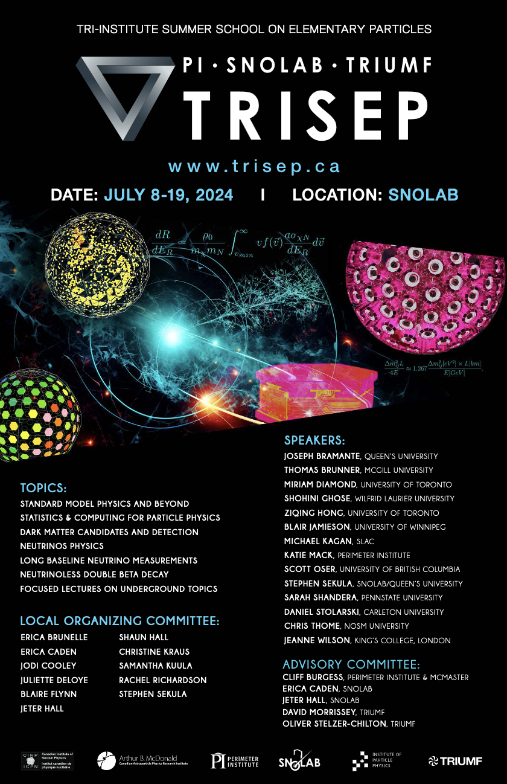
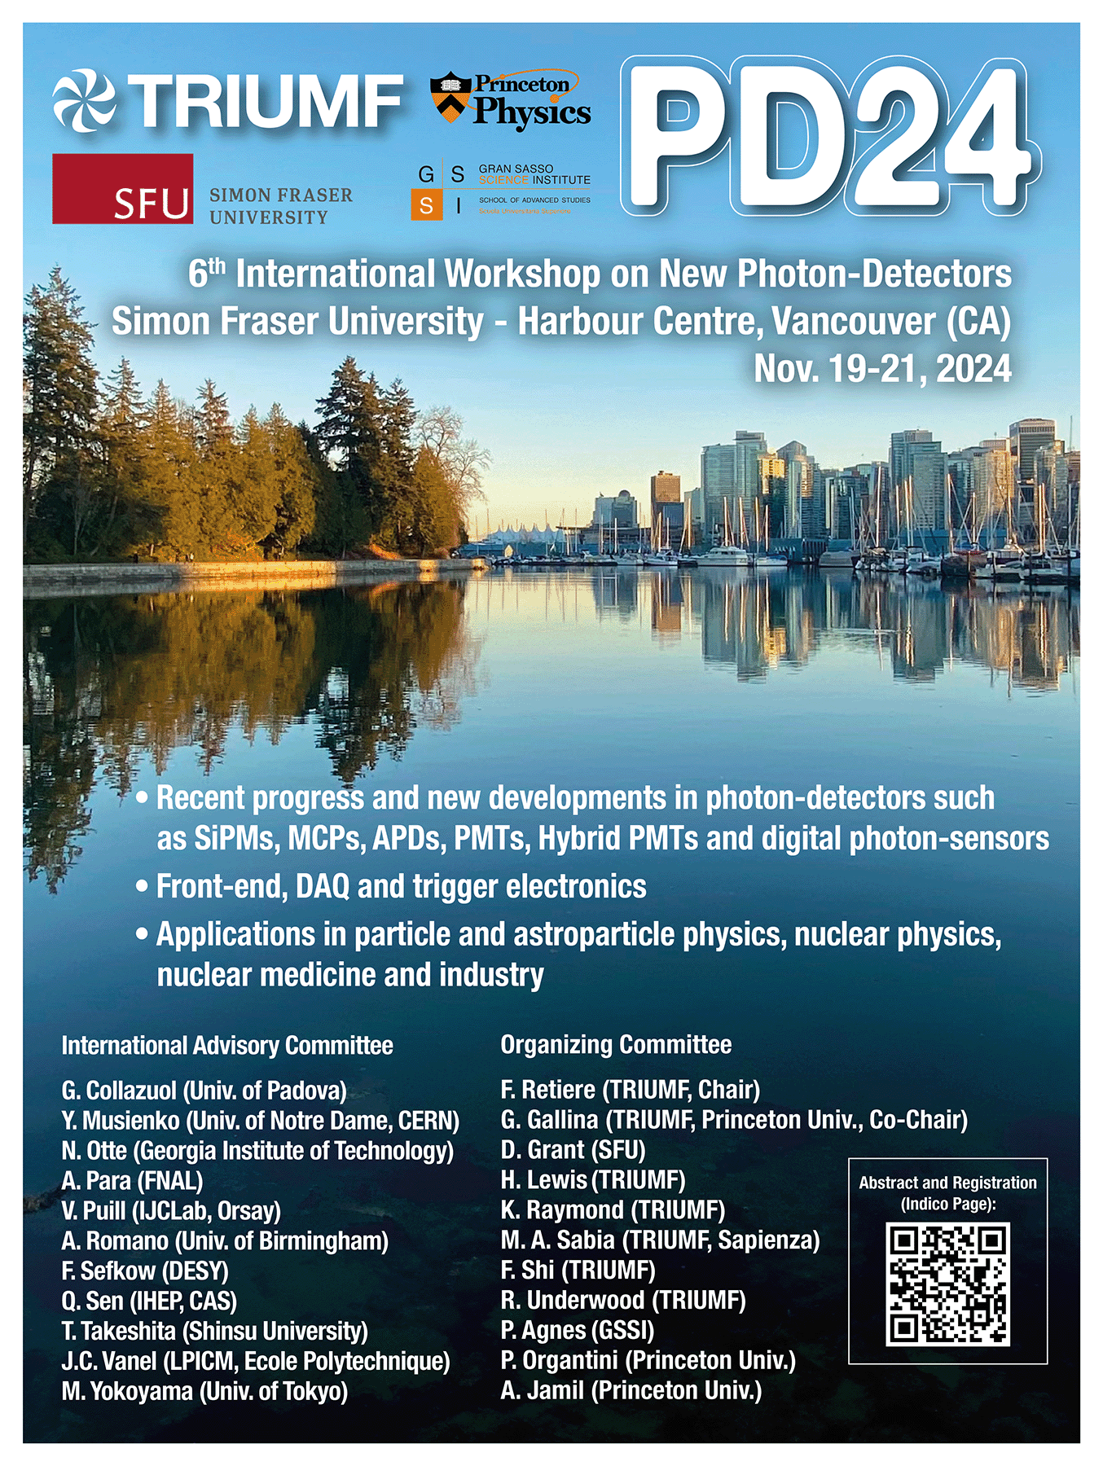
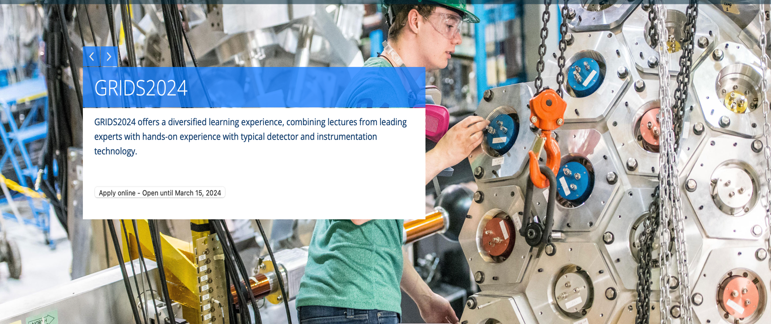
Connecting to the
Community
Summer Schools
Workshops
Conferences

Slide 9
Summary
Many breakthrough results in Particle Physics expected over the next Five-Years
We welcome the green light by the director to proceed with the replacement BAE hire for UCN
Short list interviews completed
Awaiting search committee report
Impact of the 2026 shutdown on Particle Physics
Directly impacts on-site projects like TUCAN and DarkLight
Impacts through availability of resources on CFI projects especially new CFI proposals
Indirect impacts on Particle Physics projects through Science & Technology Department
Quantum synergies with Nuclear Physics and CMMS
Had a fruitful visit by Quantum BC in August and were invited to their next general meeting
Issues
Space remains a commodity (both office and research)

Slide 10
Agenda
Particle Physics – Oliver Stelzer-Chilton (5+3)
Scientific Computing – Reda Tafirout (7+3)
Science & Technology – Pietro Giampa (15+5)
Project updates
ATLAS – Max Swiatlowski (5+3)
T2K/Hyper-K – Akira Konaka (5+3)
TUCAN – Ruediger Picker (5+3)
ALPHA/ALPHA-G/HAICU – Andrea Capra (5+3)
SuperCDMS – Wolfgang Rau (3+2)
DarkLight – Kate Pachal (3+2)
PIONEER – Chloe Malbrunot (3+2)
nEXO – Chloe Malbrunot (3+2)

Slide 11
Thank you Merci
www.triumf.ca
Follow us @TRIUMFLab

Slide 12
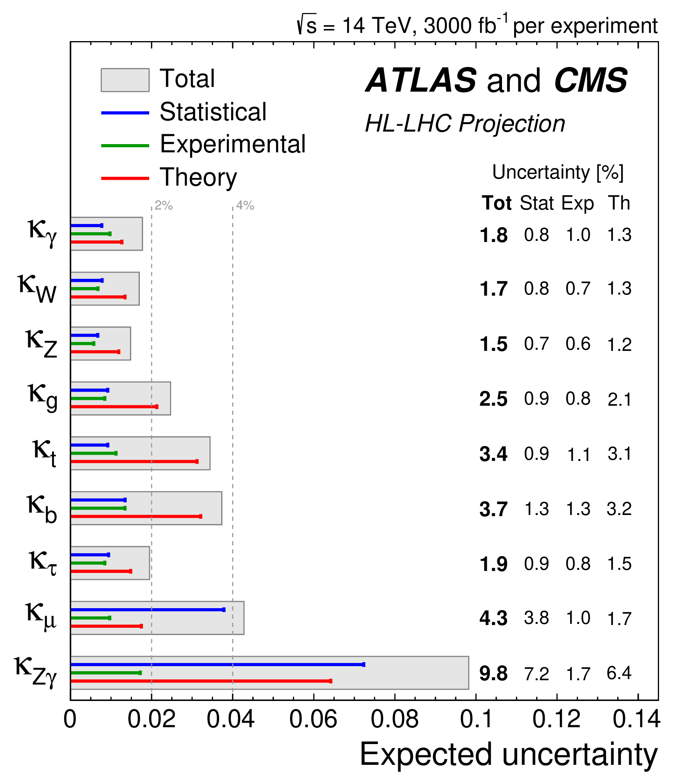
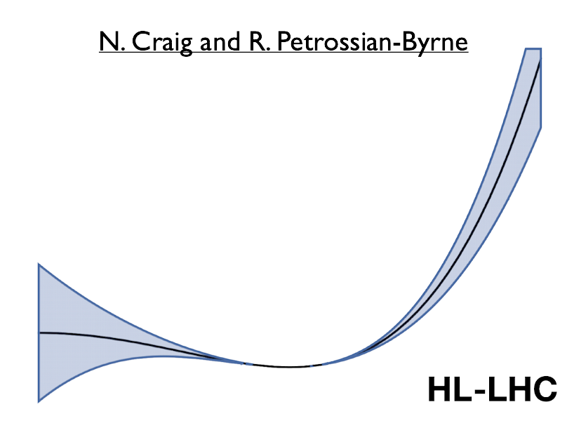
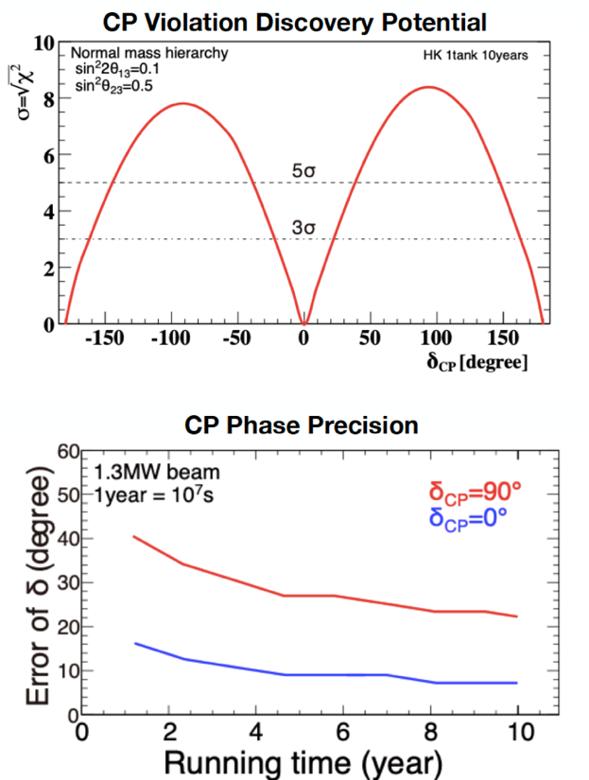
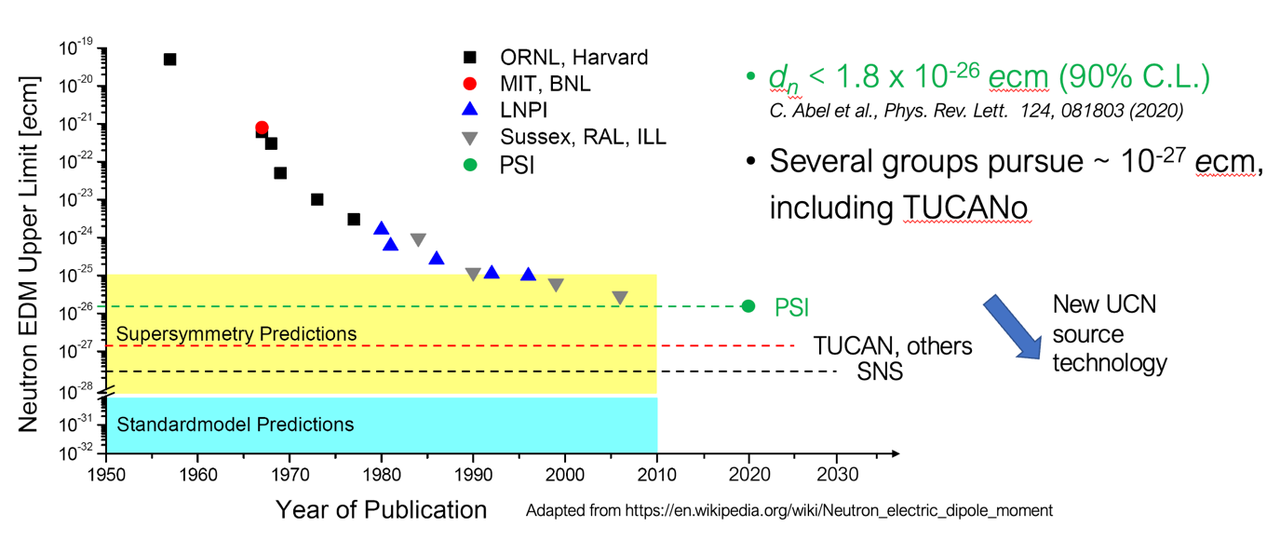
Exciting Science in next 5 YP
Particle Physics addresses many of the most compelling questions
Embedded in international collaborations
Growing onsite effort with new opportunities
Expect many exciting results from Particle Physics by 2030
ATLAS: Higgs boson potential, sensitivity to many new particles, precision measurements
Hyper-K: Probing CP violation in neutrino sector
UCN: World leading neutron EDM and neutron lifetime
ALPHA: Precision anti-matter spectroscopy and effect of gravity on anti-matter
SuperCDMS: Most sensitive Dark Matter results
DarkLight: Sensitivity to find new low mass dark boson
PIONEER: Towards the world’s most precise e-µ universality test

