Slide 1
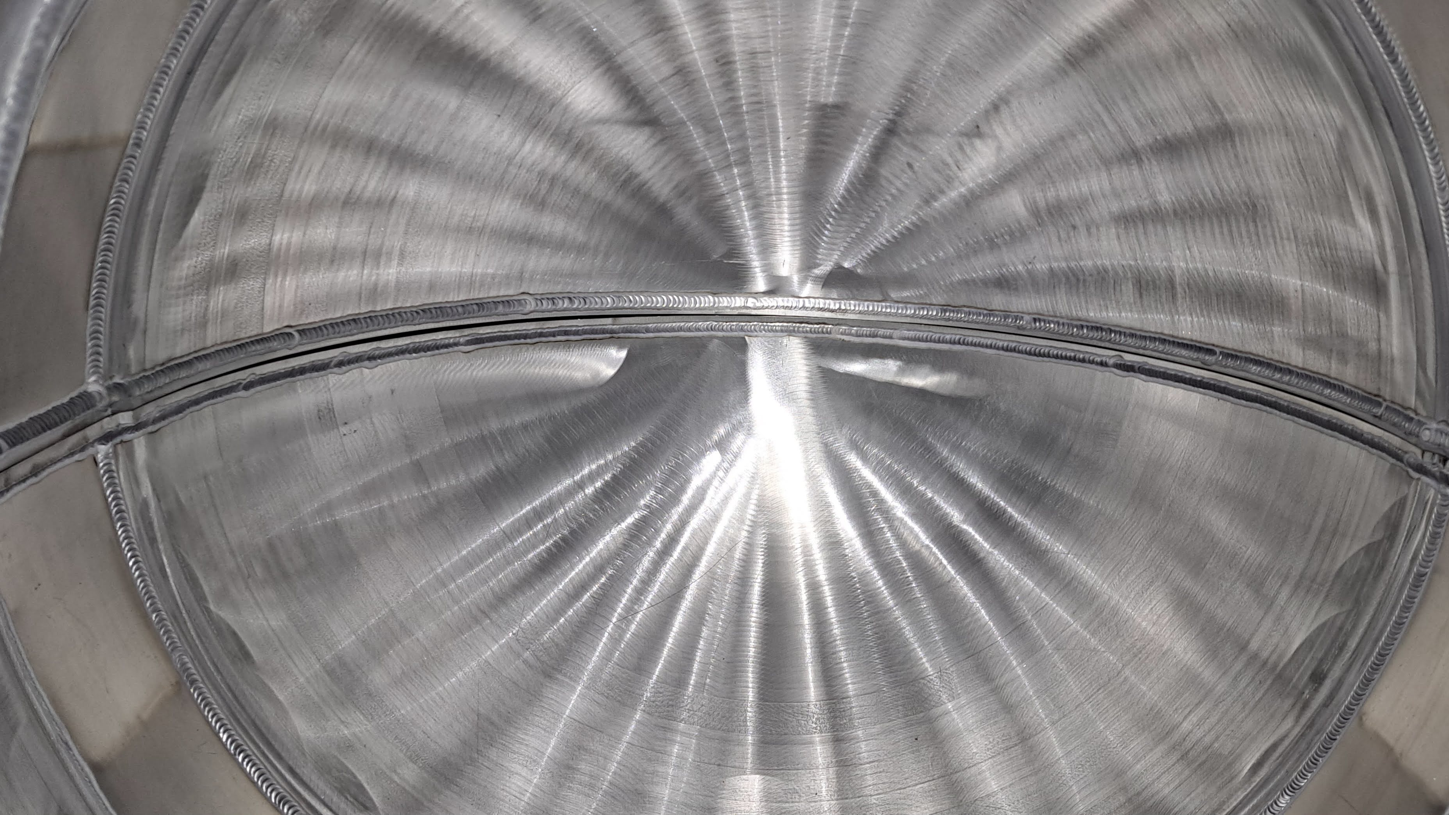
Securing a Long-Term Future for Ultracold Neutrons PRJ_<xxx>
PMOG CFI Review, Oct 2024
Project Leaders: J. Martin (U. Winnipeg),
T. Momose (UBC),R. Picker (TRIUMF)
Project Sponsor: R. Kanungo
Discovery,
accelerated

Slide 2
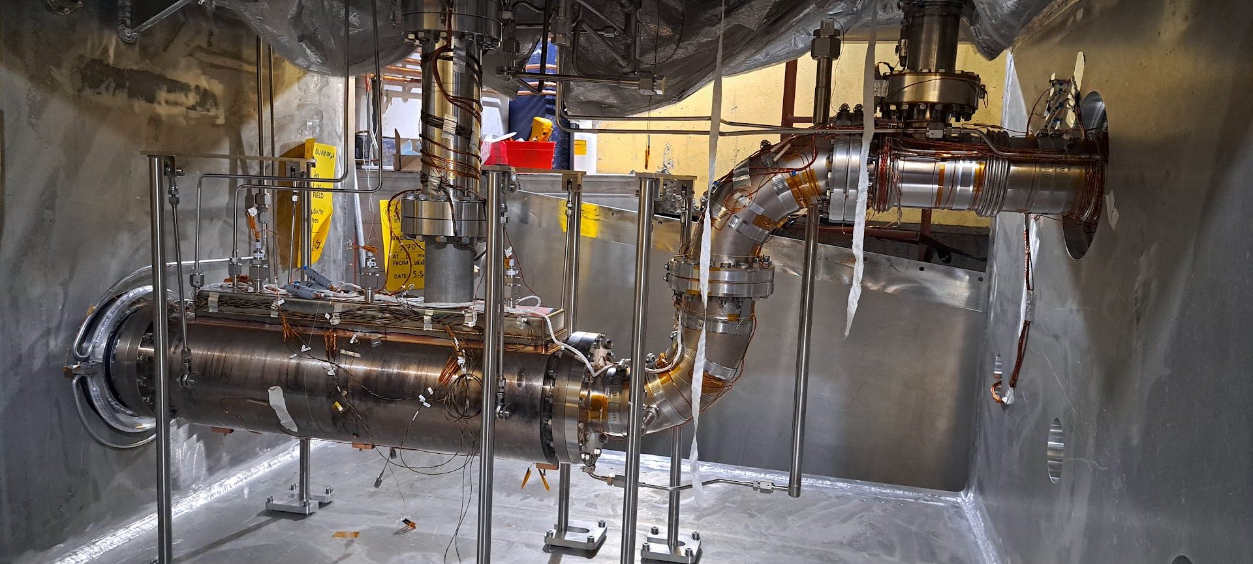
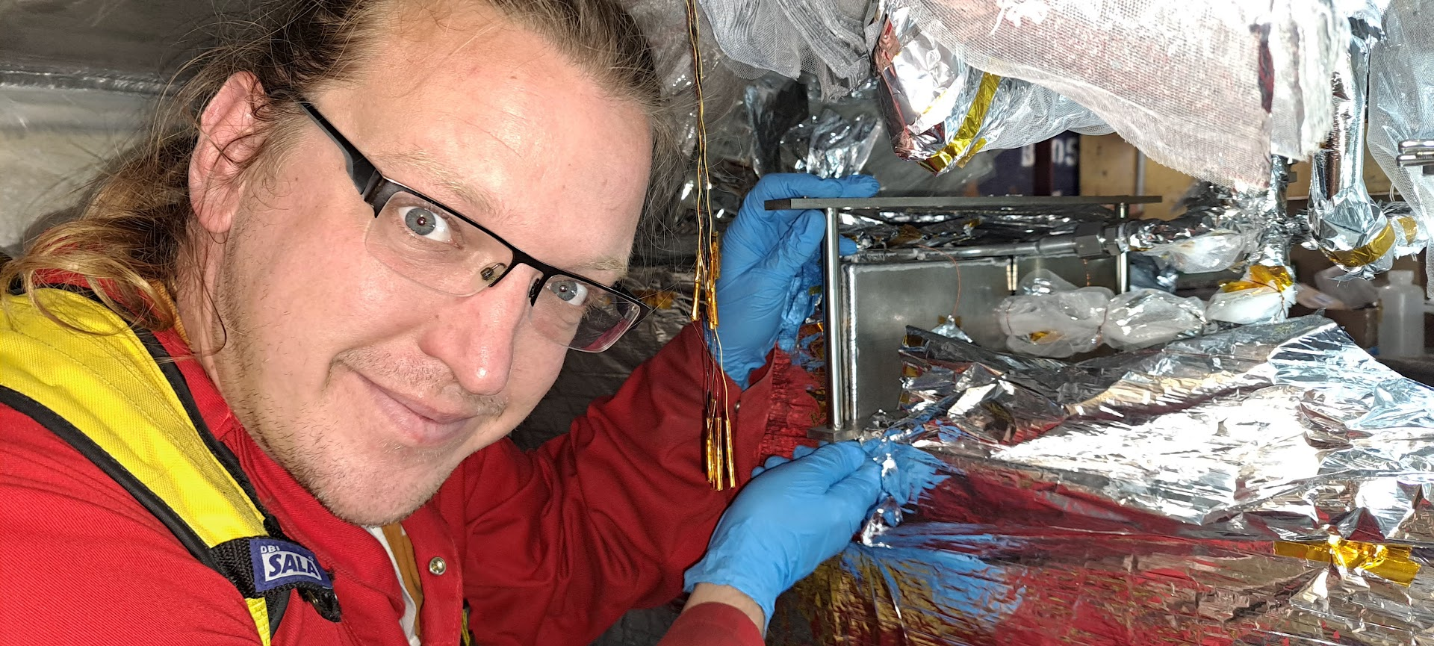
Project Description: Science Goals
Measure neutron EDM to 10⁻²⁷ ecm precision, a factor of 10 better than world’s best.
Experiment is designed to acquire data over 400 calendar days (overnight and weekends)
Build world-leading facility for ultracold neutron physics.
Base infrastructure in place:
High-intensity UCN source is about to produce first neutrons (next week!)
Magnetically shielded room (signed off Sept. 2024) is ready for the EDM experiment.
TUCAN is ready for the next phase of long-term operations!
Main heat exchanger, cryogenic UCN guides
...and how it looks after installing thermal shields and many layers of superinsulation.

Slide 3
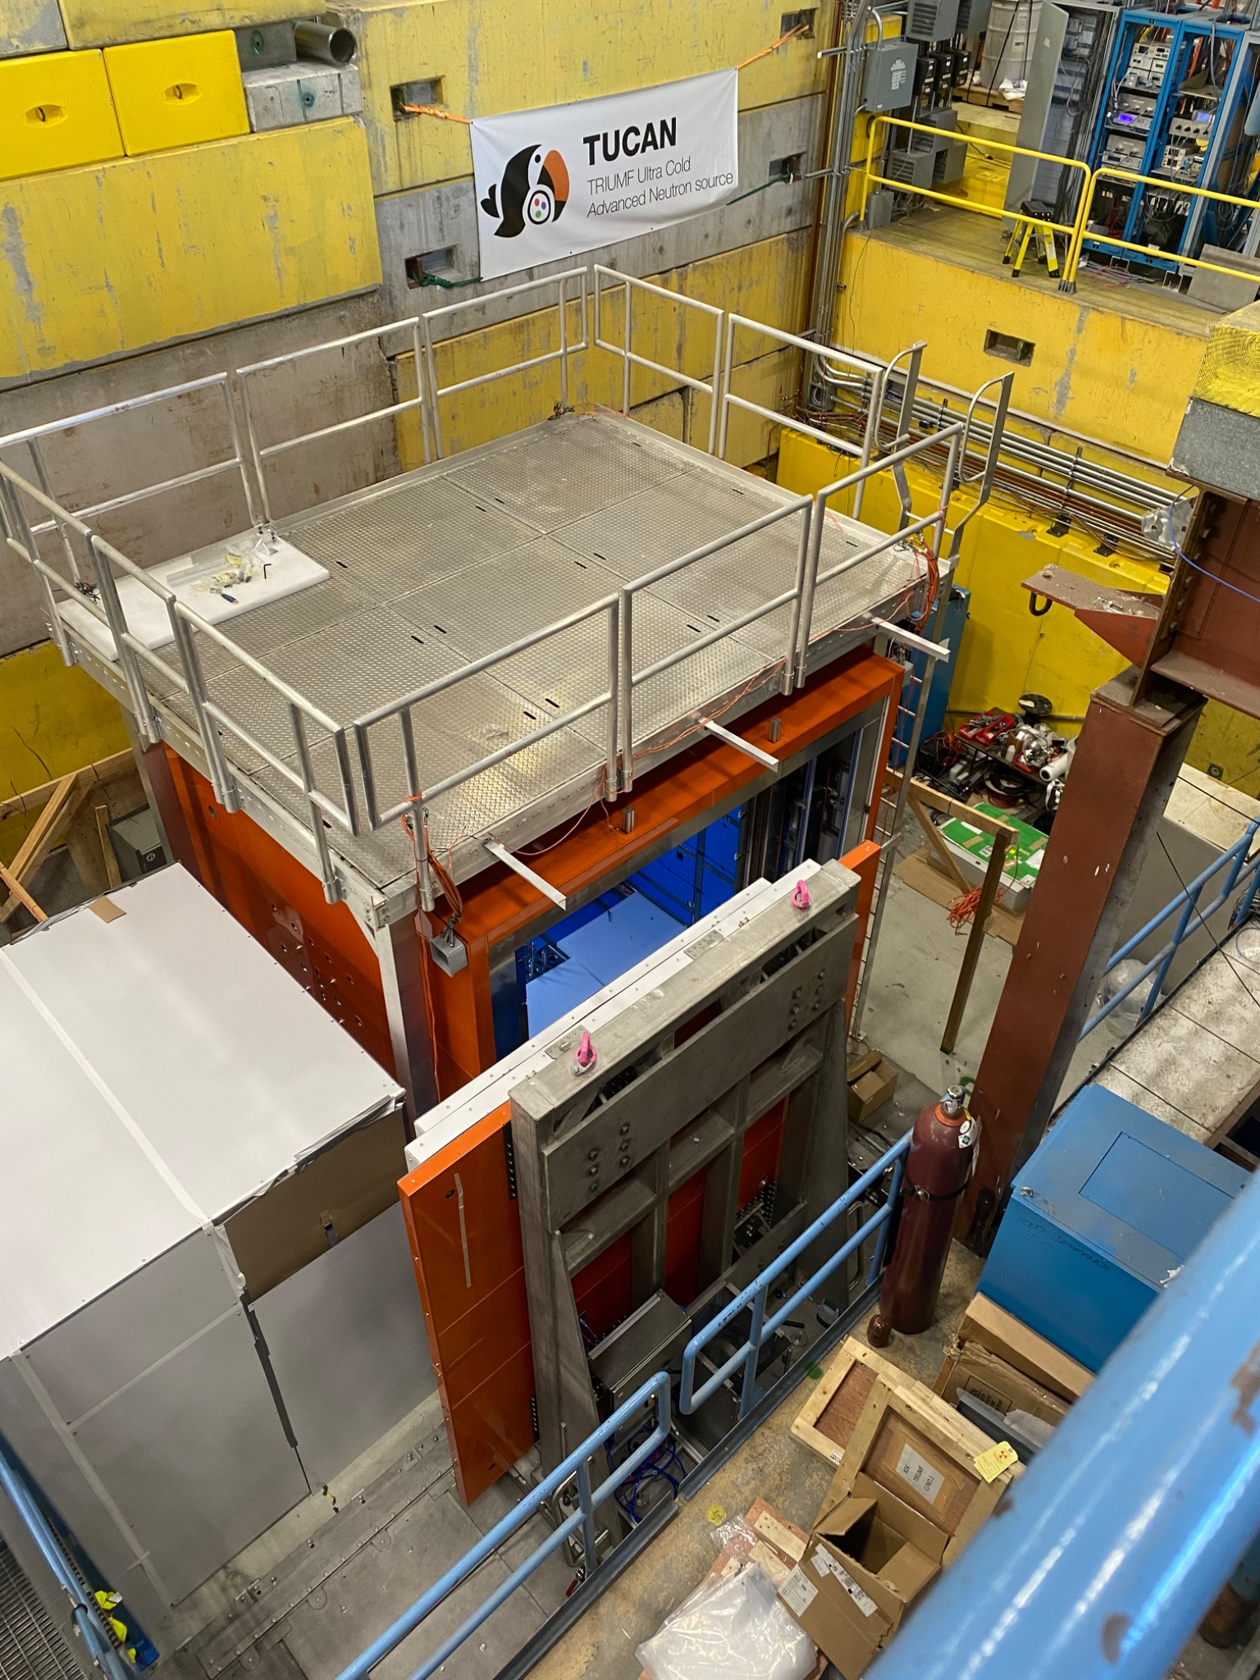
Project Description: Main Infrastructure Items
Upgrade of helium liquefier (HRF)
Higher liquefaction rate needed to reach physics goals: 45 l/h ⇒ 100 l/h
Upgrade requirement has been known and discussed with TRIUMF for more than 5 years
Replacing hard to maintain piston liquefier
UCN source
more ³He, isopure ⁴He and D₂O ⇒ higher UCN yield
tail section upgrade and spare
UCN guides and coating facility upgrade (U Winnipeg) ⇒ efficient UCN transport to EDM
EDM experiment
Xe development lab (UBC) ⇒ dual comagnetometer removes systematic effects
more Cs magnetometers ⇒ better handle on systematics
two EDM cells/HV ⇒ better use of electric field, higher statistics
Personnel at TRIUMF and in Japan to realize the above
TUCAN magnetically shielded room

Slide 4
How does this proposal align with TRIUMF’s key priorities?
What university envelope has been approved, and by whom? U. Winnipeg $5.0M UBC $4.0M U. Manitoba $0.5M
Are you seeking a financial contribution from TRIUMF? Yes, but only labour support for 12 FTE-years (out of 29 FTE-year total), reported as a $2M cash equivalent contribution. There will be a $3M contribution from CFI for TRIUMF labour, in return. Extrapolating the current TRIUMF contribution to UCN (1.75 engineers, 0.5 techs) it comes out to around $2M for 6 years.
Is your proposal competing with the identified priorities (ARIEL, IAMI, BL1A) through calendar year 2026? We expect to be working on award finalization with CFI and TRIUMF during 2026. On the technical side, we would like to engage a cryogenic engineer in 2026, for liquefier specification and vendor meetings. If the cryogenic engineer were not available from TRIUMF, we could need to contract this work out.
Can your timelines be adjusted to suit TRIUMF's available capacity? Yes. Any other technical support can likely be pushed to 2027.

Slide 5
Resources
CASH FLOW REQUIREMENTS
SOURCE \ YEAR | 2026 | 2027 | 2028 | 2029 | 2030 | 2031 | TOTAL
TRIUMF | 0 | 0 | 0 | 0 |  |  | 0
EXTERNAL | 2.21M | 3.63M | 6.40M | 6.40M | 3.63M | 2.49M | 24.75M
REVENUES/RECOVERIES
TOTAL | 2.21M | 3.63M | 6.40M | 6.40M | 3.63M | 2.49M | 24.75M
TRIUMF resource requirements, from PRIS
Based on scaling from current TUCAN project plus 50% contingency.
TRIUMF HUMAN RESOURCE REQUIREMENTS (FTE-months)
RESOURCE* \ YEAR | ONE | TWO | THREE | FOUR | FIVE | SIX | TOTAL
Administration.Project Management | 10 | 10 | 10 | 10 | 10 | 10 | 57
Engineering.Civil | 0 | 1 | 2 | 2 | 1 | 0 | 7
Engineering.Control | 0 | 0 | 1 | 1 | 0 | 0 | 2
Engineering.Cryogenic | 8 | 3 | 3 | 3 | 3 | 8 | 27
Engineering.Electrical | 1 | 2 | 3 | 3 | 2 | 1 | 11
Engineering.Electronics | 0 | 0 | 1 | 1 | 0 | 0 | 3
Engineering.Electronics Firmware | 0 | 0 | 1 | 1 | 0 | 0 | 2
Engineering.Mechanical | 5 | 16 | 33 | 33 | 16 | 5 | 110
Physics.Data Acquisition | 0 | 0 | 1 | 1 | 0 | 0 | 3
Physics.Experimental | 2 | 5 | 9 | 9 | 5 | 2 | 31
Technical.Control | 0 | 1 | 2 | 2 | 1 | 0 | 6
Technical.Electrician | 0 | 1 | 3 | 3 | 1 | 0 | 9
Technical.Electronics | 0 | 0 | 0 | 0 | 0 | 0 | 0
Technical.Mechanical | 2 | 6 | 12 | 12 | 6 | 2 | 41
Technical.Mechanical Design | 2 | 5 | 10 | 10 | 5 | 2 | 32
Technical.Physical Plant | 0 | 0 | 0 | 0 | 0 | 4 | 5
Total: | 31 | 51 | 90 | 90 | 51 | 35 | 347
SPACE REQUIREMENTS:
BL1U shielding for UCN source installations, experimental space at the Meson Hall B2 level for the EDM experiment, counting rooms at the Meson Hall B1 level for source and experiment control, space for the liquefier upgrade (compressor building north of the Meson Hall and or current Meson Hall liquefier space if the upgrade is replacing the existing helium recovery facility)

Slide 6
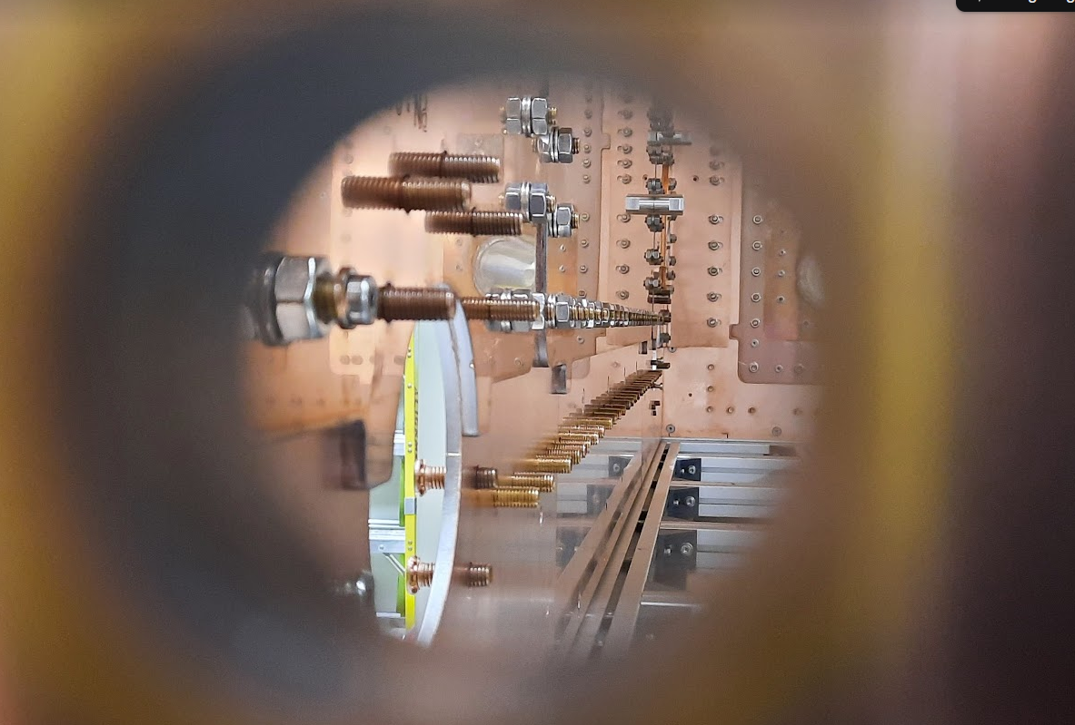
Risks
Describe major risks identified and any risk mitigation strategies
2026: Lack of a hired and available cryogenic engineer to set up the contract with the liquefier supplier.
Mitigation: hire of a contractor.
Lack of a 2nd BAE hire, which makes succession planning very difficult.
Mitigation: UCN BAE hiring ongoing.
2017 CFI source does not work or fails.
Mitigation: building in funding for a replacement tail section and ³He which could be redirected to a non-functional subsystem.
Detail of Cu layer of magnetically shielded room

Slide 7
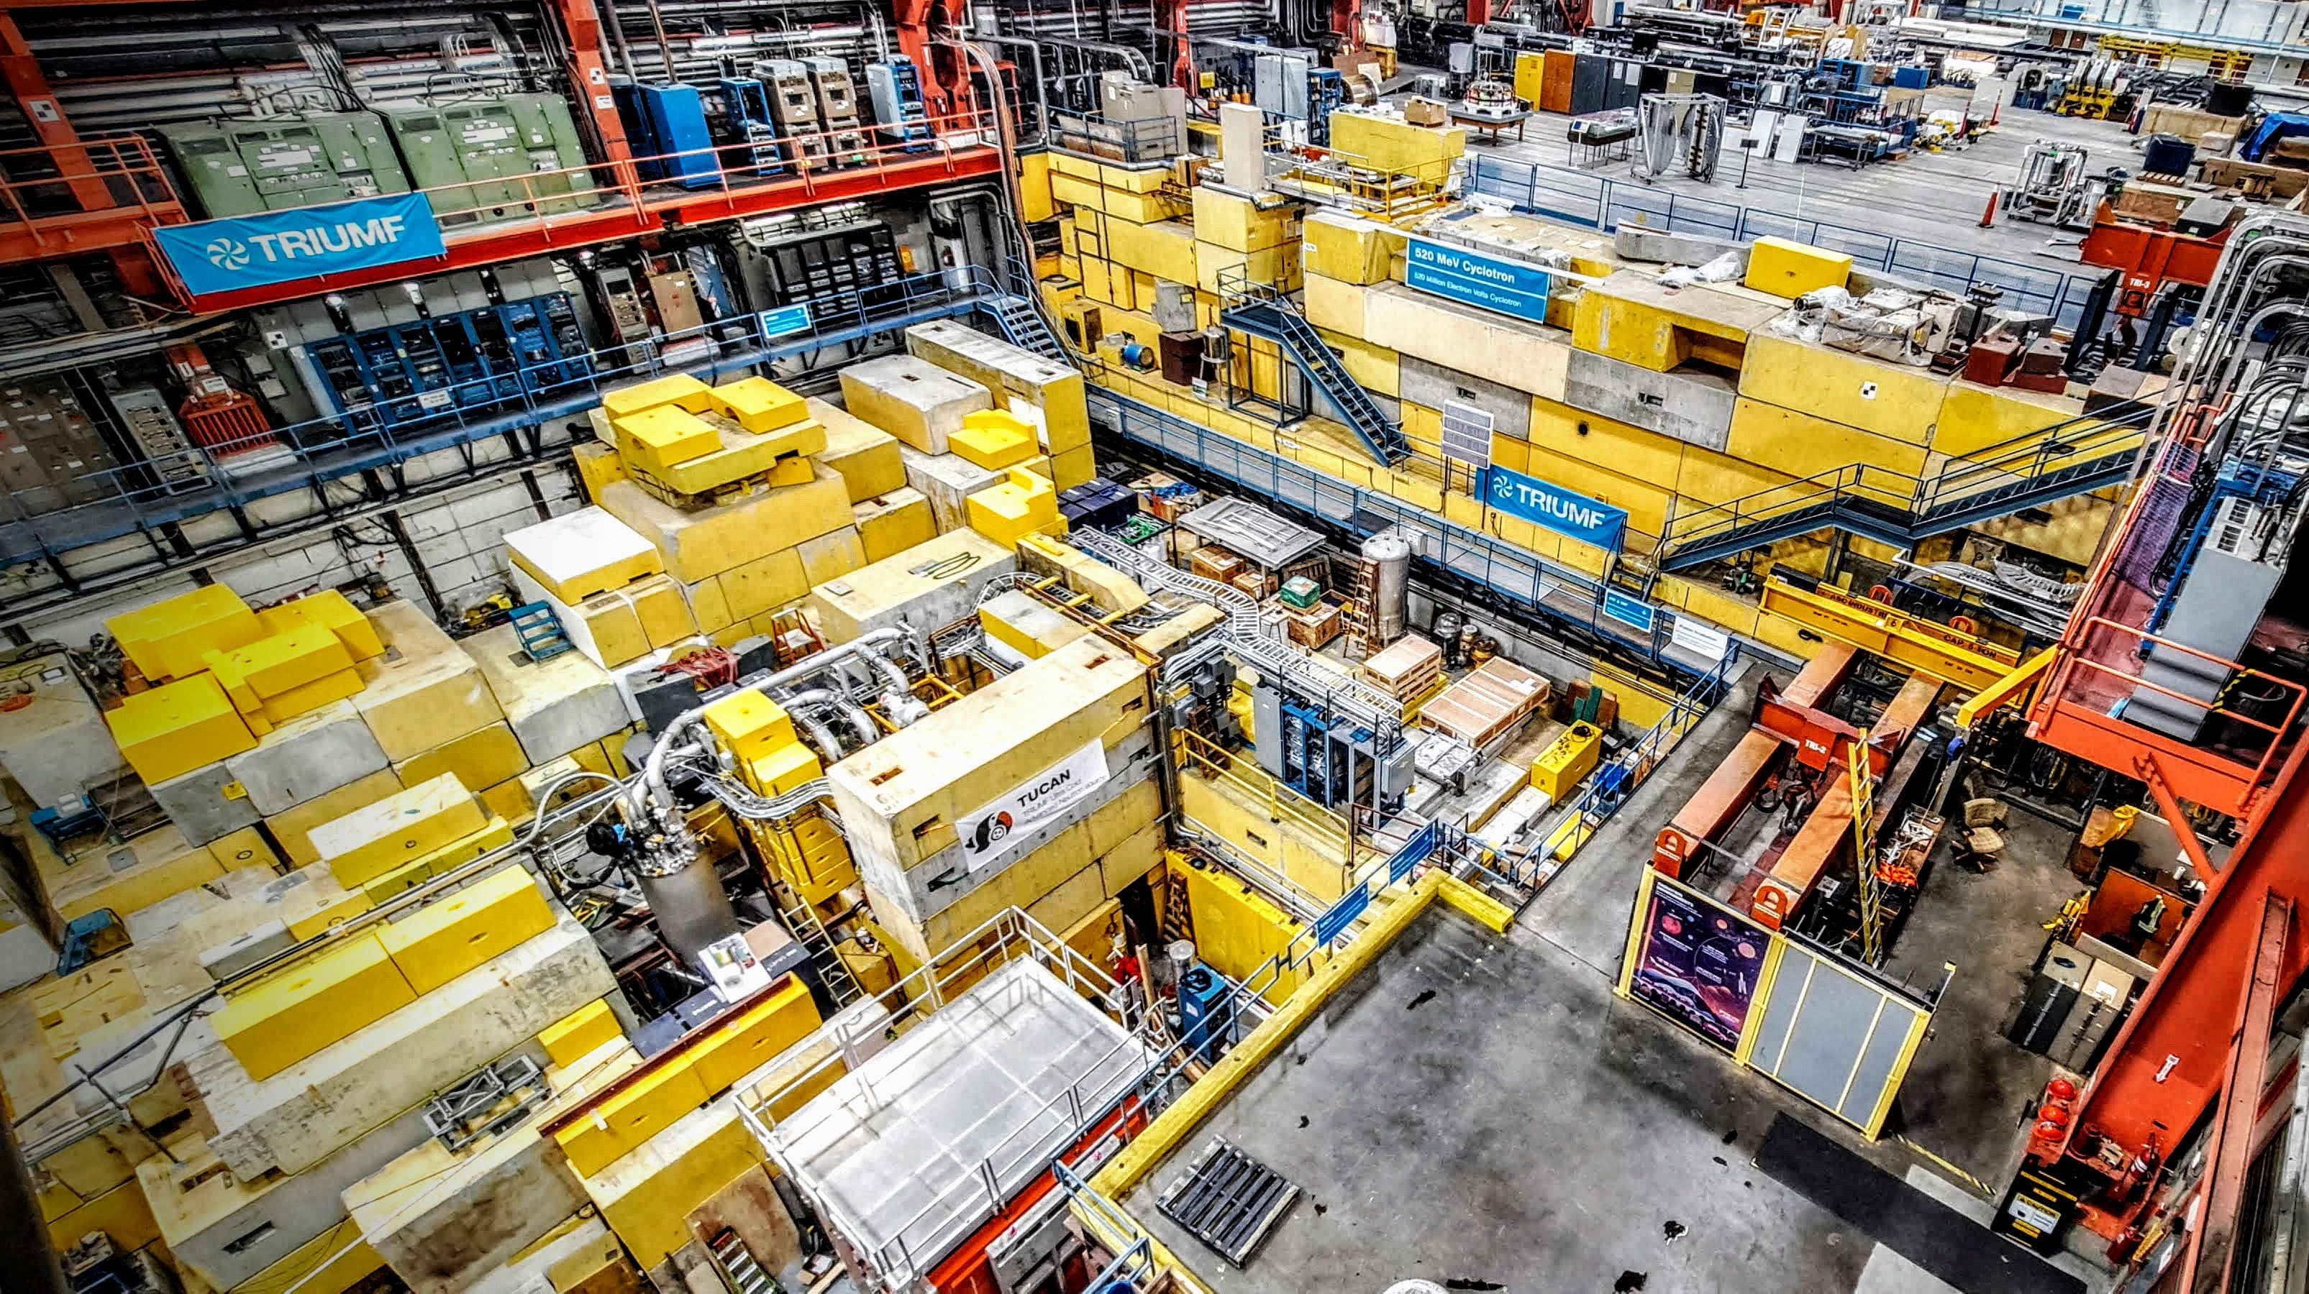
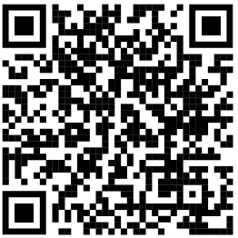
Questions?
360 degree fly over TUCAN
360 degree walk through TUCAN source

