Slide 1
Particle Physics Faculty Meeting
Agenda
News/Update
TRIUMF website refresh – PP content (Chloe)

Slide 2
TRIUMF is located on the traditional, ancestral, and unceded territory of thexʷməθkʷəy̓əm (Musqueam) people, who for millennia have passed on their culture, history, and traditions from one generation to the next on this site.
TRIUMF’s home has always been a seat of learning.

Slide 3
UCN Search
Five shortlisted candidates interviews complete
Efrain Segarra, PSI Villigen
Marie Blatnik, Los Alamos
Skyler Degenkolb, U Heidelberg
Wolfgang Schreyer, Oak Ridge NL
Noah Yazdandoost, PSI Villigen
Report was received by Ritu and myself, Ritu send it to director
A big thank you to the search committee!

Slide 4
ACOT
November 18-20
Presentations by Nigel and Division Directors on November 18th
Parallel sessions on November 19th 9:30-11:00
As before this is a combined session Particle Physics/Science & Technology/Scientific Computing
Unfortunately, had only half the time given reduced attendance by committee members
Next ACOT April 28-30

Slide 5
CFI’s
Review of CFI IF 2025 submissions on October 31st
ATLAS-Tier1, nEXO, PIONEER, ALPHA, UCN, LAr-Dark Matter, CanFINDD
Feedback from Ritu, Peter, Nigel sent to projects proponents
General categories, broadly
Either not supported (submission can still go ahead)
or supported, only resources from TRIUMF starting from 2027

Slide 6
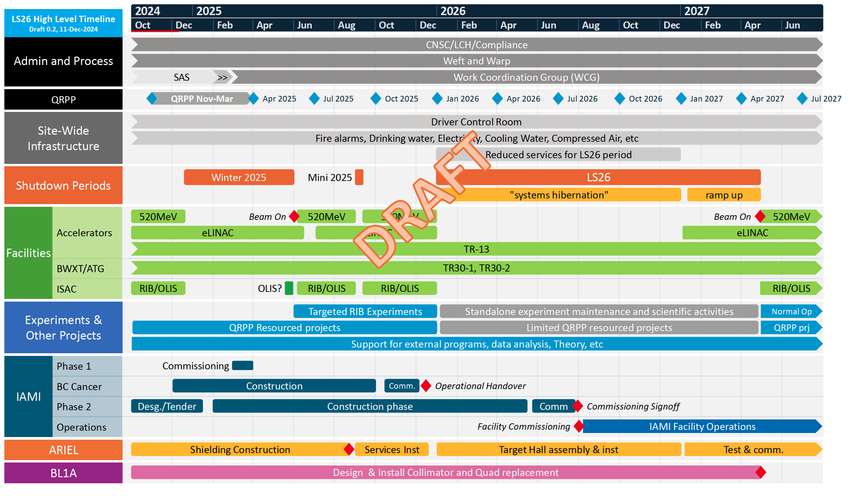
LS26

Slide 7
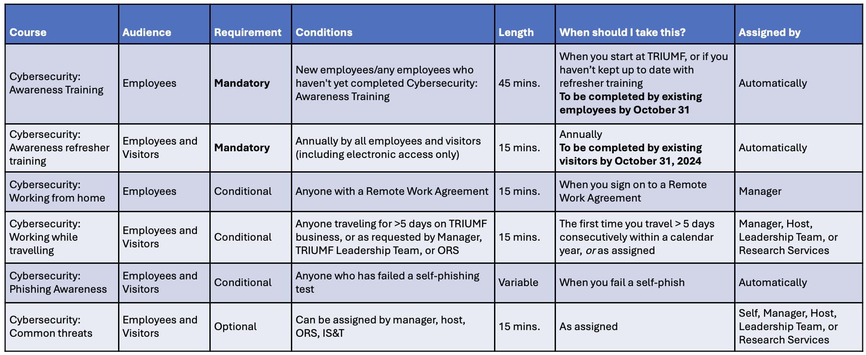
Cybersecurity Training
All employees, students, or visitors will now be required to take an initial cybersecurity training course
and complete a short annual refresher each subsequent year
Additional training will be available for people who have specific functions within the lab, or who may
be exposed to additional risks
The training will be available starting September 16th, 2024, and the initial Cybersecurity: Awareness
Training must be completed by October 31st, 2024.

Slide 8
Safety Announcement

Slide 9
Particle Physics Holiday dinner
Looks like we have a quorum
Vote seems to favour Wednesday 5:30pm next week
If you haven’t voted yet, please do so today at this link
Topic: Brainstorming on CFI resource pooling (along the ACOT chair recommendation)

Slide 10
Various
Have you filled out the grad student info about LS26?
If you have not received the email and have a student, let me know
Identify risks with magnitude of $100K or higher
Did not receive many answers
Budget
Kept last years (3K + 1K for quantum seminars)
Asked for 25K pilot R&D budget for support of new ideas (possible future increase) that can be jointly with SciTech
Next Particle Physics EEC scheduled for January 13th
TRISEP 2025 at TRIUMF
Dates set for June 16-27, 2025

Slide 11
AOB

Slide 12
Round Table
ATLAS
T2K/HyperK
TUCAN
ALPHA
SuperCDMS
DarkLight
n-EXO / PHORWARD
PIONEER
NA62
P-One
SNO+
HALO
g-2
Belle
Theory

Slide 13
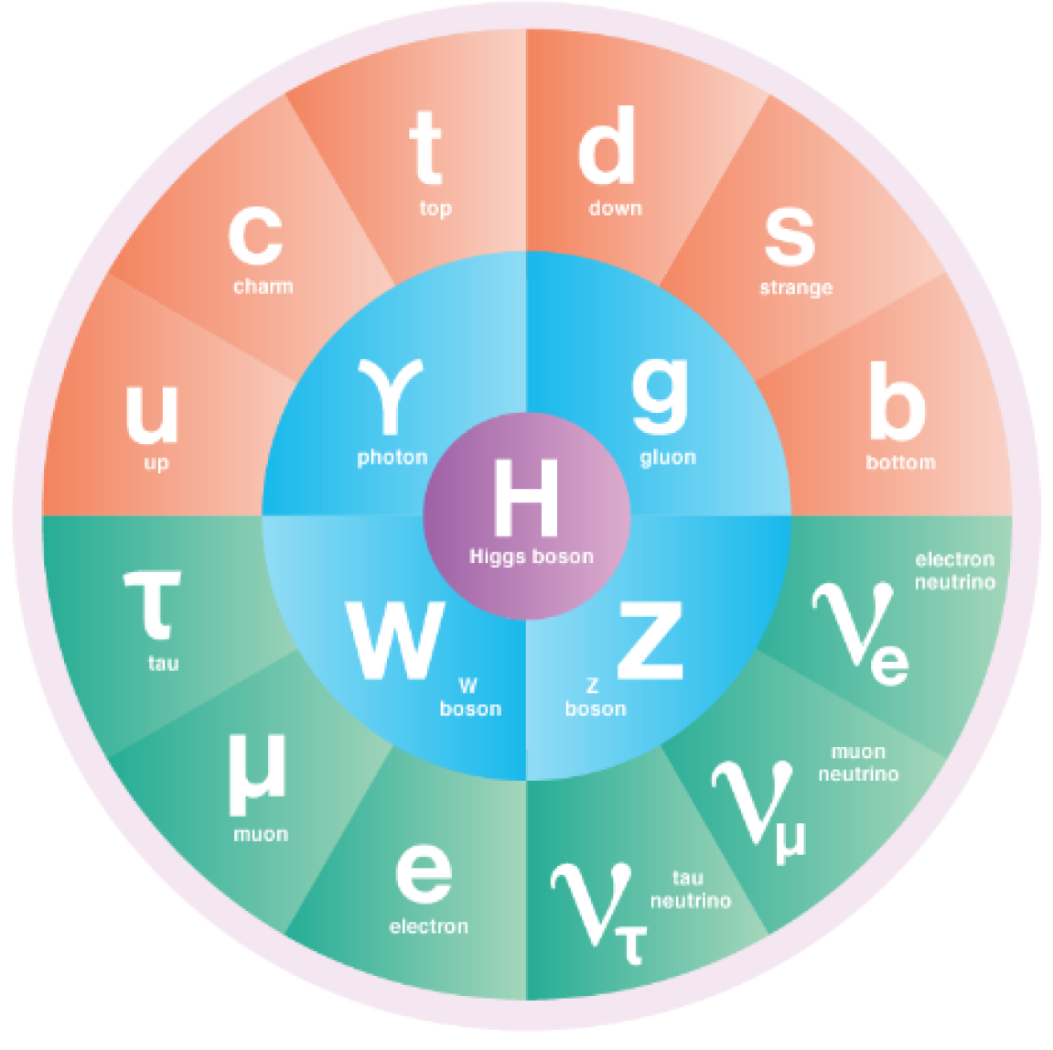
Particle Physics Updates

Slide 14
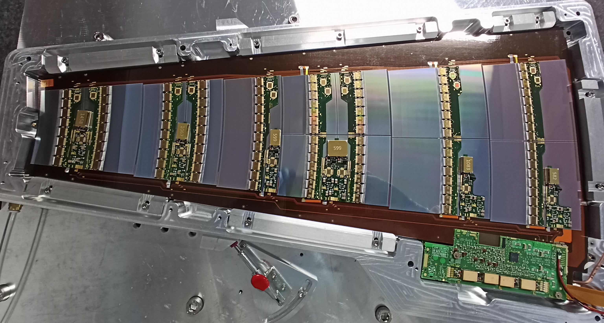
ATLAS Update
Beam is done for the year: in 2024 ATLAS recorded 118/fb of pp at sqrt(s)=13.6 TeV (for total of 183/fb in Run 3) and 1.67/nb of PbPb at sqrt(s_NN)=5.4 TeV
Evan Carlson (UVic) defended PhD in September, now a Process Engineer for nLIGHT in Vancouver WA.
NSERC held online review for ATLAS-Canada project grant December 2nd.
ITk updates since ACOT updates
CERN Review for strip tracker modules and petals on December 3-5, 7 out of 23 talks from the Vancouver team
3 out of 4 petals investigating mitigation solution being assembled in Vancouver (third petal half finished this week)
Vancouver petals VAN6 and VAN7 first petals to successfully reach –60C degrees without fractures
LAr upgrade: HPS ASICs manufactured, 2600 chips delivered. QC rests ongoing, shows good yield 97%. Radiation tests of 8 samples scheduled at TRIUMF PIF.

Slide 15
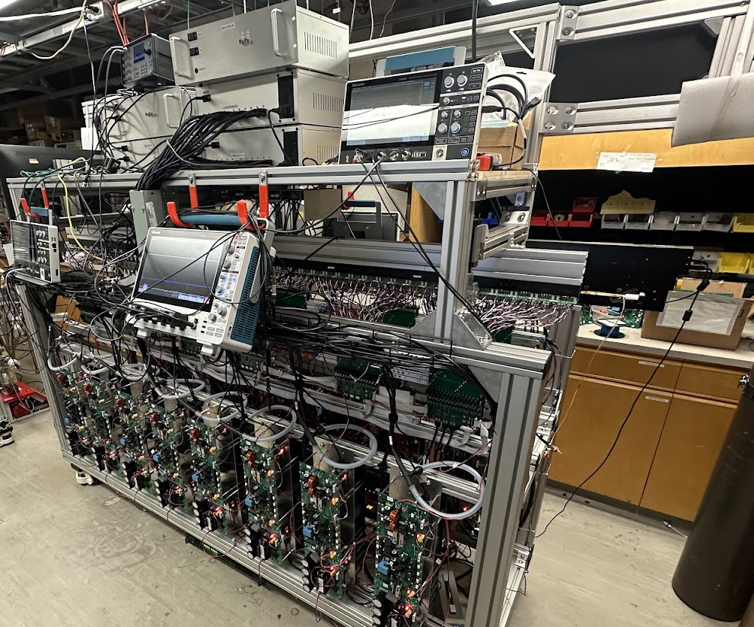
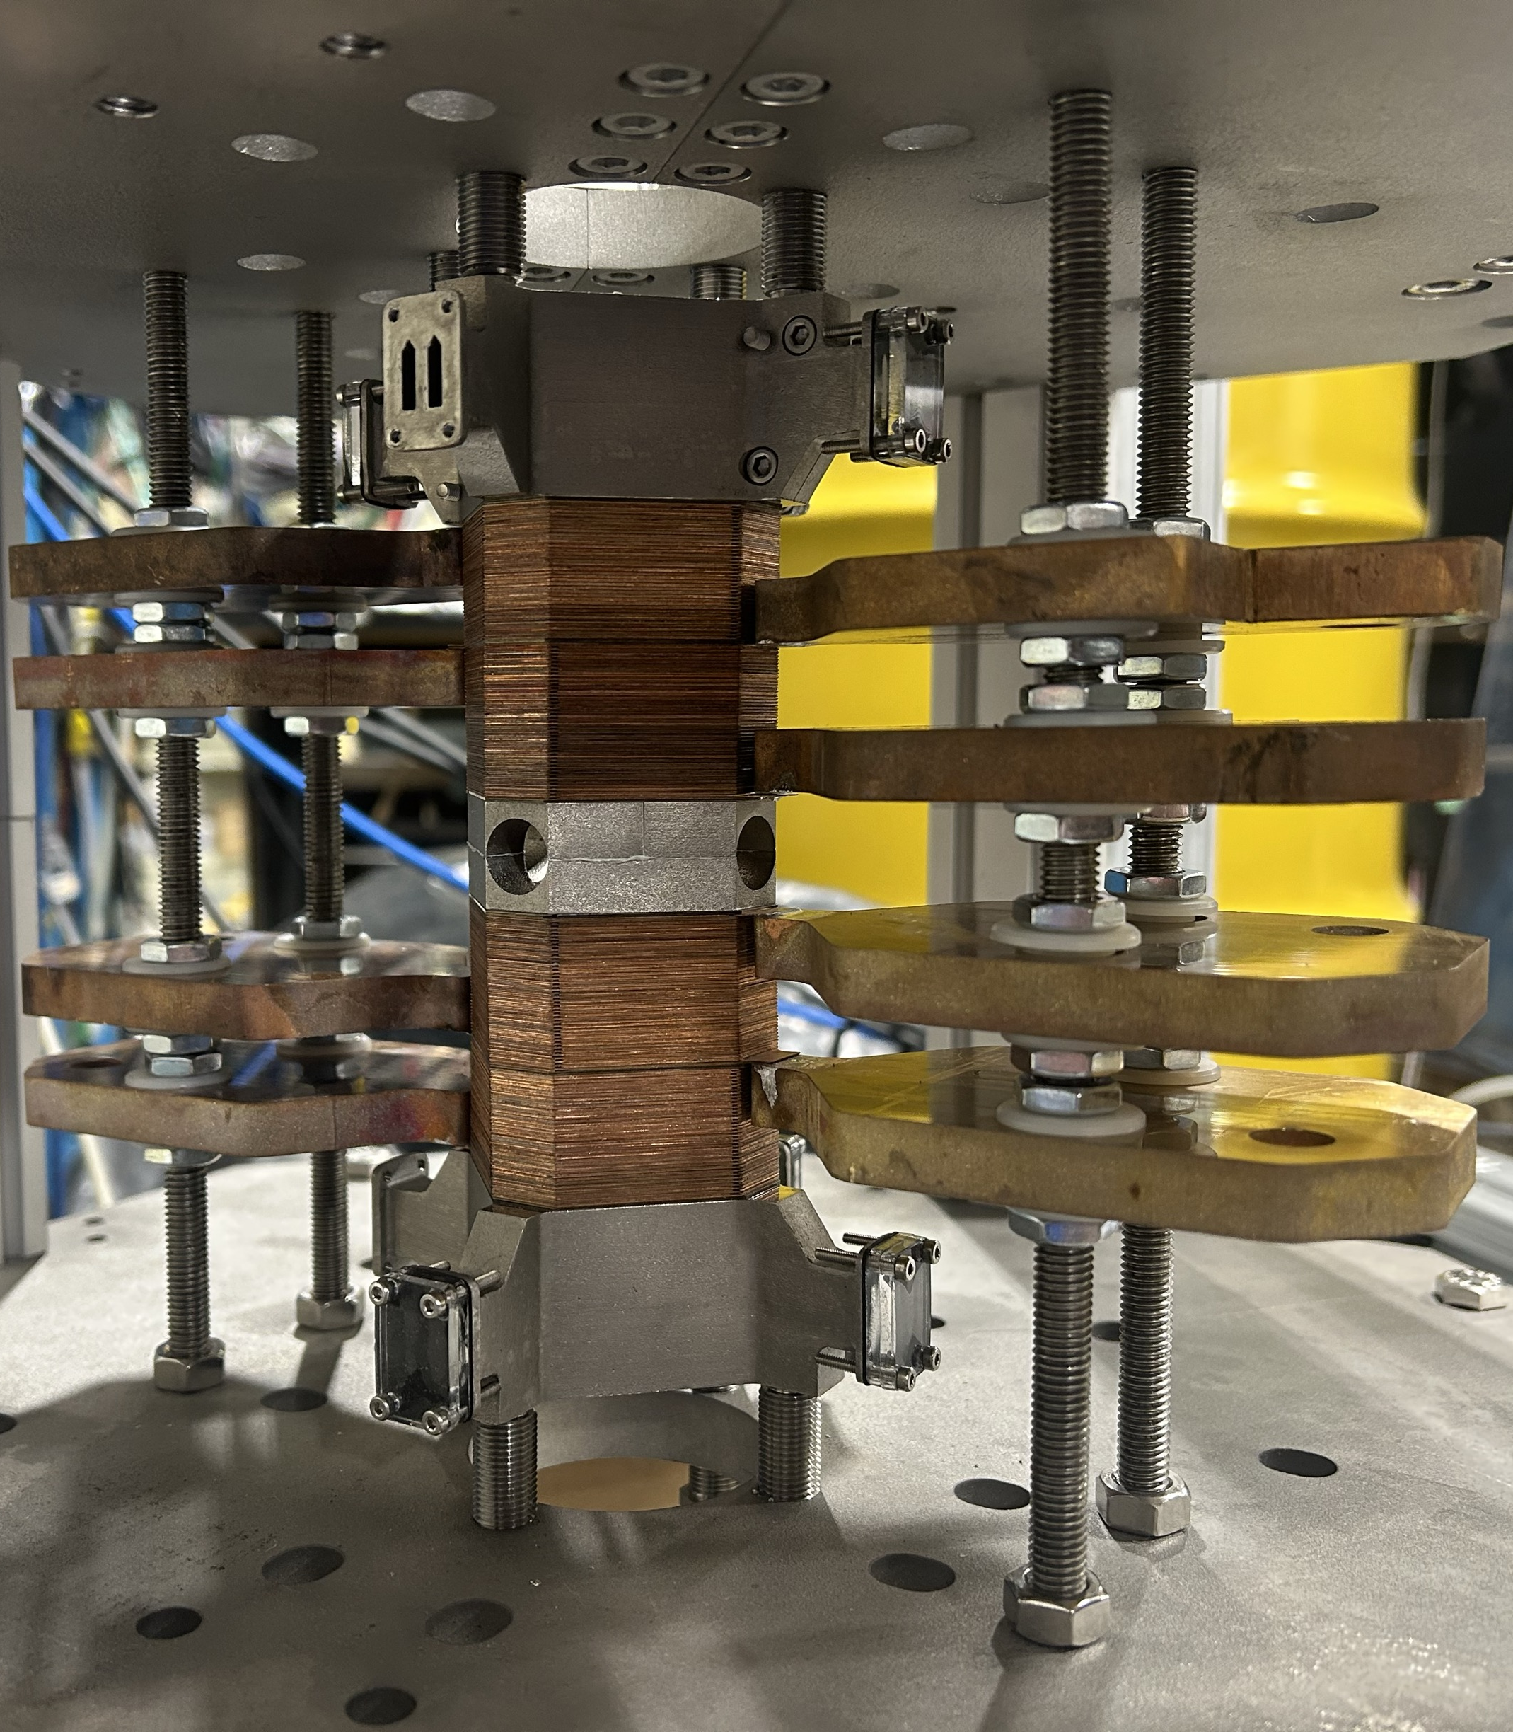
ALPHA/HAICU Update
Quadrupole test at TRIUMF
ALPHA-g trapped and dropped antihydrogen
Re-commissioned completed
lots of antihydrogen trapped!
Introduced adiabatic expansion cooling "Adiabatic expansion cooling of antihydrogen." Phys.Rev.Res. (2024)
Year-end technical stop
Water cooling
Magnet
Laser “tables”
Controls with TRIUMF FW
Trap construction at TRIUMF
HAICU
All the subsystems are expected to be completed next quarter
Installation subject to completion of electrical installation in PHE
H loading
Laser
4 bitter coils
Decelerator at UBC
H source at UBC

Slide 16
SuperCDMS and nEXO Update
SuperCDMS
NSERC expert committee review Dec. 2
Stand-alone test of dilution refrigerator with refurbished pump started
Cleaning/etching/passivation of cryostat components (SNOLAB surface) continuing
Significant progress in developing data processing/analysis tools and methods using data from CUTE
TRIUMF postodc Yan Liu moving to faculty position at UMN (Minneapolis)
nEXO
NSERC expert review committee took place Dec 4th
5 talks from TRIUMF PIs and HQPs
SNOLAB/TRIUMF CFI IF 2025 GW-1 A/PDR took place Nov 19th
LoLX run with LXe will begin next week
Purity monitor (PUMA) built at TRIUMF (PIONEER) is operating successfully in gaseous argon.

Slide 17
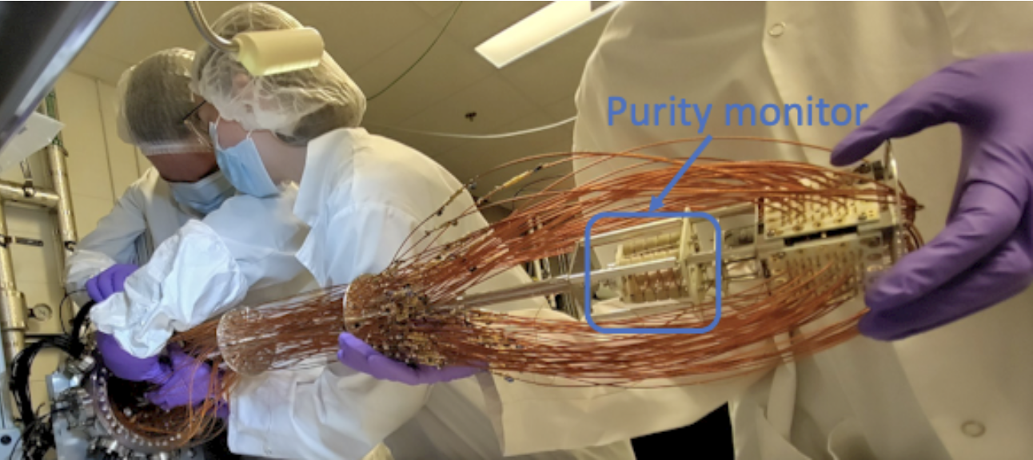
PIONEER Update
PIONEER
Collaboration meeting will take place at TRIUMF Jan 7th-10th
Theory talk by D. McKeen
Colloquium talk by Q. Buat from University of Washington
EDI talk (will be open and advertised to the entire lab) by J. McIver (UBC)
PUMA installation into LoLX
Emma Klemets, (PIONEER PhD), during the installation of LoLX detector

Slide 18
Next Meeting
January 9th

