Slide 1

Introduction:
TUG annual general Meeting @
Moritz Pascal Reiter (University of Edinburgh)
On behalf of TUEC

Slide 2
What is a TRIUMF User?
No matter where in the world you work, if you do research that takes place at TRIUMF, or relies on TRIUMF resources, infrastructure, or staff,
Some examples of users:
    A PhD student whose thesis uses data from a TRIUMF based experiment
    A faculty member at University of Toronto or Edinburgh whose experiment relies on support from TRIUMF-based detector expertise
    A TRIUMF-employed scientist whose research doesn’t take place on site, but who relies on the smooth functioning of the lab to enable their group to get paid, travel…
    An industry user who uses PIF/NIF, μSR, or other resources for R&D work at TRIUMF
    A theorist at the University of Minnesota who collaborates with TRIUMF theorists
    etc
You are most likely a TRIUMF user

Slide 3

What is the TRIUMF user’s group (TUG)?
The TRIUMF Users Group (TUG) is an organization whose members (users) have a special interest in the use of TRIUMF’s infrastructure and facilities for the purpose of conducting research, developing technology, utilizing resources (e.g., experimental facilities, access to rare isotope beams, etc.) and/or interacting with personnel.
As such, we are a loose collective of TRIUMF users who decide to join
Includes both internal (TRIUMF) and external (non-TRIUMF) users
  Defined by people being signing on to mailing list
  See https://triumf.ca/people/tug/
At the moment,
about 270 subscriptions
Notes:
Our (sparse) webpage: https://www.triumf.ca/triumf-users-group

Slide 4
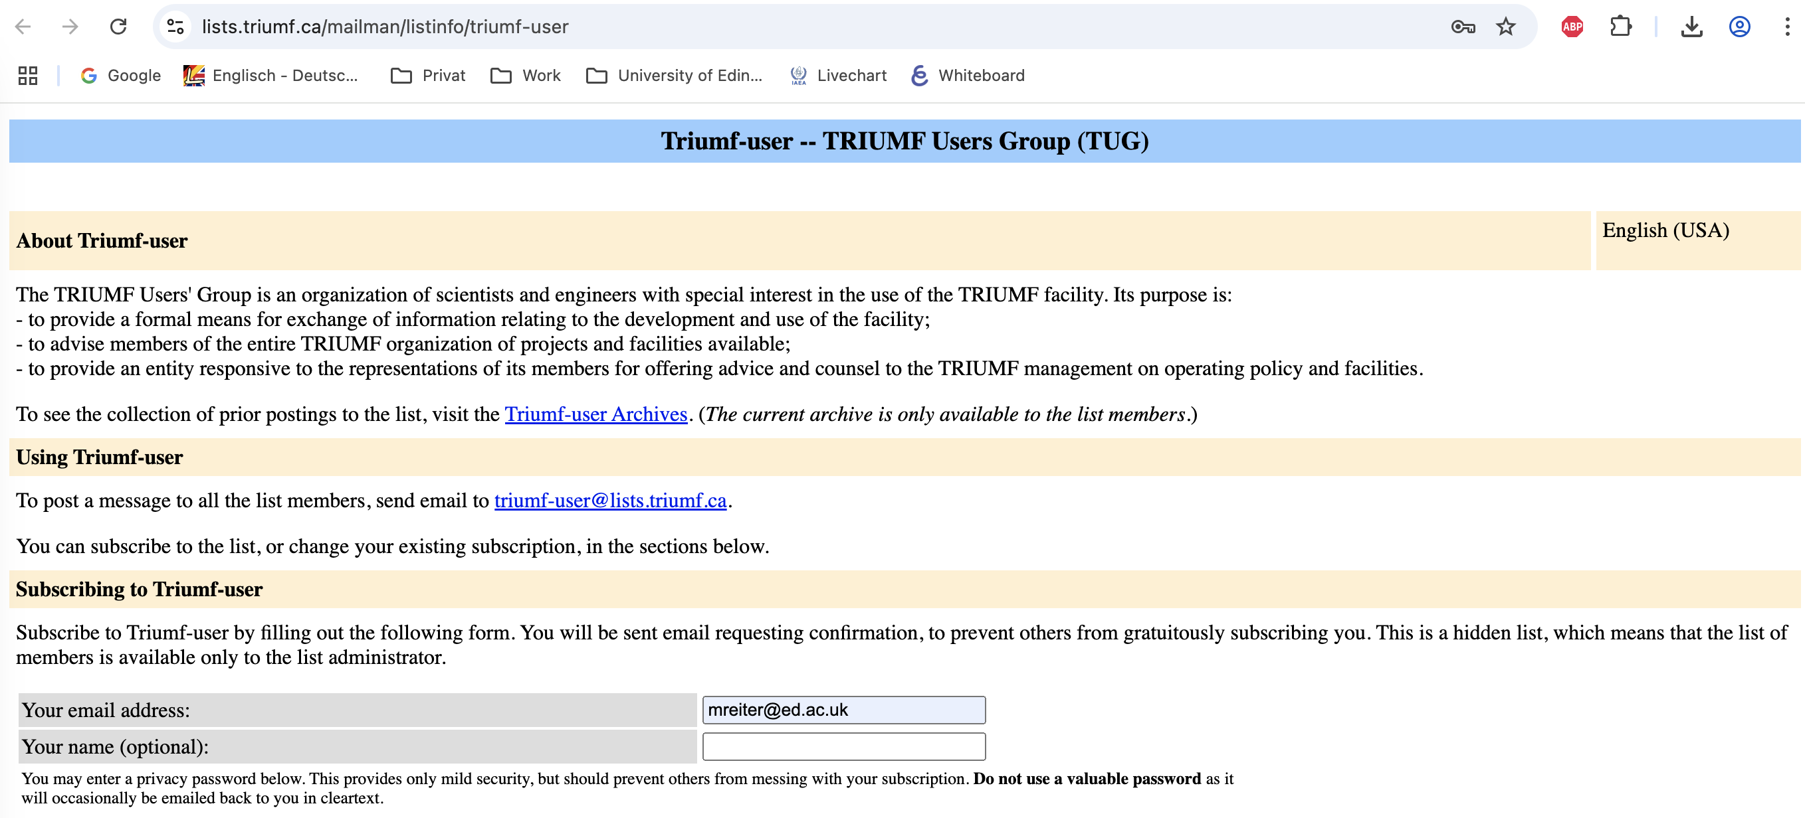
What is the TRIUMF user’s group (TUG)?
The TRIUMF Users Group (TUG) is an organization whose members (users) have a special interest in the use of TRIUMF’s infrastructure and facilities for the purpose of conducting research, developing technology, utilizing resources (e.g., experimental facilities, access to rare isotope beams, etc.) and/or interacting with personnel.
As such, we are a loose collective of TRIUMF users who decide to join
Includes both internal (TRIUMF) and external (non-TRIUMF) users
  Defined by people being signing on to mailing list
  See https://triumf.ca/people/tug/
At the moment,
about 270 subscriptions
Note: Database and membership management will be undergoing updating (work in progress), but please join current mailing list and we will make sure you are included in whatever system comes next.
Notes:
Our (sparse) webpage: https://www.triumf.ca/triumf-users-group

Slide 5
What is TRIUMF Users’ Group Executive Committee ?
The TRIUMF Users’ Group Executive Committee (TUEC) is an elected body of seven members designed to manage the business and affairs of the Users’ Group and to act as liaison between members of the Users’ Group and TRIUMF.

Slide 6
Who is TUEC?
Three chairs:
Current: Moritz Pascal Reiter (Edinburgh, UK)
Past: Katherine Pachal (TRIUMF) (Christian Diget (York,UK) until 05-2025)
Chair Elect: Andrea Capra (TRIUMF, Canada)
Four members:
Greg Christian (SMU, Canada)
Brad Schultz (TRIUMF, Canada)
Xiaoyue Li (TRIUMF, Canada)
Matt Williams (Surrey, UK)
Liaison: Marcello Pavan (TRIUMF)

Slide 7
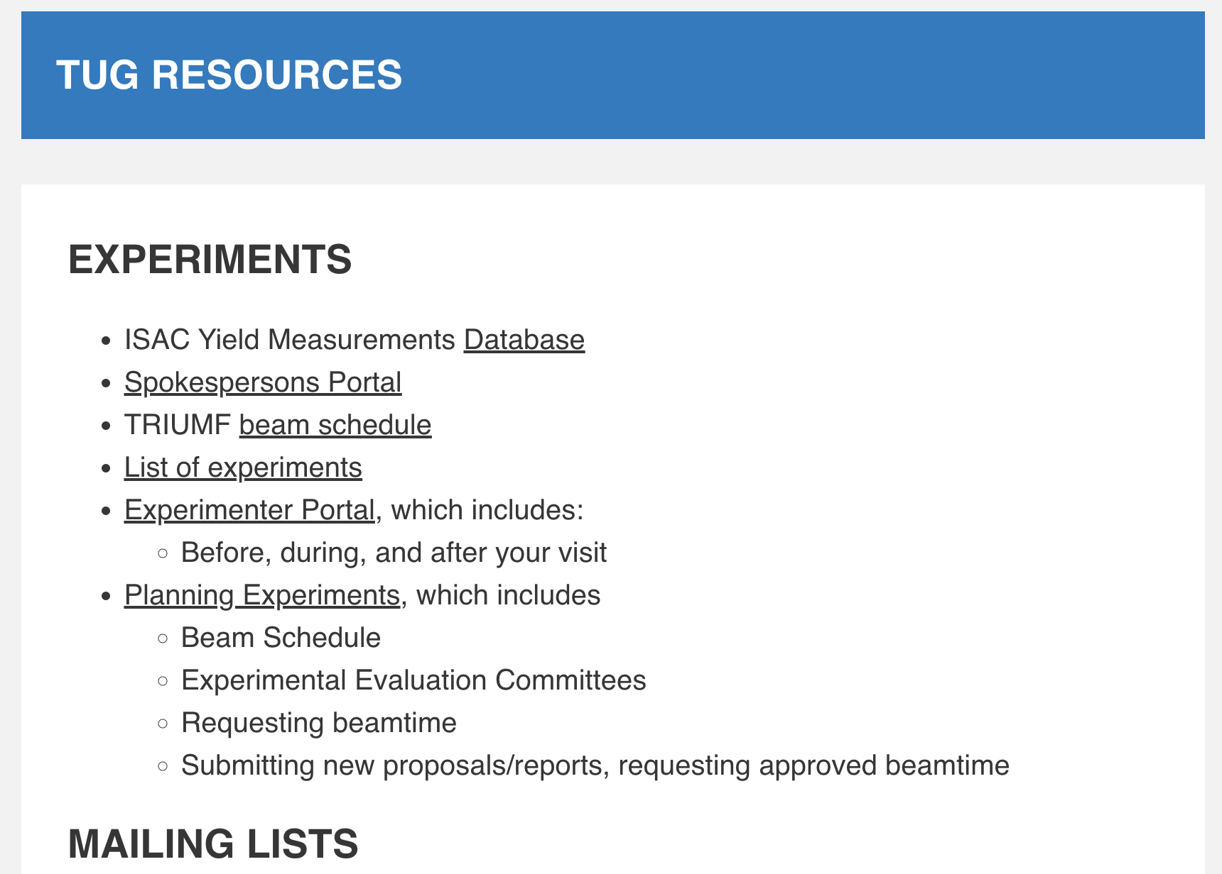
What does TUEC do?
The TUEC is an elected body of TUG members
  TUEC is not a TRIUMF organization (we do not represent the lab)
  We represent the interests of users to the lab
  Check out
  https://triumf.ca/people/tug/
  Collection of useful resources
  (some parts under construction)

Slide 8
What does TUEC do?
The TUEC is an elected body of TUG members
  TUEC is not a TRIUMF organization (we do not represent the lab)
  We represent the interests of users to the lab
  Meet ~ bi-monthly to discuss issues users have raised
    Bring those up with TRIUMF management
    via Liaison and direct meetings with TRIUMF Management
    Follow up by monitoring progress via an issue tracker
  Make sure important information gets communicated to the users group:
    Beam schedule updates, upcoming EECs, upcoming conferences, occasionally job advertisements, etc via user the TUG mailing list
  Consultation with users on the 5-year-plan and vision development
  as well as their implementation.
  Heavily involved in organization of annual Science Week

Slide 9
Communicate and participate!
Join the TUG mailing list (see earlier slides)
  If you want to send announcements to TRIUMF users:
  triumf-user@lists.triumf.ca
Contact TUEC and let us know of your problems or have suggestions
  Email to the committee: tug@triumf.ca
  Email only the chairs: tuec_chairs@triumf.ca
Stand for election for TUEC later this year!
  Particularly needed: representation from non-TRIUMF Canadian institutions ☺

Slide 10
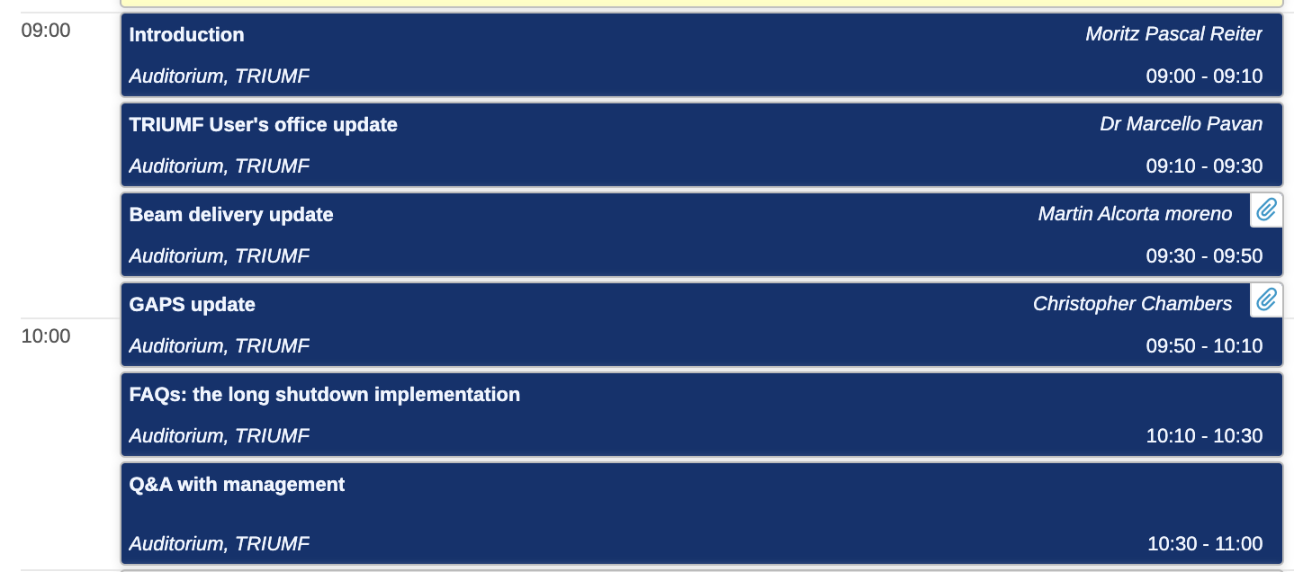
Welcome to our
Annual General Meeting (AGM)

