Slide 1
GAPS Update TRIUMF User Group
July 30th 2025
Chris Chambers
On behalf of the GAPS Committee

Slide 2
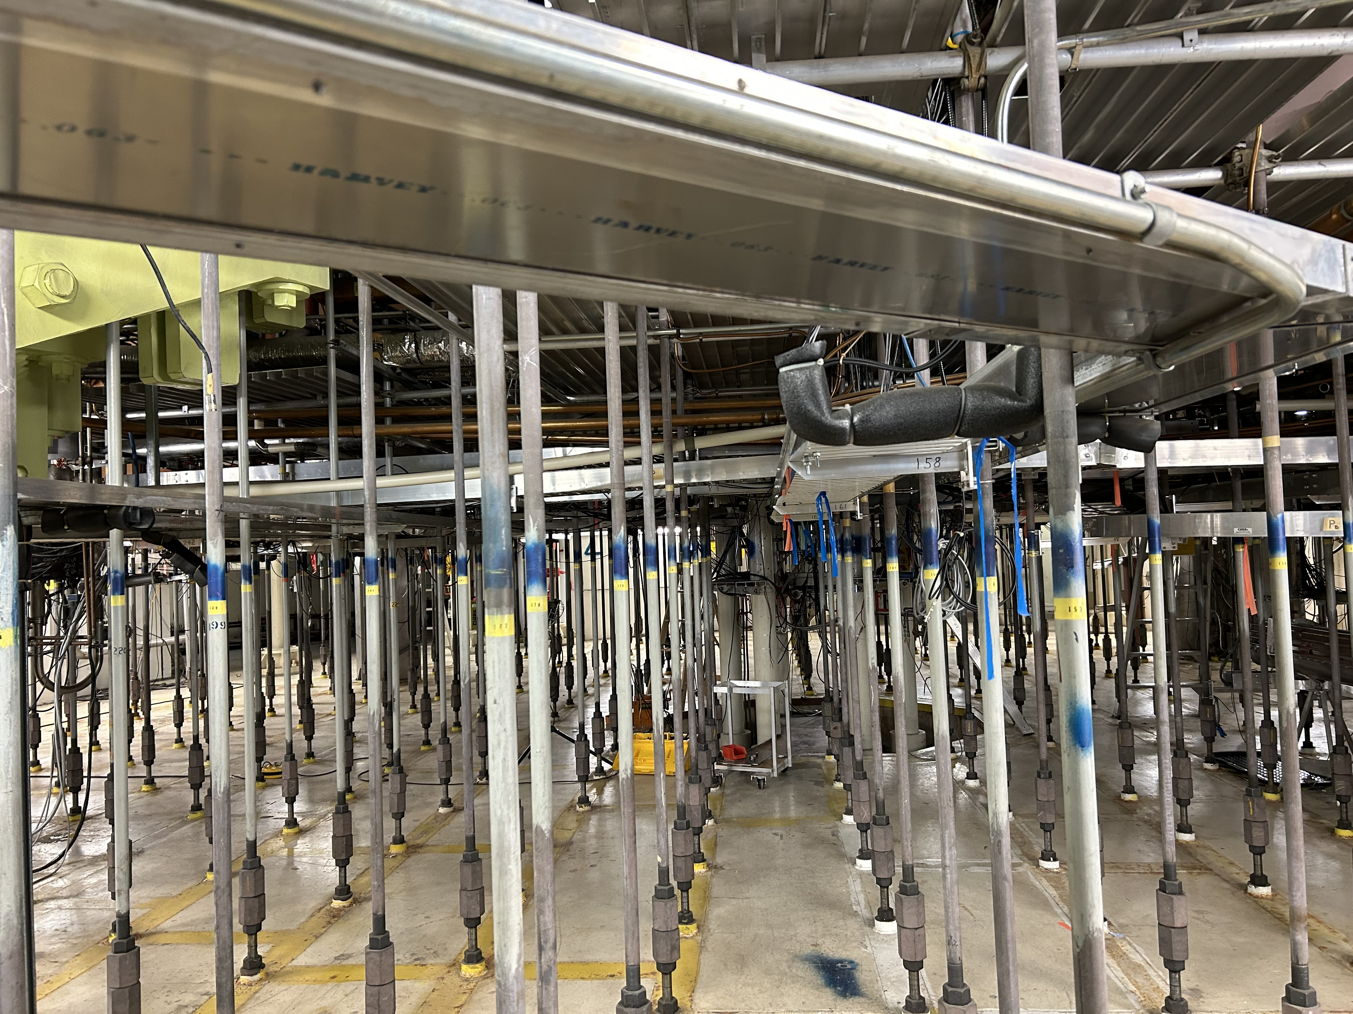
Pillars of the Grads and Postdocs Society
Represent grads & postdocs at TRIUMF (Advocacy)
Advocate for their health, safety, well-being, and administrative needs of graduates and postdocs (EDI)
Provide graduates and postdocs opportunities for academic and professional development (PD)
Foster a sense of community (Social)
The GAPS Committee is tasked with ensuring these are met

Slide 3
GAPS Advocacy/HR
New Grad Student & Postdoc Programs
Huge milestone for TRIUMF support of GAPS
Postdoc program includes
New standardized minimum salary
Clearer policies with respect to leave, service work
Grad student program includes
New stipend minimums for masters and PhD GSRAs
Support for financial hardship
Look for even more updates in 2025
Results from GAPS Surveys 2023-2025
Single biggest issue
2023
2024
2025
Salary & Cost of Living
74%​
49%​
41%​

Slide 4
GAPS Advocacy/HR
Advocated for 2026 Long Shutdown mitigation strategies for students and postdocs
Faster & clearer information from TRIUMF HR
e.g. Helped organize immigration workshops
Graduate Student Visitors will be added to HR systems
Working on clearer communication across different groups and leadership team at TRIUMF
What are the next most pressing issues that affect you?
From survey:
Better communication from leadership/management
Immigration
Searching for next job
Mental Health
GSVs: One of our main focuses for this year

Slide 5
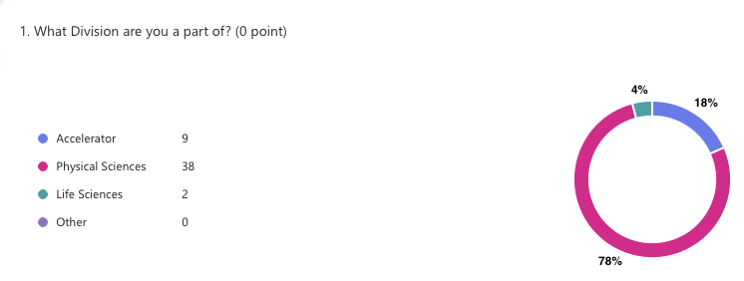
Increasing the reach of GAPS
We are looking for new members, particularly voices from accelerator and life science!

Slide 6
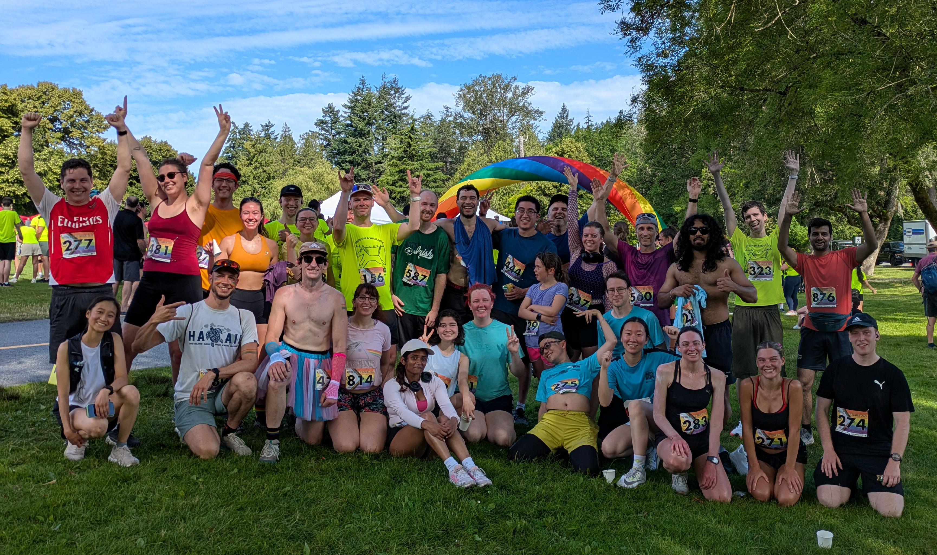


Early Career & Students for EDI (ECS-EDI)
Who we are:
Community-led committee focusing on EDI initiatives and action at TRIUMF (formerly GAPS EDI)
Open to anyone at TRIUMF who considers themselves early career includes undergrads & staff)
Recent initiatives include:
Movie screenings
Picture a Scientist, Signal Fire
Group activities
TRIUMF Team @ Vancouver Pride Run
Women and Gender Diverse Networking event
Community Coffee events
Pride Month, Conscious Purchasing
Action Plan for Incident Reporting
Meetings are open – new members welcome!
Mondays @ 3pm in MOB Boardroom
Elections on Monday August 11
7 official roles (3 elected, 4 volunteer), no limit on members at large
Email gaps.edi@triumf.ca for more info and/or come chat!
2025 TRIUMF Pride Run Team

Slide 7
Professional Development
Science Communication
Outreach Talks Workshop
GAPS-lead Saturday Morning Lecture
Abstract Writing Workshop
WNPPC Practice
Job Search Aids
Interviewing for Industry Talk
Negotiation Skills Workshop
Elevator Pitch Workshop
TRIUMF Headshots
Networking and Career Exploration Opportunities
Facility Tours
Career Talks
Science Week Career Panel and Speed Mentoring
Event suggestions and feedback are always wanted!

Slide 8
NEW! Job posting and scholarship opportunities mailing list
GAPS has started a mailing list for people to share career opportunities
Scholarships
Graduate Positions
Postdocs
Academic Jobs
Industry Jobs
If you have anything to advertise, email it to gaps-careers@lists.triumf.ca
Get the inside scoop from the TRIUMF network!
Sign up: https://lists.triumf.ca/mailman/listinfo/gaps-careers

Slide 9
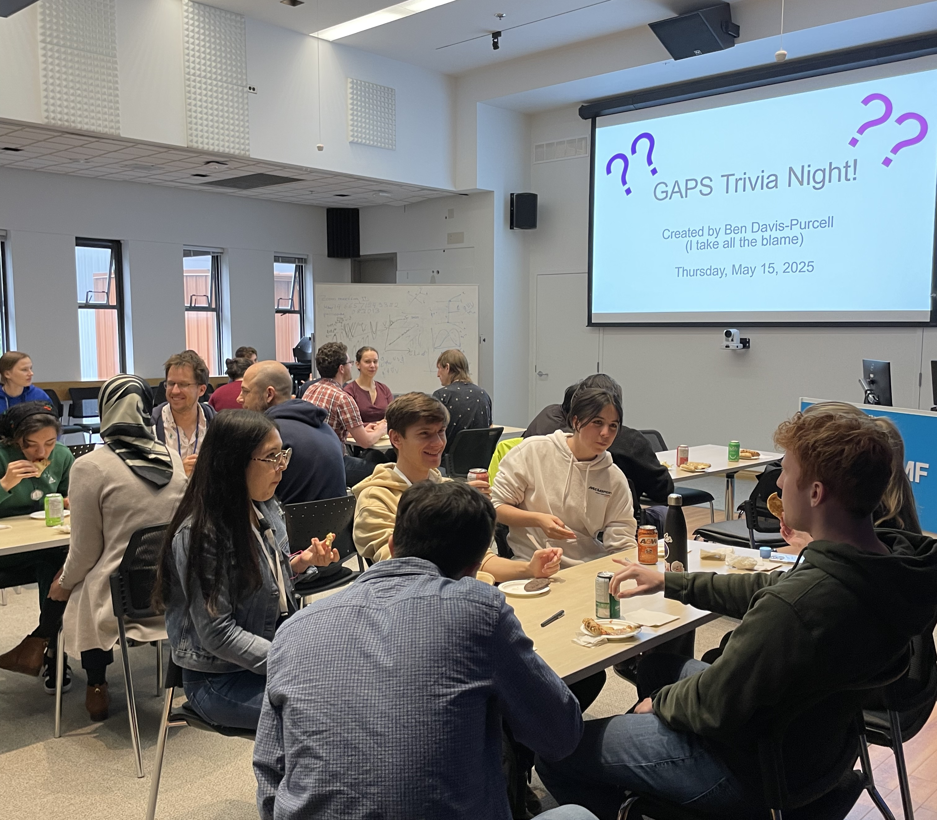
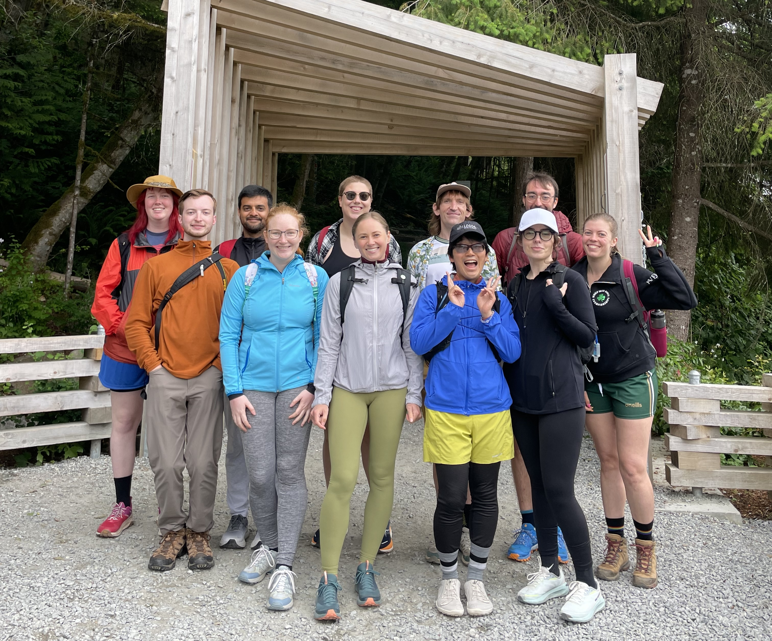
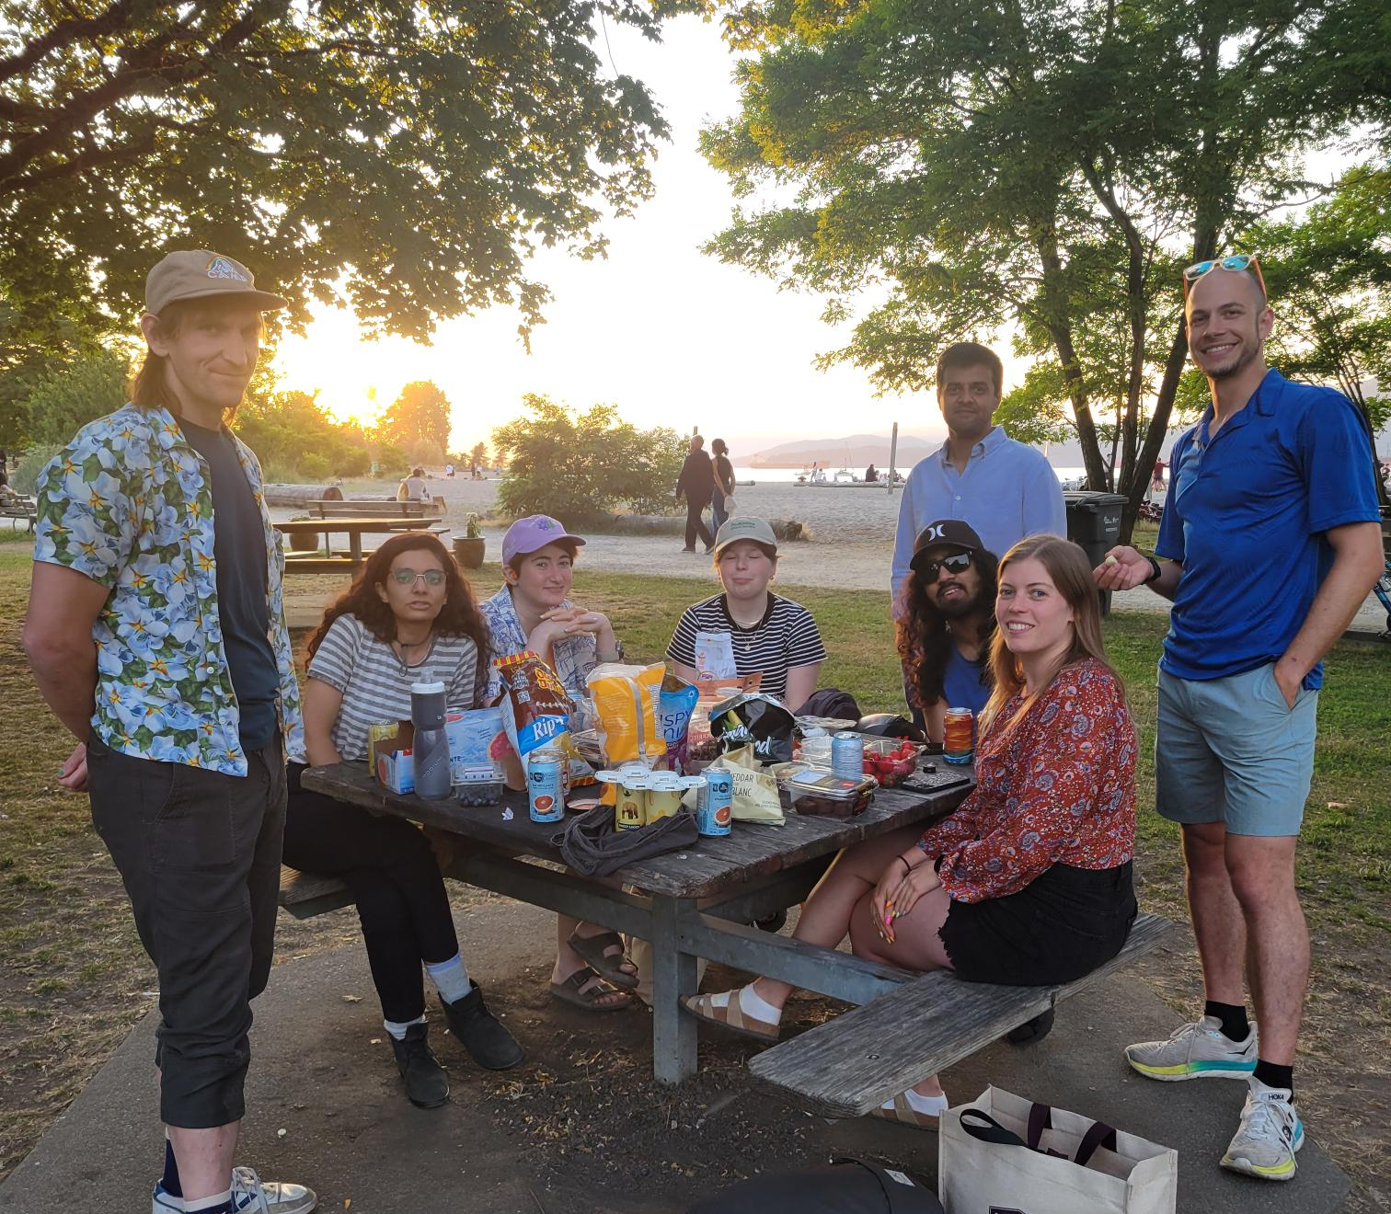
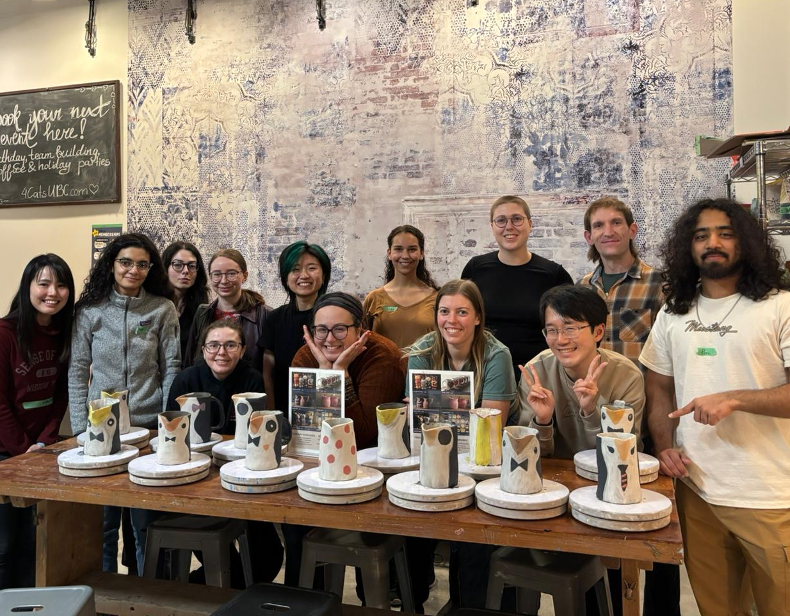
Social Activities
Regular social events:
Coffee & Cookie Hour each Wednesday
Pub night / Beach hang start of each month
Latest Events:
Pottery 🌸
Board Games Night 🎲
Swing dance 💃🏽🕺🏼
Upcoming:
Beach BBQ!
Summer Hikes ⛰️

Slide 10

Help us help you!
You can also be part of the committee without having an elected position, and volunteer your time as you see fit
Anybody can join the committee if you want to make a difference!
We meet at 3pm on Fridays in MOB Conference Room
Elections are at the Aug. 15th meeting
All grads and postdocs can vote!
Join our mailing list below!
https://gaps.triumf.ca/general-resources

Slide 11
You can help too!
Grad school/postdocs can be an isolating experience
Especially if moving to new city
GAPS tries to foster sense of community, while building professional skills and making everyone feel like they belong
GAPS Committee is made up of volunteers who dedicate precious time to making TRIUMF a better place for grads & postdocs
We always need more help
Volunteer for one-off events if you can
Tell your new students/postdocs about us
Support our initiatives

Slide 12
Resources and Reminders
GAPS mailing lists:
Grads: https://lists.triumf.ca/mailman/listinfo/grads
Postdocs: https://lists.triumf.ca/mailman/listinfo/postdocs
Job posting and scholarship opportunities mailing list:
https://lists.triumf.ca/mailman/listinfo/gaps-careers
GAPS Website
https://gaps.triumf.ca/
Instagram:
@triumfgaps https://www.instagram.com/triumfgaps/
GAPS Committee meetings Fridays at 3pm in the MOB conference room
ECS-EDI meetings Mondays at 3pm in the MOB boardroom (Tuesday @ 4pm next week)
Elections Soon!
ECS-EDI: August 11 at 3pm
GAPS: August 15 at 3pm
Social hours every Wednesday, alternating time and location (check your inbox and the calendar on the GAPS website)
BBQ at Locarno Beach on Saturday, July 26!
Questions or concerns? Email gaps@triumf.ca anytime

