Slide 1


TRIUMF Life Sciences program through the lens of IAEA
Valery Radchenko, PhD TRIUMF/UBC

Slide 2
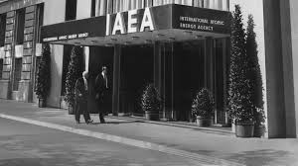
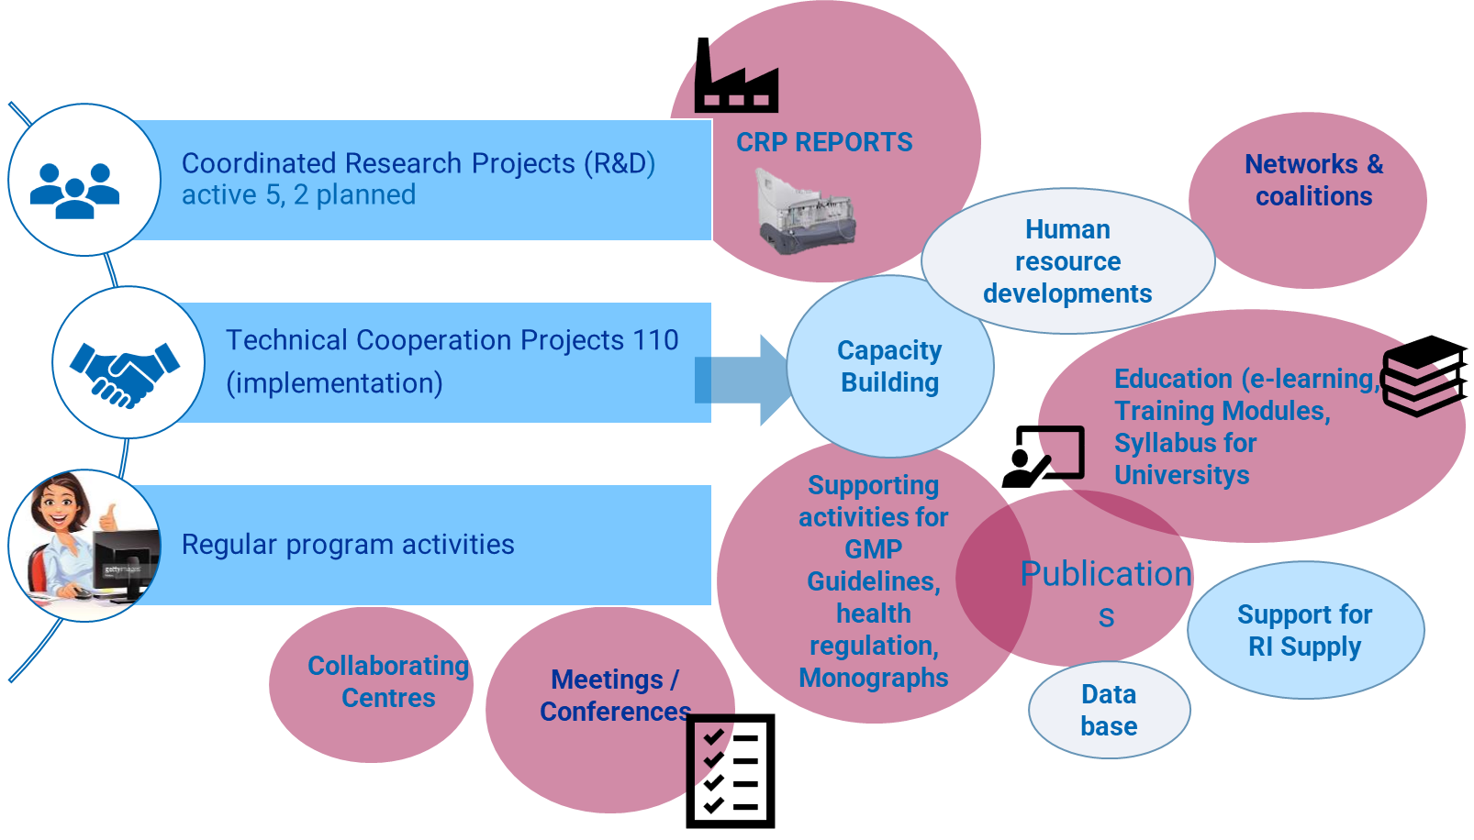
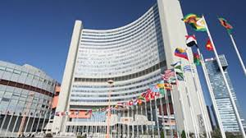
Introduction to International Atomic Energy Agency (IAEA)
The IAEA was created in 1957 in response to the deep fears and expectations generated by the discoveries and diverse uses of nuclear technology. The Agency’s genesis was U.S. President Eisenhower’s “Atoms for Peace” address to the General Assembly of the United Nations on 8 December 1953.
First IAEA Headquarters Vienna Grant Hotel
Current IAEA Headquarters Vienna International Centre

Slide 3
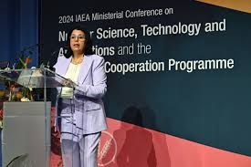


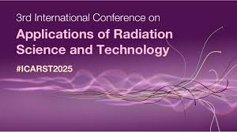
My time at the International Atomic Energy Agency (IAEA)
November 2024 - May 2025 Consultant at the International Atomic Energy Agency (IAEA), Department of Nuclear Applications (NAPC), Division of Physical and Chemical Sciences, Vienna, Austria
Participated in Ministerial Conference on Nuclear Science, Technology and Applications (November 2024)
Participated in Technical meeting on Ra-226 initiative (December 2024)
ARCAL project (regional project for Latin America) (planning for 2026-2029) (February 2025)
Presented at Dubai Theranostic Summit (Oncidium Foundation), Dubai, UAE (January 2025)
Presented at PRISMAP winter school in Riga, Latvia (February 2025)
Co-organized 1st CRP meeting (virtual) on Tc-99m radiopharmaceuticals (December 2025)
Co-organized 3rd CRP meeting on Ga-68 cyclotron production, Debrecen, Hungary (April 2025)
Supporting Division booth at ICARST 2025 (April 2025)
Co-organized Consultancy meeting on Supply of Theranostic radionuclides (April 2025)
Alpha Atlas and IAEA activities on Alpha-emitting radiopharmaceuticals (published May 2025)

Slide 4
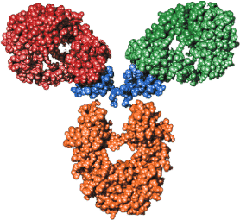
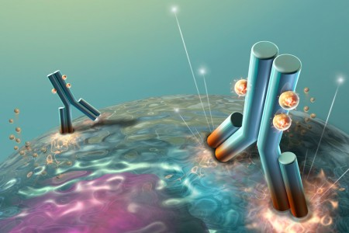
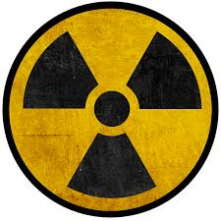
Targeted Radionuclide Imaging and Therapy (radiotheranostics)
Chelator
Radionuclide
Biomolecule
Specific target
E.g. cancer
Diagnostic: PET, SPECT
Therapy: beta, alpha, auger
Radchenko V. et al. Solvent Extraction and Ion Exchange, 39:7, 714-744, DOI: 10.1080/07366299.2021.1874099

Slide 5
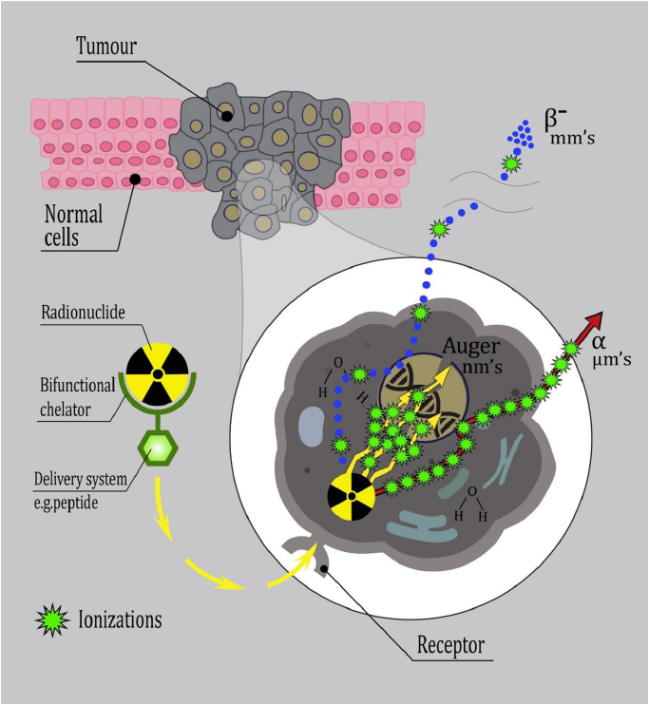
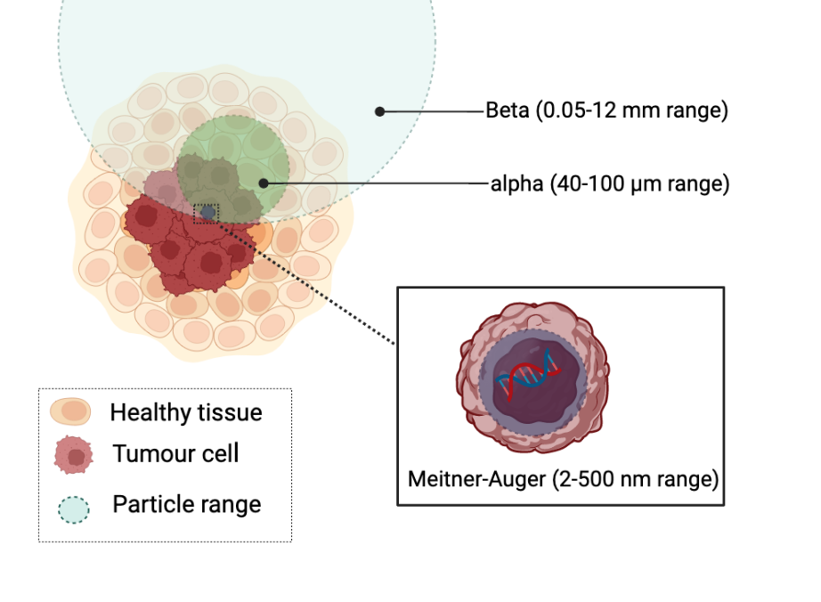
Targeted Radiation Therapy (TRT): Targeted Alpha Therapy
Beta vs. Alpha vs. Auger Emitters
Radiopharmaceutical design
Image credit Yulia Radchenko
V. Radchenko and C. Hoehr, Nucl. Phys. News, 2020

Slide 6
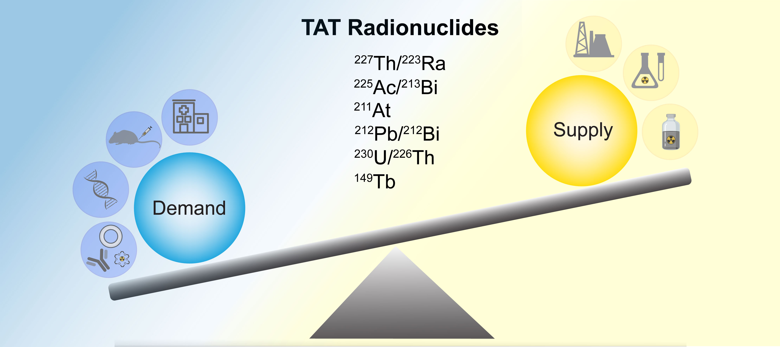
Targeted Alpha Therapy (TAT): Challenges (Production of TAT radionuclides)
Image credit Gokce Engudar
Valery Radchenko et al., Journal of Nuclear Medicine, 62 (11) 1495-1503; DOI: 10.2967/jnumed.120.261016

Slide 7
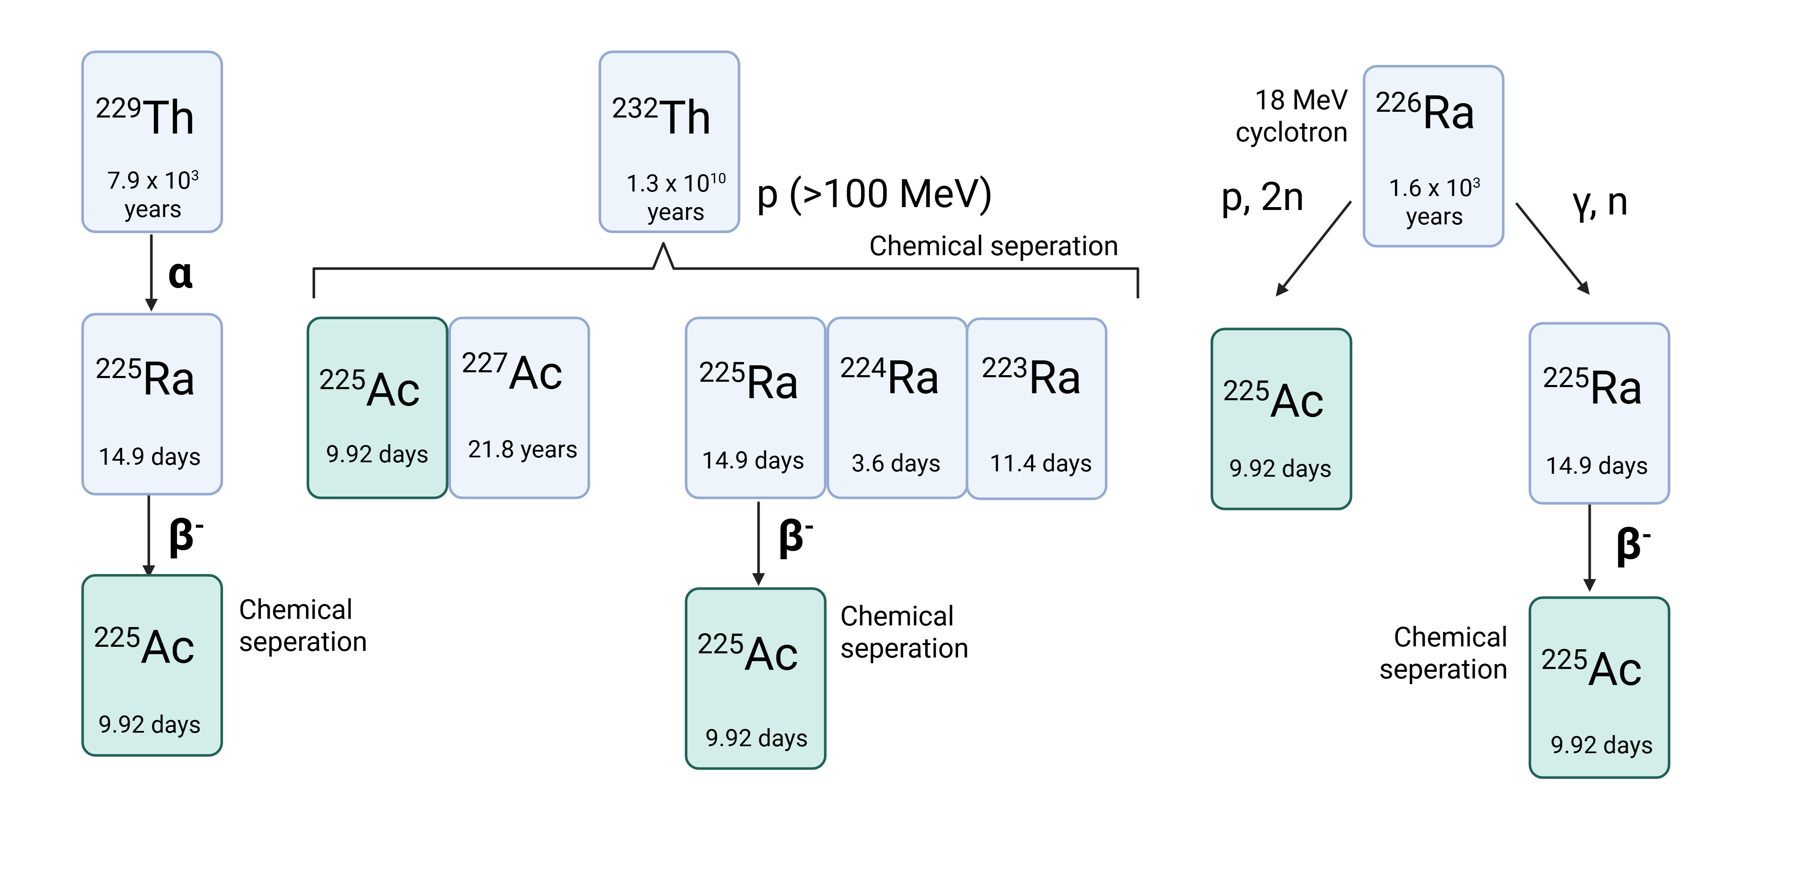
Most feasible clinical scale production routes for ²²⁵Ac
Decay of ²²⁹Th decay
Challenge: Limited stock of ²²⁹Th (1.7 Ci of ²²⁵Ac per year)
²³²Th spallation with high (≥ 100 MeV) energy protons
Challenge: Co-production of ²²⁷Ac
Irradiation of ²²⁶Ra with medium-energy protons and photons
Challenge: limited quantities of ²²⁶Ra, target preparation
Figure credit Janke Kleynhans
A. Robertson Curr Radiopharm. 2018;11(3):156-172. doi: 10.2174/1874471011666180416161908
V. Radchenko et al. Journal of Nuclear Medicine Nov 2021, 62 (11) 1495-1503; DOI: 10.2967/jnumed.120.261016

Slide 8
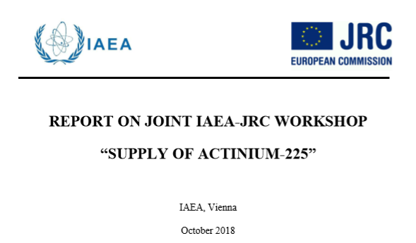
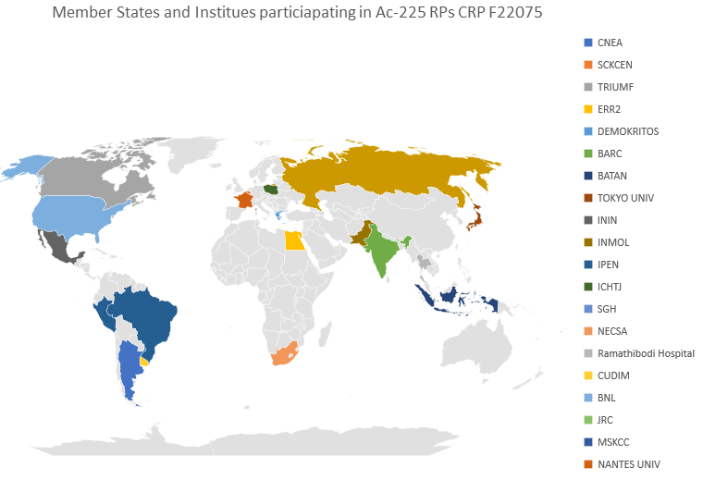
Workshop on Supply of ²²⁵Ac (2018)
In collaboration with EC-JRC
Trends in global demand and supply for Ac-225
CRP on production and quality control of Ac-225 radiopharmaceuticals
Initiated to assist with capacity building and technology transfer of new generation of therapeutic radiopharmaceuticals with focus on Ac-225 radiopharmaceuticals (peptides, immunoconjugates, small molecules, etc.),
Addressing method development and standardization of preparation, quality control and pre-clinical studies of Ac-225 radiopharmaceuticals
1st RCM held in Nov 2022, 2nd RCM July 2024
2022-2026 (5 years) 25 participants
Virtual Consultants Meeting on “The Status of Alpha Emitter Radiopharmaceuticals: June 2021
Notes:
For Ac-225 there are still several questions which needs to be addressed other than the availability of radioisotope.,
the quality specifications of Ac-225 produced via different routes requires to be specified. Robust QC methods should be developed, the effects due to recoil of alpha particles generated during decay process on stability needs to be understood. The ongoing CRP of the IAEA on Ac-225 radiopharmaceutical preparation and quality control, where we expect collaborative efforts to address these questions.

Slide 9
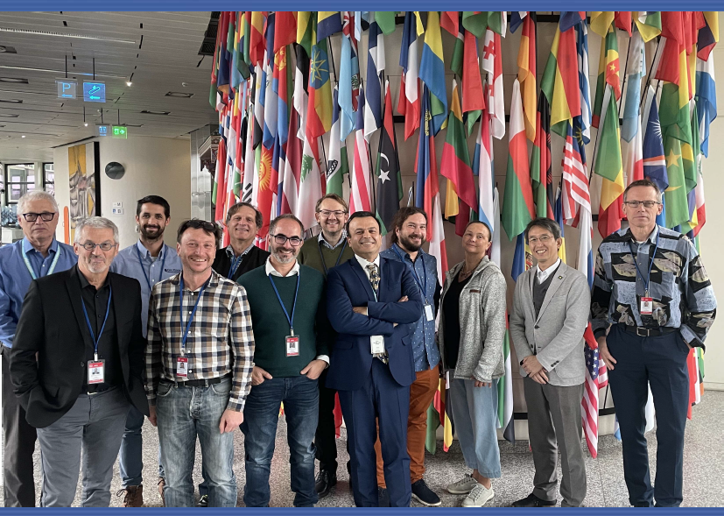
Preparation of an IAEA Tec-Doc on “Production of Ac-225 radiopharmaceuticals“ November 20-24, 2023, IAEA Headquarters, Vienna, Austria
Technical Meeting on: Production of Alpha Emitters and Radiopharmaceuticals IAEA Headquarters, Vienna, November 2023
https://www.iaea.org/publications/15707/production-and-quality-control-of-actinium-225-radiopharmaceuticals

Slide 10
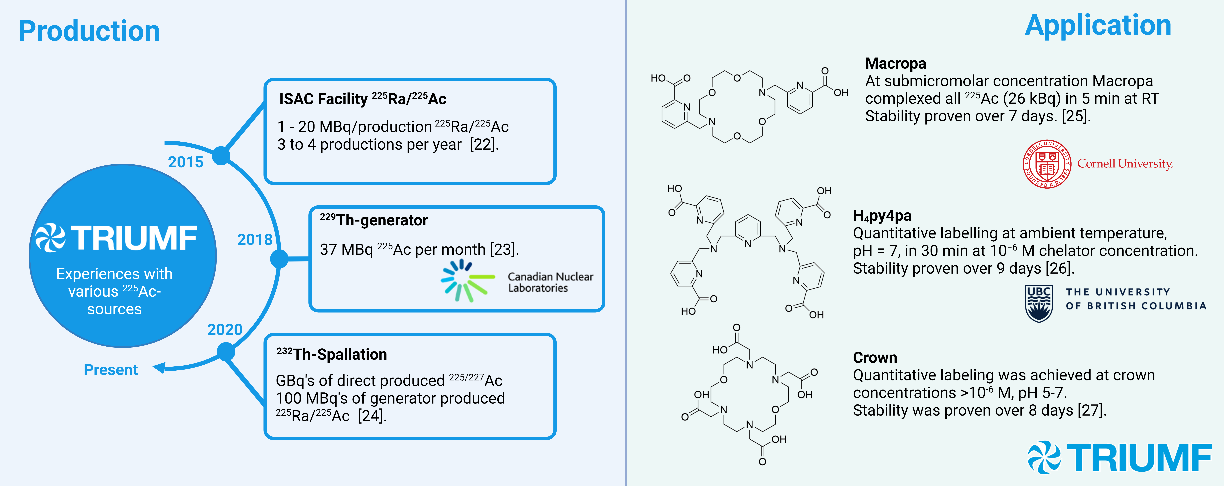
Summary of TRIUMF experience with various sources of ²²⁵Ac
IAEA activities to support the Member States in the production of Targeted Alpha Therapy Radiopharmaceuticals: Actinium-225 https://doi.org/10.1016/j.nucmedbio.2025.109008
Image credit: Dr. Janke Kleynhans

Slide 11
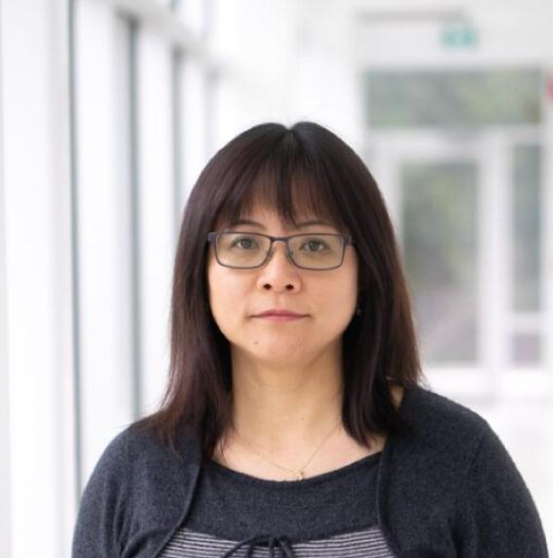
TRIUMF’s Ac-225 experience: High-purity ²²⁵Ac production available via ²²⁵Ra
Qing Miao
Robertson A.K.H. et al., Inorganic Chemistry 2020 59 (17), 12156-12165 DOI: 10.1021/acs.inorgchem.0c01081

Slide 12
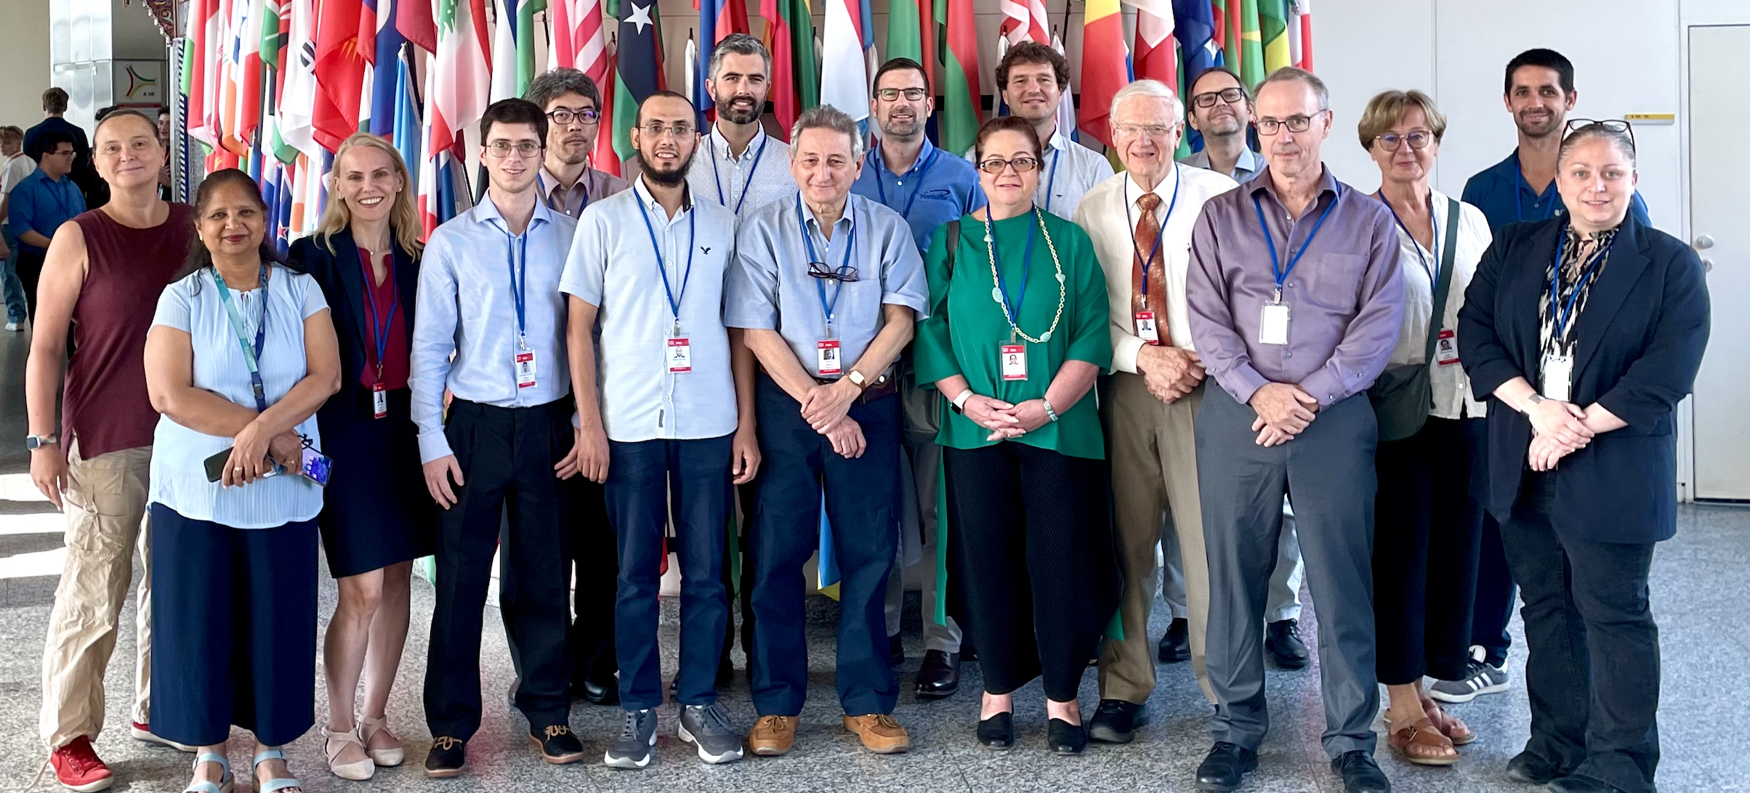


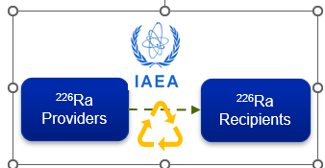
The IAEA ²²⁶Ra Global Management Initiative
Promote and facilitate the global recycling of DSRS, specifically ²²⁶Ra – to produce ²²⁵Ac for use in Nuclear Medicine.
Establish a platform to facilitate contacts between Member States holding disused ²²⁶Ra and potential recipients to produce ²²⁵Ac.
Facilitate the coordination and safe and secure implementation of the transference of ²²⁶Ra (holders) to (recipients), and to gather and disseminate experience and good practice in implementing such transfers.
https://nucleus.iaea.org/sites/connect/DSRSpublic/SitePages/Home.aspx
“Technical Meeting on Radium-226 targets for therapeutic radioisotope production” 2-6 Sep 2024
TECDOC is in preparation
Conny Hoehr
Eleanor Dunling

Slide 13
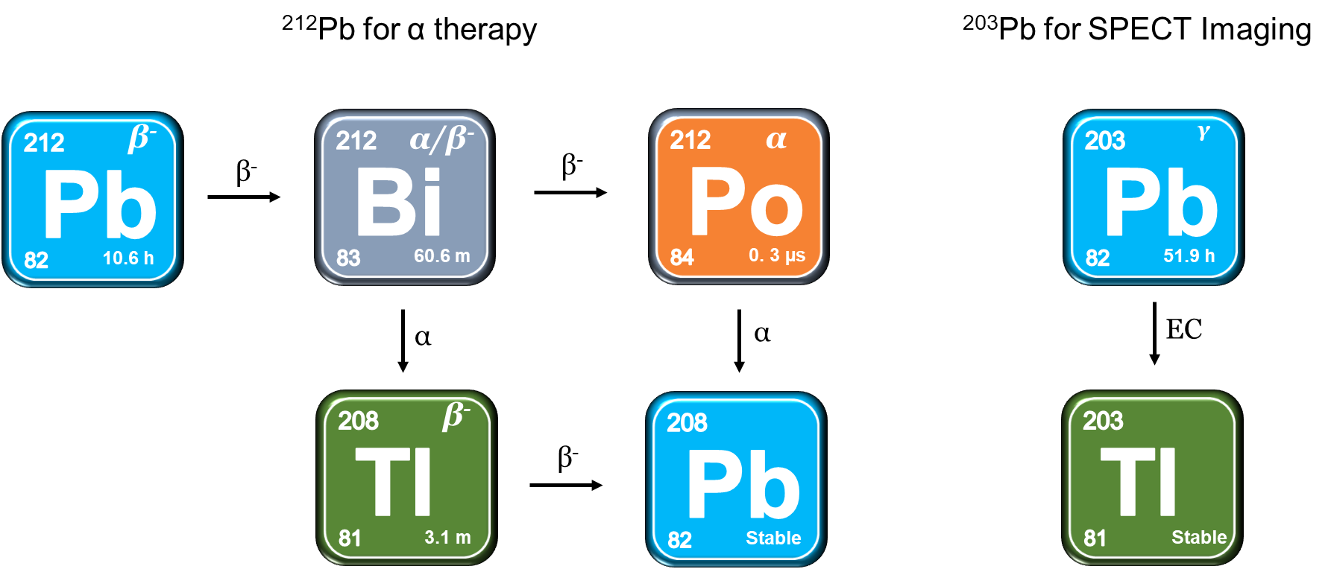
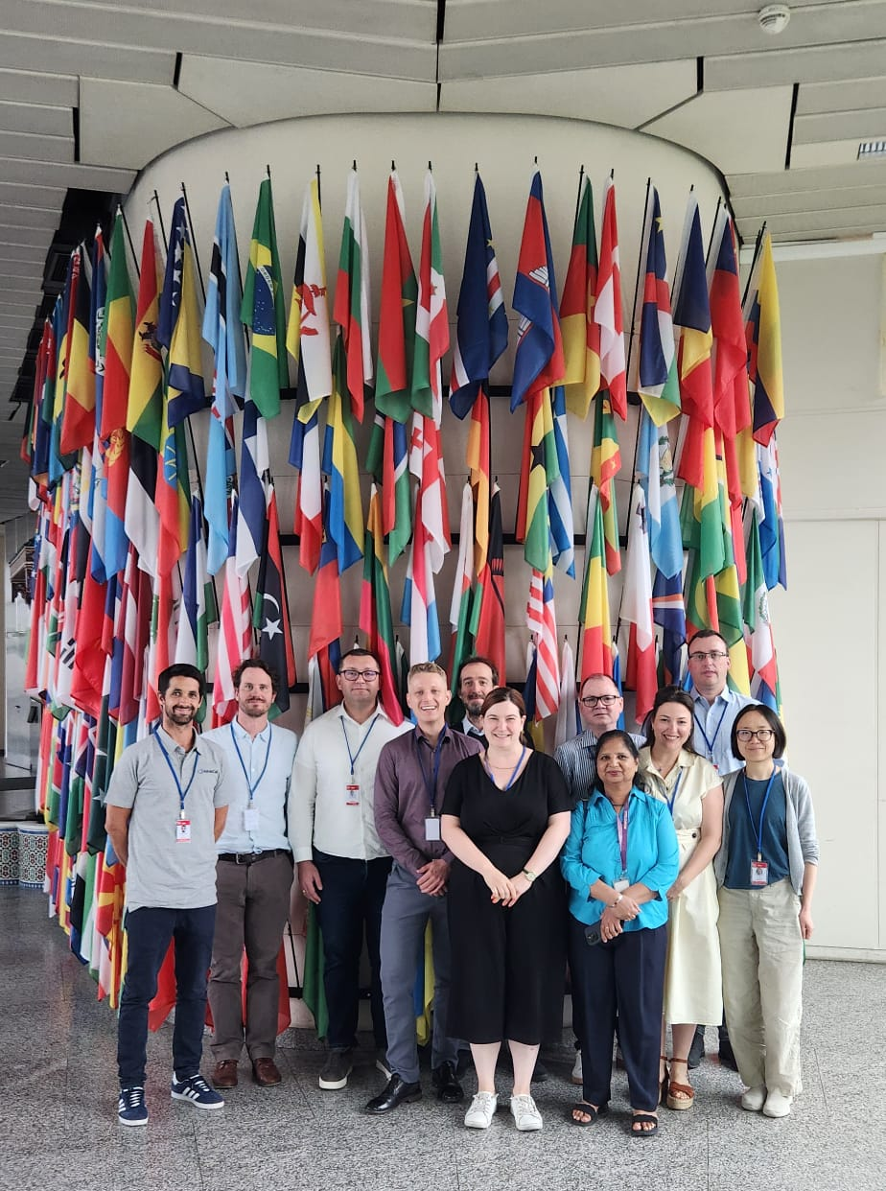
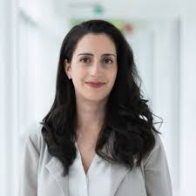
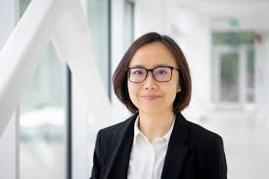
TRIUMF’s Pb-212/Bi-212 experience
Figure credits to Luke Wharton
Pb-212/Bi-212 Radiopharmaceuticals
Consultancy Meeting (July 2025)
Hua Yang
Caterina Ramogida

Slide 14
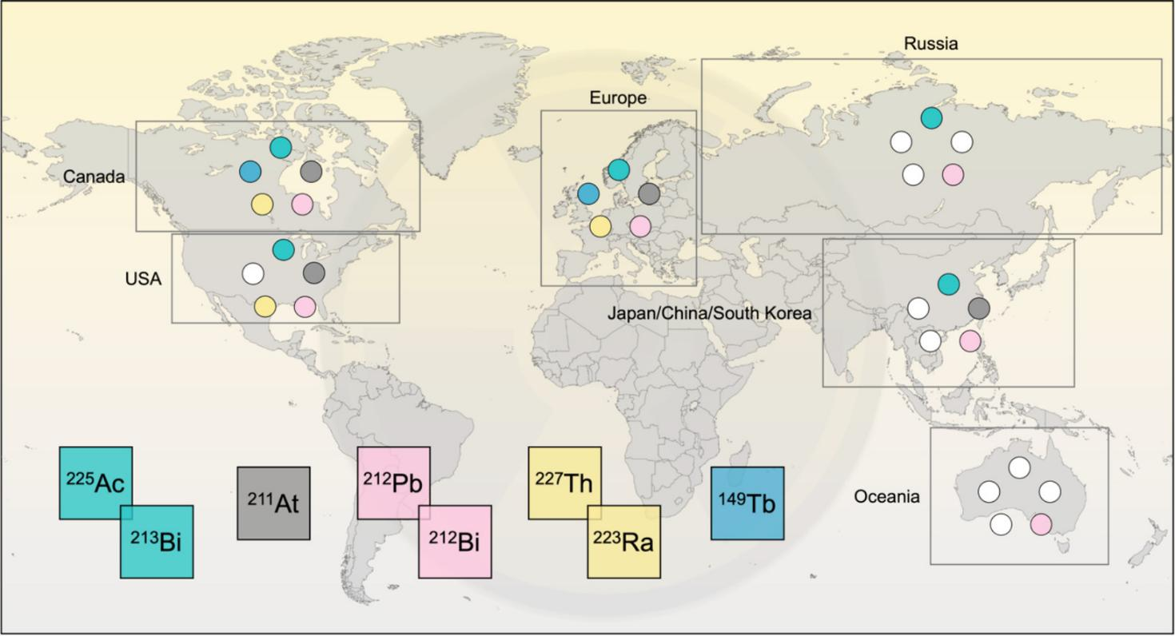

Alpha Atlas: Mapping Global Production of α-Emitting Radionuclides for Targeted Alpha Therapy
Marianna Tosato
Postdoc at SFU
Marianna Tosato, Chiara Favaretto, Janke Kleynhans, Andrew R. Burgoyne, Jean-François Gestin, Nicholas P. van der Meulen, Amirreza Jalilian, Ulli Köster, Mattia Asti and Valery Radchenko
Nuclear Medicine and Biology 2025 (open access) https://doi.org/10.1016/j.nucmedbio.2024.108990

Slide 15
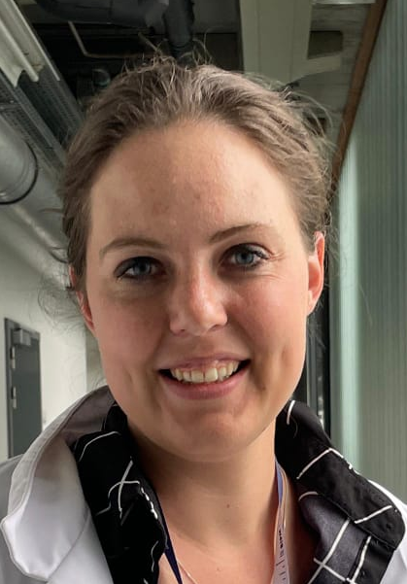
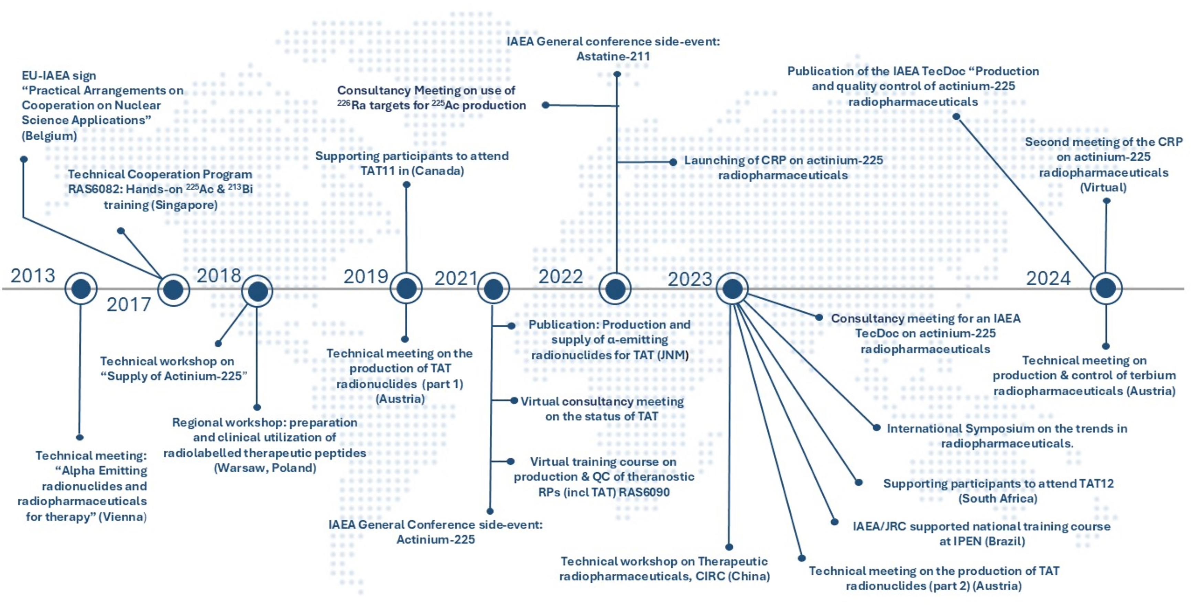
IAEA activities to support the member states in the production of targeted alpha therapy radiopharmaceuticals
Janke
Kleynhans
postdoc
KU Leuven
Jalilian AR, Kleynhans J, Bouziotis P, Bruchertseifer F, Chakraborty S, De Blois E, Denecke M, Elboga U, Gizawy M, Horak C, Jang J, Korde A, Majkowska-Pilip A, Mdlophane A, Ocampo-Garcia B, Selivanova SV, Starovoitova V, Wojdowska W, Zeevaart JR, Radchenko V. IAEA activities to support the member states in the production of targeted alpha therapy radiopharmaceuticals. Nucl Med Biol. 2025 doi: 10.1016/j.nucmedbio.2025.109008.

Slide 16
Targeted Radiation Therapy (TRT): Targeted Auger Electron Therapy
Beta vs. Alpha vs. Auger Emitters
Radiopharmaceutical design
Image credit Yulia Radchenko
V. Radchenko and C. Hoehr, Nucl. Phys. News, 2020

Slide 17
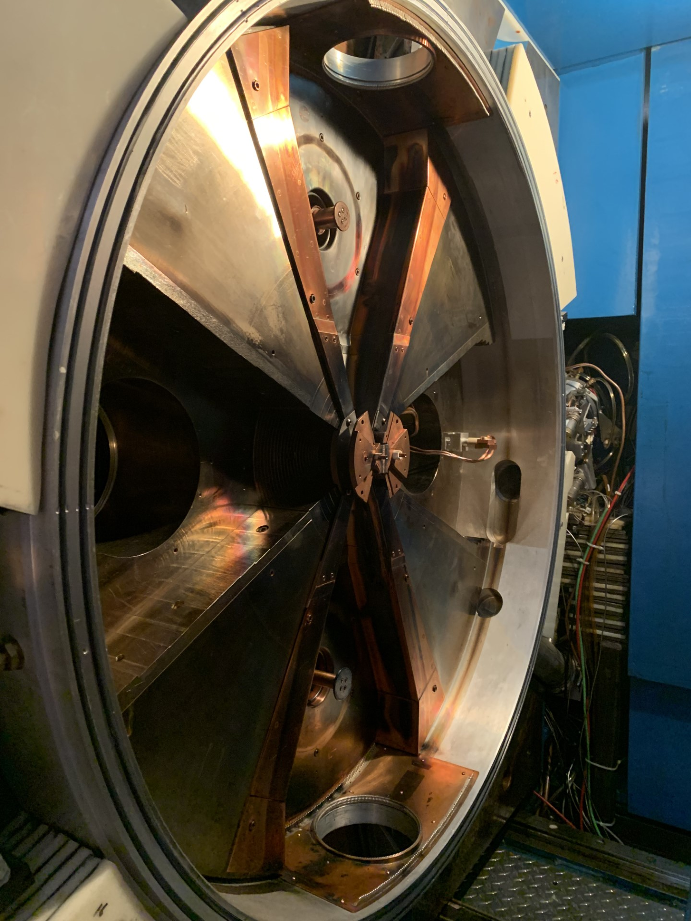
Auger Emitters: Production and selection of suitable radionuclides
Many suitable candidates for Targeted Auger Electron Therapy (TAET) can be produced with small to medium energy protons (10-20 MeV) via simple p, n reaction
(e. g. TR-13 at TRIUMF)
Radionuclide | Half-life | Energy* γ(X)+e⁻, keV | Energy* γ(X), keV | Energy* e⁻, keV | Number of electrons
 |  |  |  |  | 0.1 - 1.5 keV | 1.5 - 5 keV | > 5 keV
¹¹¹In | 2.8 d | 440 | 405 | 35 | 1.91 | 1.02 | 0.31
^{103m}Rh | 56.1 min | 39.8 | 1.8 | 38 | 1.49 | 0.79 | 0.99
¹¹⁹Sb | 38.5 h | 48.8 | 23.1 | 25.7 | 2.77 | 1.47 | 0.96
¹²⁵I | 59.4 d | 61.4 | 42 | 19.4 | 2.99 | 2.40 | 0.33
⁶⁷Ga | 78.3 h | 193 | 158 | 35 | 1.69 | - | 0.95
^{197m}Hg | 23.8 h | 308 | 94 | 214 | ? | 1.90 | 2.40
¹⁹⁷Hg | 64.1 h | 136.3 | 69.9 | 66.4 | ? | 2.07 | 1.70
Radionuclide | t_{1/2}, days | Number of AE’s | Total Energy* KeV | other emissions/AE’s | Production
^{197g}Hg | 2.7 | ~30 | 13.4 | 10 | ¹⁹⁷Au(p, n)¹⁹⁷Hg
¹¹⁹Sb | 1.6 | 24 | 26.0 | 0.9 | ¹¹⁹Sn(p, n)¹¹⁹Sb
¹¹¹In | 2.8 | 14.5 | 7.0 | 62 | ^{111g}Cd(p, n)¹¹¹In
Filosofov D, et l.. Nucl Med Biol. 2021;94-95:1-19. doi: 10.1016/j.nucmedbio.2020.12.001

Slide 18
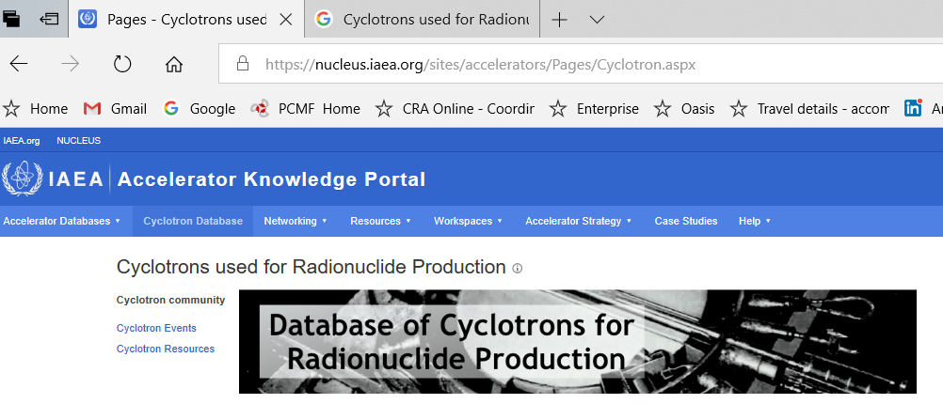
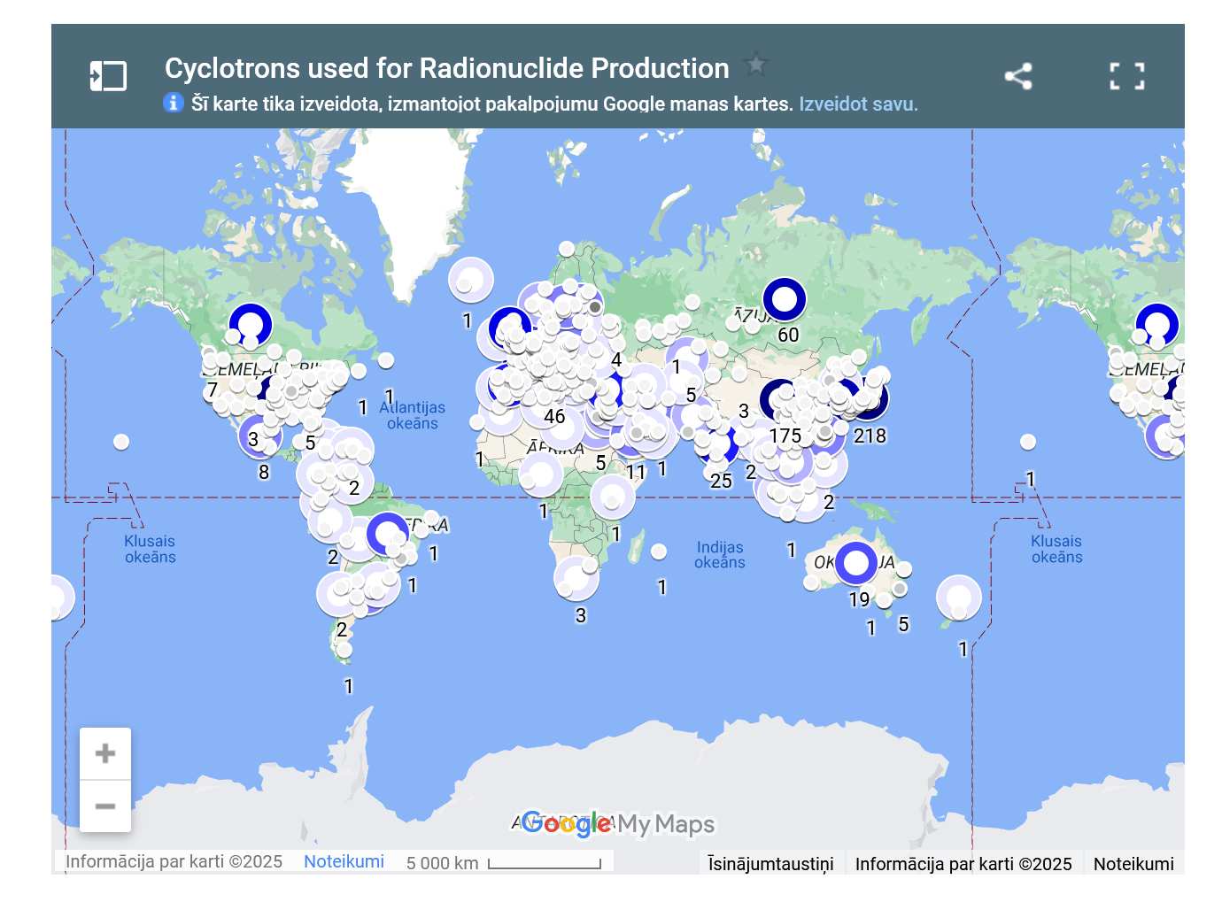
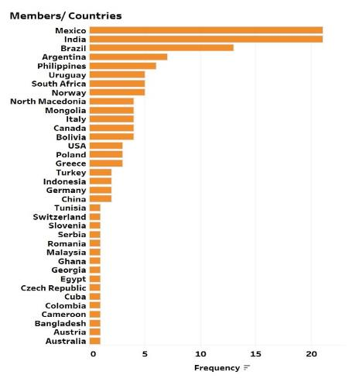
Useful “tools and toys”: Cyclotron database
https://nucleus.iaea.org/sites/accelerators/Pages/Cyclotron.aspx
>1350 cyclotrons 89 MSs
160 members from 41 MS

Slide 19
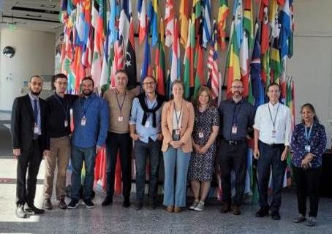
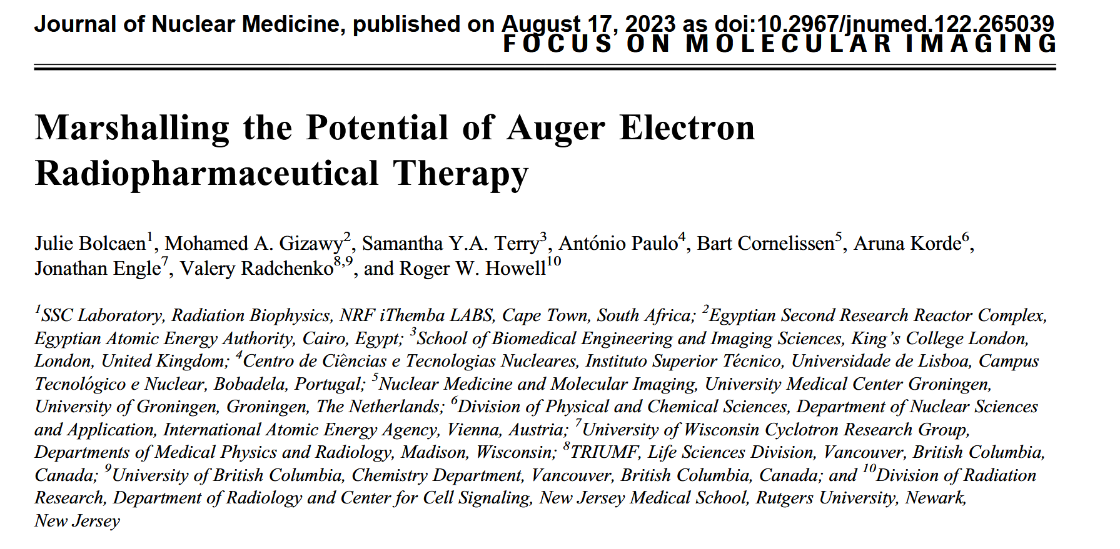
IAEA activities on Auger emitting radionuclides
“Auger Electron-Emitters for Radiopharmaceutical Developments” : 5-9 Sep 2022

Slide 20
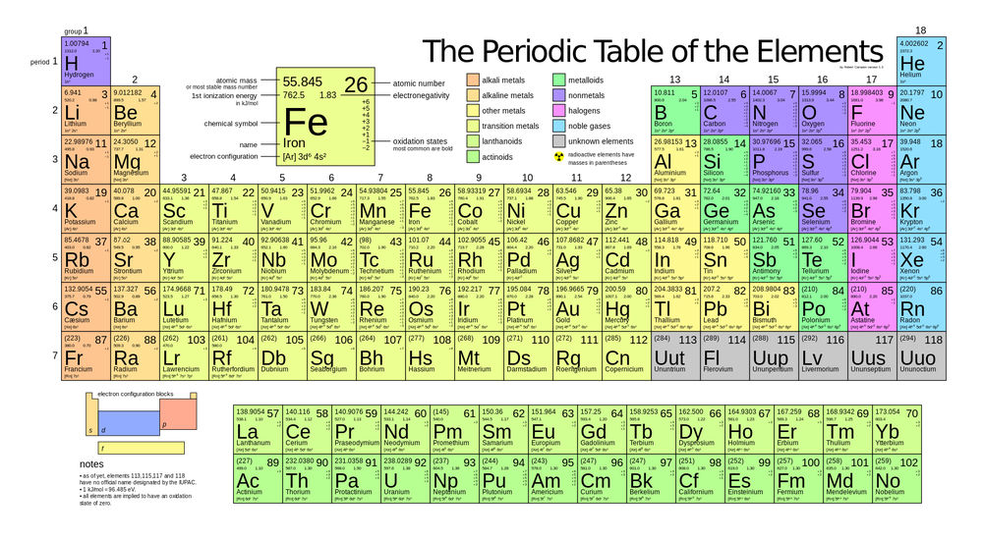
¹¹C PET
¹⁸F PET
⁴⁴Sc PET/ ⁴⁷Sc β⁻ therapy
⁴⁵Ti PET
^{52,54}Mn PET
⁵⁵Co PET
⁶⁴Cu PET/ ⁶⁷Cu β⁻ therapy
⁶⁸Ga PET/ ⁶⁷Ga Auger therapy
⁸⁶Y PET/ ⁹⁰Y β⁻ therapy
⁸⁹Zr PET
⁹⁰Nb PET
^{99m}Tc SPECT/ ^{94m}Tc PET
^{103m}Rh Auger therapy
¹¹¹In SPECT
¹¹⁹Sb Auger/¹¹⁸Sb PET/¹¹⁷Sb SPECT
¹²⁴I PET/ ¹²⁵I Auger therapy
¹⁴⁹Tb Alpha therapy/ ¹⁶¹Tb β⁻ therapy
¹⁶⁵Er Auger therapy
¹⁷⁷Lu β⁻ therapy
²⁰³Pb/ ²¹²Pb Alpha therapy
²¹³Bi Alpha therapy
^{223,224}Ra Alpha therapy
²²⁵Ac Alpha therapy
^{227,228}Th Alpha therapy
TRIUMF’s “Hot Kitchen”
Blue available
Green can/planning be produced
Yellow commercially available
ISAC and Th spallation provides
endless possibility for production of many
other medical isotopes

Slide 21

April 1-4, 2021,
Ottawa, Canada
IAEA supported the participation of trainees and delegates for TAT 11, TAT 12 and in planning for TAT 13

Slide 22
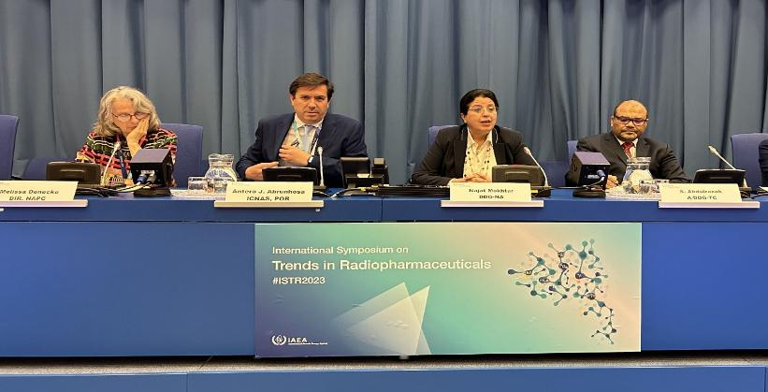
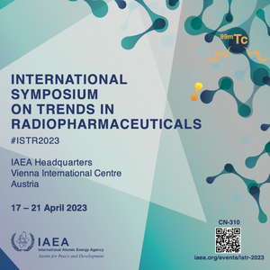
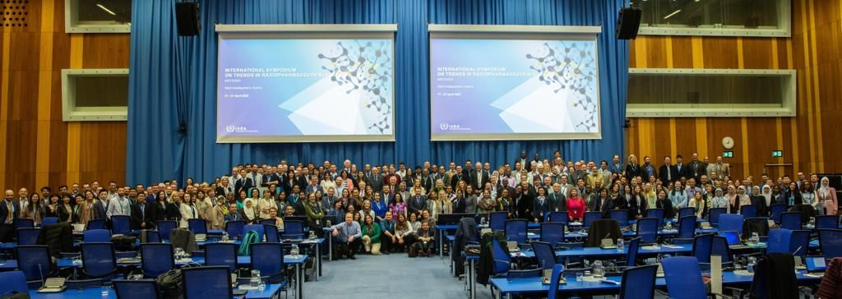
335 Abstracts
30 Companies
3 Professional Societies
550 participants
5 young investigator awards
88 Member States
4 side events:
IAEA-Partnership,
Speed mentoring for young researchers
Women in radiopharmacy
Save the date: NEXT ISTR June 21-25, 2027
International Symposium on Trends in Radiopharmaceuticals

Slide 23





Acknowledgements
British Columbia Cancer Agency
Francois Benard
Kuo-Shyan Lin
Chengcheng Zhang
Bernard and Lin labs
Paul Schaffer
Chris Orvig
Conny Hoehr
Caterina Ramogida
(Ramogida lab)
Hua Yang
(Yang lab)
Esther Schirrmacher
Luke Wharton
Eleanor Dunling
Justin Bailey
Peter Kunz
Neil Weatherall
Julius Balatoni
Vicky Hanemaayer
Joe Huser
Gloria Botelho
Tom Ruth
Jaewoong Jang (U.Tokyo)
Gokce Engudar
Siuwong Chan
Aivija Grundmane
Viktoria Krol
Parmissa Randhawa
Behrad Saeedi
Yumeela Ganga-Sah
Jordanne Burgess
Patrick Davey
Imma Carbo Bague
Marianna Tosato
Janke Kleynhans (KU Leuven)
UBC chemistry
Orvig lab
TRIUMF RPG
Bradley Noakes
Roxana Ralea
Justin Dileo
UW Madison
Jonathan W. Engle
Todd Barnhart
Aeli Olson
Eduardo (Ed) Aluicio-Sarduy
TR-13 team
Dave Prevost
Toni Epp
Ryley Morgan Spencer Staiger
Celina Horak
Aruna Korde
Amir Jallilian
Valeria Starovoitova
Raymond Reilly
Zhongli Cai
Madeline Brown
Arthur Chu

Slide 24









Thank you
Merci
vradchenko@trumf.ca
www.triumf.ca
Follow us @TRIUMFLab

