Slide 1
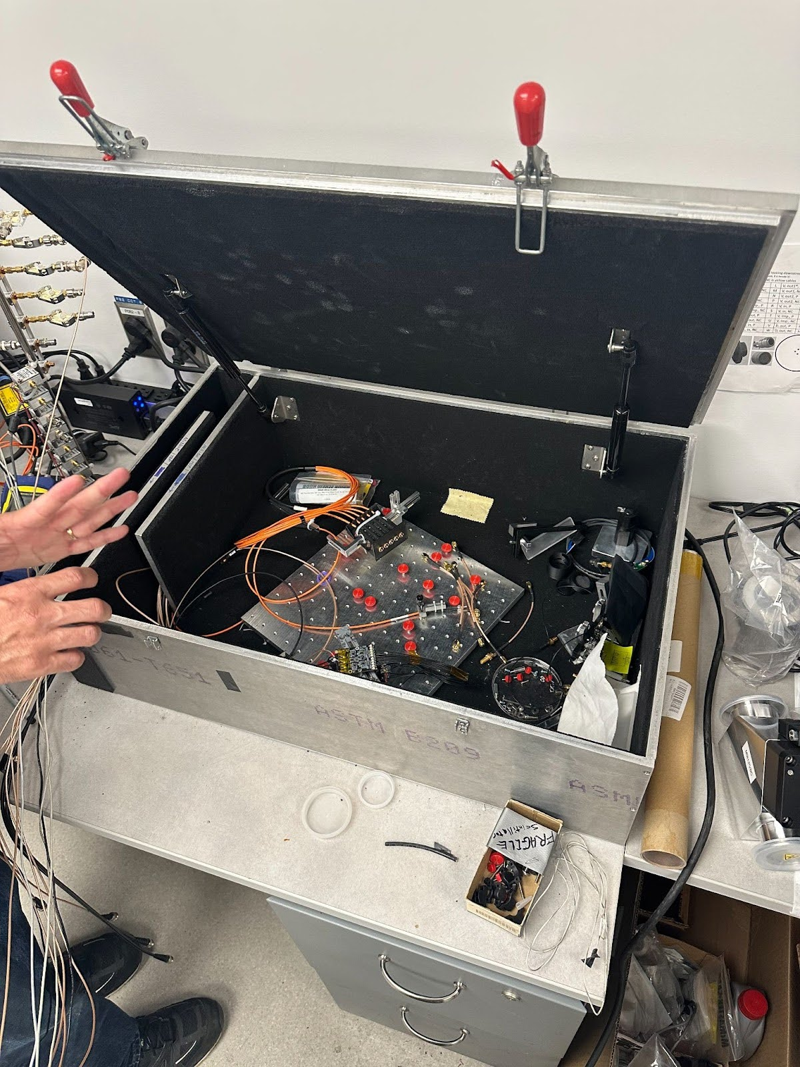
Neutron Detection with Organic Scintillators: Creation to Usage
Austin Keetley
CMMS

Slide 2

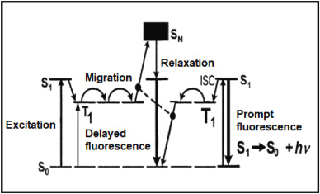
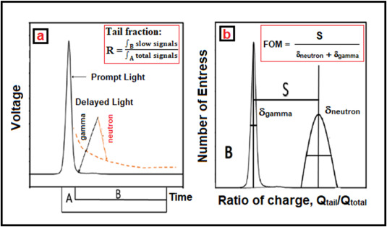
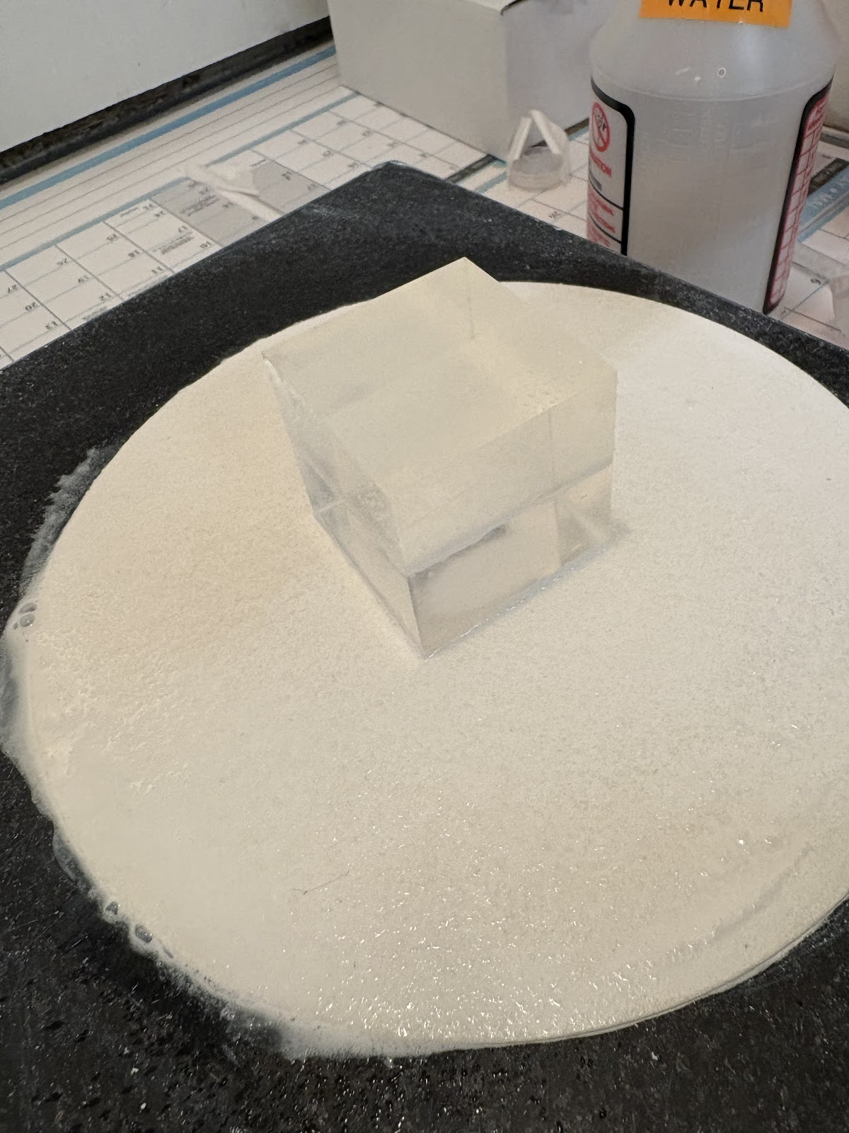
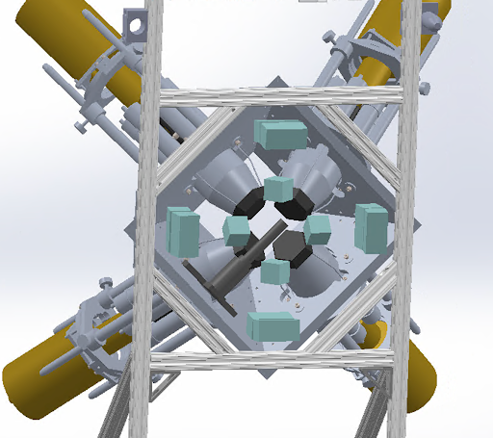
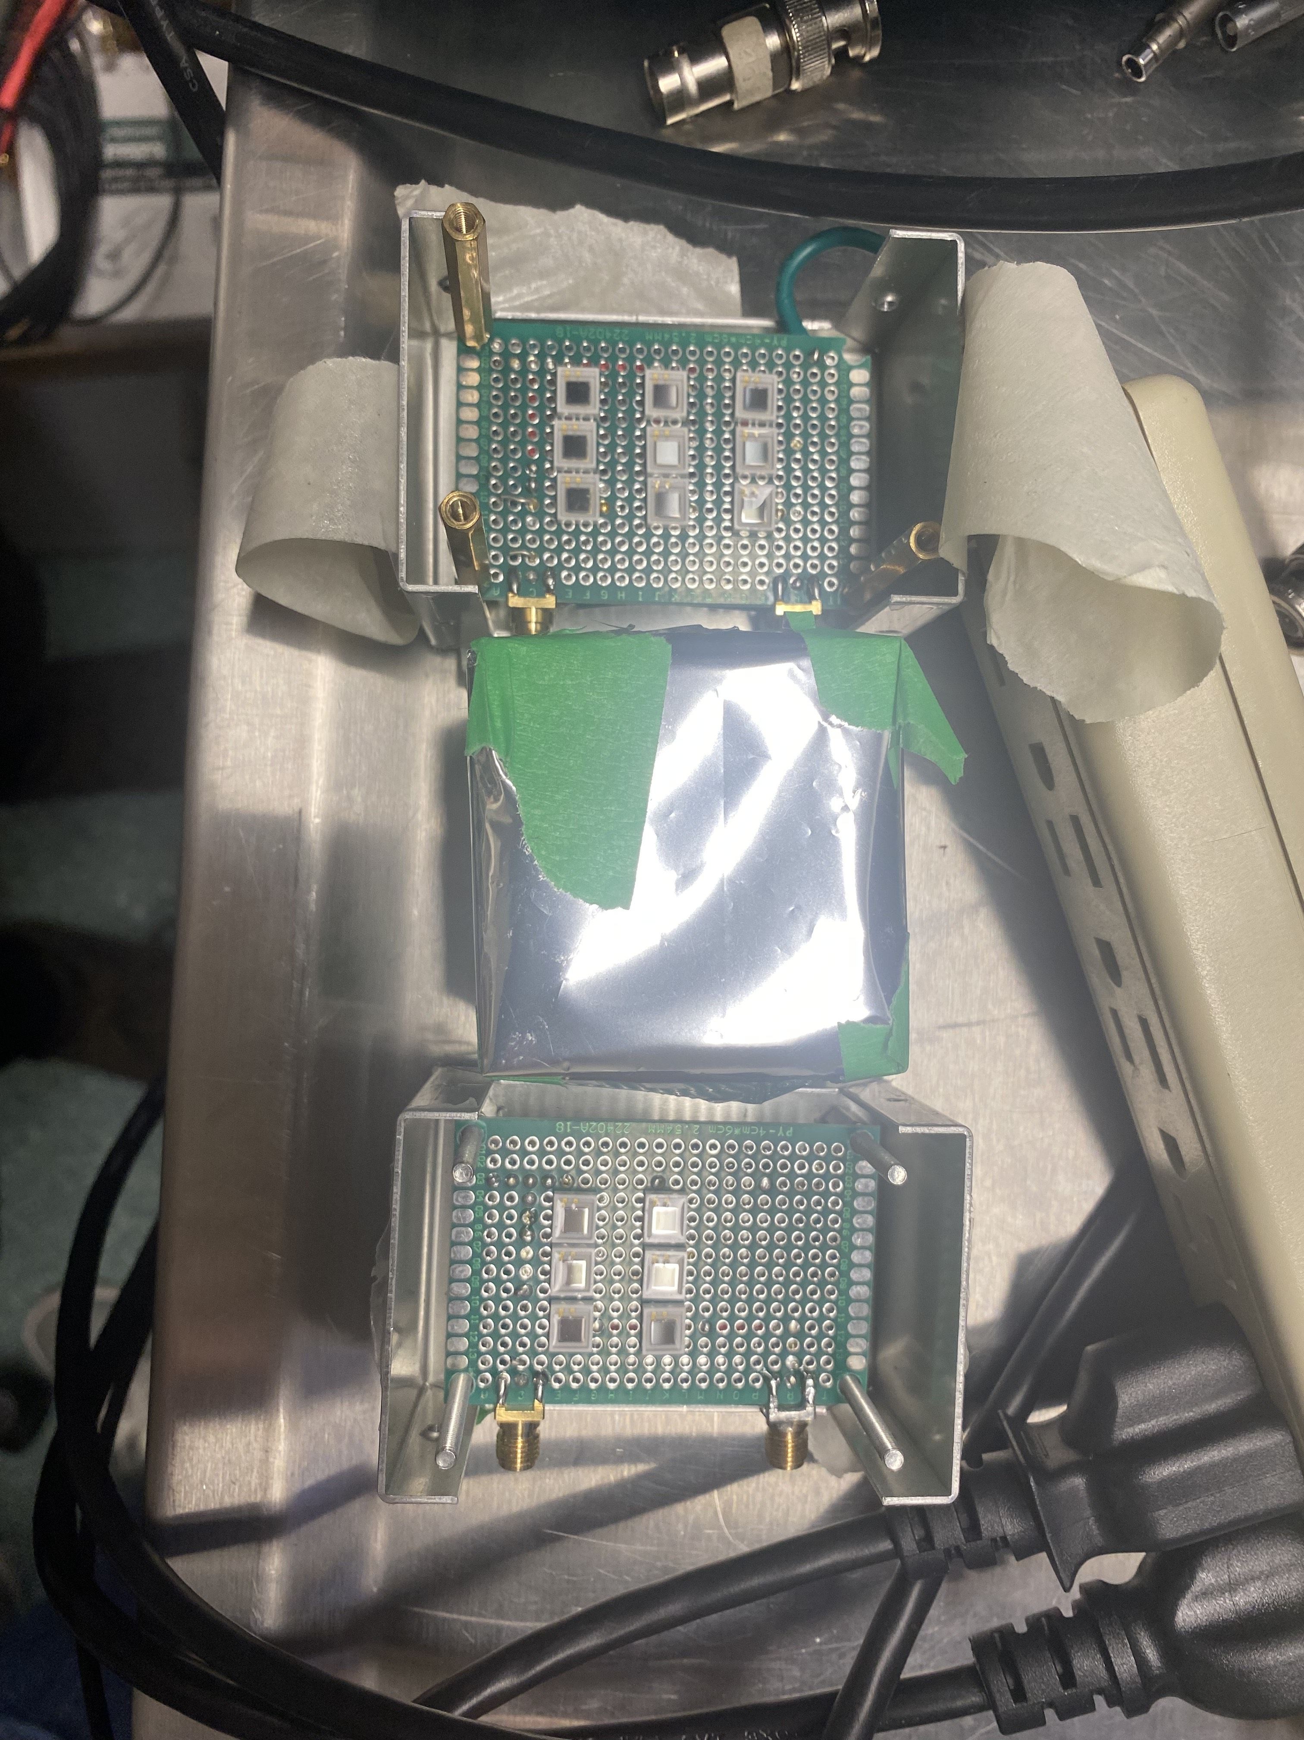
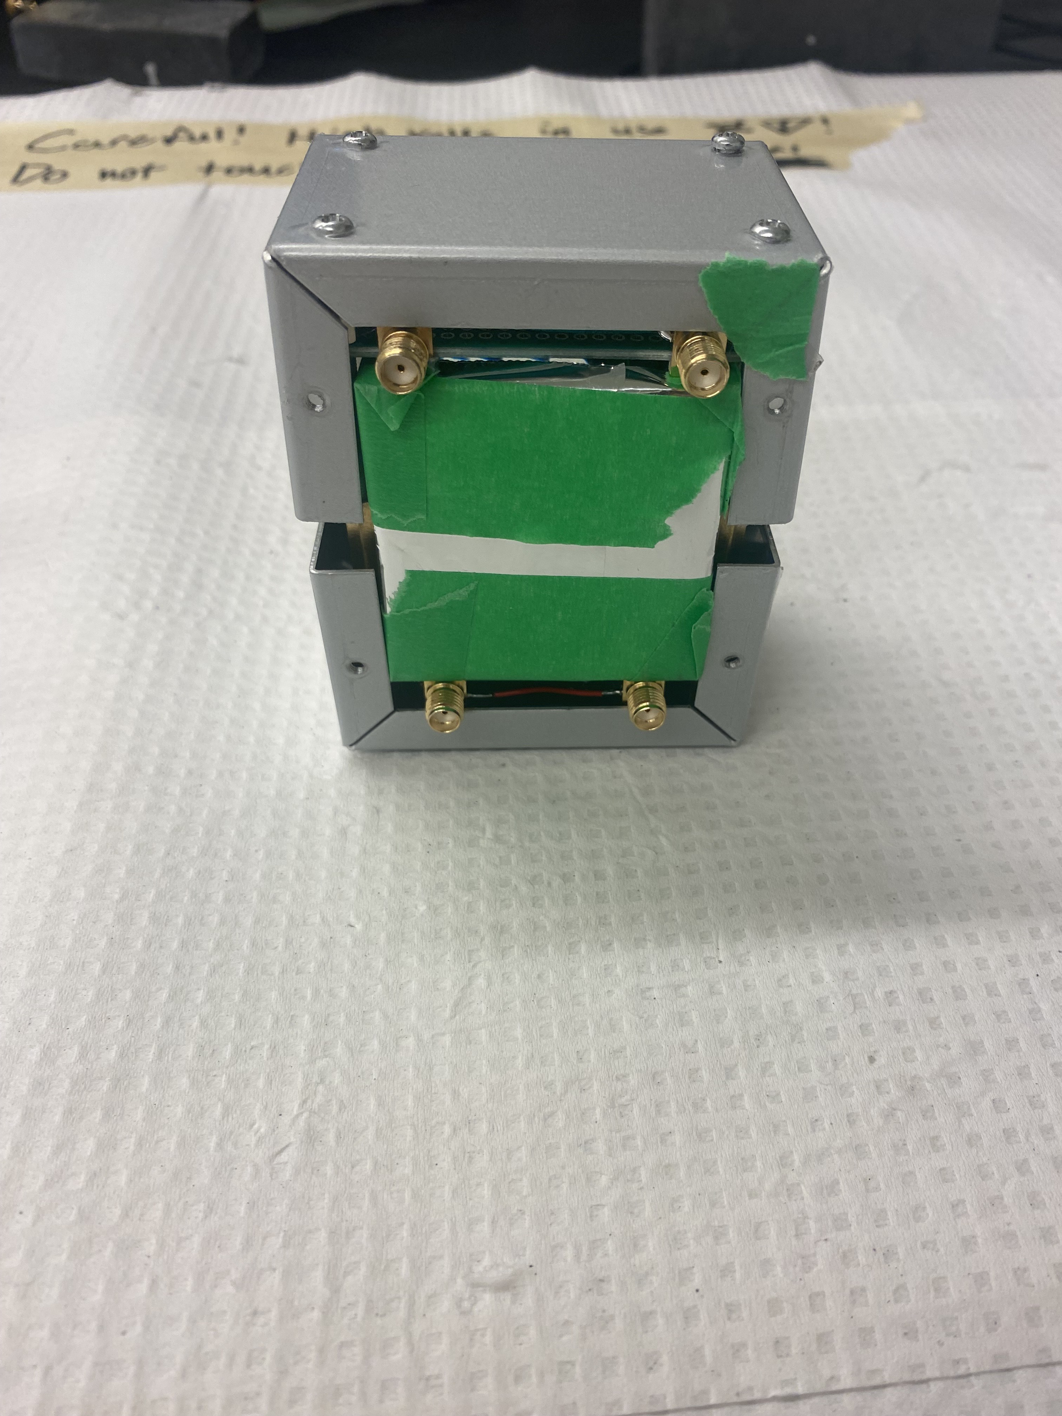
Fig 1 - Kumar and Parthiban , Nuclear Analysis (2025)
Fig 2 - Kumar and Parthiban , Nuclear Analysis (2025)

Slide 3





Thank you Merci
References
www.triumf.ca
Follow us @TRIUMFLab

