Slide 1
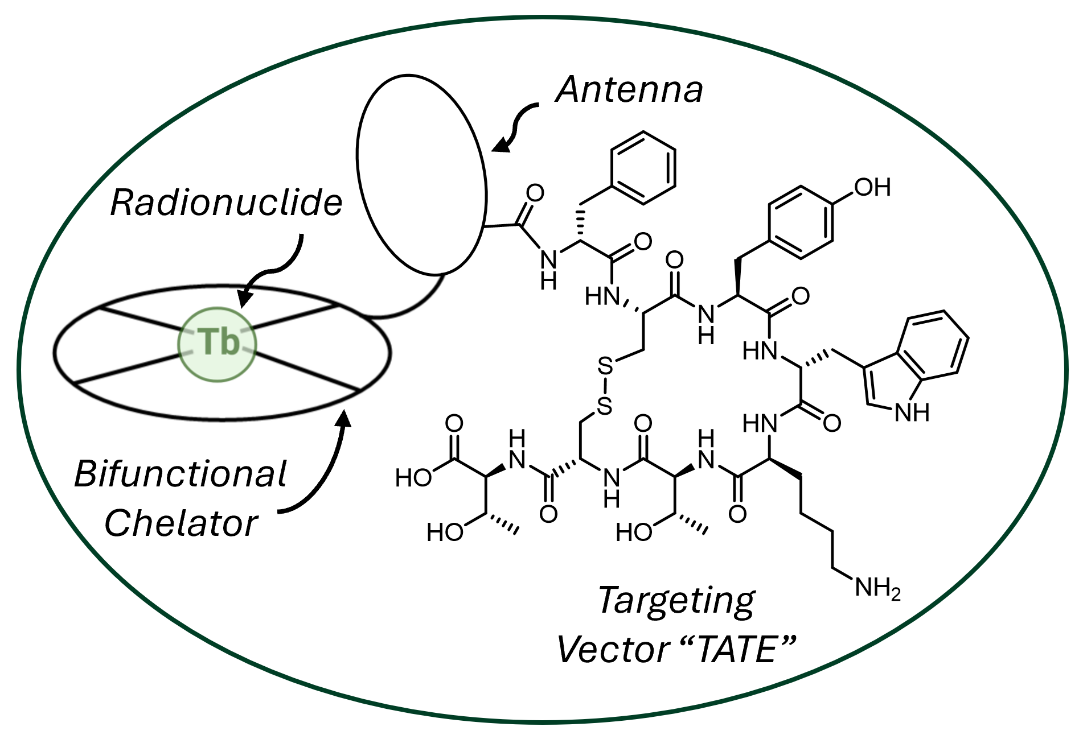
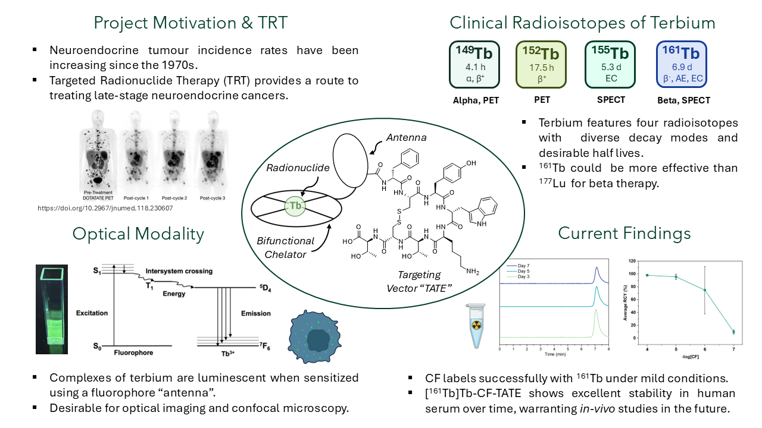
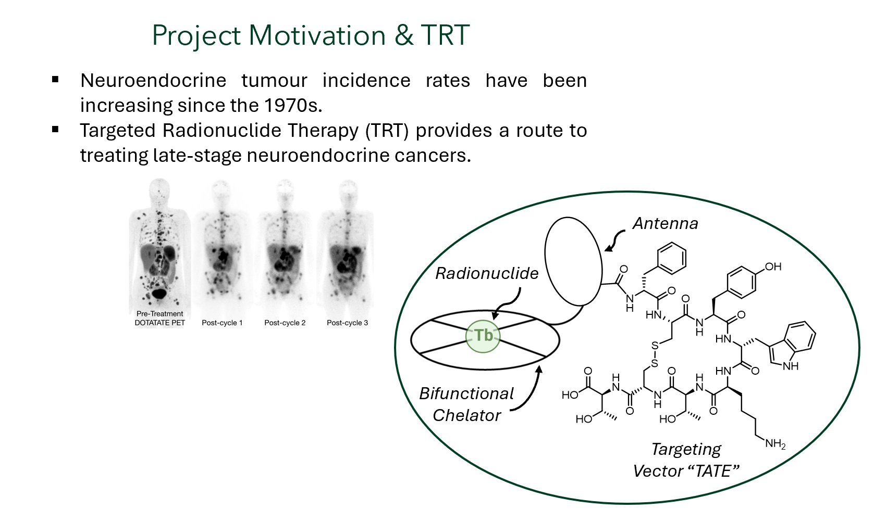
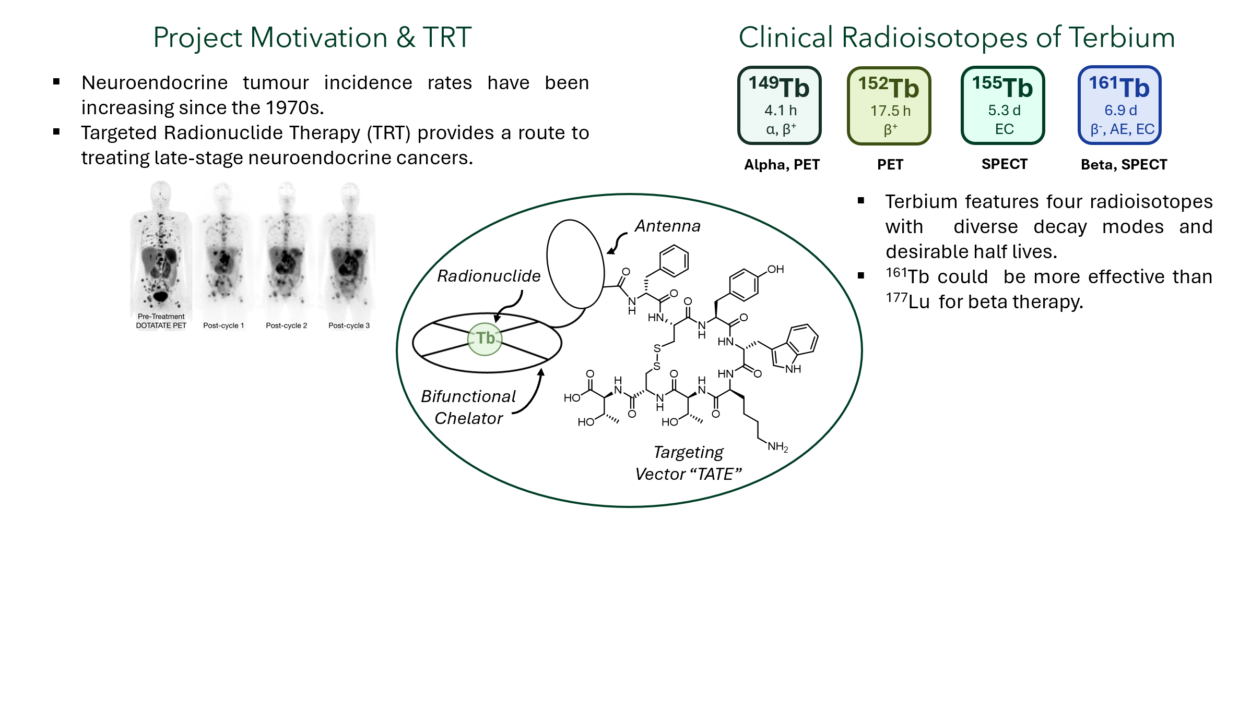
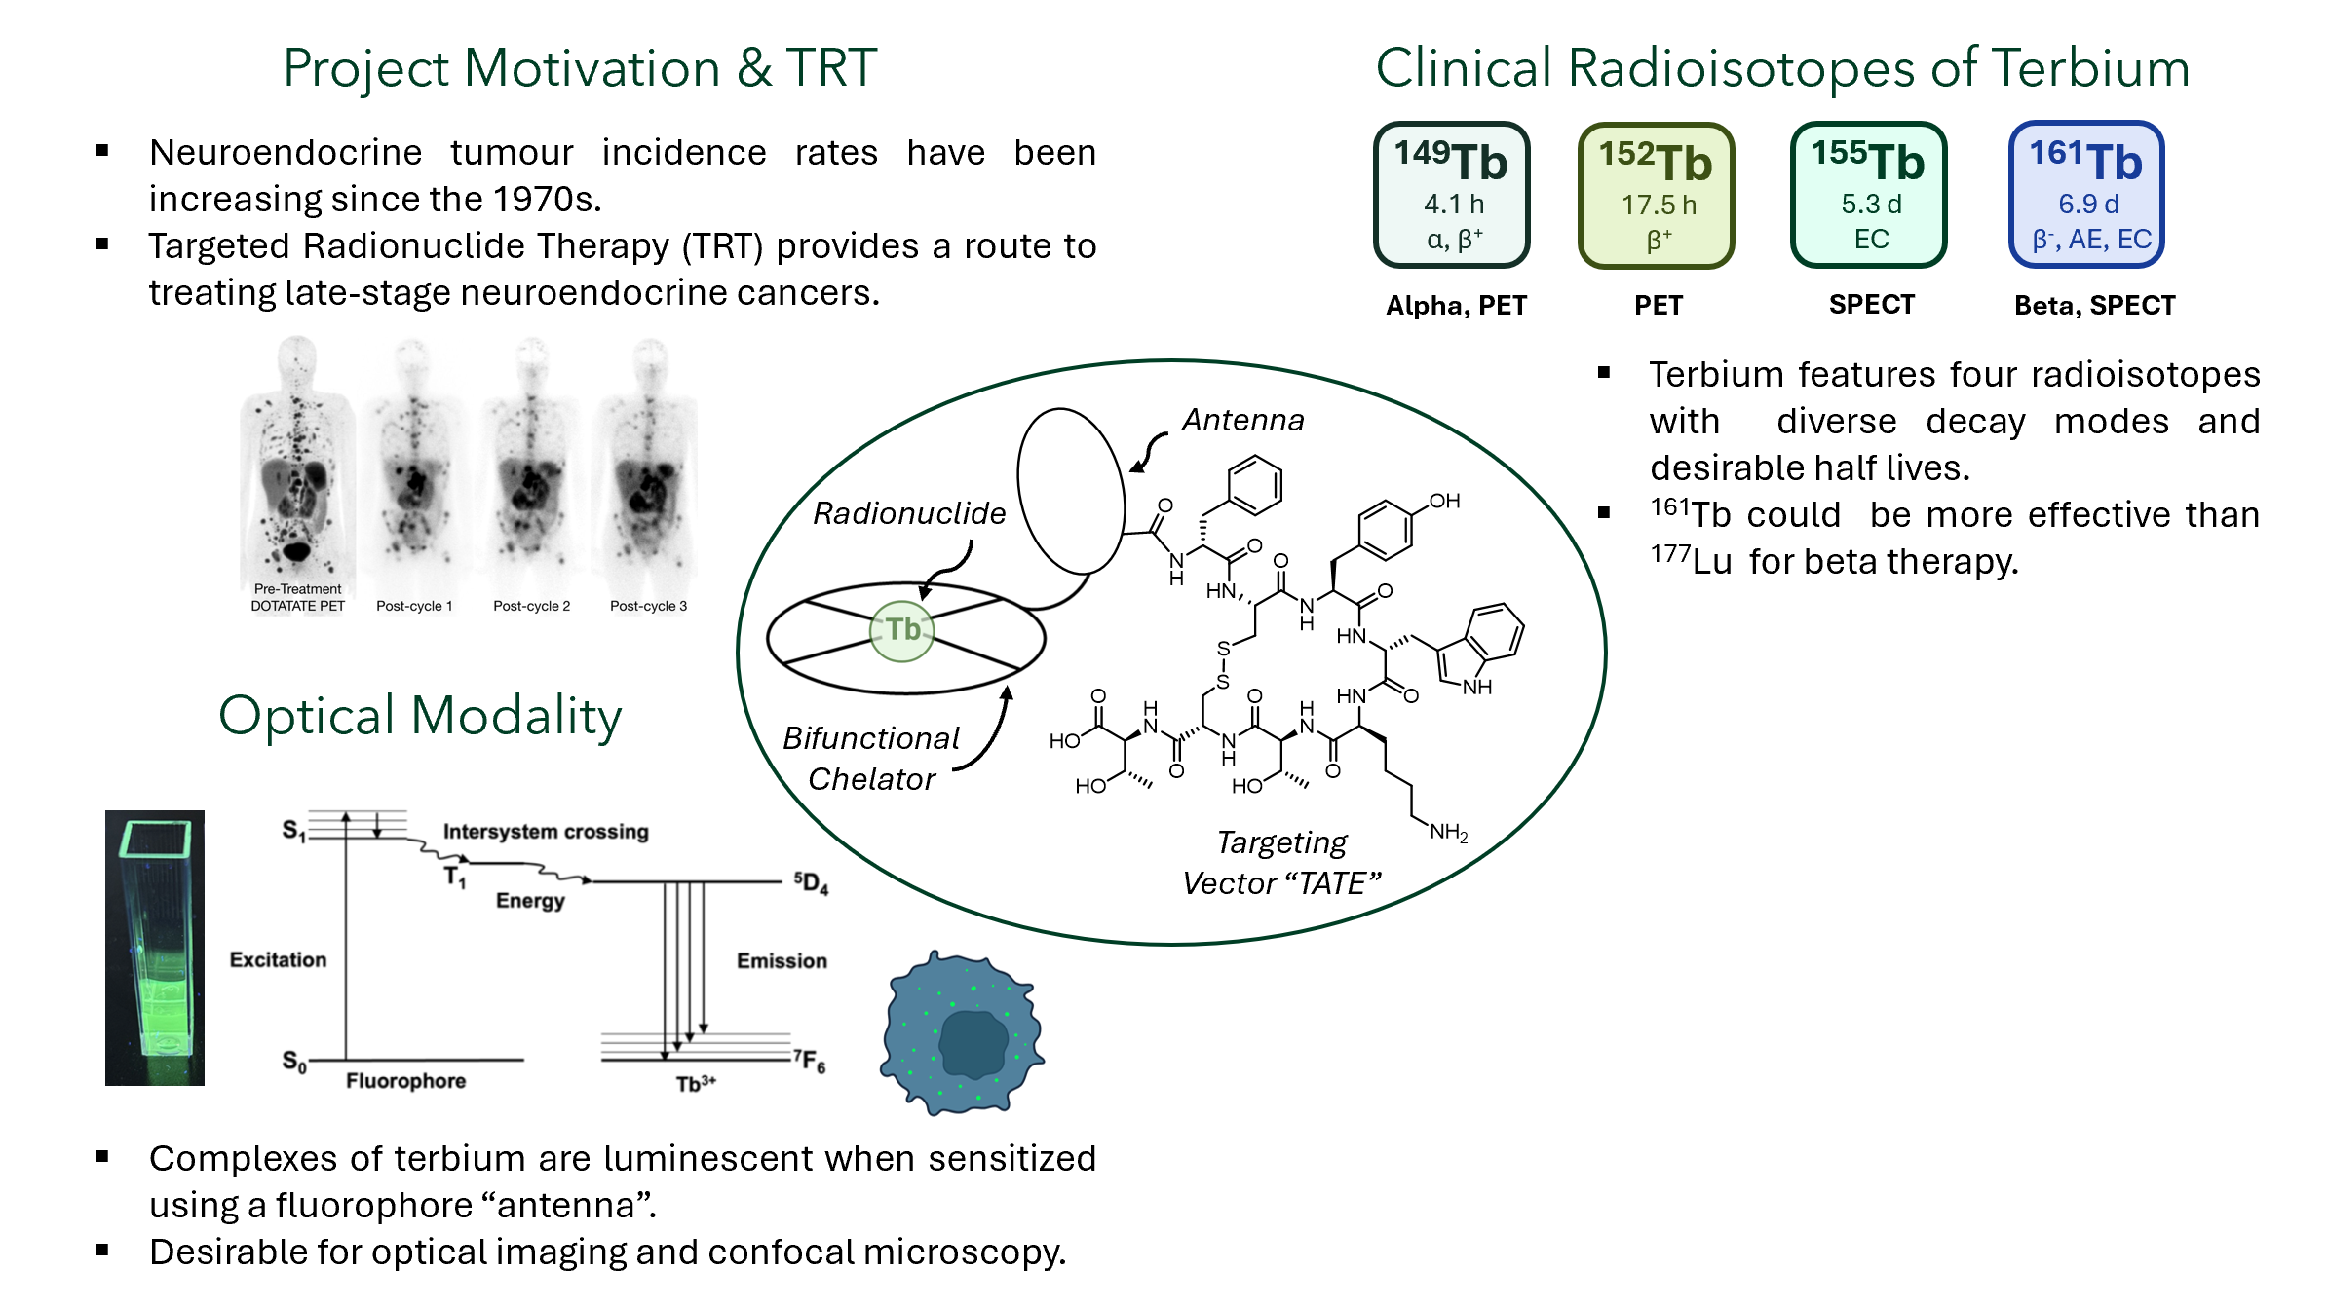

Slide 2
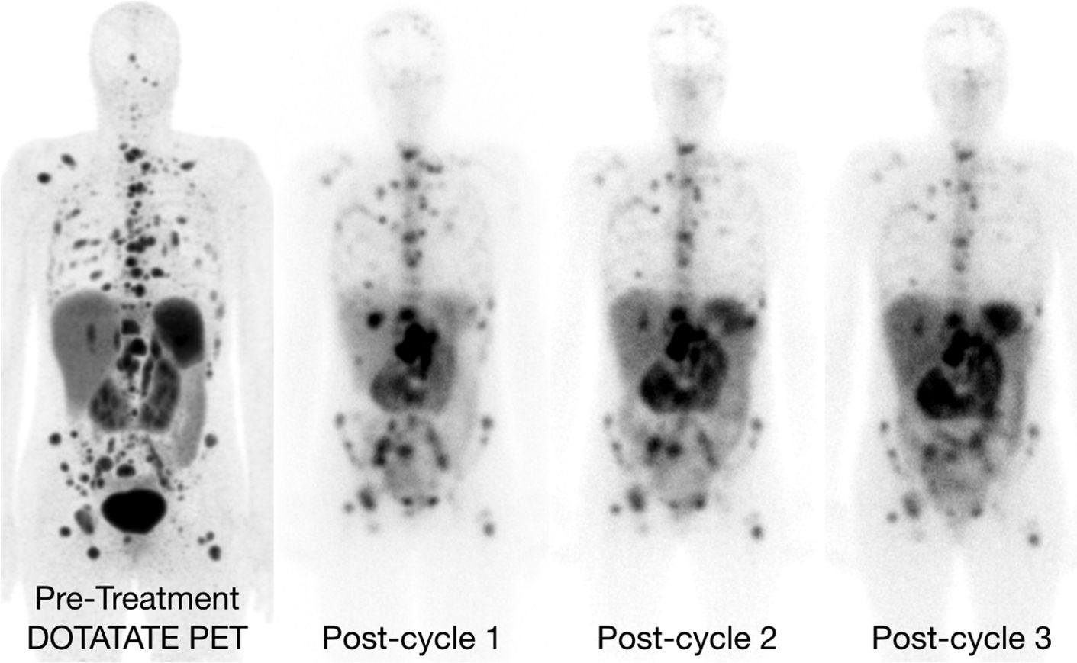
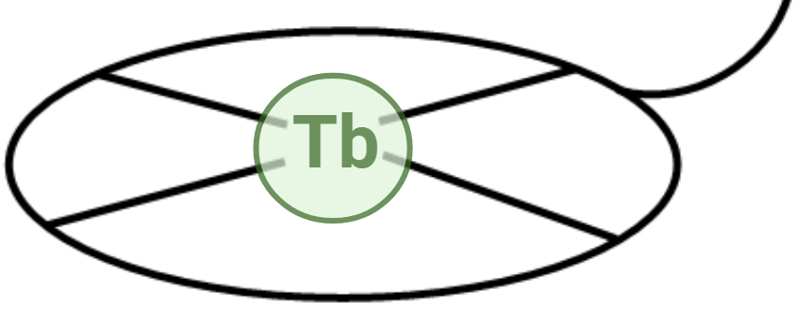
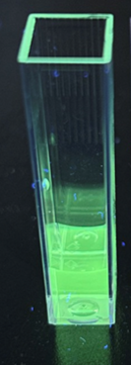
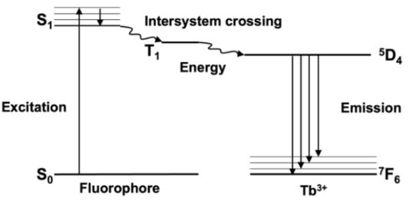
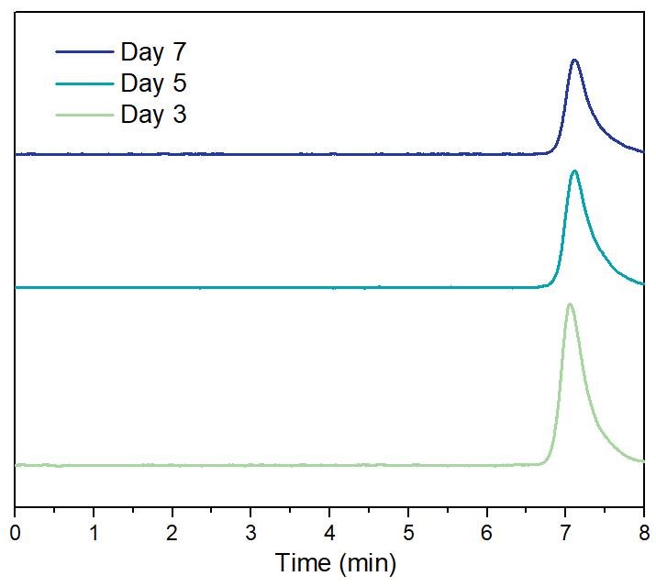
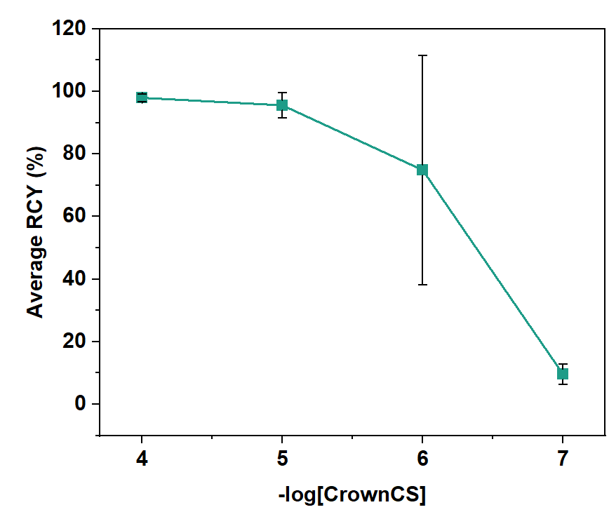
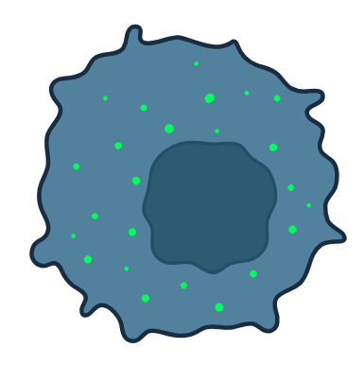
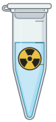
Project Motivation & TRT
Clinical Radioisotopes of Terbium
Neuroendocrine tumour incidence rates have been increasing since the 1970s.
Targeted Radionuclide Therapy (TRT) provides a route to treating late-stage neuroendocrine cancers.
¹⁴⁹Tb
¹⁵²Tb
¹⁵⁵Tb
¹⁶¹Tb
4.1 h
α, β⁺
17.5 h
β⁺
5.3 d
EC
6.9 d
β⁻, AE, EC
Alpha, PET
PET
SPECT
Beta, SPECT
Terbium features four radioisotopes with diverse decay modes and desirable half lives.
¹⁶¹Tb could be more effective than ¹⁷⁷Lu for beta therapy.
Antenna
Radionuclide
https://doi.org/10.2967/jnumed.118.230607
Optical Modality
Current Findings
Results and Next Steps
Bifunctional Chelator
Targeting Vector “TATE”
Complexes of terbium are luminescent when sensitized using a fluorophore “antenna”.
Desirable for optical imaging and confocal microscopy.
CF labels successfully with ¹⁶¹Tb under mild conditions.
[¹⁶¹Tb]Tb-CF-TATE shows excellent stability in human serum over time, warranting in-vivo studies in the future.

