Slide 1

Thorium Beams for Radioactive-Molecule Experiments:
Development of a Glow Discharge Ion Source
Presenter: Stephanie Cui
Supervised by Stephan Malbrunot-Ettenauer

Slide 2
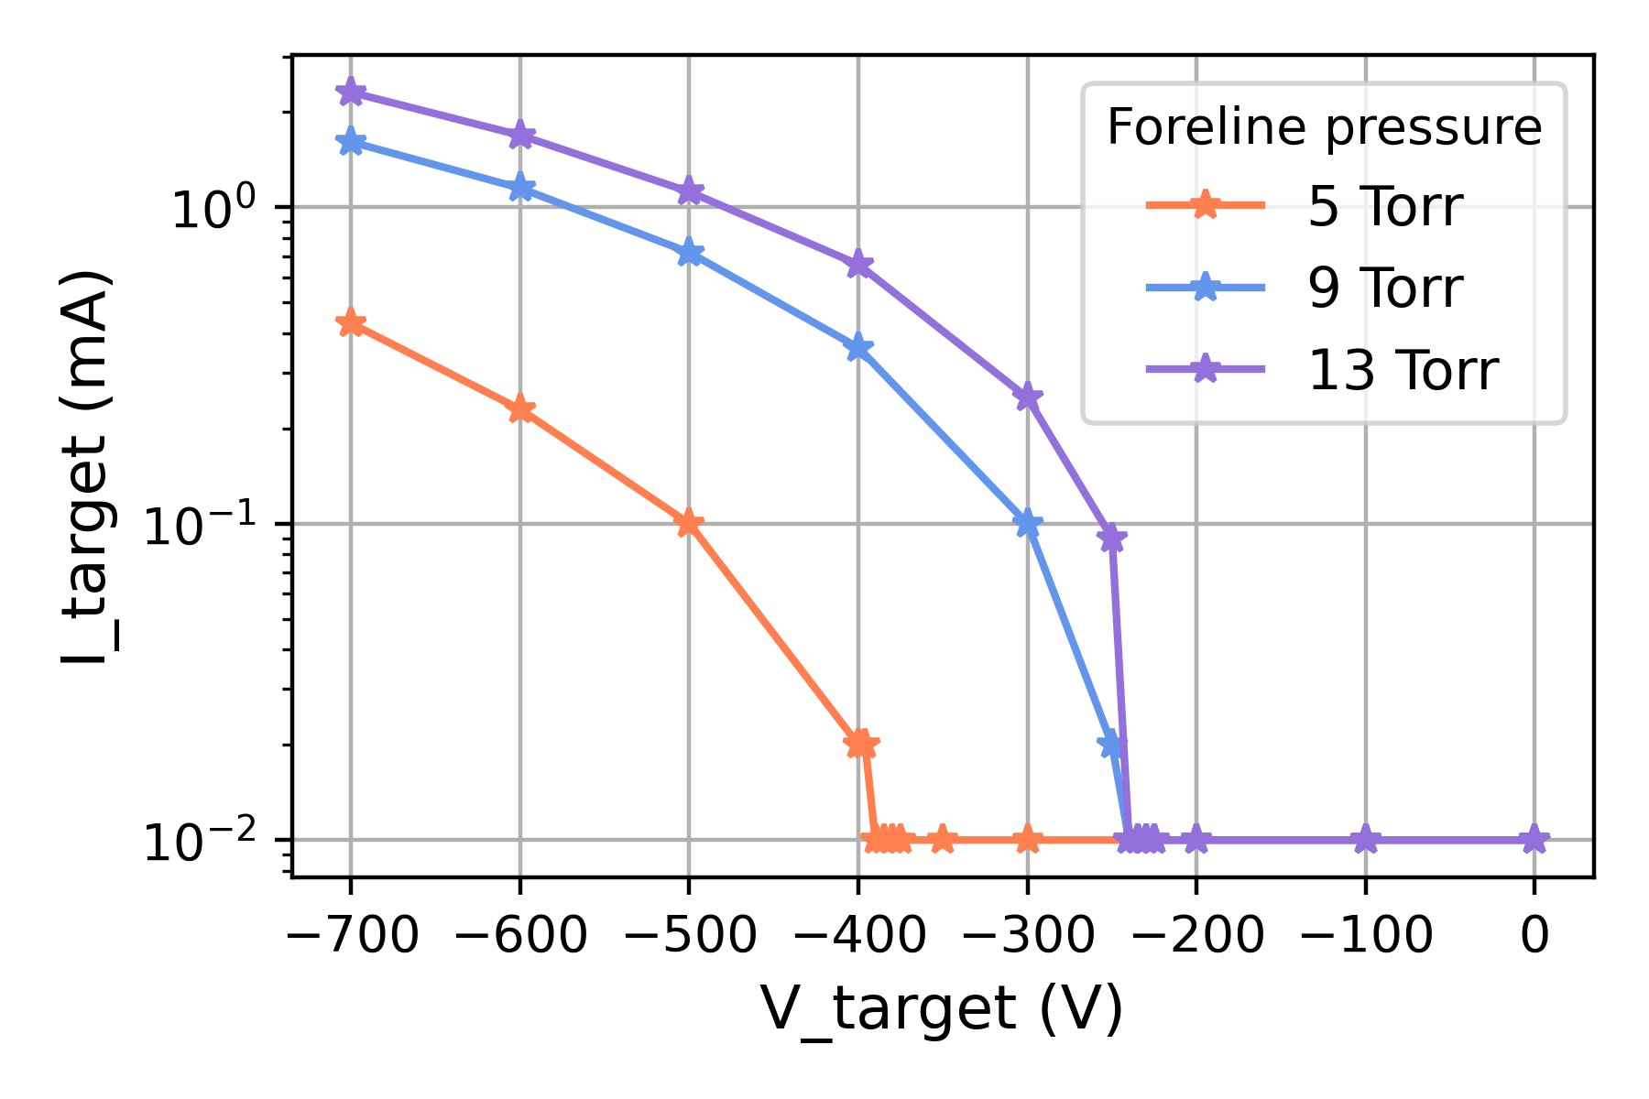



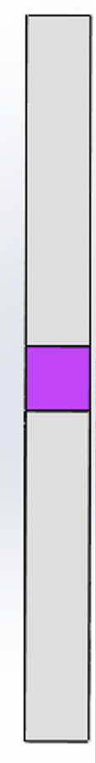

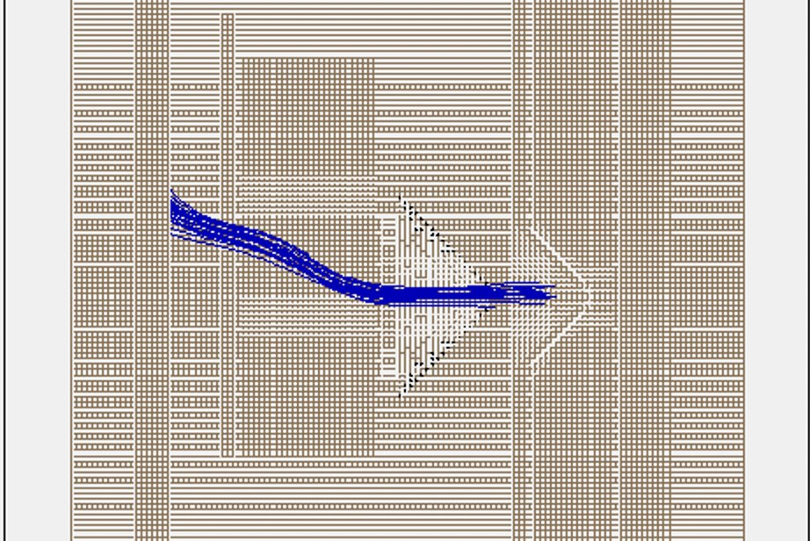
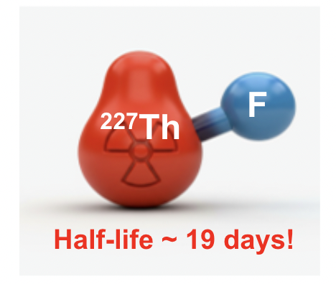
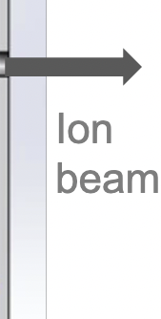
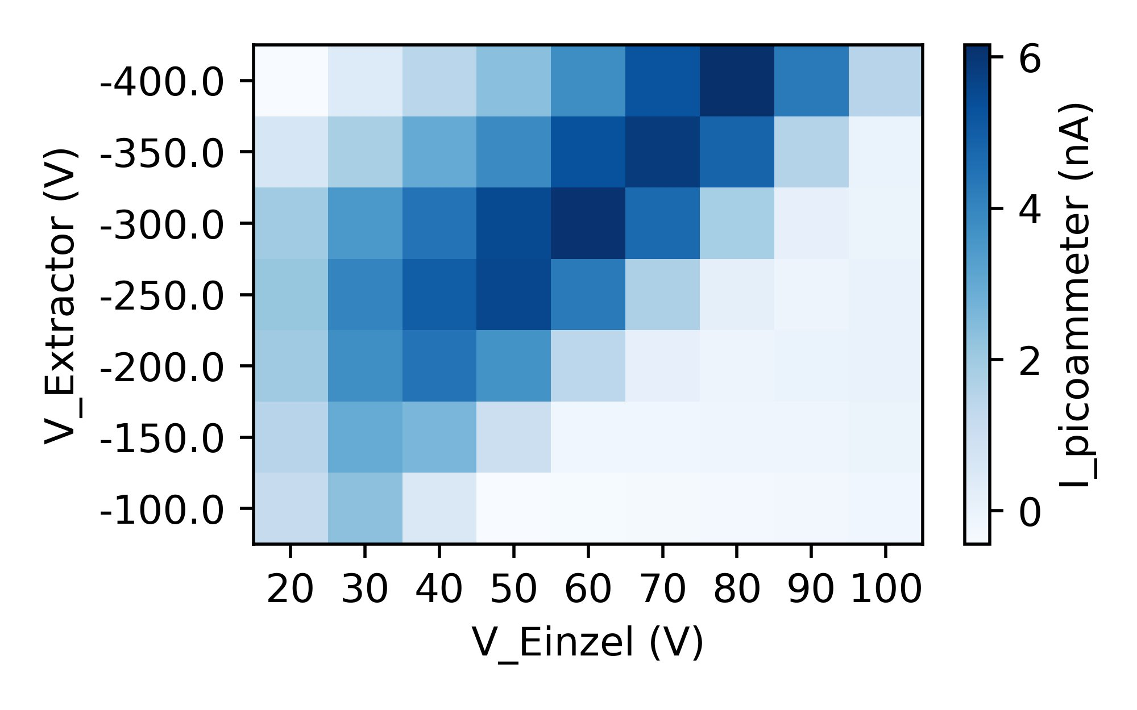
Motivation:
Measure Nuclear Schiff Moment (NSM) in radioactive molecules
Experimental set-up:
Glow discharge ion source
~30 mm
Ar inlet
holder
extractor
target
discharge/
skimmer
einzel lens

