Slide 1

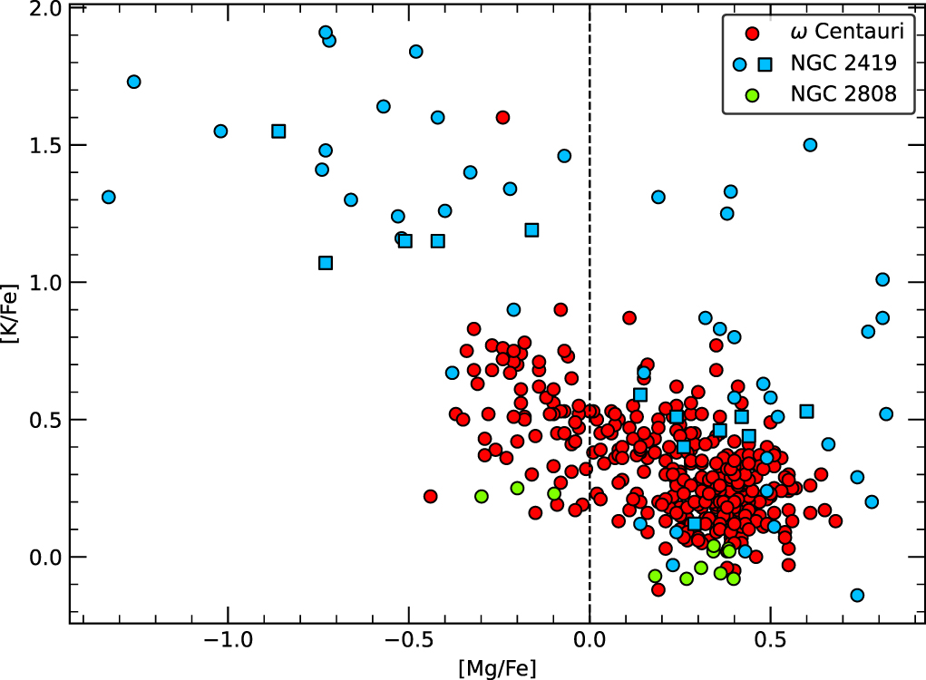

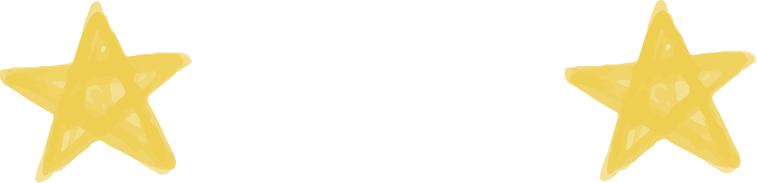



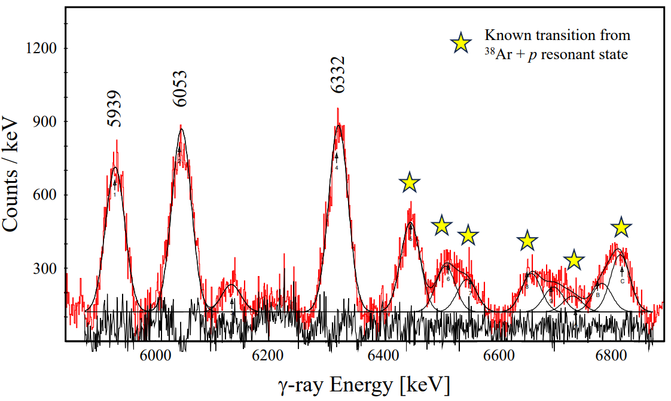
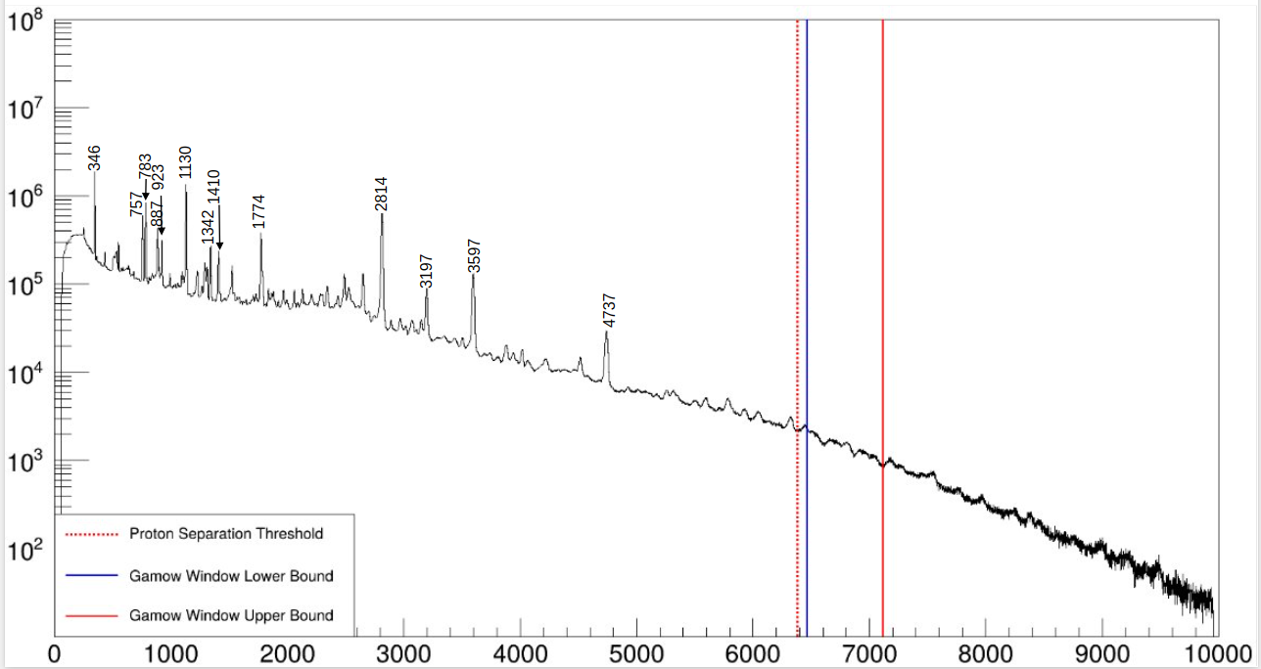
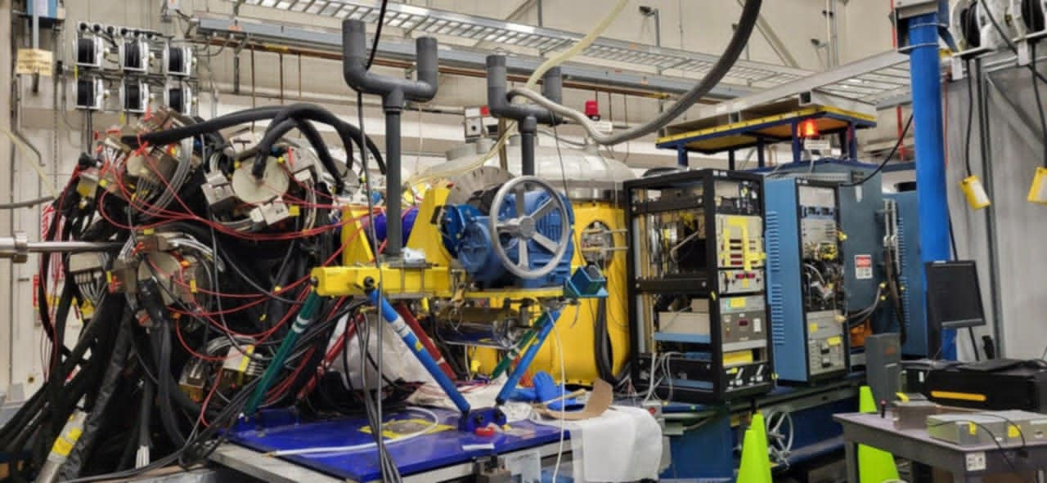

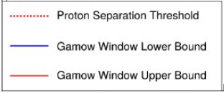
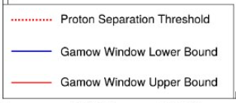
Claire Jameson supervisors: Matthew Williams and Gavin Lotay
³⁸Ar(p, γ)³⁹K
Whodunnit?
classical novae
super-AGB
D. Garay et al., Astrophys. J. Lett. 928, L11 (2022).​
Counts
γ-ray Energy [KeV]​
Counts
Counts
Counts
Counts
Counts
Counts
Counts
Counts
γ-ray Energy [KeV]
γ-ray Energy [KeV]
γ-ray Energy [KeV]
γ-ray Energy [KeV]
γ-ray Energy [KeV]

