Slide 1

Welcome to

Slide 2
TRIUMF is located on the traditional, ancestral, and unceded territory of the xʷməθkʷəy̓əm (Musqueam) people, who for millennia have passed on their culture, history, and traditions from one generation to the next on this site.
TRIUMF’s home has always been a seat of learning.
To know more, visit https://www.musqueam.bc.ca/our-story/

Slide 3
Code of conduct
Abridged from https://indico.triumf.ca/event/616/page/381-code-of-conduct
All participants, including attendees and organizers will treat each other with respect and conduct themselves in a professional manner […]
Contacts:
Andrea acapra@triumf.ca
Iris dillmann@triumf.ca

Slide 4
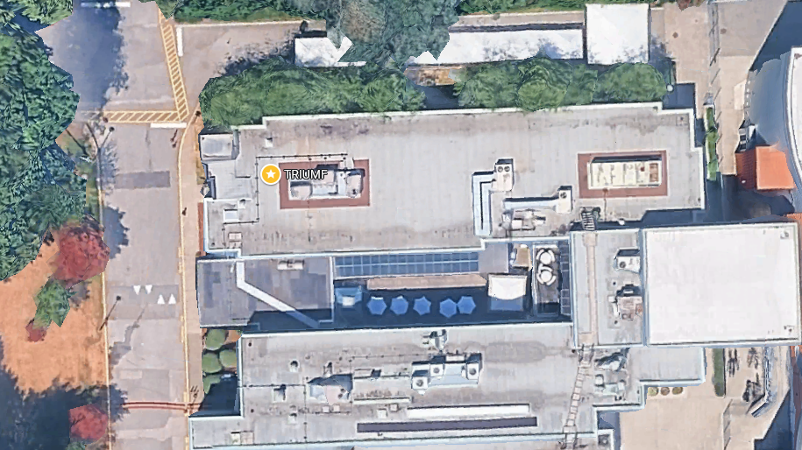

Slide 5
Fire Lane: Breaks/Lunches and Reception
Auditorium
Poster session

Slide 6
Program Overview: Monday
Morning (next 3 hours):
TRIUMF update from Executive Director and CEO, Nigel Smith
IAMI, BL1A and ARIEL
Work Coordination Group in preparation for Long Shutdown 2026, Doug Preddy
Afternoon – start of the scientific sessions
Collider physics
Detectors
Evening events starting at 18
Competitive students’ poster session, winner announcement on Wednesday
Reception

Slide 7
Program Overview: Tuesday
Entire day dedicated to scientific highlights from the lab and beyond:
New opportunities with accelerators
Life Sciences program
TUCAN, ALPHA, Hyper-K

Slide 8

Program Overview: Wednesday
TRIUMF User Group (TUG) Annual General Meeting (AGM)
with beam delivery update, GAPS and Q&A with senior management
Panel discussion: When will digital SiPM move beyond the R&D phase for subatomic physics and other applications?, lead by Fabrice Retiere
Student 3 minutes talks (competition) and awards (posters and talks)
Symposium: Quantum Science at TRIUMF, lead by O. Stelzer
Celebration of the 2025 International Year of Quantum Science and Technology

Slide 9
Program Overview: Thursday
Early-Career Researcher Workshop by GAPS
Cover letters
Panel discussion
Speed mentoring
Git crash course

Slide 10
Good to know
Lunch: tickets in your badge, if you registered.
Coffee break: Bring you own mug if possible.
Zoom link has been shared by email on Friday.
For virtual attendees, raise you hand to ask questions.

Slide 11
Local Organizing Committee
Iris Dillmann
Kate Pachal
Brad Schultz
Xiaoyue Li
Gabby Gelinas
Jenn Cheung
Jana Thompson
Marcello Pavan
Pascal Retiere
Christian Diget
Pauline Dela Zilwa
Lauren Gorman
Session chairs
Mark Hartz
Bob Laxdal
Chloé Malbrunot
Petr Navratil
Fabrice Retiere
Oliver Stelzer
Isabel Trigger
Hua Yang

Slide 12
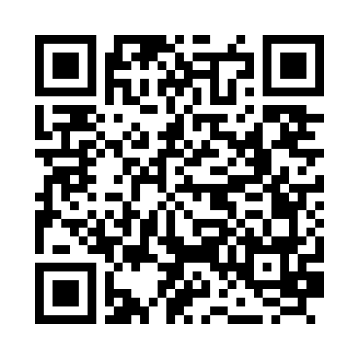
Enjoy Science Week!
https://indico.triumf.ca/event/616/timetable/#all.detailed

