Slide 1
Particle Physics Faculty Meeting
Agenda
  News
  ACOT
  Update from Groups
  Update from Committees
  AOB

Slide 2
Budget
Strengthening Canada’s World-Class Physics Research
TRIUMF is a world-class sub-atomic physics research laboratory located in British Columbia, and home to the world’s largest cyclotron particle accelerator. TRIUMF has played a leading role in many medical breakthroughs—such as developing alongside Canadian industrial partners new approaches to the medical imaging of diseases—and brings together industry partners, leading academic researchers and scientists, and graduate students from across Canada and around the world to advance medical isotope production, drug development, cancer therapy, clinical imaging, and radiopharmaceutical research.
Budget 2019 proposes to provide TRIUMF with $195.9 million over five years, starting in 2020–21, to build on its strong track record of achievements. Combined with an additional $96.8 million from the existing resources of the National Research Council, federal support for TRIUMF will total $292.7 million over this five-year period.

Slide 3
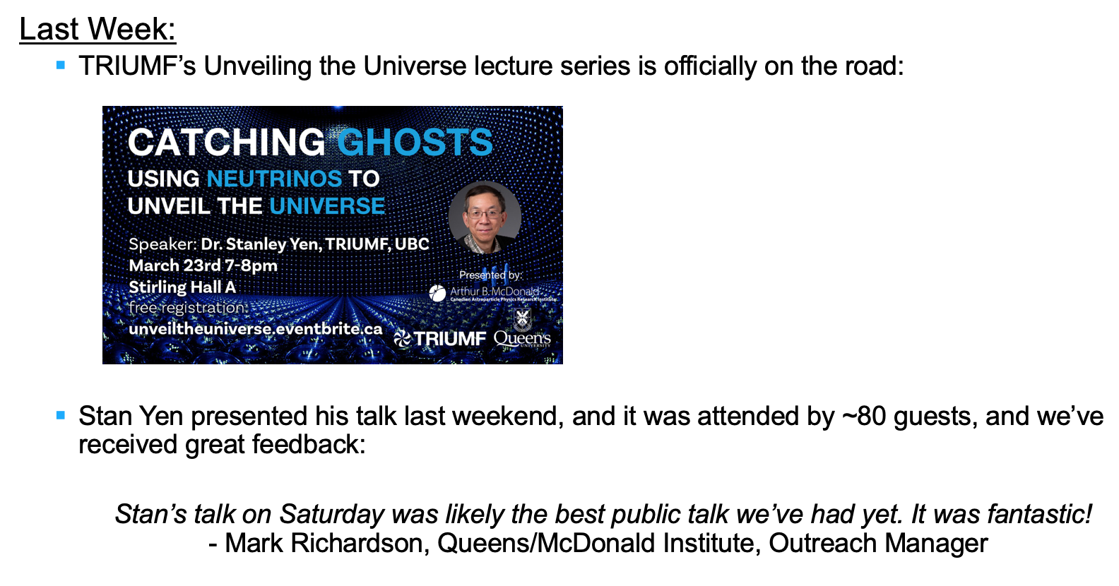
News

Slide 4
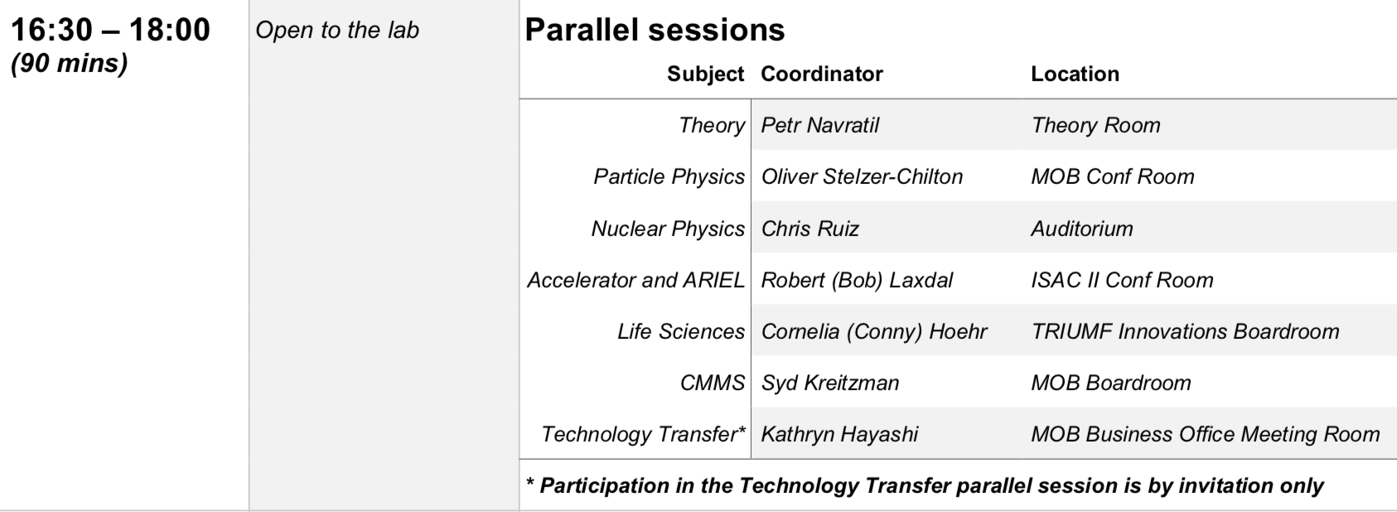
ACOT
April 8-10

Slide 5
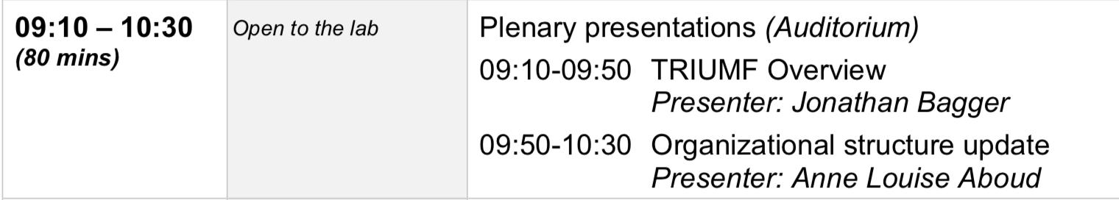
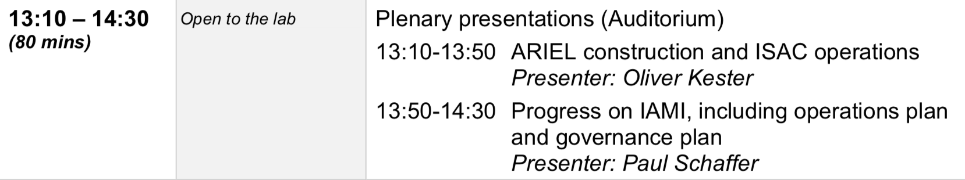
ACOT
Tuesday April 9

Slide 6
ACOT
From YKK
I would like to start with an introduction talk covering
Overall "TRIUMF" particle physics vision and strategies
  How each project (your list) fits in this strategy
  Challenges: past, now and future
See below for my suggestion:
  Introduction - 15' + 5’ vision, strategies and challenges
  News and Updates (do not repeat what was covered in the introduction talk)
    ATLAS - 5'+3’
    T2K/HyperK - 5'+3’
    TUCAN - 5'+3’
    ALPHA - 5'+3’
    SuperCDMS - 5'+3’
    Science and Technology: Update - 10’
  Q/A with students and postdocs - 20’

Slide 7
ACOT
For Intro talk, start with talk at Physical Sciences Division retreat by Mark / IPR talk by Beatrice
  What to mention for:
  How each project (your list) fits in this strategy
  Challenges: past, now and future
Hold practice talk session on Monday April 1st at 2pm in MOB Boardroom
  Confirm speakers for SciTech, ATLAS, T2K/HyperK, TUCAN, ALPHA, SuperCDMS
Q/A with students and postdocs - 20’
  Inform your students
  Suggest to create mailing list
  Graduate Students and Postdocs in Particle Physics

Slide 8
ATLAS BAE Search
Five candidates are visiting TRIUMF April 2nd (Tuesday) - April 8th (Monday)
Seminars will be 2pm – 3pm except on Thursday10:30am – 11:30am
Particle Physics group meetings with candidates
  9-10:15 am meeting (coffee and snacks)
  Tour of facilities at 10:30-11:30 except on Thursday 2:15-3:15
    sTGC (Isabel) -> UCN (Beatrice/Ruediger) -> T2K/mPMT -> SciTech (TBD) -> ITK (Nigel)
  Separate meeting with ATLAS group and Affiliated Scientists
  Provide feedback to the chair of the search committee by Monday (8th) evening
    Stew Smith smithajs@Princeton.EDU
  HR gave green light to share CV’s + letters of five candidates with the department
  Access rights needs to be manually given
  Need to keep application packages confidential!
  https://documents.triumf.ca/docushare/dsweb/View/Collection-24443

Slide 9
Hiring Plan
According to our plan for the remaining of this 5 year plan 2015-2020, we put forward 2 priorities
ALPHA/Quantum Sensing BAE
    Job Description / Request for hire submitted at the end of 2018
    Supported by Jens
    Directorate: Is the timing right?
    Status: Jens committed “it is slotted” but with no ARIEL connection might be delayed
UCN
    Made the case (Ruediger and Beatrice) that
    The UCN project is in a critical stage with both, the new UCN source and EDM experiment being developed at the same time while running the prototype source
    The manpower is very thinly spread among these projects, so the milestone to install the UCN source in 2021 and start with an EDM experiment right after source commissioning is at risk
    Finding more offsite collaborators does not help enough, since there are many vital aspects of the projects intimately connected with TRIUMF
    Jens: No new BAE hire until new source is commissioned
    Jens: Supports P&S hire
      Job Description / Request for hire submitted March 12th
      Questions: does new hire free resources for ARIEL & could it strengthen diversity

Slide 10
Project News
  ATLAS
  T2K/HyperK
  UCN
  ALPHA
  SuperCDMS
  Pienu
  NA62
  DEAP
  SNO+
  EXO
  HALO
  g-2
  Belle 2
  Theory

Slide 11
Committee Updates
  Seminar/Colloquia
  Safety
  Space
  5S
  Academic
  Health & Wellness
  Data Science
  Summer schools
  Diversity committee
  Physical Sciences Division Structure
  PPR Working Group
  IPP
  CAP PPD

Slide 12
AOB
Next meeting Thursday April 11th 2019 12:30?
  Olivia diMatteo will visit

