Slide 1
Particle Physics Faculty Meeting
Agenda
News/Update
Committee updates

Slide 2
TRIUMF is located on the traditional, ancestral, and unceded territory of thexʷməθkʷəy̓əm (Musqueam) people, who for millennia have passed on their culture, history, and traditions from one generation to the next on this site.
TRIUMF’s home has always been a seat of learning.

Slide 3
UCN Search
Five shortlisted candidates interviews complete
Efrain Segarra, PSI Villigen
Marie Blatnik, Los Alamos
Skyler Degenkolb, U Heidelberg
Wolfgang Schreyer, Oak Ridge NL
Noah Yazdandoost, PSI Villigen
Report was received by Ritu and myself, Ritu send it to director
HR to make an offer to top ranked candidate
A big thank you to the search committee!

Slide 4
Bonus Pay Nominations
Due to be submitted by the Division to the LT by January 17
Particle Physics to submit to Ritu by January 15th
General criterion:
To recognize performance/contribution (what was achieved) that exceeds expectations of job function AND
while modelling TRIUMF values and behaviors (how things were achieved)

Slide 5
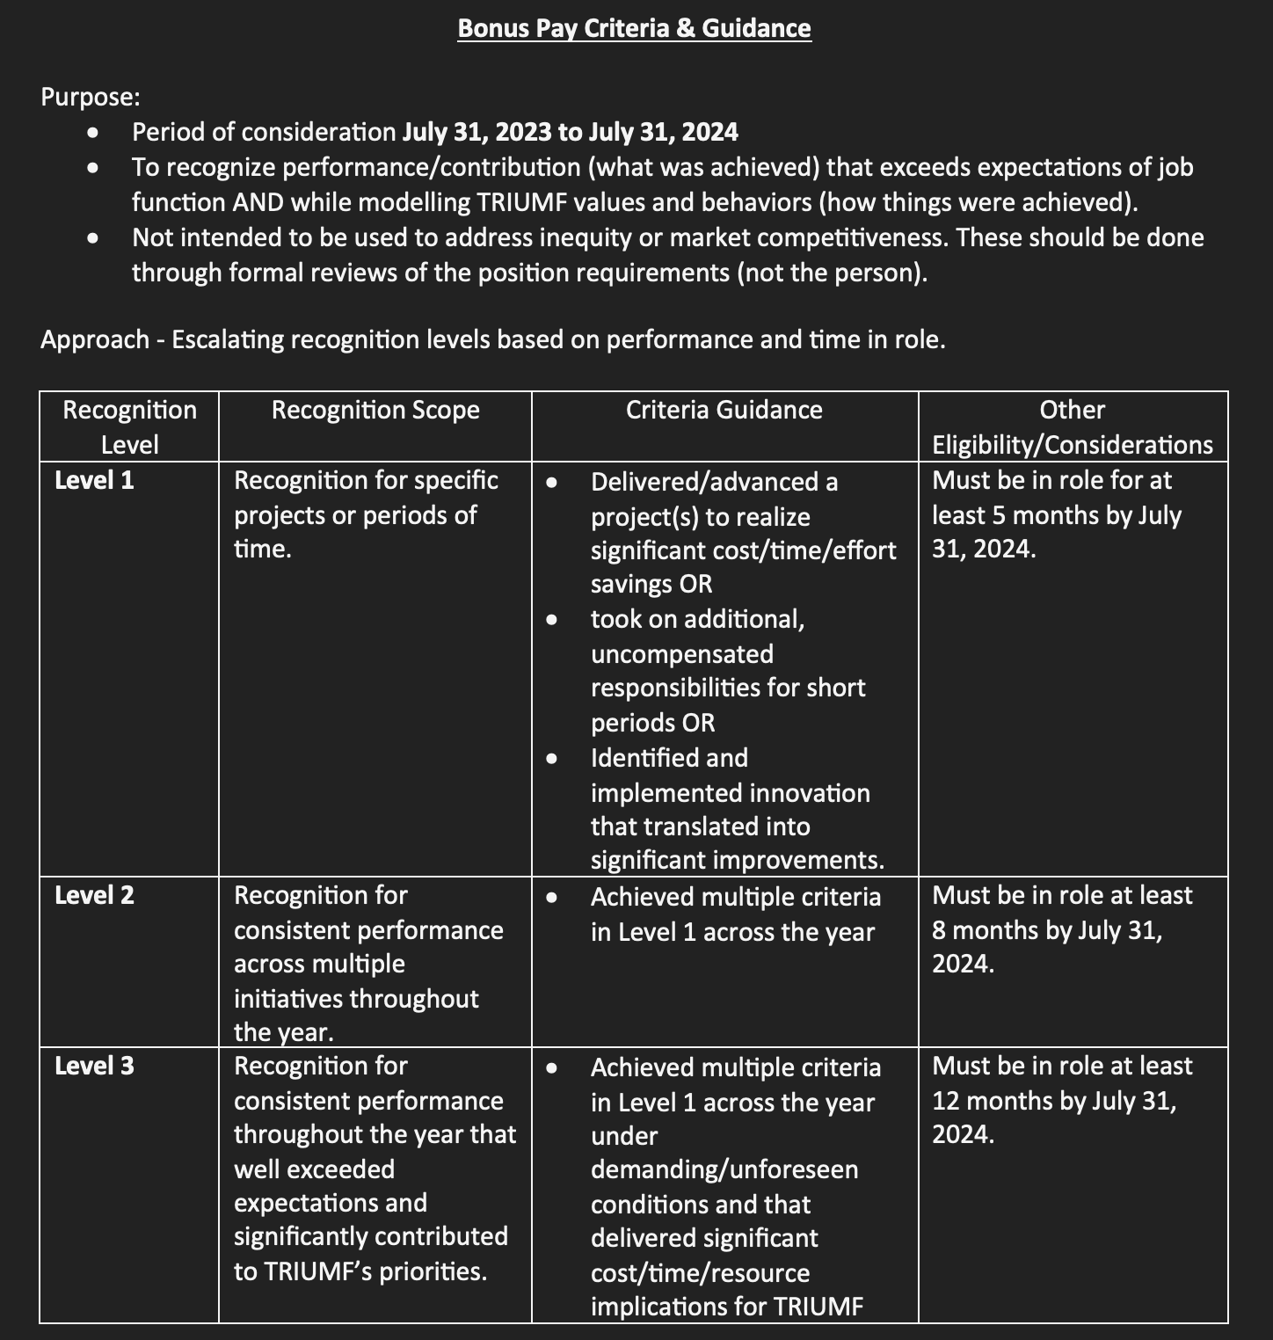
Bonus Pay

Slide 6
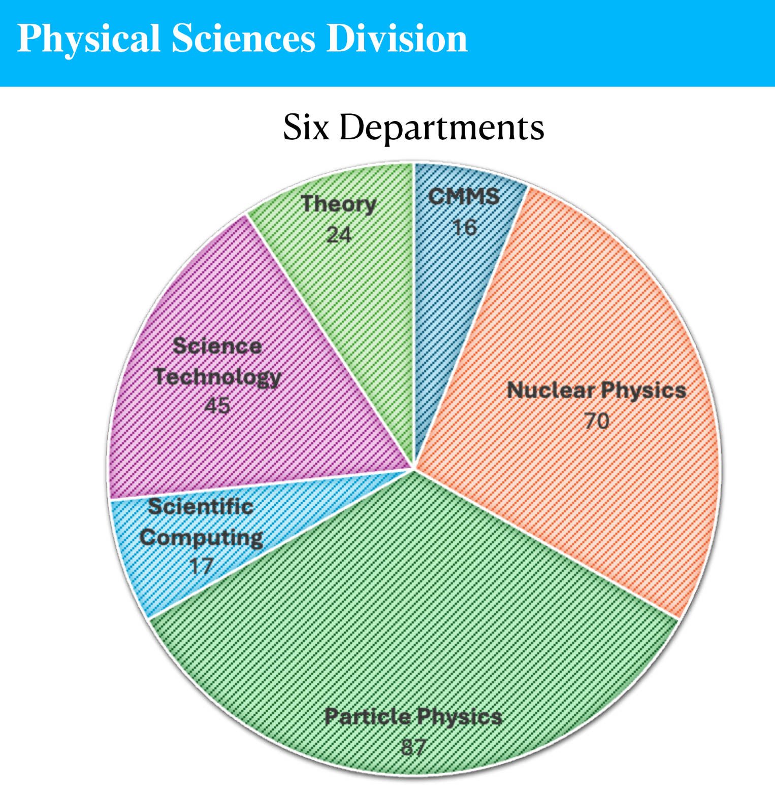
How many nominations?

Slide 7
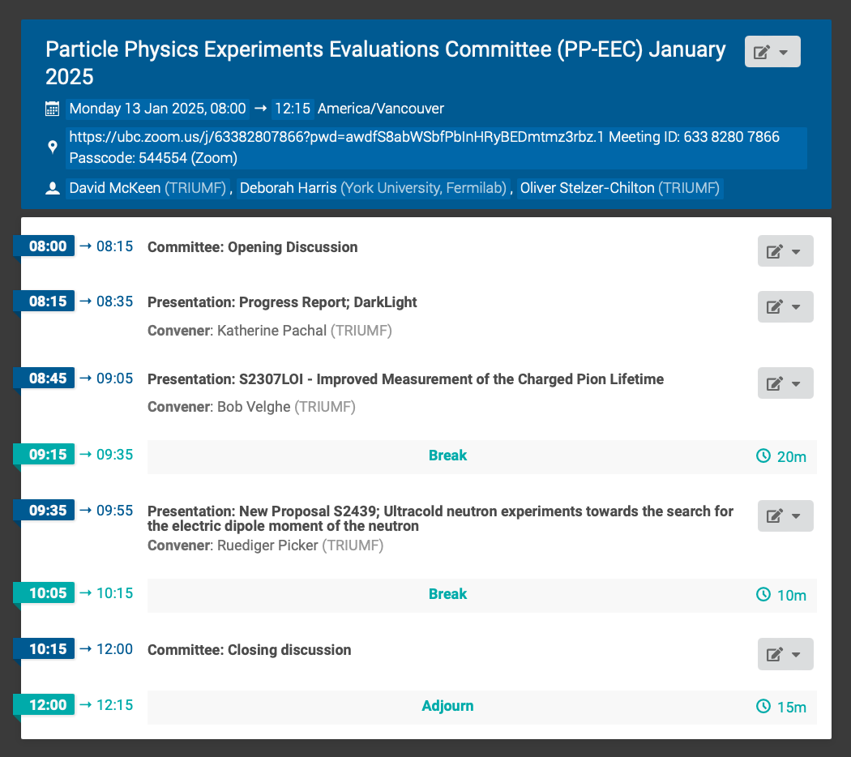
Particle Physics EEC
Monday January 13th
New this year: Presentations and report restricted to collaborations

Slide 8
Mixer
From Max
For the mixer, we are introducing a new session for students/postdocs to give brief talks on papers or other contributions they’ve made in the recent while. The idea is for Ritu to spend less time summarizing people’s work in front of us, and to give the chance for our HQP to speak for themselves instead. This doesn’t necessarily have to be a paper, but just something “substantial” that you think deserves some attention from the division.
We have room for one more in the January 17 mixer, and I’d like to make a call for nominations/suggestions from the particle department.

Slide 9
Website
3 research pillars are
High energy Frontier
Neutrinos and Dark Matter
Precision Tests of Fundamental Interactions
We will need a set of illustrating pictures that can go, if possible, on individual carousels.
The experiments listed under each pillar are (in alphabetic order)
ATLAS
T2K/Hyper-K, Super-CDMS, nEXO
ALPHA/ ALPHA-g/ HAICU, TUCAN / PENELOPE, DARKLIGHT, PIONEER / NA62
Each of those would have separate sub-pages (8 in total)
The list of members of the department would appear listed in alphabetic order at the bottom of the particle physics main page

Slide 10
PP Website Brief Overview
The driving motivation behind experimental particle physics is the desire to uncover the true nature of fundamental forces and particles. Our current standard model is believed to be an effective theory, which has a deeper underlying theory reachable in the next generation of experiments. Particle Physics addresses some of the most compelling questions in science. Why is there more matter than anti-matter in the universe, what is the nature of dark matter, why is the Higgs boson so light and what more can we uncover from the weakest interacting particles, the neutrinos. At TRIUMF we are engaged in five focus experiments, embedded in international collaborations. For these focus experiments, we have been engaged in all phases of the experiment, starting at the design/conception, construction, operations and data analysis. Our focus experiments are currently ATLAS at the LHC, Hyper-Kamiokande and T2K at J-PARC, ALPHA/ALPHA-g at CERN, TRIUMF UltraCold Advanced Neutron source TUCAN and SuperCDMS at SNOLAB. Upcoming and future projects include, DarkLight at TRIUMF, nEXO at SNOLAB and PIONEER at PSI. You can learn more about our involvement in all of these experiments and more at the group links below.

Slide 11
INSPIRE
The INSPIRE collaboration reached out to TRIUMF as a potential partner
“I am sure you and many of the TRIUMF colleagues are enjoying INSPIRE on a daily basis. However, it is, unfortunately, very little known in the community how the information ends up in our database. Despite a significant technical effort to maintain and further improve the platform – an effort entirely taken care of by CERN – good quality information requires a lot of manual curation of the metadata. While we also work hard on increasing the rate of automation here, there is still a lot of work for curators amongst the INSPIRE collaboration members and other partners (CERN, DESY, Fermilab, IHEP, IN2P3, STFC). Every contribution to this effort would be precious.”
The INSPIRE operations manager at CERN. He can give you more details in terms of scale for a meaningful contribution and share some concrete examples of how we have organised participation from some other institutions.
This would count as service work. Let me know if anyone is interested

Slide 12
Various
Facilities Division
Head of Engineering Services – Norman Muller P.Eng.
KEK-TRIUMF Symposium
Jan 28-30
Colloquium today
Quentin Buat (University of Washington)
Title: PIONEER : a next generation pion decay experiment

Slide 13
AOB

Slide 14
Committee Updates
IPP Council / CINP / CAP
Science Council
Space
Seminar/Colloquia
SciTech seminars / Quantum Forum / Dark Matter Forum
Mixer
Science Week
TUEC
Safety
Summer schools
EDI committee
IDSSD - Earth Humanity Coalition

Slide 15
International Year of Quantum Science and Technology (IYQ)
The 2025 International Year of Quantum Science and Technology recognizes 100 years since the initial development of quantum mechanics. Join us in engaging with quantum science and technology and celebrating throughout the year!
On June 7, 2024, the United Nations proclaimed 2025 as the International Year of Quantum Science and Technology (IYQ). According to the proclamation, this year-long, worldwide initiative will “be observed through activities at all levels aimed at increasing public awareness of the importance of quantum science and applications.”

Slide 16
International Year of Quantum Science and Technology (IYQ)
Current Task Force Members (listed in alphabetical order by last name)
Hemish Ahuja, York University (Student Advisory Council rep.)
Svetlana Barkanova, Memorial University of Newfoundland
Olivia Di Matteo, UBC/QuantumBC
John Donohue, University of Waterloo/IQC
Anna Dyring, University of Toronto
Francine Ford, Canadian Association of Physicists
James Fraser, Queen’s University
Pamela Fuentes Peralta, University of Toronto
Shohini Ghose, Wilfrid Laurier University / IUPAP WG QS&T
Melissa Greene, Université de Sherbrooke/Curieux Quantique
Ania Harlick, University of Toronto (DPE)
Thomas Jennewein, Simon Fraser University
James LeBlanc, Memorial University
Lindsay LeBlanc, University of Alberta
Shahpoor Moradi, University of Calgary
Ben Newling, University of New Brunswick
Angela Olano, Quantum Industry Canada
Emily Petroff, Perimeter Institute
Damian Pope, Perimeter Institute
Sarah Purdy, University of Saskatchewan
Nicolás Quesada, Polytechnique Montréal
Chitra Rangan, University of Windsor
Fanny Rohrbacher, Science pour tous, QC
Julien Ross, Dalhousie University
Carlo Maria Scandolo, University of Calgary (DQI)
Jaclyn Semple, Yukon University
Scott Taylor (Let’s Talk Science)
Dorina Verli (ISED)
William Whelan, University of Prince Edward Island
The CAP formed a nation-wide task force chaired by Daria Ahrensmeier (DQI) and Oliver Stelzer(DIA) with monthly meetings since Congress
We acknowledge the support of the Natural Sciences and Engineering Research Council of Canada

Slide 17
International Year of Quantum Science and Technology (IYQ)
Activities:
CAP-IYQ 2025 Design Competition, open to all physics students from high to grad school
Prize of $1k, and see your design on t-shirts, mugs etc: deadline January 13th
Launch of IYQ on February 4th at UNESCO HQ in Paris with several Canadian speakers/participants – social media campaign, short videos and photo at embassy
Special issue of Physics in Canada celebrating IYQ
Proposal submissions deadline February 28
Canadian Quantum “Open Doors Day” for academic and private sector institutions
Save the date: May 3rd - open your doors to the public
Production of the IQC’s Canadian Quantum Explorations Student Toolkit project
Supported by the APS Innovation Fund
Several additional local events, conferences, Canadian Wide Science Fair, Congress, …
Will be advertised on our website: Are you planning any events? Please reach out!

Slide 18
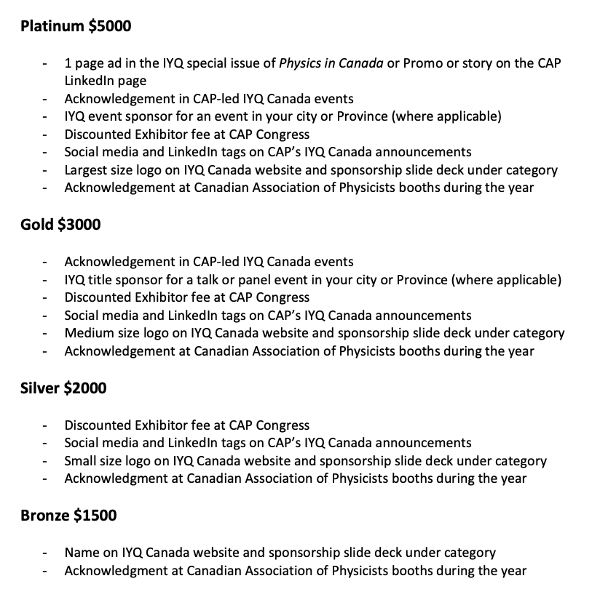
International Year of Quantum Science and Technology (IYQ)
Support IYQ Canada by becoming an official sponsor!
Value proposition and sponsorship form can be found on the IYQ Canada team website
https://cap.ca/programs/iyq/

Slide 19
Next Meeting
February 13th

