Slide 1
PENeLOPE Cooldown Progress and To-Dos

Slide 2
Isolation vacuum pumps set up
Slow control PC
Now
Lid access
Cooldown
Buy flanges: DN300 plate flange (burst disk), DN200 blind flange
Finalize LN2 and LHe piping/return line designs and buy/get equipment
Buy Swagelok adapters for LN2 lines
Buy compressed air adapters if necessary
Buy overpressure valves for LN2 dewars

Slide 3
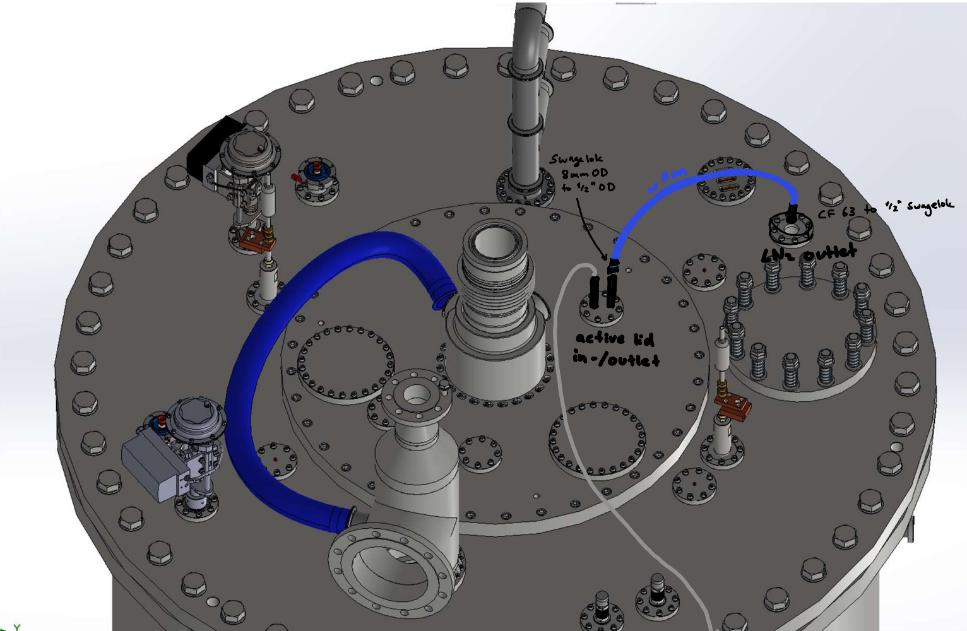
Nitrogen

Slide 4
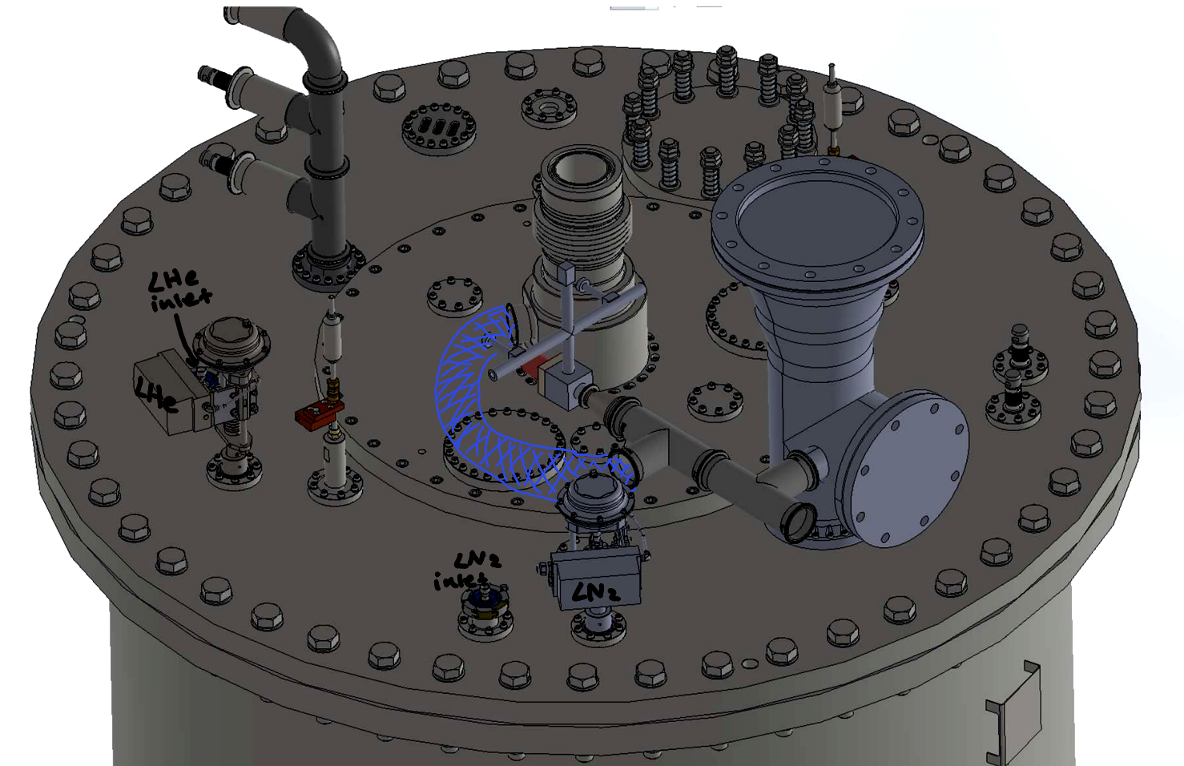
Helium

Slide 5
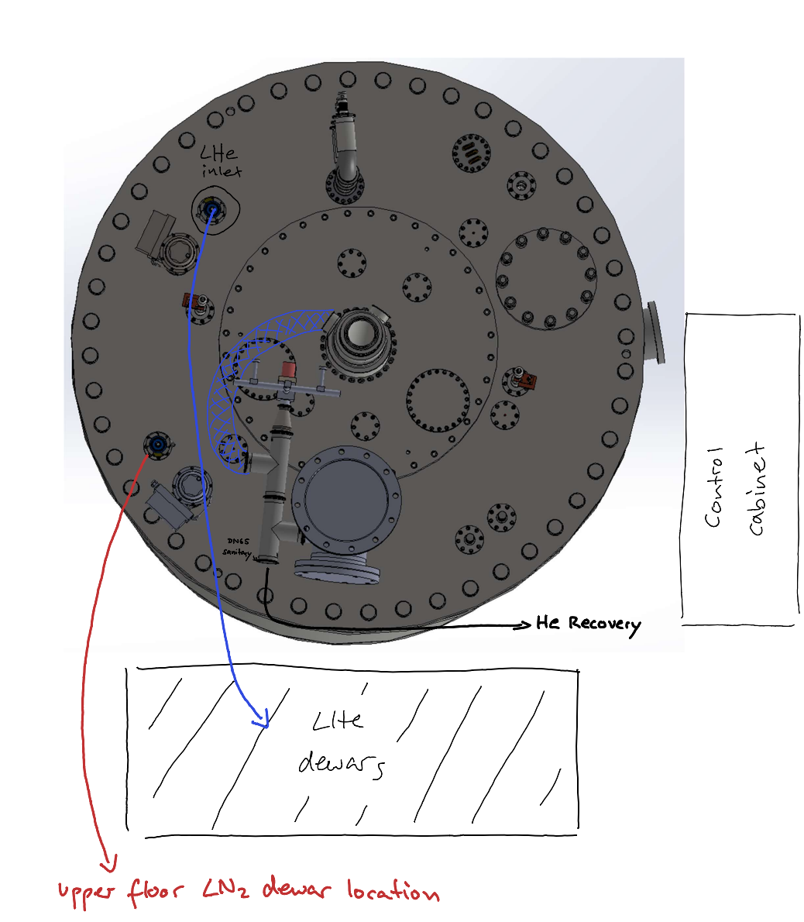

Slide 6
Isolation vacuum pumps set up
Slow control PC
Now
Lid access
Cooldown
Buy flanges: DN300 plate flange (burst disk), DN200 blind flange
Finalize LN2 and LHe piping/return line designs and buy/get equipment
Buy Swagelok adapters for LN2 lines
Buy compressed air adapters if necessary
Buy overpressure valves for LN2 dewars
Missing: compressed air connection for gate valve and KF40 tubing between turbo and backing pump
Once physically set up: first test of slow control possible, pumping isolation vacuum
Cabling of all lid equipment, install turbo pump, turret,…
Priority: start pumping UCN vacuum
Install LN2 lines (dewar to shield, shield to active lid). LN2 cooling can be tested first, once UCN and isolation vacuum are both pumped
Install helium return lines
Critical for data storage during cooldown
Network connection and IT details need to be cleared up

Slide 7
Backup slides: Subsystem details

Slide 8
Slow control
Finish database server connection with PLC (Rishi)
Upload PLC and HMI to the Beckhoff
Perform tests of the slow control
Start with isolation vacuum, can be done before we have lid access

Slide 9
Vacuum system
UCN vacuum:
Install Pfeiffer turbo pump, connect to backing pump on the ground (buy more KF40 corrugated tubes)
Isolation vacuum:
Only corrugated tubes between turbo and backing pumps missing

Slide 10
Electronics
Once lid accessible:
Cabling between lid instruments and control cabinet (~half a day's work)
Set up slow control PC and network connection

Slide 11
Cryogenics
LN2 line from dewar to lid needs to be installed
This will involve welding a pipe to the dewar end and extending it to reach the dewar
LN2 line from shield outlet to active lid inlet
Buy adapters: Swagelok 8mm OD to ½ inch OD tube adapter, CF 63 to ½ inch Swagelok
Need around 1 m of ½ inch pipe
Rubber tube to divert outlet gas off the lid, away from electronics?
LHe line from dewar to lid
Pretty much just what we shipped. More pressing: concept for how we want to change dewars
LHe exhaust lid construction:
Buy DN200 PN16 blind flange and DN300 PN16 plate flange to hold burst disk
Double check that we have all sanitary flanges needed
TRIUMF recovery line needs to attach to our DN65 sanitary flange
Helium heat exchanger:
Specs: ½ inch piping, how long should the winded piping in the bath be?
Buy pot for the warm-up bath

Slide 12
Misc
Compressed air: adapters to our valves?
Cryogenic safety report?
Fall arrest training

