Slide 1
PENeLOPE PLC and HMI
Jacqueline Dellith

Slide 2
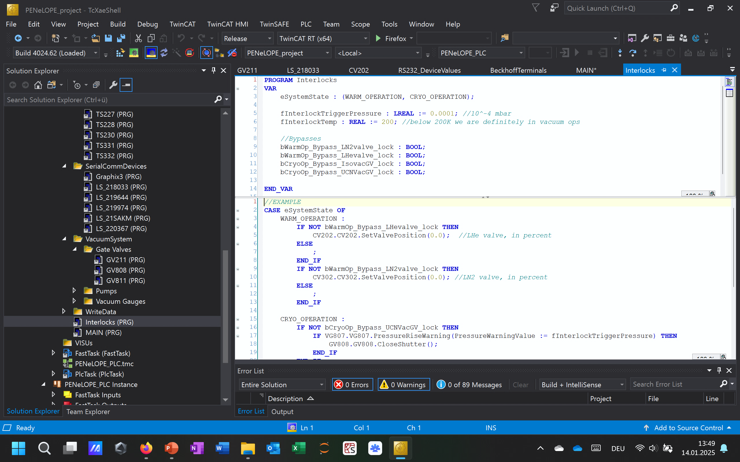
PLC Structure

Slide 3
Function blocks (FBs)
Programs (PRG)
Legend
Component
BP = Backing Pump
TP = Turbo Pumps
CV = Cryo Valves
GV = Gate Valves
LVL = Level Gauge
VG = Vacuum Gauge
LS = Lakeshore (Temperature Readout)
TS = Temperature Sensor
Number
[Component]xyy –
x ϵ {0 “Inner Coil”,
1 “Outer Coil,
2 “Helium Tank”,
3 “LN2”,
8 “Vacuum”}
Backing Pumps
BP814
BP816
Turbo Pumps
TP813
TP815
Cryo Valves
CV202
CV302
VAT Shutters
GV808
GV811
GV211
Liquid Level Gauge
LVL208
LVL231
VG807
Vacuum Gauge
Graphix
VG810
MAIN
calls all programs every PLC cycle
VG812
Serial Comms
LS220367
TS001
TS109
TS217
TS325
LS219974
TS002
TS110
TS218
TS326
TS003
TS111
TS219
TS227
Temperature Sensor
LS218033
TS004
TS112
TS220
TS228
LS219644
TS005
TS213
TS221
TS229
TS006
TS214
TS222
TS230
LS21SAKM
TS107
TS215
TS323
TS331
TS108
TS216
TS324
TS332
Interlocks

Slide 4
Function blocks (FBs)
Programs (PRG)
Legend
Component
BP = Backing Pump
TP = Turbo Pumps
CV = Cryo Valves
GV = Gate Valves
LVL = Level Gauge
VG = Vacuum Gauge
LS = Lakeshore (Temperature Readout)
TS = Temperature Sensor
Number
[Component]xyy –
x ϵ {0 “Inner Coil”,
1 “Outer Coil,
2 “Helium Tank”,
3 “LN2”,
8 “Vacuum”}
Backing Pumps
BP814
BP816
Turbo Pumps
TP813
TP815
Cryo Valves
CV202
CV302
VAT Shutters
GV808
GV811
GV211
Liquid Level Gauge
LVL208
LVL231
VG807
Vacuum Gauge
Graphix
VG810
VG812
MAIN
Serial Comms
LS220367
TS001
TS109
TS217
TS325
LS219974
TS002
TS110
TS218
TS326
TS003
TS111
TS219
TS227
Temperature Sensor
LS218033
TS004
TS112
TS220
TS228
LS219644
TS005
TS213
TS221
TS229
TS006
TS214
TS222
TS230
LS21SAKM
TS107
TS215
TS323
TS331
TS108
TS216
TS324
TS332
Interlocks
HMI
grabs/writes object parameters to
display/control every cycle

Slide 5
What does this look like?

Slide 6
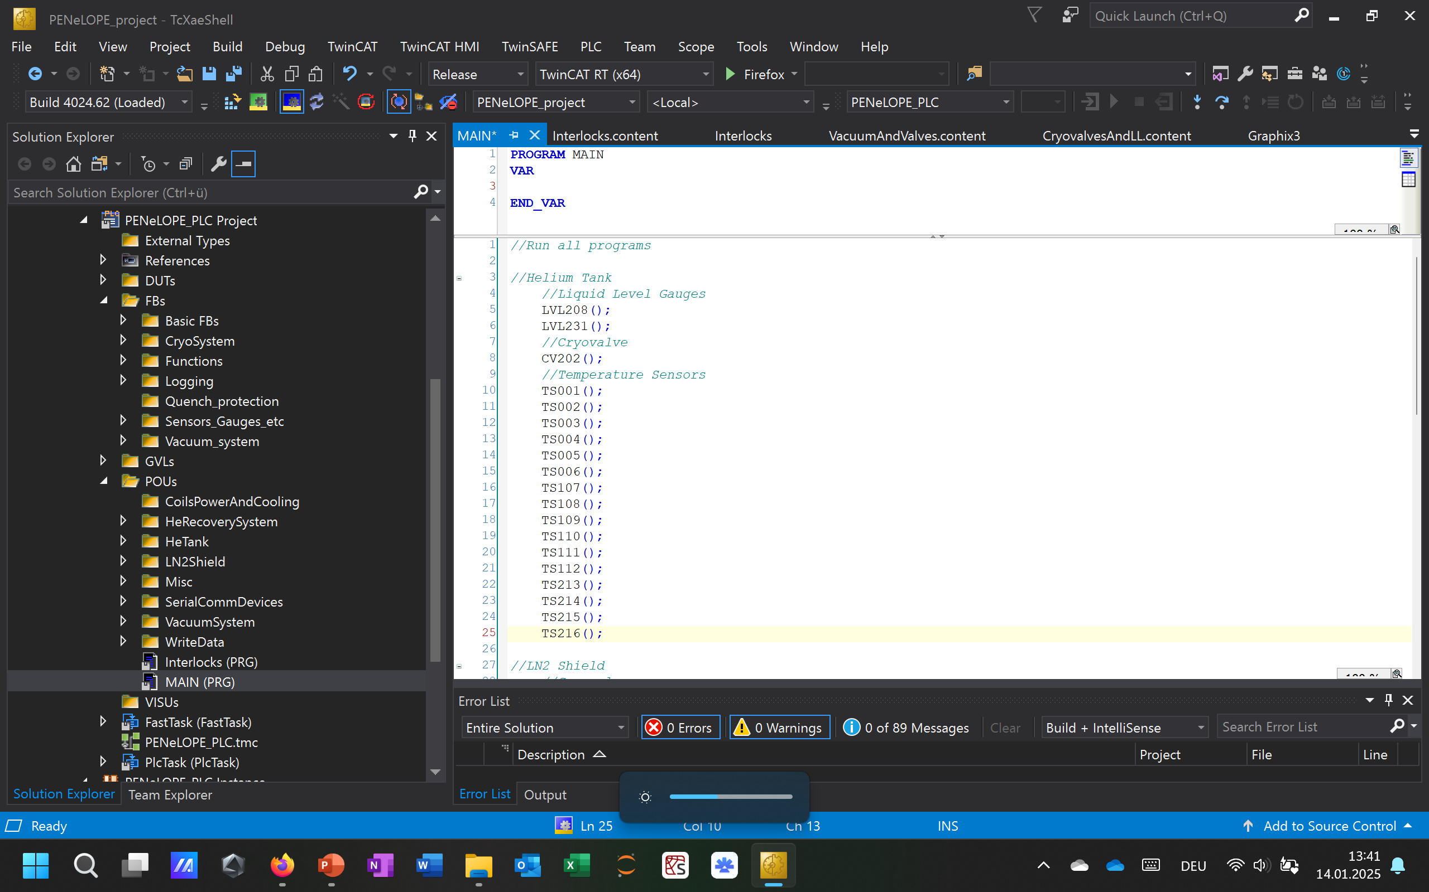
Overview
Variable Declaration
Code
Data Unit Types
Function Blocks
Global Variable Lists
Programming Organization Unit

Slide 7
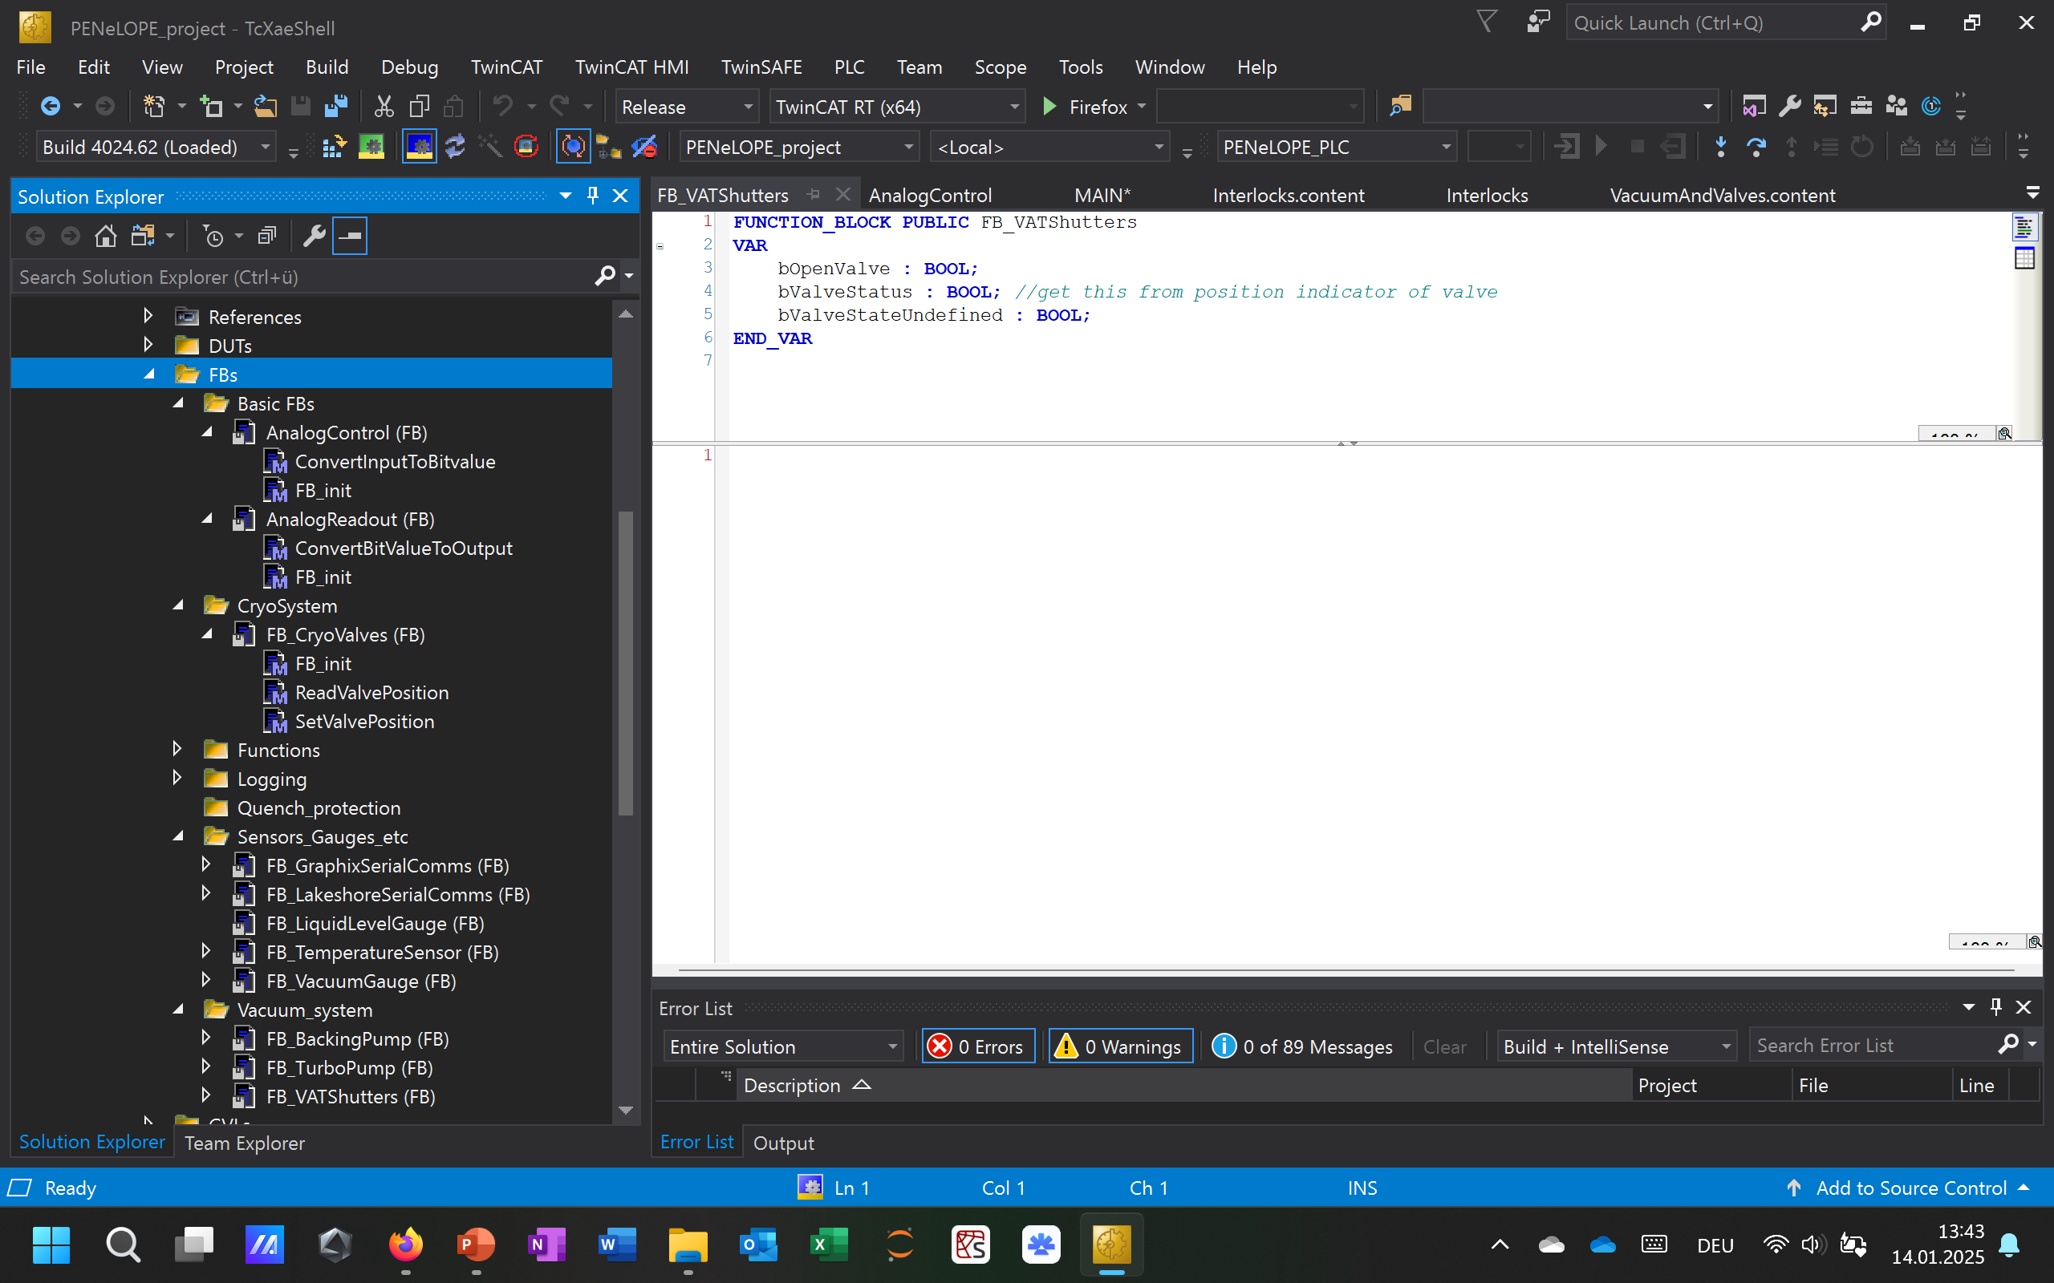
Function Blocks
„Methods“

Slide 8
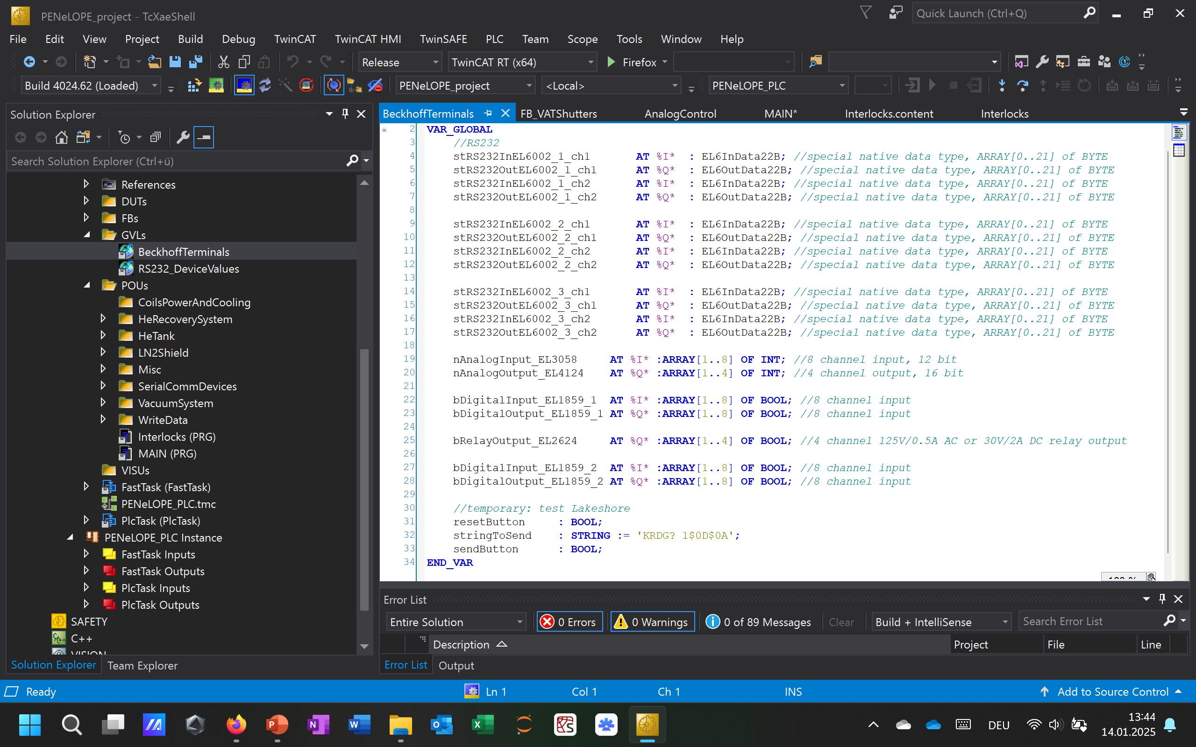
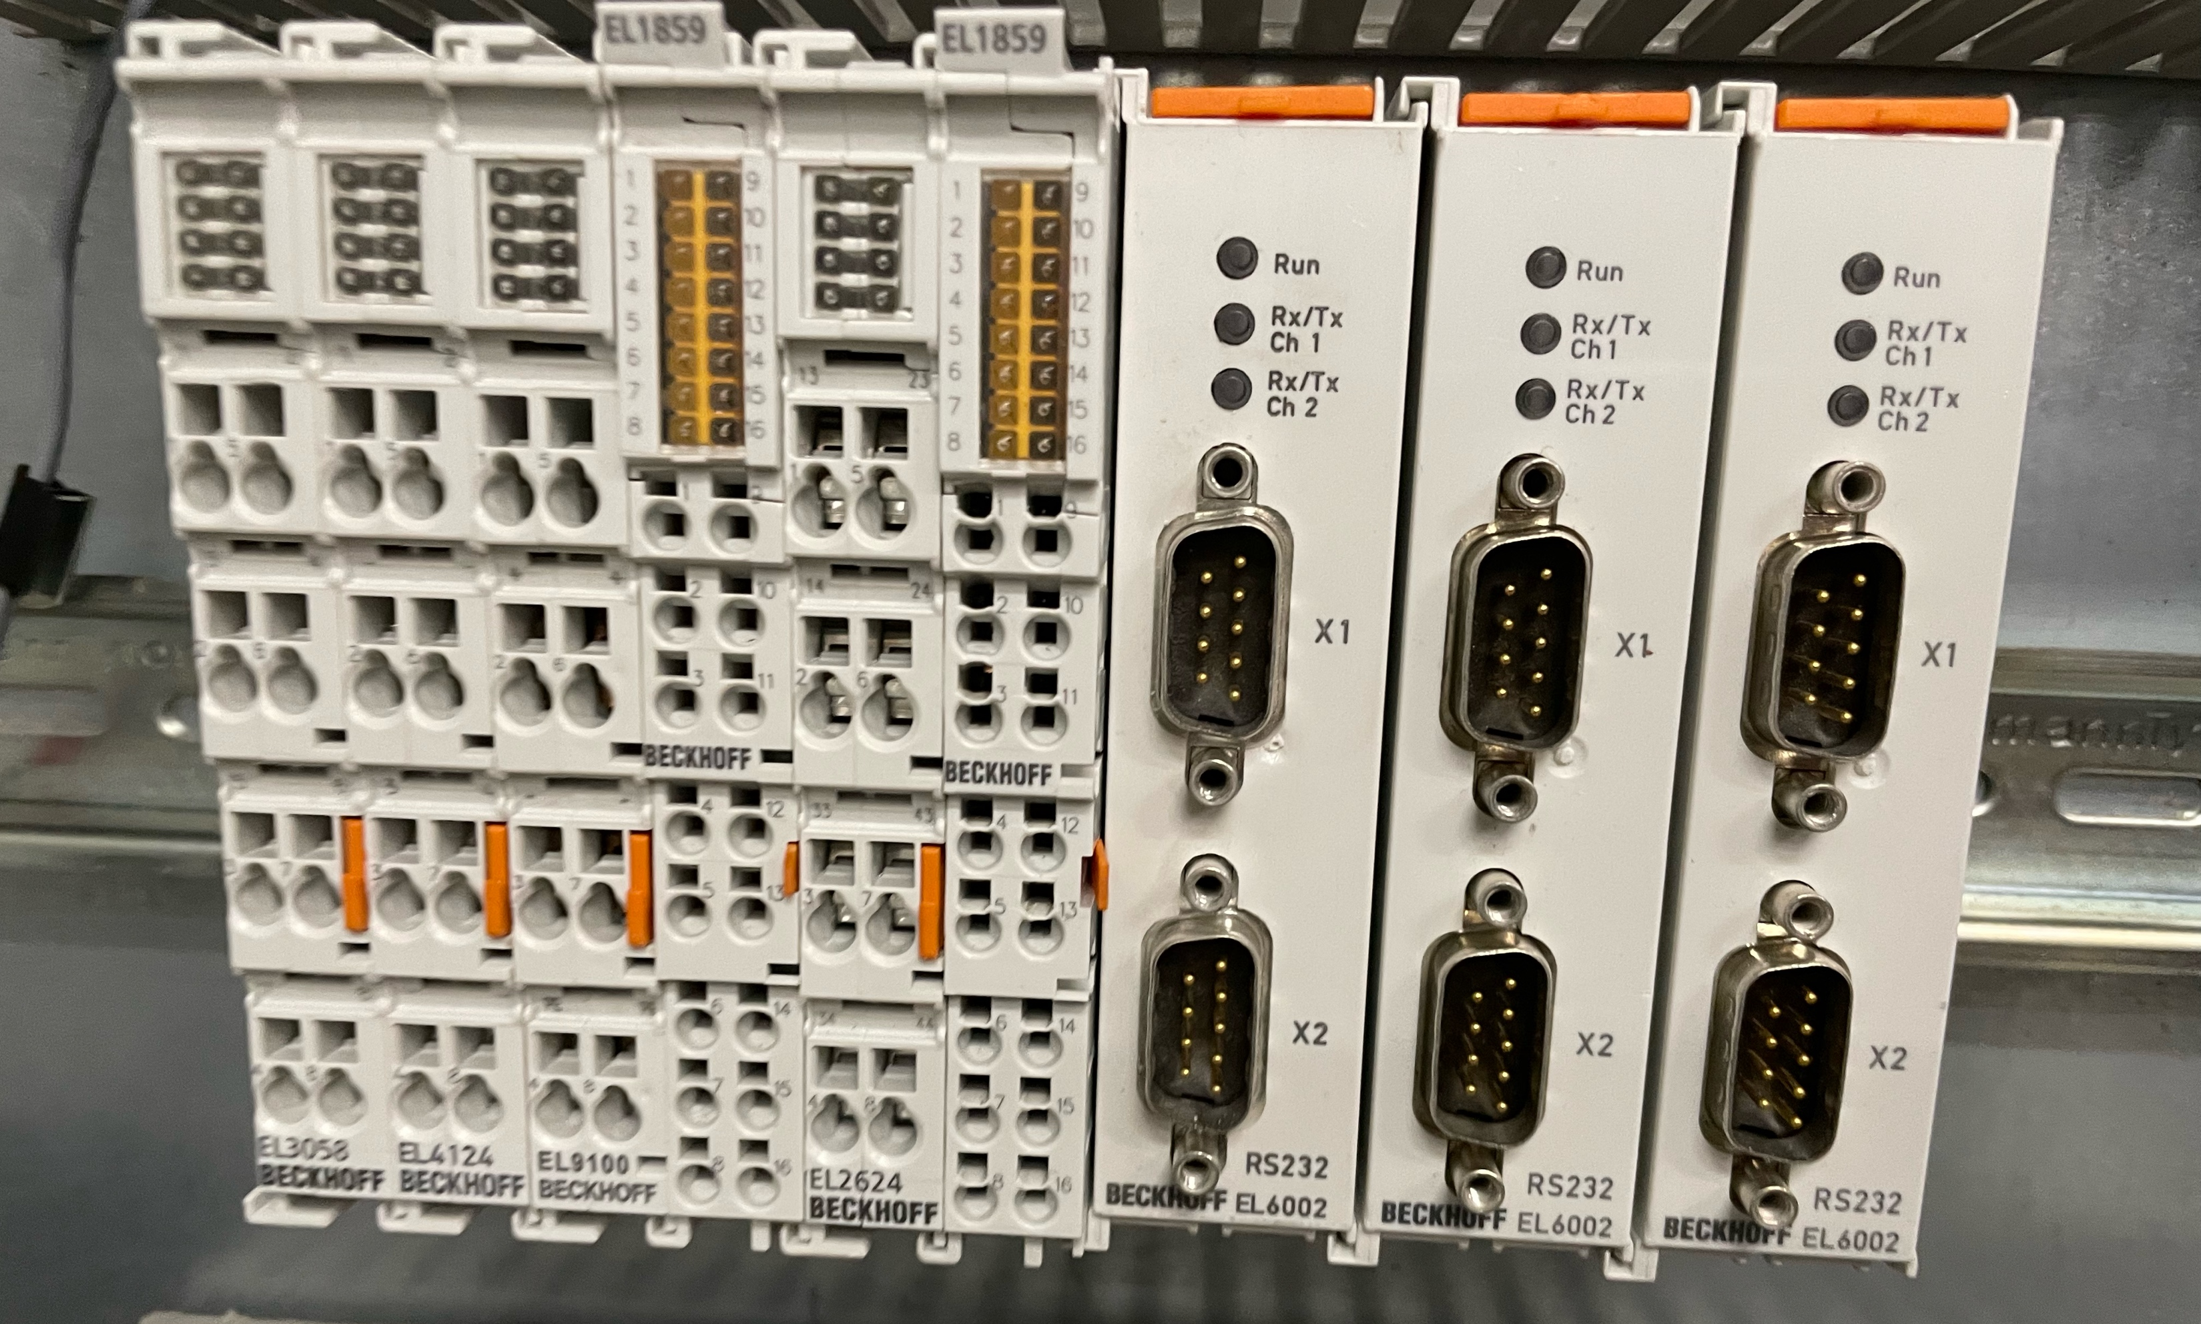
Global Variable Lists (1)

Slide 9
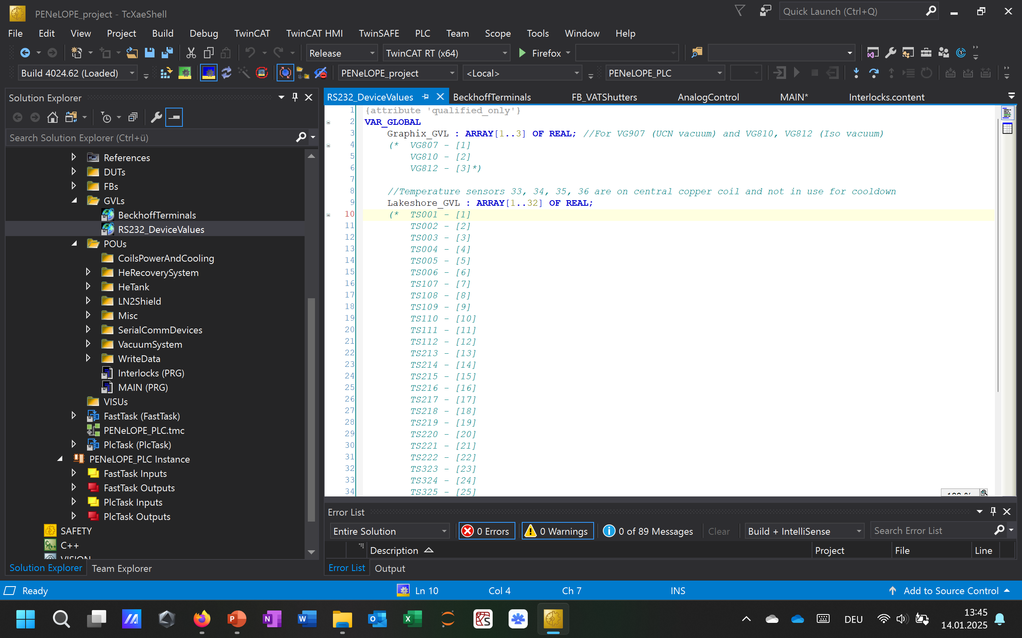
Global Variable Lists (2)

Slide 10
VG807
Graphix
VG810
Sensor values
VG812
Beckhoff Terminals
RS232 Devices
GVL
Sensors
LS220367
TS001
TS109
TS217
TS325
LS219974
TS002
TS110
TS218
TS326
LS218033
TS003
TS111
TS219
TS227
TS004
TS112
TS220
TS228
LS219644
TS005
TS213
TS221
TS229
LS21SAKM
TS006
TS214
TS222
TS230
TS107
TS215
TS323
TS331
TS108
TS216
TS324
TS332

Slide 11
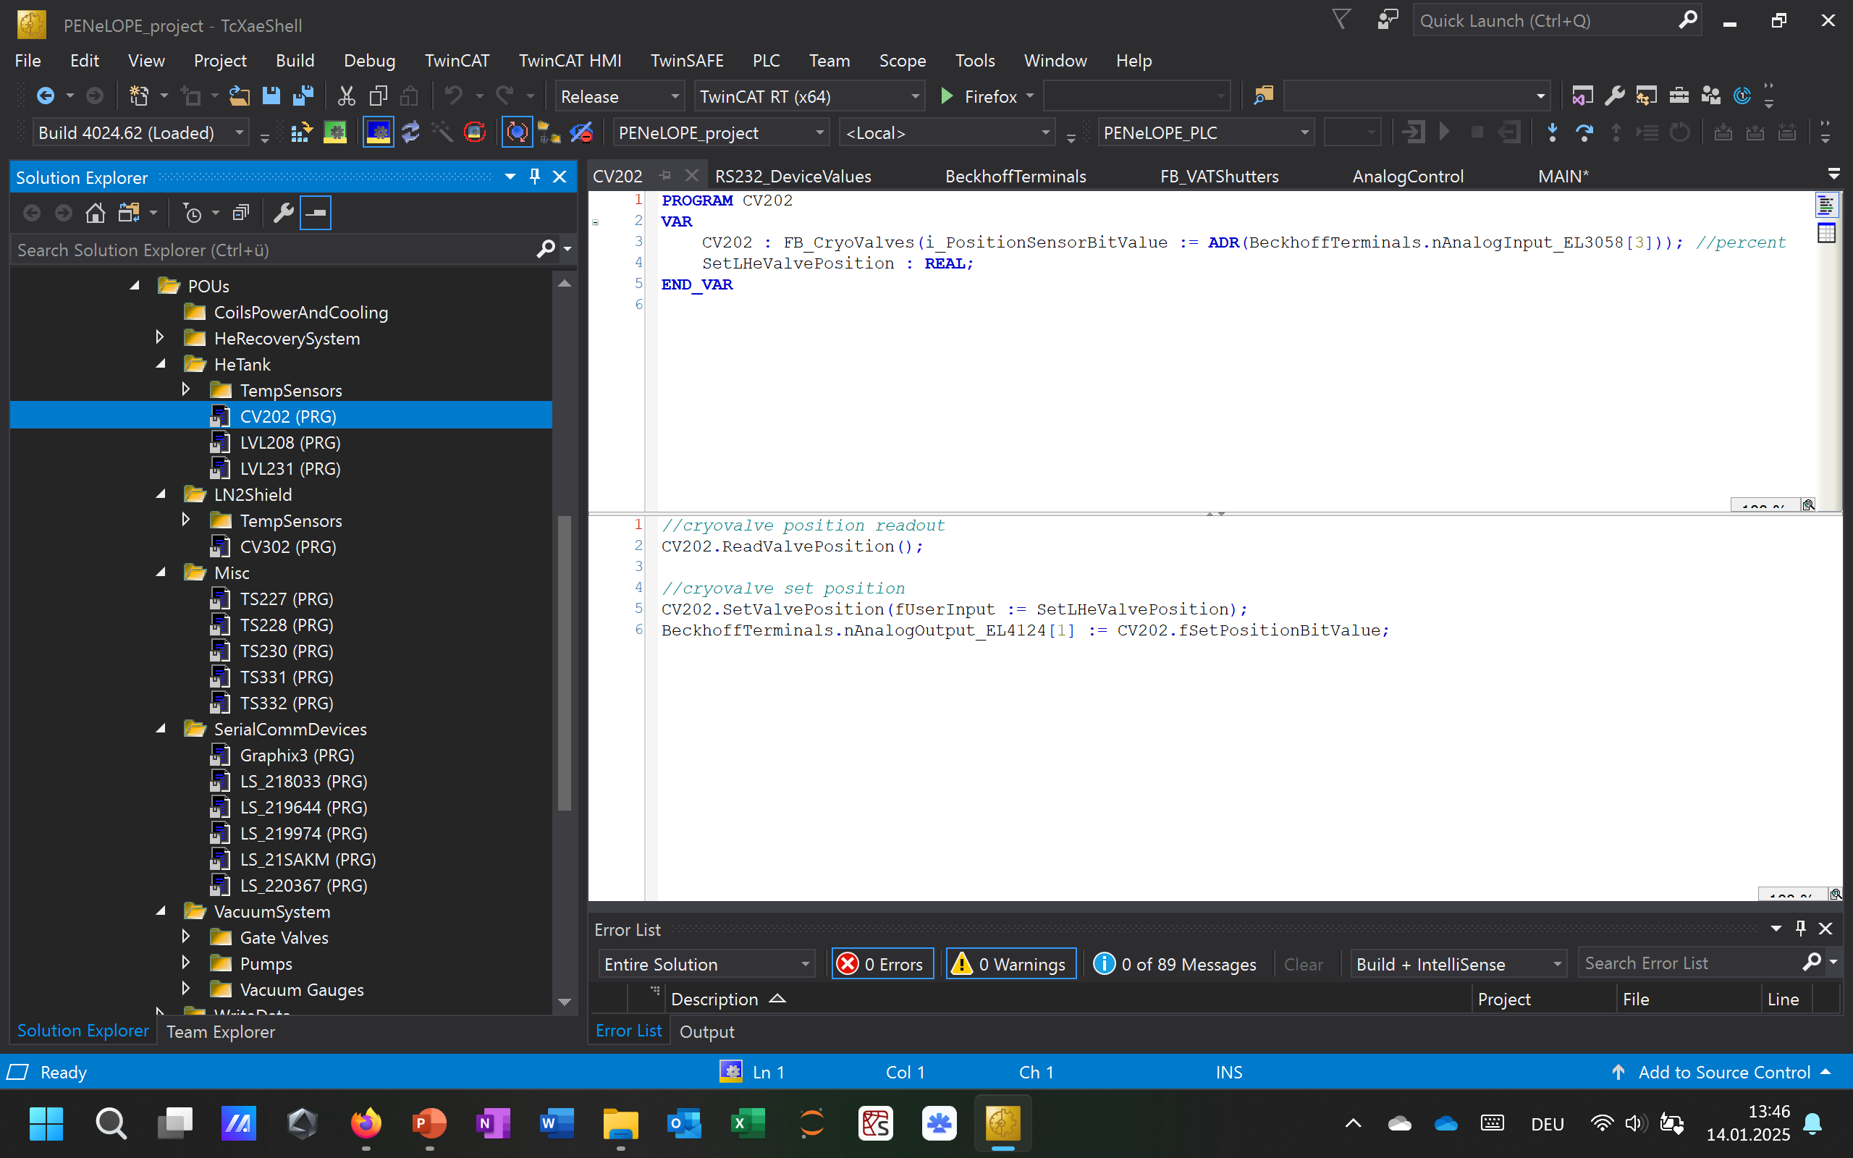
Programs

Slide 12
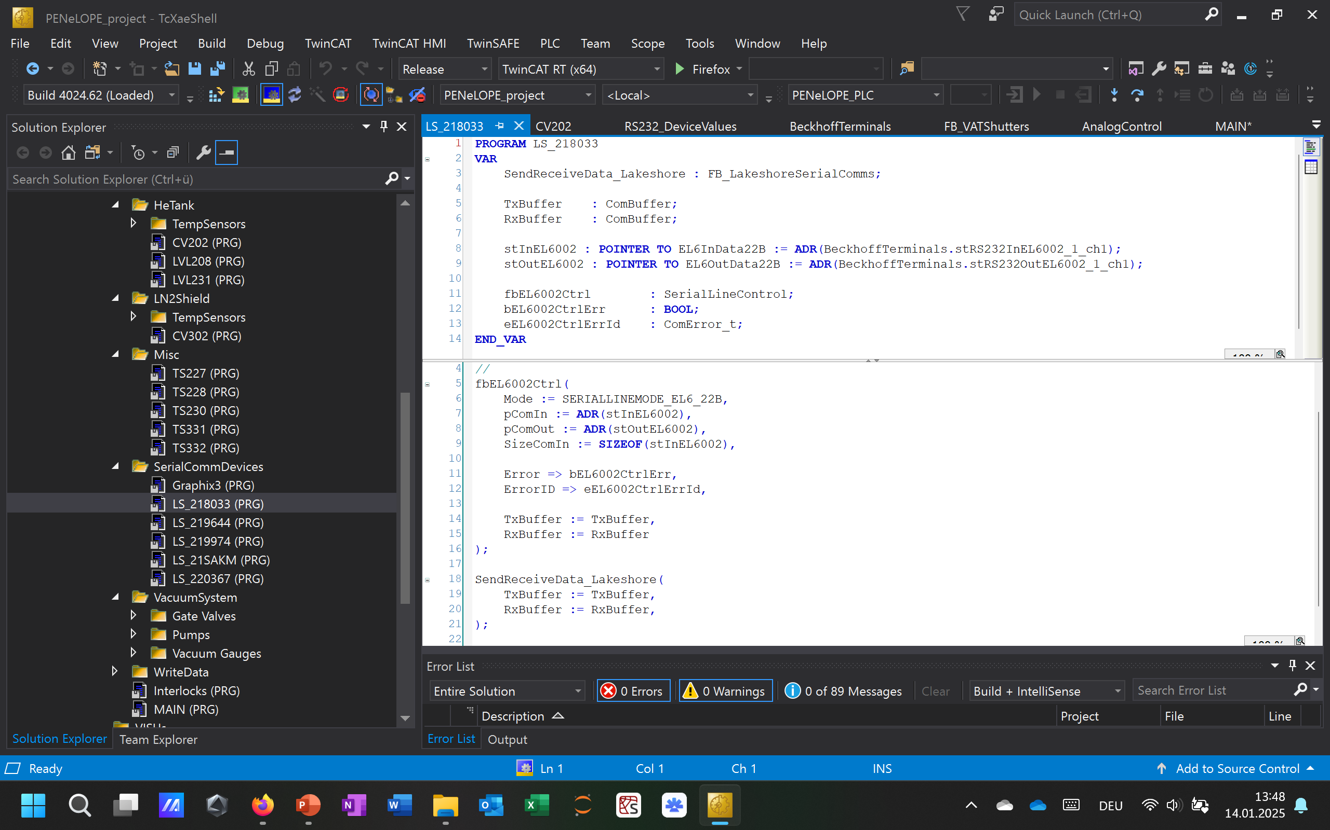
Programs

Slide 13
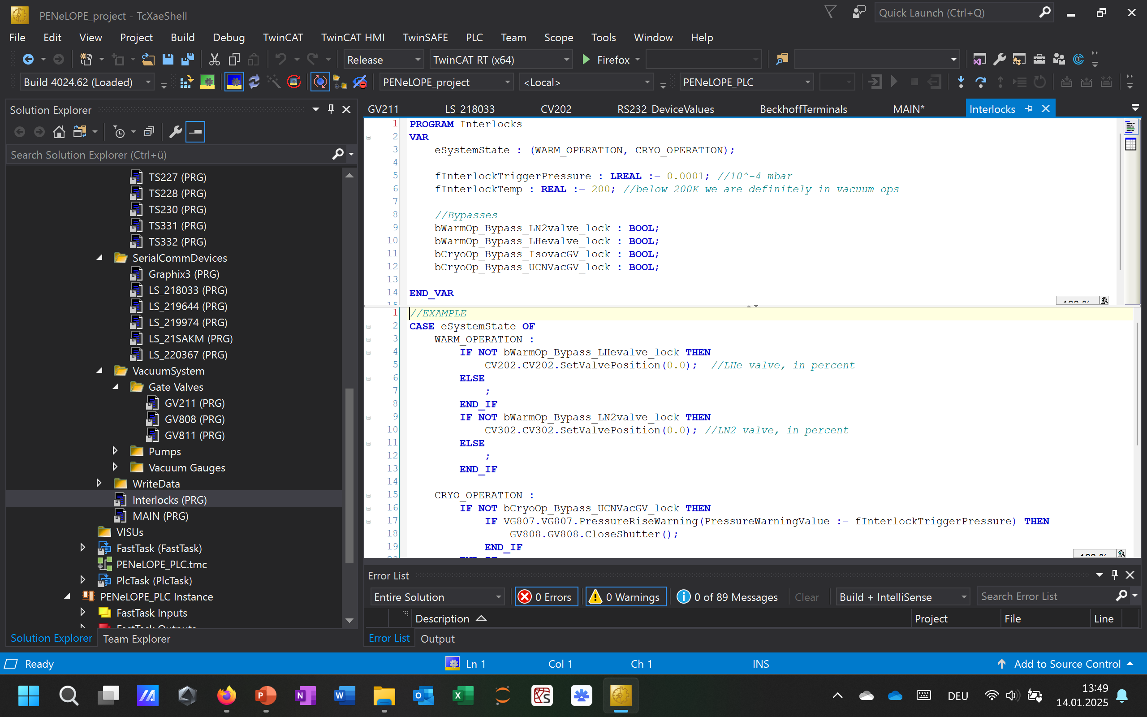
Interlocks

Slide 14
MAIN

Slide 15
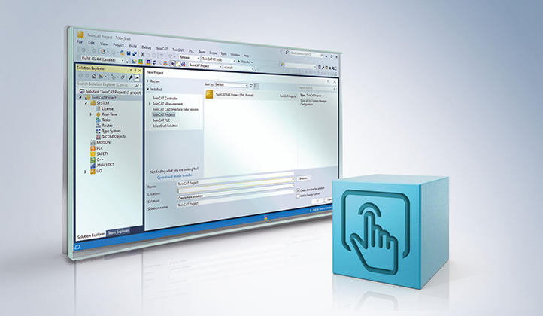
HMI

Slide 16
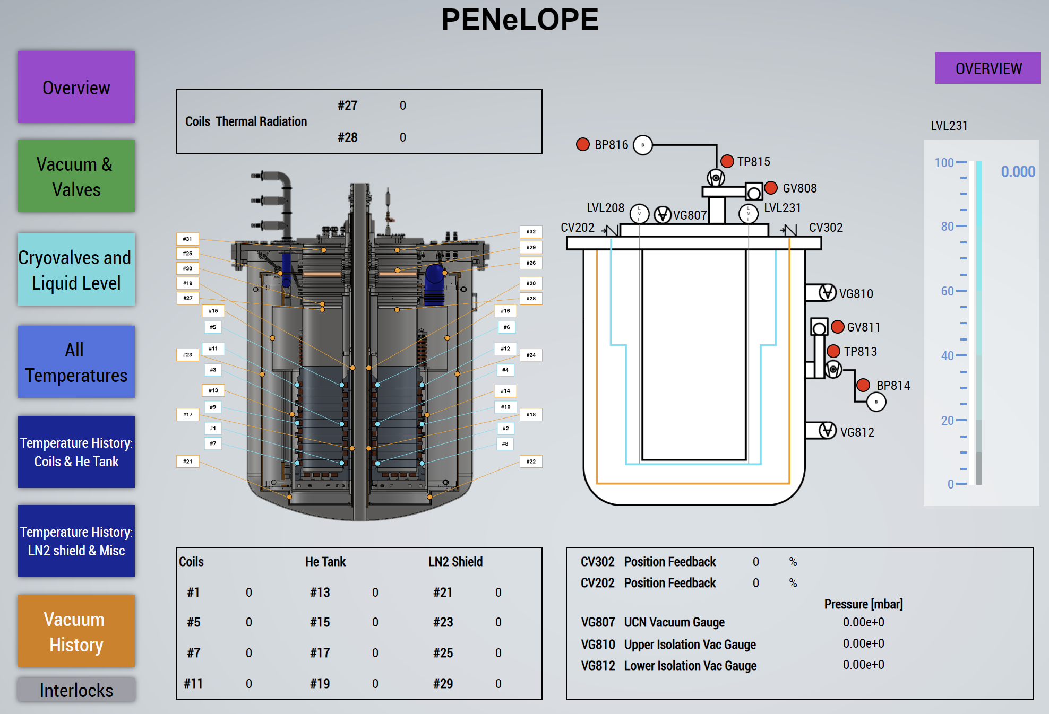

Slide 17
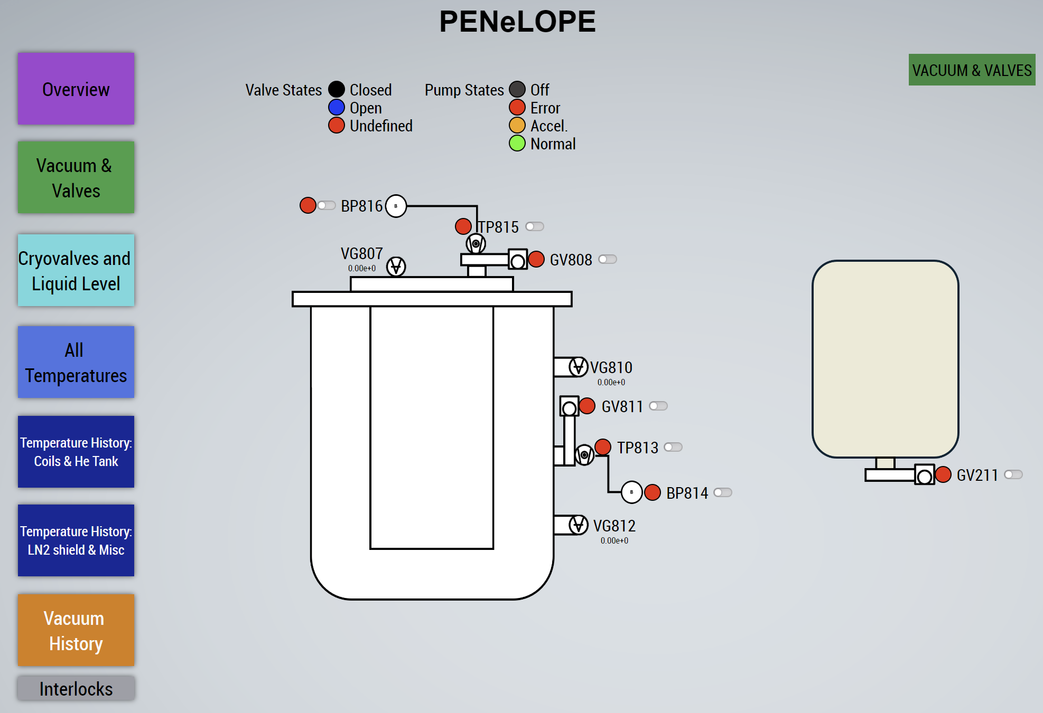

Slide 19
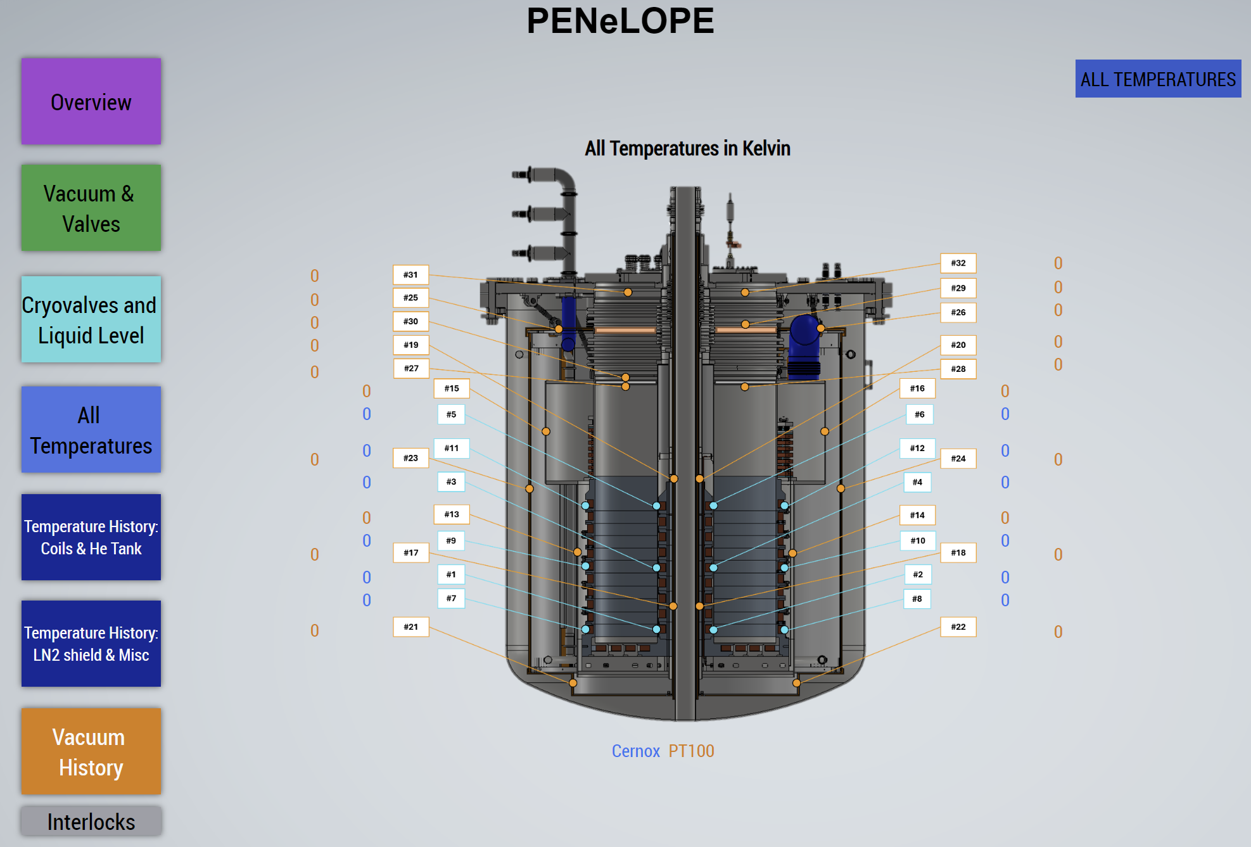

Slide 23
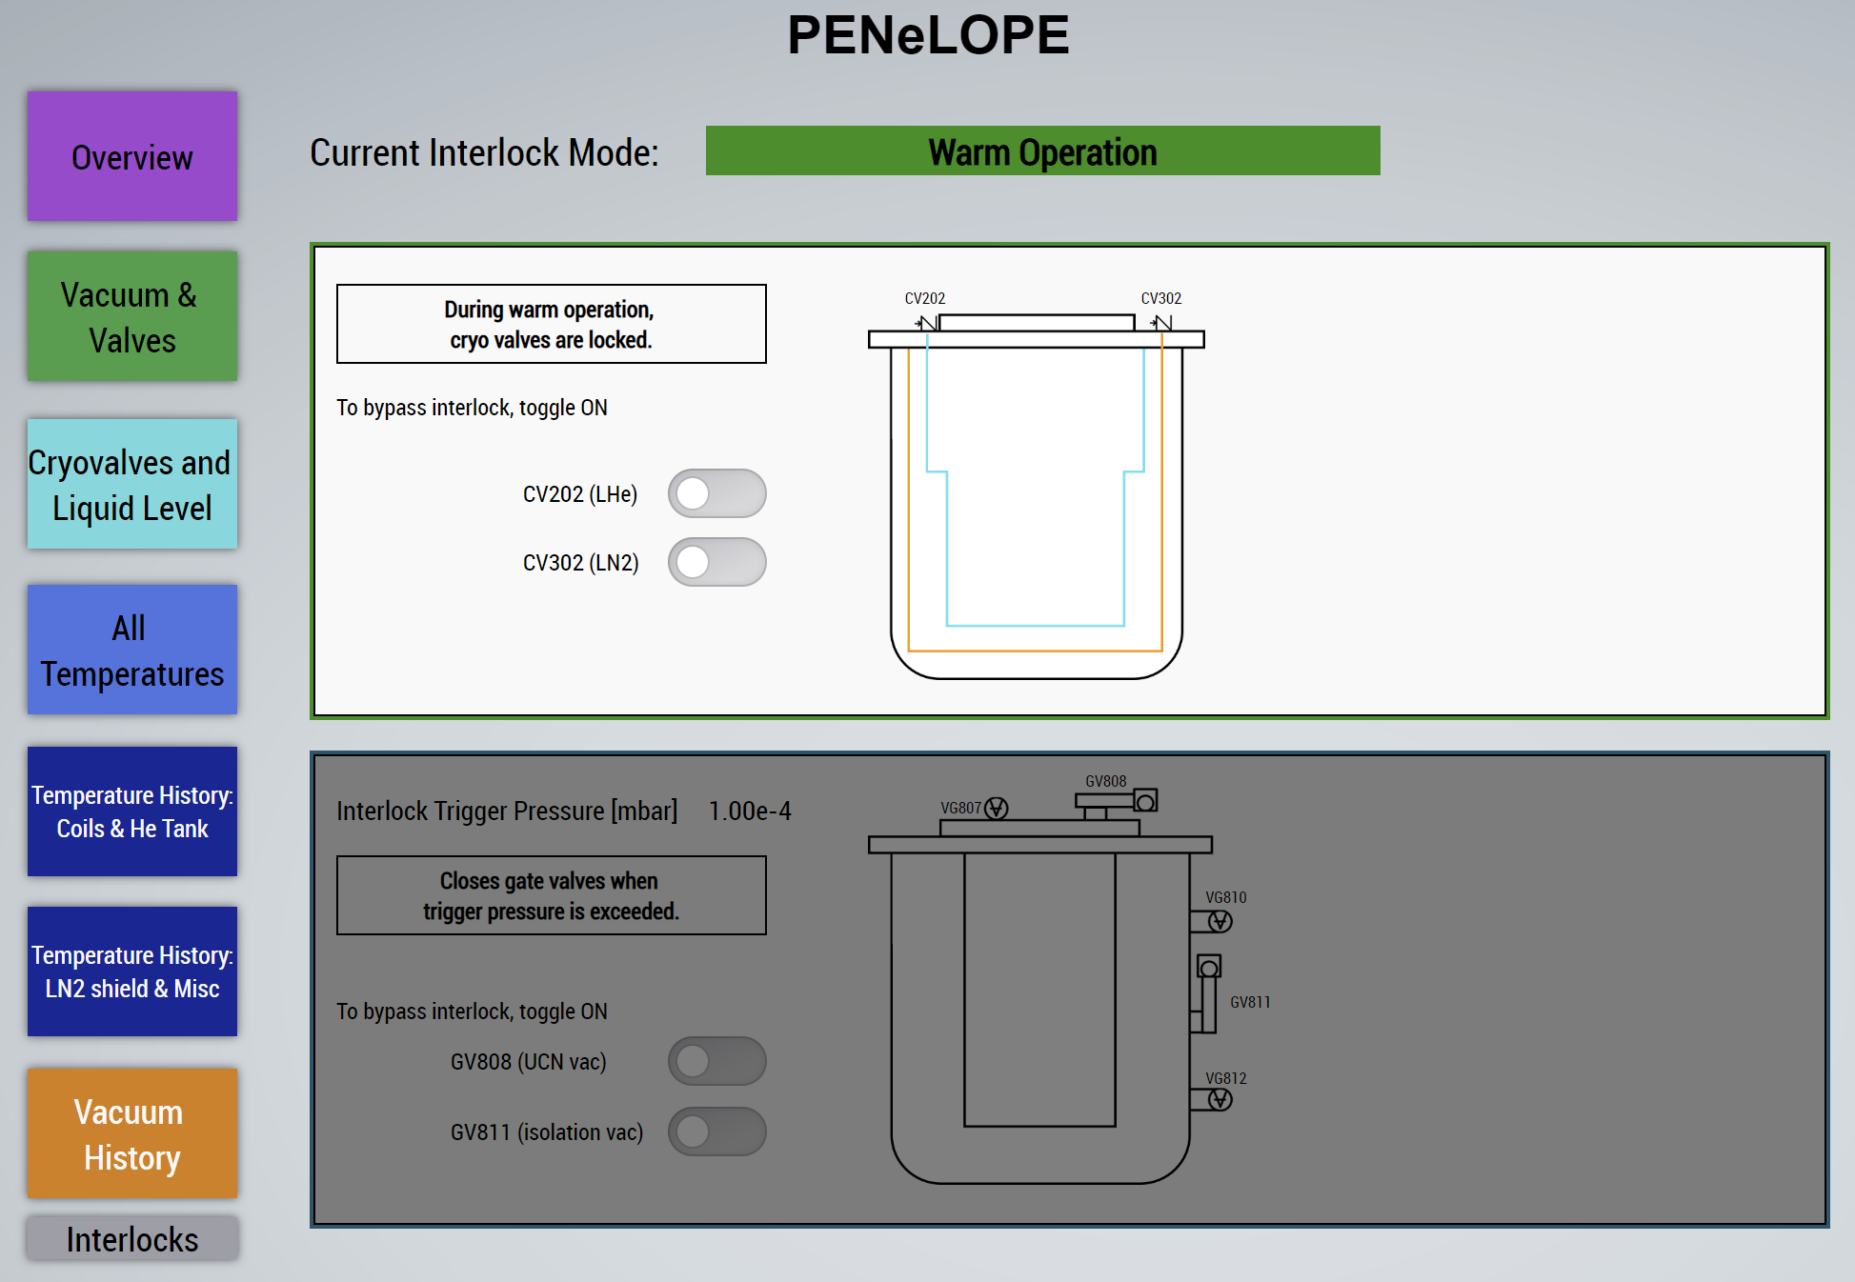

Slide 24
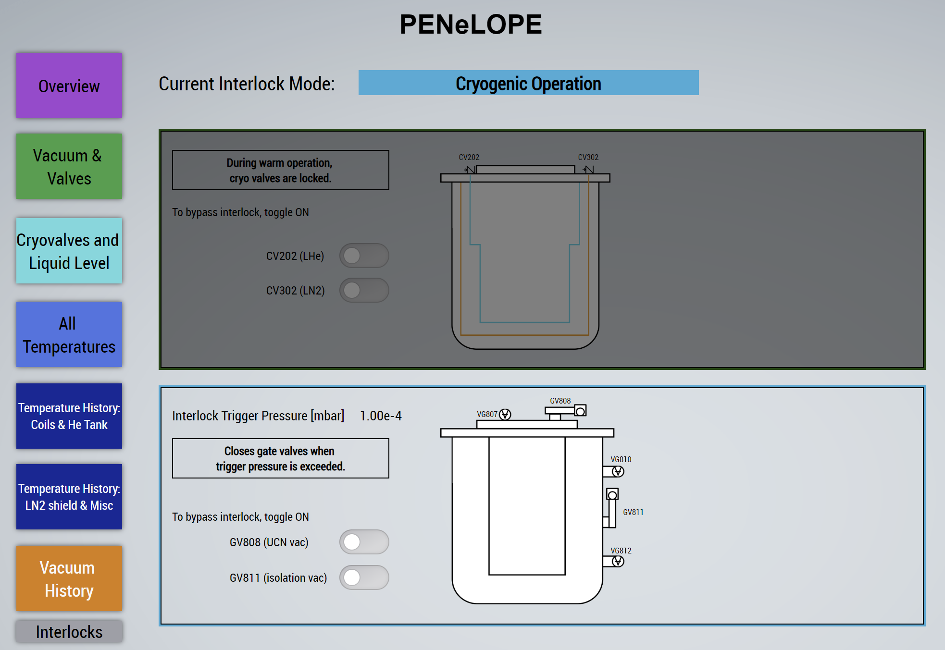

Slide 25
Thank you for your attention!

