Slide 1
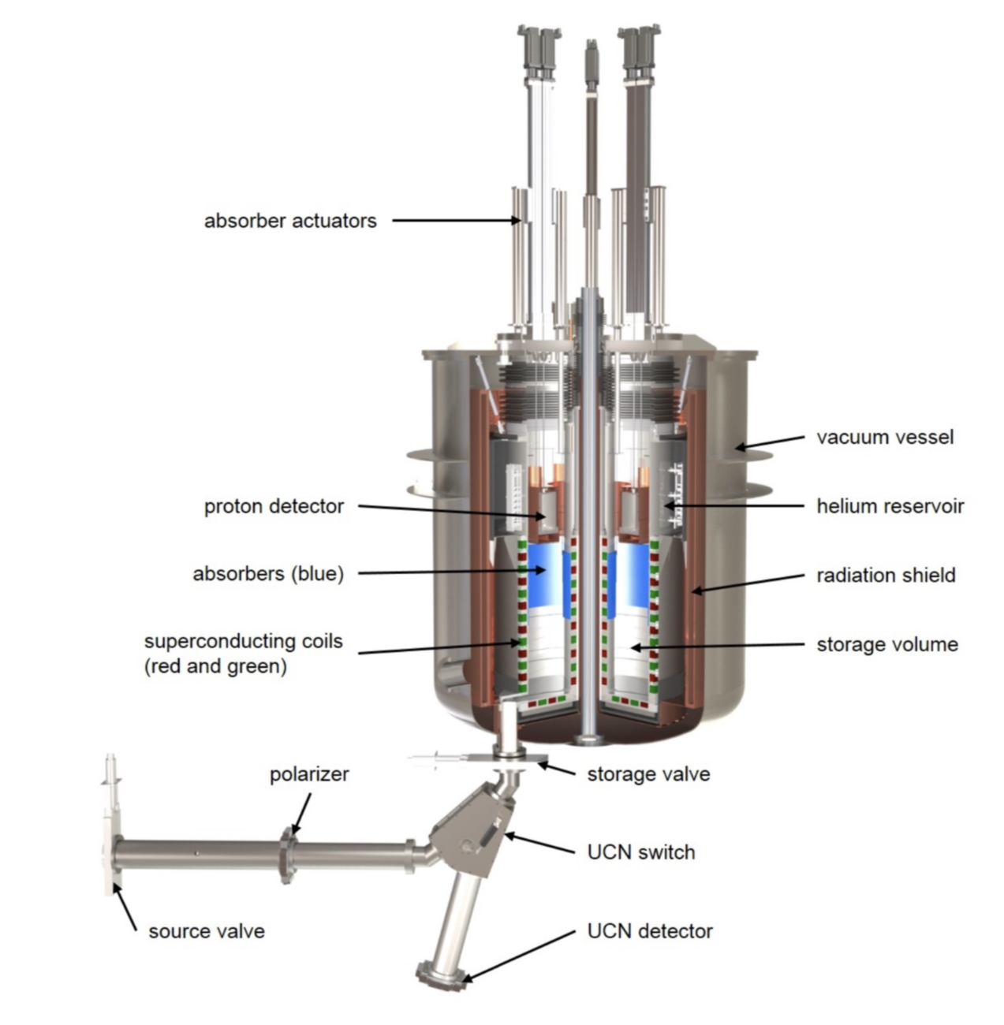
Results of ILL measurements and setup for first PENeLOPE neutron measurements

Slide 2
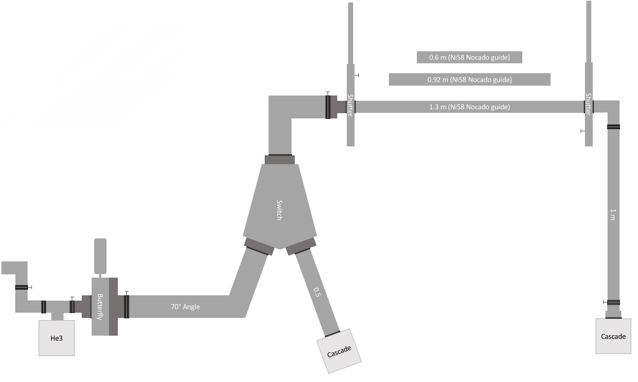
Experiments conducted at ILL Grenoble
Storage experiment: two ways of emptying (either of the two branches)
Additional inlet valve & monitoring detector
60/92/130 cm storage length
Notes:
Upgraded storage exp compared to Mainz: inlet valve, monitor, two detectors
similar to penelope ignoring right side/close right shutter
Computer controlled, empty to one side
Dark grey parts: adaptors -> potential leak

Slide 3
Results: neutron lifetime
Notes:
Count neutrons after storage
Shown: 152 runs/ 21 storage times (13/2e2/b)
1/b => 43s lifetime <<15 min -> how good‘s the guide
Mention: absortion depends on n energy -> multiple exp-decays

Slide 4
Results: neutron lifetime
Lifetime [s] | ILL |  |  | TRIGA
Length | 1.3 m | 0.92 m | 0.6 m | 2 m
Left | 57.1(5.0) | 17.6(2.1) | 33.1(7.1)
Right | 57.9(1.0) | 43.9(9.1) | 47.3(3.0) | 73.9(5.9)
Shortest lifetime for 92 cm guide
Equal for both detectors at 130 cm, large differences for both shorter guides
Energy dependant loss after storage
Notes:
Best lifetime Mainz, worst 92 -> replica guides are good, volume helps (130mm/70mm)
#no side difference 13, error bc less n -> like mainz
#large difference -> Why?
Imagine loss on one side -> offset, but same results
Energy dependant loss
Look at difference between sides individually

Slide 5
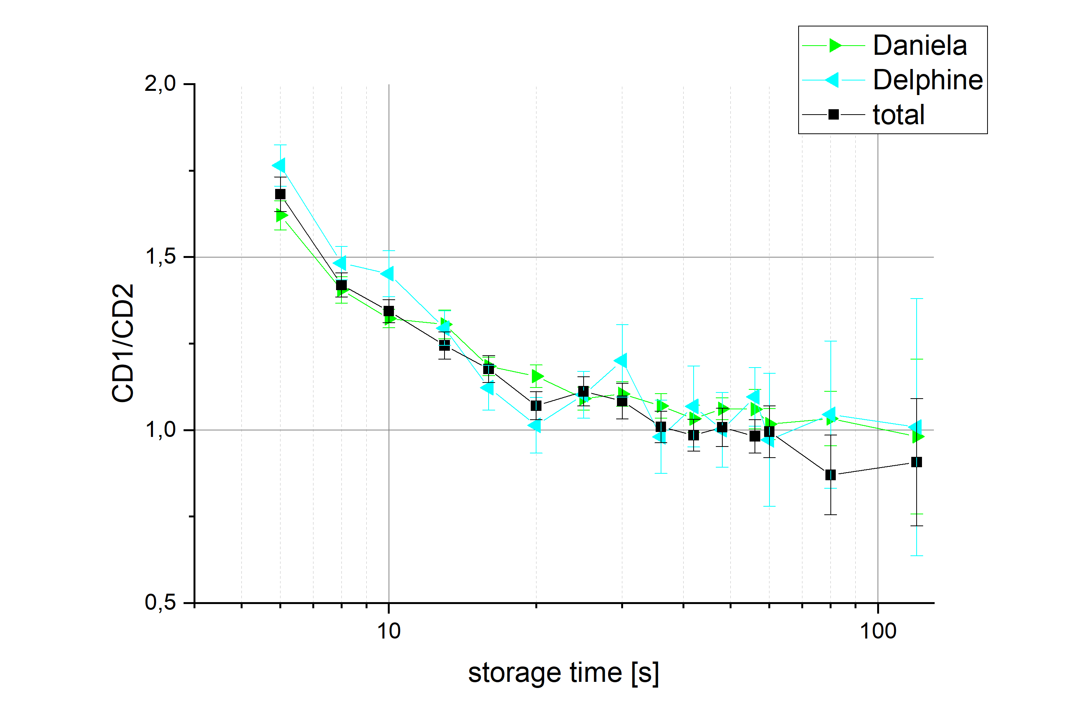
Results: Side difference vs Storage time
Notes:
1.3m: Use data of each detector seperately: switched halfway through
No systematic assymmetry between detectors
Expected if energy independant: singular/constant value
No, CD1 larger for short times
Idea: Residual Neutrons from flap movement
Since half runs provide data for 1e2 -> estimate & subtract
(sidenote: no longer storage times as error is huge)

Slide 6
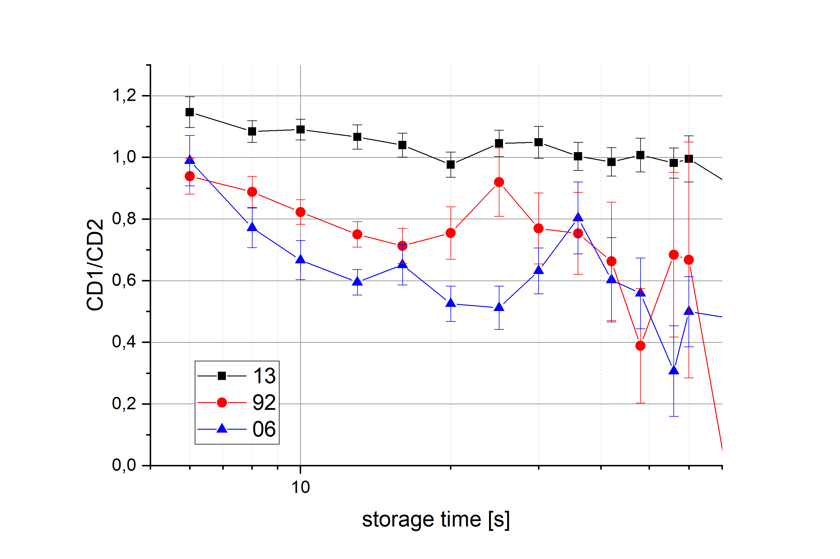
Results: Side difference vs Storage time II
Notes:
Look at different storage volumes
Three different heights, all follow downwards trend
(1.3m slightly higher – but relEff was measured independantly of lifetime)
Longer storage -> lower energy
If switch leak prefers lower energies…

Slide 7
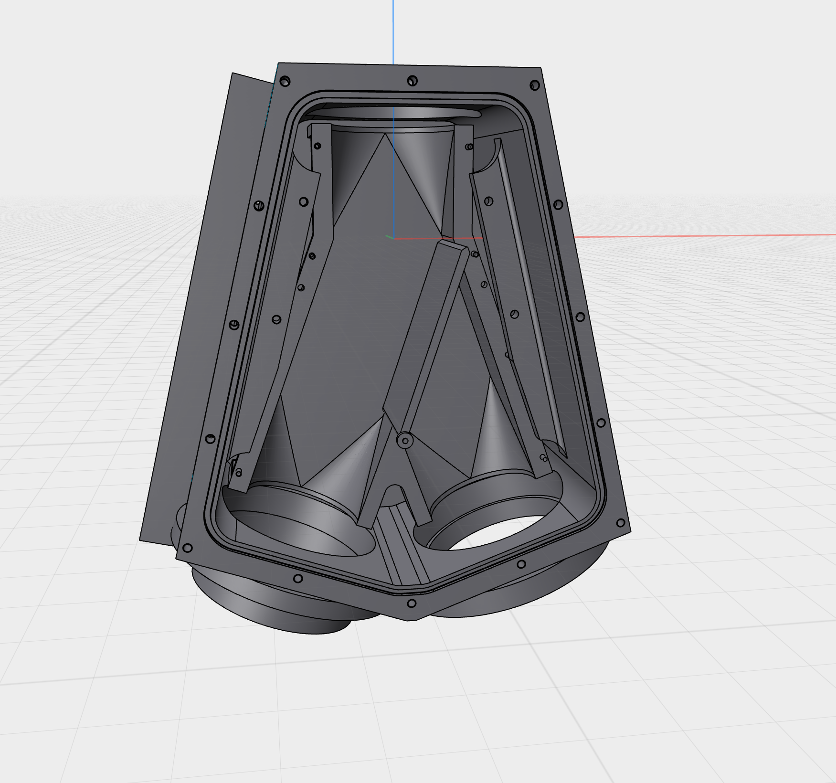

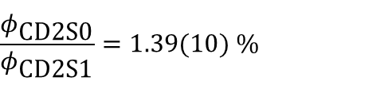
Results: Switch leakage
$$\frac{φ_{\text{CD}\text{1}\text{S}\text{0}}}{φ_{\text{CD}\text{1}\text{S}\text{1}}}=104.07(90) \%$$
$$\frac{φ_{\text{CD}\text{2}\text{S}\text{0}}}{φ_{\text{CD}\text{2}\text{S}\text{1}}}=1.39(10) \%$$
Notes:
Talking about switch leak
Not one leak for all directions: asymmetries
Also: Imagine with water: more leak if closed off than to the side
Left eq: 4% more leakage // possible explanation: preferred low energies
cant get to the top // 100 neV/m
Right: same procedure right CD; 1,4% leak
Realistic, rather low
Doesnt account for energy dependant losses in guide

Slide 8
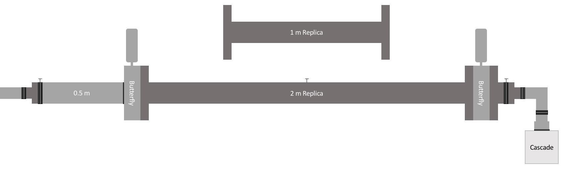
Results: Valve leakage
Leakage [%] | In setup | Standalone
Butterfly 1 | 1.96(11) | 3.42(4)
Butterfly 2 | 0.92(10) | 2.22(5)
combined | 0.46(10)
Combined leak significantly higher than product of individual leak rates
Leakage is energy dependant
Notes:
Measured in Mainz
?? Mention dennis
Energy independant number only as first impression
Lower leak in setup than standalone -> shorter setup
Combined = both closed higher than product of individuals
=> Most likely energy dependant

Slide 9
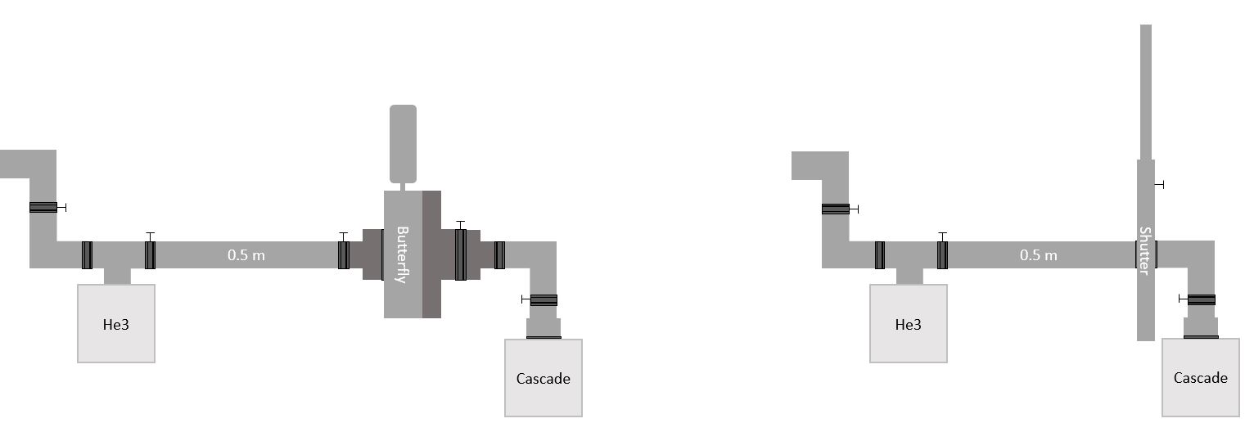
Results: Valve leakage II
 | Leakage [%]
Butterfly 1 | 0.66(1)
Butterfly 2 | 3.94(2)
Leakage [%] | Shutter 1 | Shutter 2
Polished | 0.024(2) | 0.045(3)
Dull | 0.030(2) | 0.048(4)
Notes:
Same it ILL: smaller test setup
Butterfly 1 is better -> reworked before, flap got stuck, great job Thomas
Shutter: assymmetric, one side gets a polished plate pressed to the guide
Negligible leak, one n every few seconds

Slide 10
Minimal working setup - externals
Guide neutrons from a source into PENeLOPE and to an external detector
Using:
Guides
Valves
Switch
Detector
Polarizer
Notes:
Would be great to have neutrons
Polarizer -> not impossible, but work
Detector, guides -> available, use easiest
Ideally: „milk tubes“ with shutters
Switch: problematic; as Fierlinger has in Grenoble maybe?

Slide 11
Minimal working setup - internals
Keep neutrons inside PENeLOPE
Using:
Superconducting Magnets
Central Coil
Get neutrons inside?
Construct interface
Notes:
Inside Penelope:
Superconducting magnets of course
Central coil: hurdles to use power supply + coolant, control minor point
No absorbers, no proton detector

Slide 12
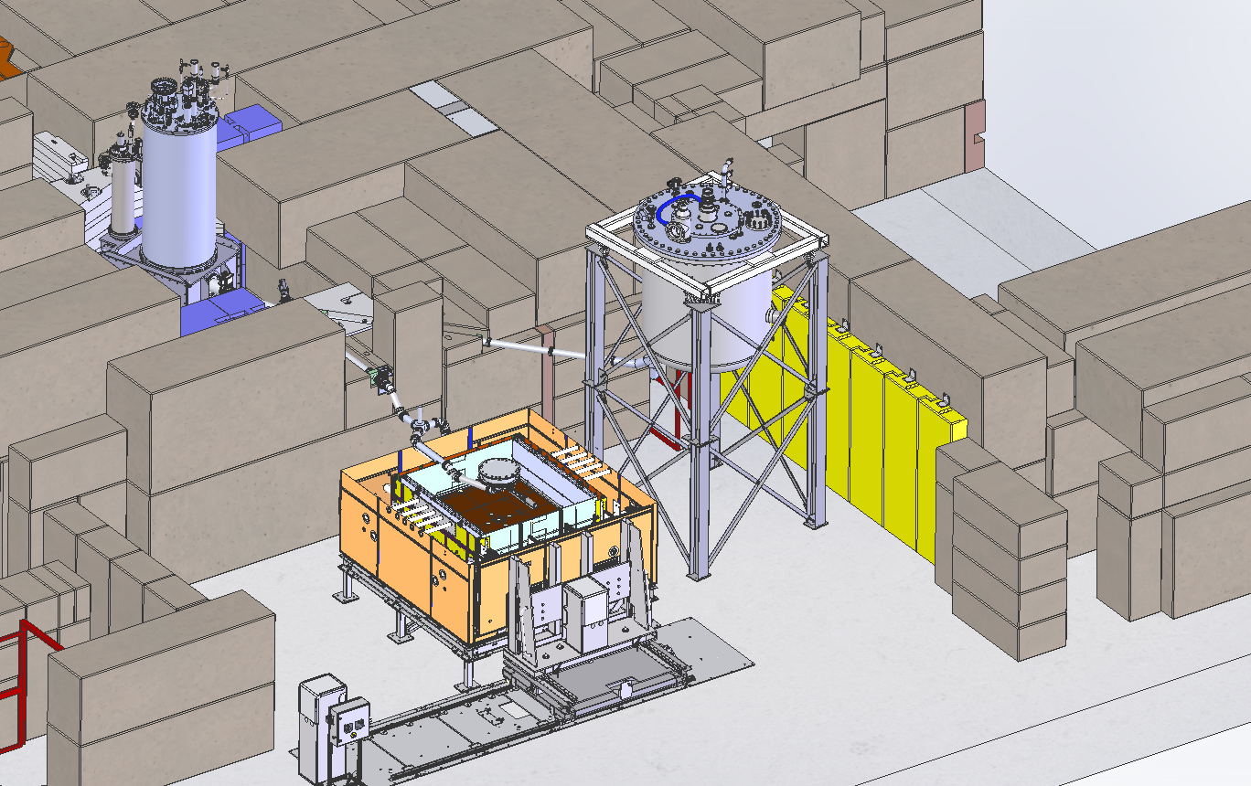
Minimal working setup - neutrons

Slide 13
Outlook: Key takeaways
Externals:
  Valves: Shutters are reliable with low leakage
  Switch: working, but leakage + geometry challenging
  Guides: adequate transmission
  Detectors: better readout would be beneficial
Internals:
  Central coil + power: install & certify
  Enable UCN connection
  We need neutrons!
Notes:
Shutters work well, good handling
Butterfly: heavy, round, different connection
Switch: horizontally before, different drive for flap
did work, but asymmetry and leakage provide challenges
Guides: as expected, comparable to other exp, better cleaning methods
Detectors: work reliably, software has limitations, not all at one place, likes to crash

Slide 14
ende

Slide 15
example readout
Blue: emptying to the right (ILL), comparable to TRIGA data
Orange: emptying to the left through the switch
filling
storage
counting
transmission
Notes:
Example runs 13before 2e2/1e1 20s storage
Raw data: counts summed each second
Blue: ILL right/TRIGA; almost no n during fill/store, low bg
Orange: high bg -> leak switch, peak -> switching, lower bg later -> inlet valve

Slide 16
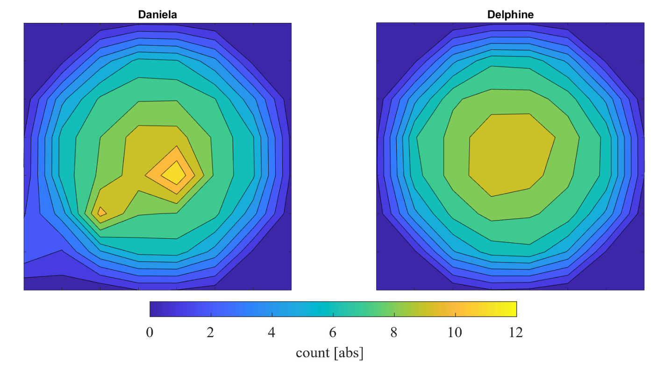
detector efficiencies at ILL
2 Cascade detectors: Daniela and Delphine (Identical model, 8 by 8 pixels)
Below: Transmission through the setup with 1.3 m storage guide
Notes:
Two detectors ILL, data nomalization -> relative eff would be interesting
=> BUT no influence on lifetime if energy independant
Achieved by switching detectors halfway 1.3m runs
=> Daniela shows artifacts, unclear why (software/electronics/sensor?)

Slide 17
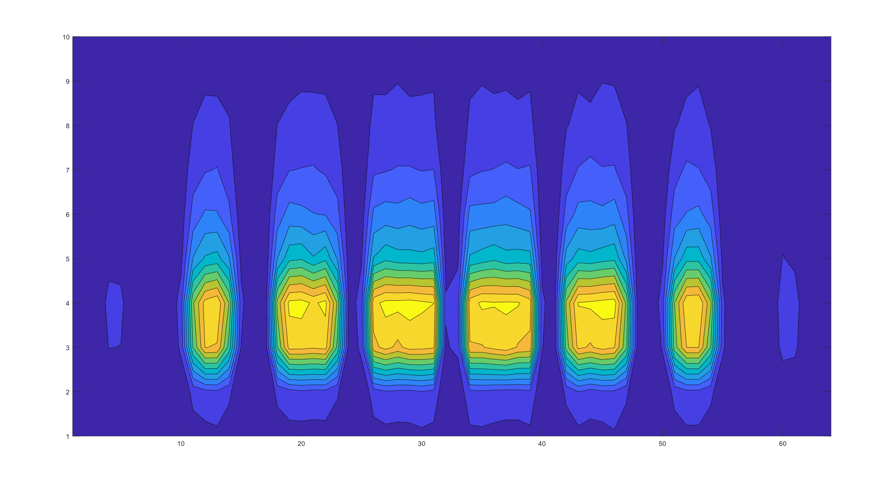
CD1 spacial development
Notes:
X: 64 Pixels Y: time upwards
1e2 peak development
=> Looks perfectly homogenous

Slide 18
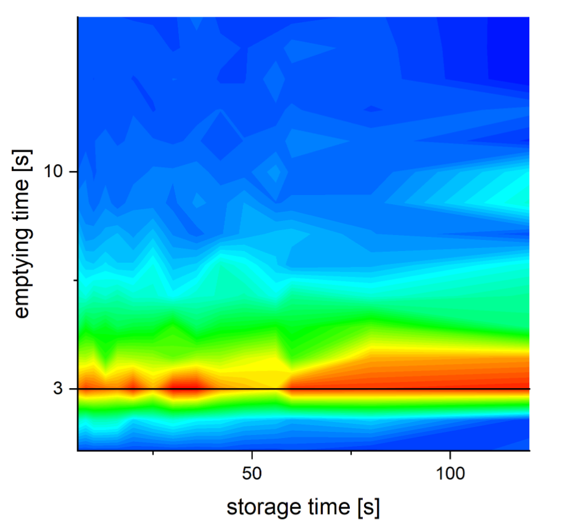
Emptying peak for different storage times
Notes:
Cd2 data
Each run upwards, storage times to the right
Mean velocity of n decreases -> peak would be later
=> Not visible

