Slide 1
Particle Physics Department
Introduction
Oliver Stelzer-Chilton
ACOT Meeting
April 8th, 2019

Slide 2
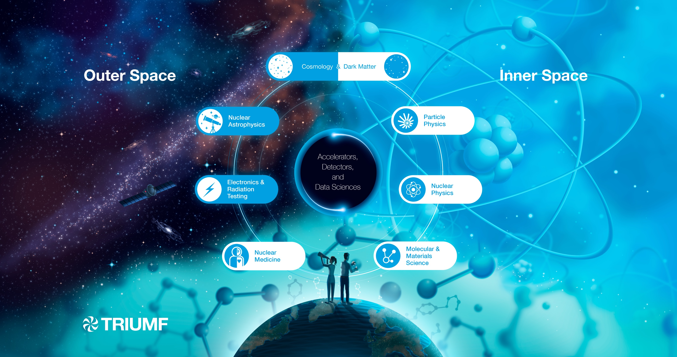

Slide 3
Particle Physics within the Physical Sciences Division
The Departments for Particle Physics, as well as Theory and Science & Technology address the following Research topics:
High Energy Frontier
Neutrinos and Dark Matter
Precision Tests of Fundamental Interactions
Monthly meetings inclusive to Particle Physics Theory and
Science and Technology Department members
Dark Matter Forum Meetings
Science and Technology Seminars

Slide 4
Particle Physics Department
Carry out and support particle physics experiments with the TRIUMF community
Focus projects:
ATLAS, T2K/HyperK, UCN, ALPHA, SuperCDMS
Recent hires
Wolfgang Rau (TRIUMF/McDonald Inst.)
Mark Hartz (IPMU/TRIUMF)
TRIUMF based since July 2018
Neutrino BAE scientist
Patrick dePerio
ATLAS BAE scientist interviews this week
Data Scientists
Wojtek Fedorko (Machine Learning)
Olivia diMatteo (Quantum Computing)
Particle Physics – O. Stelzer-Chilton
Deputy – M. Hartz
G. Azuelos (UofM) I. Trigger
M. Vetterli (SFU) O. Stelzer-Chilton
D. Gingrich (UofA) P. Savard (UofT)
S. Yen M. Hartz (with IPMU)
D. Karlen (UVic) J-M. Poutissou (emeritus)
R. Gornea (Carleton) A. Konaka
P. de Perio W. Rau (McDonald Inst.)
M. Fujiwara
A. Olin (emeritus) A. Carpa (RA)
T. Numao R. Picker
R. Mammei A (UofW) P. Giampa (OHF)
R. Helmer (emeritus)
ATLAS Tier 1 - R. Tafirout
R. Tafirout
A. De Silva (P&S)
D. Deatrich (P&S)
A. Wong (P&S)
R. Devbhandri (tech)
V. Kondratenko (P&S)
D. Qing (P&S)
S. Liu (P&S)
Y. Shin (P&S)
W. Fedorko (Data Science)
O. Di Matteo (Data Science)
Affiliated Scientists
D. Axen (UBC) R. McPherson (UVic)
S. Bhadra (YorkU) M. Hasinoff (UBC)
B. Stelzer (SFU) S. Oser (UBC)

Slide 5
Particle Physics Mission Statement
  Lead world‐class Particle Physics experiments in strong collaboration with Canadian universities.
  Provide, maintain, and exploit the specialized, centralized facilities at TRIUMF required for Canadian scientists to perform state‐of‐the‐art particle physics experiments here, elsewhere in Canada, and abroad. This includes development of beams, detectors, electronics, data acquisition, computing facilities and data analysis.
  Train students and young scientists to become leaders in Canada's future scientific endeavours. Train HQP in electronics, computing and detector technology.

Slide 6
Outline
How does TRIUMF participate in the following research topics:
  High Energy Frontier
  Neutrinos and Dark Matter
  Precision Tests of Fundamental Interactions
Which are TRIUMF’s related flagship projects and involvements?
  Science highlights
Strategic overview:
  A showcase for TRIUMF’s research excellence
  TRIUMF and Canadian universities: a mutually beneficial relationship
  How do we move into TRIUMF’s next 5YP (2020-2025) and ensure continued excellence?
  Challenges and opportunities

Slide 7
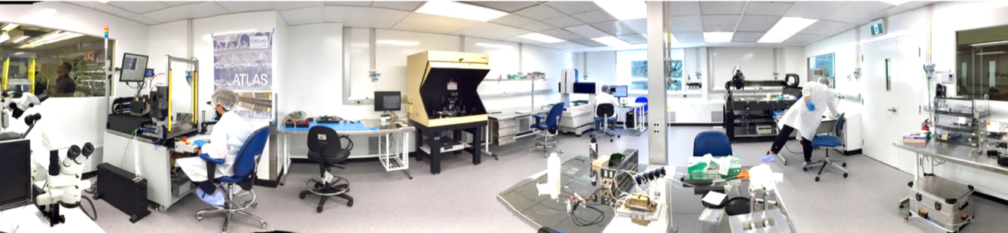








High Energy Frontier
Oliver Stelzer-Chilton
Isabel Trigger
Reda Tafirout
Nigel Hessey
Motivation / “big questions”
  What is the precise nature and stability of the Higgs boson? Is there new physics at the TeV scale or beyond? Dark Matter Searches
TRIUMF staff and trainees
  6 faculty, 3 affiliated scientists, 3 joint faculty, 1 emeritus,
  6 postdocs, 7 graduate students, 3 undergraduate students,
  9 techs, 1 engineer, 8 staff (Tier-1 operation)
TRIUMF local infrastructure
  ITK (inner tracker ) clean room, sTGC spray room and assembly lab, LAr electronics
  Tier-1 data centre
Projects: ATLAS,
ATLAS Tier-1 data centre
Large contributions to 3 major ATLAS upgrades in collaboration with international ATLAS partners and Canadian Universities
  LAr Electronics (Phase 1 and 2)
  New Small Wheel
  Inner Tracker
Cleanroom for ITK

Slide 8
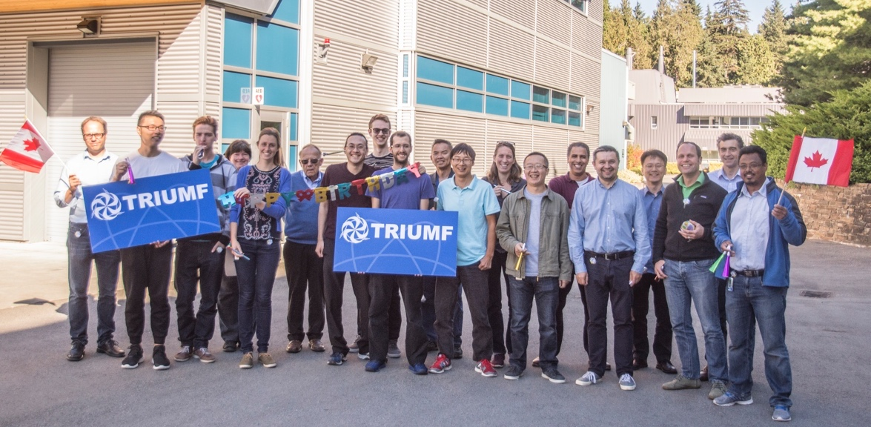
High Energy Frontier
Large Contributions to Physics Program
  Higgs Boson Characterization
  New Physics Searches
New BAE Scientist hire underway
  Five strong finalists at ”in person” interview stage
  Hope to make the offer very soon
ATLAS Tier-1 CFI Plans
  Need to keep up with the experimental program
  Expect a “slow” year for 2021, with further ramp up in performance for 2022 and 2023 (leading to LS3)
  Plan for 50% increase in capacity relative to 2018 for year 2021, with more nominal increases to cover 2022 and 2023
  For year 2023, the projected needs are:
  11,000 cores / 14 PB disk / 39 PB tape
  Estimated CFI total project cost: from $6.5M to $9.2M

Slide 9
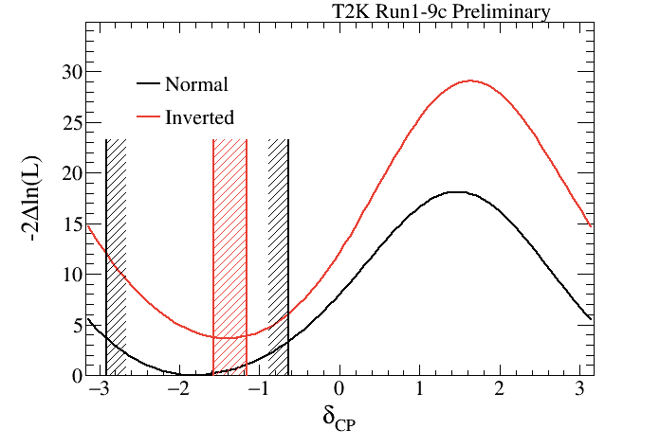
Neutrinos and Dark Matter
Motivation / “big questions”
  neutrino oscillations, CP violation, mass hierarchy, Dark Matter searches
TRIUMF staff and trainees
  7 faculty, 2 affiliated scientists, 5 joint faculty, 8 postdocs, 10 graduate students, 2 undergraduate students, 1 software engineer, 3 emeriti
TRIUMF local infrastructure
  Detector prototyping and construction at TRIUMF
  Photosensor Test Facility (PTF)
  specialized plastics & scintillator workshop
T2K/SuperK
Neutrino oscillation measurements and search for CP violation
  2σ indication of CP violation
Construction of 8-times larger Hyper-K to begin in 2020
  10% CP violation effect can be measured at 3σ significance
  Hyper-K Canada collaboration is formed
Projects:
T2K/HyperK, SuperCDMS, DEAP-3600, nEXO, HALO, SNO+

Slide 10
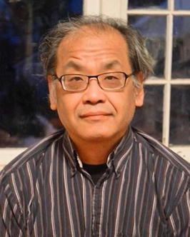
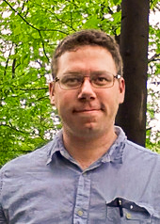

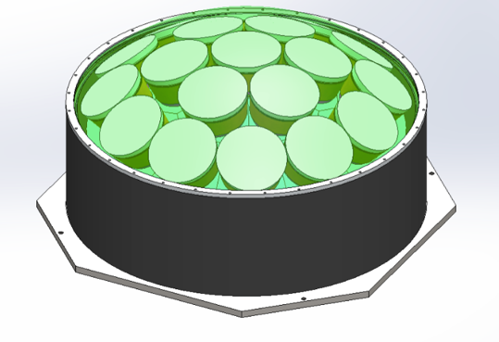
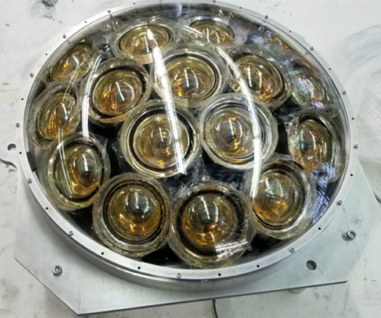



Hyper-K: E61 Experiment
  Canada will lead the construction of an intermediate water Cherenkov detector (IWCD) for Hyper-K: the J-PARC E61 (NuPRISM) experiment
  E61 will control critical systematic uncertainties related to modeling of neutrino-nucleus scattering
  Primary international contribution is 500-600 multi-PMT photodetectors
  CFI-IF project led by UVic will build 400 multi-PMT modules in Canada
  Project budget is ~$6M
Mark Hartz
Thomas Lindner
Akira Konaka
Patrick de Perio
Design
Water
Level
50 m
Prototype
10 m

Slide 11
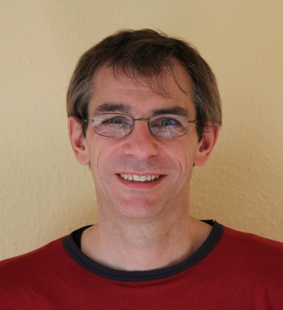
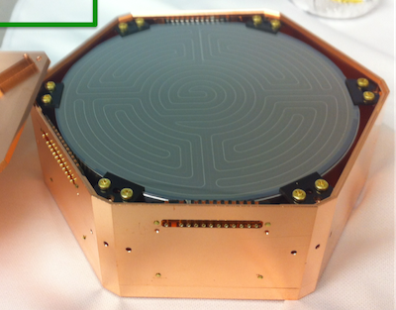
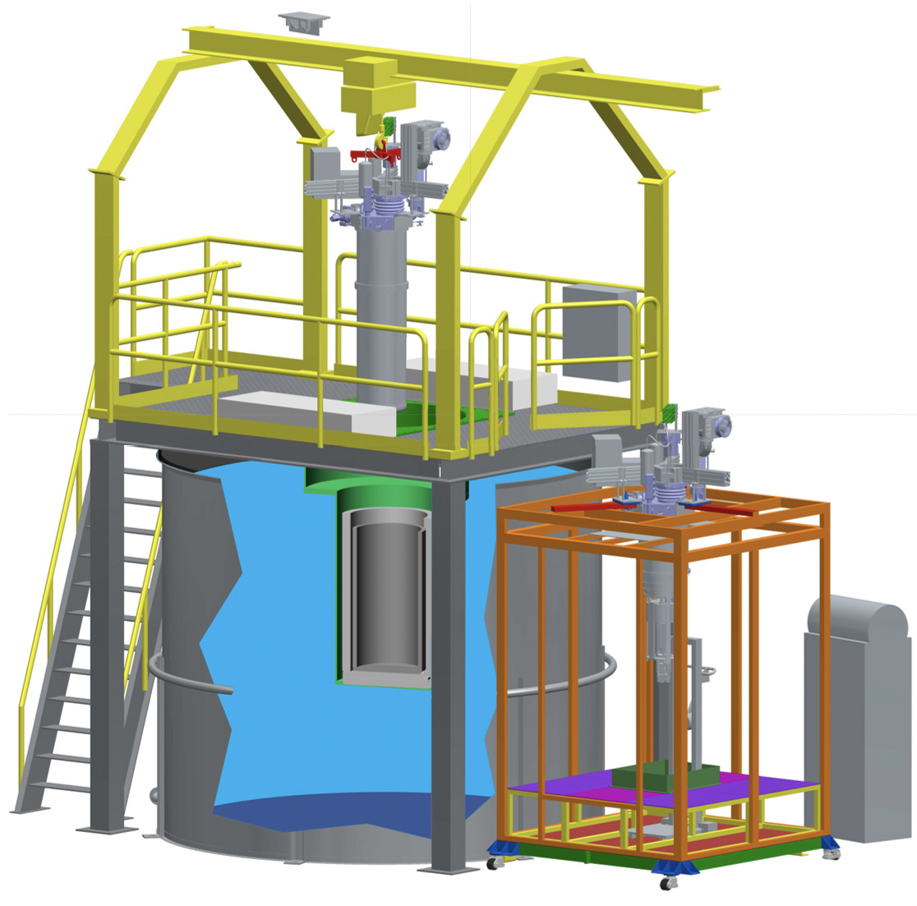




SuperCDMS
  Dark matter constitutes over 80% of matter in the Universe
  Recoil of a scattered target is a potential observable – requires low background environment/infrastructure such as provided by SNOLAB
  Cryogenic semiconductor detectors, Si, Ge; ~30 mK
  Very low threshold (eV range) and low background
  Under construction at SNOLAB, commissioning in 2020
  A Cryogenic Underground TEst facility at SNOLAB (CUTE) being commissioned at SNLOAB
Wolfgang Rau

Slide 12
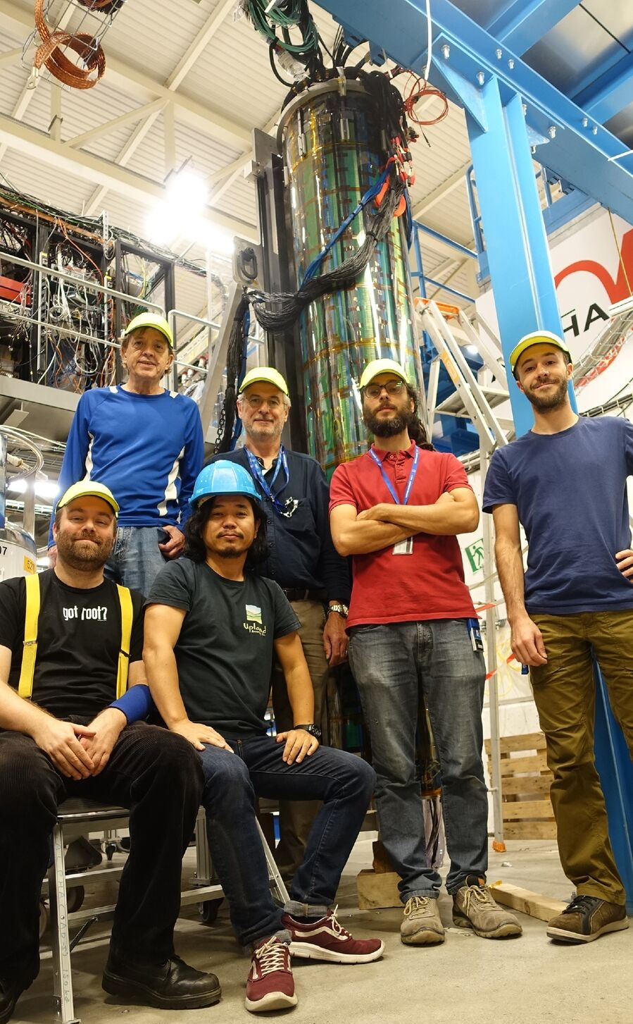
Precision Tests of Fundamental
Interactions
ALPHA-g at CERN
Motivation / “big questions”
  Matter– Antimatter asymmetry, CP-violation, CPT theorem
TRIUMF staff and trainees
  4 faculty, 2 affiliated scientists, 1 joint faculty, 14 postdocs, 8 graduate students, 5 undergraduate students, 1 project manager, 5 emeriti
TRIUMF local infrastructure
  ALPHA apparatus built at TRIUMF
  UCN facility on site (former PiENu site)
Projects: ALPHA, UCN, Rare Decay Group (PiENu, NA62)

Slide 13
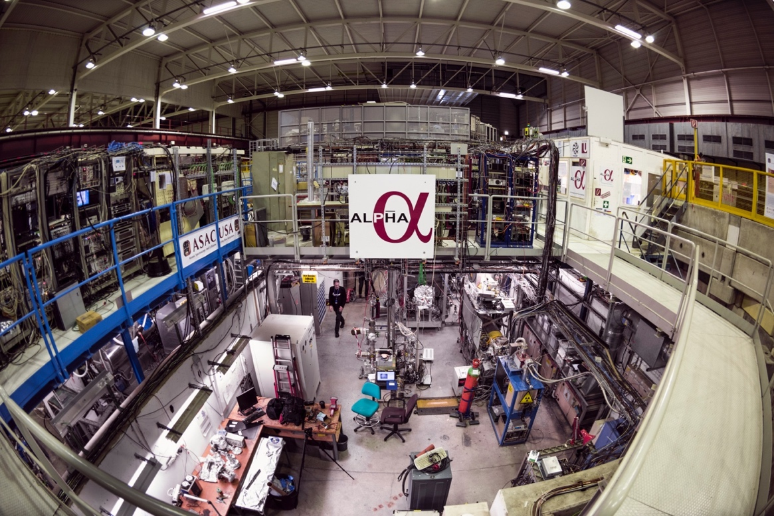
ALPHA
  ALPHA is testing the symmetry between matter and antimatter by studying properties of antihydrogen atoms
  Spectroscopic tests of CPT symmetry
  2x10⁻¹² precision in 1s-2s laser spectroscopy (most precise measurement on antimatter to date)
  Lyman-alpha, Lamb shift, and hyperfine spectroscopy of antihydrogen
  Laser cooling of antihydrogen
  Gravitational free fall of antimatter – ALPHA-g
    Construction complete
    Commissioning ongoing
Makoto Fujiwara

Slide 14
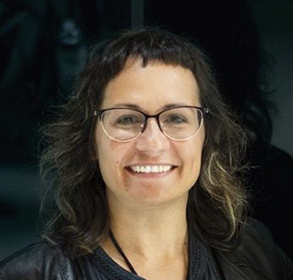
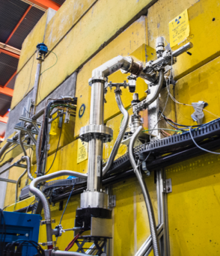





TUCAN - Ultracold Neutrons (UCN)
  Creating Ultracold Neutrons UCN for the Neutron electric dipole moment search (nEDM) & future UCN user facility
  Ultracold neutrons (UCN): 300 neV energy neutrons
  Can be stored like a gas
  UCN enable high precision measurements of neutron properties and interactions
  Search for a neutron EDM
  First production of polarized UCN
  Next generation world class UCN source, currently at technical design stage aiming at competitive densities
  Developing next generation nEDM spectrometer, currently at conceptual stage
Ruediger Picker
Beatrice Franke
UCN beamline and counter

Slide 15

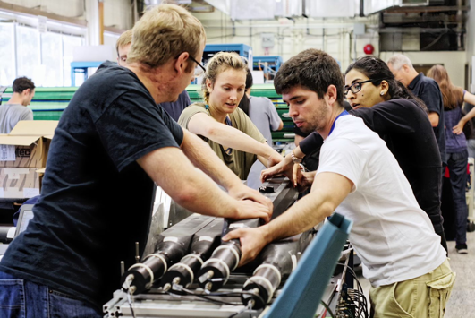
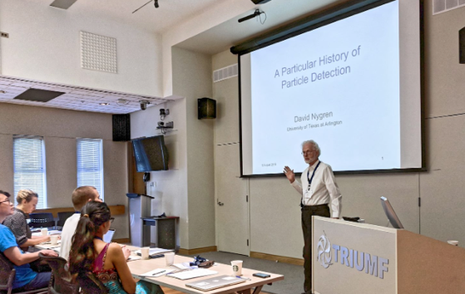
Connecting to the Community
Through organizing workshops (together with theory colleagues) conferences and summer schools
GRIDS, in collaboration with the
TRISEP
Rotating between PI, SNOLAB and
TRIUMF: July 2018 at Perimeter

Slide 16
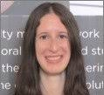

Data Science Platform
  TRIUMF hired a Data Scientist and a Quantum Information Scientist
  Several pilot projects (TRIUMF wide) have been started in this area over the last 6 months
    Event classification and synthetic data generation for Water Cherenkov detectors
    Extrapolation of No-Core Shell Model calculations
    Particle identification in NA62 experiment
    Automatic analysis of µSR data
  Collaboration between Helmholtz Association and TRIUMF in several working groups
Wojtek Fedorko
Olivia diMatteo
  Several workshops and schools with full or partial focus on Data Science
    Machine learning for Water Cherenkov Detectors Workshop (April at UVic)
    TRISEP Summer School (August at TRIUMF)
    Helmholtz Association-TRIUMF workshop (September in Hamburg)
  Study sessions in Quantum Machine Learning
  Next month (May 9th -14th) four introductory (hands on) lectures on quantum computing and quantum annealing

Slide 17
International and National Connections
CERN:
  ALPHA-Canada is led by TRIUMF scientist and is the single largest group within international collaboration
  Through the TRIUMF ATLAS Tier-1 data centre and key detector contributions TRIUMF enables Canadian researchers to play a crucial role in the international ATLAS collaboration at CERN.
  Gateway to CERN for Canadian University researchers through contributions to LHC accelerator complex
JAPAN:
  TRIUMF’s unique accelerator infrastructure attracted Canadian and Japanese funding for the construction a world class next generation Ultracold Neutron source.
  Strong connection to Japanese institutions through collaborations and MOUs (KEK, Osaka University, RCNP, Nagoya University,…) leverages existing bond between TRIUMF and Japanese particle physics landscape
  TRIUMFs current and future involvement in T2K and HyperK ensure continuation of these relationships
US:
  SuperCDMS DAQ
  EMPHATIC: hadron production measurements at Fermilab for long-baseline neutrino measurements
SNOLAB:
  Support in construction and DAQ/electronics of their detectors (HALO, DEAP-3600, SNO+, SuperCDMS, nEXO)
  TRIUMF enables world leading underground experiments that operate at low noise & low background
IPP/McDonald Institute/Perimeter/SNOLAB
  NSERC Canadian Long Range Plan community consultation
  Joint summer schools
  Input to European Strategy

Slide 18
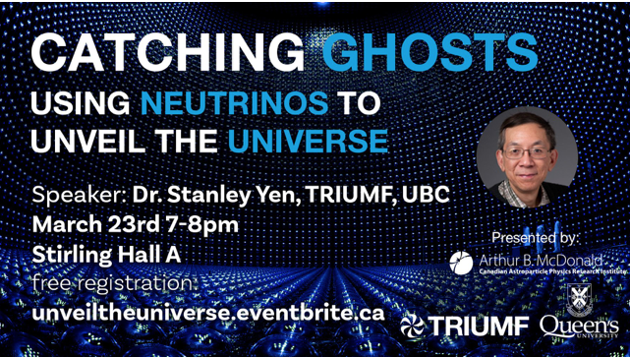
Outreach
Saturday Morning Lectures
Annual ATLAS Masterclass
TRIUMF’s Unveiling the Universe lecture series

Slide 19
Hiring Priority for this 5 year plan and beyond
Science flagship projects and involvements
High energy frontier:
ATLAS: upgrade & science exploitation, Tier-1, High Luminosity LHC - BAE scientist hire at interview stage
Neutrinos & Dark Matter:
SNOLAB involvement → SuperCDMS - BAE scientist hire with McDonald Institute complete
T2K, HyperK and NuPrism - BAE scientist hire complete
Precision tests of fundamental interactions
ALPHA and ALPHA–g - BAE scientist hire request submitted
UCN: competitive sensitivity for neutron EDM & user facility - P&S scientist hire request submitted
With the announcement of the 2020-2025 5-year plan, the planning for future hires in the department and division can proceed. Retreats and workshops later this year.

Slide 20
Challenges
Space
Extremely limited office and meeting space for students, postdocs, scientists and visitors
Currently the problem is further emphasized by de-commissioning of trailers
Available laboratory space has been an issue for several years
Conclusion: We see the space issue as one of the primary inhibitors of further growth of TRIUMF
A new building is necessary

Slide 21
Opportunity
Science and Technology Department
Unique research & development capabilities based on many years of experience with cutting edge detector design and construction track record
Support of large- and small scale projects: a team of ~25 people supports and executes simultaneously up to 30 different projects
Expertise in:
  Gas detectors
  Photo sensors and light guides
  Data acquisition
TRIUMF’s expertise and infrastructure for detector development & construction enables Canadian scientists to carry out world leading underground experiments at SNOLAB and make leading contributions to international projects like ALPHA, ATLAS, and T2K.
Its well-being crucially affects everything we do in the department.
A refresh of equipment and strengthening the department is central to the next 5-year plan.

Slide 22
Summary
Excellent track record on designing, enabling and extracting science from particle physics experiments
It is crucial to complete the 2015-2020 hiring plan
We will ensure the continued relevance and success of Canadian and TRIUMF’s particle physics by exploiting previous and forthcoming investments in experiments in Canada and abroad
Succession planning and hiring priorities for the next 2020-2025 5-year plan will be explored in forthcoming retreats and workshops
A primary emphasize for the next 5-year plan is the strengthening of the Science and Technology Department for both detector development and construction

Slide 23
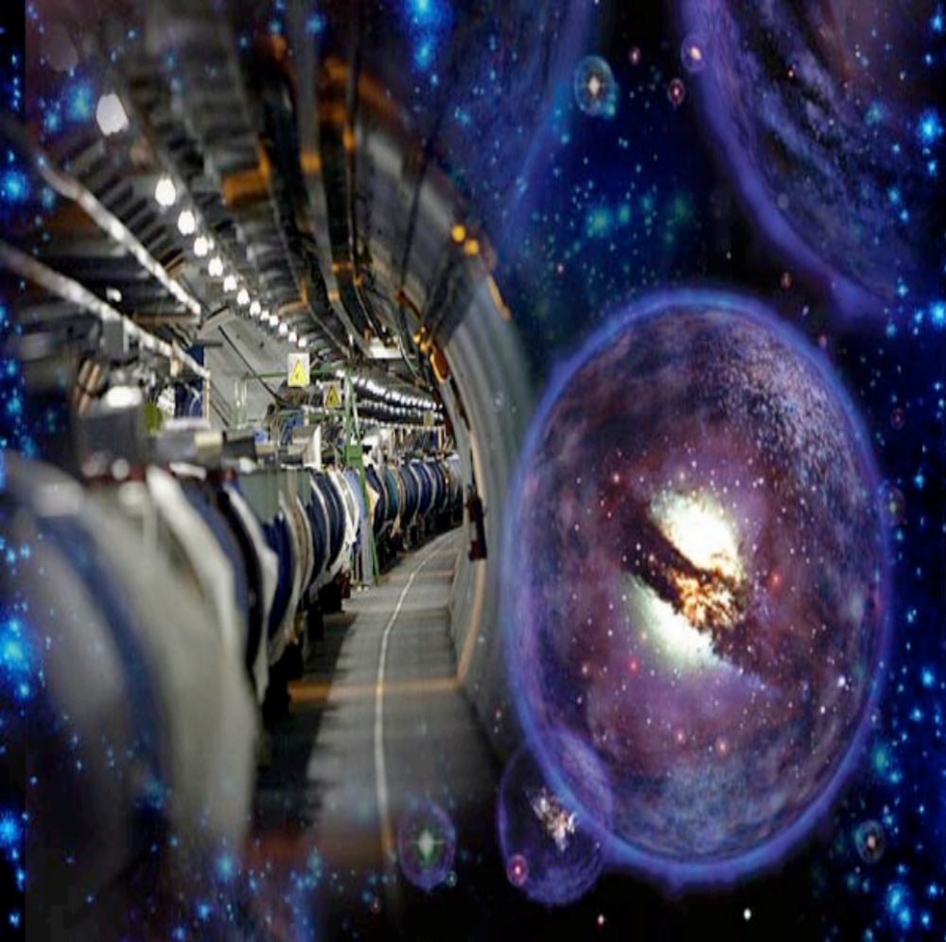




Thank you
Merci
www.triumf.ca
Follow us @TRIUMFLab

