Slide 1
SuperCDMS and CUTE
Dark Matter Search with Cryogenic Detectors
W. Rau

Slide 2
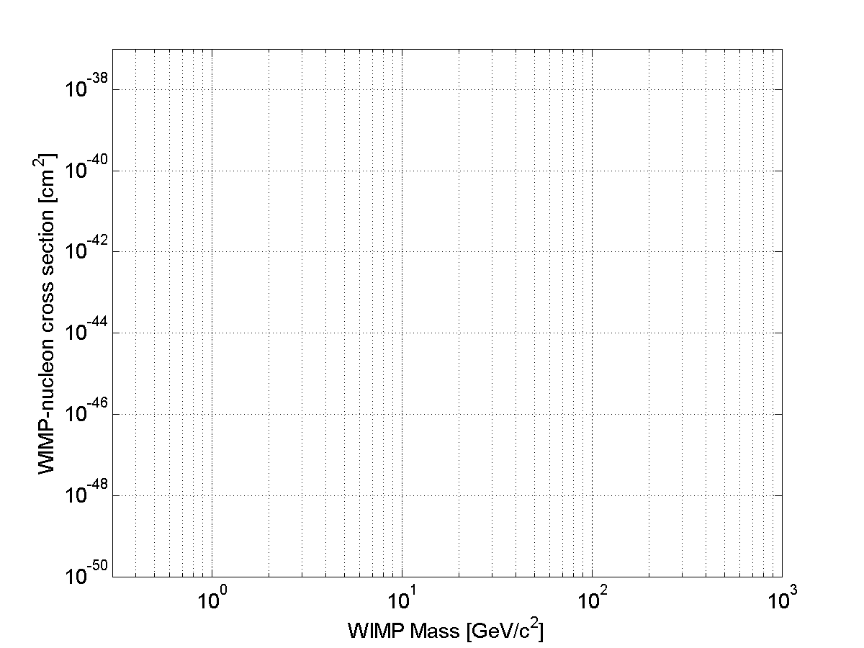
SuperCDMS
Overview
Focus on low-mass dark matter (<10 GeV)
Under construction; ~75 % complete
Installation at SNOLAB: support infrastructure started; experiment staring fall 2019; DOE status review last week.
Completion in 2020
Space for 200 kg; initial payload: 30 kg
Recent Progress
All major infrastructure items ordered (mostly CFI funded)
First set of 6 detectors complete
First full test of HV detector underway
Readout: preproduction electronics being tested
2 publications (“Soudan” data:
CRESST III
CDMSlite R3
SuperCDMS SNOLAB
Expected Sensitivity
DarkSide
SuperCDMS Soudan
Low Threshold
SupeCDMS Soudan
High threshold
DEAP-3600
Neutrino Background
XENON 1t
Astropart.Phys. 104 (2019) 1, Cosmogenic BG (led by E. Fascione, Queen’s PhD student)
Phys.Rev. D99 (2019) no.6, 062001, CDMSlite R3 (led by W. Page, UBC PhD student)

Slide 3
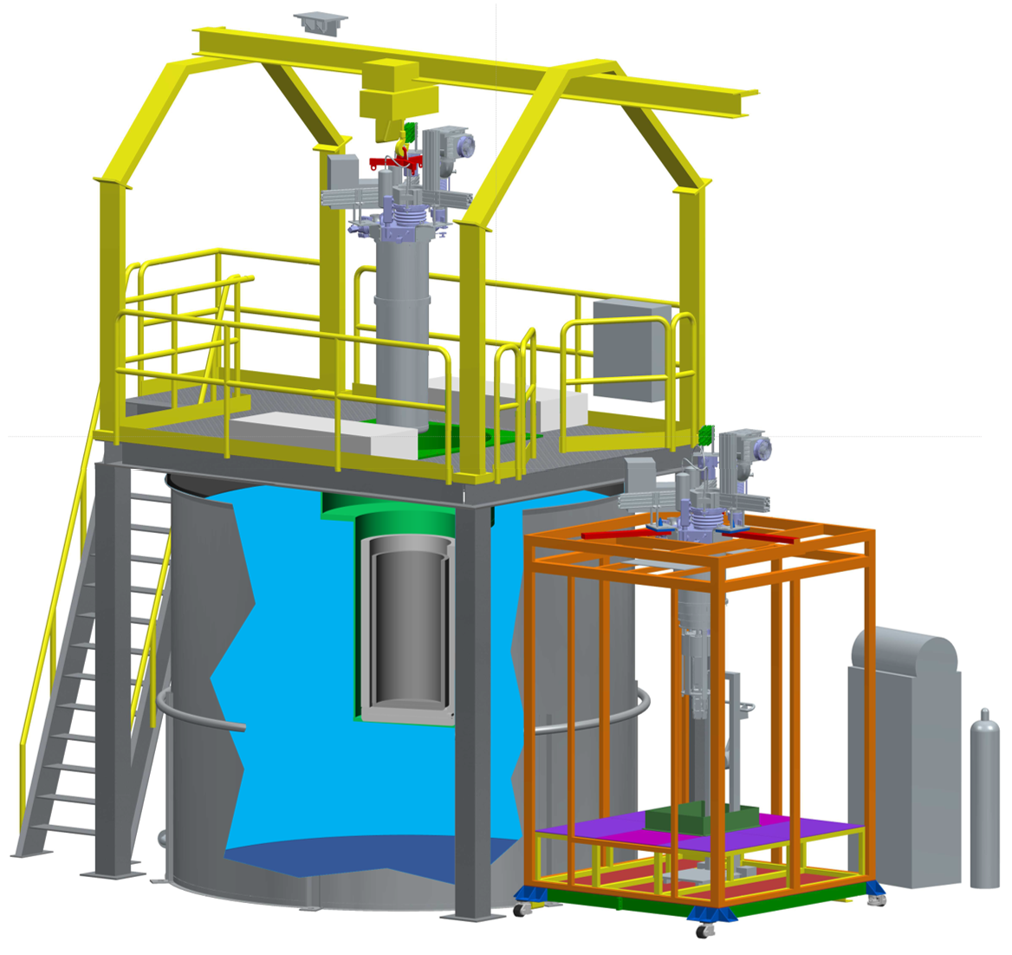
CUTE
crane
Overview
Cryogenic Underground TEst facility
For detector testing that needs low background environment
Potential for early dark matter search
Later: possible use for non-SuperCDMS studies
Recent Progress
Installation of Pb / PE shielding
Installation of suspension system (vibration isolation)
Installation of gamma calibration system
Cryostat to be shipped to SNOLAB this week (all other major items already underground)
Developing schedule up to initial operation:
complete construction in April
commissioning in May
start of operations with detectors in June
cryostat
cleanroom
water shield

Slide 4
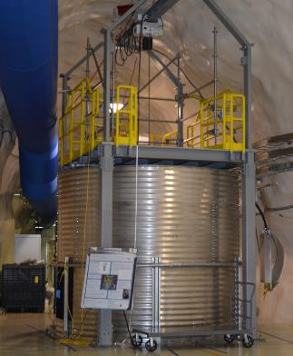
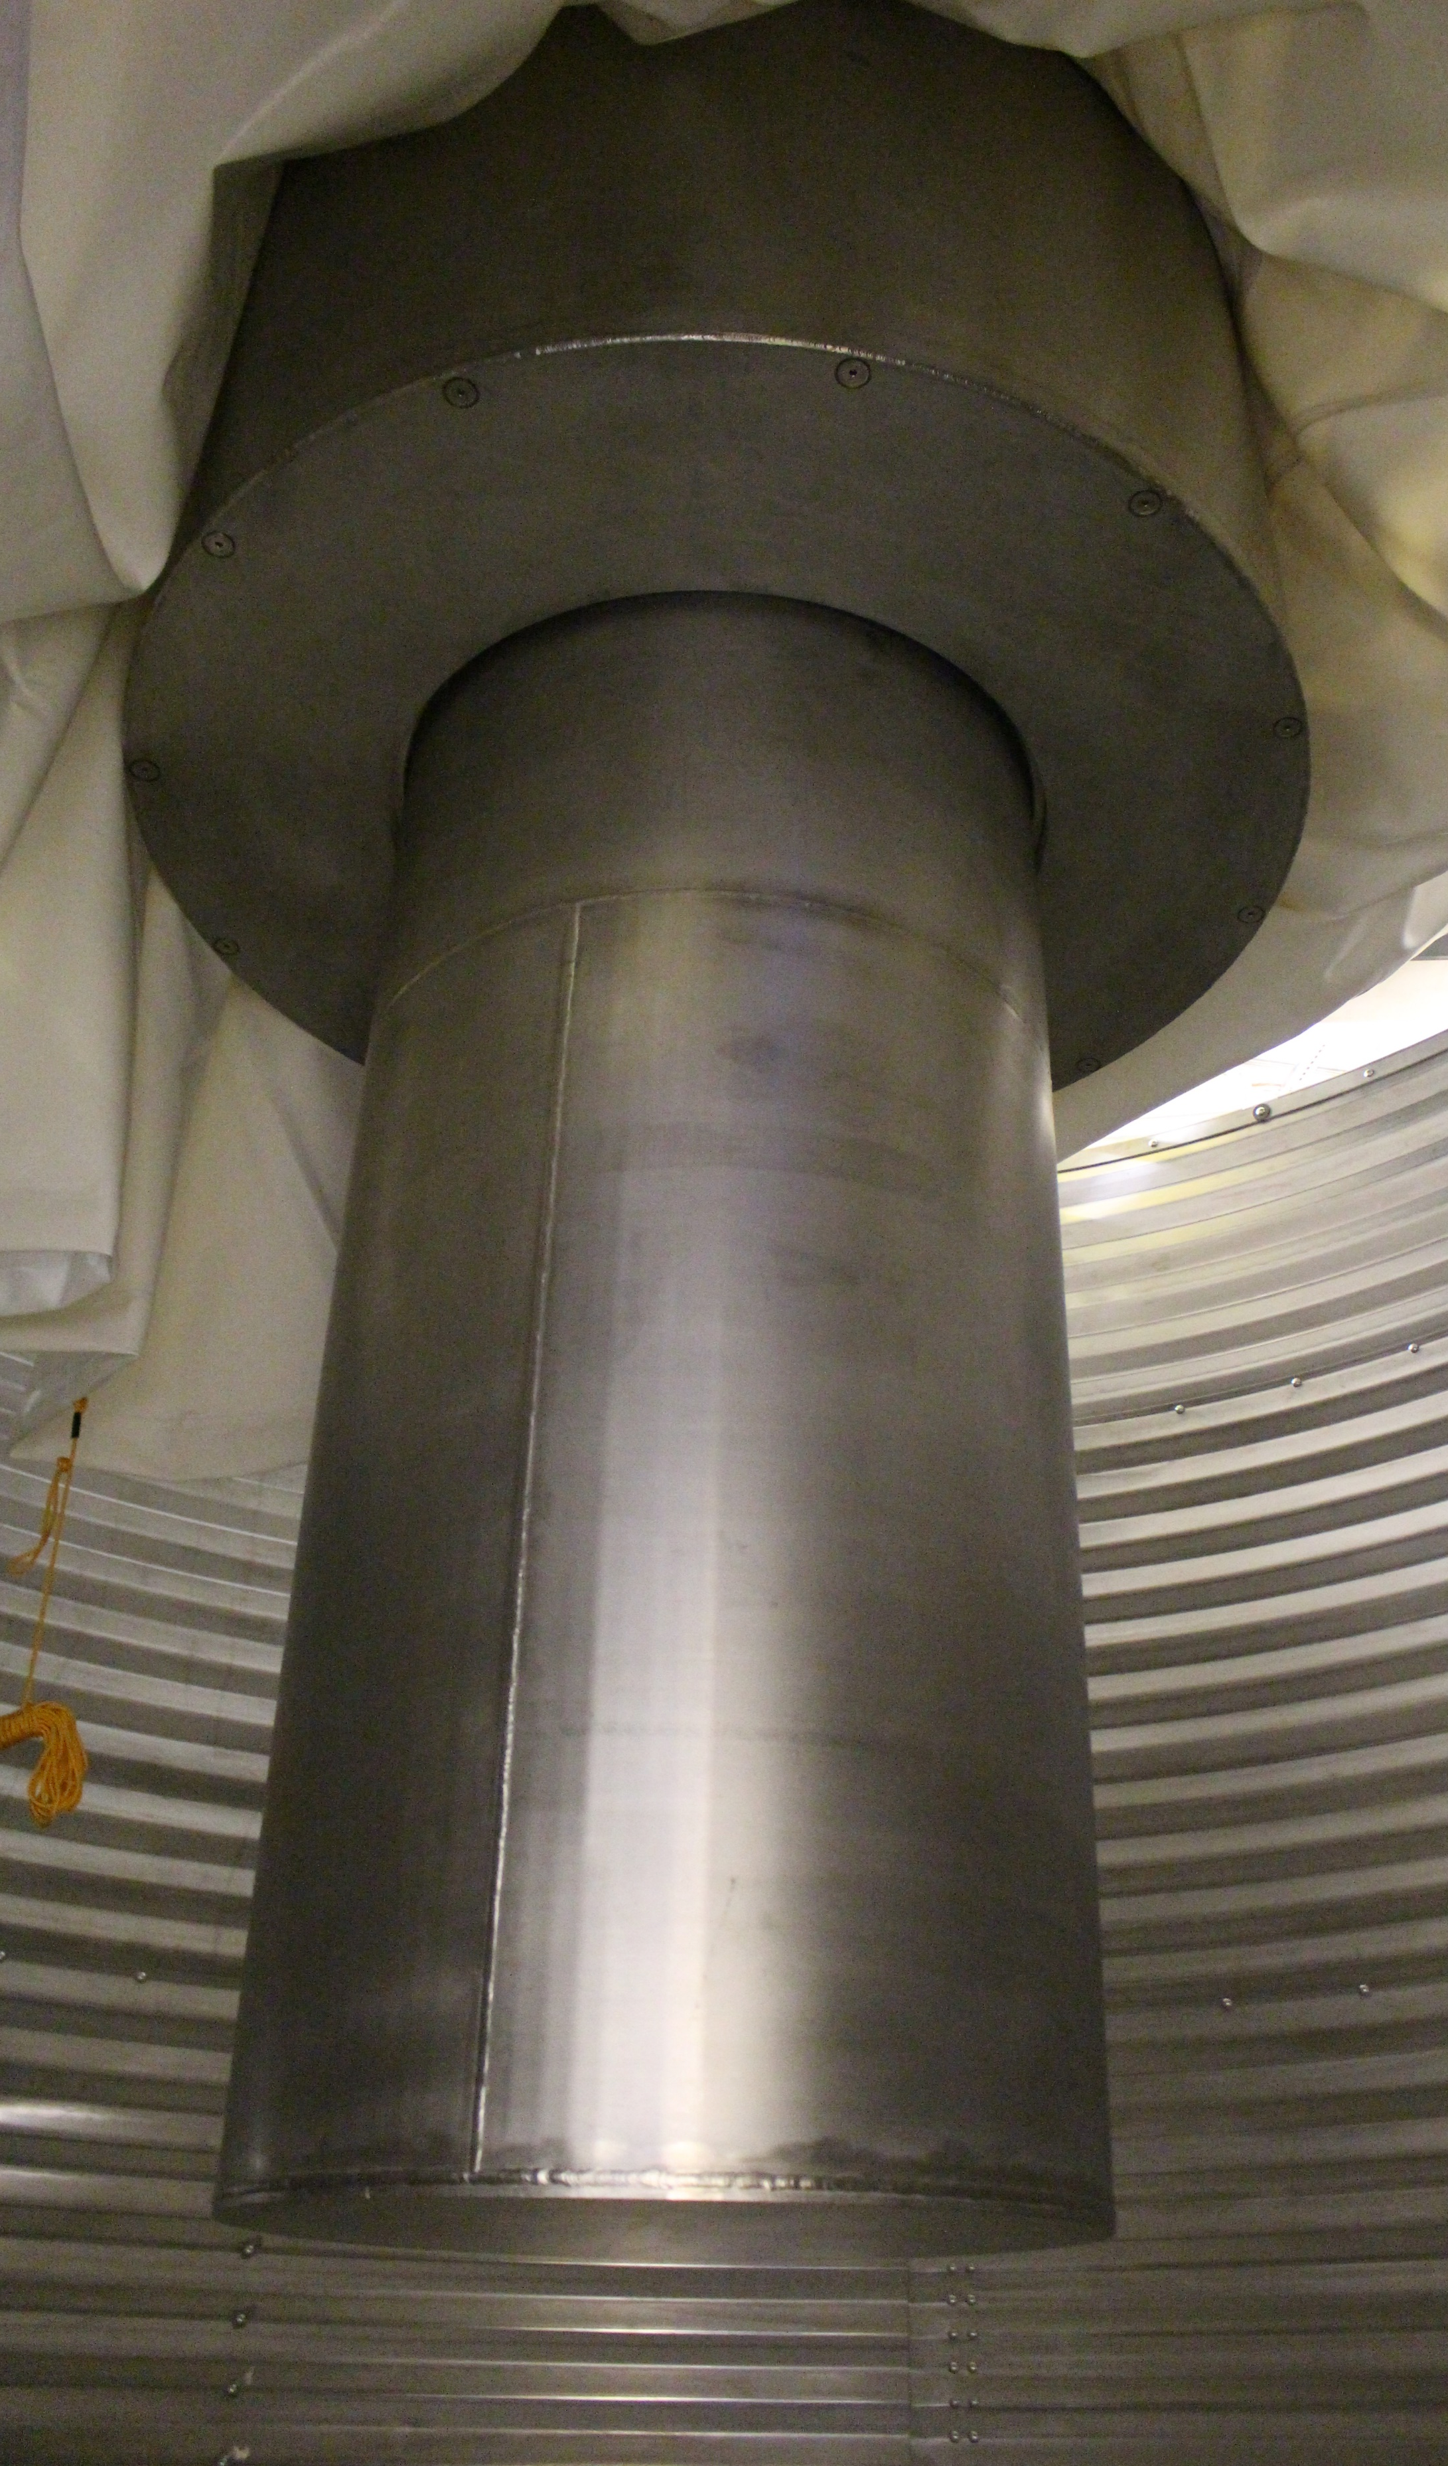
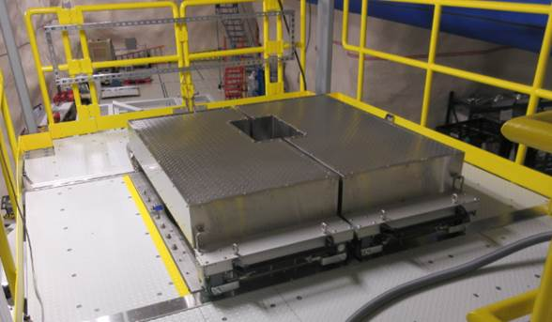
CUTE
~90 % complete
All major parts installed
except cryostat
Drywell
PE shield

Slide 5
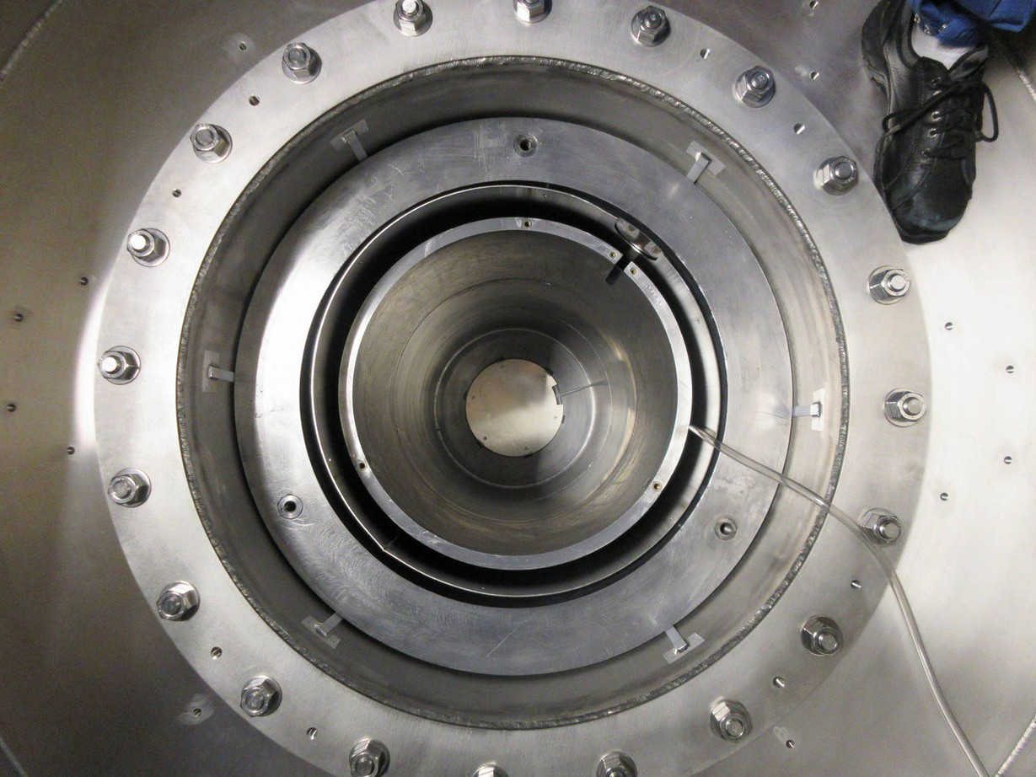
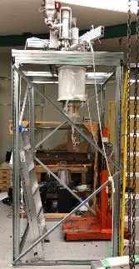
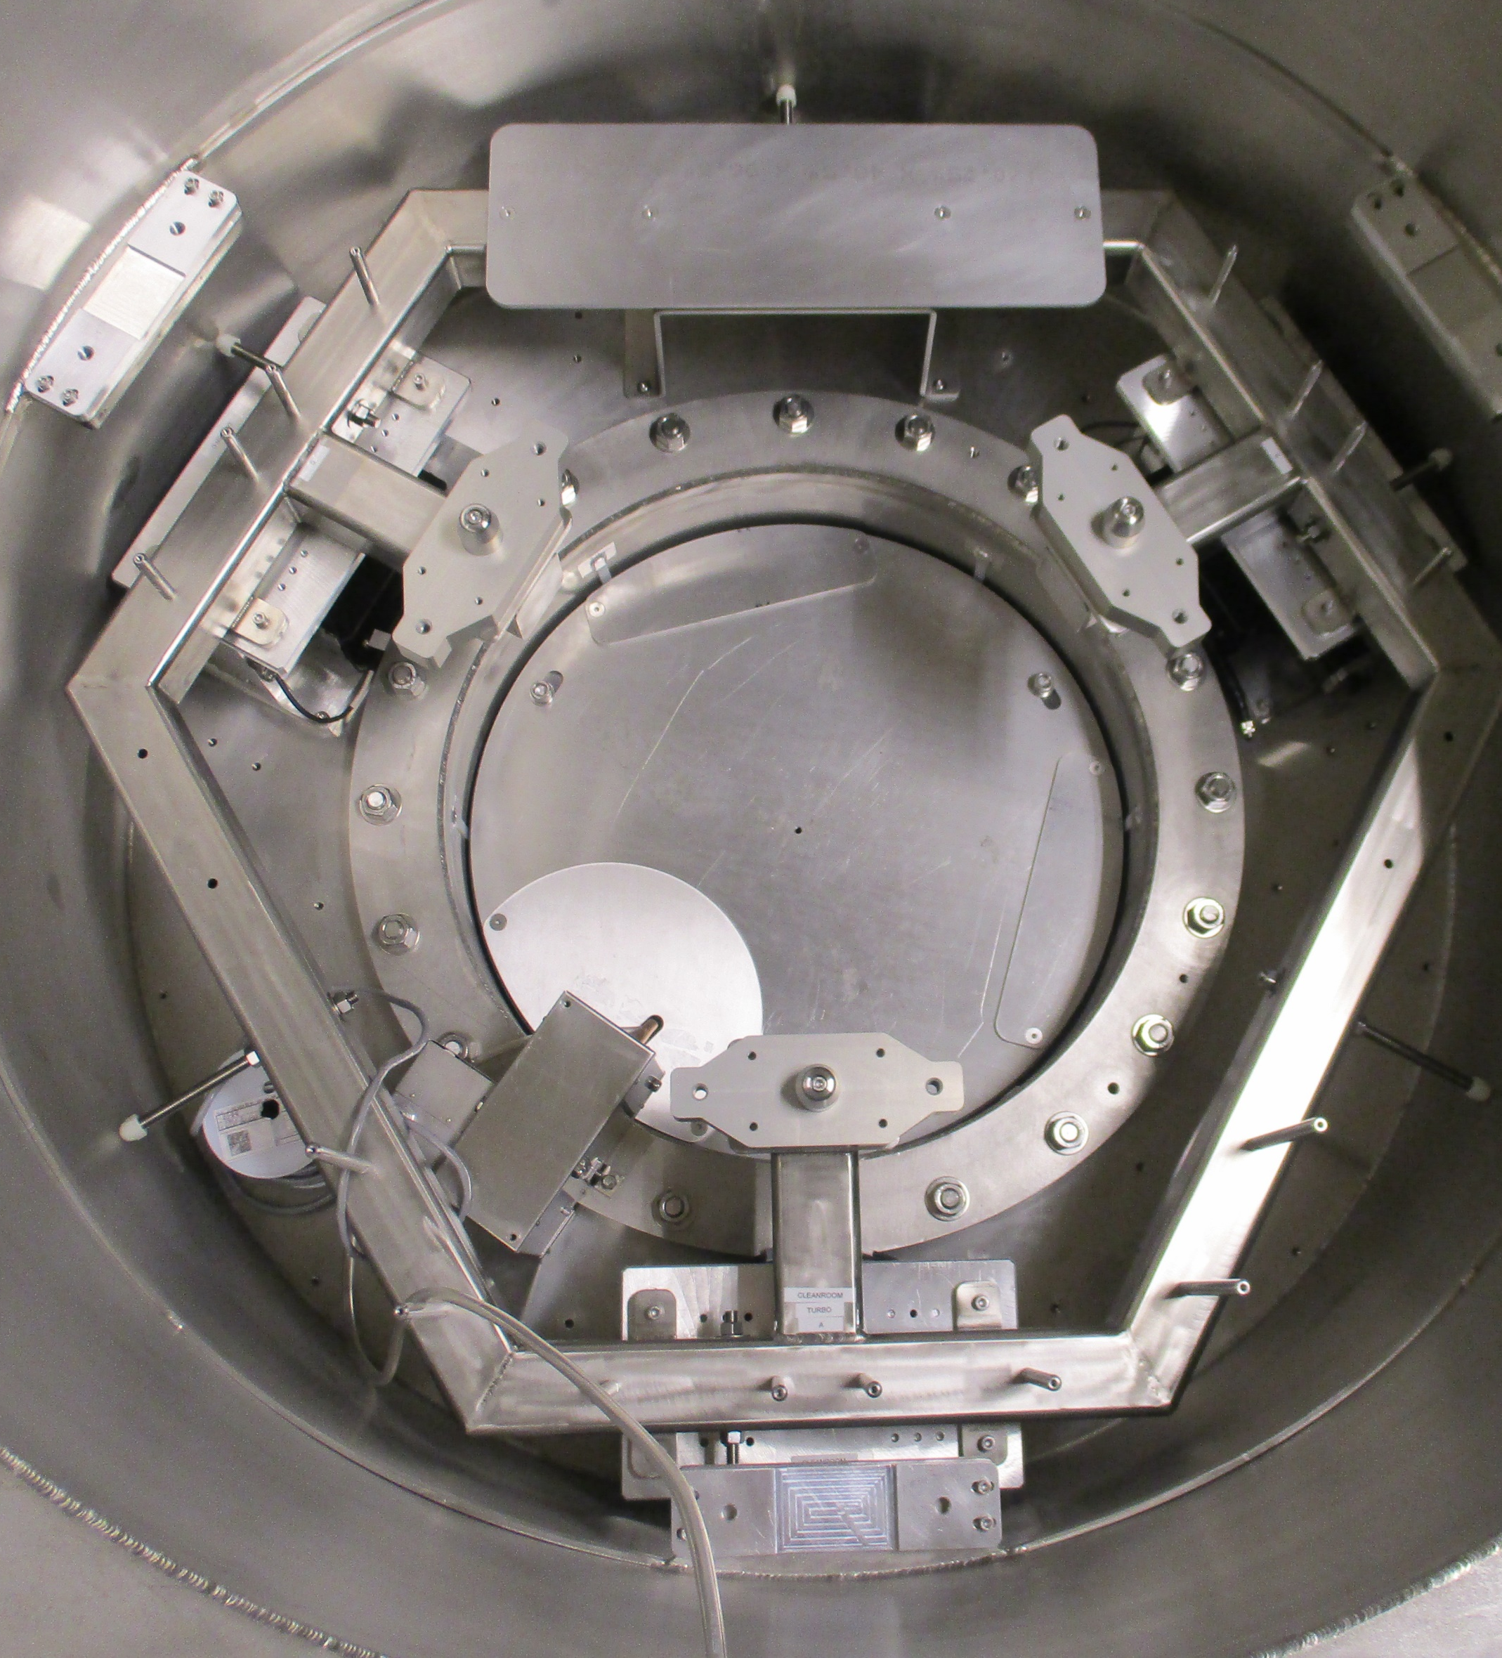
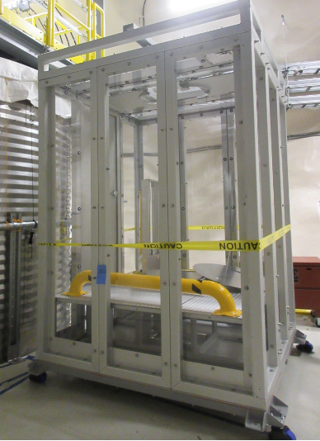
CUTE
Pb shield installed
~90 % complete
All major parts installed
except cryostat
Cryostat suspension system
Cryostat testing at Queen’s
Automated calibration source
Cleanroom at SNOLAB

Slide 6
Summary
SuperCDMS construction well underway, completed in 2020
CUTE ready for detector testing in June 2019
Local Facilities await renovation of lab space; move of cryogenic test facility from Queen’s anticipated for June 2019
TRIUMF SuperCDMS group is being established (1 PhD so far, Postdoc and 2 more PhD students arriving soon); strong presence of UBC group (2 postdocs, 2 grad students, software developer) at TRIUMF, mainly working on DAQ

