Slide 1
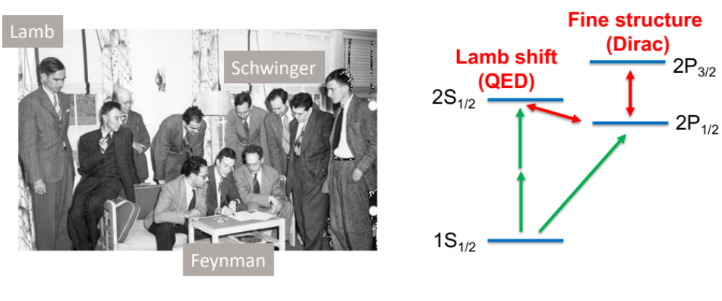
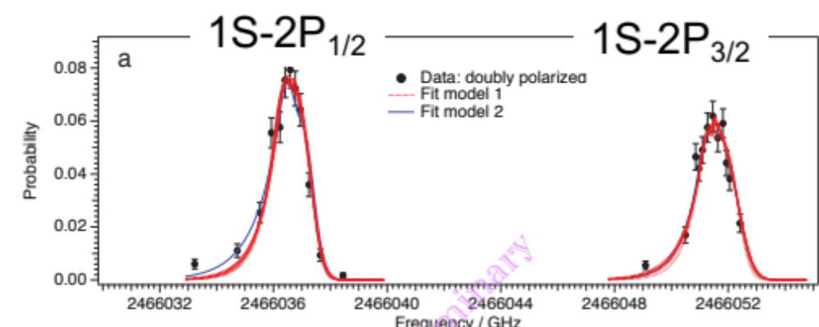
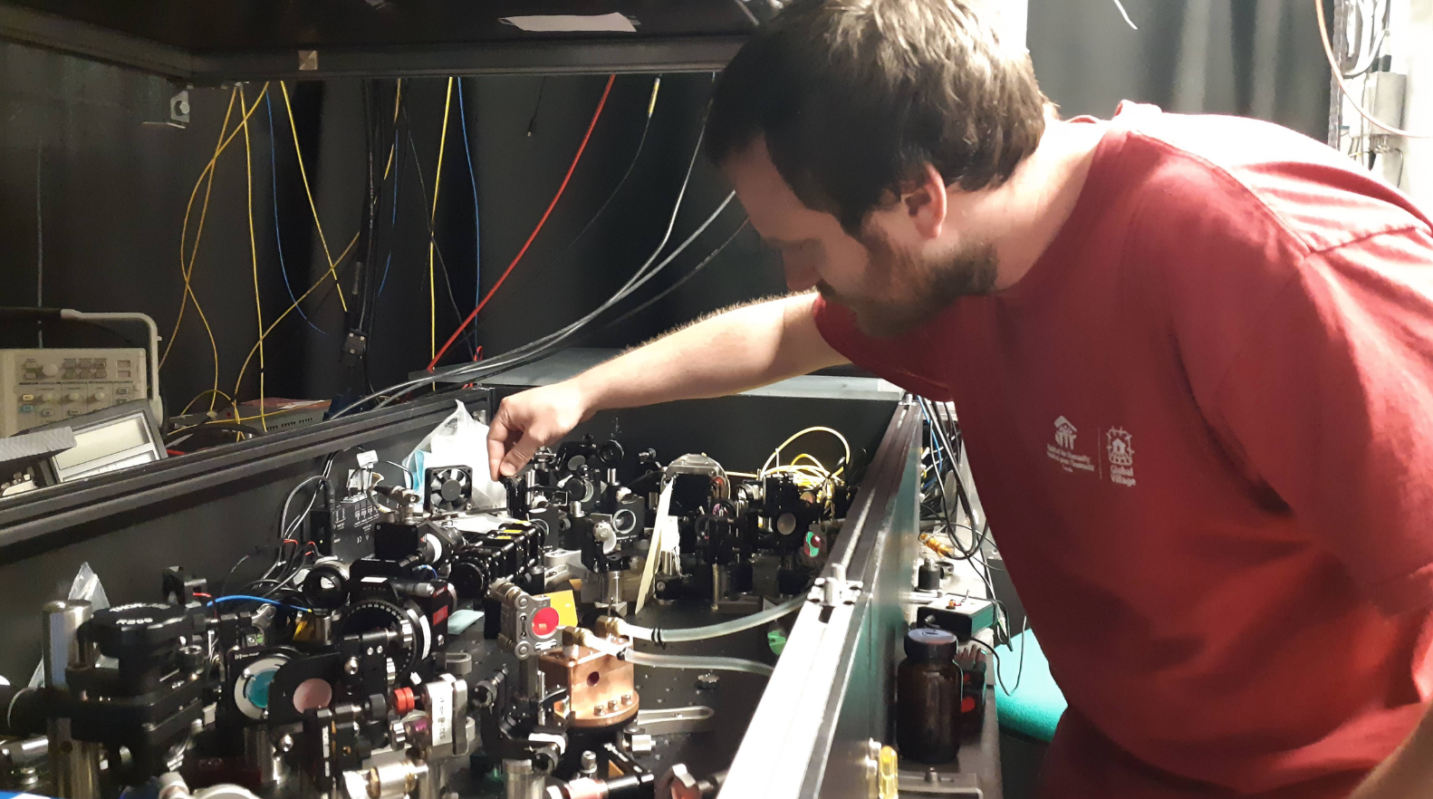
ALPHA-2: spectroscopy
ALPHA-Canada, led by TRIUMF, is 1/3 of ALPHA
Shelter Island 1948
We had successful ALPHA-2 run in May – July 2018 before moving to ALPHA-g
Major successes in Canadian-led Lyman-alpha program (following Nature Sep 2018)
  Fine structure and Lamb shift studies
    Paper under review
  Laser cooling to ultracold temperatures: a dream for us!
    Paper in preparation
  Improvements in 1S-2S transition
Calgary student
Andrew Evans
(won 1st prize in
Banff meeting, Feb 2019)
ALPHA-2 upgrade being planned during LS2
Incl. adopting to the AD upgrade - ELENA

Slide 2
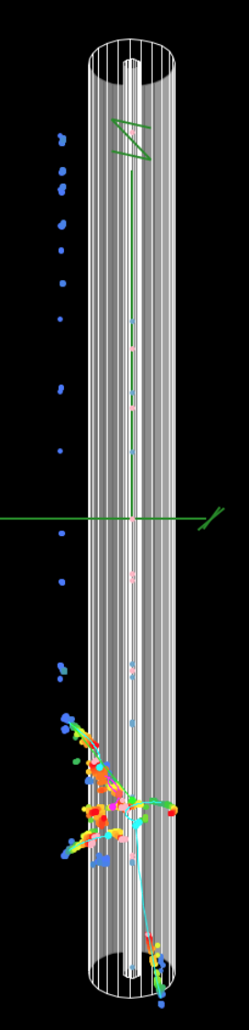
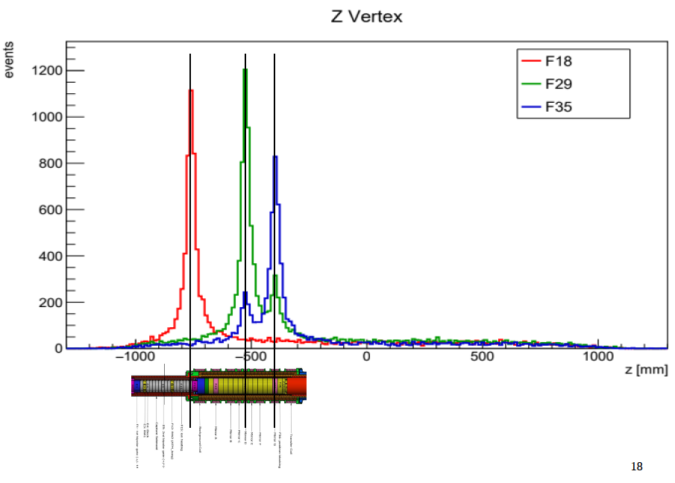
ALPHA-g: gravity
ALPHA-g: 80% of funds from Canadian sources
ALPHA-Canada team
at CERN, Nov 2018
Direct test of Equivalence Principle with antimatter
  No reasons to expect asymmetry
  First step for precision measurements
Key parts of experiment commissioned before Nov 2018
  Antiproton annihilations detected via TRIUMF-built TPC
  Could not perform any physics measurements due to leaks
Analysis of the commissioning data underway; challenges being identified
Attempts for machine learning starting
Aggressive schedule to complete the construction by end of 2019
Antiproton annihilation
positions

Slide 3
Summary
The ALPHA beam time at CERN has ended in November, 2018, and CERN has entered an extended 2 year shutdown. The 2018 run had two main components: (1) Physics with ALPHA-2, and (2) commissioning on ALPHA-g. A major achievement in (1) is the demonstration of laser cooling of antihydrogen, a process once considered a "dream" by many in the field. The Canadian team, led by UBC and TRIUMF scientists, has led this effort [Paper is in preparation]. Another important ALPHA-2 result, studies of fine structure and the Lamb shift in antihydrogen, has been submitted for publication. This paper was also led by UBC and TRIUMF scientists. Regarding (2), many important parts of ALPHA-g were commissioned with antiproton beams, with detailed analysis is on-going and challenges being identified. ALPHA has aggressive schedule to complete ALPHA-g construction and ALPHA-2 upgrades.

