Slide 1
Particle Physics Faculty Meeting
Agenda
  Introduction to QC - Olivia di Matteo
  News
  Updates

Slide 2
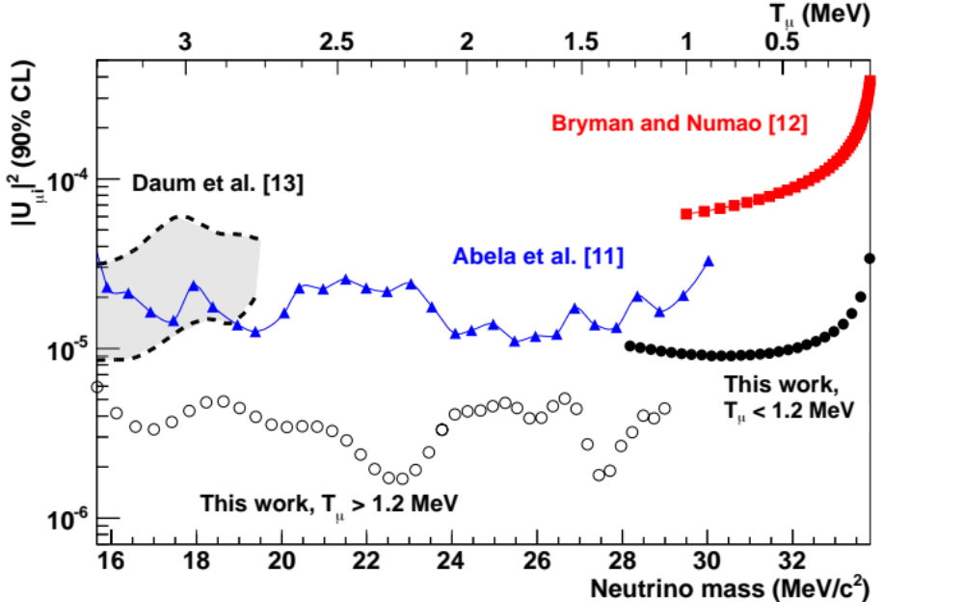
PIENU
New result from PIENU group: "Search for Heavy Neutrinos in pi-->mu nu Decay”
Paper submitted to Phys. Lett. a few days: arXiv:1904.03269

Slide 3
ATLAS
ATLAS has new ASICS for ITk strip-detector readout which need Single Event Upset tests in beams
With CERN shutdown TRIUMF was selected to continue some of the tests
An international team, with support from locals from TRIUMF/UBC/SFU, will come to the PIF/NIF with a test set-up for three different ASICs for 24 hours of beam at the end of April
The ASICs are on the critical path for the ATLAS HL-LHC upgrade

Slide 4
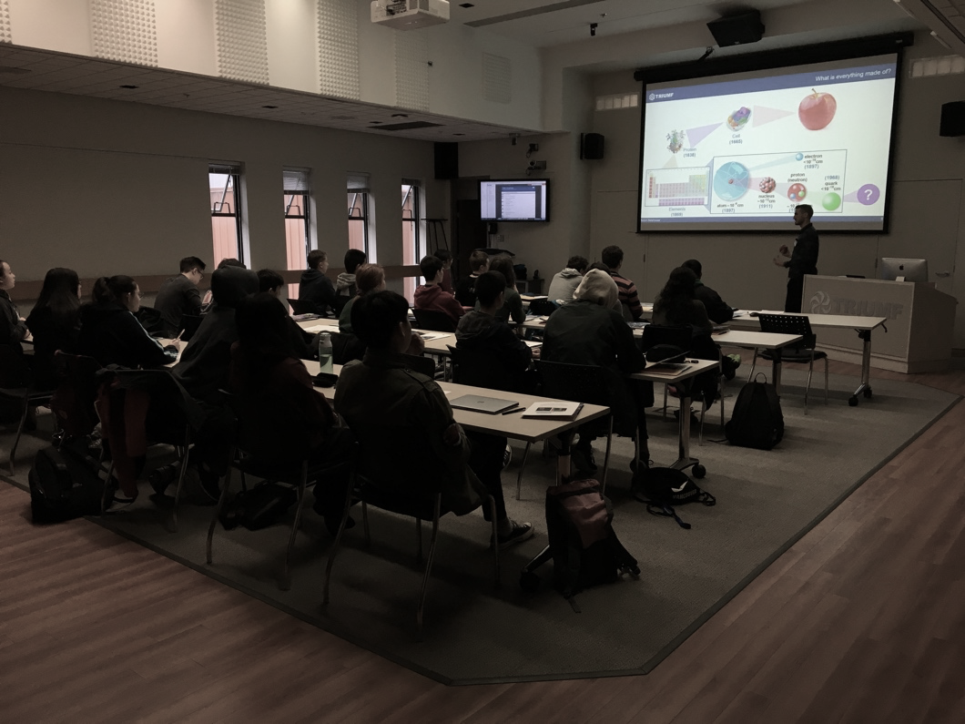
ATLAS Masterclass
Coordinated by Communications group and local ATLAS group
Combined event with SFU/UBC/Victoria groups at three locations
23 motivated high school students attended at TRIUMF, similar groups at SFU and Victoria
Big thanks to communications group, grad students & postdocs & faculty who helped

Slide 5

HyperK

Slide 6
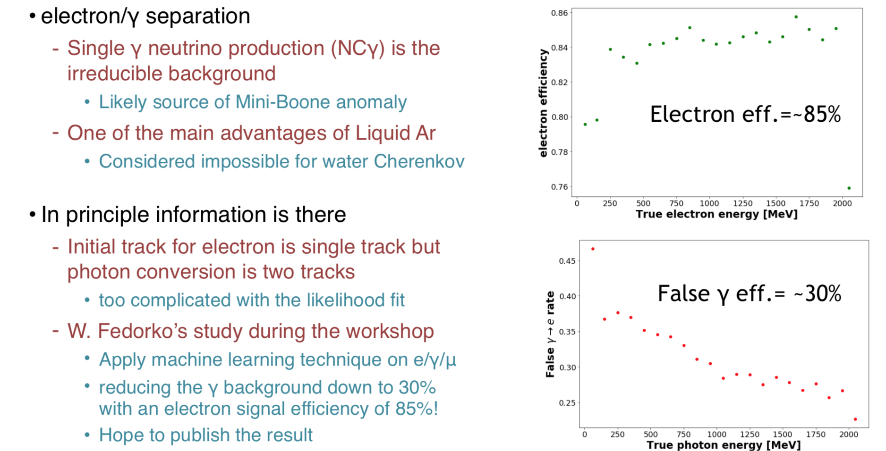
HyperK

Slide 7
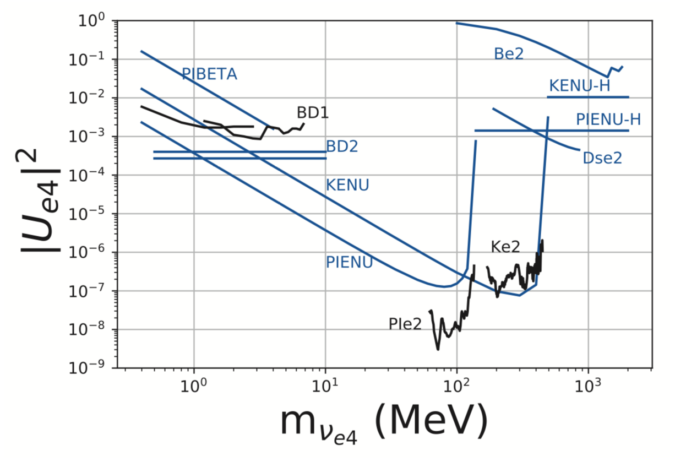
PIENU
New papers on Improved Constraints on Sterile Neutrinos in the MeV to GeV Mass Range
arXiv:1904.06787

Slide 8
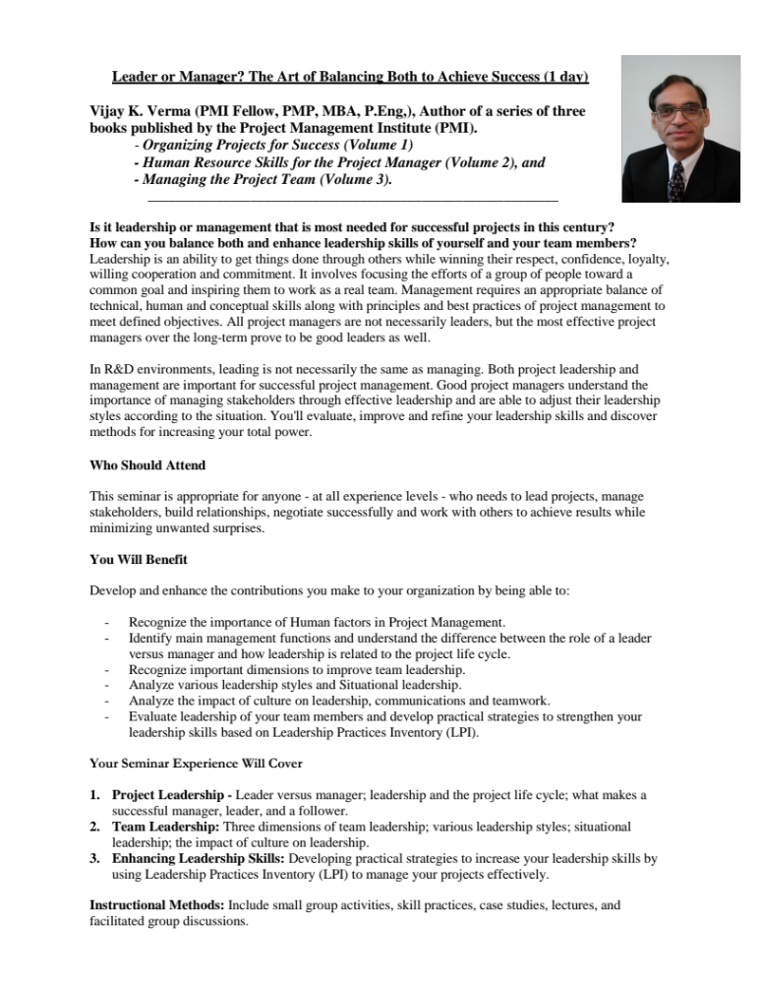
Leader or Manager Workshop

Slide 9
Student Thesis
List of student graduated in last FY
“TRIUMF Assisted Student Thesis”
Please send to Allayne by tomorrow

Slide 10
ARIEL “Service work”
Possibility to have contributions to ARIEL count towards service to the laboratory
Contact Adam Garnsworthy if interested
  Projects include (including supervisory roles)
  Proton target stations conceptual studies
  Machine protection system
  Simulations using Comsol, Fluka
  …
  Adam will produce list of needed projects, but also welcomes specific suggestions

Slide 11
Retirement Events
Plan for a special retirement events for all BAE who retire
  Special colloquium (name of event to be confirmed)
  Would take place on a regular colloquium day, have a longer intro followed by a colloquium (by a close collaborator) to include science from the retirees contributions
  This is followed by a reception at TRIUMF
  After would move to a ‘retirement party’ offsite

Slide 12
Major Cash Commitments in 2020 and Beyond
Feedback on current and anticipated projects on cash contributions (or dedicated in kind hires) from TRIUMF in the next 5YP (April 2020-March 2025
3DdSiPM development | 438
ALPHA - Measurement of Antimatter Gravity | 344
ATLAS ITk Upgrade | 401
ATLAS Phase-2 Upgrade LAr FE | 453
G-2 EDM Measurement | 196
HALO-1kT | 460
Hyper-Kamiokande and T2K upgrade | 336
Modern particle physics detector development infrastructure | 414
Multi-PMT Development and Prototyping for NuPRISM and Hyper-K | 456
NA62 | 370
nEDM and UCN Source Upgrade (2017 CFI project) | 407
NuPRISM detector for Hyper-K | 461
Reconfigured shielding blocks for M11 area | 413
sTGC (ATLAS) | 318
DEAP | 112
Infrastructure using liquid argon for Dark Matter detection | 462
Search for neutrinoless double-beta decays in Xe-136 with nEXO | 470
Super-CDMS | 325

Slide 13
Project News
  ATLAS
  T2K/HyperK
  UCN
  ALPHA
  SuperCDMS
  Pienu
  NA62
  DEAP
  SNO+
  EXO
  HALO
  g-2
  Belle 2
  Theory

Slide 14
Committee Updates
  Seminar/Colloquia
  Safety
  Space
  5S
  Academic
  Health & Wellness
  Data Science
  Summer schools
  Diversity committee
  Physical Sciences Division Structure
  PPR Working Group
  IPP
  CAP PPD

Slide 15
AOB
Next scheduled meeting Thursday June 6th 2019 12:30?
  Clash with CAP at SFU…
  Car pooling ideas to CAP?
Move to Thursday May 30th 12:30

