Slide 1
Training, TapRooT and Continual Improvement
International Technical Safety Forum 2017
Philip Jones
Manager of Training and Development
TRIUMF
Notes:
TRIUMF uses the Systematic Approach to Training (SAT) for training development and implementation. In addition we use the TapRooT System for root cause investigations. In this presentation I will discuss how these two systems integrate as part of the continual improvement cycle for training programs at TRIUMF.

Slide 2
The Systematic Approach to Training (SAT)
A
D
D
I
E
Analysis
Design
Development
Implementation
Evaluation
Notes:
The Systematic Approach to Training or SAT is also known as the ADDIE model because of the five phases in the system. Analysis, Design, Development, Implementation and Evaluation.

Slide 3
Analysis
Task | D | I | F | T | Conditions | Standards | Knowledge/Skills/Abilities
Perform routine radiation field/contamination survey (general occupancy area) | 2.5 | 3 | 4 | T | Use of radiation protection instrumentation | Completion of area dose rate/contamination map or Inspection Index entry | Radiation protection, TSOP-08 Calibration and Inspection, PET Lab Access
Perform on-demand radiation/contamination survey (high active area) | 3 | 4 | 3 | O | Use of radiation protection instrumentation, Time constraints, Dose intensive | Completion of area dose rate/contamination map Effective communication of hazards | Radiation protection, Work permit system, administrative dose limits, TSOP-08 Calibration and Inspection Index, working in exclusion areas, lockout/tagout, personnel safety alarm response
Assist with Beamline Openings in Experimental Areas | 3 | 3 | 4 | T | Use of radiation protection instrumentation, Follow approved procedures | Work Permit Completed | Radiation protection, Work permit system, Basic understanding of beamline/component function
Process/sort radioactive waste | 2 | 3 | 3 | T | Use of radiation protection instrumentation and detectors, Follow approved procedures, Record Keeping | Waste Tracking Spreadsheet Updated | Radiation protection, familiarization with rad. waste characterization levels, General OH&S knowledge, good lifting practices, use of counting cave, forklift training, fire extinguisher operation
Perform Gamma Assays | 1 | 2.5 | 3 | N | Use of detectors, Follow approved procedures, Record Keeping | Spectrum saved to appropriate location | Radiation Protection, Genie2K Software
Notes:
In the analysis phase you begin by creating a list of tasks performed by the worker. Each task is then rated on a scale of 1 to 5 based on its difficulty, importance and frequency.

Slide 4
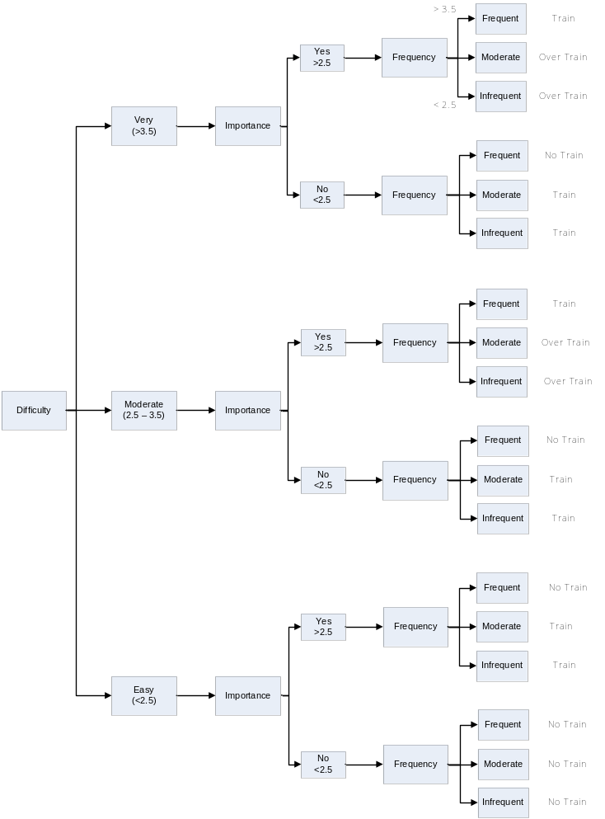
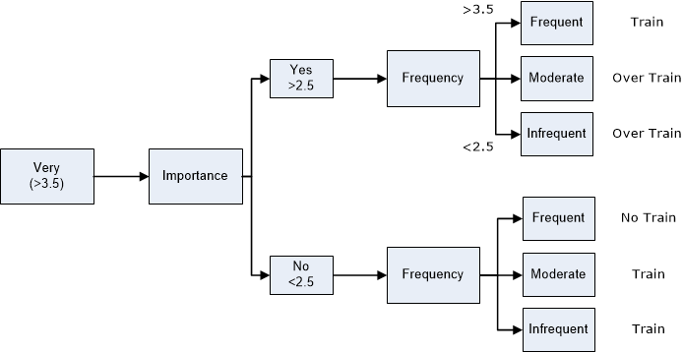
Difficulty, Importance, Frequency
Notes:
Using this decision tree you can then determine the level of training for each task. Simple tasks that are performed frequently may not need any formal training. However more difficult tasks that aren’t performed often may need over training. This may mean that the task needs ongoing periodic training.

Slide 5
Analysis
Task | D | I | F | T | Conditions | Standards | Knowledge/Skills/Abilities
Perform routine radiation field/contamination survey (general occupancy area) | 2.5 | 3 | 4 | T | Use of radiation protection instrumentation | Completion of area dose rate/contamination map or Inspection Index entry | Radiation protection, TSOP-08 Calibration and Inspection, PET Lab Access
Perform on-demand radiation/contamination survey (high active area) | 3 | 4 | 3 | O | Use of radiation protection instrumentation, Time constraints, Dose intensive | Completion of area dose rate/contamination map Effective communication of hazards | Radiation protection, Work permit system, administrative dose limits, TSOP-08 Calibration and Inspection Index, working in exclusion areas, lockout/tagout, personnel safety alarm response
Assist with Beamline Openings in Experimental Areas | 3 | 3 | 4 | T | Use of radiation protection instrumentation, Follow approved procedures | Work Permit Completed | Radiation protection, Work permit system, Basic understanding of beamline/component function
Process/sort radioactive waste | 2 | 3 | 3 | T | Use of radiation protection instrumentation and detectors, Follow approved procedures, Record Keeping | Waste Tracking Spreadsheet Updated | Radiation protection, familiarization with rad. waste characterization levels, General OH&S knowledge, good lifting practices, use of counting cave, forklift training, fire extinguisher operation
Perform Gamma Assays | 1 | 2.5 | 3 | N | Use of detectors, Follow approved procedures, Record Keeping | Spectrum saved to appropriate location | Radiation Protection, Genie2K Software
Notes:
The train status is added to the analysis as well as any conditions (equipment needed, time constraints, etc) and the standards used to evaluate if the task has been performed correctly. Finally all the associated knowledge, skills and abilities needed for the task are identified.

Slide 6
Task to Training Matrix
Task | Train Status | Evaluation Method | Responsibility | Frequency of Training | Lesson Plan or Job Performance Number
Perform routine radiation/contamination survey (general occupancy area) | Train | OJT | RPG | Once | JPM-0013
Perform on-demand radiation/contamination survey (high active area) | Train | OJT | RPG | Once | JPM-0014
Assist with Beamline Openings in Experimental Areas | Train | OJT | RPG | Once | JPM-0015
Process/sort radioactive waste | Train | OJT | RPG | Once | JPM-0016
Perform Gamma Assays | Train | OJT | RPG | Once | JPM-0017
Assist Receiving/Packaging of Radioactive Shipments | Over train | TDG Training | RPG | Every two years | N/A – Periodic external training from qualified provider
Notes:
From here we generate a task-to-training matrix which identifies the type of training, responsibility and frequency.

Slide 7
Design – Learning Objectives
The RPG Surveyor shall be able to:
use radiation protection instrumentation to perform a radiation survey to accurately measure radiation fields/dose rates and detect radioactive contamination.
assist in the opening of beamlines when maintenance is required.
process and sort radioactive waste delivered to the Radioactive Waste Handling Area.
obtain radioactive samples and assay them for gamma emitting radionuclides or tritium concentration.
state TRIUMF administrative dose limits
Notes:
In the next phase we use the information from the task analysis to write learning objectives. These can be either task based or knowledge based learning objectives.

Slide 8
Design – Course Outline
Lesson | Delivery Method | Responsibility
TRIUMF Safety Orientation | Online Content | Manager, Training and Development
Radiation Protection Training | Classroom/Practical | Radiation Protection Group
Radioactive Calibration Source Training | Online Content | Manager, Training and Development
Personnel Safety Alarms | Online Content | Manager, Training and Development
Lockout/Tagout | Online Content | Manager, Training and Development
Working in Exclusion Areas | OJT (JPM-0077/0078) | Radiation Protection Group
WHMIS Training | Computer based training | OHS
Forklift Operation | External Training | Certified company specified by TRIUMF OH&S
Fire Extinguisher Operation | OHS | OHS
Perform a Routine Survey | OJT | Radiation Protection Group
Perform an On-Demand Survey | OJT | Radiation Protection Group
Assist with Beamline Openings | OJT | Radiation Protection Group
Process/Sort Radioactive Waste | OJT | Radiation Protection Group
Perform Gamma Assays | OJT | Radiation Protection Group
Perform Tritium Assays | OJT | Radiation Protection Group
Handle portable HPGe Detector | OJT | Radiation Protection Group
Approve Work Permits | OJT | Radiation Protection Group
Calibrate DRDs | OJT | Radiation Protection Group
Notes:
The other output of the design phase is the course outline. On-the-Job Training is still structured and documented.

Slide 9
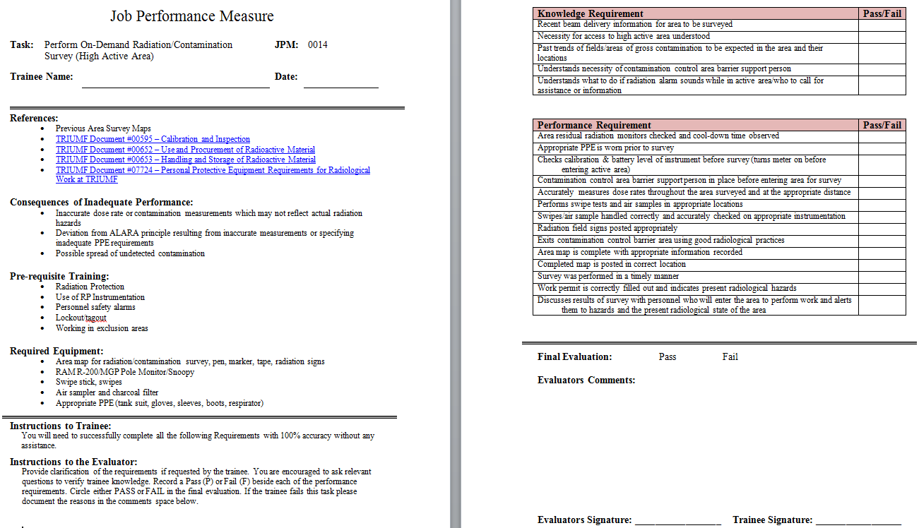
Development
Notes:
In the development phase you create your lesson plans, exams, online content and for each trainable task a Job Performance Measure (JPM). This JPM acts as both the lesson plan and evaluation tool for the task. The first page being the lesson plan with reference documents, consequences of inadequate performance, pre-requisite training, required equipment and instructions for both the trainee and evaluator. On the back are the knowledge and performance requirements for the task. Upon completion of the JPM the trainee is competent to perform the task unsupervised.

Slide 10
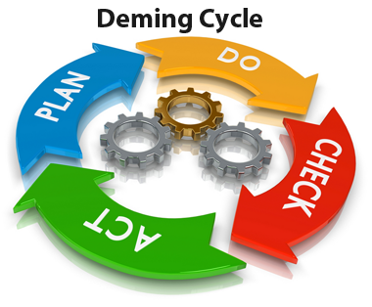
Implementation and Evaluation
Implement the training program
Collect data on trainee performance, course evaluations, trainee/supervisor feedback, nonconformities/lessons learned, internal/external audits, facility/document changes
Revise training program
Notes:
The final two phases of SAT can begin at the same time. As you implement your training program you begin to collect data on trainee performance, course evaluations, supervisor feedback, nonconformities and lessons learned, internal and external audits, and changes to documents or facilities. The training program is continuously updated and revised based on this data as part of the continual improvement cycle.

Slide 11

TapRooT
Notes:
When we do have a problem TRIUMF uses the TapRooT system for analyzing causal factors to determine the underlying root causes. This system is a structured approach that groups root causes into basic cause categories such as procedures, communications, work direction and of course training.

Slide 12
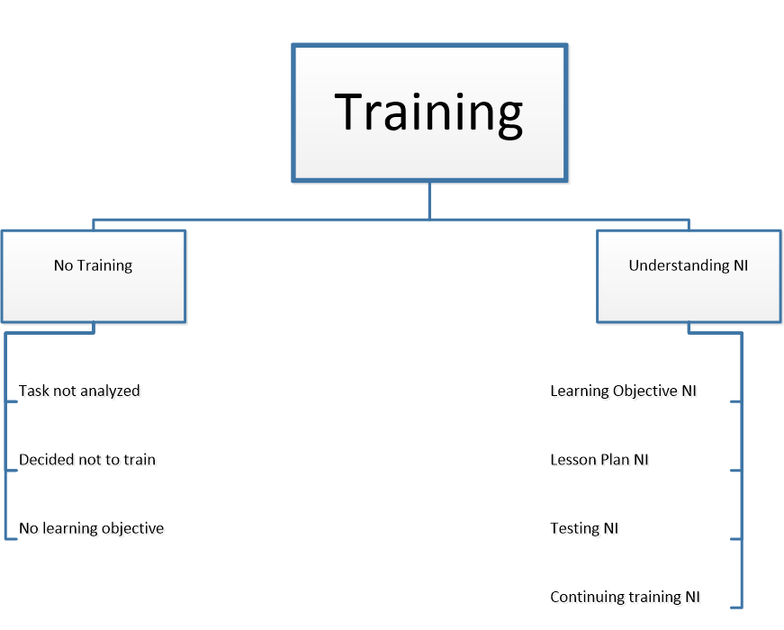
Training Basic Root Cause Category
NI = Needs Improvement
Notes:
The basic root cause category is further broken down into two near root causes, one where the person did not receive training and the other where training was provided but needed improvement. The basic root causes are then listed beneath each of these sections.

Slide 13
SAT and TapRooT – No Training
Task | D | I | F | T | Conditions | Standards | Knowledge/Skills/Abilities
Perform routine radiation field/contamination survey (general occupancy area) | 2.5 | 3 | 4 | T | Use of radiation protection instrumentation | Completion of area dose rate/contamination map or Inspection Index entry | Radiation protection, TSOP-08 Calibration and Inspection, PET Lab Access
Perform on-demand radiation/contamination survey (high active area) | 3 | 4 | 3 | O | Use of radiation protection instrumentation, Time constraints, Dose intensive | Completion of area dose rate/contamination map Effective communication of hazards | Radiation protection, Work permit system, administrative dose limits, TSOP-08 Calibration and Inspection Index, working in exclusion areas, lockout/tagout, personnel safety alarm response
Assist with Beamline Openings in Experimental Areas | 3 | 3 | 4 | T | Use of radiation protection instrumentation, Follow approved procedures | Work Permit Completed | Radiation protection, Work permit system, Basic understanding of beamline/component function
Process/sort radioactive waste | 2 | 3 | 3 | T | Use of radiation protection instrumentation and detectors, Follow approved procedures, Record Keeping | Waste Tracking Spreadsheet Updated | Radiation protection, familiarization with rad. waste characterization levels, General OH&S knowledge, good lifting practices, use of counting cave, forklift training, fire extinguisher operation
Perform Gamma Assays | 1 | 2.5 | 3 | N | Use of detectors, Follow approved procedures, Record Keeping | Spectrum saved to appropriate location | Radiation Protection, Genie2K Software
task not analyzed
no learning objective
decided not to train
Notes:
If no training was provided it could be that you did not include that task in your analysis, or you did include it but based on your difficulty, importance and frequency ratings you decided not to provide formal training on that task. It may be that it was knowledge or skills or abilities the person needed but you failed to identify a learning objective for it.

Slide 14
SAT and TapRooT – Understanding NI
Task | Train Status | Evaluation Method | Responsibility | Frequency of Training | Lesson Plan or Job Performance Number
Perform routine radiation/contamination survey (general occupancy area) | Train | OJT | RPG | Once | JPM-0013
Perform on-demand radiation/contamination survey (high active area) | Train | OJT | RPG | Once | JPM-0014
Assist with Beamline Openings in Experimental Areas | Train | OJT | RPG | Once | JPM-0015
Process/sort radioactive waste | Train | OJT | RPG | Once | JPM-0016
Perform Gamma Assays | Train | OJT | RPG | Once | JPM-0017
Assist Receiving/Packaging of Radioactive Shipments | Over train | TDG Training | RPG | Every two years | N/A – Periodic external training from qualified provider
continuing training NI
Notes:
If training was provided but the problem still occurred it may be due to the training not being provided frequently enough or the time between training and the task being performed was too long.

Slide 15
SAT and TapRooT – Understanding NI
The RPG Surveyor shall be able to:
use radiation protection instrumentation to perform a radiation survey to accurately measure radiation fields/dose rates and detect radioactive contamination.
assist in the opening of beamlines when maintenance is required.
process and sort radioactive waste delivered to the Radioactive Waste Handling Area.
obtain radioactive samples and assay them for gamma emitting radionuclides or tritium concentration.
state TRIUMF administrative dose limits
learning objective NI
Notes:
If a learning objective was written it may need improvement and that may lead back to the conditions, standards and knowledge, skills and abilities you identified during your task analysis.

Slide 16
SAT and TapRooT – No Training
Task | D | I | F | T | Conditions | Standards | Knowledge/Skills/Abilities
Perform routine radiation field/contamination survey (general occupancy area) | 2.5 | 3 | 4 | T | Use of radiation protection instrumentation | Completion of area dose rate/contamination map or Inspection Index entry | Radiation protection, TSOP-08 Calibration and Inspection, PET Lab Access
Perform on-demand radiation/contamination survey (high active area) | 3 | 4 | 3 | O | Use of radiation protection instrumentation, Time constraints, Dose intensive | Completion of area dose rate/contamination map Effective communication of hazards | Radiation protection, Work permit system, administrative dose limits, TSOP-08 Calibration and Inspection Index, working in exclusion areas, lockout/tagout, personnel safety alarm response
Assist with Beamline Openings in Experimental Areas | 3 | 3 | 4 | T | Use of radiation protection instrumentation, Follow approved procedures | Work Permit Completed | Radiation protection, Work permit system, Basic understanding of beamline/component function
Process/sort radioactive waste | 2 | 3 | 3 | T | Use of radiation protection instrumentation and detectors, Follow approved procedures, Record Keeping | Waste Tracking Spreadsheet Updated | Radiation protection, familiarization with rad. waste characterization levels, General OH&S knowledge, good lifting practices, use of counting cave, forklift training, fire extinguisher operation
Perform Gamma Assays | 1 | 2.5 | 3 | N | Use of detectors, Follow approved procedures, Record Keeping | Spectrum saved to appropriate location | Radiation Protection, Genie2K Software
learning objective NI
learning objective NI

Slide 17
Development
testing NI
lesson plan NI
Notes:
Perhaps the lack of understanding was due to a poor lesson plan or could have been caught if the testing of the persons knowledge/skills had been better.

Slide 18

no learning
objective
train status
DIF ratings
learning
objective NI
decided not
to train
learning objective
task analysis
lesson plan
NI
task not
analyzed
job performance measures
training frequency
continuing
training NI
testing NI
lesson plans
Notes:
So as you can see these two systems really mesh well with each other.

Slide 19
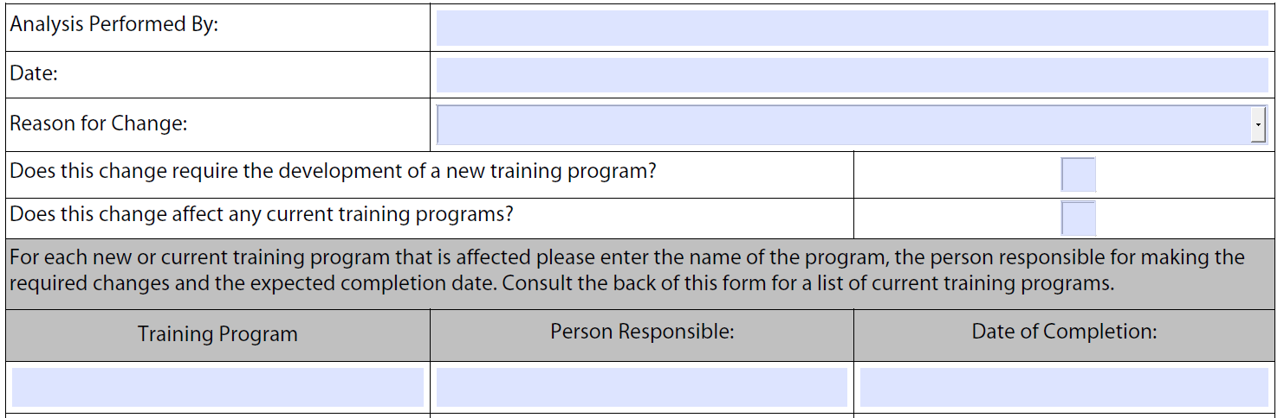
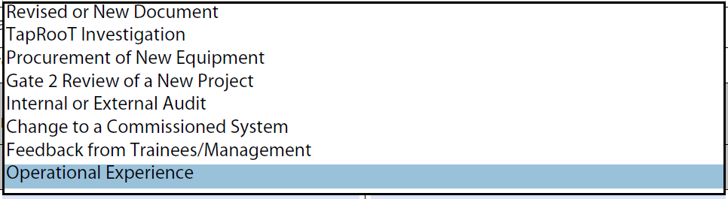
Training Needs Analysis Record
Notes:
In addition we have created a Training Needs Analysis Record for tracking changes to training programs.

Slide 20
References
DOE-HDBK-1078-94 Training Program Handbook: A Systematic Approach to Training
TapRooT
pjones@triumf.ca
Notes:
For more information.

