Slide 1
Accident and incident reporting and management at CERN: status and outlook
Angela Goehring-Crinon (CERN), ITSF September 2017
EDMS No: 1845506

Slide 2
Incident reporting and management at CERN today
Reporting of
accidents and
near misses
SC A2
Follow-up
of serious incidents
SC A 11
Reporting of significant radiological events to the authorities
Incident classification
and incident
management
procedures
IS 51
Reporting of deviations
in beam facilities
Professional Accident
Declaration
Various AIM procedures
Crisis management
EDMS No: 1845506

Slide 3
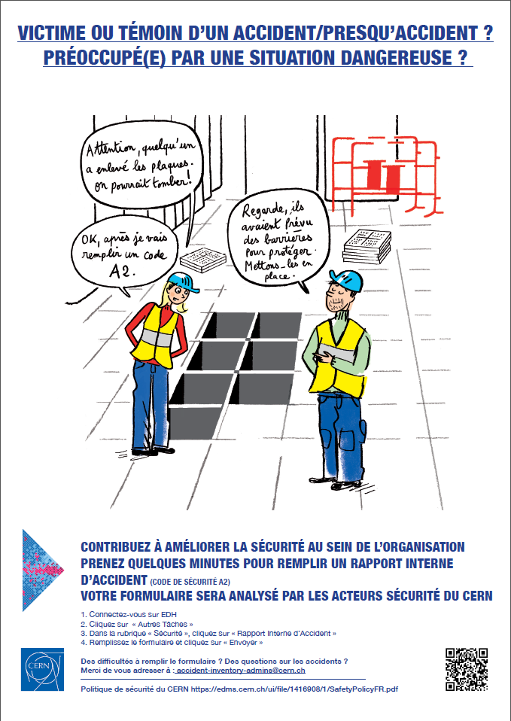
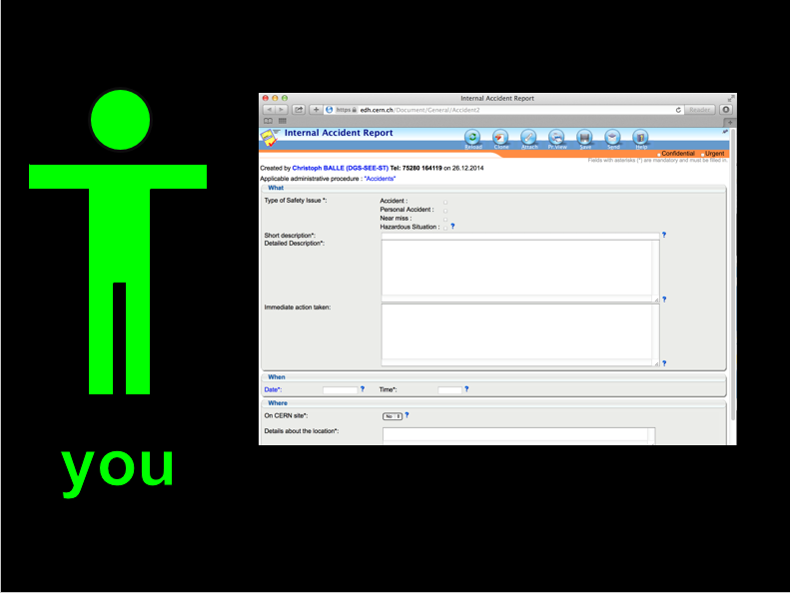
Reporting and management of accidents and near misses
Safety Code A2 : Any person directly concerned or witness must declare an event which results or may result in bodily injuries, has or may have consequences on the environment, or cause significant damage to property belonging to CERN or third parties. This includes road accidents on the CERN site.
          Declaration made via an electronic form accessible to any person having a CERN computing account i.e. any person carrying out activities on the CERN site.
EDMS No: 1845506

Slide 4
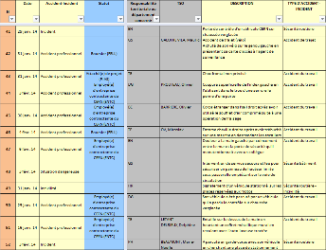
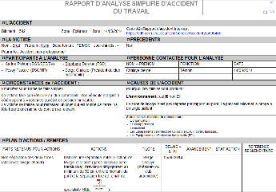
Reporting and management of accidents and near misses
Analysis and follow-up
Safety officers in Departments/Experiments:
  analyse accident - near miss
  write report
  define action plans with the person(s) responsible
HSE unit
  carries out own analysis according to an internal classification
  compiles declaration in an EXCEL file (used for accident statistics)
EDMS No: 1845506

Slide 5
Follow-up of serious accidents
Safety Code A 11 sets out a special procedure for incidents with serious consequences or potential serious consequences:
  CERN FB ensures that preservation of evidence is kept until enquiry
  Factual enquiry by head of HSE
  Report sent to DG who decides whether a Fact Finding Group should be set up
  Fact Finding group establishes within a week a report regarding the circumstances of the incident but refraining from judging responsibilities
  Accident Board examines the report and makes recommendations for further actions (CE, REX..) communicated to staff and Safety Policy Committee
  Committee of Enquiry : reports to Accident Board on detailed causal analysis, attribution of responsibilities
  Re step 5
  Final decisions taken by DG
A11 procedure is seldom used (fatal accident during LHC construction, a serious fire….)
EDMS No: 1845506
Notes:
Fact Finding Group : Safety Officer of a Department not concerned (chair), Senior staff of Department concerned, Senior staff HSE, Legal advisor
Accident Board : DG, Director of Admin, Directors concerned, Legal counsel, Head of HR, Head of HSE, repres SA secretary
Enquiry Committee : Senior staff, 2 other staff, SA, Legal advisor (secretary)

Slide 6
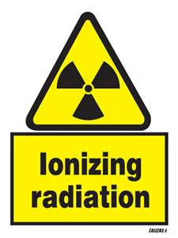
Reporting of significant radiological events
Radiation protection and Radiation safety is subject to a treaty between CERN and its host states (CH and F)
Within the scope of this treaty CERN has a agreed to declare significant radiological events according to conditions mutually agreed
Significant events definition: a deviation from the regular functioning of an installation that deserves to be analysed on the grounds of REX or as a precursor to more serious events
EDMS No: 1845506

Slide 7
Reporting of significant radiological events
Declaration on the basis of 2005 French ASN guide to significant “INB” events adapted to CERN
Scope:
  RP
  Environment
  Radiation Safety
  Radioactive transports
Classification on the basis of INES scale
EDMS No: 1845506

Slide 8
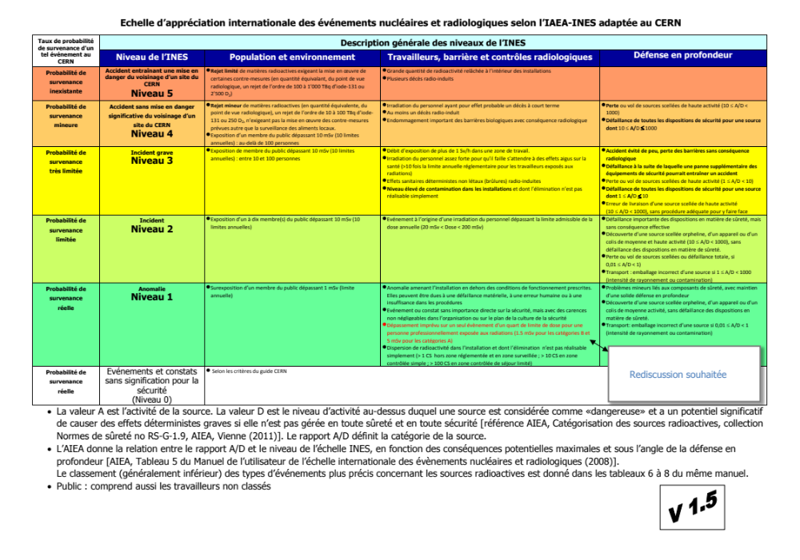
INES scale - CERN scenarios
EDMS No: 1845506

Slide 9
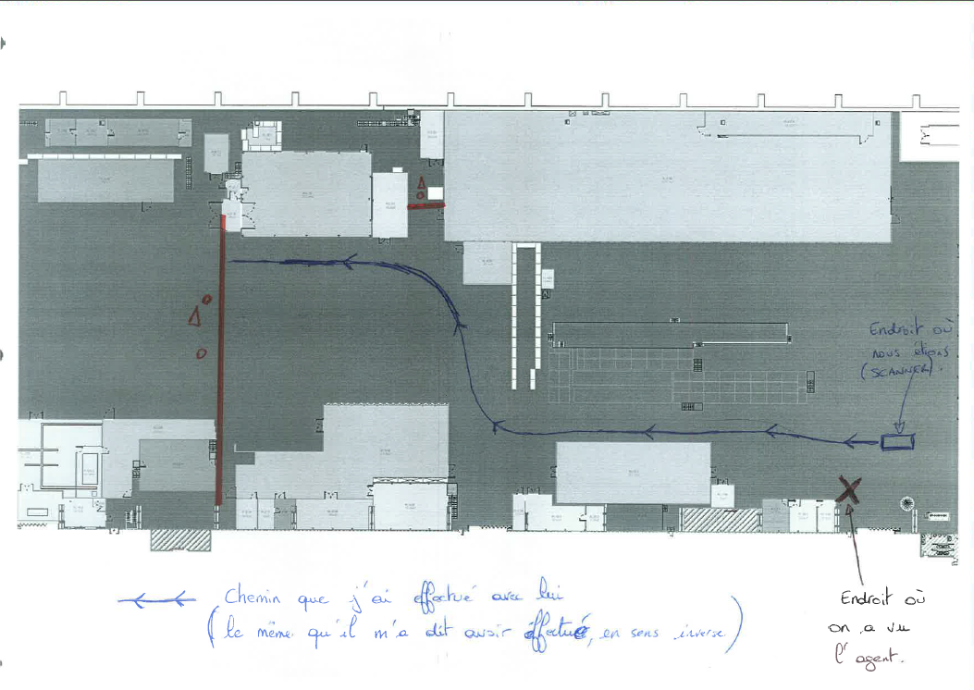
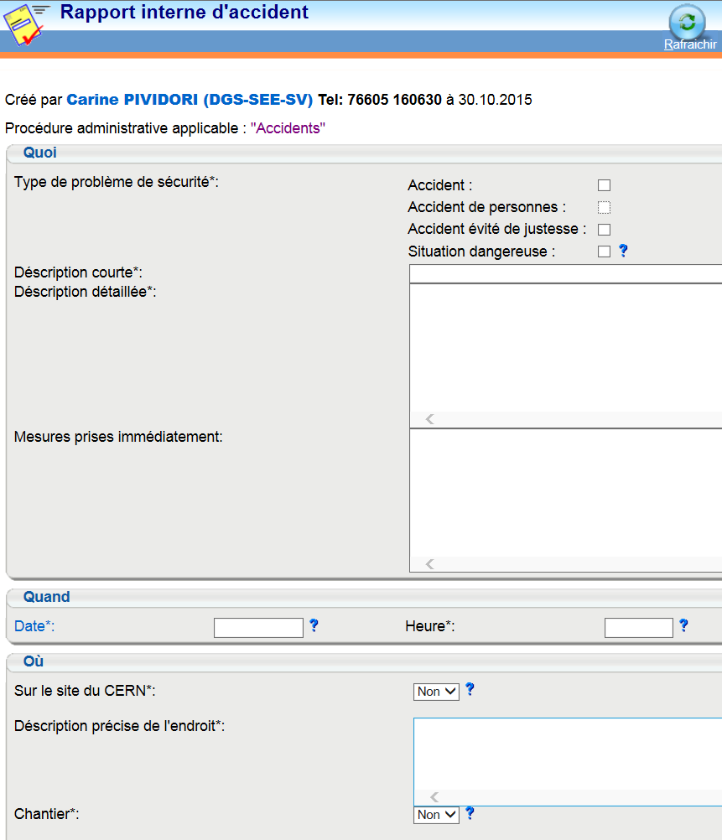
Reporting of significant radiological events
Initial declaration to the authorities with first analysis, a proposal for classification and a follow-up actions
Agreement on classification and actions
Final report (status and actions taken, REX)
Since 2015 : one INES 0 event declared
EDMS No: 1845506

Slide 10
Reporting on deviations in beam facilities
Service Now (SNOW) tool used to declare deviations (minor irregularities) in beam facilities
Declarations followed up by Safety officers of Department concerned
Tool allows for automatic tracking of follow-up actions
Mainly used by Beams Department
EDMS No: 1845506

Slide 11

Critical appraisal of the current system
Incident reporting and management mechanisms exist but they lack consistency and overall coherence:
  Rules/procedures use different definitions
  Various classification mechanisms with different objectives (information, action, analysis)
  Various incident analysis procedures
  Multiple forms and reporting tools which causes confusion (for example the A2 form and the occupational accident declaration form)
Information routing to be reviewed
  No systematic routing of incivilities/car accidents to site security
  A2 report of 12.000 users go to EP Department head! No information representative of home institution for users
EDMS No: 1845506

Slide 12
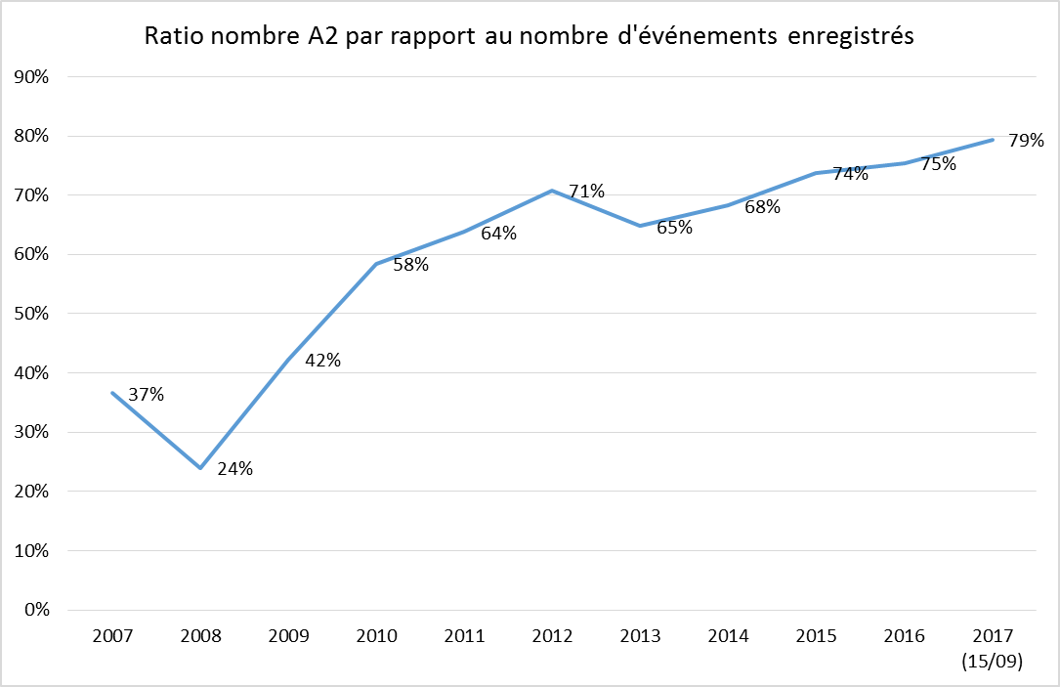
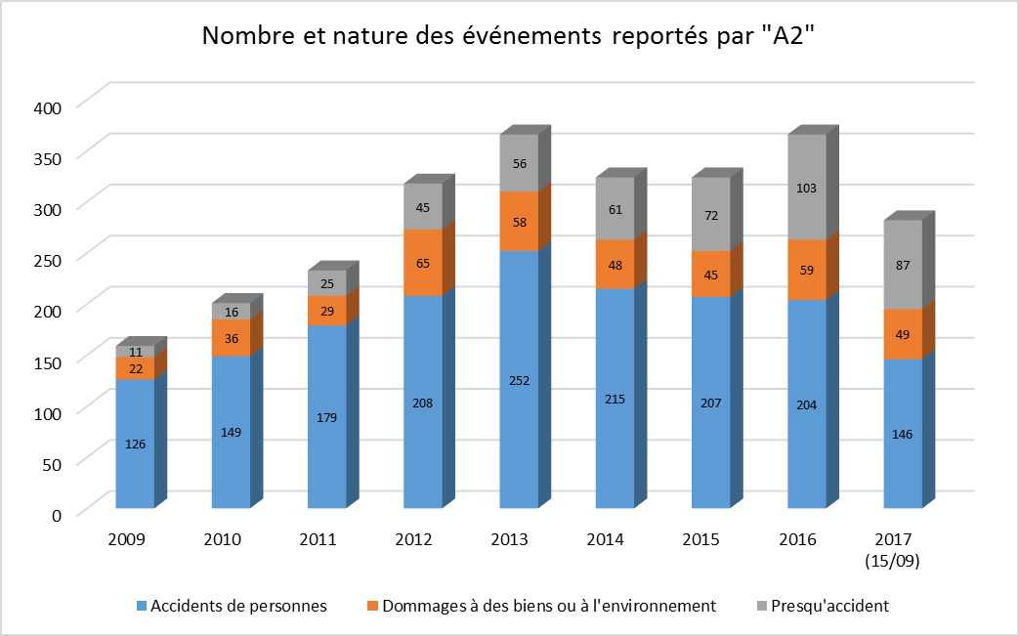
Critical appraisal of the current system
Reporting of near misses and deviations needs to be improved
EDMS No: 1845506

Slide 13
Critical appraisal of the current system
Reporting of near misses and deviations needs to be improved
  Need to identify the barriers to reporting
  Special case of users-contractors
  Quid anonymous reporting in some cases ?
Serious incidents
Incidents
Minor incidents
Near misses-deviations
This is where action is required
EDMS No: 1845506

Slide 14
Critical appraisal of the current system
  Insufficient distribution of lessons learnt:
  Annual reports on accident statistics to SAPOCO and Management
  Awareness campaigns and safety bulletins
  No feed back to reporter of accident and near misses
  No systematic follow-up on implementation of recommendations from A2/A11 reports
  No REX dissemination policy
No (unique) tool for reporting and follow-up
  A 2 declarations compiled manually in an EXCEL sheet
  No tool for follow-up of serious accidents
  SNOW tool only used for deviations in beam facilities
  Different routing systems for different tools
EDMS No: 1845506

Slide 15
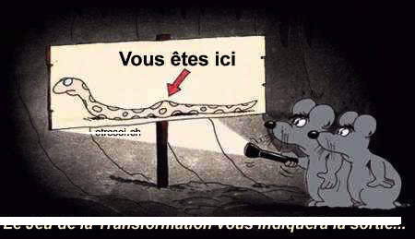
The future and its challenges
  Following a critical review of the current system we are now in the process of establishing a new graduated and coherent incident reporting and management system
  Challenges:
    An understandable set of definitions of events that need to be reported with clear processes associated to each of them
    Clear classification criteria (possibility for safety professionals to correct an initial classification)
    A unique AIM tool
    A system that takes into account CERN specificities (large collaborations with a huge user community, extensive presence of contractor personnel).
EDMS No: 1845506

Slide 16
  Thank you
  Questions - Suggestions ?
EDMS No: 1845506

