Slide 1
ESS - Emergency Preparedness &
Rescue Service
Peter Jacobsson
Head of Environment, Safety & Health
Presentation to ITSF #14
TRIUMF, Canada 2017-09-18--22
www.europeanspallationsource.se

Slide 2
Overview
Legal Aspects – Requirements
Location of Site
Emergency Preparedness
  Organisation
  Time frames
Rescue Service
  General
General Remarks

Slide 3
Legal Aspects
Environmental Code
Radiation Safety Protection Act
  Specific conditions for ESS
    Emergency Preparedness
    Security (Physical Protection)
Planning & Building Act
  Fire Safety & Evacuation
The Act on Flammable Materials and Explosive
  Fire Safety
Work Environment Act
  Evacuation

Slide 4
Requirements
ESS Emergency Preparedness Plan
  Organisation (on duty, on call, back-up)
  Controls
  Communication
  Equipment
  Training
  Exercises
ESS Fire Safety Program
  ESS Fire Strategy

Slide 5
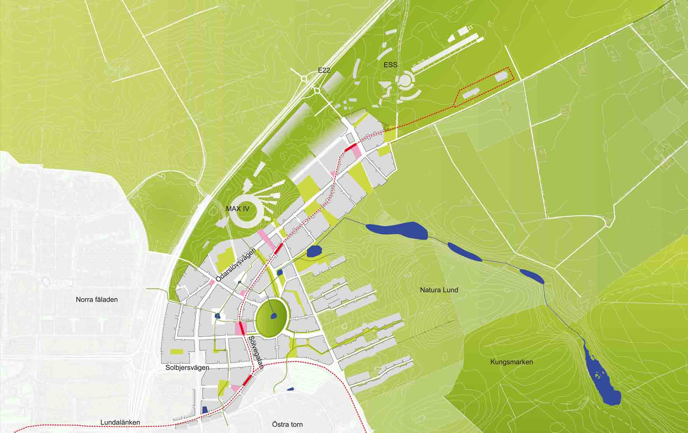
Northeast Lund
2 km

Slide 6
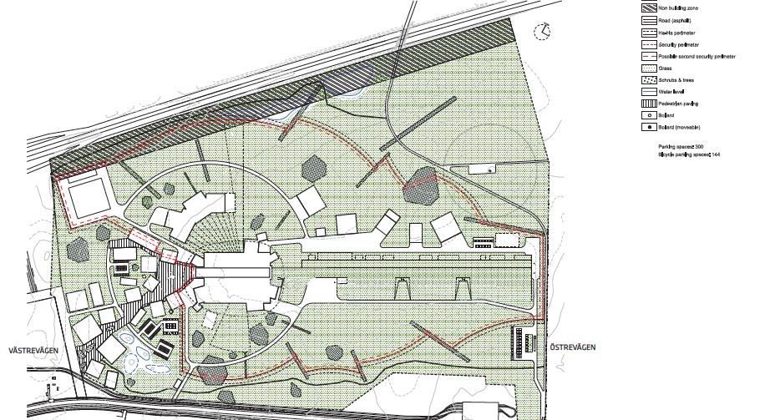
ESS Lay-out

Slide 7
Emergency Preparedness - ESS
Capability of doing emergency preparedness of the site (staff, users, visitors)
  Alarms
  Emergency assembly points
  Possible evacuation
  Need of sanitary services
  Safety Training
Capability of alarming/communication of the “blue-light authorities”
  Back-up communication lines
  Exercises

Slide 8
Time frames
t=0
ESS staff as “First responder” (Security guards)
ESS Emergency Preparedness Plan
ESS Physical Protection Plan
t+10
Local Fire Brigade
Rescue service intervention plan
t+60
ESS Crisis Management Team
Preparedness plans from different authorities

Slide 9
ESS Emergency Preparedness – Organisation
Main Control Room (MCR) - Shift Supervisor
First Responder (staff on site)
Alarm chain, by the MCR
Radiation/Electricity Hazards (on-call ?)
Call for the ESS Crisis Management Team
When the local rescue service arrives, in principal the chief rescue manager have the mandate to decide upon possible actions (evacuations, alarms..)
Thus, general exercises are foreseen on a regular basis in order to coordinate the activities between different authorities

Slide 10
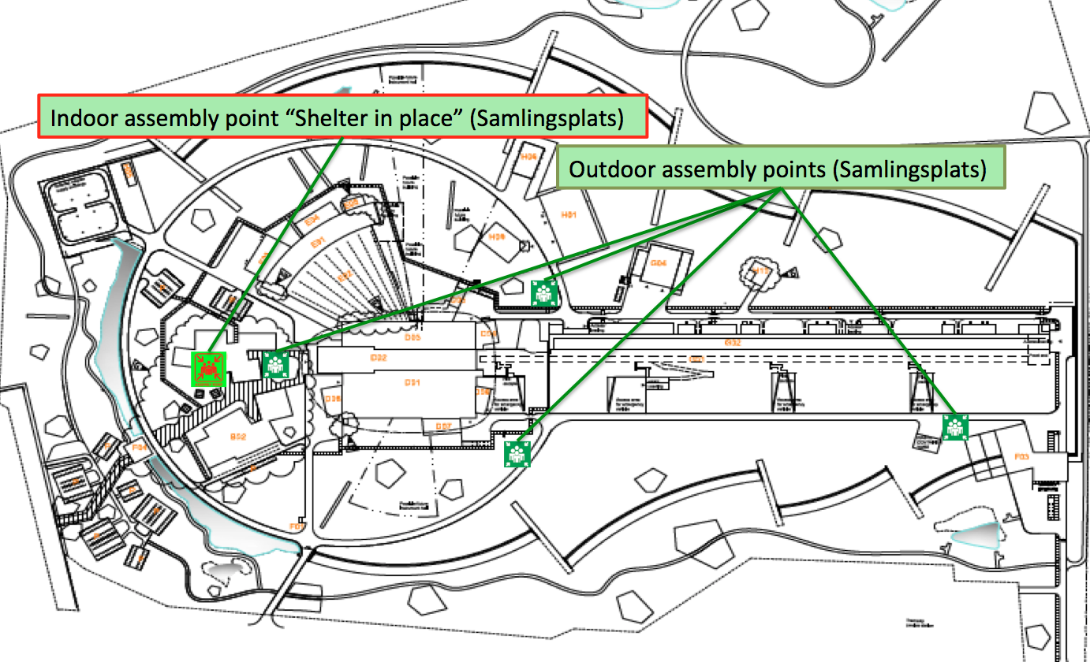

Slide 11
Emergency Preparedness Zone (EPZ)
A decision to be taken by the Swedish Government on recommendation from the Swedish Radiation Safety Authority (SSM)
Will be based on a environment dose consequence analysis, with input (source term) from ESS
Will affect the planning of the surrounding structure (houses, offices…) and the need for local rescue service
Possible actions discussed would be “sheltering”
The preliminary suggestion is that the only the ESS site would be considered as a EPZ

Slide 12
General outline – Rescue Service
Rescue Service provided by the local fire brigade (Räddningstjänst Syd)
The rescue station is located 2,5 km from the site. Additional stations around the city
The local fire brigade saves lives and make sure that a fire does not spread!
  Protection of property – Fire Safety Protection Equipment (sprinklers, material choices….)
  Specific concern regarding radiation, electrical, chemicals, explosives....(biology)

Slide 13
Fire Safety Program & Strategy
In general, a sprinkler system is installed throughout the facility. As a green-field site, there is not enough water provided by the municipality water company; i.e. we build a fire water building (cisterns)
We will have 24/7 duty for an RPT to make sure that the local fire brigade can enter any part of the facility at any time
Instructions & trainings
More training
Exercises

Slide 14
Emergency Preparedness & Fire Safety - Today
Regular planning meetings with the authorities
Training exercise at the construction site for the fire fighters at the local station
  5 training sessions (5 shift); half day training
“Table” exercise with the local rescue service for 8 identified fire accident scenarios
Discussions has started of which equipment, ESS needs to provide for the rescue service

