Slide 1


Mitigation of Human Factors to complement
Safety Instrumented Systems
around Beam Facilities
SIS available around CERN Beam Facilities
Factors influencing the functionality of SIS
Management of several SIS & Risks not covered by SIS
  3.1. Procedures in place at CERN
  3.2. Proposed additional procedures
Summary and lessons learned

Slide 2
1.0. Safety Instrumented Systems
available around CERN Beam Facilities
Systems typically designed for the safe operation of the “Machines” :
Temperature sensors on equipment
Voltage and current control & interlocks
Fluid-leak detections
Vacuum-leak detection
Beam-Loss monitoring
“Machine Protection System” (for the LHC)
…
These systems must essentially be operational during machine operation.
They also have a beneficial effect on personnel and environment protection.
Marc Tavlet @ ITSF – Triumf ‒ 2017-09-21
Notes:
Temperature sensors on equipment : magnets, motors, electronics…
Fluid-leak detections : water, coolants, SF6…

Slide 3
1.1. Safety Instrumented Systems
available around CERN Beam Facilities
Systems typically designed for the personnel protection :
Personnel Protection System (PPS)
Fire detection systems
Automatic (and manual) fire-fighting systems
Flood detection
Flammable gas leak detection
ODH detection
Evacuation push-buttons and lighting
Emergency power-stops
…
Notes:
Most of these systems must essentially be operational during personnel access into facilities; with the exception

Slide 4
1.1. Safety Instrumented Systems
available around CERN Beam Facilities
Systems typically designed for the personnel protection :
Personnel Protection System (PPS)
Fire detection systems
Automatic and manual fire-fighting systems
Flood detection
Flammable gas leak detection
ODH detection
Evacuation push-buttons and lighting
Emergency power-stops
…
Most of these systems must essentially be operational during personnel access into facilities.
“Alarm Level 3” systems must be available 24/365.
Notes:
Most of these systems must essentially be operational during personnel access into facilities; with the exception

Slide 5
1.1. Safety Instrumented Systems
available around CERN Beam Facilities
The PPS is the main SIS to protect people against the highest hazards from accelerator operation:
the beam itself,
ionizing and non-ionizing radiation, radio-frequency,
strong lasers,
electricity from non-standard equipment
moving heavy objects or robots
…
Systems typically designed for the personnel protection :
Personnel Protection System (PPS)
Its main functions are: If hazard is present → no people allowed
If people present → interlocks on hazards
Notes:
Most of these systems must essentially be operational during personnel access into facilities; with the exception

Slide 6
1.1’. Safety Instrumented Systems
“Alarm Level 3” systems at CERN
“AL3” = when life is at stake, obviously designed for the personnel protection
  Fire detection systems
  Flood detection
  Flammable gas leak detection
  ODH detection
  Evacuation push-buttons and lighting
  Emergency power-stops, electricity-stops
  Emergency telephones
  Alarm & communication from blocked lift
  “Dead-man” devices
Notes:
Most of these systems must essentially be operational during personnel access into facilities; with the exception

Slide 7
2. Factors influencing the functionality of SIS
“Functionality” ← Availability, Integrity, Vulnerability
The factors influencing the functionality can be sorted in 4 classes:
  Engineering
  Maintenance
  Operation
  Environment
Made, controlled and validated by human
Made, controlled and validated by human
Made, controlled and validated by human
Including “undesired” humans
Human factors !

Slide 8
2.1. Factors influencing the functionality of SIS
How to manage the Engineering process of SIS ?
Design of a SIS ← needs identified by a risk analysis.
Risk analysis conducted by safety officer (SO), in collaboration with (risky) equipment specialists + hazard specialists
Example: power-converters specialists + electrical-safety specialists
At this stage, SO will identify the risks that will not be addressed by the SIS.
(To be addressed later by other means.)
Functional specification written by safety specialists
and validated by management

Slide 9
2.1. Factors influencing the functionality of SIS
How to manage the Engineering process of SIS ?
Design of a SIS ← needs identified by a risk analysis.
Risk analysis conducted by safety officer (SO), in collaboration with (risky) equipment specialists + hazard specialists
Functional specification written by safety specialists
and validated by management
Technical specification written by SIS designers
SIS implemented and tested by SIS specialists
SIS operation validated by safety officer

Slide 10
2.2. Factors influencing the functionality of SIS
How to manage the Maintenance process of SIS ?
Clear written procedure
Qualified personnel
Check by third party
Possible validation by safety officer
Covered by
IEC 61508
+ Maintenance scheme foreseen during design
          must be compatible with foreseen operation scheme

Slide 11
2.3. Factors influencing the functionality of SIS
How to manage the Operation process of SIS ?
Most of its operation will be fully automatic (by definition)
During maintenance, the system must remain (partially) operational, with some function disabled.
Need for compensatory measures
  Defined by safety officer
  Implemented by SIS specialist (+ record !)
  Validated by safety officer

Slide 12
3. Risks not covered by SIS
and
Management of several SIS

Slide 13
3. Risks not covered by SIS
and
Management of several SIS
3.1. How to manage risks not covered by SIS ?
By general safety-management principles:
Remove or replace hazard…
Isolation, separation of hazard and possible target
Collective passive personnel protections

Slide 14
3. Risks not covered by SIS
and
Management of several SIS
3.1. How to manage risks not covered by SIS ?
By general safety-management principles:
Remove or replace hazard…
Isolation, separation of hazard and possible target
Collective passive personnel protections
→ Remaining risk, to be managed by
  Organisational measures
  Procedures
  PPEs
  Training of people

Slide 15
3. Risks not covered by SIS
and
Management of several SIS
3. Risks not covered by SIS
and
Management of several SIS
3. Risks not covered by SIS
and
Monitoring of all SIS
3.2. How can safety officers (and the management) be sure that all SIS
are operational
  in a given facility
  for a given period of operation or access ?

Slide 16
3.2. Monitoring of all SIS (and more)
Today; checklists for Safety Permits
= Safety procedures that accompany major milestones in the lifecycle of a (beam) facility.
= Checklists, signed-off by different parties involved in preparing/ensuring the safe conditions for the next step of the facility.
They address  facility integrity,
        operational safety (Sûreté de fonctionnement),
        occupational health and safety,
        environmental issues.
They add quality assurance in terms of
 traceability
 archiving
Notes:
Safety Permits : Powering permit, laser permit, cooldown permit, irradiation permit, beam permit…

Slide 17
3.2. Monitoring of all SIS (and more)
1’. Examples of Safety Permits today at CERN:
    Hardware permit
    Powering permit
    Laser permit
    RF permit
    Source permit
    Cool-down permit
    Irradiation permit
    Beam permit
    (…)

Slide 18
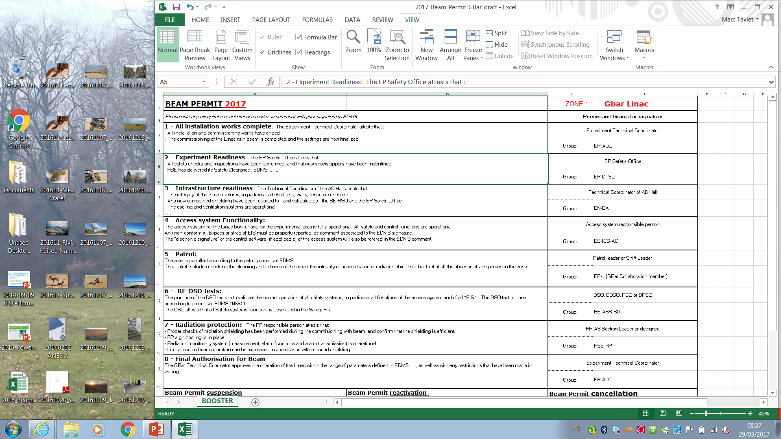
3.2. Monitoring of all SIS (and more)
1”. Example of Beam-Permit
Beam Operation Group-Leader

Slide 19
3.2. Monitoring of all SIS (and more)
Proposal; checklist for Access-Permit or Work-Permit
= Procedure applicable at the beginning of technical stops of accelerators, in order to make sure that the following systems/services are operational:
PPS to ensure beam safety
Ventilation of underground areas
Radiation sweep performed
Fire detection & fire extinguishing systems (automatic and manual)
ODH, flam-gas leak, flood … detections
Elevators
Alarm transmission systems
GSM system
…
Notes:
Proposal from Safety Officers of the Accelerator_&_Technology Sector

Slide 20
3.2. Monitoring of all SIS (and more)
Proposal; Safety Status® software
This concept imagined by [SIS specialists] establishes a dashboard of the functional safety aspects of every system.
It is based on a methodology [taking into account the criteria (technical and human) listed in IEC 61508 for SIS] and a software tool allowing updating automatically or manually the data coming from relevant sources.
Its main objective is to monitor the efficiency of the SIS, in terms of availability.
Ref.: P. Ninin at al., Int. J. of Safety and Security Eng., Vol. 0, No 0 (2017) 1-11 : Safety Status® an innovative concept for maintaining the safety integrity level of operational safety systems.

Slide 21
4. Summary and lessons learned
4.1. Human factors must always been considered
Human errors must always been considered as possible
Proper procedures must complement SIS, as they may reduce the likelihood of errors or oversights
4.2. Despite these procedures in place, we have experienced some “mishaps” at CERN.
… and I’ll be happy to discuss them with you,
… as well as to learn how you address human factors in your institutes.
This is the end. Bye for now…

