Slide 1
Safety Considerations & International Collaboration
John Anderson Jr., Associate Head for Operations Support,
Office of the Chief Safety Officer
2017 International Technical Safety Forum
18-22 September 2017

Slide 2
DOE and Fermilab – Understanding the playing field is important
Fermilab works for the US Department of Energy (DOE) to do basic research that makes discoveries, inspires people, and drives national growth.
DOE is our (Fermilab’s) sponsor. With their support comes rules and expectations. And those expectations are important because we are spending the taxpayer’s money.
If we worked for a private company, the rules may be different. But working on public funds, the stakes are high. No politician, government official, or taxpayer wants their tax dollars spent in a way that hurts people or the environment – people are nervous.
DOE has their own enforcement arm – they can levy fines against their rule called 10CFR851.

Slide 3
Two Considerations to Discuss Today
How do we accept in-kind contributions when those contributions are components designed to non-U.S. standards and not allowed according to 10CFR851
(there are specific exceptions)?
How do we acclimate our International colleagues and deal with challenges like training, expectations, and cultural differences?

Slide 4
Accepting In-Kind Contributions
Here’s the language from 10CFR851 we used to build our process to establish equivalency:
When national consensus codes are not applicable (because of …. use of special materials, etc.), contractors must implement measures to provide equivalent protection and ensure a level of safety greater than or equal to the level of protection afforded by the ASME or applicable state or local code.
It goes on to discuss the design drawings, reviews and documentation required.
The process was accepted by our DOE Fermi Site Office (FSO) and is now memorialized as a Fermilab ES&H Manual (FESHM) chapter.
We’ve used it successfully several times over the last 18 months.

Slide 5
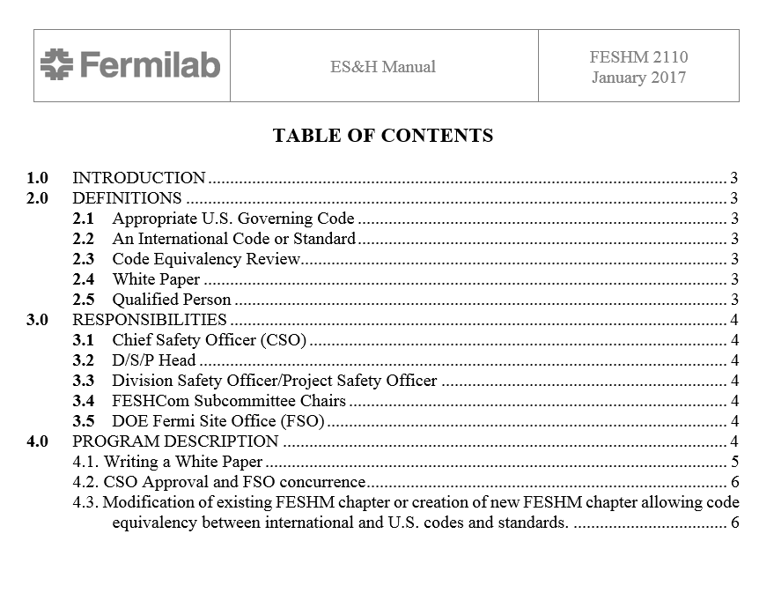
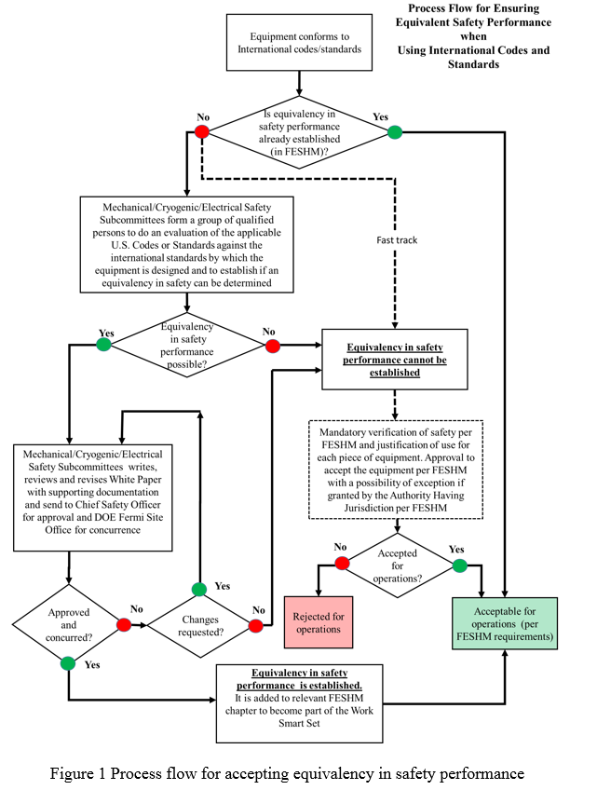
The Process - FESHM 2110: Ensuring Equivalent Safety Performance when Using International Codes and Standards
http://esh-docdb.fnal.gov/cgi-bin/ShowDocument?docid=3253

Slide 6
Process Flow –
Following path where equivalency can be achieved
SMEs evaluate U.S. Codes against International standards.
If they think an equivalency can be achieved they write a white paper and prove their assertion.
White paper reviewed (external or peer review).
White paper with supporting documentation is review by CSO and approved.
Forwarded to Site Office for concurrence.
Relevant internal policies updated.

Slide 7
It sounds simple – it is not
It takes an extraordinary amount of engineering resources
Time consuming
BUT – we have a process, DOE likes it, we have a paper trail for each exception, so we’re doing it.
This process transfers the risk back to the Laboratory – in other words, DOE is not allowing us to follow different codes, they are concurring that we’ve used a process that establishes an equivalent level of safety performance between two codes. We (the laboratory) are accepting the risk. It’s a subtle but important point.

Slide 8
Acclimating Users
Setting Expectations
  Users at Fermilab understand expectations through communication and training.
  Some are easier than others to acclimate (Universities typically have a less mature safety culture).
  Fermilab has a process we follow if safety and health rules are not followed. This has proven to be effective.
  Ensuring a point of contact for each user is critical to identifying the appropriate training and holding the user accountable.
Training
  Onboarding personnel can be time consuming.
  We’ve done a fair amount of work to establish reciprocity – especially with CERN (and a couple U.S. labs). This has helped tremendously!
  Other training is available on-line and can be completed prior to the user arriving, hence expediting the process.

Slide 9
Acclimating Users (continued)
Successes
  Working with our International partners to establish reciprocity in training has helped the relationship and demonstrated a team spirit.
  Users with a deep commitment to safety serve as an example to our employees and help bring a unique perspective.
Challenges
  International partners have a low tolerance for the DOE structure we are bound to work under.
  Communicating our culture is difficult – at times we appear to be non- cooperative, but really we’re just complying with our own M&O contract.
  Risk tolerance is not consistent and that creates potential gaps in the work performed in the U.S.
  Differences in regulations around hand held power tools has created some angst for us and our International partners.

Slide 10
Conclusion
International collaboration is critical for success!
Working within the boundaries of DOE is challenging when we are accepting in-kind contributions – BUT – we have a process and our DOE Fermi Site Office has been supportive.
Small things can derail progress – i.e. power tools
Determining commonalities and exploiting them (like training) can demonstrate a willingness to work together AND streamline the process for our users.
As in any endeavor, communication and clear expectations are key. Without them, you end up with delays and mistrust.

Slide 11

Questions?

