Slide 1
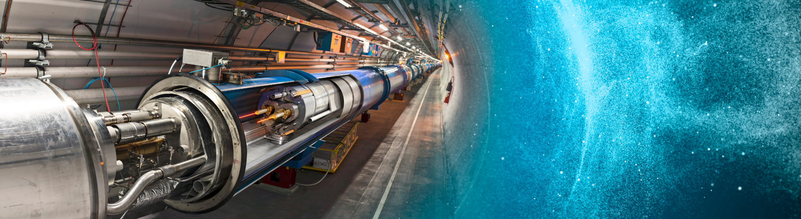

Slide 2

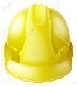


METHODOLOGICAL APPROACH TO SAFETY ANALYSIS AT CERN
Francesca VIGGIANO, TE-HDO
Thomas OTTO, TE-DSO
Fabio FORMENTI, TE-DDSO
Delphine LETANT-DELRIEUX, TE-VSC

Slide 3
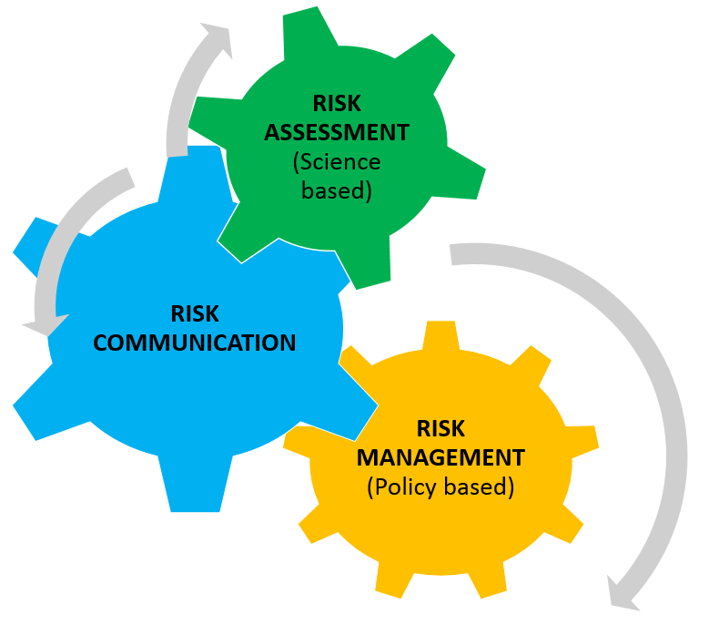

OBJECTIVE
Identify hazards, evaluate risk where required and propose to reduce the risk level by adding precautions or controls, as necessary
Provide a coherent approach for creation and review of workplace risk analysis in the Technology department
18-22 September, 2017

Slide 4
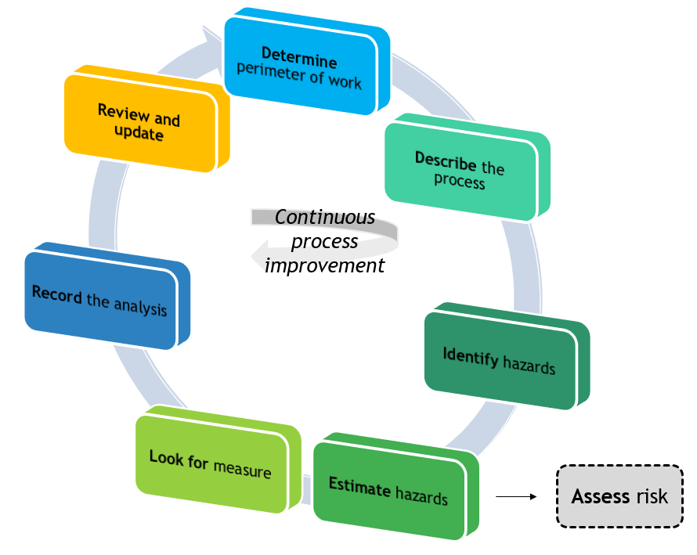
METHODOLOGICAL APPROACH
1
The methodology has been developed according to the SUVA* approach and has been customized for CERN’s facilities
*Suva, the Swiss National Accident Insurance Fund, is an independent company under public law, which insures people at work and at leisure.
18-22 September, 2017

Slide 5
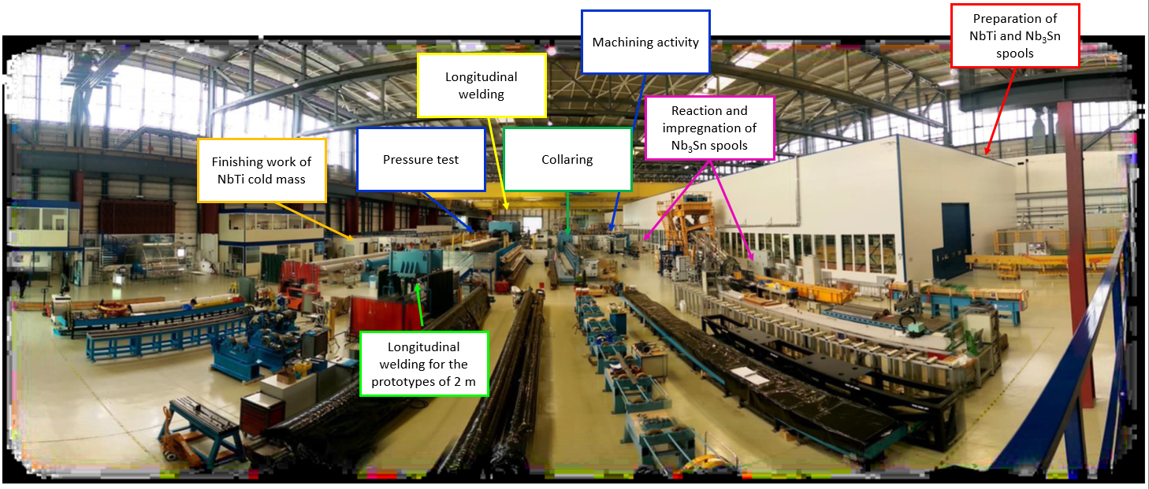
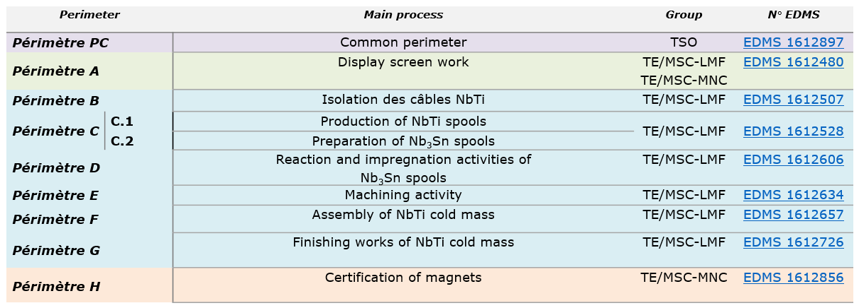
STEP 1 –Determine the work perimeter
The identification of the perimeter/the process can alternatively be done by considering:
Group of workers - Workers belonging to the same section (TE-CRG-OD or TE-MSC-LMF)
Process/activity sector – Machining, welding, assembly work
18-22 September, 2017

Slide 6
METHODOLOGICAL APPROACH
The methodology has been developed according to the SUVA* approach and has been customized for CERN’s facilities
2
*Suva, the Swiss National Accident Insurance Fund, is an independent company under public law, which insures people at work and at leisure.
18-22 September, 2017

Slide 7
STEP 2 –Describe the process
Process P: Is the activity carried out in the work perimeter
AB1 | To Move
AB2 | Move on the workplace environment
AB3 | To receive the magnet
PP1 | Transport of working equipment
PP2 | Cleaning with ethanol and/or scotch-brite (scrub sponges)
PP3 | Assembly of work equipment
PP4 | Positioning of supports
PP5 | Wiring of magnets
PP6 | Isolation of busbars
PP7 | Soldering
Partial Process PP: Is a set of activities or steps carried out by personnel (CERN staff, associates or contractors) to complete the Process P
Basic Activity AB: An activity that is performed in many Partial Processes PP and that remains the same in terms of hazards.
N° | Work process, work equipment, substances | Hazards | Severity of hazard |  | Safety rules | The hazard is adequately covered by safety rules? |  | Identified safety deficiency (See action plan)
 |  |  | High | Low
 |  |  |  |  |  | Yes | non, partially
PP7 | The technician installs the work equipment (filler parts, busbar guides, bottom plates, spiders, etc.) into their housings on the cold mass using the handling tools. Then, he solds all the installed parts with a soldering irons (soft soldering, 400 °C). During the activity, the technician cleans the equipment with scotch-brite and ethanol. The working procedure «Finitions des extremités masse froide», EDMS 1530515 must be followed. | Thermal: Hot surface |  | X | CERN IS 7 CL: SUVA 67091.f FE: SUVA 44091.f DI: Renseignement concernant l'OPA, Art.337.10 | X
 |  | Noxious Substances: gas, vapour (smoke) |  | X | CERN GSI-C1 CERN NS26 CERN Guide de sécurité C-1-0-3 CL: SUVA 67104.f FE: SUVA 44053.f | X
 |  | Noxious Substances: Dusts | X |  | CERN GSI-C1 CERN NS26 CERN Guide de sécurité C-1-0-3 CL: SUVA 67104.f FE: SUVA 44053.f | X
 |  | Psychological constraints: Working posture |  | X | CL: SUVA 67090.f | X
 |  | Le processus de base a été traité sous: AB1
 |  | Le processus de base a été traité sous: AB2
 |  | Le processus de base a été traité sous: AB3
 |  | Le processus de base a été traité sous: PP2
18-22 September, 2017

Slide 8
METHODOLOGICAL APPROACH
The methodology has been developed according to the SUVA* approach and has been customized for CERN’s facilities
3
*Suva, the Swiss National Accident Insurance Fund, is an independent company under public law, which insures people at work and at leisure.
18-22 September, 2017

Slide 9
STEP 3 – Identify the hazards
N° | Work process, work equipment, substances | Hazards | Severity of hazard |  | Safety rules | The hazard is adequately covered by safety rules? |  | Identified safety deficiency (See action plan)
 |  |  | High | Low
 |  |  |  |  |  | Yes | non, partially
PP7 | The technician installs the work equipment (filler parts, busbar guides, bottom plates, spiders, etc.) into their housings on the cold mass using the handling tools. Then, he solds all the installed parts with a soldering irons (soft soldering, 400 °C). During the activity, the technician cleans the equipment with cloths and ethanol. The working procedure «Finitions des extremités masse foride», EDMS 1530515 must be followed. | Thermal: Hot surface |  | X | CERN IS 7 CL: SUVA 67091.f FE: SUVA 44091.f DI: Renseignement concernant l'OPA, Art.337.10 | X
 |  | Noxious Substances: gas, vapour (smoke) |  | X | CERN GSI-C1 CERN NS26 CERN Guide de sécurité C-1-0-3 CL: SUVA 67104.f FE: SUVA 44053.f | X
 |  | Noxious Substances: Dusts | X |  | CERN GSI-C1 CERN NS26 CERN Guide de sécurité C-1-0-3 CL: SUVA 67104.f FE: SUVA 44053.f | X
 |  | Psychological constraints: Working posture |  | X | CL: SUVA 67090.f | X
 |  | Le processus de base a été traité sous: AB1
 |  | Le processus de base a été traité sous: AB2
 |  | Le processus de base a été traité sous: AB3
 |  | Le processus de base a été traité sous: PP2
18-22 September, 2017

Slide 10
METHODOLOGICAL APPROACH
The methodology has been developed according to the SUVA* approach and has been customized for CERN’s facilities
*Suva, the Swiss National Accident Insurance Fund, is an independent company under public law, which insures people at work and at leisure.
4
18-22 September, 2017

Slide 11
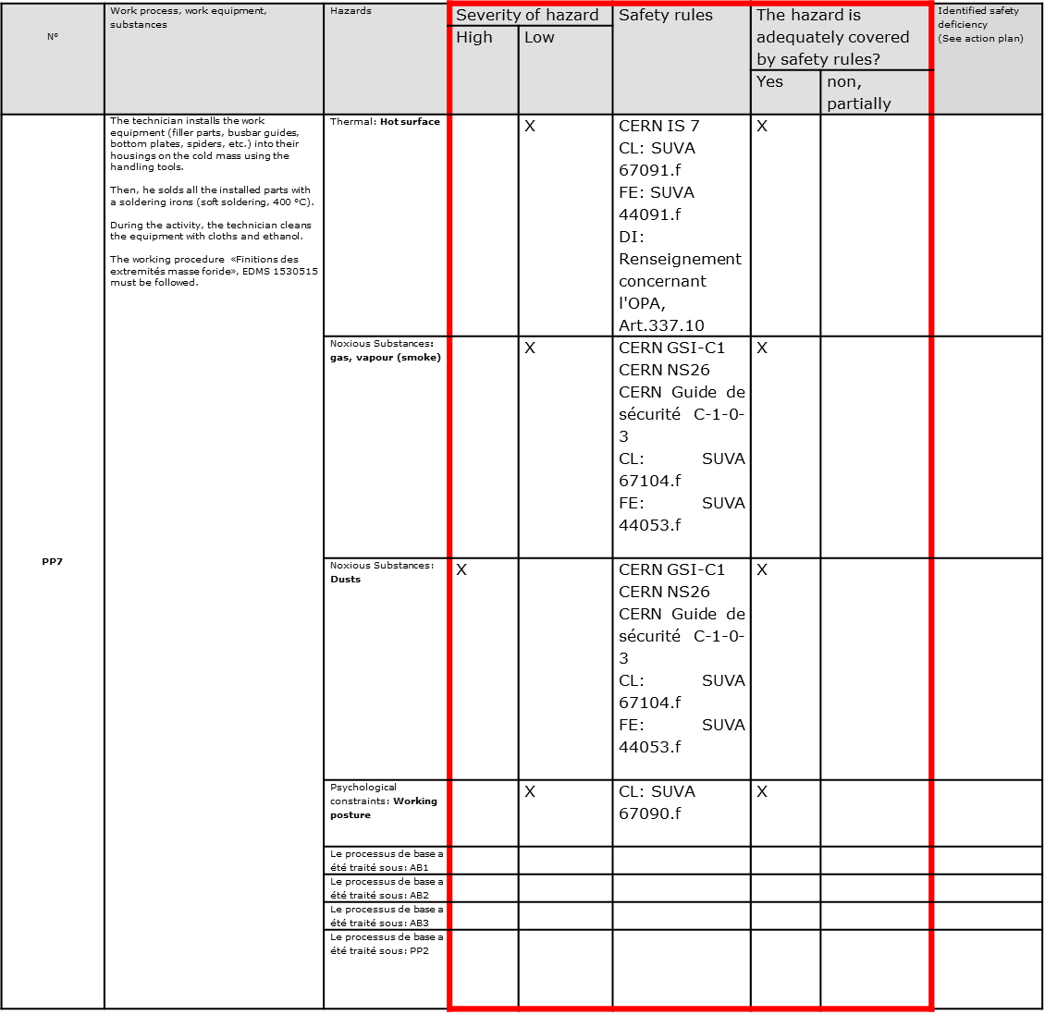
STEP 4 – Estimate the hazards
HIGH – Results in death or permanent injury, failing to heal completely (irreversible),
quality of life substantially reduced
LOW – Curable, minor injury, possibly with reversible incapacity to work
Risk assessment
Sometimes estimating a hazard is not sufficient due to the particular source of harm, insufficient knowledge of a linked installation, etc. and consequently a full risk assessment is necessary (an example could be the assessment of cryogenic risk)
18-22 September, 2017

Slide 12
METHODOLOGICAL APPROACH
The methodology has been developed according to the SUVA* approach and has been customized for CERN’s facilities
*Suva, the Swiss National Accident Insurance Fund, is an independent company under public law, which insures people at work and at leisure.
5
18-22 September, 2017

Slide 13
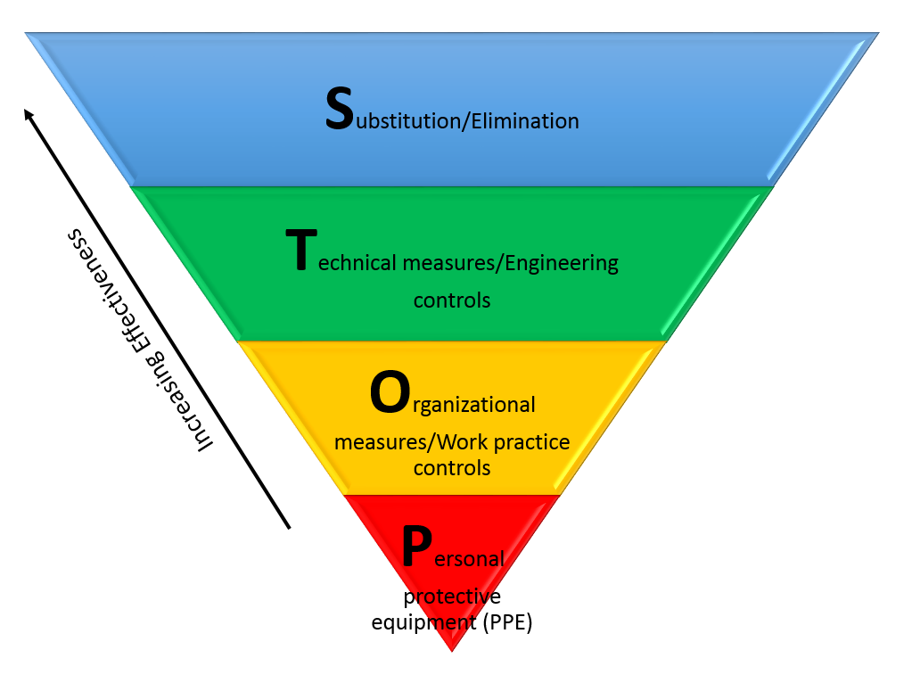
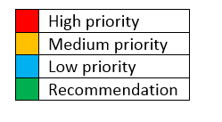
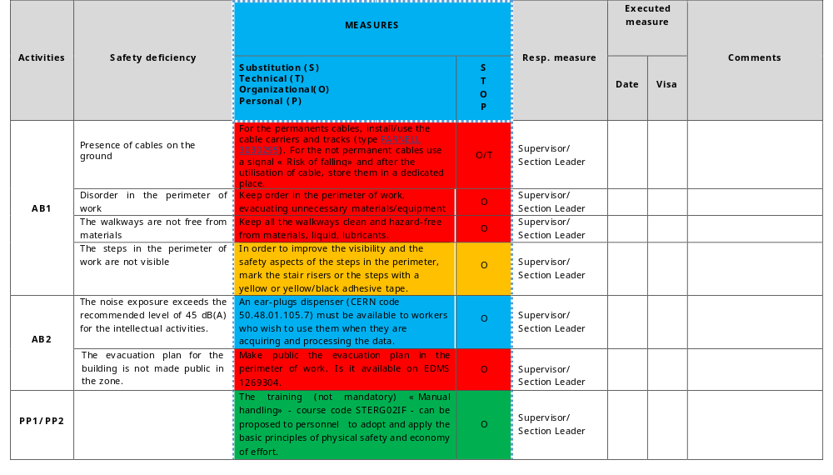
STEP 5 –Look for measures
For each identified hazard, list the measures that need to be put in place to eliminate or control the likelihood of the risk occurring.
18-22 September, 2017

Slide 14
METHODOLOGICAL APPROACH
The methodology has been developed according to the SUVA* approach and has been customized for CERN’s facilities
6
*Suva, the Swiss National Accident Insurance Fund, is an independent company under public law, which insures people at work and at leisure.
18-22 September, 2017

Slide 15
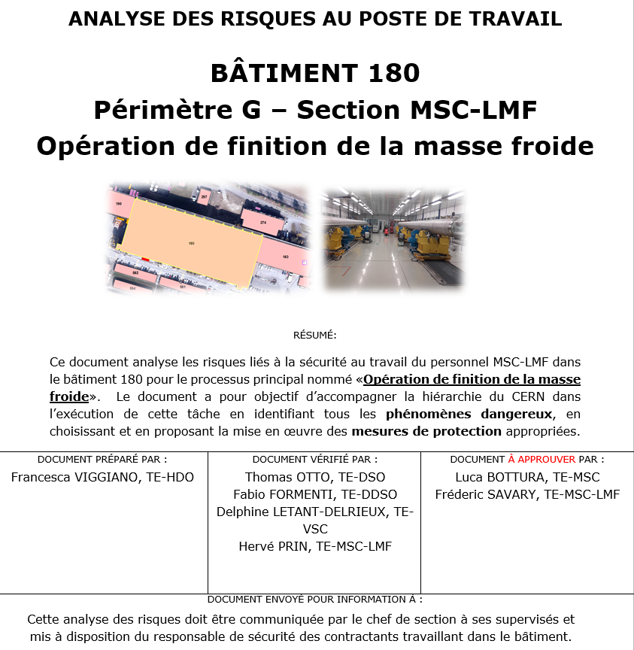
STEP 6 –Record the safety analysis
  Completed analysis recorded in EDMS (CERN's Engineering Data Management Service)
  Verification by Safety Officers, interviewed workers and Section leader
  Approval by Group Leader and Department Head.
This approval policy makes the analyses known and available to the hierarchically responsible persons
18-22 September, 2017

Slide 16
METHODOLOGICAL APPROACH
7
The methodology has been developed according to the SUVA* approach and has been customized for CERN’s facilities
*Suva, the Swiss National Accident Insurance Fund, is an independent company under public law, which insures people at work and at leisure.
18-22 September, 2017

Slide 17

STEP 7 –Review and update
The workplace risk analysis should be periodically reviewed.
In deciding the frequency of the review, the nature of their operations and consequently the level of risk (high, medium or low) is considered.
In general, the workplace risk analysis should be reviewed whenever:
  the work perimeter changes
  the task/activity changes
  after a near miss, personal accident or professional illness associated with the task/activity
18-22 September, 2017

Slide 18
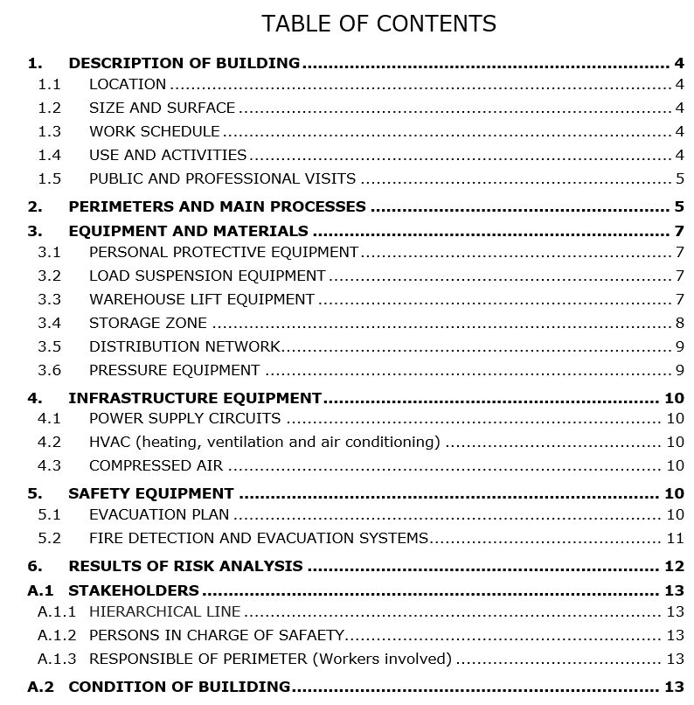
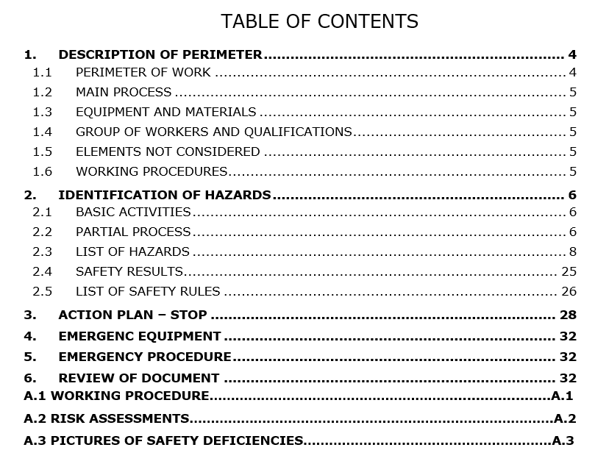

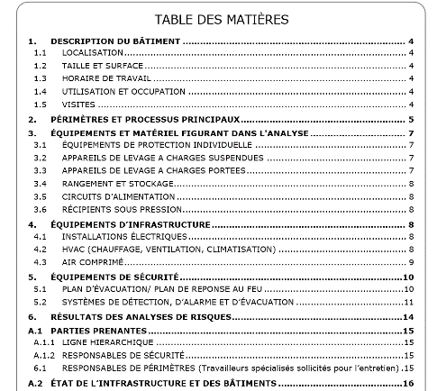
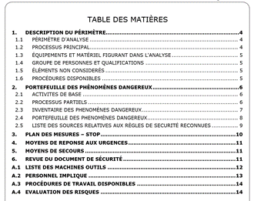
RESULTS – Documents to be prepared
DESCRIPTION OF THE BUILDING
It gives an overview of the building from a safety point of view.
The document contains:
a description of the identified work perimeters
a presentation of the working equipment
the evacuation plan, alarm system, fire and safety equipment
a graph that shows the percentage of satisfactory and unsatisfactory
results as an indicator of the safety level in a building.
WORKPLACE RISK ANALYSIS
This document comprises all the steps of methodology,
which can be divided into three main sections:
Description of the work perimeter
Identification and estimation of the hazards
for each basic activity and partial process
Action plan
18-22 September, 2017

Slide 19
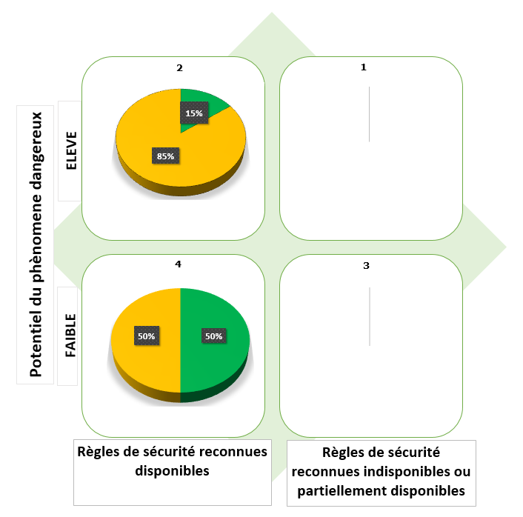

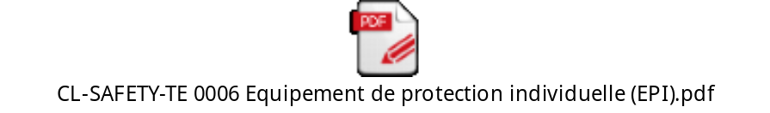
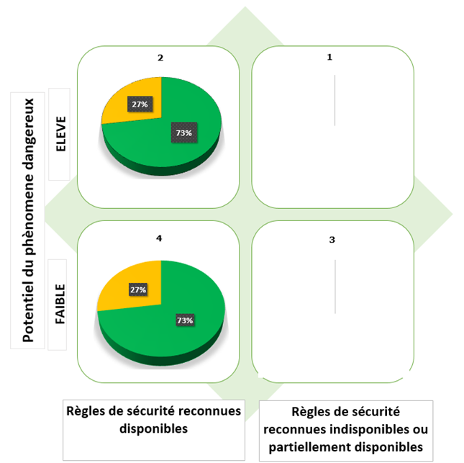
MATERIALS HELPING THE ANALYSIS
1. HAZARD CLASSIFICATION
To ensure completeness of the hazard inventory by giving an exhaustive list of potential hazards and to unify the terminology in the hazard register
2. CHECKLISTS
The scope of the checklists is to support the person in charge of Safety with a list of health and safety issues to consider during the identification of hazards. They are a useful tool to help identify hazards, unsafe conditions and measures to take to eliminate or reduce injuries.
3. SAFETY RESULTS
All the results coming from each analysis are collected in an excel file with the purpose of calculating the percentage of the safety
deemed to satisfactory (green) or unsatisfactory
(orange or red) in a building.
18-22 September, 2017

Slide 20

CONCLUSIONS
INNOVATION AND NEW WAY OF THINKING
Ensure everyone has a role to play
Make everyone’s responsibilities clear
Focus on managing risk
Enable the workers to participate on an ongoing basis to safety aspects
Allow flexibility in managing health and safety risks
The document can be used to inform, form and train the workers in the safety matters by the person in charge of safety
18-22 September, 2017

Slide 21

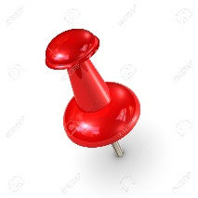
METHODOLOGICAL APPROACH TO SAFETY ANALYSIS AT CERN
Thank you for your attention
francesca.viggiano@cern.ch

