Slide 1
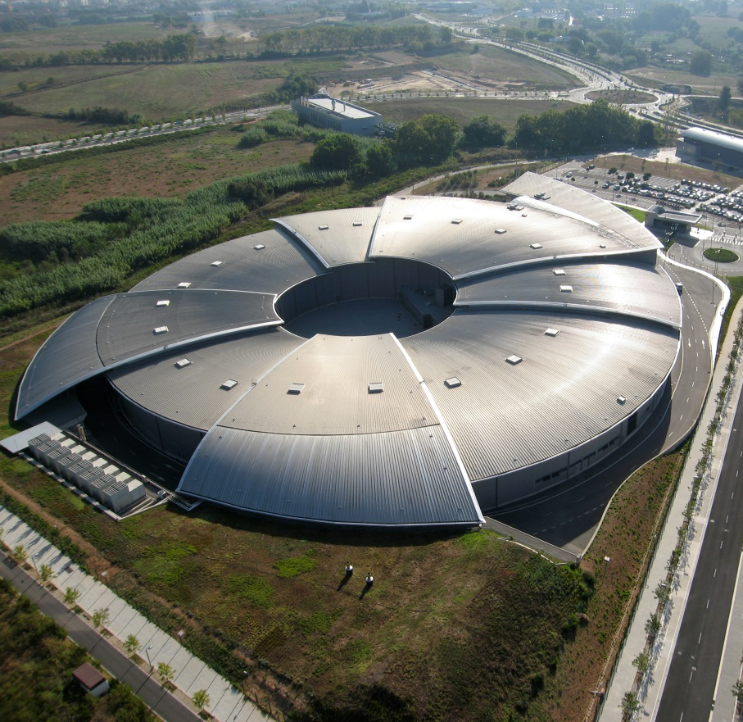
Health & Safety Management Process & Tools at ALBA Synchrotron facility
J. Aguilar¹
C. Mármol¹
V. Garrido¹
Health & Safety Office, ALBA Synchrotron

Slide 2
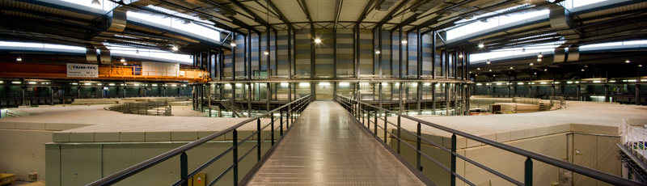
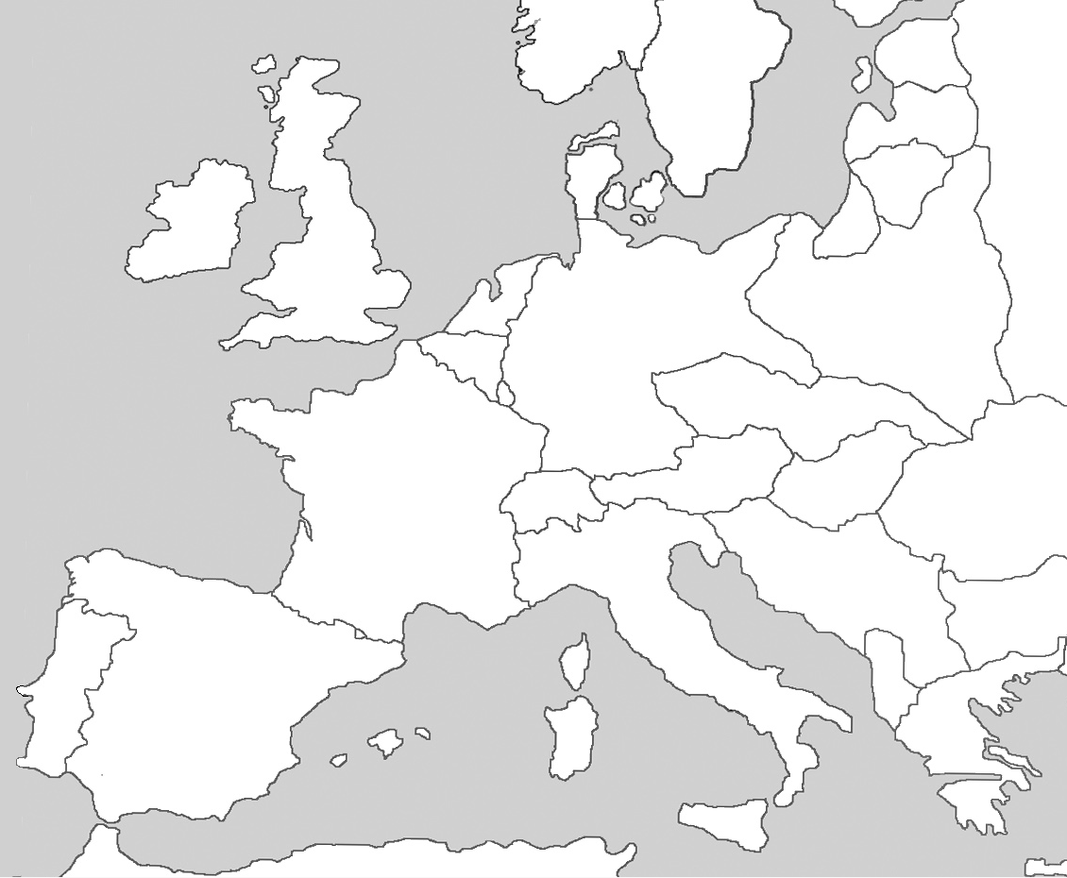
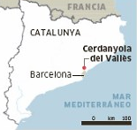

ALBA Synchrotron Light Source
3 GeV electron synchrotron accelerator
8 Beamlines (+1 under construction, +2 in design stage)
Location: Cerdanyola del Vallès (Barcelona)
ALBA

Slide 3
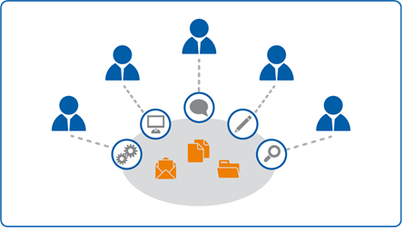
CONFLUENCE, JIRA SERVICE DESK & JIRA SOFTWARE
1
Introduction
2
Tool Description
3
Acknowledgement
4
Improvements

Slide 4


1. INTRODUCTION
Necessity of sharing safety information (from H&S to ALBA staff) reducing paperwork.
  Working procedures
  Safety authorization
  Emergency information
  …

Slide 5

1. INTRODUCTION
Necessity of collecting and canalizing information (from ALBA staff to H&S) to take actions.
  Asking us for a training, authorization, radiation measurement, …
  Informing us about a new events (external company, equipment purchasing, health conditions, …)
  Informing us about an accident or about any situation that can imply an accident

Slide 6


1. INTRODUCTION
So, what can we do?

Slide 7


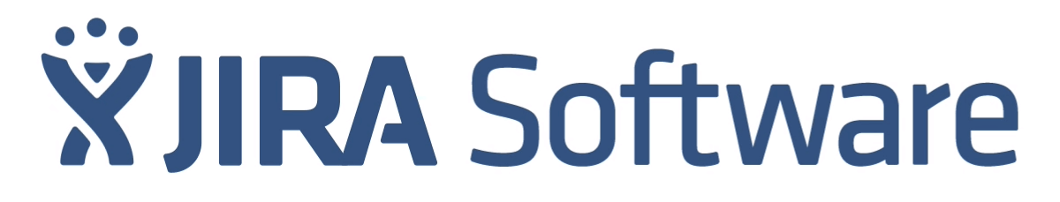
2. TOOL DESCRIPTION
CONFLUENCE, JIRA SERVICE DESK & JIRA SOFTWARE
  Confluence: Online collaborative spaces for sharing info
  Jira Service Desk: Serve customers with custom queues and reporting
  Jira Software: Agile project management and issue tracking software

Slide 8

2. TOOL DESCRIPTION (Confluence)
Confluence allows you:
  To have a unified space to share knowledge and information.
  To manage documents: manage version control, preview, …
  To create meeting minutes, project planning, …
  To have a feedback of your project by means of comments.
  To be connected with JIRA (Health & Safety Service Desk).

Slide 9

2. TOOL DESCRIPTION (Confluence)
Advantages:
  Great Control of documents.
  Employees have access to safety documents and information (to read only).
  Easy to use
Weaknesses:
  Economic investment for usage license.
  Time dedication to upload the documents.
  There is no record with whom the document is shared
  and who has opened and read the document (in process).

Slide 10
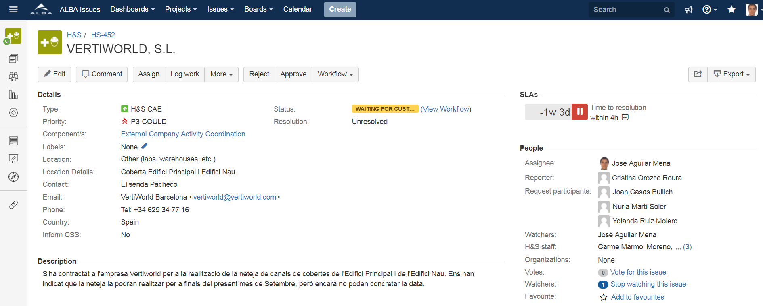
2. TOOL DESCRIPTION
(JIRA Service Desk)
JIRA Service Desk allows you:
  To classify and to resolve incidences
  To have workflow authorization.
  To be connected with CONFLUENCE
Take actions

Slide 11
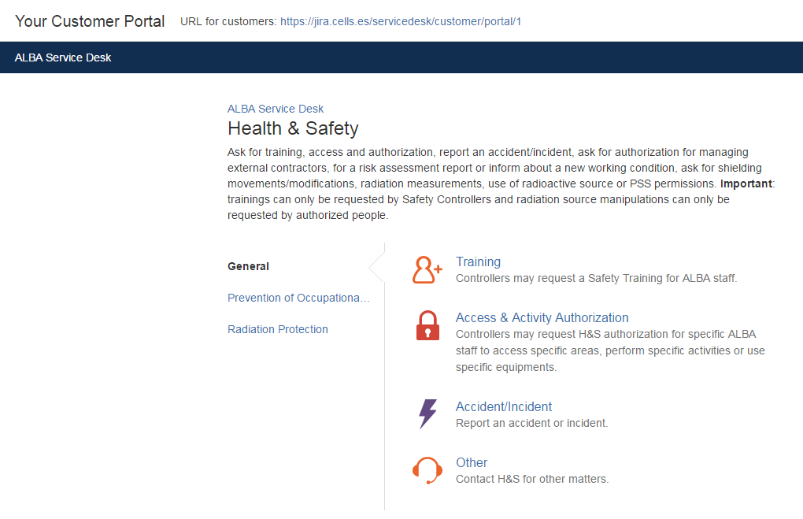
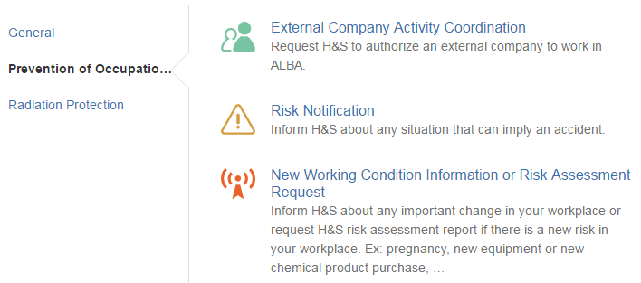
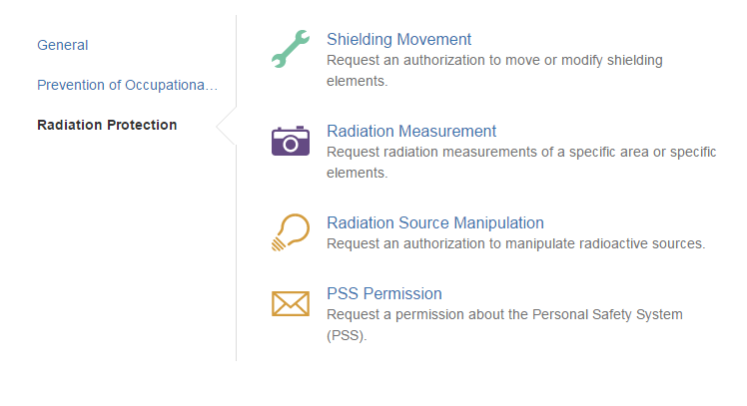
2. TOOL DESCRIPTION
(JIRA Service Desk)

Slide 12
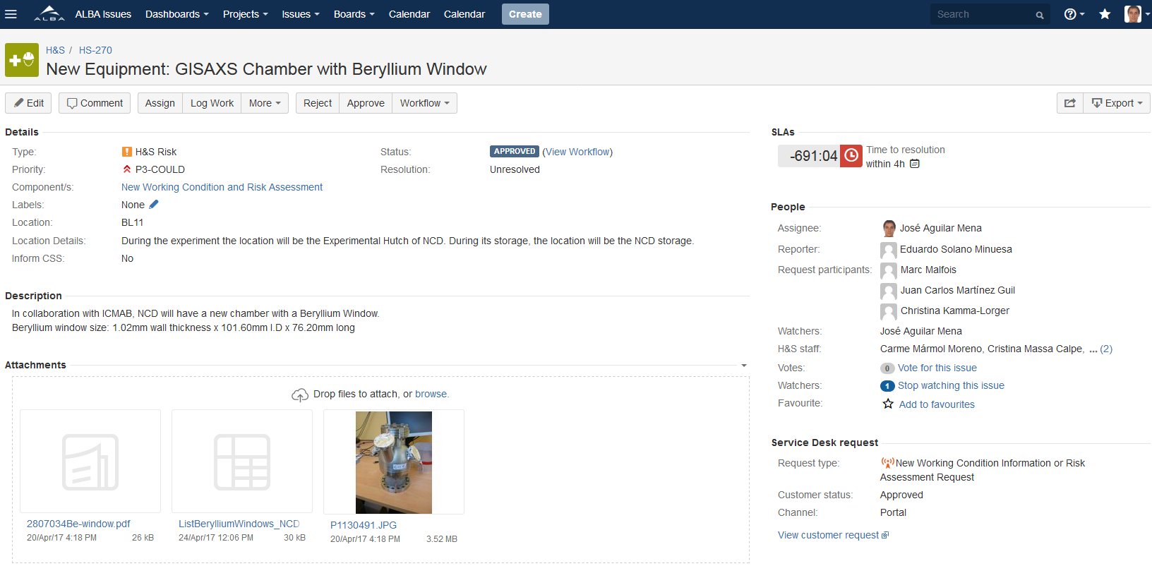
2. TOOL DESCRIPTION
(JIRA Service Desk)
Example of Ticket:

Slide 13
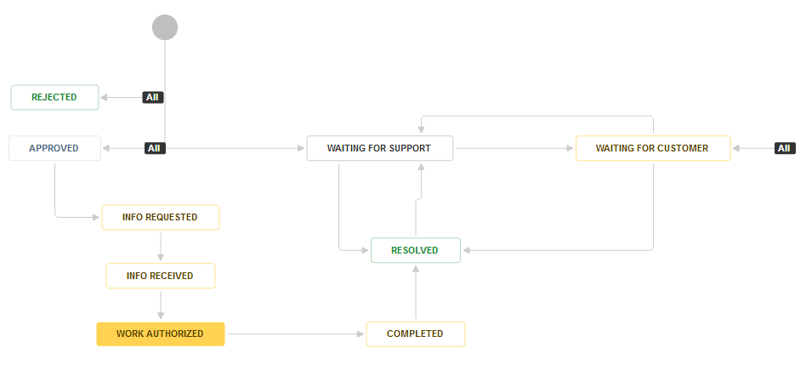
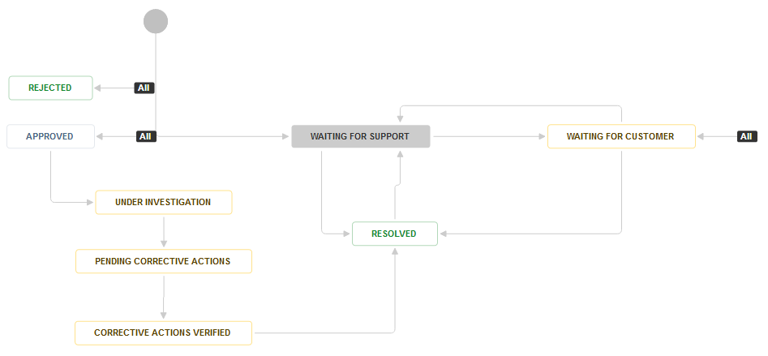
2. TOOL DESCRIPTION
(JIRA Service Desk)
Example of workflows:
EXTERNAL COMPANY AUTHORIZATION
ACCIDENT INFORMATION AND INVESTIGATION

Slide 14
2. TOOL DESCRIPTION
(JIRA Service Desk)
Advantages:
  Traceability
  Time saving (once implemented).
  Easy to use
Improvement opportunity:
  Only available for ALBA staff, no external companies.

Slide 15
2. TOOL DESCRIPTION
(JIRA Software)
JIRA Software allows you:
  To plan: create user issues, plan sprints, and distribute tasks across the software
  To track: prioritize and discuss the team's work in full context with complete visibility.
  To report: improve team performance based on real-time, visual data you can use.
  To be connected with JIRA SERVICE DESK & CONFLUENCE

Slide 16
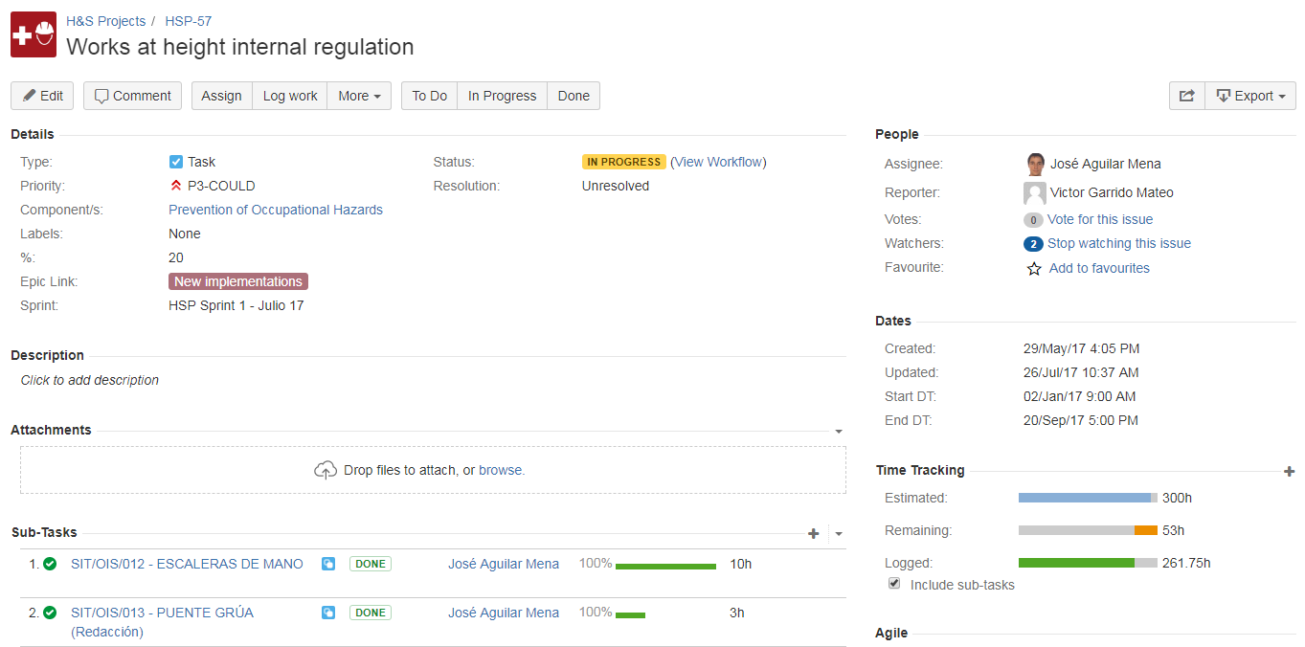
2. TOOL DESCRIPTION
(JIRA Software)
Example of Project:

Slide 17
2. TOOL DESCRIPTION
(JIRA Software)
Advantages:
  Traceability
  Time saving (once implemented).
  Easy to use

Slide 18






3. ACKNOWLEGMENT
MIS (Management Information System) section staff:
Malysa Martin
Daniel Salvat
Alfonso Burgos
Rafa Cazorla
Isidre
Costa
Toni Fernández
All staff

Slide 19
4. IMPROVEMENTS
Working methods are written and shared
Better coordination between different departments
An agile project management
Probabilities of having an accident due to lack of information are reduced

Slide 20
ANY QUESTION?
THANK YOU

