Slide 2
Conformity approach for Pressure Equipment for the High Luminosity LHC Project
Simon Marsh, Carlos Arregui

Slide 3
CERN Mechanical Safety Rules
In accordance with its intergovernmental status, CERN establishes and updates Safety Rules to implement its Safety Policy
In the June 2015 refresh of the CERN mechanical safety rules, General Safety Instructions GSI-M-2 Standard Pressure Equipment and GSI-M-4 Cryogenic Equipment came into force, together with a number of associated Specific Safety Instructions
Available on the CERN Safety Rules website: www.cern.ch/safety-rules

Slide 4
CERN Mechanical Safety Rules
Defines the minimum safety requirements related to the life cycle of pressure equipment
  Cradle to grave approach for pressure equipment integrity management
Valid for all new equipment and equipment brought onto the CERN site from elsewhere
Defines and requires an equipment “Safety File”
Aligned, as far as possible, to existing standards

Slide 5
CERN Mechanical Safety Rules
Design, manufacture and procurement
  Primarily based on European Directives for pressure equipment and transportable pressure equipment
  Use of harmonised European standards
    Use of other technical standards is subject to approval by HSE Unit
  CE marking
  Declaration of conformity
  Factory acceptance tests, where applicable
  Instruction manual

Slide 6
Pressure Equipment Directive (PED) 2014/68/EU – Annex I
Essential Safety Requirements - pressure equipment must be:
And they qualitatively cover:
As to ensure its safety when
Designed
Manufactured
Verified
Equipped and installed (if applicable)
Put into service as per manufacturer’s instructions
Other foreseeable conditions (including potential misuse)
Design
Calculation/experimental method
Provisions for safe handling/operation
Manufacturing
WPS and welding personnel to be approved by NoBo or recognised third party
NDT
Materials
Appropriate properties
Covered by EN, EAM or PMA
Adequate strength
Appropriate Safety factors
Safety accessories against overpressure
Operating instructions
Compulsory declaration from material supplier affirming compliance with a specification.
Traceability of material from receipt of material through final testing
Final proof test (normally hydrostatic, other tests allowed with additional measures, such as NDT)

Slide 7
Pressure Equipment Directive (PED)
Conformity assessment
  Conformity assessment modules: Higher the category, more demanding the requirements (increase of supervision from Notified body over the whole fabrication process).
Notified bodies
  Organisations appointed by EU states to assess conformity of a product to the ESRs before being put in the market.
  Categories II-IV require conformity to be assessed by external independent Notified bodies.
CE marking
  Affixed to equipment by the manufacturer.
  Statement that the equipment meets requirements of all relevant Directives – Declaration of conformity.
  Permitted only after Notified body attests full conformity to the Directive(s), when the Notified body involvement is required.

Slide 8
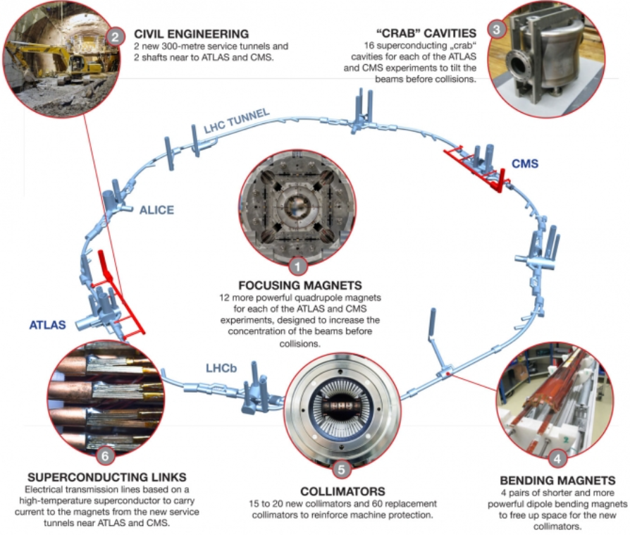
From LHC to HL-LHC

Slide 9
Application of CERN Mechanical Safety Rules – High Luminosity LHC Project
Baseline approach for pressure equipment
  Design, manufacturing and testing as per EN harmonised standards
  Compliance with Pressure Equipment Directive (PED) 2014/68/EU
  CE marking

Slide 10
Application of CERN Mechanical Safety Rules – High Luminosity LHC Project
Exceptions to the baseline approach:
  Equipment that does not readily fit into the context of European harmonised standards (e.g. due to equipment type, materials, area of application, etc.)
  Only allowed at the discretion of the HSE Unit, preceded by a formal documented request by the Project
  Foreseen by the rules – defines equipment as liable to have ‘major Safety implications’
  mSi equipment requires Safety clearance from the HSE Unit
  HSE Unit defines the Safety requirements that need to be met for the Safety clearance
  HSE Unit performs the conformity assessment, for all equipment categories

Slide 11
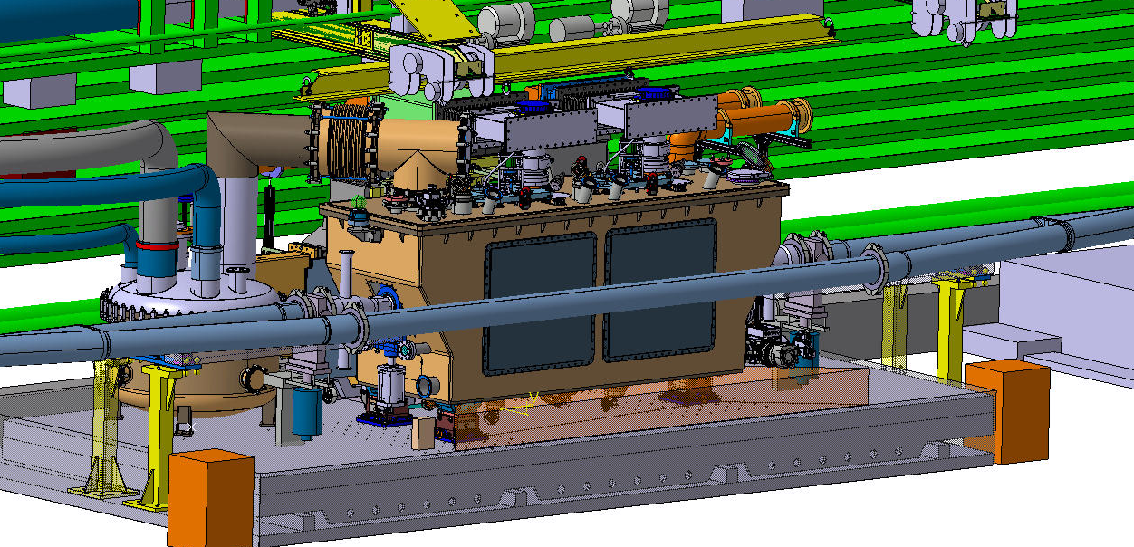
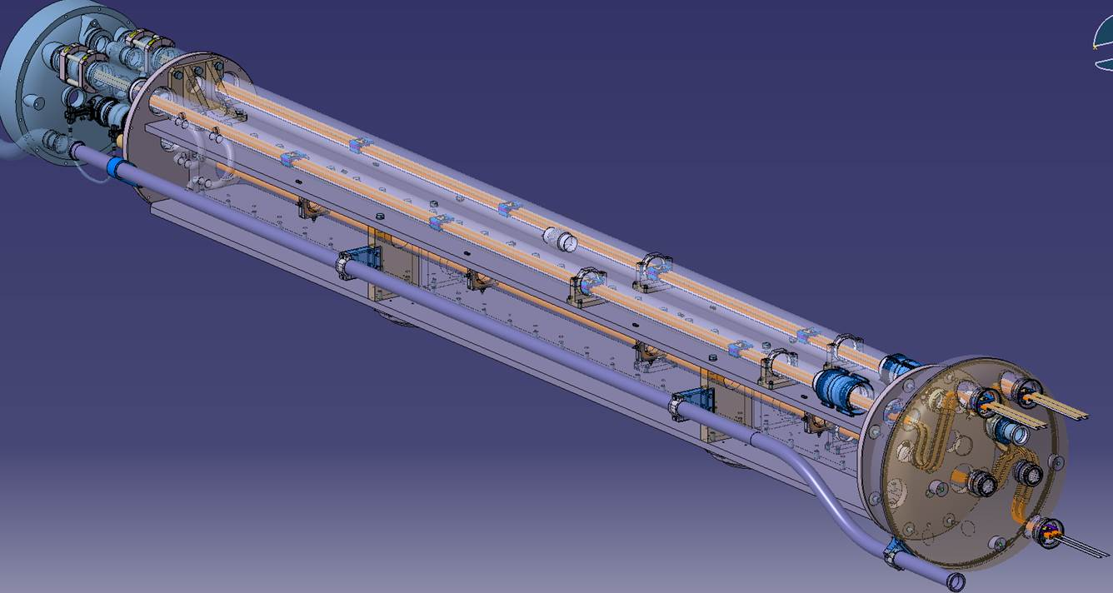
Examples

Slide 12
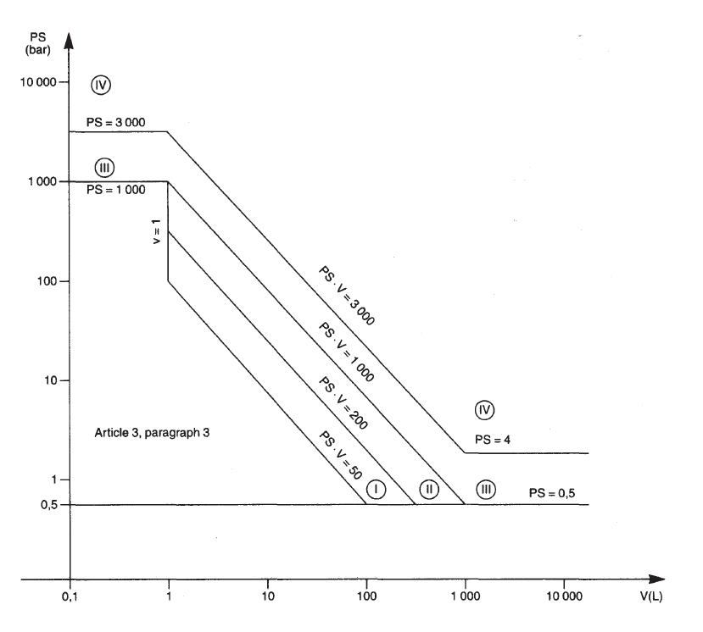
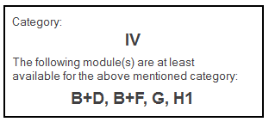
Examples – 11T cold mass
Annex II Table 2
PS = 20 bar
V = 183 L
PS V = 3630 bar L > 3000 bar L
Article 4, Paragraph 3

Slide 13
Conformity assessment by HSE
Requirements for HSE Safety clearance:
  Full compliance with the applicable Essential Safety Requirements (ESRs) in the PED
  Use of harmonised European standards wherever applicable (presumption of conformity) for design, manufacturing and testing, e.g.
    EN 13445 – Unfired pressure vessels;
    EN 13458 – Cryogenic vessels – static vacuum-insulated vessels;
    EN 10028 – Flat products made of steels for pressure purposes;
    …
  Other (inter)national standards may be used provided compliance with the ESRs is fully demonstrated
  Eventual non-compliances to be assessed individually. The Project shall propose compensatory measures to ensure a commensurate level of Safety
  Assessment of conformity to the ESRs is carried out by the HSE Unit acting as an ‘independent’ party

Slide 14
Conformity assessment by HSE
Design examination
  HSE Unit will validate the design of the equipment prior to the commencement of fabrication
  Manufacturer must produce technical documentation as to enable an assessment of the conformity of the equipment with the ESRs
Production quality assurance
  HSE Unit and Project to agree on the Inspection and Test Plan, including Safety-relevant Hold Points
  Manufacturer to provide quality records for the manufacturing part of the QA system, such as inspection reports and test data, qualifications of personnel concerned, etc.
  Documentation to ensure full traceability of components and processes

Slide 15
Conformity assessment by HSE
Provided Safety requirements are met and Safety clearance is achieved, CE marking is not compulsory as per the Safety Rules
HSE acts as de facto Notified body
  Involvement of external Notified body not required
Safety accessories (e.g. relief valves, rupture discs) have to be, however, fully compliant with the Pressure Equipment Directive and harmonised standards

Slide 16
Current status
Project has made a formal request to follow the ‘Exceptions to the baseline approach’ for 21 superconducting magnet and connection cryostat variants (concerning 191 pieces of equipment, including spares)
Currently following same approach for the Crab Cavity prototype test facility, so expectation is that this will be requested for the series production

