Slide 2
Safety Diagnosis approach
Simon Cherault
CERN

Slide 3
Agenda:
The CERN Engineering department
The Safety Office in the Engineering department
The edition of safety files for beam facility projects
The diagnosis approach prior to the safety file edition
Explanation of the diagnosis method:
    1.System breakdown structure
  2.System rating (Occurrence, Potential Severity, Level of control)
  3.Recommendations
Conclusion
Going further
EN Safety Office

Slide 4
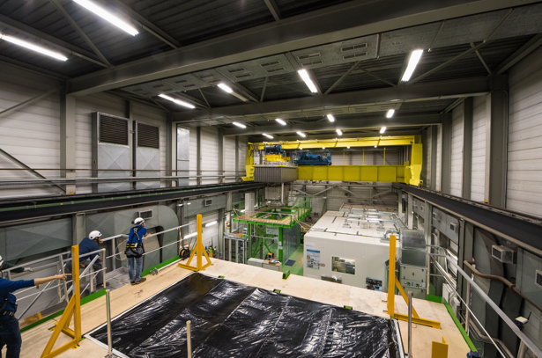
The CERN Engineering department:
Technical stop coordination
Technical coordination of beam facilities
Project management
Mechanical engineering
Mechanical systems for beam devices
Metrology of the accelerators
Handling system
Electrical systems
Cooling and ventilation system

Slide 5
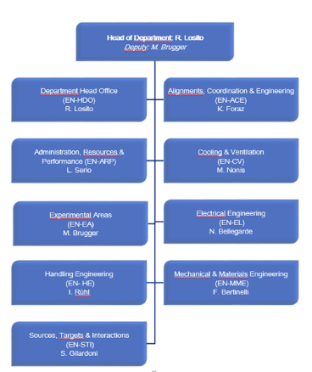
The CERN Engineering department:
EN Safety office :
Departmental Safety Officer (DSO)
Deputy departmental safety officer
3 Assistant DSOs

Slide 6

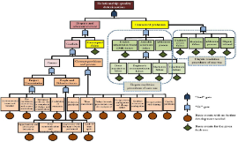

The safety office in the Engineering department:
Edition of safety files for beam facilities
Analyze Accident/Incident
Avoid black holes

Slide 7
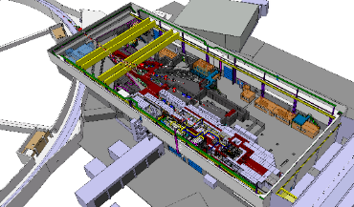
The edition of Safety file for beam facilities:
facility renovation
v_2.0
Monitoring
of events
facility consolidated
v_1.1
Monitoring
of events
Diagnosis
Safety file content :
Description of each system
Demonstration that each system is safe to operate
Safety procedure of each system
Recording and monitoring of system’s lifecycle (accident, incident, near miss, safety inspection report)
new facility
v_1.0
Diagnosis

Slide 8
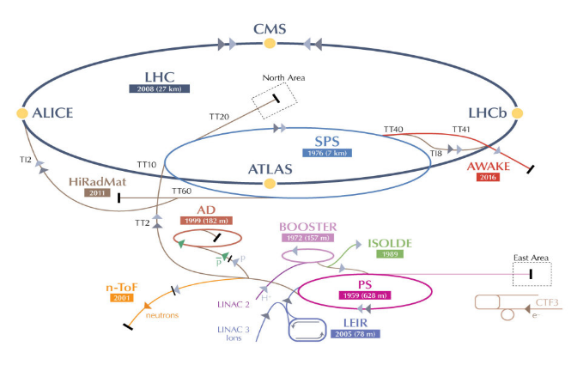

The edition of Safety file for beam facilities:
Renovation Project
?
?
?
?
New Project
Consolidation Project

Slide 9

The Diagnosis approach prior to the safety file edition:
Perform a diagnosis in line with the project life cycle:
Focused on:
Safety aspect;
Environmental aspect.
Based on the monitoring of events (near miss, incident, accident)

Slide 10
Overview of the Diagnosis approach :
The diagnosis is an analysis of the events that occurred (or not) during the last 5 years on a given system, combined with the potential severity of an event on personnel or the environment, and the current level of safety management control.
1) System /process breakdown
It is the list of each system which composed the beam facility, for each system we are performing a diagnosis
2) Rating of the system / process
Safety rating: Result of occurrence x severity x level of control
Environmental rating: Result of the multiplication occurrence x severity x level of control
3) Recommendations
Action plan proposed to the project team

Slide 11
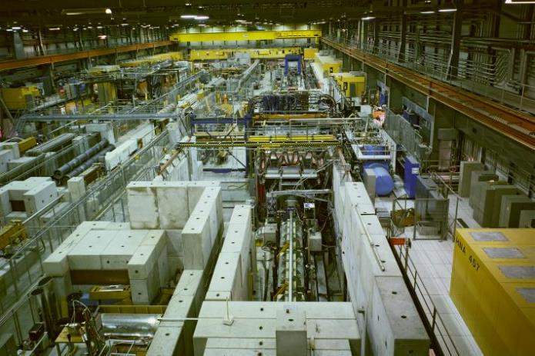
System/process breakdown
Beam monitoring
Vacuum system
Magnet
Power converter
Beam stopper (EIS)
Target
Cryogenic system
Shielding
Access system
Structure
Circulation process
Storage areas
Workshop area
Control room
Load transport
Electrical network
Gas distribution
Compressed air
Water cooling system
Ventilation system
Fire safety system
Maintenance activities
Operation activities

Slide 12
2) Rating of the system / process. EN safety office scale.
Occurrence scale :
Score | Safety or Environment events
1 | Nothing the last 5 years
3 | 1 - 5 events last 5 years
5 | More than 5 events the last 5 years
Example:
Gas distribution system
A CO2 leak in the north area in 2017
An unexpected rupture of a safety valve in 2016
Occurrence score (3) for both Safety and Environment aspect

Slide 13





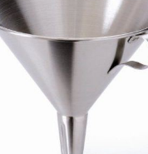
Analysis of the events (near miss, incident, accident) and find the root causes
Difficulties to collect all the data reporting process
Necessity to understand the root causes for each event

Slide 14
2) Rating of the system / process
Reasonable maximum Severity scale
Score | Safety | Environment
1 | Slight injury < 10 000 $ damages No lost of operation time | Minor impact Reversible impact (short term), local (CERN fences) area impact, small quantity
5 | Injury with days off 10 000 $ <damages< 100 000 $ Lost operation time (in hours) | Major impact Reversible impact (mid term), regional area impact, medium quantity, low toxicity
10 | Work disability or fatality >100 000 $ damages Lost operation time (in days) | Serious impact Irreversible impact, National area impact, big quantity released, high toxicity
Example:
Gas distribution system
Work disability – Fatality is possible (ODH)
- Gas such as SF6, CH4, C2H6, C4H10, SF6, CF4 –R14, R134 A are present
Severity score for Safety aspect: (5) Severity score for Environment aspect: (5)

Slide 15
2) Rating of the system / process
Level of control scale
Score
1 | Continuous improvement of the management system.
3 | A management system is in place but still have to be improved.
5 | Non-compliant with the applicable safety rules.
Example:
Gas distribution system
Level of control for both Safety and Environment aspect : (3)

Slide 16
2) Rating of the system / process
Safety score
=
Occurrence x Severity x Level of control
250
Hazardous area
Environmental score
=
Occurrence x Severity x Level of control
Example:
Gas distribution system
Safety score (90)
Environment score (45)
Safe area
1

Slide 17
2) Rating of the system / process
RANDOM values

Slide 18
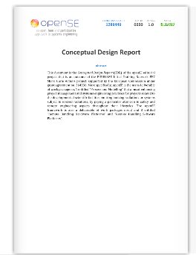
3) Recommendations
With the system process/owner:
Solution 1:_____________
Solution 2:_____________
Solution 3:_____________
Example:
Gas distribution system
ATEX conformity of the barracks
Setting up a alarm system on the gas consumption
Install flow sensors on each line.

Slide 19

Conclusion :
Diagnosis based on the Records, Experience and Monitoring of the events
Help to understand the systems and the processes “hazardousness”
Baseline for the safety management of the project
Help to make recommendation and priorities
Indicators allow to monitor the improvement
Give an overview of the current situation
Baseline for the safety file edition

Slide 20

Going further :
Sharing the lessons learned on system failures
Systematically understand the root causes
Harmonization of the indicators
Ease the data collection

Slide 21


