Slide 1
Improvement of emergency evacuation from underground at RIBF accelerator facility
RIKEN Nishina Center for accelerator based science
Safety management group
Kanenobu Tanaka

Slide 2
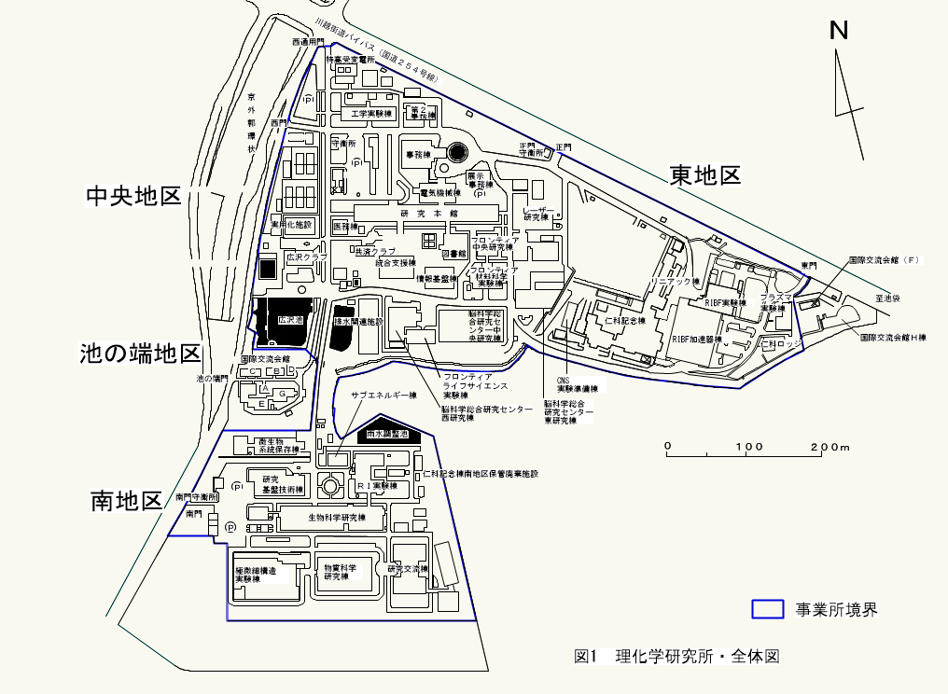
RI beam factory(RIBF) in RIKEN institute
RIKEN is Japan’s largest comprehensive research institution founded in 1917 in TOKYO for high-quality research in a wide range of science.
RIBF is cyclotron facility at east area of RIKEN institute
Heavy ion beam: H ~ ²³⁸U 350 MeV/u
Goal intensity :1 particle μA (6x10¹²pps, 80kW in ²³⁸U beam)
In Emergency, we collect to evacuation space of large parking area
Old and new buildings are mixed.
It make problem (later).
RIKEN
RIBF

Slide 3
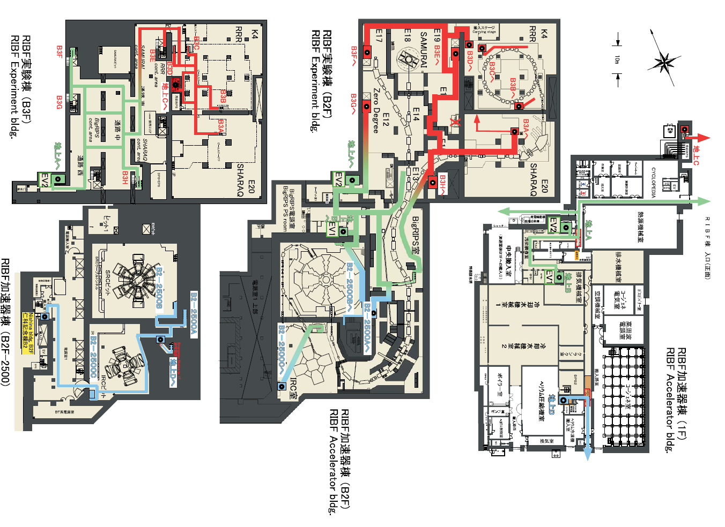
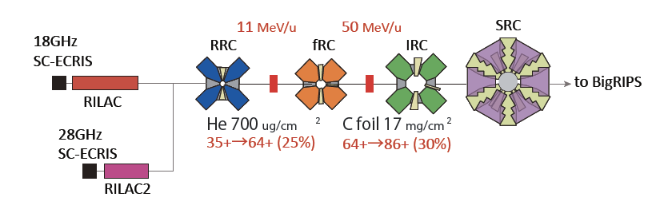
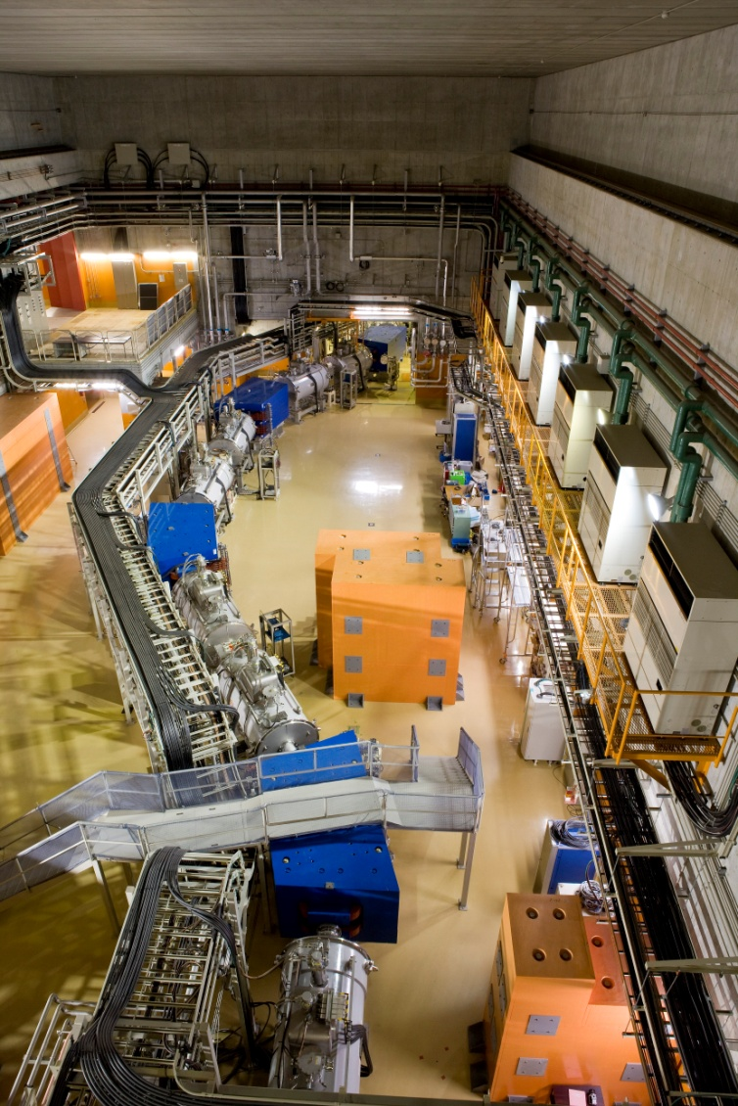
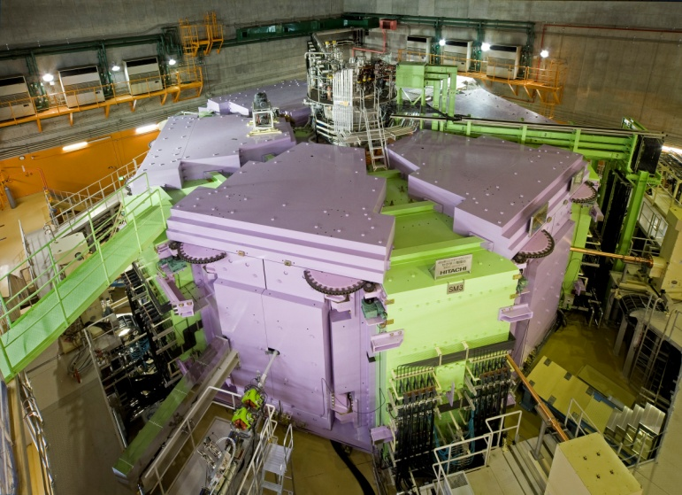
Escape route from underground area
Above ground: 1-4F
Underground: B1-B3F, 20m depth
Complicated structure as maze !
Emergency stairs to ground
SRC(superconducting ring cyclotron)
BigRIPS（RIken projectile
fragment(=RI beam) separator）

Slide 4
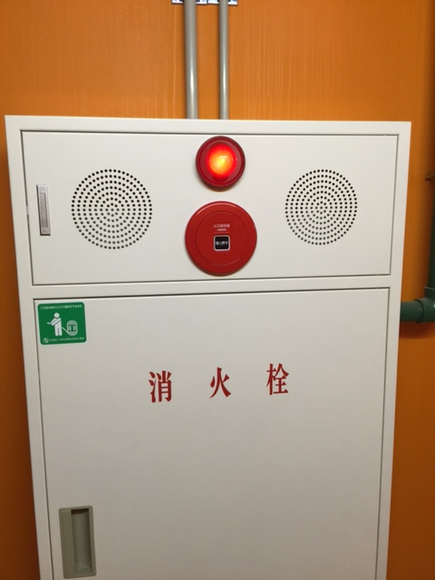
9th Nov.2015 Fire alarm activated incorrectly
9th/Nov./2015 Fire alarm near the SRC faraday Cup activated. Software error by radiation? All staffs should escape but it was not succeeded.
Was emergency warning not announced !?
Staff A：No emergency warning was announced!
Staff B：It was heard.
Different announced message with usual fire drill
(usual: Check the status! / that case: Fire! Escape!)
Many people were not escaped ! <- fire announcement was not enough
Who could escape !? How dose we take a roll call?? <- Management was not enough
Some staffs told that they must enter underground to operate equipment safely !!(high voltage elec., high pressure helium gas for superconducting system)
Error alert!? Real fire!?? (How to confirm error alert)
Alarm button
Hydrant box
Point at issue
1, Deep understanding for fire alert system
2, Improvement of alert process in an emergency
3, Improvement of self-fire brigade
a, optimization of personnel assignment
b, establish of “equipment unit” in self-fire brigade

Slide 5
1, Deep understanding for fire alert system

Slide 6
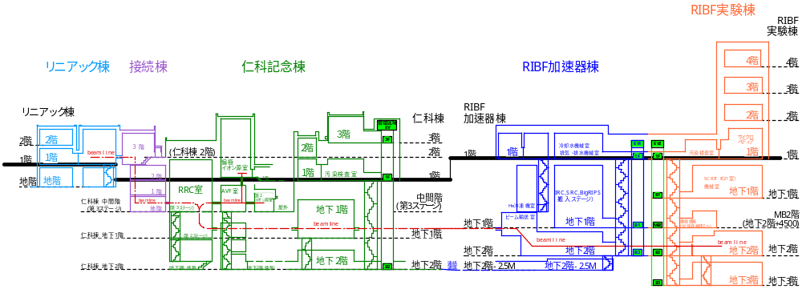
Structure of RIBF buildings and evacuation policy
Above ground：office of researcher and secretary Separated to four building
Underground ：Rad. Cont. area contain accelerators, exp. room etc. Connected each other
Emergency broadcasting protocol is ruled by fire protection law in Japan for large facility.
(Major target: large commercial building, department store, hotel, station etc.)
Fire law rule: emergency announcement should be given only to a building of fire.
RIBF case: office and exp. rooms are mixed. No one know where and when a staff exist.
->All of RIBF staffs evacuate and take a roll call !
No time difference of the emergency announcement is expected to smooth evacuation.
RIBF exp. build.
4F
3F
2F
1F
Linac build.
Nishina build.
RIBF acc. build.
2F
1F
3F
2F
1F
B1F
B1F
B2F
B1F
B2F
B1F
B2F
B3F
Old build.
New build.
Side cross-sectional view of RIBF buildings

Slide 7
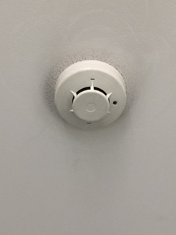
Phase 1 : fire alarm detector activation (smoke detection)
Smoke detector
Fire alarm activate ->Emergency broadcasting system start-up automatically.
Phase1:smoke detect, automatic announce only to the fire floor/+1 F/ emergency stairs, “Fire alarm activated on ○○ floor. Check the status there”
・General announcement system is inhibited.
Message and area of announcement are ruled by the fire protection law.
Fire floor (RIBF build. underground)
+1 floor (RIBF build. 1F)
Emergency
stairs
RIBF exp. build.
RIBF acc. build.
Linac build.
Nishina build.
Emergency announcement area
Old build.
Side cross-sectional view of RIBF buildings
New build.

Slide 8
phase 2: “Fire decision“
(5min. later after smoke detection)
Smoke detector
Alarm button
On Hydrant box
if smoke detector was not reset for 5 min., or someone push a button of fire hydrant, the phase 1 change to “fire decision” mode
------------------------------------------------------
Phase2:“fire decision” mode, automatic announcement
only to fire F/+1 F/stair ”FIRE ! Fire at ○○ floor! Escape! “ It repeat continuously.
Fire floor (RIBF build. underground)
+1 floor (RIBF build. 1F)
Emergency stairs
RIBF exp. build.
RIBF acc. build.
Linac build.
Nishina build.
Emergency announcement area
Old build.
Side cross-sectional view of RIBF buildings
New build.

Slide 9
Phase 3: “All area announcement”
(additional 5 min. later after “Fire decision“ )
19th Sep. 2015, fire alert
error occur.
People in the area did not
evacuate!
Phase3: after 5 min. of “fire decision”, (=10 min. later of initial smoke detection) announcement area expand to all area ”fire at ○○ floor! Escape!”
The fire law request to announce to only to a building of fire, not to other buildings of RIBF.
Above ground: All 4 build. of RIBF were connected to emergency broadcast system.
Underground: Most of old build. were not connected to emergency sys.
Message and area of announcement are ruled by the fire protection law. It can not change!
But we don’t prefer this time difference.
Emergency announcement area
30 years old build.
Hole of emergency system. General broadcasting system exists, but Is inhibited by emergency sys.
No any announcement are there.
New build.

Slide 10
If fire alarm is activated in other old building?
Old and new facility mixed in RIKEN institute !!
In case of fire alarm (smoke detector) activated
②Central operation room of all RIKEN institute
announce by general broadcast system (recorded announcement).
Staff in other building receive fire information.
Old building of 30y ago, before the current fire law start
①No emergency broadcasting system.
Emergency bells ring inside this Nishina building only
Emergency broadcasting system does not start up in all RIBF buildings. = General broadcasting system can work
Old build.
Old build.
New build.

Slide 11
2, Improvement of alert process in an emergency

Slide 12
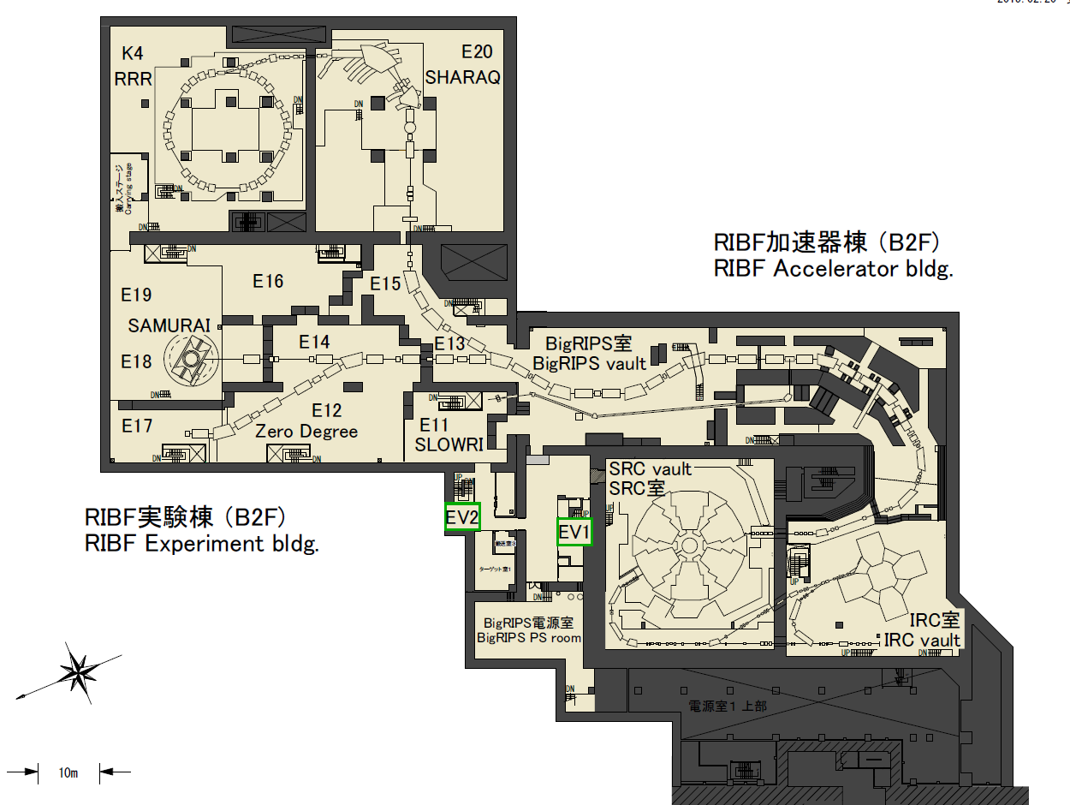
Manual announcement
B2F
Recorded program of announcement
“Fire at B2F! Escape!”
Where is fire in B2F??
But message is ruled by the fire law. No change allowed!
Additional manual announcement is given
from RIBF facility operation room, which have
fire information board and monitor camera.
“Fire at ○○room at B2F!”
Emergency stairs

Slide 13
Announce process at emergency
emergency announcement(ruled by fire law)
Improved (parallel process added)
Phase1, only the fire floor/+1 F/emergency stairs, announced automatically “Fire alarm activated on ○○ floor. Check the status”
Phase2, “fire decision” mode, automatic announcement only to fire F/+1 F/stair
”FIRE ! Fire at ○○ floor! Escape! “
Phase3, after 5 min. of “fire decision”, announcement area change to all area ”fire at ○○ floor! Evacuate!”
Given by RIBF facility operation room operator
It have fire control panel, emergency sys.
Manual announcement of emer. sys. can be given only from this room.
By the announcement to all build., all staffs have detail information of fire spot.
1, manual announce to all RIBF buildings
“fire at ○○ room. Escape ! ”
2, Check the fire by monitoring camera
Real fire：call public firehouse
No fire seen：wait, next step
Emergency
announcement is
already given to all area, staffs would be OK if the alarm stop
3, 12 min. after the initial fire alert
Reset the activated fire alarm, check to activate again.
If alarm is stable,
It maybe error alert.
It is useful to save
Equip. unit member (later)
Wait 3 min. If alert was error,
the alarm will keep stable
10 min time difference to all are for evacuation announcement
4, operator+equip. unit member(later) go to alert spot of underground to check error alert or not
No change allawed by fire law in Japan
Common process both for old and new buildings.
If operator have panic and mistake, auto-announcement by emergency broad. system work.

Slide 14
Fire drill and flaw chart of information
So far, fire drill have followed the same pattern every year!
“Fire occur in one room of all buildings, a person discover a fire”, unrealistic scenario.
Scenario was not optimized to correlate between fire brigade organization and emergency system
Problem:
1, In RIBF, “All member evacuate if other building have fire”, but it was not common sense by drills.
2, Announcement process by the emergency broadcasting system was not considered.
RIBF information flaw chart for fire
Practiced
Only this
pass
at fire drill
Fire occur
Discover person
Fire alarm system
Automatic emergency announcement
(general announcement become inactive)
Central observation room
RIBF facility operation room
General broadcasting system,
recorded program
Emergency broadcast system,
+Manual announcement

Slide 15
3, Improvement of self-fire brigade a, establish of “equip. unit” in self-fire brigade b, optimization of personnel assignment

Slide 16
3. Improvement of self-fire brigade
3-a, Equip. unit (new)
When fire alarm occur, they operate equipment for safety remotely as much as possible.
They are possible to approach underground to deal setups directly or to check error alert.
  For high voltage, high pressure helium gas for superconductivity, inflammable gas etc.
  Members are leader of each accelerator and experimental setups
  They collect to accel. operation room promptly at fire alert. (other workers escape to outside evacuation space)
3-b, Optimization of each unit member
  Consider their usual location of office and experimental room
  Clean up the overlap of task
  Check assignment every year

Slide 17
Process to approach underground to check fire alarm as safe as possible
RIBF facility operation room
Accelerator operation room
Equipment unit of self-fire brigade
1, fire control panel check
Announce by hand
to all build.
2, manual announce to all East area build.
“fire at ○○ room. Escape ! ”
1, When equip. unit member receive the alert announcement, they collect to acc. operation room
3, Check the fire by monitoring camera
Real fire：call public fire station
No fire seen：wait, next step
Information about fire alert
location, monitoring camera etc.
2, handle equipment around the fire alert spot
remotely.
4, 12 min. after the initial fire alert
Reset the activated fire alarm, check to repeat activation
Wait 3 min. If alert was error, the alarm will keep stable
A, No re-alert ->It would be error alert. Two people go underground to check status
B, Alert occur again->Real fire is possible. Wait 3 min. and check monitor camera to find fire light or smoke. If no fire sign find, error alert possible. -> case A
3, Unit leader assign from unit member to go underground to check
Operator and equip. unit member (2 people) go to underground
with permission by unit leader

Slide 18
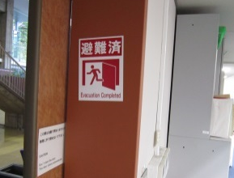
3-b, optimization of self-fire brigade member
Office and experimental room are other building
Lot of absent worker: day or night shift operation, work at other (foreign) facility, etc.
“Evacuation completed“ magnet on doors
Important：
”Evacuation unit” and
“Reporting unit”
  Evacuation unit：who usually stay office
  Reporting unit：who usually stay any room in RIBF area and can to evacuation spot
Evacuation unit
(each office floor)
evacuation information
of each floor
Reporting unit
(evacuation spot)
Correct and report information of
evacuation, roll call of each build.
Head

Slide 19
Summary for action against fire in RIBF
Design concept of emergency system for fire accident differ between old and new facility
At large facility, correlation of system and organization are important to act smoothly at emergency case.
Same scenario of fire drill every year is ineffective, easy to obsolete.
If task concentrate to a person and he busy, If a lot of cases assumed and complicated, it will not work(skipped in this slide).
Simple, common process is necessary.

Slide 20
Thank you

Slide 21
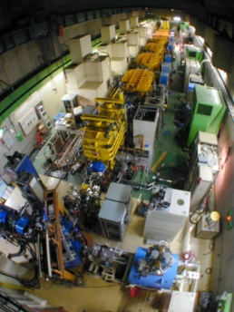
Radioactive Isotope Beam Factory(RIBF) in RIKEN Institute
Objects：Basic science (Nuclear phys., Nuclear astrophys., Nuclear chemistry, Radiobiology), RI production etc.
Accelerator: Superconducting Ring cyclotron (SRC)-> Most intense RI beam
Particle: Heavy Ion beam H, O, Ca, Zn, Xe, U etc.
Energy: ~350MeV/nucleon,
Goal intensity 1 particle μA (6x10¹²pps, 80kW in ²³⁸U beam)
BigRIPS（RIken projectile
fragment(=RI beam) separator）
(target/beam dump)
RILAC
SRC（superconducting ring cyclotron）
Old facility
(1981~)
New facility
(2006~)

Slide 22
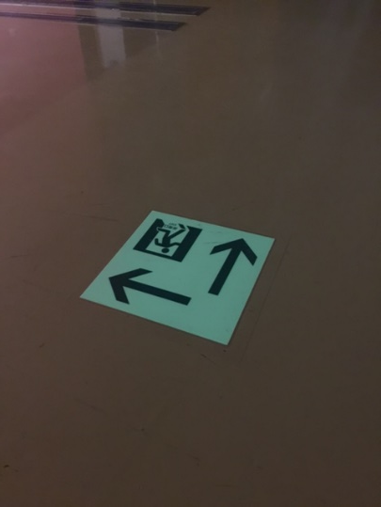
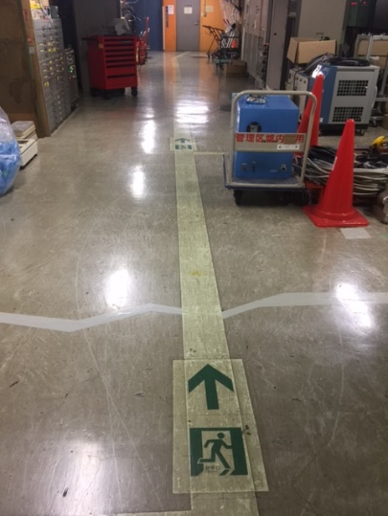
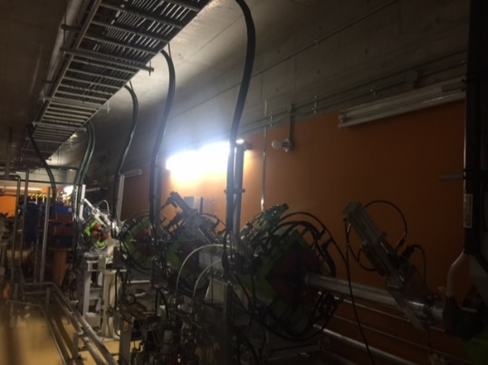
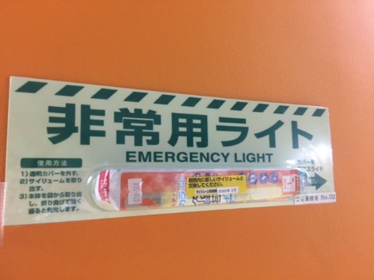
Escape route from underground area
On ground: 1-4F
Underground: B1-B3F, 20m depth
Complicated structure as maze !
Emergency stairs to ground
Fluorescent paint guide to emergency exit
electric outage ->
Emergency electric
lighting system
Fluorescent light

Slide 23
Fire emergency: self-fire brigade
(East area： Director of
Nishina center, RIBF)
Fire protection law in Japan request a self-fire brigade.
In emergency, staffs collect to the evacuate space and take a roll call. So far, we have performed fire drills every year.
Radiatcion cont. area :
Roll call by the list of intakes in Rad. Cont. system
Head
Evacuation
from Rad. Cont. area
Injured status
Radiation safety group
First aid unit
Reporting unit
通報連絡班長
Fire status
Roll call status
Evacuation status
Lab. supervisor
Fire fighting unit
“Evacuation completed“ magnet
Evacuation unit
All staffs: When they escape from a room and no one left,
they put the “Evacuation completed” magnet on the outside of the door
Evacuation unit: Check the magnets of all room of floor.
Evacuation magnet
check at each floor

Slide 24
Emergency broadcasting protocol is ruled by fire protection law in Japan for large facility.
(Major target: large commercial building, department store, hotel etc.)
Fire alarm activate (=smoke detection)->Emergency broadcasting system start-up automatically.
Phase1:smoke detect, automatic announce only to the fire floor/+1 F/ emergency stairs, “Fire alarm activated on ○○ floor. Check the status there”
・General announcement system is inhibited.
------------------------------------------------------
if smoke detector was not reset for 5 min., or someone push a button of fire hydrant, the phase 1 change to “fire decision” mode
------------------------------------------------------
Phase2:“fire decision” mode, automatic announcement
only to fire F/+1 F/stair ”FIRE ! Fire at ○○ floor! Escape! “ It repeat continuously.
Phase3: after 5 min. of “fire decision”, announcement area change to all area ”fire at ○○ floor! Escape!”
Smoke detector
Alarm button
Usual announcement
at fire drill every year
Hydrant box
Different announcement
9th Sep. 2015 ：started from here by software error of fire hydrant button.
It is alarm button, someone discover fire -> “fire decision mode”
Message and area of announcement are ruled by the fire protection law. It can not change!
But we don’t prefer this time difference.

Slide 25
Improvement of emergency broadcasting system
Fire occur
Discover person
Fire alarm system
Automatic emergency announcement
(general announcement inactive)
Fill in the hole of emergency broadcasting system
In emergency mode, announce manually
from control room of RIBF (later)
Central observation room
RIBF observation room
General broadcasting system,
recorded program
Emergency broadcast system,
Manual announcement
Emergency announcement area
Hole of emergency system, general broadcasting system exists.

