Slide 1

Pre-defined safety measures for helium leakages – theory meets reality
by Sven Mohr
DESY
Department Safety and Environmental Protection

Slide 2

structure
Experiences at DESY
Early planning XFEL
Iteration planning
Current situation

Slide 3
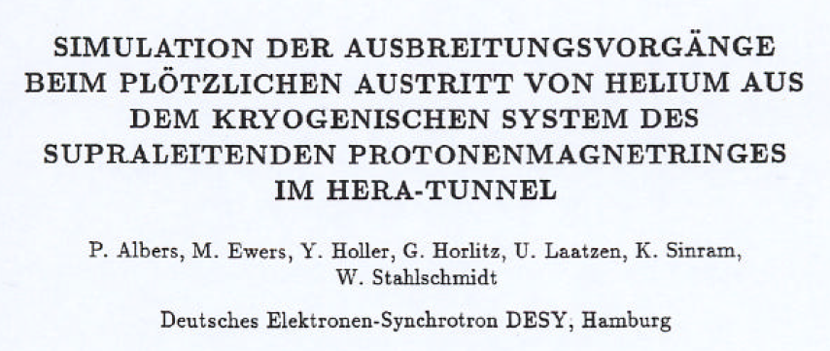
Experiences @DESY
Simulation of dispersion processes
2 tests 18.02.1989 (10:11:00)
2 x 500l (≈ 125 kg) liquid Helium in HERA tunnel (6.3km circumference, 5.2m diameter)
Assumptions for the critical case: 120kg in 10s
Hazards: suffocation caused by oxygen deficiency and frostbite
→ focus on safety (of people): technical/organizational measures? PPE?

Slide 4
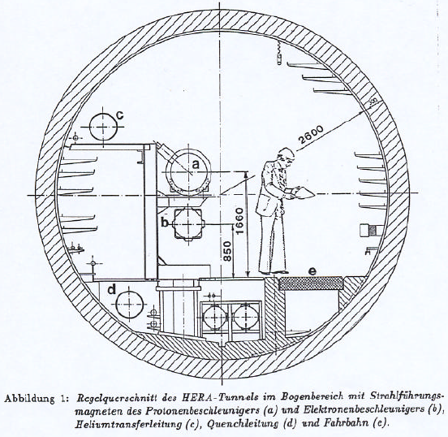
Experiences @DESY
Framework:
60 probes for temperature and oxygen level
Activated ventilation system
Test areas 20m/100m against and 100m/200m in the direction of ventilation path
Release in 2,5m/1m height

Slide 5
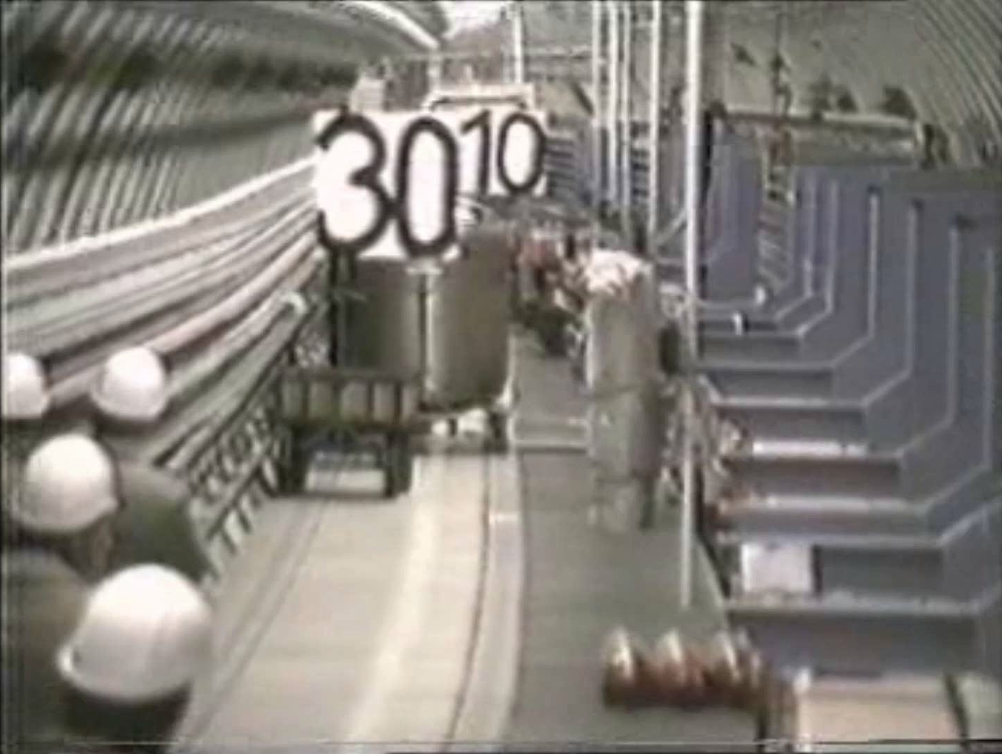
Experiences @DESY - Welcome to the 80ies!

Slide 6
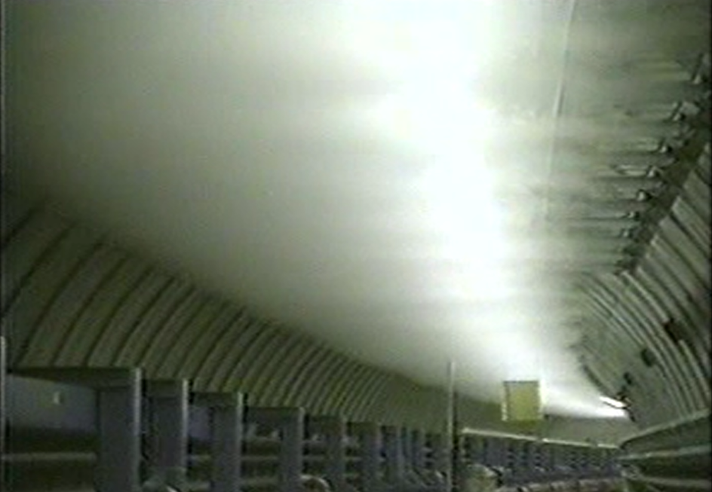
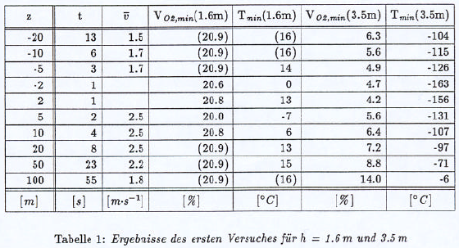
Experiences @DESY - results 1st test
Gas rises to ridge immediately
Almost no mixing with tunnel air
Fast spreading
Spreading against tunnel ventilation

Slide 7
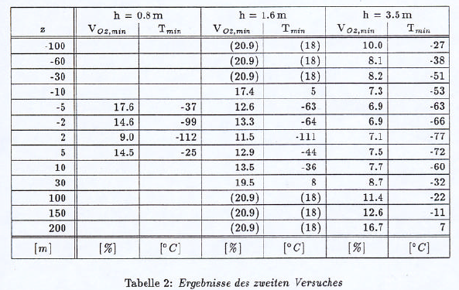
Experiences @DESY - results 2nd test
More mixing with tunnel air
Slower spreading (> tunnel ventilation)
→ cold temperatures > oxygen deficiency
→ no stationary oxygen level monitoring
→ no self-rescue devices

Slide 8
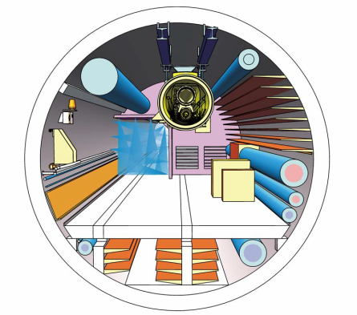
Early planning XFEL
Measures (as required in plan approval order)
Openings in fire compartment separations remain open
Helium release through shaft buildings
Activation of smoke extraction duct
Opening of nearest flaps
Performance level of smoke extraction system 23.000 m³/h (tunnel volume ≈ 46.000m³, ≈ 24.000m³ free of installations - editor´s note)
Source: STUVA safety expertise, 2005

Slide 9
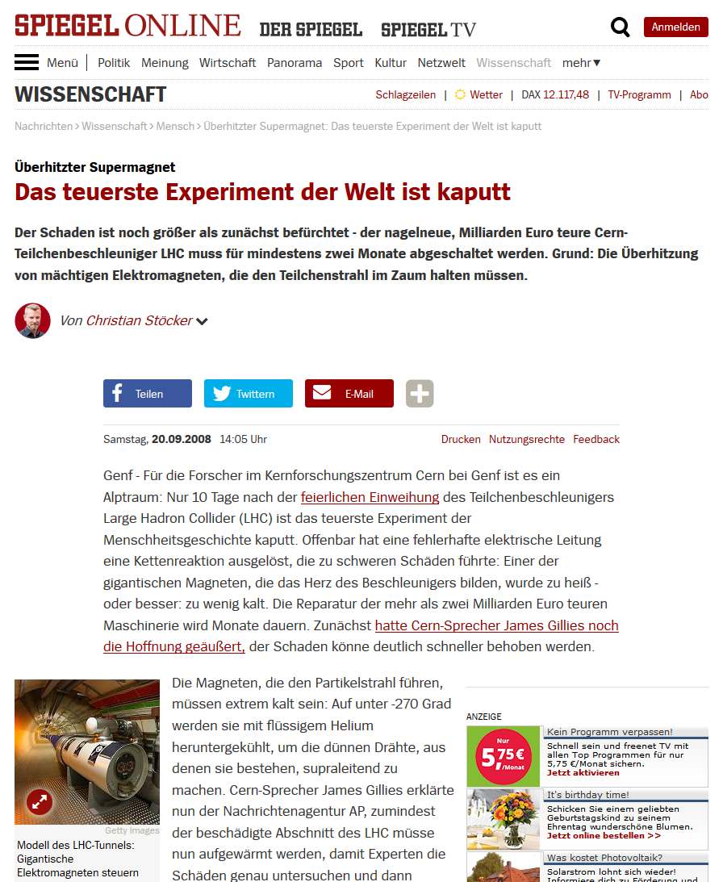
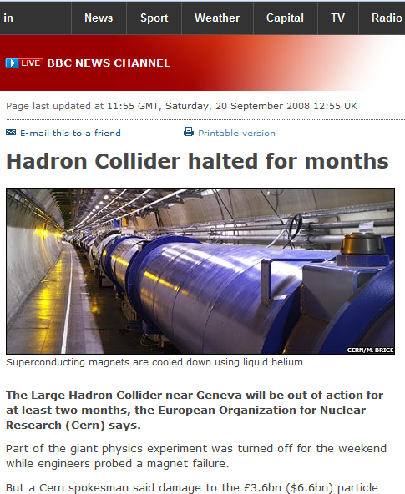
Early planning XFEL
Everything changed
Internal approaches reviewed
Legal requirements questioned
Alternative technical solutions to be found
→ additional focus on machine safety

Slide 10
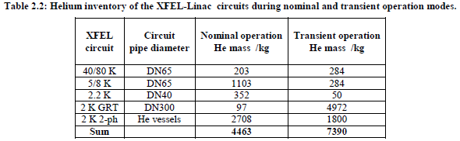
Early planning XFEL - open questions
Activation/reaction time of smoke extraction duct?
Flaps still operative in supercool range?
Can duct manage volume flow in worse/worst cases?
Can the main escape routes (staircases) be kept clear?
Source: Wroclaw University of Technology, Report on the risk analysis of the XFEL-Linac cryogenic system

Slide 11
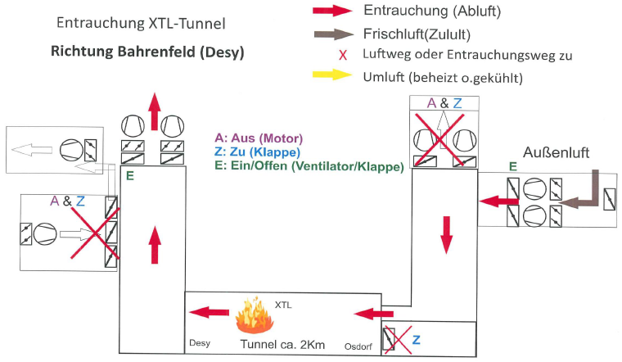
Iteration planning - existing infrastructure
Design changes in smoke extraction system:
Smoke extraction duct cancelled (→ maintenence, space)
As a result no flaps
Longitudinal smoke extraction through tunnel structure

Slide 12
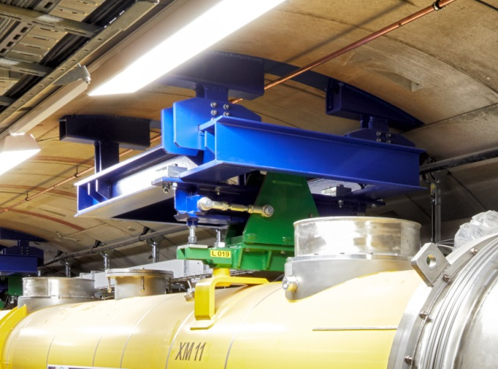
Iteration planning - existing infrastructure
Design changes in suspensions / cryo system:
Reinforced suspensions for cryo installations
Customized overpressure protection
Focus on cool down and warm up phases (bigger Helium mass in intermediate states)

Slide 13
Iteration planning
Measures:
Openings in fire compartment separations remain open
Helium release through shaft buildings
Activation of smoke extraction duct
Opening of nearest flaps
Performance level of smoke extraction system 23.000 m³/h
✓
✓
X
X
✓

Slide 14
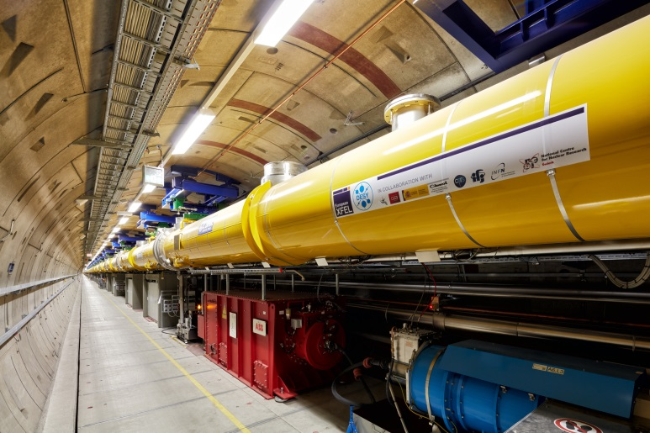
Current situation - temporary solution
Temporary solution needed for cool down and operating phases:
→ Safety measures for massive helium leakage by Fabian Saretzki

Slide 15
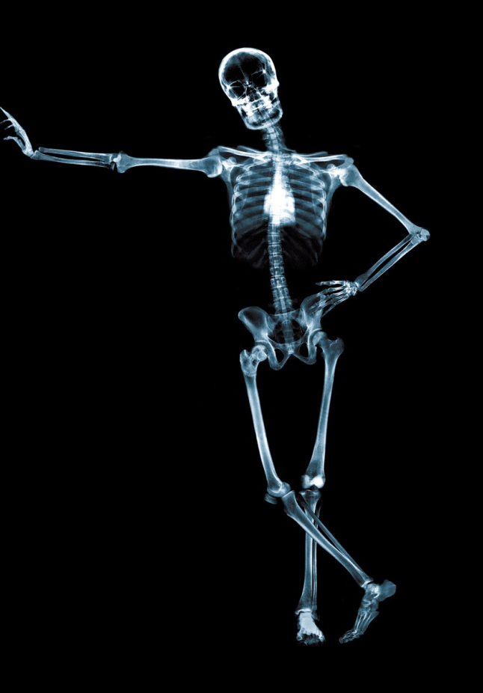
Sven Mohr
Coordination XFEL
Work package 36 - General Safety
Deutsches Elektronen-Synchrotron
D5 - Arbeitssicherheit/Umweltschutz
Notkestraße 85, Gebäude 35
22607 Hamburg
Tel.: +49 40 8998 - 4831
Fax.: +49 40 8998 - 4311
Mobil: +49 175 2619881
Mail: sven.mohr@desy.de

