Slide 1


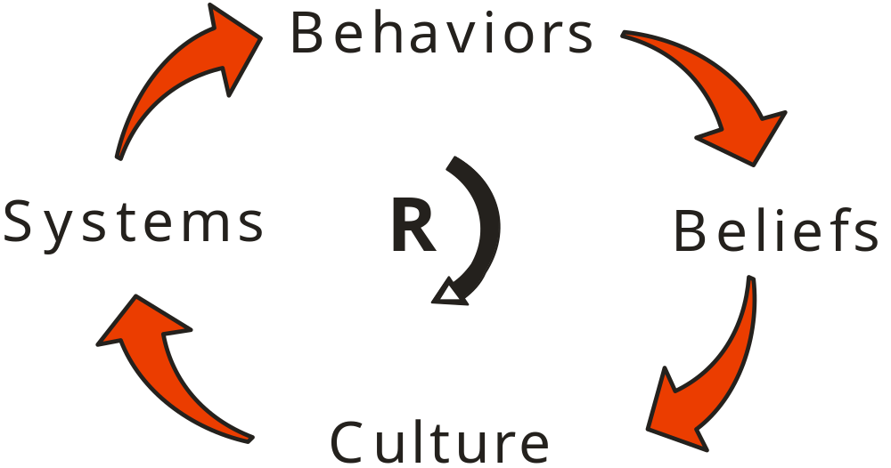
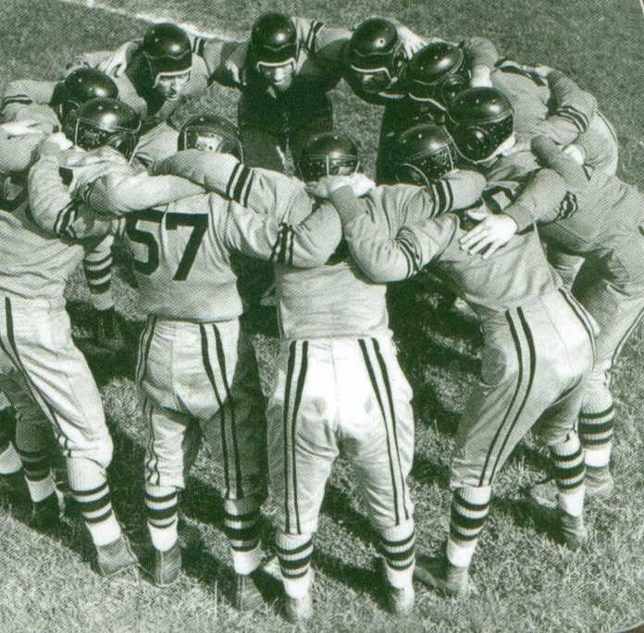

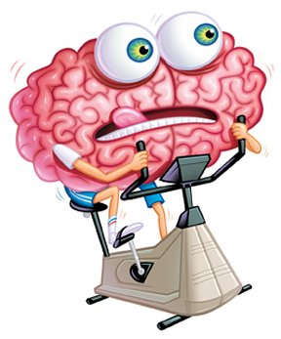
The Eight Factors of Effective Change
How to Prevent Failing Fixes
2017 International Technical Safety Forum – TRIUMF Labs
Afternoon Workshop
September 2017
Kevin McManus
Chief Excellence Officer
Great Systems
Practice-Based Training
ERROR PROOF
Walk Through
Walk Through
FLRA / Pre-Job
FLRA / Pre-Job
FLRA / Pre-Job
Task Specific JHA
Task Specific JHA
Task Specific JHA
Task Specific JHA
General JHA
General JHA
General JHA
General JHA
General JHA

Slide 2

A Need for More Effective Fixes
Health Affairs in April 2011 revealed that the standard methods hospitals use to detect medical errors fail over 90 percent of the time.
A five-year study of North Carolina hospitals, published in the New England Journal of Medicine in November 2010, showed that, in 25 percent of all admissions, the medical care harmed patients.
A 2010 government analysis found that 134,000 Medicare beneficiaries were suffering adverse events every month, many of which were "clearly or likely preventable."
Medical Errors Harm Huge Number of Patients, Huffington Post, August 2012
The September 2013 Journal of Patient Safety says that between 210,000 and 440,000 patients each year suffer some type of preventable harm that contributes to their death.
Medicare will track a hospital’s error rates and in 2014 will cut payment by 1 percent to hospitals with the highest rates of patient safety issues.

Slide 3


The Psychology of Failing Fixes
When we write a corrective action against a human error or equipment failure:
Human error or equipment failure
Weak people-focused fix
When we write a corrective action against a systemic root cause:
Human error or equipment failure
Systemic root causes of problem
Strong systems-focused fix

Slide 4
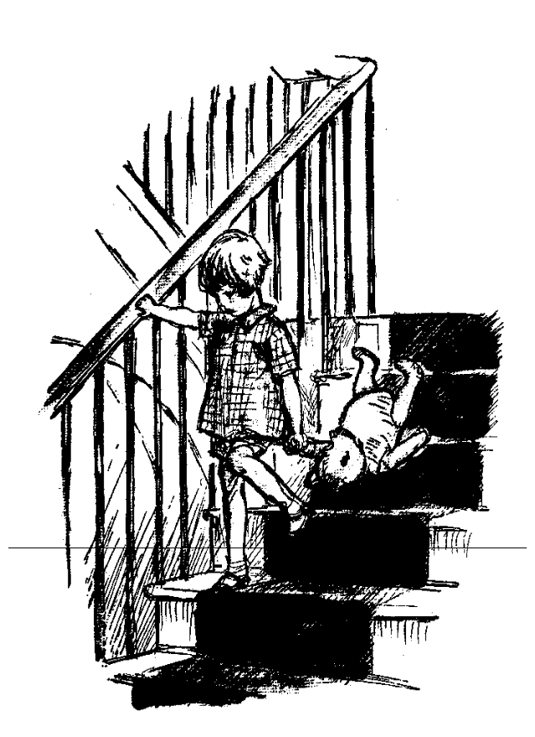
Too Busy to Change?
Here is Edward Bear,
coming downstairs now,
bump _{bump} _{bump}
on the back of his head, behind Christopher Robin.
It is, as far as he knows, the only way of coming down stairs, but sometimes he feels that there really is another way, if only he could stop bumping for a moment and think of it.

Slide 5

Improving Processes in Healthcare
Factors that constrain process improvement results in healthcare:
Patient care is much more important than process care
Fear / blame culture makes error reporting and process analysis tough
Authoritarian leaders resist big system changes
Outcome measure focus overwhelms a process measure focus
Non-clinical processes and people are not involved enough
Factors that contribute to process improvement success in healthcare:
Increasing implementation of EMRs and CPOE
Use of bar codes and RFID to track meds and patients
Great examples of success exist for benchmarking
Need for work system designs that support error-free performance

Slide 6
Thirty+ Years of Personal Learning
The Power of Diversity
Steris Isomedix Experiment
Fill In Supervisor
Annual Planning Process
Challenge of the Time Hump
Leadership Index Use
Leadership Development Process
It Really Works!
Error Proof
Standard Costing
Project Teams Done Right
OIP
Toys
Pens
Roofing
Candy Bars
Trucking
Syrup
TapRooT®
1980
2000
2017
1990
Pay for Ideas
23 Different Cultures
Systems Shape Culture
Insulation and Personal Change
Capital Justification
Balanced Scorecards
Great RCA!
My First Quality Circle
Self Directed Work Teams
Open Book Management
Daily Error and Defect Tracking
On the Side
MBA
Team Excellence Judge
National Baldrige Examiner

Slide 7
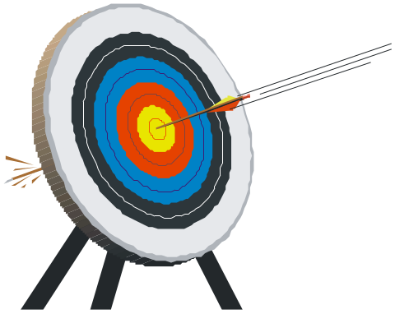
Potential Learning Opportunities
In this session, you will learn how to:
Explore the factors that required for, and drive, true human behavior change
Look at examples of mistake proofing applications
Gauge the manner in which you personally use, or don’t use, effective safeguards to minimize process errors
Better define potential fix impact and the types of fixes needed
Improve the quality and effectiveness of the corrective actions you develop
How error free would you like to be?

Slide 8


My Error Proof Motivations
People are being held accountable to unrealistic goals
The need for continuous improvement is getting lost
I don’t like wasting time or processing rework
I want better service and products as a customer
Shifts from reactive to proactive work cultures are needed
What value do you see in becoming error proof?

Slide 9
How Much Risk Can We Accept?
RISK ASSESSMENT MATRIX
 | Consequence / Severity
Likelihood | Negligible | Marginal | Major | Critical | Catastrophic
Frequent | 5 | 10 | 15 | 20 | 25
Occasional | 4 | 8 | 12 | 16 | 20
Seldom | 3 | 6 | 9 | 12 | 15
Remote | 2 | 4 | 6 | 8 | 10
Unlikely | 1 | 2 | 3 | 4 | 5
Does Your Potential Fix Impact equal the POTENTIAL Severity of the problem?

Slide 10
Is 99% Good Enough?
2 unsafe landings at O’Hare Airport each day
How often can you go a day without a defect?
16,000 lost pieces of mail per hour
20,000 incorrect drug prescriptions per year
50 newborn babies dropped at birth each day
32,000 missed heartbeats per person each year
2 million books in the next year will have the wrong cover
900,000 credit cards will have the wrong information

Slide 11
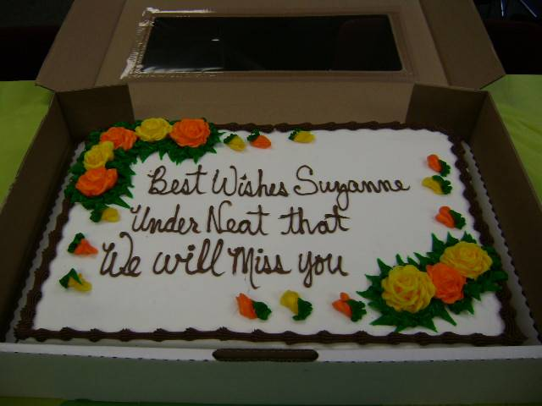
What is the Root Cause?

Slide 12
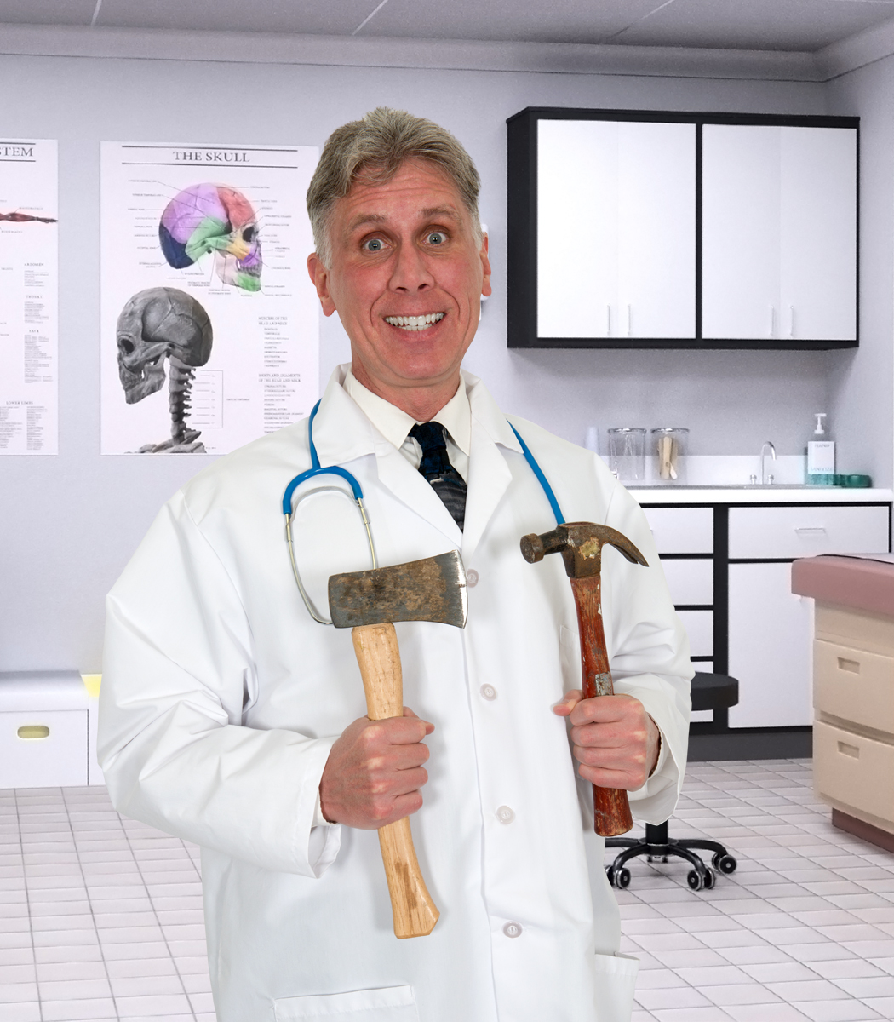

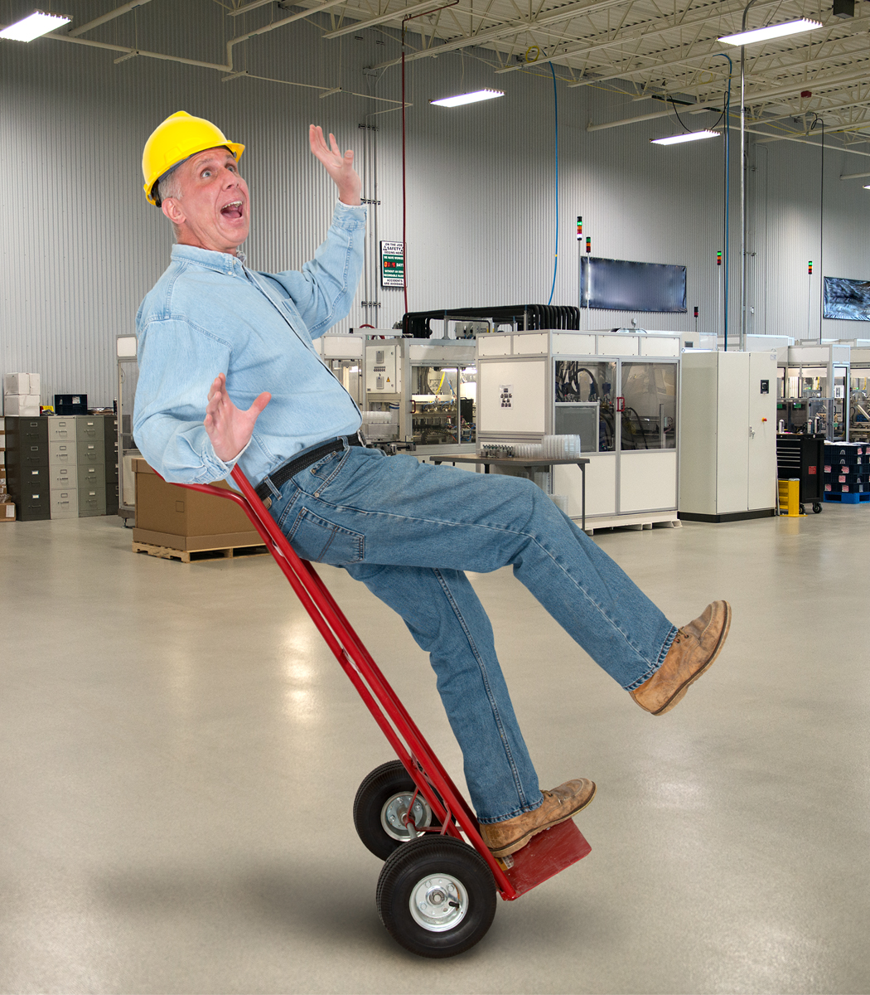
A Key Improvement Thought
If leaders knew the cost of the errors that occur EACH DAY …
They would be making VERY DIFFERENT decisions

Slide 13
Test Yourself!
How Many F’s Do You Count?
Count the total number of F’s in the paragraph
Finished files are the result of years of scientific study combined with the experience of years
Now count the total number of F’s in this paragraph
THE NECESSITY OF TRAINING HANDS FOR FIRST-CLASS FARMS IN
THE FATHERLY HANDLING OF FRIENDLY FARM LIVESTOCK IS
FOREMOST IN THE MINDS OF FARM OWNERS. SINCE THE
FOREFATHERS OF THE FARM OWNERS TRAINED THE
FARM HANDS FOR THE FIRST-CLASS FARMS

Slide 14
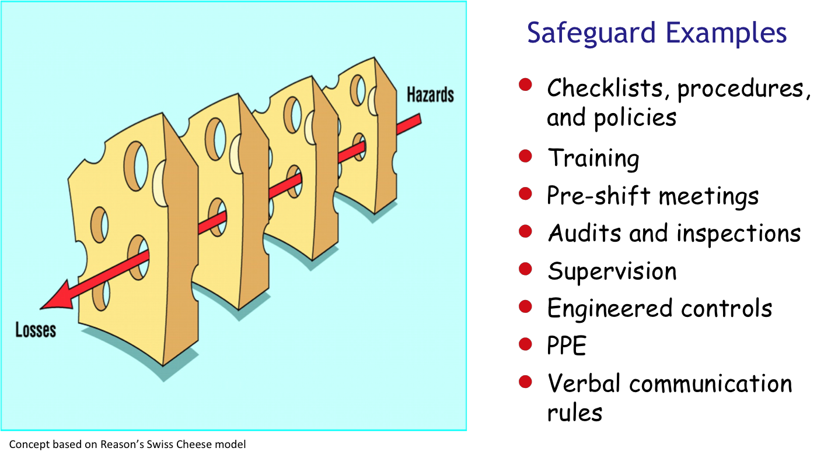
How Effective are Your Safeguards?

Slide 15
Stacking Safeguards to Reduce Risk of Error
LOWER
Each process should be evaluated and improved at least annually
Practice-Based Training
Walk Through
Walk Through
Risk of Human Error
FLRA / Pre-Job
FLRA / Pre-Job
FLRA / Pre-Job
Task Specific JHA
Task Specific JHA
Task Specific JHA
Task Specific JHA
General JHA
General JHA
General JHA
General JHA
General JHA
HIGHER
LOW
Safeguard Effectiveness
HIGH

Slide 16
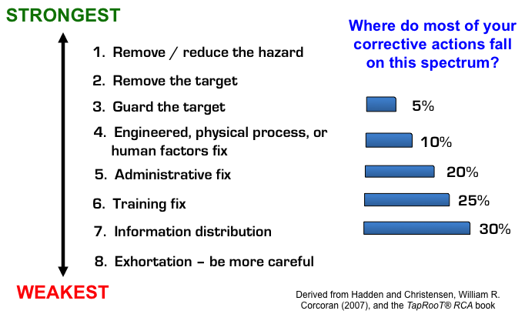
All Fixes are Not Created Equal

Slide 17
Creating Better Work Packages
Towards Better Work Systems
Instructions exist, but not part of work package
Includes safety JSA and risk assessment
Daily instructions written to grade 6-8 level
Verbal work instructions only
General review of tasks at orientation
Reviewed annually as part of development planning
Part of daily pre-shift work review
Crisp, single action steps with signoffs
Create simple, picture-based instructions
Effective Work Package Building Codes
Get the instructions close to the work
Involve users in work package improvement
Make special instructions OBVIOUS!

Slide 18

How Good Do We Need to Be?
HIGH
A six sigma level of quality allows for 1 defect out of 294,118 opportunities
1 out of 200
2015
Rate of Human Error
1 out of 2,000
2016
1 out of 20,000
1 out of 200,000
2017
2018
LOW
HIGH
Safeguard Effectiveness

Slide 19
What’s Your Potential for Error?
Your HEPI consists of five factors …
Degree that work environment shifts
O
2 3 4 5
O
Degree that scope of work shifts
2 3 4 5
Shifts in team experience levels
O
2 3 4 5
Amount of blame culture that exists
O
2 3 4 5
Degree of task complexity
O
2 3 4 5
HEPI = Human Error Potential Index
HEPI = 18 / 25 – 72%
As your HEPI increases, process waste levels also increase

Slide 20
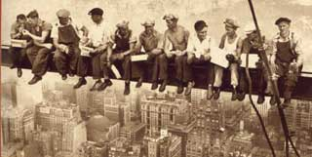
What Does It Take to Be Error Proof?
How many hours can you go without making a mistake?
What % of the time is human error the root cause of a problem?
“95% of the problems are caused by systems, not people.” – W. Edwards Deming

Slide 21


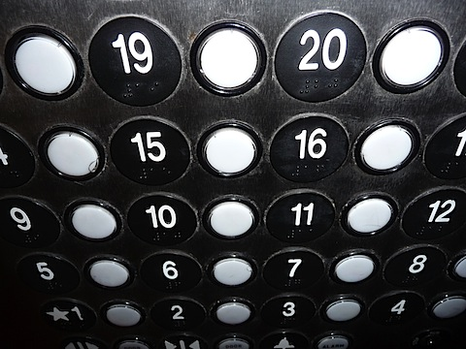
Thoughts on Human Error and Performance
Human error is rarely a root cause
Few people really want to make mistakes
Faulty systems account for 90% or more of errors

Slide 22
What is Mistake Proofing?
Poka-yoke – Japanese term for ‘fail safing’ or ‘mistake proofing’
Any mechanism in a lean process that helps an operator avoid (yokeru) mistakes (poka).
Formalized as a concept and practiced by Shigeo Shingo as part of the Toyota Production System
Examples:
Trapped key interlocking – can’t remove key if car is not in ‘Park’
3.5 inch floppy disc – right corner was shaped different to prevent the disc from being inserted upside down
Source: Wikipedia, the free Encyclopedia – January 2010

Slide 23

Errors versus Defects
DEFECT: Product that deviates from specification or does not meet customer expectation
ERROR: Any deviation from an intended process
All defects are created by errors
Defects are only the tip of the iceberg

Slide 24
3 Rules of Error Proofing
A error proofing system should take into consideration these three simple rules:
Don’t ACCEPT a defect
Don’t MAKE a defect
Don’t PASS ON a defect
Your Suppliers
You
Your Customer
Ideally, design the product or service so that it can’t be assembled or performed incorrectly!!
Source: ‘Poka-Yoke, Improving Quality by Preventing Defects, Shigeo Shingo, 1986

Slide 25
Shingo’s Zero Defect Strategies
Prevent errors from becoming defects
Zero defects
Level Five
Don’t pass defects on
Level Four
Defects do not leave the process
Don’t let defects recur
Level Three
Decrease defects
Strive for no complaints
Level Two
Defects do not leave the company
Lots of defects, lots of complaints
Level One
Defects leave the company
Source: ‘Poka-Yoke, Improving Quality by Preventing Defects, Shigeo Shingo, 1986

Slide 26
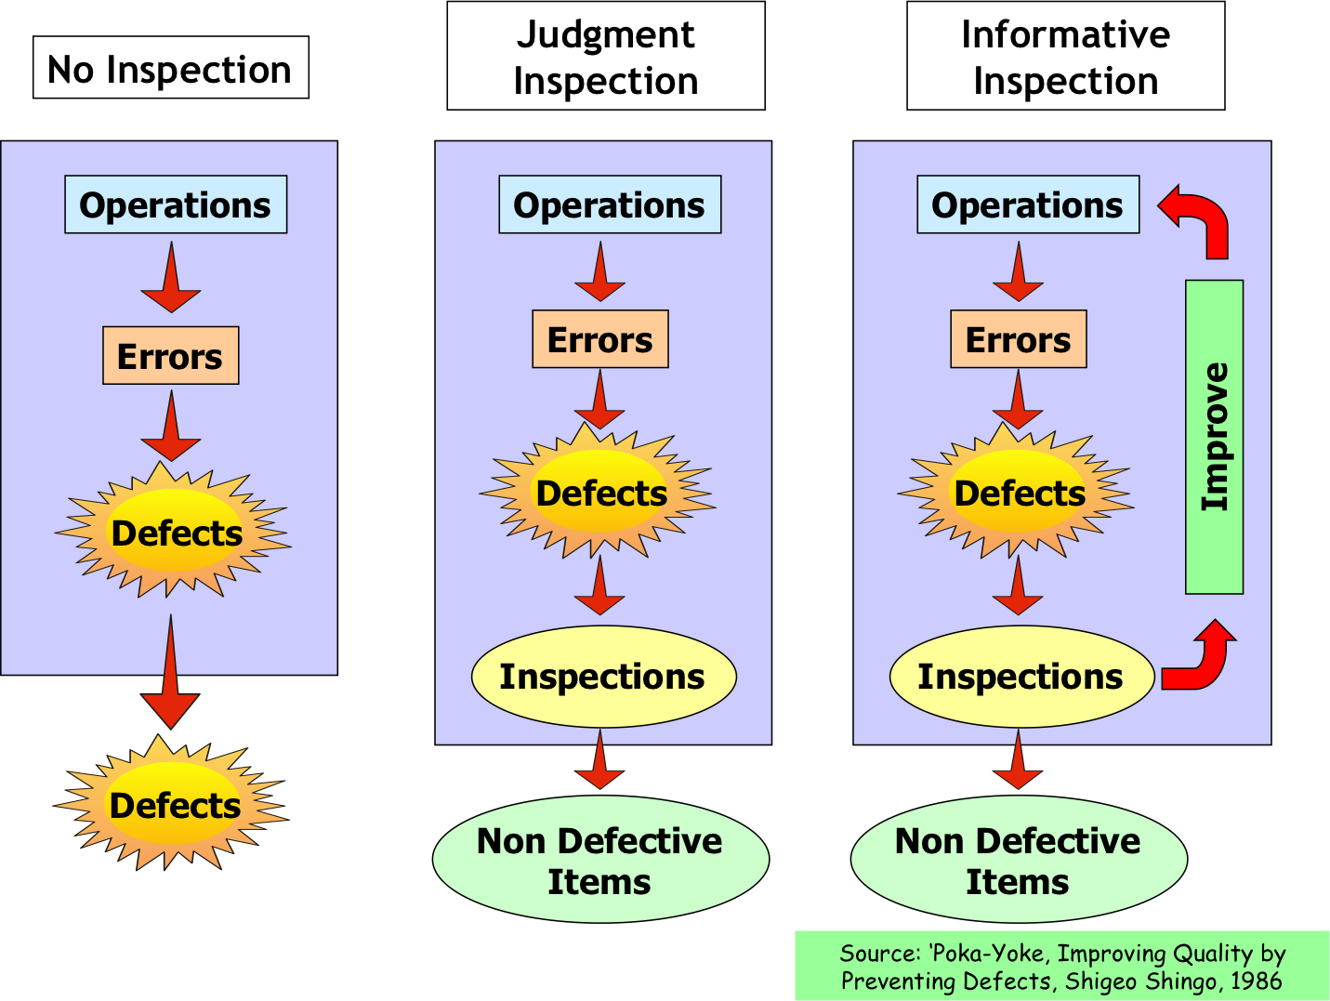

Slide 27
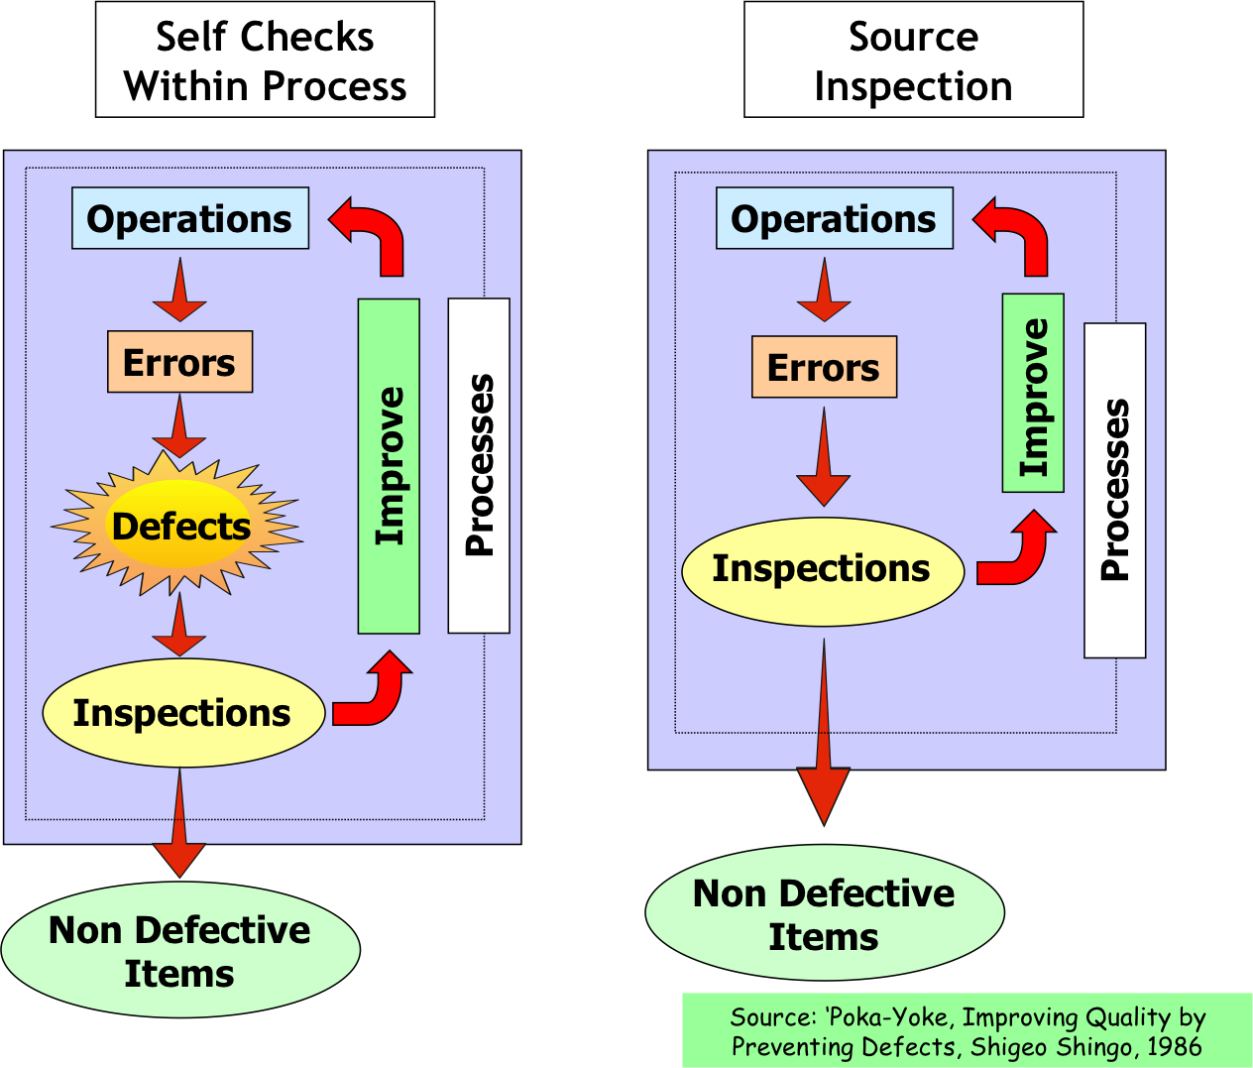

Slide 28
The Culture Loop
At what rate is your process excellence culture gaining or losing momentum?

Slide 29
What’s Holding Us Back?
We have not learned from the past
We don’t see all work as a process
We aren’t using our problem solving tools
HIGH
Efficient Workplace
High Performance Workplace
We only engage a small percentage of our people
% of Processes DMAI’d
Traditional Workplace
Engaged Workplace
We can’t find time for improvement
LOW
% of Workforce Involved
HIGH

Slide 30
The Key to Proactive Improvement
The goal of proactive improvement is to find and analyze high leverage errors and defects!
How do you find key waste, such as errors and defects?
Fix the root causes of defects, errors, and failures
Capture key process errors and defects on a daily basis!!

Slide 31
The Proactive Path to Error Proof
PROACTIVE
Mistake proof key work systems, including non-standard work
Track, trend, and tackle daily process errors and failures
Use Pareto analysis of audit findings to identify key process-based errors
Map key value streams – make system changes to address non-value added tasks
Complete GREAT reactive problem analyses – learn and improve from our mistakes!
REACTIVE

Slide 32
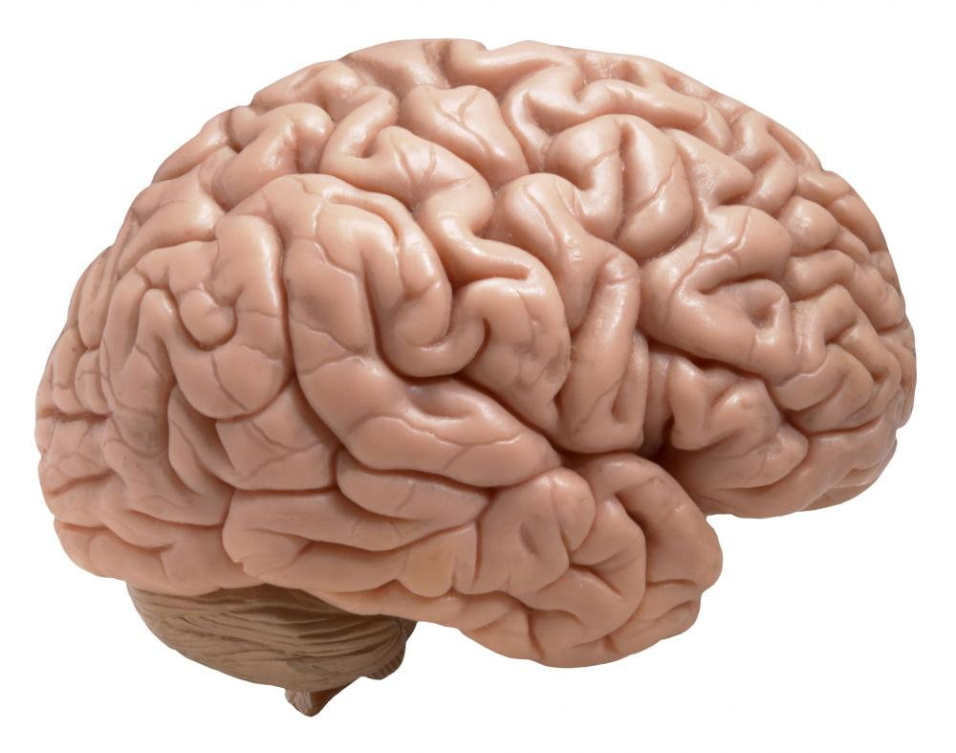
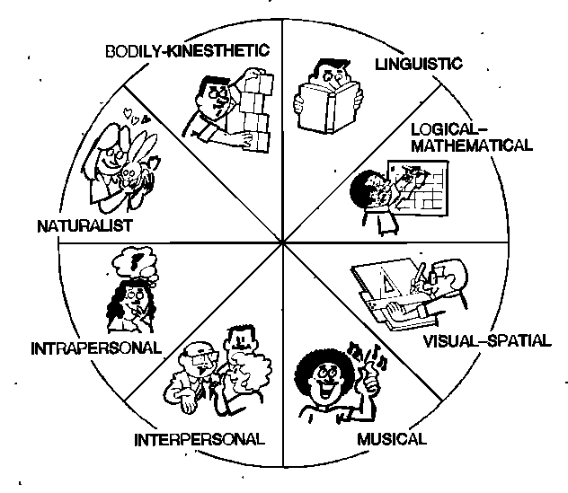
Exploring the Eight Cognitive Processes
What are the eight cognitive processes we use daily?
How do these processes affect the potential for errors?
“If you get to the point where you think you know it all, you’re going to stop learning.” – John Wooden

Slide 33

Eight Cognitive Processes
Memory
Awareness
Communication
Reasoning
Perception
Judgment
Emotion
Planning

Slide 34

Forgetting the Weaknesses of Memory
How often do you relay on memory as a safeguard?
What factors affect recall speed and accuracy?
How can we make our memory more effective?

Slide 35
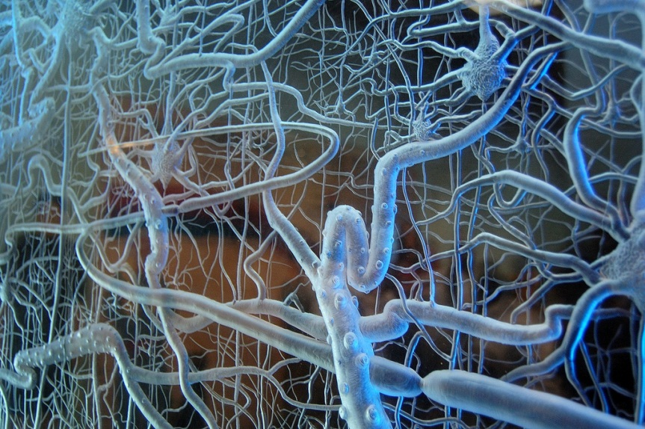
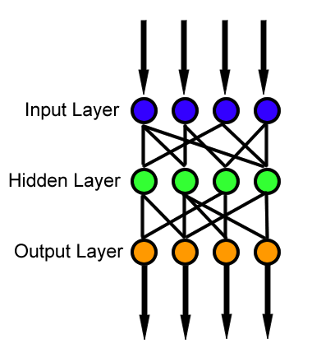
Creating Long Term Memory Pathways
Long term memory occurs when you have created neural pathways for storing ideas and information which can then be recalled up to years later.
To create these pathways, you must make a deliberate attempt to encode the information in the way that you intend to recall it later. This encoding process is called "active learning".

Slide 36

How Memory-Based are You?
How do we use our memory to minimize human error?
Meaningful organization
Engage multiple senses
Chunking and mnenomics, such as HOMES
Rehearse, teach the concept to others
Visualize and relate
Use visual and auditory cues
When we first hear new information
100%
Ebbinghaus Forgetting Curve
One day later without reinforcement
60%
Hermann Ebbinghaus, 1885
% Information Retained
Two days later without reinforcement
40%
None
0
1
2
3
7
# of Days

Slide 37
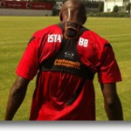
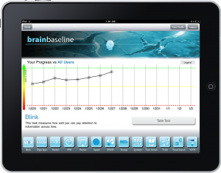
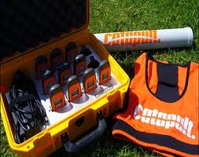
How Aware are You?
Decision Speed?
Decision Accuracy?
Physical fatigue?
Fit for duty?

Slide 38
Are We Failing to Communicate?
Preferred Sensing Modality
Preferred Thinking Style
Preferred Mode of Expression
Visual
Visual
Serial
Auditory
Auditory
Parallel
Kinesthetic
Kinesthetic
What are your preferences?

Slide 39
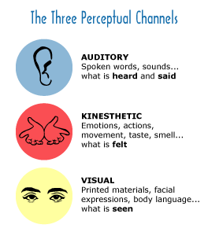
What Your Communication Preferences?
V _____
A _____
K _____

Slide 40
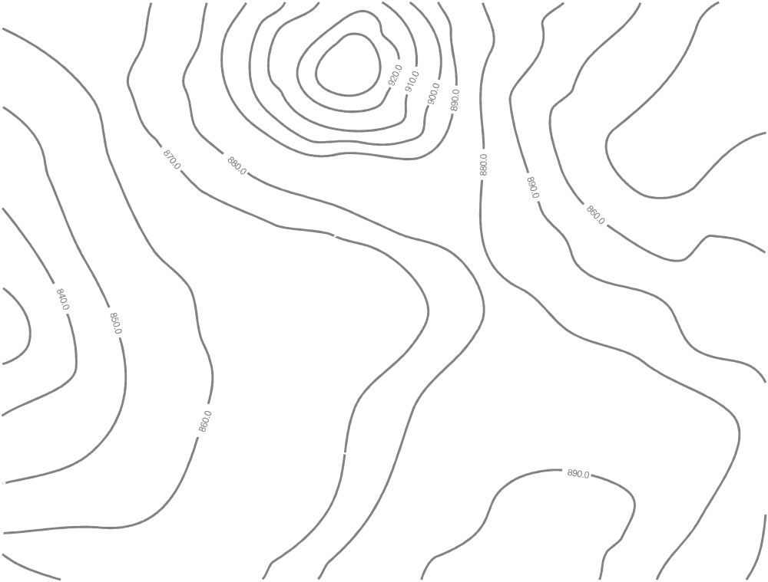
The Map is Not the Territory
Real maps differ from their territories by:
Topography
Weather
Encounters / experiences
Personal maps differ from their territory by:
Values
Moods and emotions
Mental models
Personal maps are more different to experience and read

Slide 41
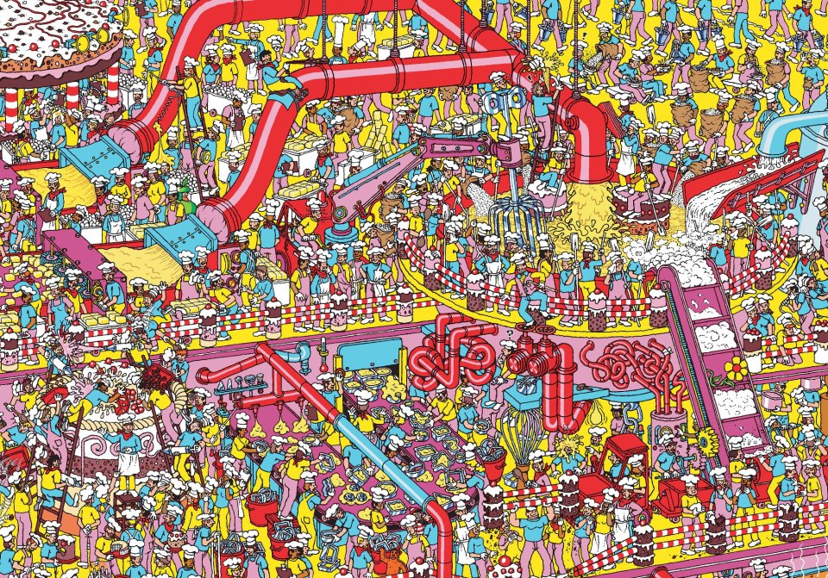

How are You Processing That?
Serial versus parallel thinking
Elliot Jacques – Ability to look forward into time
Gardner’s Seven intelligences
Mind speed and OODA loops
Right versus left brained thinking
Myers Briggs, DISC, True Colors

Slide 42

Do You See a Pattern Here?

Slide 43

Get a Grip!
Emotional intelligence – Daniel Golman
Impact of emotion on cognition – decision speed and accuracy
Which brain is in use – limbic system or neocortex?
Stay out of fight or flight’ mode to help minimize human errors

Slide 44

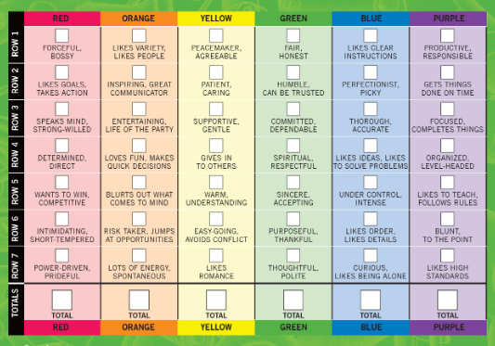
Test Yourself!

Slide 45
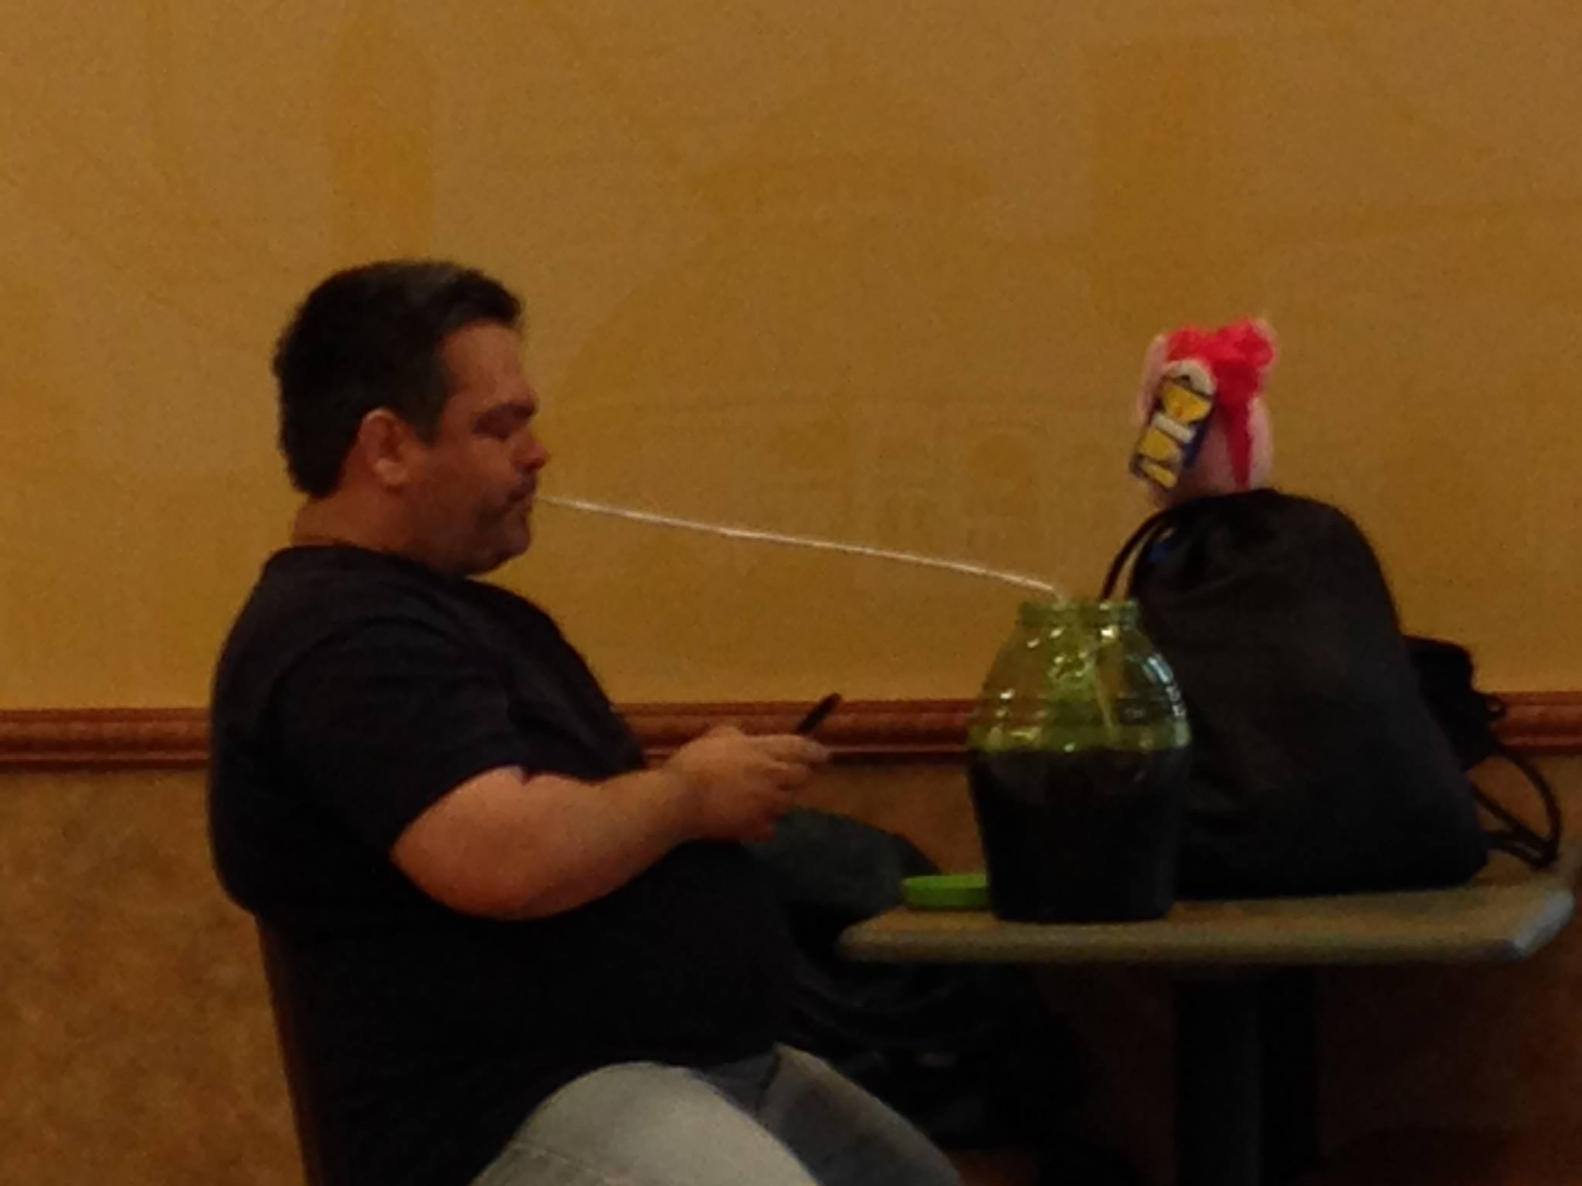
A Daily Dose of Rationale
By understanding rationale, we can understand behavior
Problem solving skills help clear hurdles to getting results
How do each of the seven intelligences apply to rationale?
If we understand rationale, we can design away the excuses

Slide 46
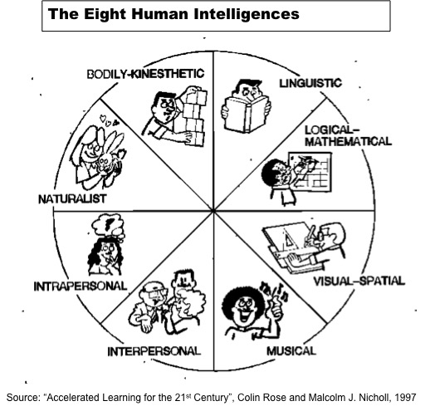
I’ll Let You be the Judge of That
How do our other cognitive abilities affect our judgment?
How well do you see systems and the longer range picture when making choices?
How do the seven intelligences apply to this cognitive ability?

Slide 47

Get Your Mind Right
What types of exercises do you use to condition your brain?
How do diet and hydration levels affect human error rates?
What is your Sleep Quality Index?
“If you get to the point where you think you know it all, you’re going to stop learning.” – John Wooden

Slide 48

Maintain Your Brain
FEED it – Nutrition and hydration matter – GIGO applies to your brain too!
EXERCISE it – Neuroplasticity can both activate and reshape neural networks
Mental fitness comes through proper brain nutrition and exercise
Failing to exercise existing neural networks will result in their atrophy
REST it – Sleep quality plays a key role in overall brain function

Slide 49
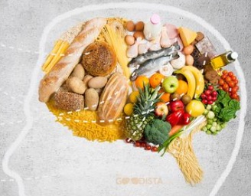
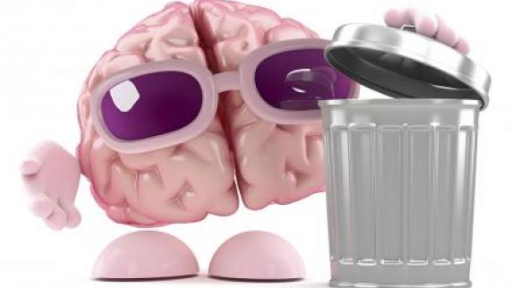
Feed Your Brain
Nutrition and hydration matter – GIGO applies to your brain too!
The brain represents only 2% of the body weight, yet it receives 15% of the cardiac output, 20% of total body oxygen consumption, and 25% of total body glucose.
If the brain is left without glucose, it can lead to hypoglycemia, which can result in loss of consciousness.
20 % of the energy used by the human body is consumed by the brain.

Slide 50
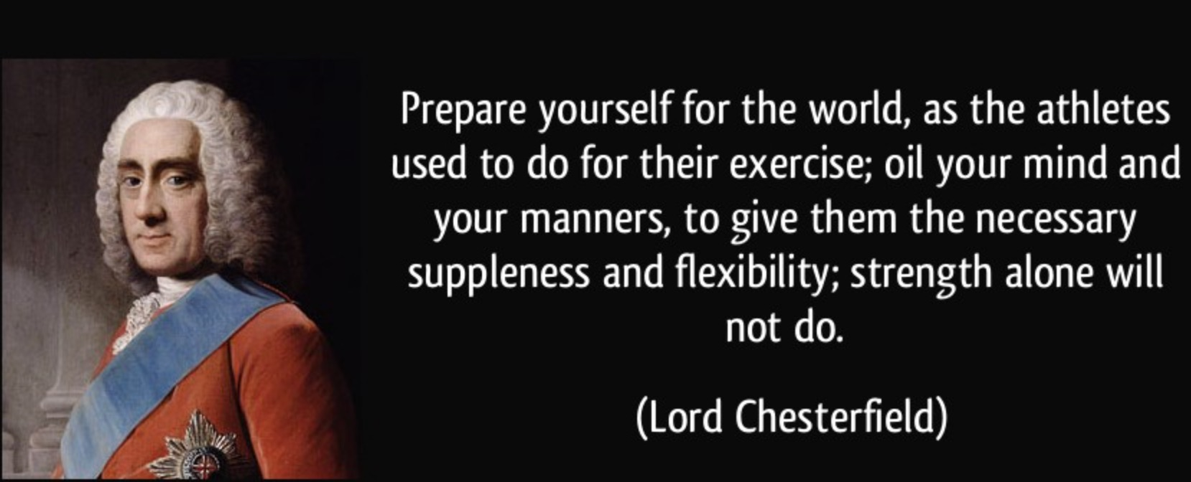
Exercise Your Brain!
What percent of your life do you spend asleep?
What level of sleep quality do you get nightly?
How do you optimize sleep quality and duration?

Slide 51
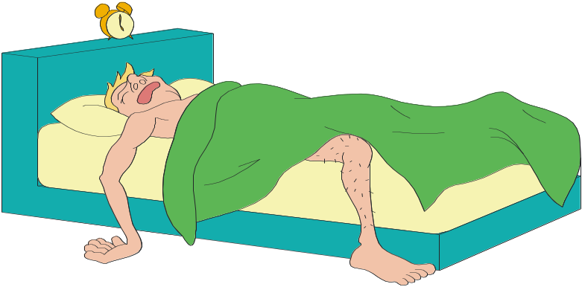
Rest Your Brain
What percent of your life do you spend asleep?
What level of sleep quality do you get nightly?
How do you optimize sleep quality and duration?
“Never go to sleep without making a request to your subconscious.” – Thomas Edison

Slide 52
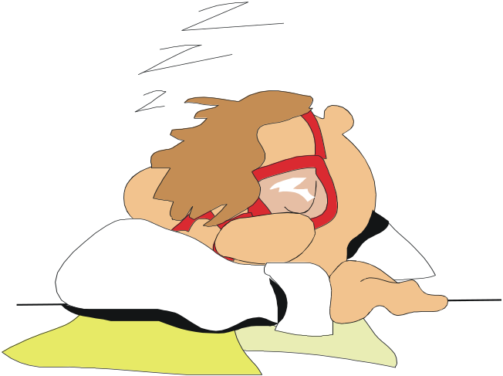
Our Need for Value Added Sleep
We invest 33% of our personal time in sleeping
Sleepiness costs us $100 billion annually
More than 100,000 auto crashes are sleep-related
Sleep revives and recharges our body
Sleep value can be compromised
How much value added sleep do you get on average?

Slide 53
The Sleep Process
80% of adult sleep is NREM sleep (4 stages)
REM sleep involves high physical and mental activity
Sleep cycle = 80 min of NREM + 10 min of REM
This cycle is repeated 3 to 6 times nightly
Both stages of sleep are needed
How many cycles do you go through each night?

Slide 54
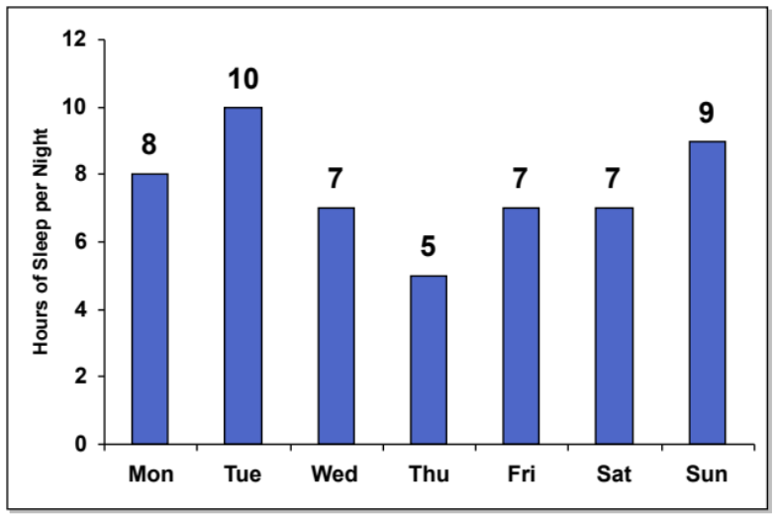
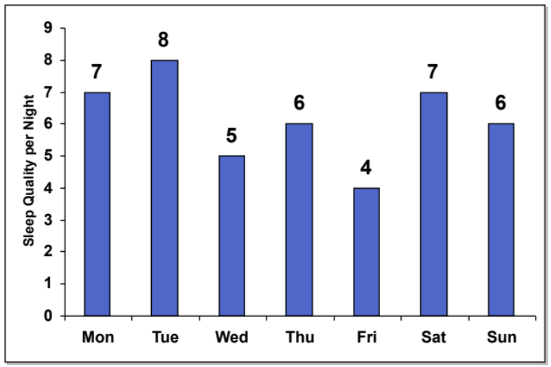
What is Your Sleep Quality Index?
Step One: How much sleep do you get each night?
SQI = Hours X Quality %
Step Two: What was the quality of your sleep?
(on a scale from 1 to 10, with 10 being great!)

Slide 55
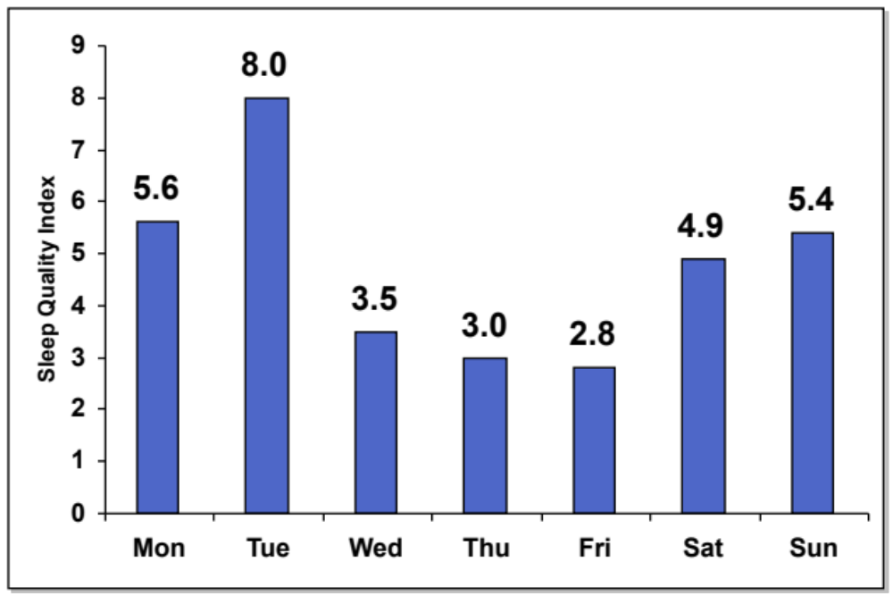
Charting Your SQI Over Time
SQI = Hours X Quality %
To Improve: Shoot for 8 hours of sleep a night
Try to improve your average SQI percent

Slide 56

Getting More Value Added Sleep
Avoid alcohol and caffeine before bedtime
Go to sleep and get up at the same time each day
Avoid heavy meals or spicy food before bedtime
Create a comfortable sleep environment
Exercise regularly
Avoid watching the clock
How is your current sleep quality index trending?

Slide 57
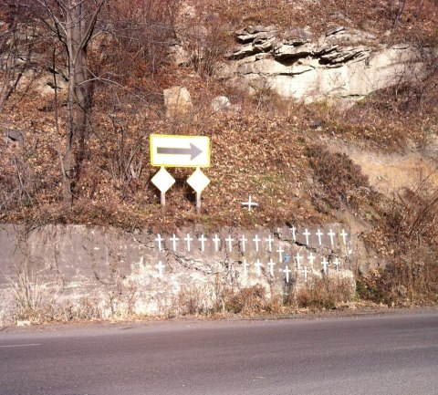
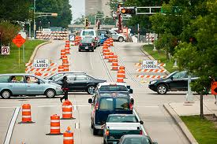
Step Up Your Fixes to Escape Reactive World
What are your favorite fixes?
What factors cause most corrective actions to fail?
How might we assess the potential impact of our fixes?
“If you always do what you’ve always done, you will always get what you’ve always got.” – Henry Ford

Slide 58
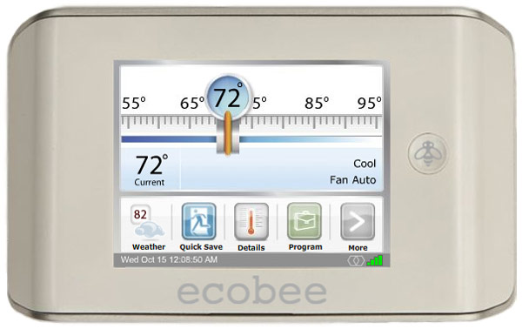
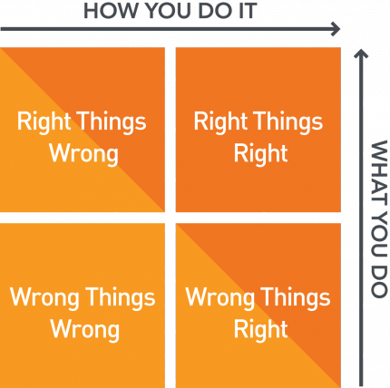
Why are We Trying The Same Fix Again?
Doing Things Right
Single Loop Learning
A thermostat that works
Doing the Right Things
Double Loop Learning
A thermostat that asks why before it works

Slide 59
Why Our Fixes Fail
Over half of the root causes identified are not root causes
Do you think HUMAN ERROR can be the root cause of a problem?
Do you think EQUIPMENT FAILURE can be the root cause of a problem?
A high percentage of our fixes are only quasi-safeguards
The right HUMAN ACTION must happen for the safeguard to work
How many mistakes a day do humans make?
We have limited time to spend on solving problems
We limit the scope and number of fixes that can be approved by budget, not potential severity
Hundreds of hours analyzing often yields only one or two weak fixes – policy change and more reminding

Slide 60
What’s a Systems Change … Really?
Which is easier to fix, people or systems?
Few would argue that it is hard to get people to change, but …
Systems change just costs too much – or does it?
What are we often trying to fix, people or systems?
A high percentage of our fixes focus on trying to change people – reminding, discipline
Redesigning systems force people to act differently
Systems shift cultures!

Slide 61
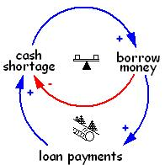
How Often Do Your Fixes Fail?
Most organizations are unaware of their true daily error rates
Fix effectiveness is often gauged by lack of incident reoccurrence – dumb luck
Delays exist between fix implementation and system response
Other system changes can offset the positive impact of a fix
How do you know if a fix works or not?

Slide 62
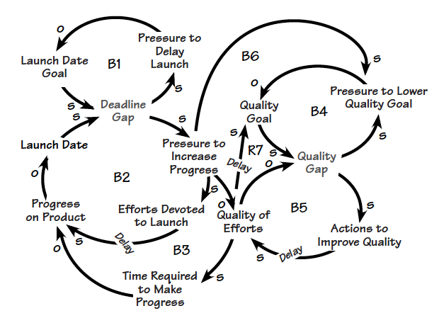
Evidence of Failing Fixes
Small problems don’t go away – instead, we budget for them
We design work systems to quickly address daily issues
Departments exist to manage problems like rework or complaints
Reinforcing the existing rules is a favorite fix for internal problems
People are surprised when a ‘mistake free’ day occurs

Slide 63
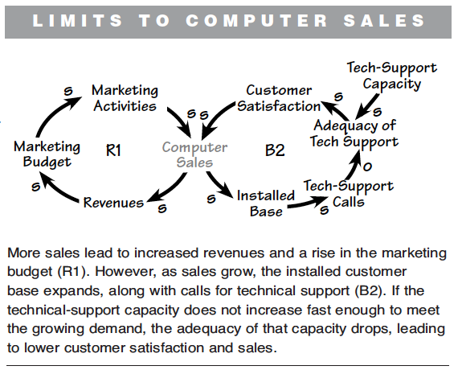
It’s the Systems, Silly …
Source: Systems Archetypes III, Daniel H. Kim, Pegasus Communications, 2000

Slide 64
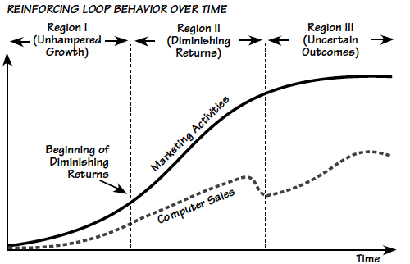
What is Really Affecting Sales?
Source: Systems Archetypes III, Daniel H. Kim, Pegasus Communications, 2000

Slide 65
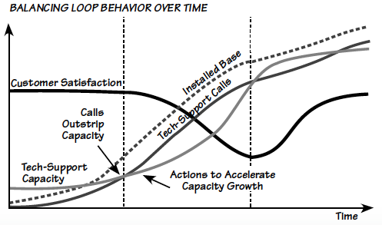
What Really Needs to Change?
Source: Systems Archetypes III, Daniel H. Kim, Pegasus Communications, 2000

Slide 66
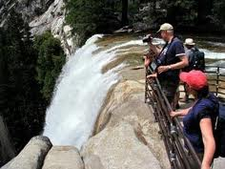

Why Effective Fixes Matter
Any fix costs time and money to put in place
Have you ever spent 100 hours on a problem, only to end up with a modified policy … new rules?
We have limited time to spend on solving problems … but we waste it
Effective fixes create time for proactive efforts … but are your fixes failing too often?
Error free processes are safer and more effective
Effective fixes improve customer service and quality

Slide 67
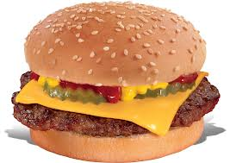
Creating a Great Corrective Action Burger
The ‘Three Sentence’ approach can be used to write a more well-rounded corrective action
First Sentence
Describe the system change to be made and its expected impact on the causal factor(s)
Second Sentence
List 2-3 key features of the change to help identify how this fix will minimize future CF occurrences
Third Sentence
Describe the key approaches that will be used to roll out / deploy the fixes once they have been developed
You can also add implementation verification and effectiveness validation sentences as dressing!

Slide 68
Assessing Potential Fix Impact
Active Safeguard?
Passive Safeguard?
Ask to Change?
Engineered Fix?
Add New Safeguard?
Improve Existing Safeguard?
New rule or policy?
Remove Hazard?
Singular fix?
Mix of fixes?

Slide 69
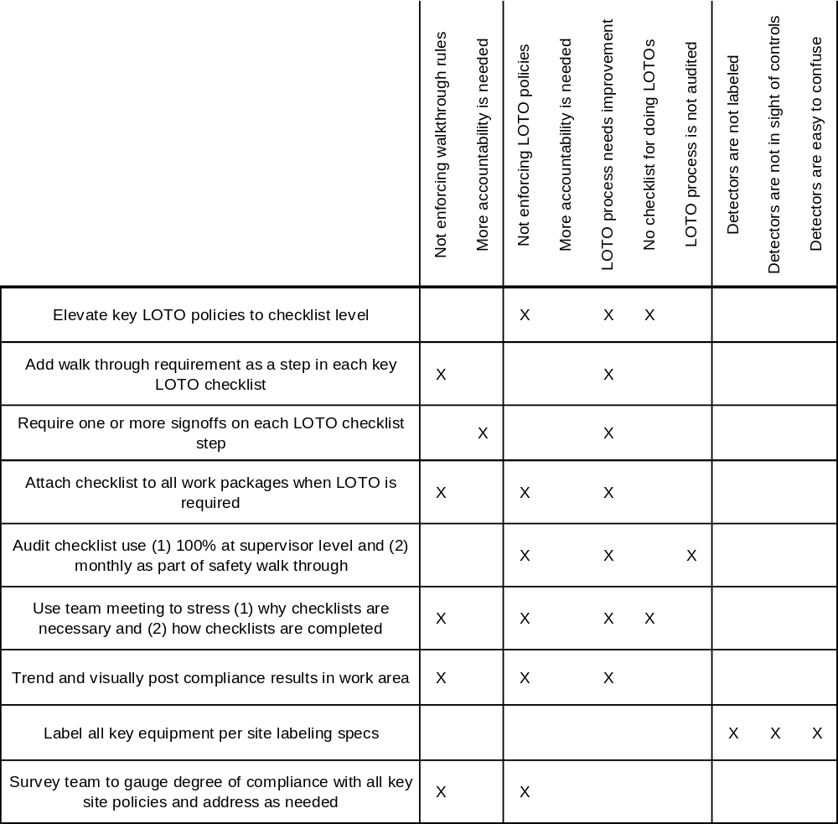
Are All of Your Root Causes Being Fixed?
Are your fixes specific or systemic?
Does your ‘fix mix’ address the potential severity of the problem?
Will all of your fixes actually get fixed?

Slide 70
Measuring Potential Fix Impact
Calculate a score for EACH corrective action that is defined
To What Degree …
LOW ------------ HIGH
Is each corrective action specific?
1 2 3 4 5
Is the corrective action measurable?
1 2 3 4 5
Has accountability for completion been defined?
1 2 3 4 5
Has a return on investment been considered?
1 2 3 4 5
Have timeliness factors been considered?
1 2 3 4 5
Has a means of verifying effectiveness been identified?
1 2 3 4 5
Have unintended consequences been anticipated?
1 2 3 4 5
Have all applicable root causes been addressed?
1 2 3 4 5
Total Score:

Slide 71
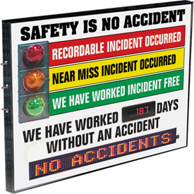

How to Step Up Your Fixes
Review a list of your most recent root causes and corrective actions – what patterns exist?
Use examples of well and poorly written corrective actions to define standards
Expect ‘fix mix’ strength to match potential problem severity
Strive for creative, engineered fixes – 1 passive = 5 active
Use daily error and defect trends to help gauge corrective action impact
Reduce the holes in your current safeguards before adding new cheese slices

Slide 72
Example Fix That Will Fail #1
A Maintenance Supervisor cut his right hand on an insulation covering band at Tank #514. This injury occurred while attempting to kneel down to read and inspect a data plate on a valve that was being assessed for replacement at Tank #514. The injured party did not notice the raised edge of the insulation band. In removing his gloves, the injured removed a layer of hand protection. The injury required 4 sutures.
Root Cause: Attention LTA
Lesson Learned: This injury could have been avoided by approaching the work in a slightly different fashion. The injured could have recruited the assistance of the contractor supervisor to write down the valve data as the injured party inspected the valve data plate. This would have eliminated the need for the injured party to remove his gloves while kneeling.
Recommendation: Conduct a safety meeting with all Metal Shop personnel and nested metals contractors for a review of this event and the lessons learned in investigating the incident.

Slide 73
Example Fix That Will Fail #2
Two contractors were removing a deck plate adjacent to the convection section. Contractor #1 was using a pry bar to lift up the deck plate after the tack welds that were holding it had been burned off. Contractor #2 was using his left hand to hold the deck plate up when the pry bar slipped and allowed the deck plate to drop and pinch the left hand index and middle fingers. Both contractors were wearing proper PPE. No treatment was required.
Root Cause: Attention LTA – JSA was found to be adequate, was being followed, and matched the field conditions. Handling of materials is a normal construction practice.
Lesson Learned: Any piece of deck plate that needs to be removed along the convection section will have a hole cut in it and held with a piece of #9 wire or use of a wedge where possible. This will prevent using hands to hold the deck plate.
Recommendation: Same as Lesson Learned.

Slide 74

What Error Rate Do You Want to Sustain?
Engineered Fix
What error rate do you want to sustain?
What is your potential for human error?
Error Free TASK Execution
Policies and Procedures
Org Ergonomics
Which fixes are the most effective?
Which fixes are used the most often?
Training

Slide 75
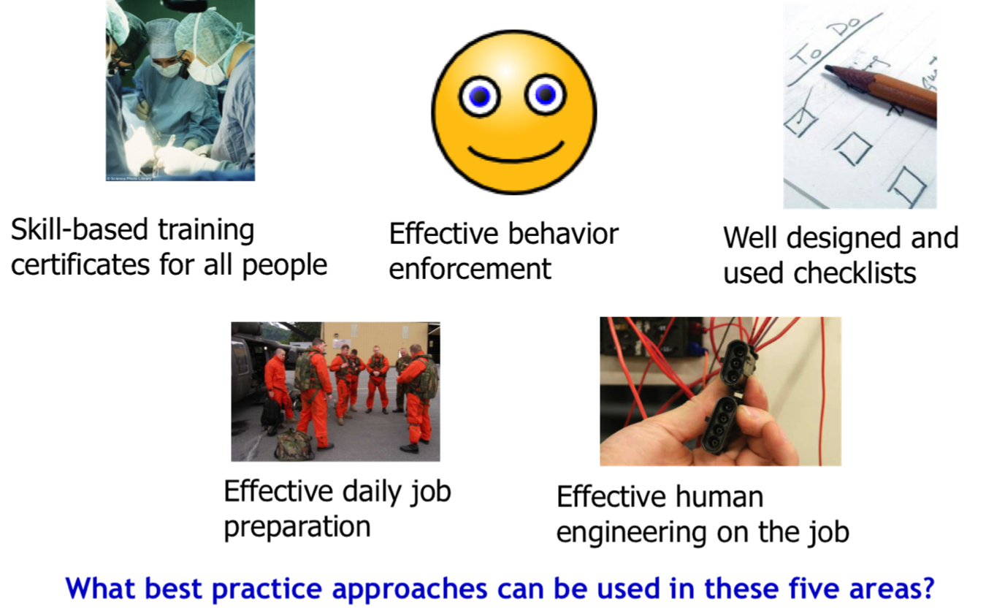
Key Approaches for Reducing Human Error

Slide 76
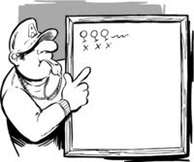
Team Exercise #1
What’s Affecting Your Corrective Action Effectiveness?
1
Rank order the eight factors from 1 (high) to 8 (low) from a personal perspective
How Effective are Your Fixes?
10 minutes group work
2-3 minute / team report
Compare your individual rankings to those of the others in the group – what differences exist?
Reach consensus in your group as to what you feel the top three factors are
BE CREATIVE, HAVE FUN, and ACHIEVE THE GOAL!

Slide 77
Contact Information

Slide 78
The Five P’s of Perfection
Be Prepared
Using Processes to Guide People
The Foundational Power of Paper
ERROR PROOF
Positive, Purpose Driven Culture
Perfect Practice Makes Perfect

Slide 79

The Foundational Power of Paper
What are some key work instruction design flaws?
How can we get information closer to the work?
How much do we count on memory to prevent human error?
How much information is needed to improve performance?

Slide 80
A Clinical Example of Process Improvement
In the Checklist Manifesto, Dr. Atul Gawande cited the work of Peter Provonost and the Keystone Initiative in early 2000’s Michigan
ICU staff must execute 178 different tasks during a day per patient
80,000 CL infections per year in United States alone – 4% infected after 4 days
2004: Explored the use of simple checklists across five Sinai-Grace ICUs for central line and ventilation procedures
Required monthly visits by senior executive owners to listen and help solve problems, such as disinfectant soap supply chain issues
Dec 2006: Checklist use helped save $175 million and 1,500 lives in 18 months – a 66% reduction in CL infection rates
What processes need checklist use to help avoid memory errors?
How do we motivate people to consistently use checklists?

Slide 81
Best Practice Work Instruction Design
Instructions are used DURING work to reduce the risk of relying on memory
Use small words and short sentences
Write instructions at a 5-6 grade level
Use check boxes and initial lines to increase accountability
Limit of one action per step
Be specific, quantitative, and clear
Specify instruction use requirements on the document

Slide 82


Work Instruction Examples
Can you think of examples where poor instructions resulted in a human error or equipment failure?

Slide 83


Example Job Hazard Analysis Form
How is the collected information used to improve performance?
How does the design of the form affect its potential effectiveness?

Slide 84

Getting Information Closer to the Work
Instructions in notebook
Instructions in PDA
Instructions on job aid
Checklist in hand
Ease of retrieval is improved
Memory loss impact is reduced
How much do you rely on memory to minimize human error?

Slide 85
Creating Better Work Packages
Towards Better Work Systems
Instructions exist, but not part of work package
Includes safety JSA and risk assessment
Daily instructions written to grade 6-8 level
Verbal work instructions only
General review of tasks at orientation
Reviewed annually as part of development planning
Part of daily pre-shift work review
Crisp, single action steps with signoffs
Create simple, picture-based instructions
Effective Work Package Building Codes
Get the instructions close to the work
Involve users in work package improvement
Make special instructions OBVIOUS!

Slide 86

Perfect Practice Makes Perfect
What are the key training packages that we rely on?
What percent of course time do you devote to practice?
How do we enhance our training AURA?
“Perfect practice makes perfect.”
– Rick Pitino, NCAA and NBA Basketball Coach

Slide 87
Three Impact Areas
HOW we train
WHERE we train
WHAT we train
Awareness
Understanding
Retention
Application
“Provide the greatest learning in the least amount of time.”

Slide 88
Exploring the Training Half Life
On average,
we remember …

Slide 89









Learning Styles and Neural Pathways
Is your information reaching the neocortex where learning occurs, or are your trainees in defense mode?
Limbic System
Neocortex
Which of the eight intelligence areas do you score strongly in?
Source: “Accelerated Learning for the 21st Century”, Colin Rose and Malcolm J. Nicholl, 1997
Reptilian Brain

Slide 90
Error Proofing Your Training System
Here are some common training system gaps that you should be on the lookout for:
Certification requirements have not been defined for each job
Low percentage of course time devoted to skill practice
No trainer assessment, certification, or development process
Weak, or no, skill demonstration–based competency testing process
Limited chances for skill re-certification or further skill development

Slide 91

Certification Process Pieces
PowerPoint
Presentations
Procedure
Review
Flash Cards
Used to gain an overview of the job and its requirements
Used to review key job work instructions, hazards, and customer requirements
Used for self-study of skill proficiency test concepts
Position
Observation
Checklists
Skill
Proficiency
Tests
Used by supervisor and team member to assess work practices
Used to gauge understanding and 100% retention of key work practices

Slide 92

Example Position Certification
Filler Operator Certification Requirements
80 hours of training time on job w/ certified peer
200 hours of time on job following peer training
Skill proficiency test score (90% first pass / 100% second pass)
75% or better score on Position Observation Checklist
Personal procedure review and update time
Accident free for past six months / good attendance

Slide 93

Position Observation Checklist (POC) Example

Slide 94
Skill Certification Best Practices
Certifications are used to help emphasize the need for demonstrated skill success
Minimize use of lecture in favor of practice time
Use Position Observation Checklists to gauge skill proficiency
Require time on job to demonstrate expected work behaviors
Link certification requirements to EACH job description
Identify what needs to be 100% committed to memory
Use computer-based training (CBT) for compliance or awareness needs only

Slide 95
Training Effectiveness Spectrum
Towards Better Work Systems
Self Study
Lecture / Classroom
Skill Practice with Coach
Pre-Task Toolbox Talks
Certification Process
Read and Sign Training
Web-based Training
Interactive with Skill Testing
Skill Practice in Field
Step by step walkthroughs
Match prep style to team skill mix
Training System Building Codes
Team lead keeps the big picture in mind
Add prep detail and layers as risk increases
Engage the entire team in planning

Slide 96


Developing a Positive, Error Proof Culture
What rules are key for creating an error proof culture?
What are the key reasons people use to break the rules?
How do we positively enforce the right things daily?
“The prevailing system of management has destroyed our people.” – W. Edwards Deming

Slide 97
What is Really Being Reinforced?
Define Policy
Communicate Policy
Enforce Policy
Review and Improve Policy
Audits
Formal recognition
Informal recognition
Pre-job briefs
All key rules must be reinforced regularly
Training
Letters and e-mails
One-on-one coaching
Work package contents
Signs, labels, and alarms
Discipline

Slide 98
The Enforcement Matrix
INFORMAL
FORMAL
What % of your enforcement actions fall into each square?
Daily, consistent, positive, and meaningful thank you / feedback
Monthly Give Aways, 100 Point Clubs, Profit Sharing
POSITIVE
Which square contains the most effective enforcement strategies?
How was your current enforcement culture shaped over time?
Beratement, no positive feedback, limited communication
Discipline for errors, poor job assignments, pay cuts / layoffs
NEGATIVE
How can leaders learn to enforce rules differently?

Slide 99
Layers of Enforcement Example
Practice-Based Training
PROBLEM: A job site was having an abundant number of near misses on stairways
Walk Through
Walk Through
ROOT CAUSE: Plant policy regarding safe use of stairways was not being consistently enforced
FLRA / Pre-Job
FLRA / Pre-Job
FLRA / Pre-Job
Task Specific JHA
Task Specific JHA
Task Specific JHA
Task Specific JHA
General JHA
General JHA
General JHA
General JHA
General JHA
Actions Taken TO IMPROVE:
Managers given ‘Safe Climber’ cards to randomly give out ($1 value)
Stairway use JHA written and posted at top and bottom of stairwells
All employees urged to give immediate feedback to violators and report
Hand sanitizers installed at the top and bottom of each stairwell
Annual hazard training modified to include 5 minutes of safe stairway practice

Slide 100
Reinforcing Safe Work Behaviors
Towards Better Work Systems
JHA completed at start of day
Safe Work Practices
Job position-specific JHA
Task Specific JHA
Onboarding review of rules
Reviewed annually
Part of daily tool box talk review
Reviewed when job scope changes
Create task specific JHAs before work
Effective JHA Building Codes
Teach ‘effective JHA design’ skills
Review and update JHAs annually
Engage users during tool design and review

Slide 101

Enforcing Through Relationships
95% or more of effective positive enforcement is INFORMAL
Enforcement Through Stronger Relationships
Do you know what types of work your people do each day?
Do you know their preferred communication styles?
Do you know what their daily work ‘headaches’ are?
Do you know what their personal development needs are?
Do you have action plans for addressing their key needs?

Slide 102
The Formal Recognition Spectrum
Employee of the Month
Drawings and Raffles
Team Giveaways
Achievement Awards
Monthly Profit Sharing
Spot Rewards
Commission / % Rewards
Point Earning Catalogs
Progress Stickers
Employee Stock Ownership
Recognize the right people
Recognition System Building Codes
Reward the right tasks and behaviors
Refresh the process annually
No ‘one winner’ systems
Designing Better Work Systems

Slide 103

Rule Enforcement Best Practices
Multiple approaches to rule enforcement are needed to send a clear, consistent message
Each rule needs to be clearly defined – expectations and consequences
Rules must be clearly, consistently, and regularly communicated
Audits, training, and job prep are also used to reinforce rules
Positive reinforcement works better than negative reinforcement
All leaders must use a consistent approach to rule enforcement
Discipline should only be used for ‘one off’ situations

Slide 104


Be Prepared
What is the purpose of formal job preparation?
What activities are part of effective job preparation?
How do our job preparation activities help minimize errors and risk?
“An ounce of prevention is worth a pound of cure.” – Benjamin Franklin

Slide 105


Fail to Plan, Plan to Fail
Where do you require checklist use to help guide your job planning efforts?

Slide 106
Daily Job Preparation Spectrum
Towards Better Work Systems
Clock in and start working
Start of Shift Toolbox Talks
Interactive Toolbox Talks
Pre-Task Toolbox Talks
Team pre and post briefings
Daily Schedule
Work order for each job
Position specific JHA and FLHA
Task specific JHA and FLHA
Step by step walkthroughs
Match prep style to team skill mix
Daily Preparation Building Codes
Team lead keeps the big picture in mind
Add prep detail and layers as risk increases
Engage the entire team in planning

Slide 107

Conducting Effective Pre-Task Reviews
Have a plan – use some form of agenda to guide the meeting
Provide everyone with a visual agenda
Involve everyone – assign an agenda item to each participant
Use emotion and humor appropriately to provide emphasis
Use questions and repeat back to help ensure the message is understood
If jobs change scope, take time to hold a new briefing
Job preparation approaches help reduce memory reliance and increase rule enforcement

Slide 108
Elements of Effective Job Preparation
Job preparation approaches should be designed to match the expected task risk level
Pre- and post-job meetings
Checklist and cue card use
Practice-Based Training
Simulations
Walk Through
Walk Through
FLRA / Pre-Job
FLRA / Pre-Job
FLRA / Pre-Job
Team facilitation training (leaders) and group dynamics training (all)
Task Specific JHA
Task Specific JHA
Task Specific JHA
Task Specific JHA
General JHA
General JHA
General JHA
General JHA
General JHA
What is the likelihood of human error?
What is the potential impact of human error?

Slide 109

Work Group Meeting Survey Example

Slide 110


Using Processes to Guide People
How do our process designs and work environment affect the potential for human error?
What are the common daily human errors we see?
How can we redesign the work to minimize or eliminate these errors?
What are some key techniques for designing error free workplaces?

Slide 111





Key Human Engineering Factors
Cognition– How the brain works
Conditions –Work environment matters!
Controls – Look, feel, location

Slide 112




Examples of HMI ‘High Error’ Systems
Heavy lift crane controls
Tank farm hose connections
CLAP Triangle example

Slide 113




Where Proprioception Really Matters
Speed Well in Bar
Dental surgical tray
Overhead bridge crane controls
Courtroom stenographer

Slide 114

Job Aids Help Reduce Human Error
Job aids should be easy to access
Job aids must be well designed
Use of job aids must be well enforced
Job aid use must be required by policy
Begin by using job aids on high risk work

Slide 115



Color Coding to Reduce Human Errors
How have you seen color coding used to prevent human error?

Slide 116






Engineering Out the Potential for Error

Slide 117

The New Human Machine Interface

Slide 118


Possible RFID Applications
Tracking physical asset location and movement
Real-time PPE use compliance checking
Tracking human asset location and movement
Setting and controlling security perimeters and safe work zones
Capturing time-based data for use in optimizing asset utilization

Slide 119



Active versus Passive RFID Applications
Passive RFID: $.05 to $5 / tag
Active RFID: $15 to $100 / tag
Source: www.cisco.com

Slide 120





Managing Assets with Lean Data Capture
Bar Coding
Quick Response Codes
Easy to use app interfaces
RFID Bands
Implants

Slide 121

Tag You’re It! At Celebration Health
Operating room staff at Celebration Health Hospital in Orlando, FL wear RFID tags to track their movements and time management.
"There was nervousness at first about being tracked," says Ashley Simmons, performance manager at the hospital. "But over time as we showed it was not being used punitively, they adapted very quickly and got into their normal routines."
Based on the feedback received, Simmons says that staff have been located too far from each other and patients, and that the workplace environment is to be modified to improve communication.
Staff are given access to their performance data and provide input on what their ideal routine would be in the support of shift redesign
The most advanced wearable trackers include sensors for motion, sound, and infra-red to support patient safety, security, and behavior pattern analysis.
Source: “Happier, more productive … would tagging help your business?” Kieron Monks, CNN, December 3, 2014

Slide 122
Organizational Ergonomics Best Practices
The best approach for minimizing human error is to engineer out the risk
Standardize control layouts and shape coding
Remove the impact of work environment factors – lighting, temperature, noise
Improve error detection approaches
Reduce task complexity to skill level if possible
Match screen displays to the process / form being transacted
Use color coding, icons, and creativity to engineer out risk

Slide 123
The Daily Process of Error Proofing
HIGH
Efficient Workplace
High Performance Workplace
% of Processes DMAI’d
Traditional Workplace
Engaged Workplace
Who are we going to engage in our error proofing efforts?
LOW
% of Workforce Engaged
HIGH
Which processes are we going to focus our error proofing efforts on?
“If you get to the point where you think you know it all, you’re going to stop learning.” – John Wooden

Slide 124

Three Approaches to Improvement
Reactive Problem Solving
Process Improvement
Problem Prevention
Select the problem to be solved
Select the process to be improved
Measure to understand the system
Find the root causes of the problem
Map the ‘as is’ process and find NVA activities
Track key daily errors and process counts
Find and test fixes to eliminate the root cause
Create the new process design
Find root causes of high frequency errors
Implement corrective actions
Standardize the new process
Change the system to eliminate root causes

Slide 125
The Key to Error Prevention
Every process owner should be responsible for tracking and trending process performance and process waste on a regular basis, and for using that information to improve those processes.
Use the TapRooT® root cause analysis process daily to analyze your highest risk human errors

Slide 126







Operator Checksheets
Database records
Transaction records
Timekeeping records
Daily Performance Dashboard
Capture
Performance Summary Spreadsheet
Error Tracker Database
Reducing Daily Errors
Change
Crunch
Use TapRooT® to find and fix the root causes of high leverage errors
Trend Lines w/ Control Limits
Error Breakdown Paretos
Key Improvement Project List

Slide 127



All Processes Have Vital Signs!
Human Body
Dental Office
Food Plant
Heartbeats / minute
Revenue / office hour
Pounds / minutes
Blood pressure
Visits / office hour
Cost / pound
Respirations / minute
Complaints / M visits
OSHA accident rate
Body mass index
OOPs errors / M Visits
Non-conformance rate
Years of age
Staff retention rate
Retention rate
A process scorecard shows the vital signs for that process (1-2 ratios per KPA)

Slide 128

Example Error Tracker Database

Slide 129
The Process Improvement Process
Value Stream Mapping
Process
Definition Matrix
Process
Flow Chart
Mistake Proofing
Performance Summary Spreadsheet
Kaizen
Teams
DEFINE
5S Process
Process
Improvement
Process
Trend and
Control
Charts
IMPROVE
MEASURE
Scorecards and Dashboards
Key Project List
Visual Workplace
ANALYZE
Error Tracker
Database
Quick Changeover
Seven Quality Tools
Spaghetti Diagrams
Pareto Charts
Root Cause Analysis

Slide 130

Planning to Become More Error Proof
What are your favorite fixes?
What factors cause most corrective actions to fail?
How might we assess the potential impact of our fixes?
“If you always do what you’ve always done, you will always get what you’ve always got.” – Henry Ford

Slide 131

Shifting Mindsets
Total Time Spent at Work
Doing Reactive Tasks
% of Daily Work Time
Doing Proactive Tasks
NOW
Time
FUTURE

Slide 132

What Should Happen When You Improve?
Cross-functional Safety Committee formed / redesigned agenda
System Changes
Monthly safety audits began to be conducted
Began using TapRooT® process on all reportable incidents
Improved safety recognition process for all work teams
Changed supervisor safety improvement responsibilities

Slide 133
What Error Rate Do You Want to Sustain?
Engineered Fix
What error rate do you want to sustain?
What is your potential for human error?
Error Free TASK Execution
Policies and Procedures
Org Ergonomics
Which fixes are the most effective?
Which fixes are used the most often?
Training

Slide 134

Eight Key Error Proofing Practices
Provide effective daily work packages
Lead quality job prep huddles each day
Utilize task specific job hazard analyses
Know where your problems are – track and trend key errors daily at the process level
Deliver effective on the job training (OJT)
Enforce effective personal protective equipment (PPE) use
Use audits and observations to help spot daily ‘at risk’ behaviors
Lead well-planned, thorough investigations

Slide 135
Strategies for Improvement
Rounds and Audits
How do you systematically improve performance at your facility?
Leadership Camps
Improvement Teams
Supervisor Training
Kaizen Blitzes
Weekly Blitz Calls
Annual Meeting
Improvement Tool Use
Annual Surveys
Mid-Year Meeting
Do formal RCA on all process non-conformances

Slide 136
Reducing Daily ‘At Risk’ Behaviors
PROACTIVE
Mistake proof key work systems, including non-standard work
Track, trend, and try to reduce daily ‘at risk’ behaviors at the process level
Use Pareto analysis of observations to identify areas needing improvement
Implement effective corrective and preventive actions
Execute GREAT reactive problem solving – learn and improve from your mistakes!
REACTIVE

Slide 137
Team Exercise #2
Planning for Future Error Proofing
2
How will you use what you have learned today?
Action Plan for Future Error Proofing
What key insights, tools, or best practices do I want to try using NEXT WEEK?
Of these actions, which ones need to be addressed first?
What is the urgency level for achieving action plan completion?

Slide 138



Contact Info
E-mail: Kevin@greatsystems.com
Snail mail: 70460 Walker Road
Rainier, OR 97048
Phone: 206.226.8913
Website: www.greatsystems.com
Root Cause and Incident Analysis: www.taproot.com
@greatsystems
https://www.facebook.com/greatsystems/
https://www.linkedin.com/in/kevin-mcmanus-5138322
If you like this workshop, you also might enjoy my books -
Please check them out on Amazon.com!

Slide 139



New Books by Kevin McManus!
Now available on Amazon.com!
150 pages of ideas and examples that will help you accelerate and sustain your process improvement efforts
Over 25 examples of ‘best practice’ assessment tools that leaders can use to encourage and support high performance work
Pursuing Process Excellence
12 team exercises that can be used to begin applying each concept as it is learned
128 pages of ideas and examples to help you make your existing measurement systems more meaningful
Over 30 examples of ‘best practice’ measurement tools and techniques that leaders can use to promote high performance work
Vital Signs Measurement
14 team exercises that can be used to begin applying key concepts as they are learned
162 pages of strategies and dialogue questions to help you stop daily goofs for good
Over 100 proven best practices that you can use to help error proof your key work processes
Can be paired with the 100 page workshop workbook that contains 13 team exercises to help you begin applying key ideas
Error Proof

