Slide 1
International Technical Safety Forum 2017
New projects and challenges at DESY campus
Anca-Simona Ciobanu
DESY Hamburg, Germany
Vancouver, September 2017

Slide 2
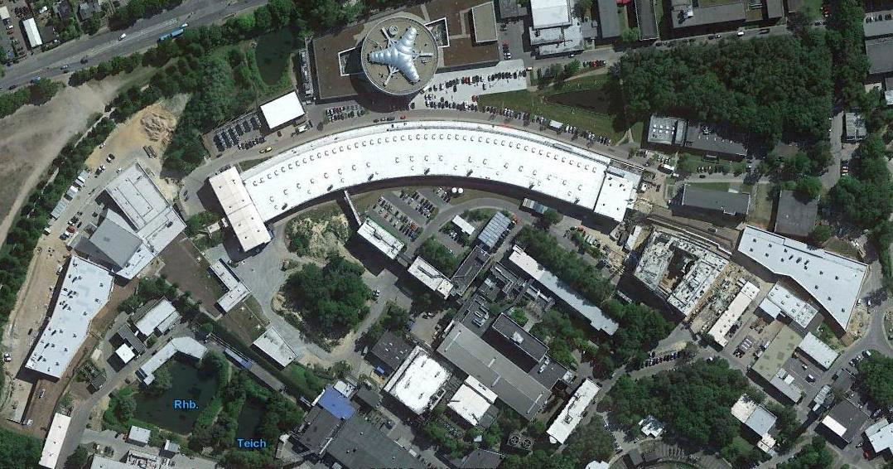
Overview
PETRA III
PETRA Extension East Hall
PETRA Extension North Hall
FLASH1 and FLASH2
PETRA IV

Slide 3
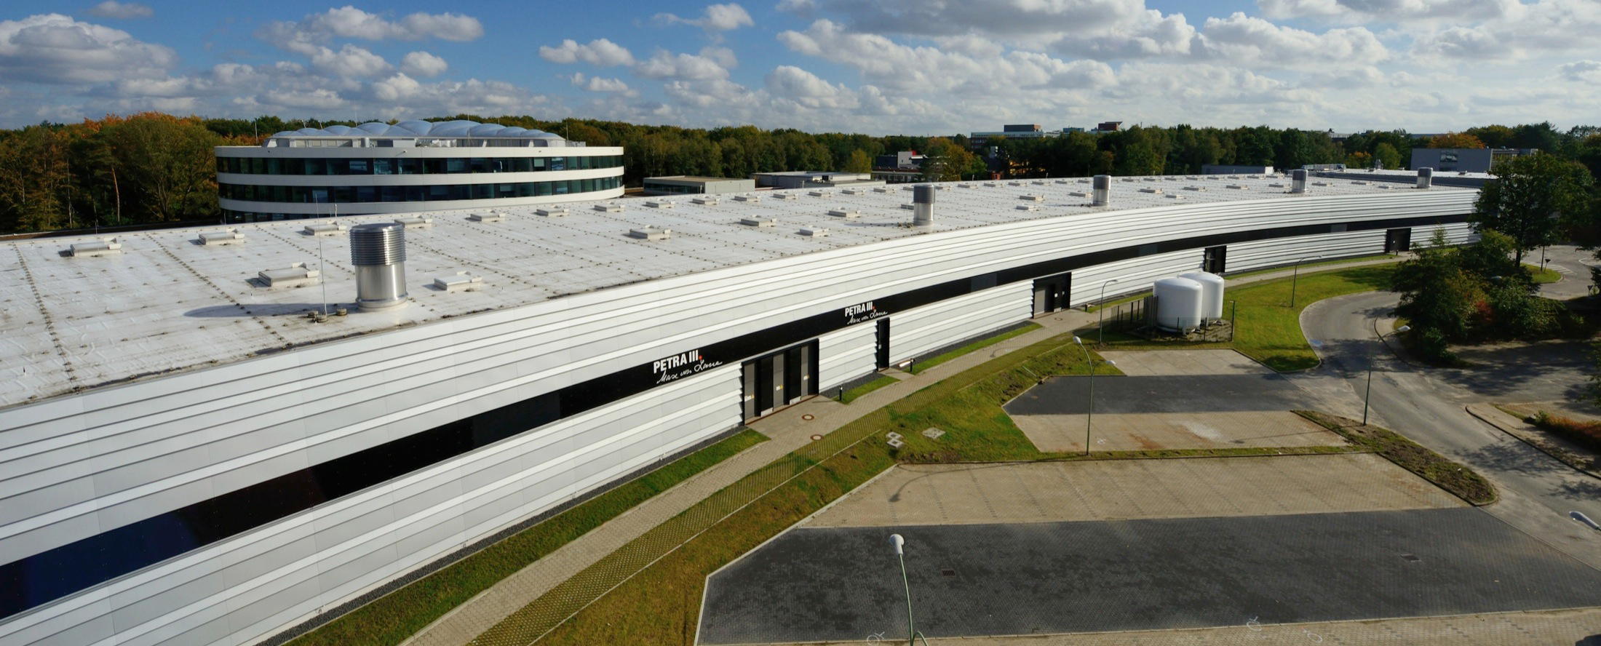
PETRA III – Operation and developments
built in 1978 as a particle physics experiment
rebuilt as a synchrotron radiation source stating in 2007
operation since 2010
upgrade: March 2014 – April 2015
back in operation since April 2015
shutdowns for accommodation of extension beamlines: Jan.-Apr.2016 and Jan.-Apr.2017

Slide 4
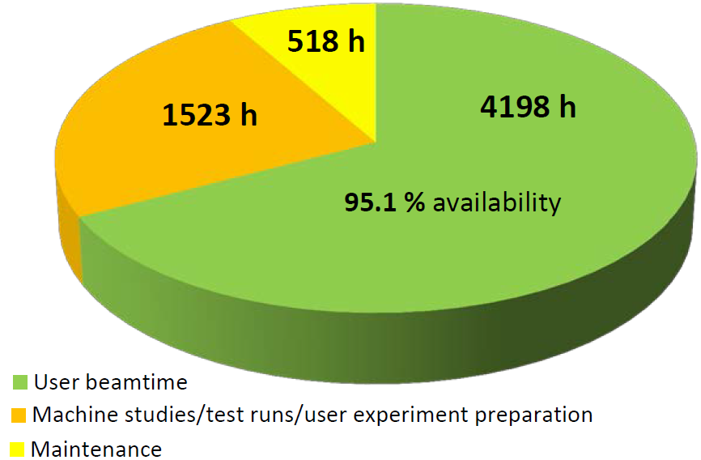
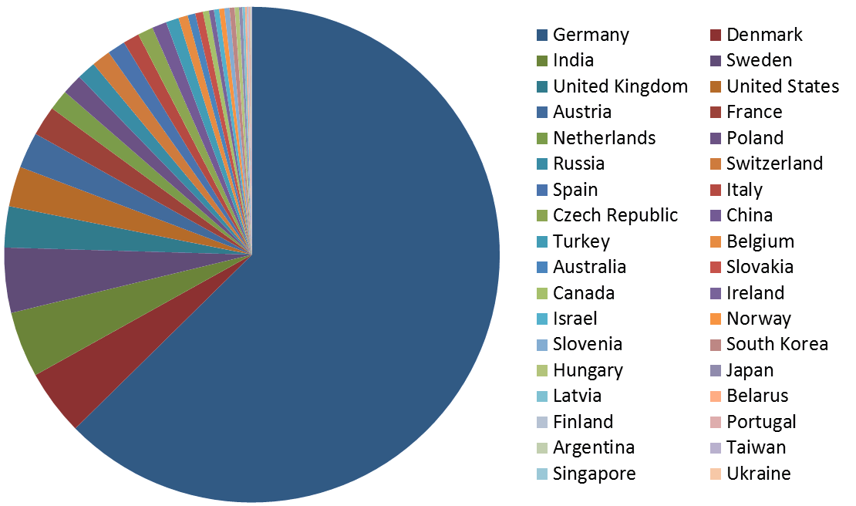
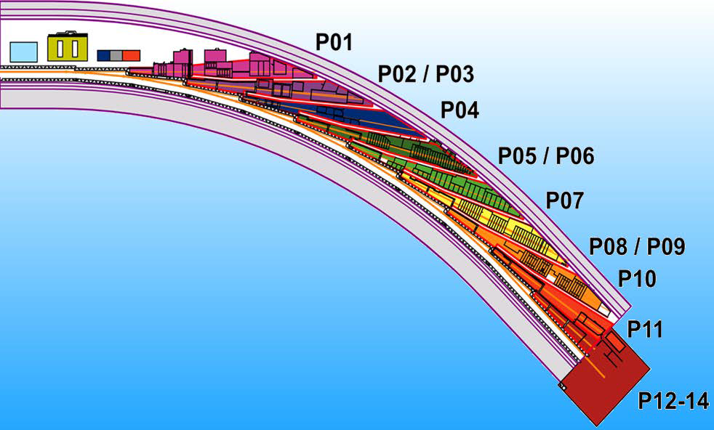
PETRA III – Statistics of the year 2016
Germany
63.4%
P01 High Resolution Dynamics
P02.1 High Resolution Powder Diffraction
P02.2 Extreme Conditions
P03 SAXS/GISAXS (micro & nano focus)
P04 Variable Polarization XVUV
P05 Imaging & Tomography (HZG)
P06 Micro- and Nano Probe
P07 High Energy Materials Sciences (HZG)
P08 High Resolution Diffraction
P09 Resonant Scattering & Diffraction
P10 Coherence Applications
P11 Bio Imaging & Diffraction
P12 Bio SAXS (EMBL)
P13 Macromolecular Crystallography (EMBL)
P14 Macromolecular Crystallography (EMBL)

Slide 5
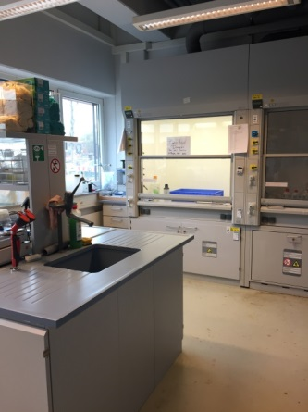
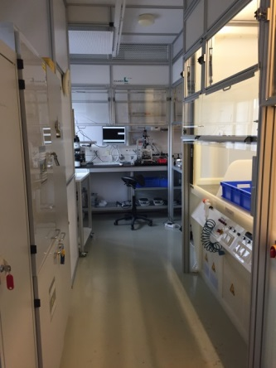
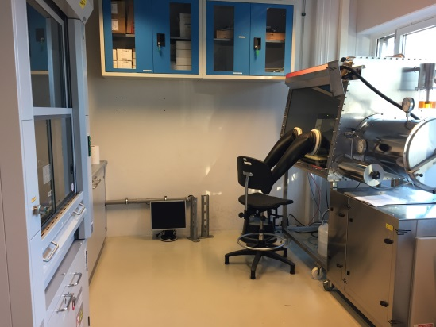
User chemistry laboratories in the Max von Laue Hall
Chemistry lab
(L031)
Clean room (L032)
Beamlines laboratories
Sample preparation lab for P10 users
Sample preparation lab for P11 users
Chemistry lab for P02.1/P02.2 users

Slide 6
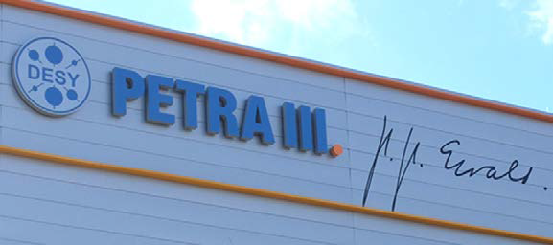
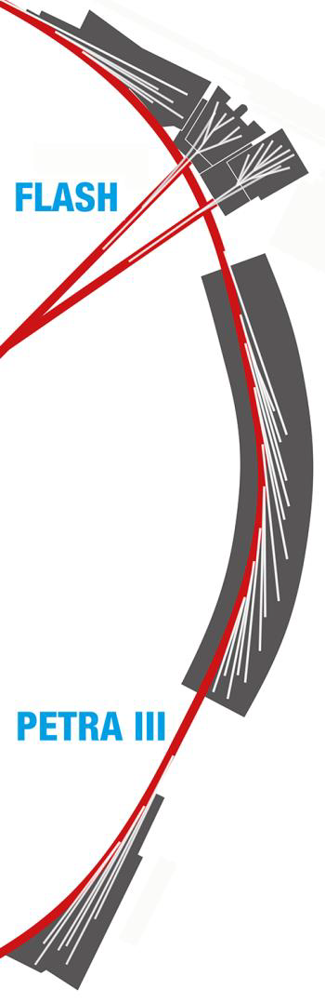
PETRA III Extension North Hall
P61.1
P61.2
P62
P63
P64
P65
P66
High Energy Engineering Materials Science (HZG)
High Pressure Extreme Conditions
Small angle X-ray scattering
not funded yet
X-ray Absorption Spectroscopy
High-Energy X-ray Absorption Spectroscopy
Time-resolved luminescence spectroscopy
design
phase
design
phase

Slide 7
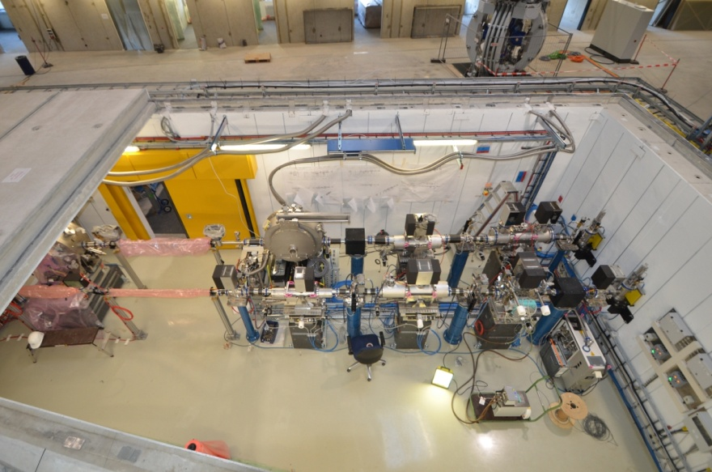
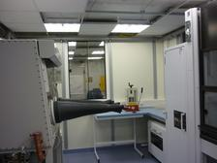
Beamlines P64 and P65
Beamline P65 - High-Energy X-ray
Absorption Spectroscopy
Beamline P64 - X-ray Absorption
Spectroscopy
user operation started in June 2016
commissioning with first monochromatic
beam in the experimental hutch started in
April 2016
in April 2017 started regular user operation
P64/P65 Optics hutch
Sample preparation lab for P64 and P65

Slide 8
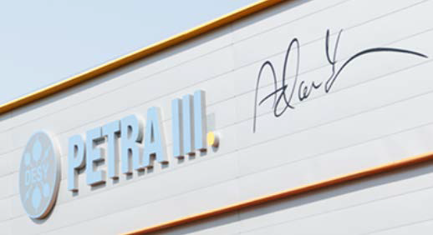
PETRA Extension East Hall
P21
P22
P23
P24
High energy material science
X-ray photon electron spectroscopy
X-ray nano-diffraction
Chemical Crystallography
first beam
this year

Slide 9
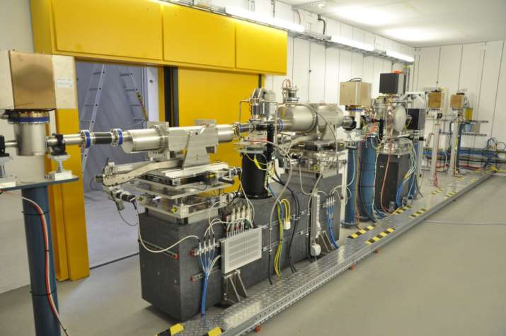
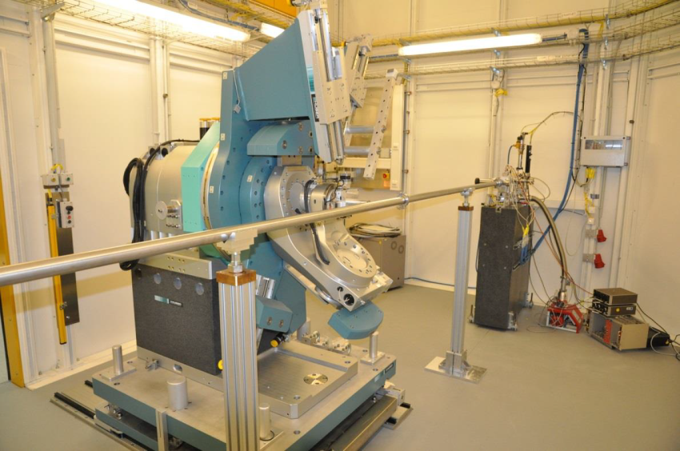
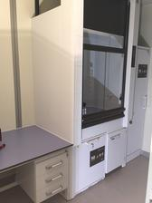
Beamline P24 – Chemical Crystallography
commissioning has started
P24 user workshop-May 2017
friendly users planned fall 2017
first proposal call Sept.2017
user operation from spring 2018
Optic hutch
Diffractometer in experimental hutch
Sample preparation

Slide 10
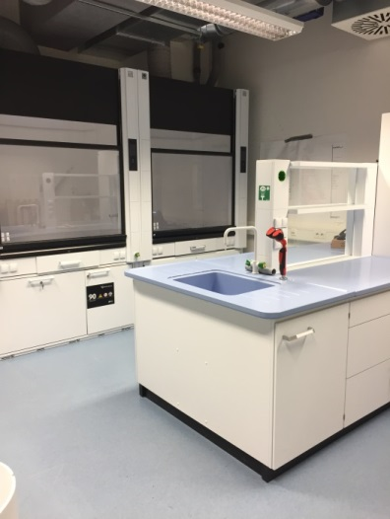
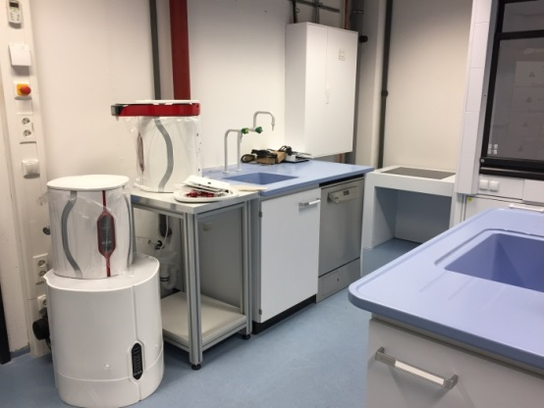
User chemistry lab in the PETRA Extension East Hall
a fully equipped chemistry lab is available for users since April 2017

Slide 11
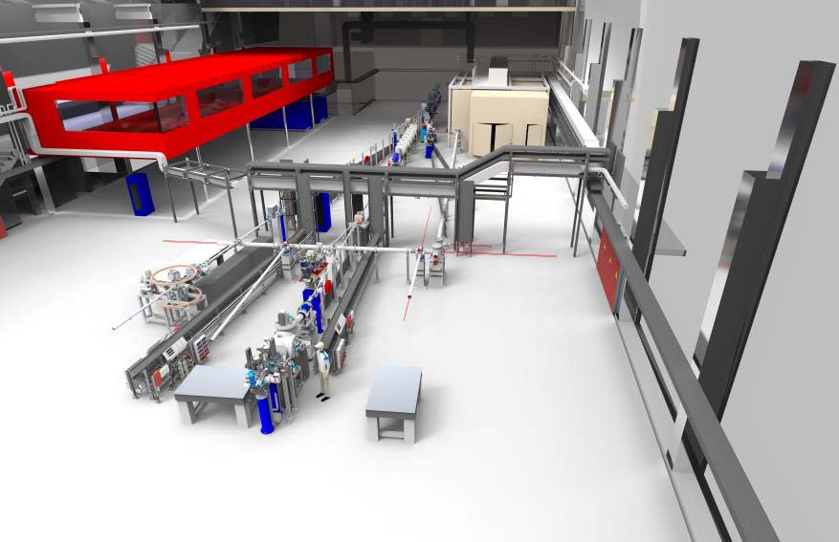
FLASH1and FLASH2
FLASH, the Free-Electron LASer in Hamburg, started user operation in summer 2005 as the first free-electron laser for XUV and soft X-ray radiation.
is operated in the "self-amplified spontaneous emission" (SASE) mode
FLASH1 offers five beamlines for users
first lasing of FLASH2 was achieved in August 2014 in parallel to FLASH1
since spring 2016, the beamlines FL24 and FL26 are available for users in the "Kai Siegbahn" hall
FL26
FL24

Slide 12



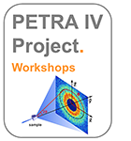
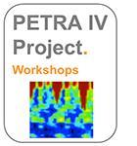



PETRA IV – Decoding the Complexity of Nature
DESY plans to convert the PETRA storage ring into an ultralow
emittance synchrotron radiation source, able to provide beams of hard X-rays with remarkable coherence properties that can be focused to dimensions in the nanometer regime
experts and future users from many fields of science are discussing
frequently during the workshops about the science case for the ultralow emittance storage ring PETRA IV
in spring 2018 DESY will present a conceptual design report for PETRA IV

Slide 13
Acknowledgements
  Laboratory staff
  FS-TI Group and Photon Science Safety Officer
  D5 department

