Slide 1
Two Institutes
– one Access Control System
Access Controls at DESY and the European XFEL
Sabine Brinker (DESY - MPS)
for the DACHS-Team
ITSF Sept 2017

Slide 2
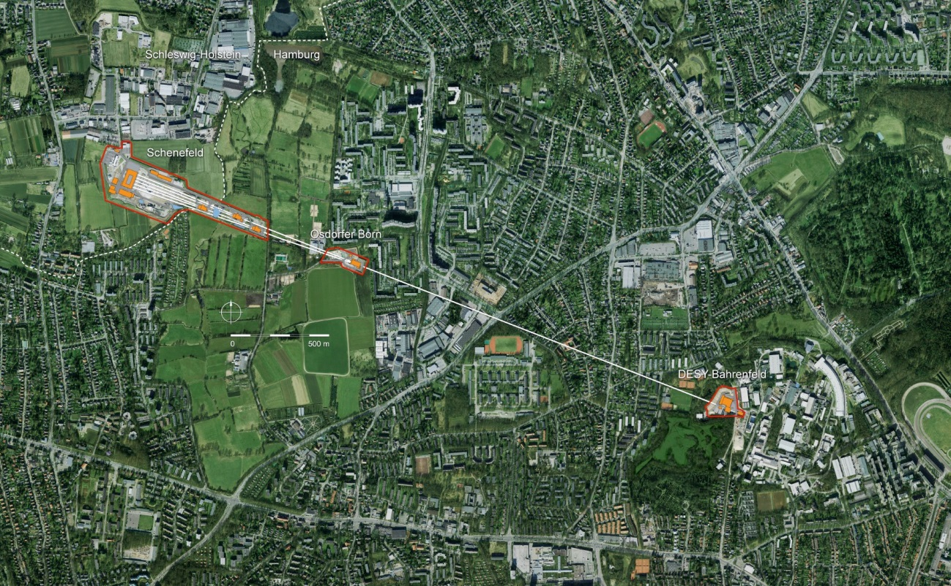
Overview – DESY and Eur. XFEL

Slide 3
Some General Information about DESY
Two sites (Hamburg and Zeuthen)
About 2 500 colleagues
3 000 photon user per year
Several accelerators (PETRA III, FLASH,…)
Accelerator research (plasma accelerator – LUX, SINBAD…)
High energy physics (CMS, ATLAS, BELLE, BELLE II..)
Test beams for detector development
Astro-particle physics
Theory
Many cooperations (EMBL, HZG, CFEL, Univ. of Hamburg, CSSB…)

Slide 4
Some General Information about the Eur. XFEL
3 Sites (Bahrenfeld, Osdorf, Schenefeld)
~ 400 colleagues
Superconducting linear accelerator
6 km tunnel length, 1.7 km acceleration length
6 to 38 m depth of the tunnels
17.5 GeV
0.05 to 4.7 nanometers wavelength (hard X-rays)
27 000 flashes per second
2016 commissioning
2017 user operation

Slide 5
DACHS (Desy ACcess Handling System)
Commercial access control system (Interflex, security)
  Badges with RFID chip (Mifare Classic)
  Online and offline terminals
  Online terminals often with interface to a safety-system (e.g. laser interlock)
  Large, scalable database application
DARF-DACHS - Database developed by DESY
  Heart of the DACHS system
  Management of access rights, trainings and other requirements (dosimeter)
  Validity of all access rights and requirements
  Roles for decentralized data administration
    Room managers can grant access to their rooms for any person
    Group leaders can see all rights and instructions of the members of their groups
  Full integration into the DESY and Eur. XFEL IT environment

Slide 6
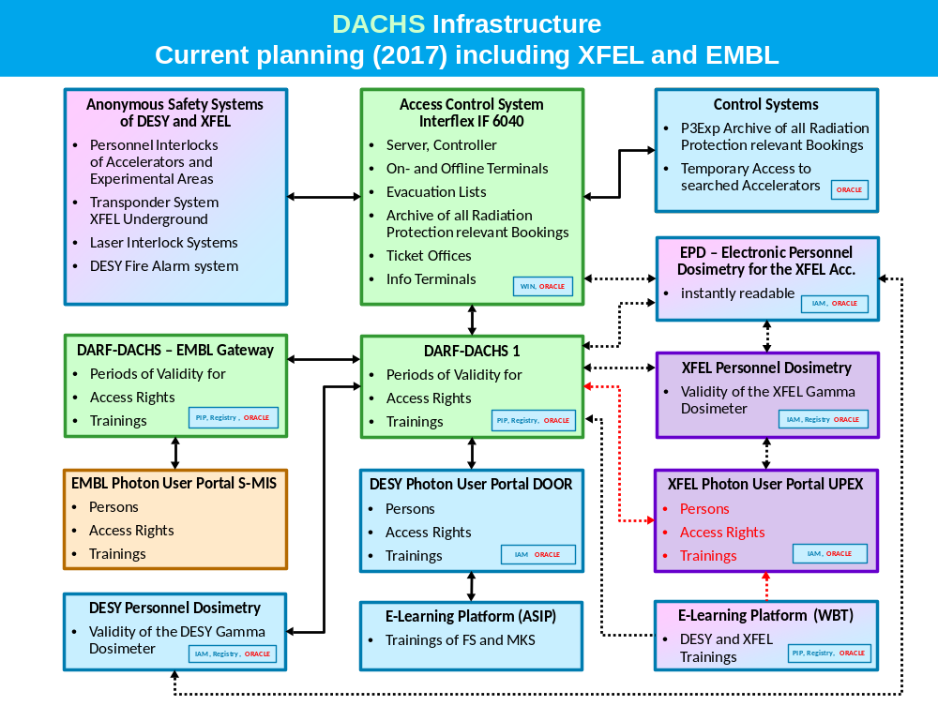

Slide 7
Current Key Numbers
DARF-DACHS | Sep. 2017
Persons (Data Base) | > 30 000
New Users per year | ~ 2 000
Areas (e.g. Labs) | > 300
Different Trainings | ~ 220
Ext. Companies |  | > 550
People entering data | > 350
Interflex System | Sep. 2017
DACHS Badges since 2008 Currently active | > 18 000 > 11 000
Sites | 4
Badge Printer Stations | 11
Terminals | Online: > 450 Offline: > 250
Controller (Network Devices) | ~ 100
Online Bookings / Day | ~ 3 000

Slide 8
Two Institutes - Dosimetry
DESY is responsible for the radiation protection of the Eur. XFEL-accelerator at the moment
Hand over of the responsibility to the Eur. XFEL company within the next months
At that time DESY staff has to carry the official dosimeter AND a directly readable dosimeter in Eur. XFEL radiation protection areas to be able to assign the measured dose to the institute (similar to contracted company - StrSchV §15)
Everyone will have to carry both dosimeters
  Alarm function of directly readable dosimeter
  Practical reasons
Three data bases for dosimetry
  DESY – official
  Eur. XFEL – official
  Directly readable dosimeters

Slide 9
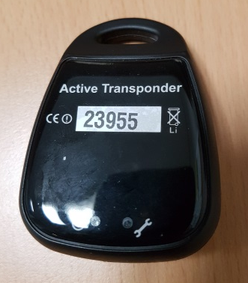
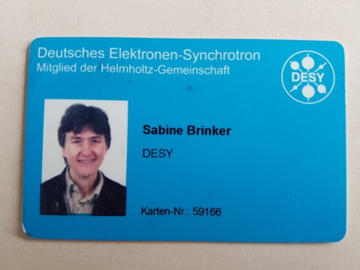
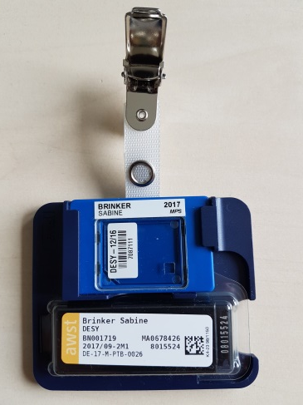
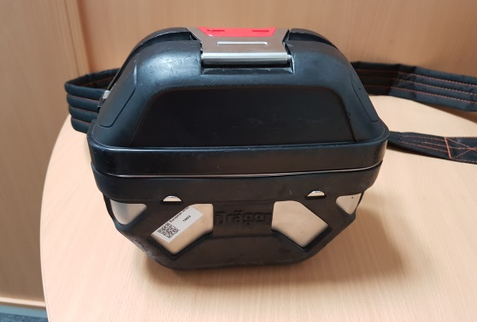
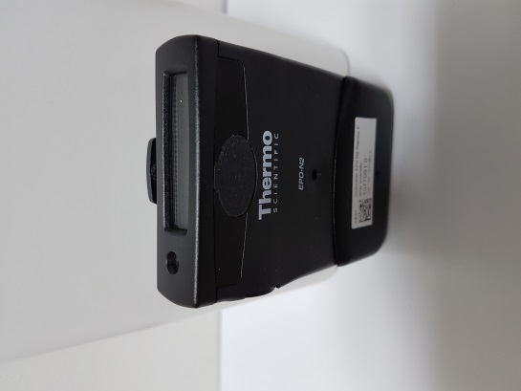
Entering the Eur.XFEL experimental Hall / the Eur.XFEL Accelerator
Requirements for the Eur. XFEL experimental hall (under ground):
  Valid access right
  Valid instructions
additionally for the accelerator:
Transponder
DACHS Badge
Official dosimeter
Directly readable dosimeter
Self-rescue device

Slide 10

Procedure to pass the Turnstile – enter the Tunnel Area
Open dosimeter locker with DACHS
Get a directly readable dosimeter
Put it in the dosimeter reader for activation
Authorization by DACHS badge at the DACHS reader
Simultaneously transponder is checked
Dosimeter is assigned to person
Remove dosimeter
Turnstile lock opens for entry

Slide 11
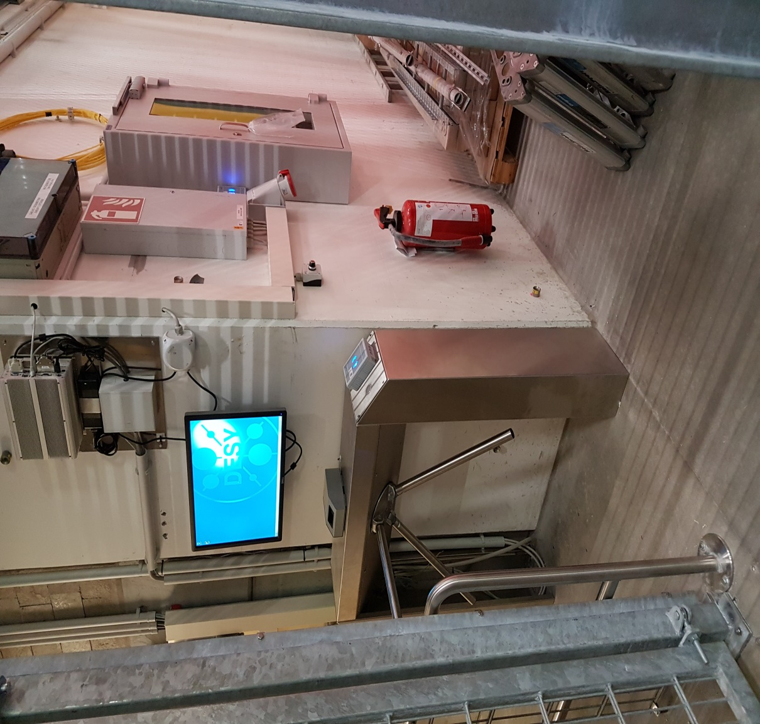
Turnstile and locker for temporary dosimeters

Slide 12
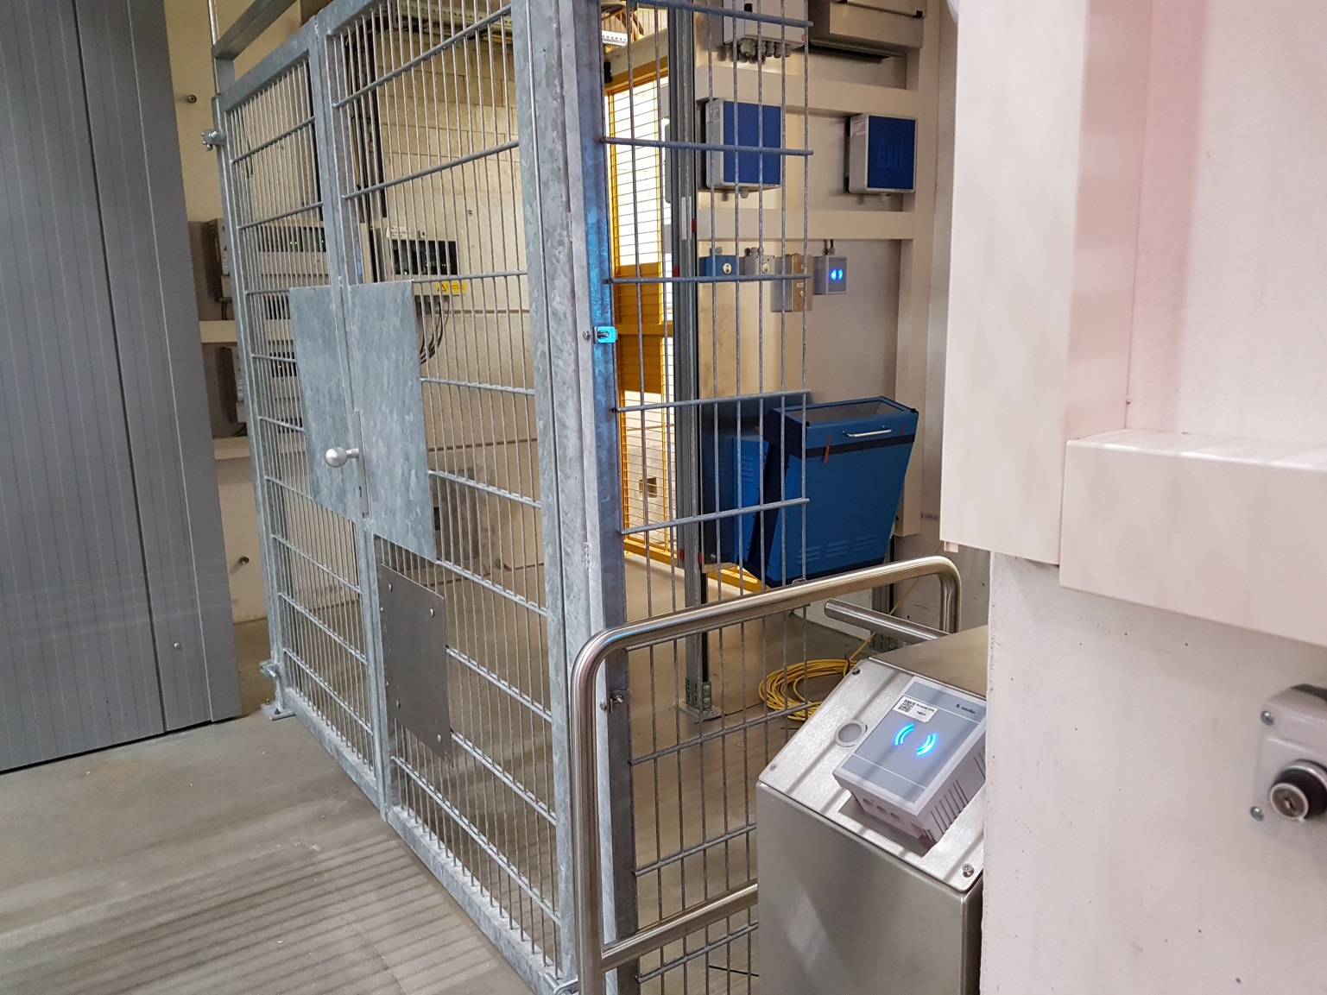
Entrance to accelerator

Slide 13
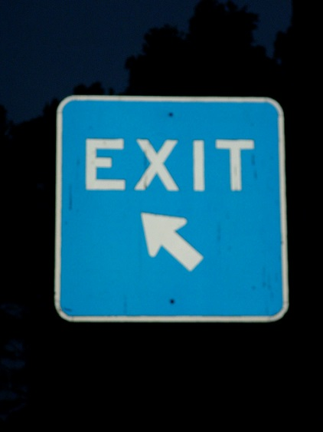
Procedure to pass the Turnstile – leave the Tunnel Area
Dosimeter is put in reader
Dose is read and assigned to person
Dose is stored in data base
Dosimeter is deactivated
Remove dosimeter
Turnstile lock opens for exit
Open locker with DACHS and put dosimeter back

Slide 14
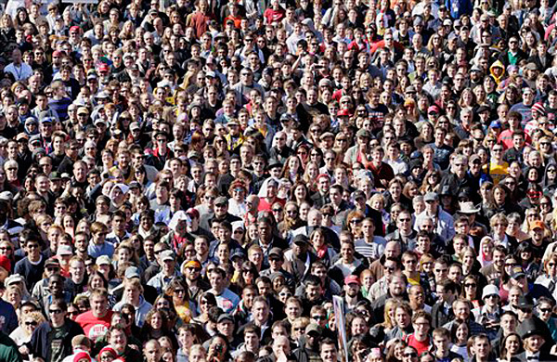
Database to identify all People of all Institutes
IAM – Identity and Access Management
  Developed and operated by DESY
Clients at present:
  DESY, Eur. XFEL, EMBL, University of Hamburg
Three photon user portals connected
  DOOR (DESY), SMIS (EMBL), UPEX (Eur. XFEL)
Two HR systems (leading systems for staff)
  DESY SAP HCM, Eur. XFEL rexx
DESY can administer all data
BUT visibility of other clients has to be limited (data protection)

Slide 15
Personal Data Handling
Data can be entered by hand
Automatic import of person data coming from 3 photon user portals
Automatic import of person data coming from 2 HR systems
Visibility is set automatically by the source of the data or
by the person concerned directly in the IAM
E.g. the data a photon user who registered
him/herself in UPEX and SMIS can
be seen by DESY, EMBL and
Eur. XFEL
UPEX
Eur. XFEL
DESY
Others
EMBL
Univ. of Hamburg
SMIS
DOOR

Slide 16


DARF-DACHS at the Eur. XFEL and Data Protection
At the moment DARF DACHS can not handle clients
  Eur. XFEL Administrators have to be restricted to the Org. Unit „Eur. XFEL“
DACHS support has to enter data of „non Eur. XFEL people“ for Eur. XFEL areas
Eur. XFEL room managers are unable to see the complete lists of access rights and trainings
Revised DARF-DACHS version will adopt multi-client capability of IAM
Negotiations with DESY works council about an interim agreement
  Same rights for Eur. XFEL room managers as for DESY staff
  Most information public (telephone book)
  No birth dates visible
Expecting approval soon

Slide 17

Thanks to the Colleagues of …
… the IT-department
… the radiation protection group
… the Eur. XFEL company
… the administration
… the DACHS-team
and…

Slide 18
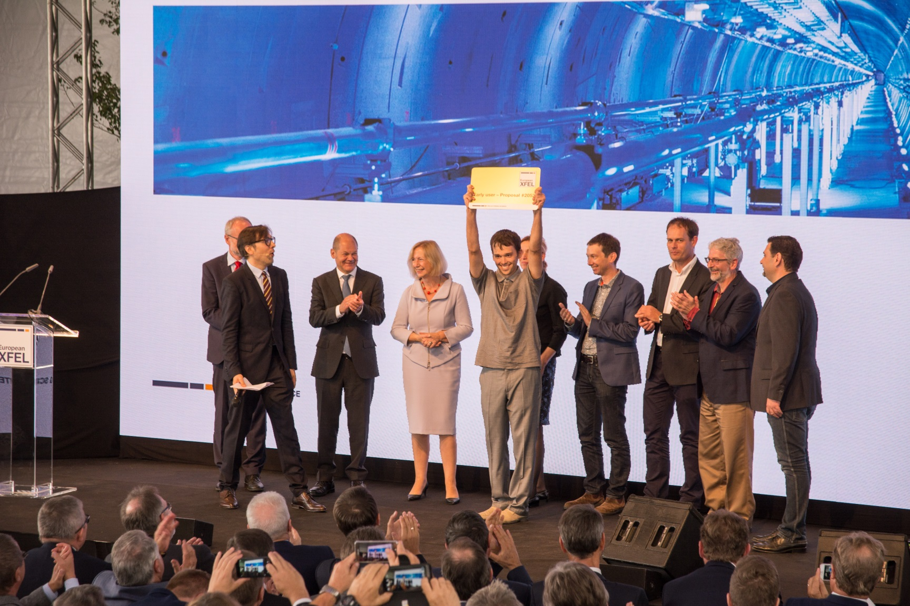
..to you for your Attention!

