Slide 1

ITSF 2017 Lessons learned
Lessons learned in DESY Photon Science user chemistry laboratories or how to get users to avoid and report spillages?
Sabine Lessmann-Bassen
Anca Ciobanu
ITSF 2017

Slide 2
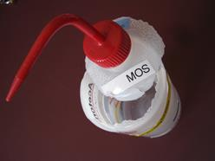
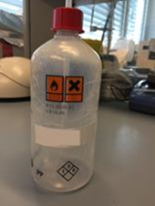
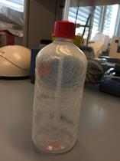
Lessons learned: Chemistry Laboratories
What we learned from last ITSF
  Ives Lörtscher from PSI presented a broken solvents container
  We also found brittle container and could renew them before breakage
Some minor incidents in the DESY Photon Science user chemistry laboratories
  Different cases of chemical spillage lead to improvements and suggestions in the process of user registration,
  on-site support and to new procedures.

Slide 3

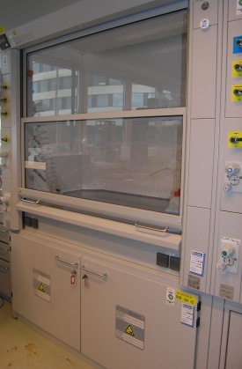
Lessons learned: User Chemistry Laboratories
  First incident during a two weeks shutdown period: acid was found in an open vessel in a non-ventilated fume hood, which caused corrosion of valves.
  Glass vessel was not labeled, indicator: acidic pH
  Check of chemistry declarations (list of declared substances, equipment) for this lab/ time period, discussion with beamline responsibles
  Access control data: DESY workers council denied an agreement to data evaluation because of the long time period
  → No satisfactory outcome. What could we do better?
  - Lab checks also during shut down periods
  - Discussion with works council, workers agreement: evaluation and follow-up together with the workers council
  - Remark in safety training: „your access data may be evaluated for safety reasons“

Slide 4

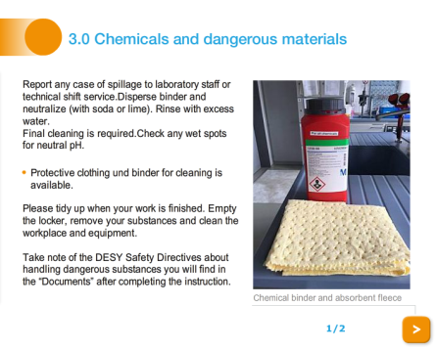
Lessons learned: User Chemistry Laboratories
  2nd incident during beamtime: Monday morning: a yellow liquid was spilled in fume hood, drawers, floor
  Closed lab, get information
  Check for substances in chemistry declarations: two specific inhouse user groups could be identified.
  Two days relevant for access data evaluation together with workers council, two badge id‘s were found.
  The supervisors had to find dates for official discussions with the relevant persons, which took weeks. The responsible student was found, but it turned out, that this (personal) badge was lend to s.o. else. Still unclear what had happened. „If your lab is not clean, how could we possibly work there?“
  Substance was heated in a glass vessel on a hot plate, glass broke
  → No satisfactory outcome. What could we do better?
  Discussion when to block a lab, shift user groups to a spare chemistry lab
  Signs prepared for blocking whole lab/ single fume hoods,
  Discussion of a procedure: what to do in case of a spillage?
  First measures, whom to inform, role of shift service, technical emergency service etc.
  Qualified cleaning company, which is able to act on short notice
  Spill kit explained during on-site instruction, extra slide in online safety training, users are trained to report any spill
  Electronic logbook for user chemistry laboratories
  Chemistry declaration form: Import of list of participants per beamtime → every participant by name

Slide 5
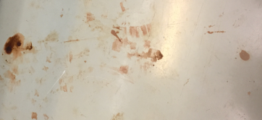


Lessons learned: Chemistry Laboratories
  3rd incident: Red stains and shoe prints in the chemistry clean room
  Result of access data evaluation, discussions: Peroxomonosulfuric acid (caro‘s acid/ piranha) dripped during filling in another container on a tissue (leaving dark stains) and on the floor.
  Person involved said they did not notice/ stains had already been there. The second person did not use their badge although having a valid one.
  → No satisfactory outcome. What could we do better?
  Besides a granted long-term chemistry declaration: register for work with Piranha/ HF in the lab schedule
  Then easier to be in the right place, at the right time…
  Talk by A. Ciobanu “Safety in chemistry laboratories” in the Photon Science meeting
  Clear drop marks on the floor - spillage of chemicals?
  - New staff of contracted cleaning company spread drops of concentrated cleaning fluid on the floor and left to get a wiper. His badge did not work and he could not find the shift technician to open the door again. He was in a a hurry, left the building without wiping (leaving very clean spots..) and returned the other day.
  What could we do better?
  We suffer from high fluctuation in the contracted cleaning company. We were not immediately informed if someone else is in charge and needs a personal badge or returned the badge. New cleaning company for specialized laboratories (chemistry and biology lab, clean room), twice a week
  Define an easy procedure how to get a badge and safety instructions for contracted companies with DESY administration

Slide 6
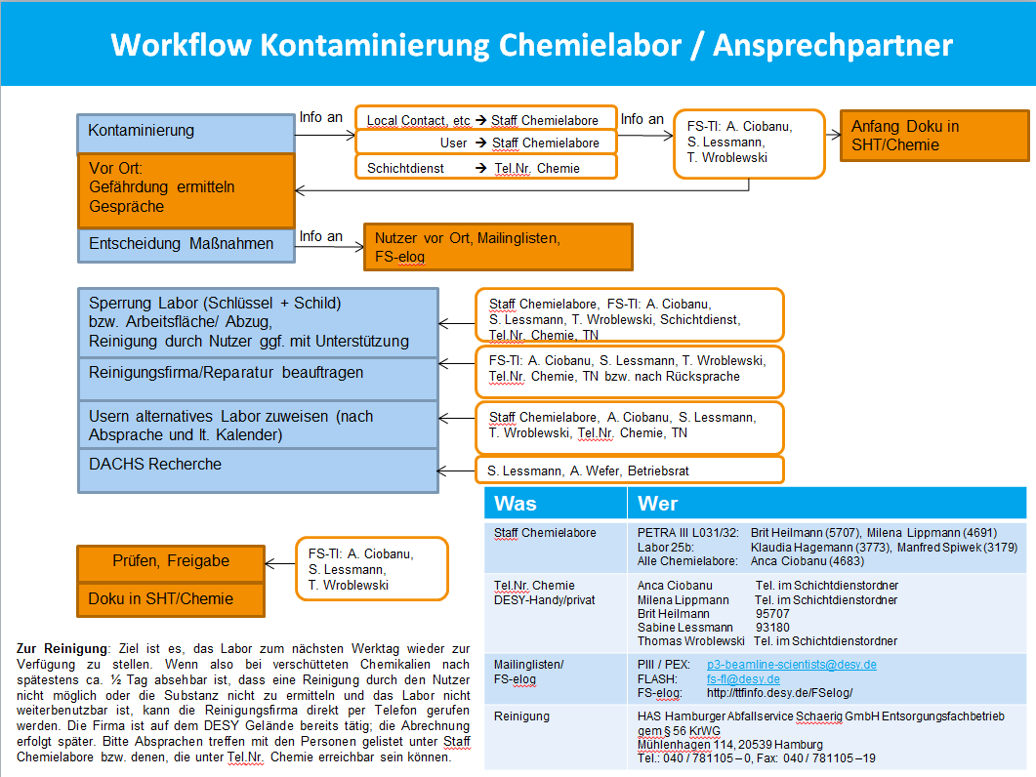
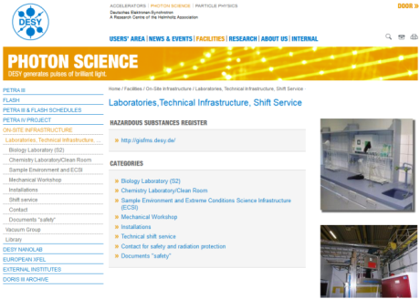
Lessons learned
  Improvements
Lab checks during shutdown
Proven procedure in access control evaluation via DACHS
Workflow contamination
Qualified cleaning company on short notice and another one for regular cleaning
On-site Instruction: spill kit explanation, encourage user to report any spill, offer support
Updated information on website, online safety training
Updated chemistry declaration form: responsible person + list of participants
It makes sense to even take the small incidents for further improvement
Minor incidents help to make the lab safer
Thanks to the DESY colleagues FS-Technical Infrastructure
Thanks for your attention!
;)

