Slide 1


Safety measures for massive
helium leakage
by Fabian Saretzki
DESY
SAVE – service center for system safety, fire prevention
and emergency service

Slide 2

content
Current status
Possible technical solutions to detect leaks
Prepared solution
Preferred solution
Structural measures that would have been advantageous

Slide 3
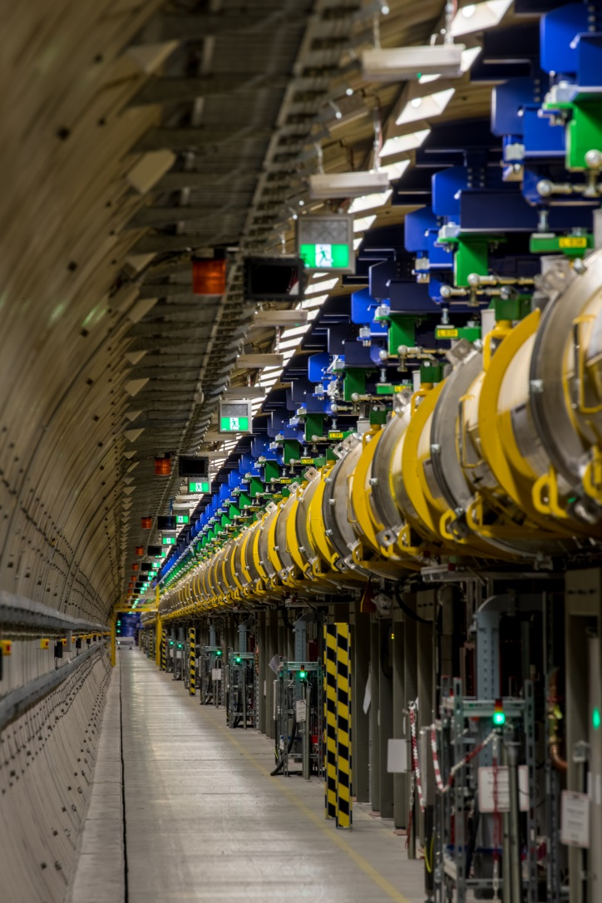
Current status
Ventilation flaps continuously open
Heightened awareness for O₂ deficit alarms coupled with “smoke” detection
Foto: Dirk Nölle

Slide 4
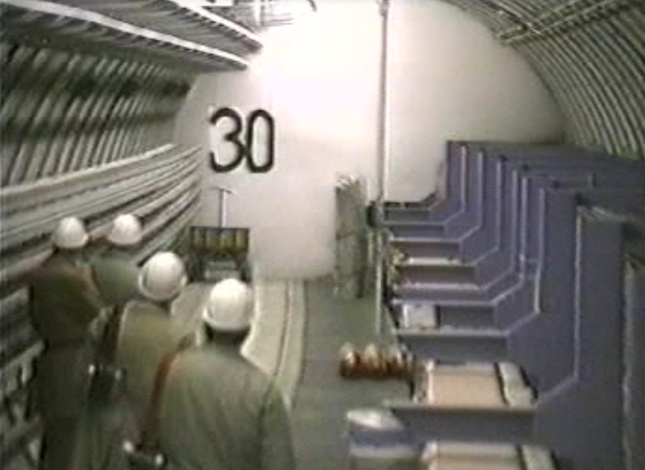
Possible technical solutions to detect leaks
“smoke” detection of condensing humidity
Oxygen deficit detection
Substance detection
Pressure monitoring
Temperature monitoring
Thermal infrared imaging

Slide 5
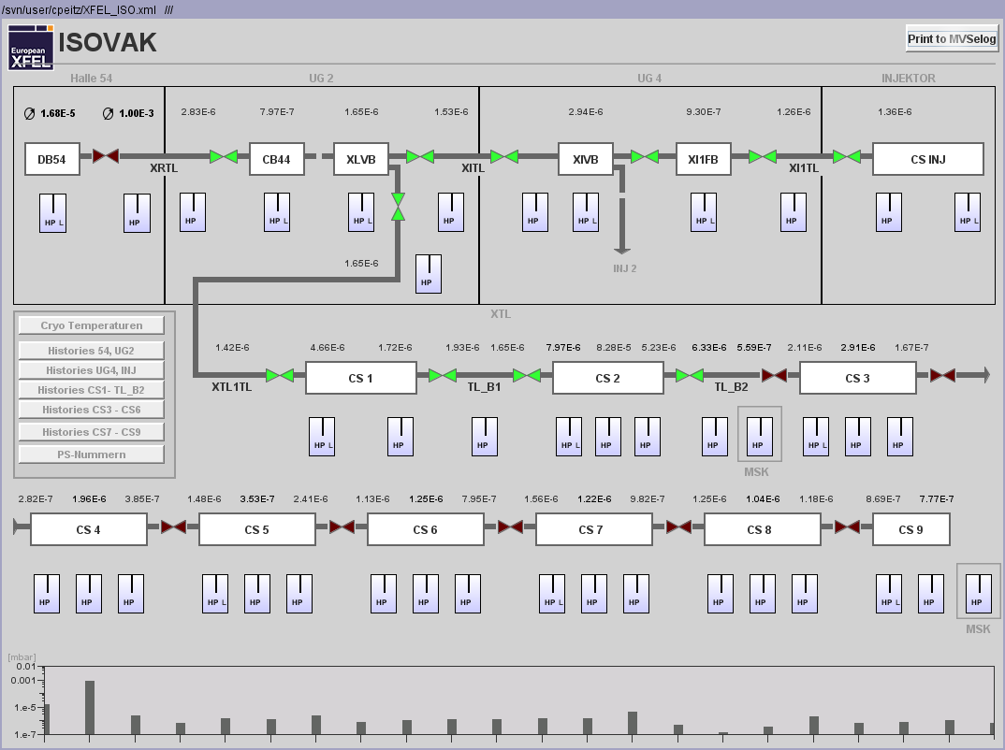
Prepared solution
1. Instance:
Error in isolation vacuum control system
- Open ventilation flaps
2. Instance:
O₂ deficit- combined with “Fire”-Alarm

Slide 6
Prepared solution
1. Instance:
Error in isolation vacuum control system
- Open ventilation flaps
2. Instance:
O₂ deficit- combined with “Fire”-Alarm

Slide 7
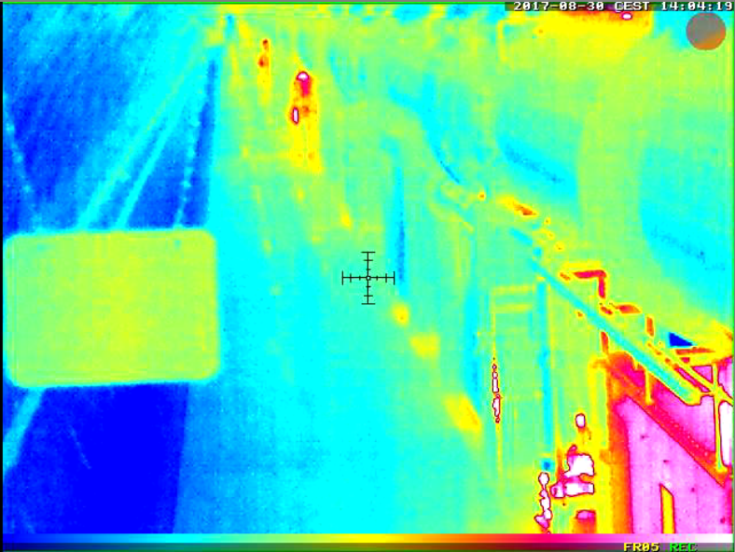
Preferred solution
Thermal Infrared Imaging
2nd choice: Helium detection

Slide 8

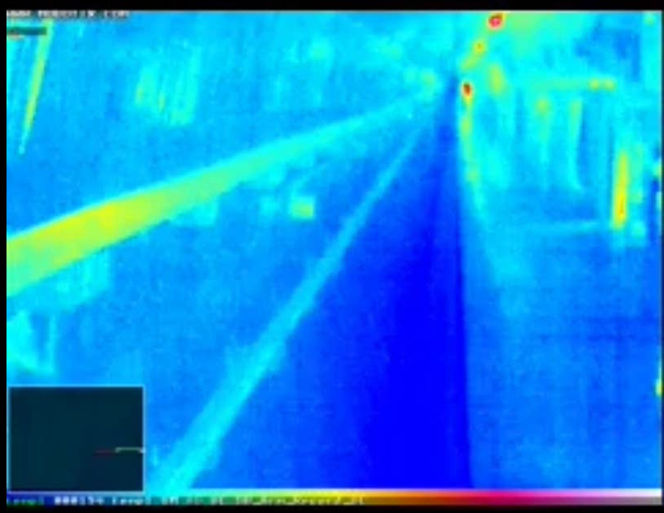

Slide 9
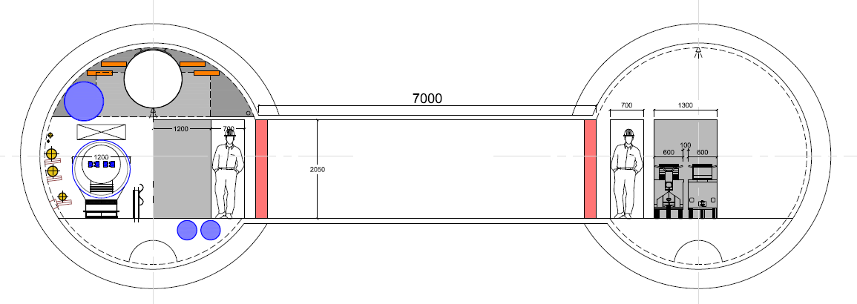
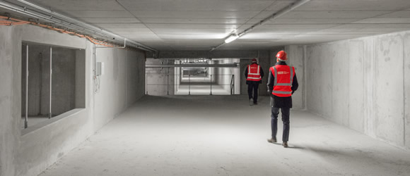
Structural measures that would have been advantageous
Helium extraction duct
Predetermined breaking structures

Slide 10

Fabian Saretzki
Work package 36 - General Safety
Deutsches Elektronen-Synchrotron
SAVE
Notkestraße 85, Geb. 35
22607 Hamburg
Tel.: +49 40 8998 - 4763
Fax.: +49 40 8998 – 4311
Mobile: +49 171 105 3424
Mail: fabian.saretzki@desy.de

