Slide 1


regulatory framework for construction and operation of the European XFEL facility
by Sven Mohr
DESY
D5 – Occupational Safety and Evironmental Protection
Notes:
How to edit the title slide
Upper area: Title of your talk, max. 2 rows of the defined size (55 pt)
Lower area (subtitle): Conference/meeting/workshop, location, date,
your name and affiliation,
max. 4 rows of the defined size (32 pt)
Change the partner logos or add others in the last row.

Slide 2
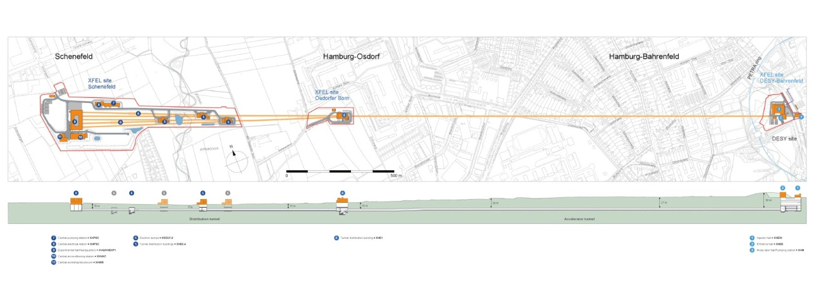
facility overview
3 sites
facility crosses federal state borders
tunnels 6 to 38 metres deep
total length: 3.4 kilometers
a total of 5.4 kilometers of underground tunnel system

Slide 3

legal requirements
plan approval order („Planfeststellungsbescheid“) of July 20th 2006
advantage:
key planning tool including most legal requirements
§ BImSchG §
§ BImSchV §
§ HWaG §
§ BBodSchG §
§ HmbNatSchG §
§ BNatSchG §
§ BArtSchV §
§ UPVG §
§ TA Luft §
§ EMVG §
§ LNatSchG §
§ DSchG HH/S-H §
§ VwVfG §

Slide 4
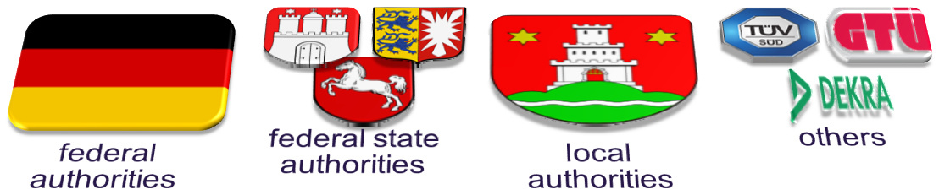
legal requirements
plan approval order („Planfeststellungsbescheid“) of July 20th 2006
disadvantage:
restricted flexibility and adaptability in later project phases (e.g. smoke extractor duct)

Slide 5
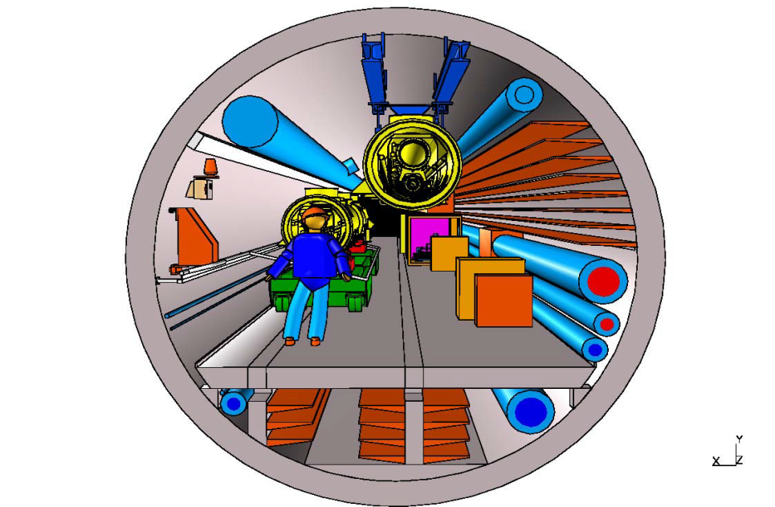
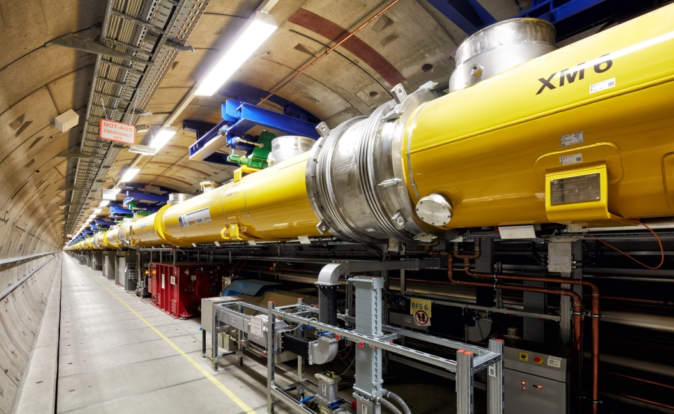
example: smoke extraction duct
!
?
specification defined by STUVA expertise
actual tunnel view

Slide 6
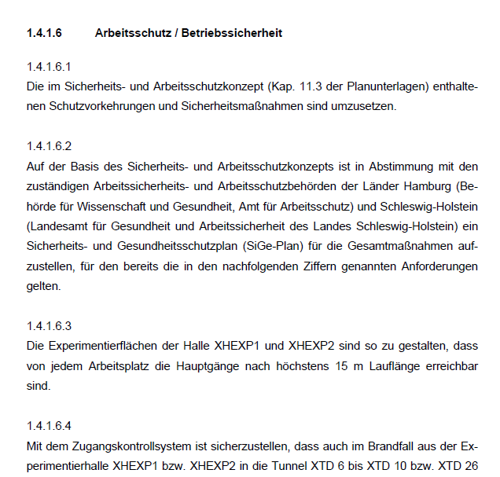
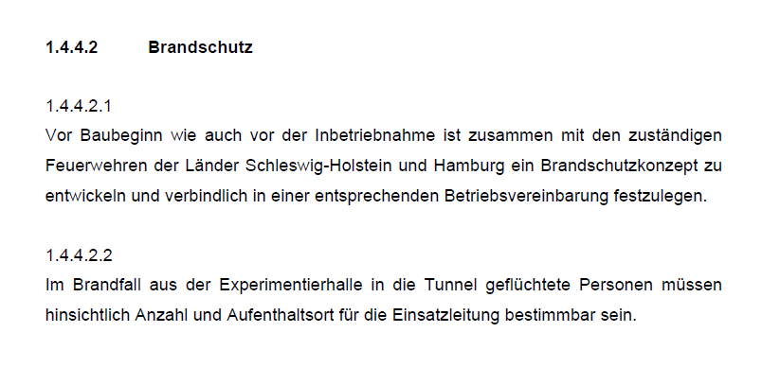
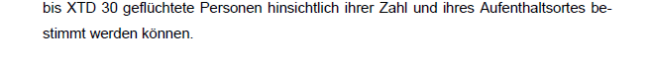
another example:
“number and location of fleeing persons has to be known…”

Slide 7


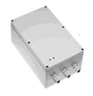
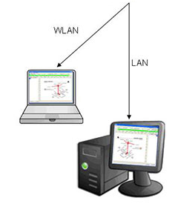
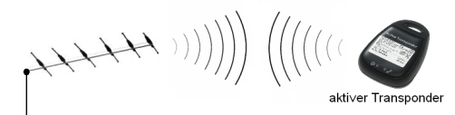
another example: tracking system
LF position badge:
generation of defined low frequency field 125kHz
LPS data
servers:
processing of LPS data, redundant multiple server solution
position transmission
position transmission
wake up of transponders
HF receiving point:
high frequency reference signal 868MHz, high range, network connection
visualization:
licence-free client software for position display, tamper-proof subnet
active transponder

Slide 8
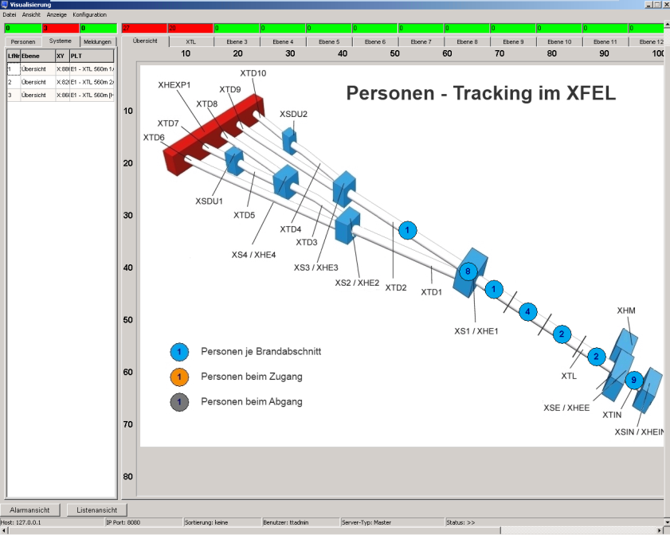
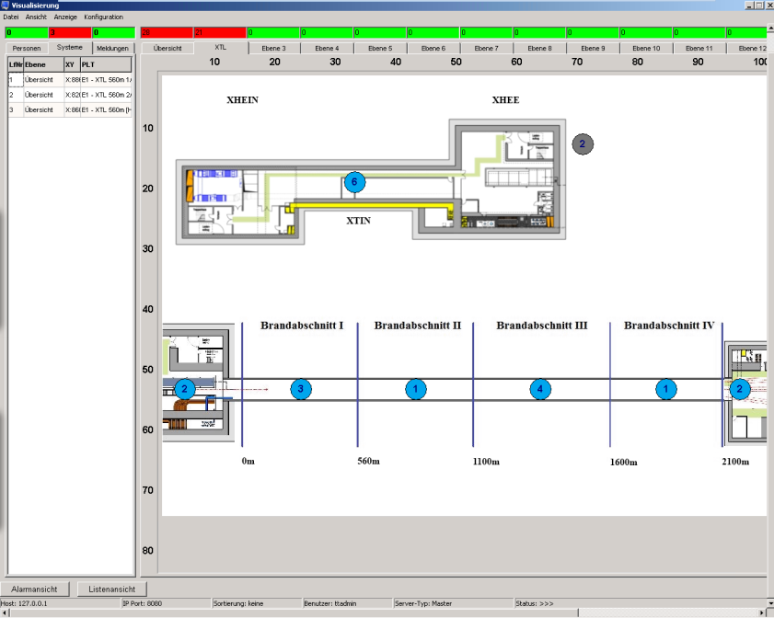
another example: tracking system
visualization in different layers
real-time
“intelligent” technology

Slide 9

legal requirements
comments regarding plan approval order by LBEG*
on imprecisely formulated requirements
on external reports and expertises
(e.g. fire protection expertises for shaft buildings)
on construction applications
* Landesamt für Bergbau, Energie und Geologie

Slide 10
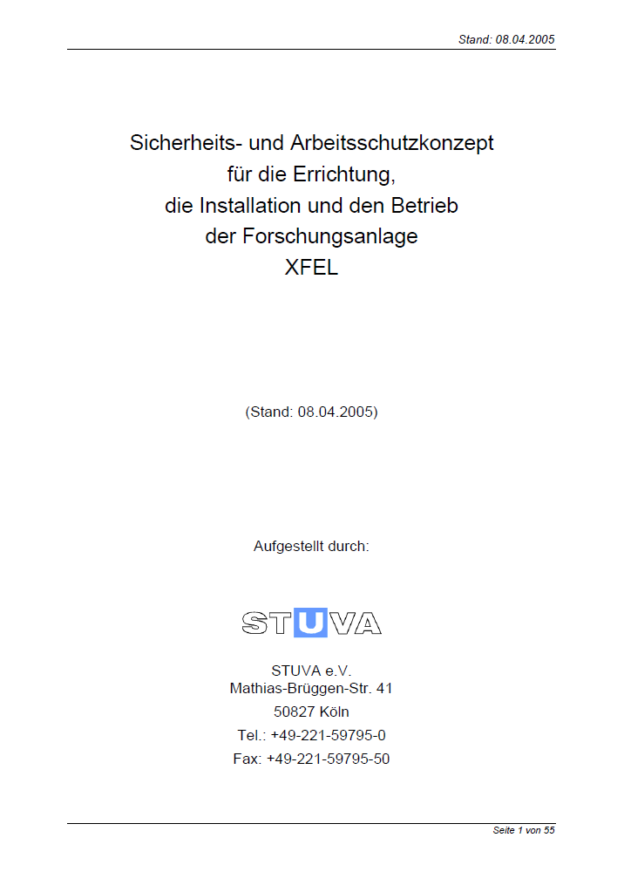
legal requirements
STUVA* expertise of April 8th 2005
officially approved document
requirements to be handled like plan approval order
safety-related requirements
* Studiengesellschaft für unterirdische Verkehrsanlagen e.V.

Slide 11
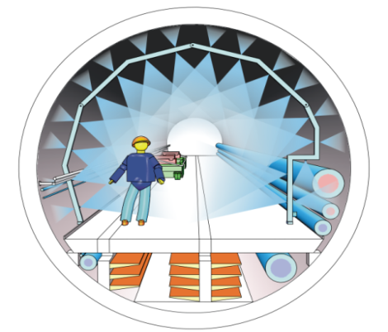
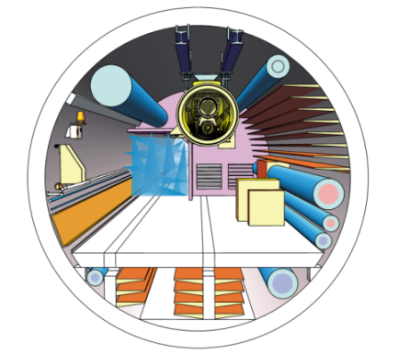
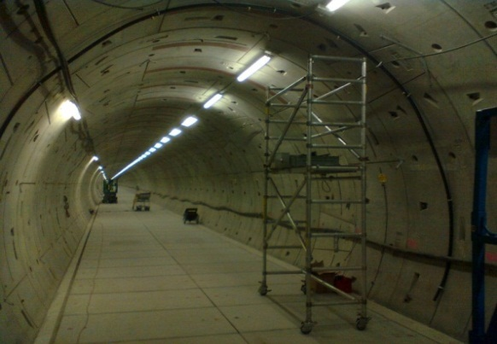
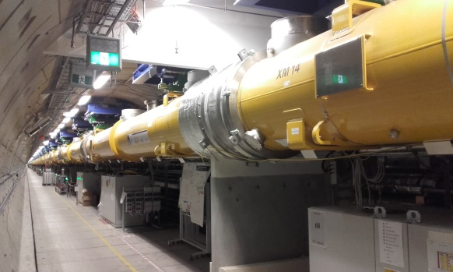
example: fire compartments (technical level)
“high pressure water curtain” as separation of fire compartments
Installation phase
operating phase
planned
actual implementation
Notes:
Firewalls all 600m
Survey systems and need for transports make it impossible to build solid walls
Equivalent to fire resistance of F90
Curtains ensure areas free of smoke and fire -> save areas

Slide 12
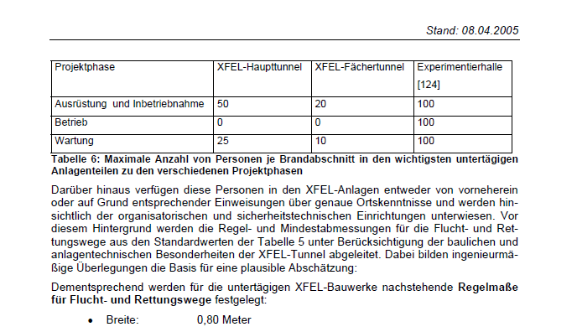
example: density of personnel (organizational level)

Slide 13
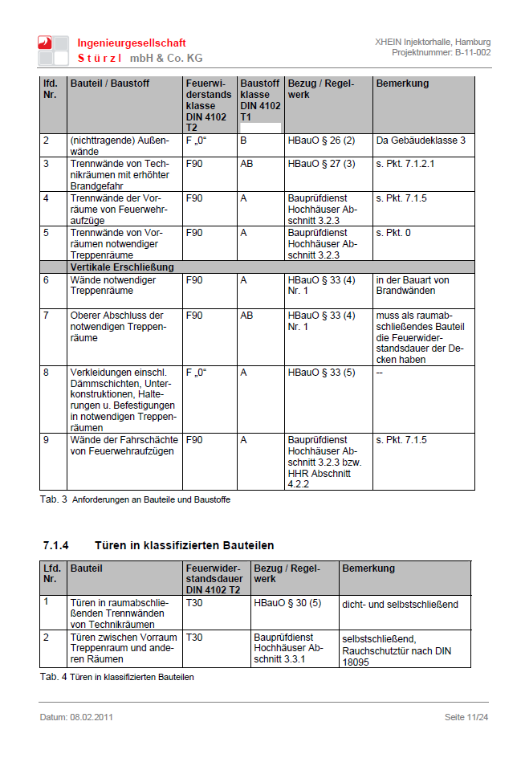
legal requirements
fire protection expertises incl. statement of LBEG
building-related requirements
in some cases deviations to former requirements possible
valid only with approval and explanatory remark of LBEG

Slide 14
legal requirements
comments on construction applications of local authorities
for issues not handled in former documents
for buildings not covered by plan approval process
plus facility-specific conditions for external intervention forces

Slide 15



example: coordination of fire brigades
two federal states involved
different kinds of fire brigades
  ► different technical standards (equipment)
  ► different command structures and strategies
  ► different demands to be satisfied
Notes:
Hamburg: professional fire brigades
Schleswig-Holstein: volunteer fire brigades
i.e. digital and analogue radio

Slide 16
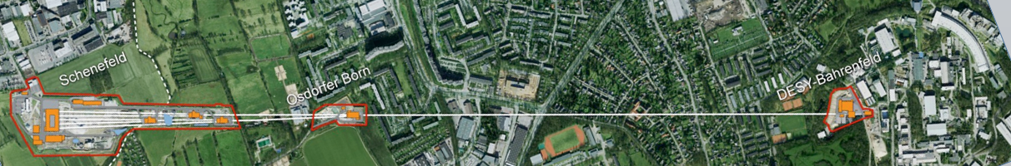
conclusion: a lot of regulatory framework (!) but…
3 different phases at the same time
➔ 3 different focuses!
civil construction
Infrastructure installation
machine installation

Slide 17
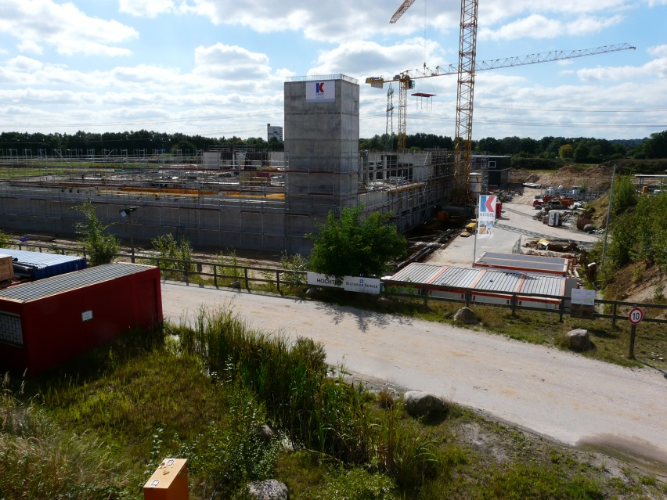
construction: covered ✓
civil construction
free falling edges
construction machinery
physical strain
electric shock
moving material
noise

Slide 18
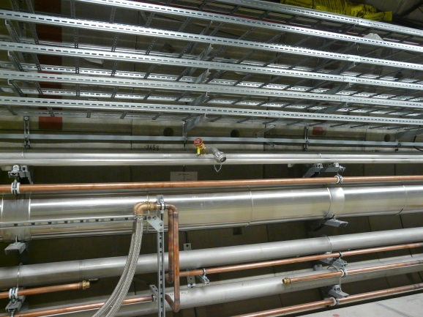
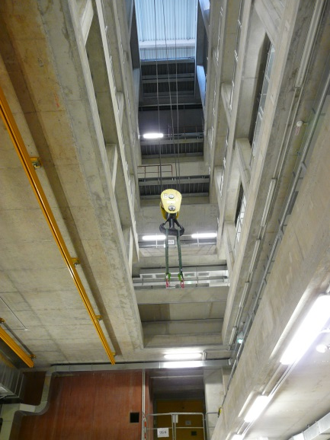
infrastructure installation: covered ✓
installation
moving material
electric shocks
moving work equipment
hot surfaces
inhalation of hazardous substances
combustable gases

Slide 19
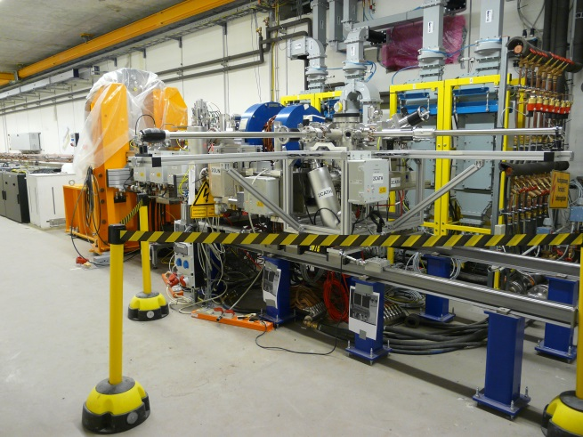
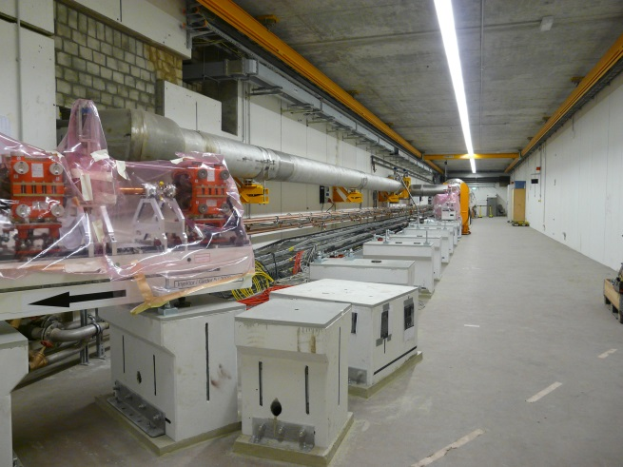
machine installation & commissioning: covered ✓
machine installation
electric shock
electric arcs
combustible gases, liquids
Inhalation hazardous substances
electrostatic charges
skin contact hazardous substances
hot/cold surfaces
radiation

Slide 20
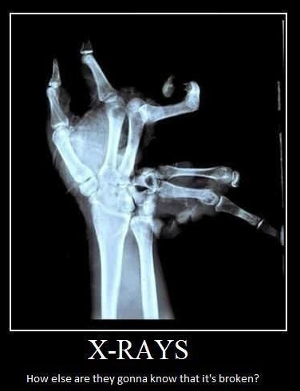
Many thanks for your attention!
Sven Mohr
Coordination XFEL
Work package 36 - General Safety
Deutsches Elektronen-Synchrotron
D5 - Arbeitssicherheit/Umweltschutz
Notkestraße 85, Gebäude 35
22607 Hamburg
Tel.: +49 40 8998 - 4831
Fax.: +49 40 8998 - 4311
Mobil: +49 175 2619881
Mail: sven.mohr@desy.de

