Slide 2

FRPAM a Fire Response Probabilistic Analysis Model
International Technical Safety Forum
ITSF 2017
September 18-22, 2017
TRIUMF, Vancouver Canada
A. Andreini, O. Rios, S. La Mendola, A. Arnalich – CERN, HSE-SEE-XP

Slide 3
FRPAM a Fire Response Probabilistic Analysis Model
Joint effort of CERN Fire Safety Engineering Team
Early stage of development
Limited to CERN though easy to outstretch
Additional validation needed, yet encouraging results

Slide 4
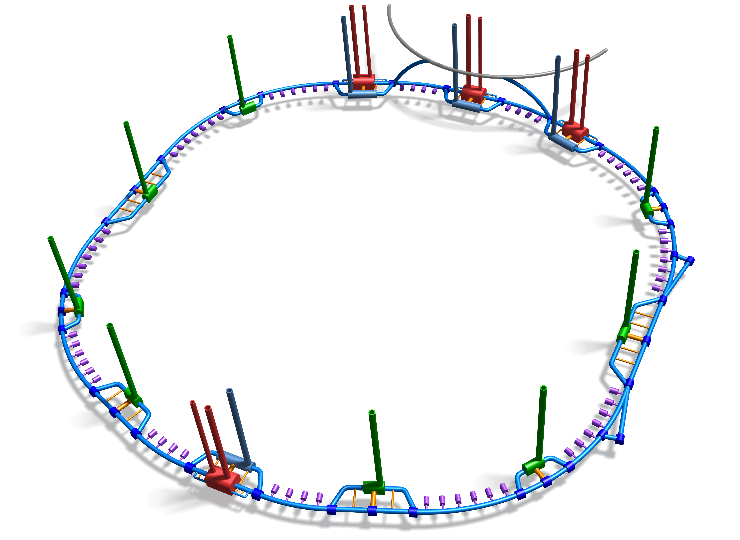
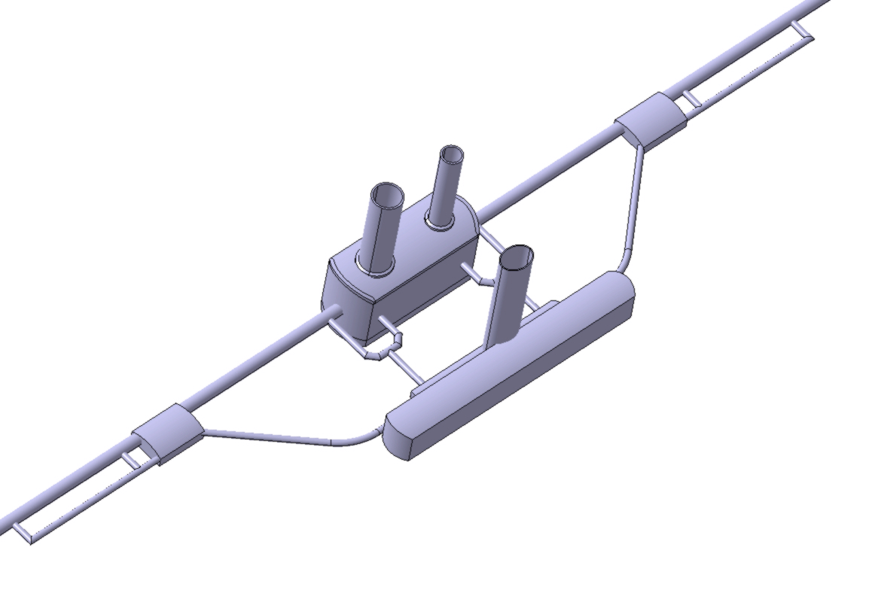
FRPAM
FRPAM is a probabilistic tool to assess the fire response of a complex facility.

Slide 5
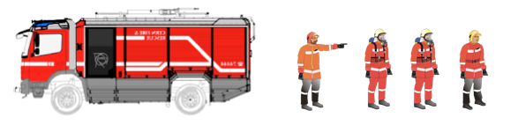
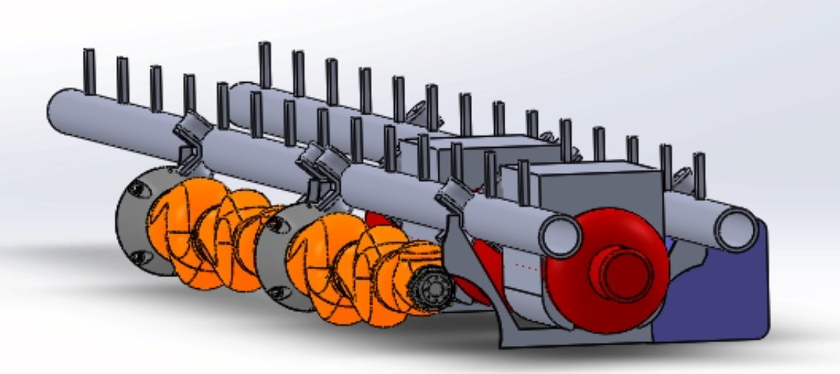
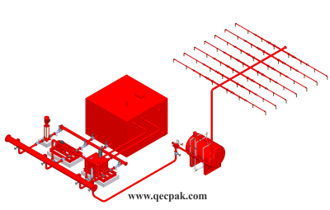
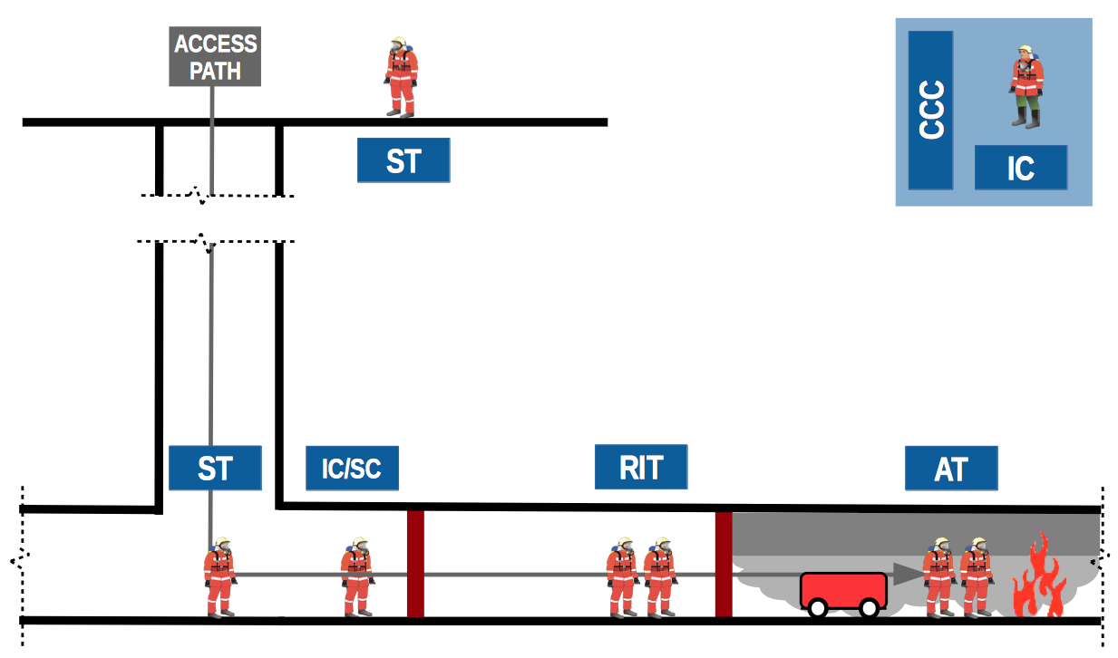
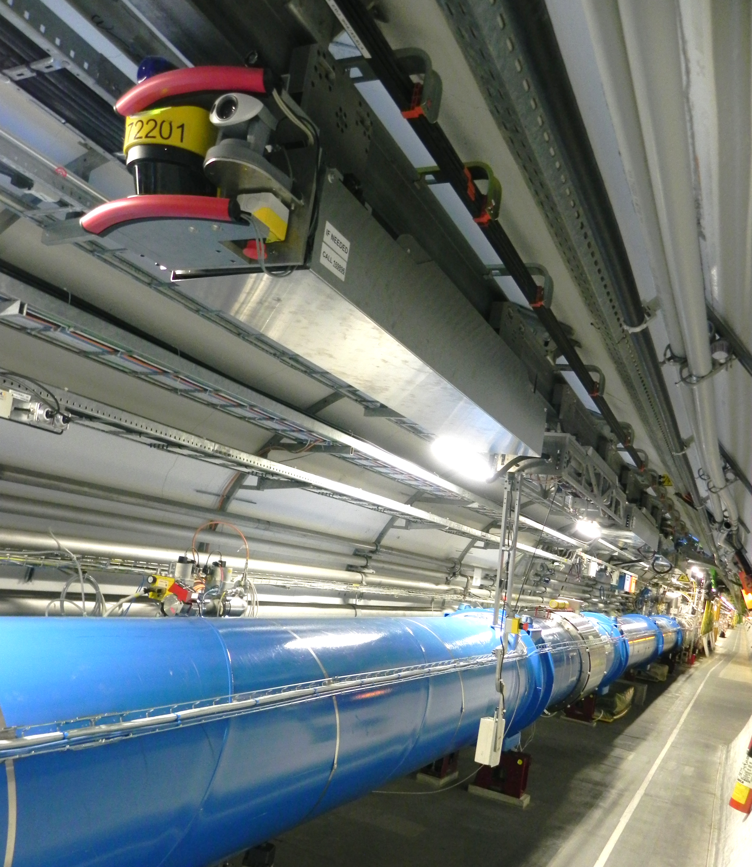
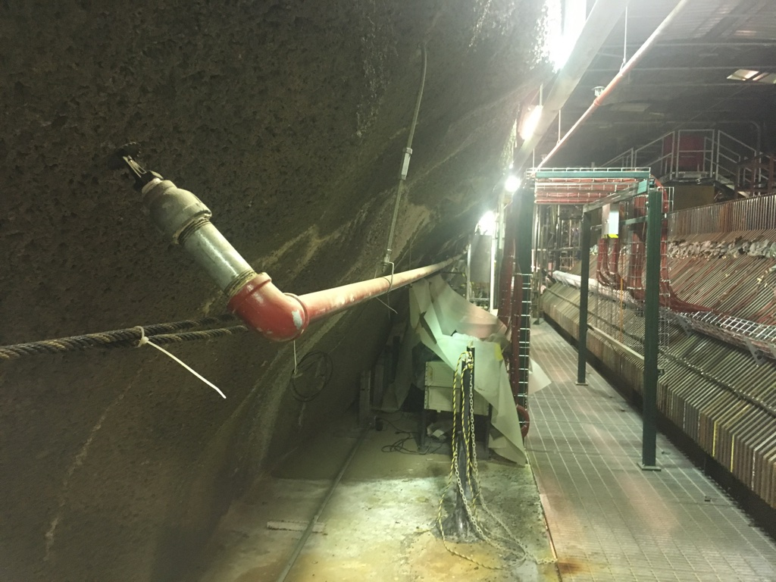
FRPAM
FRPAM is a probabilistic tool to assess the fire response of a complex facility.
CERN
FIRE BRIGADE
FIREFIGHTING TRAIN
SPRINKLER
FFFS
LHC tunnel and TIM, CERN
MINOS detector, Fermilab

Slide 6
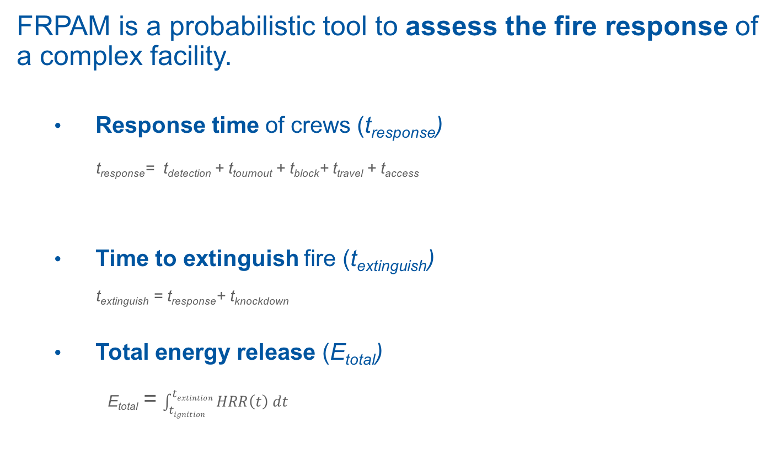
FRPAM
FRPAM is a probabilistic tool to assess the fire response of a complex facility.
  Response time of crews (t_{response})
    t_{response}= t_{detection} + t_{tournout} + t_{block}+ t_{travel} + t_{access}
  Time to extinguish fire (t_{extinguish})
    t_{extinguish} = t_{response}+ t_{knockdown}
  Total energy release (E_{total})
      E_{total} = $\int_{tignition}^{textintion}{HRR\left(t\right) dt}$
MEDICAL SUPPORT
EVACUATION SEARCH& RESCUE
FIRE CONDITIONS
PROPERTY DAMAGE

Slide 7
FRPAM
FRPAM is a probabilistic tool to assess the fire response of a complex facility.
CDF
1
90%
P_{i}
time
x_{i}
75m
CDF (Cumulative Distribution Function)
Probability of extiguishing the fire under a given time lapse or energy release.

Slide 8
FRPAM
FRPAM is a probabilistic tool to assess the fire response of a complex facility.
CDF
1
90%
P_{i}
energy release
x_{i}
50GJ
CDF (Cumulative Distribution Function)
Probability of extiguishing the fire under a given time lapse or energy release.

Slide 9
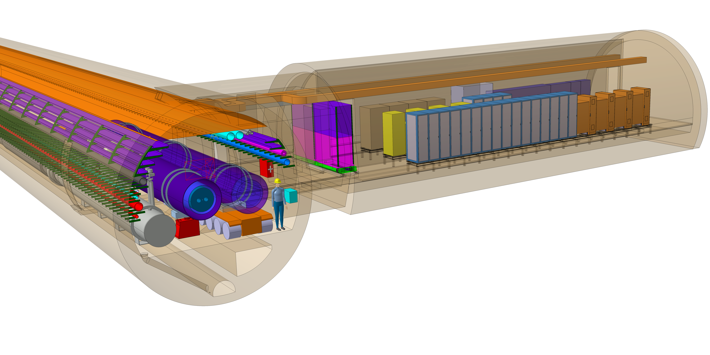
Trial Design benchmark

Slide 10
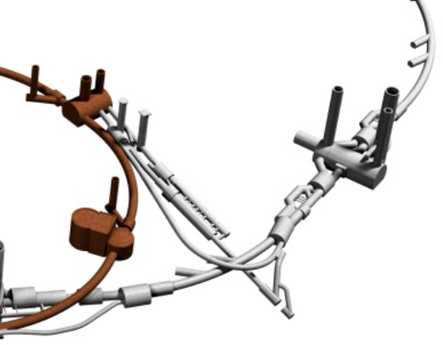
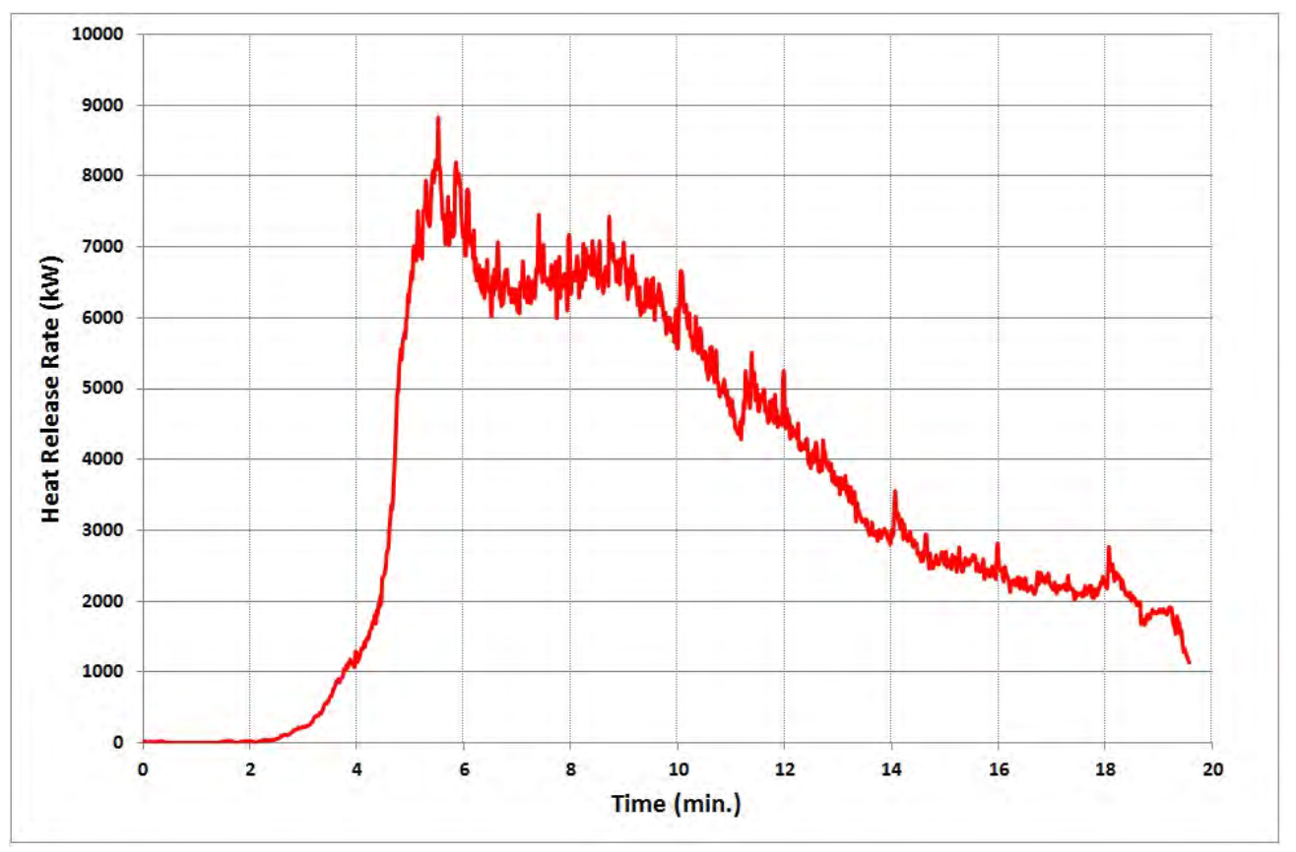
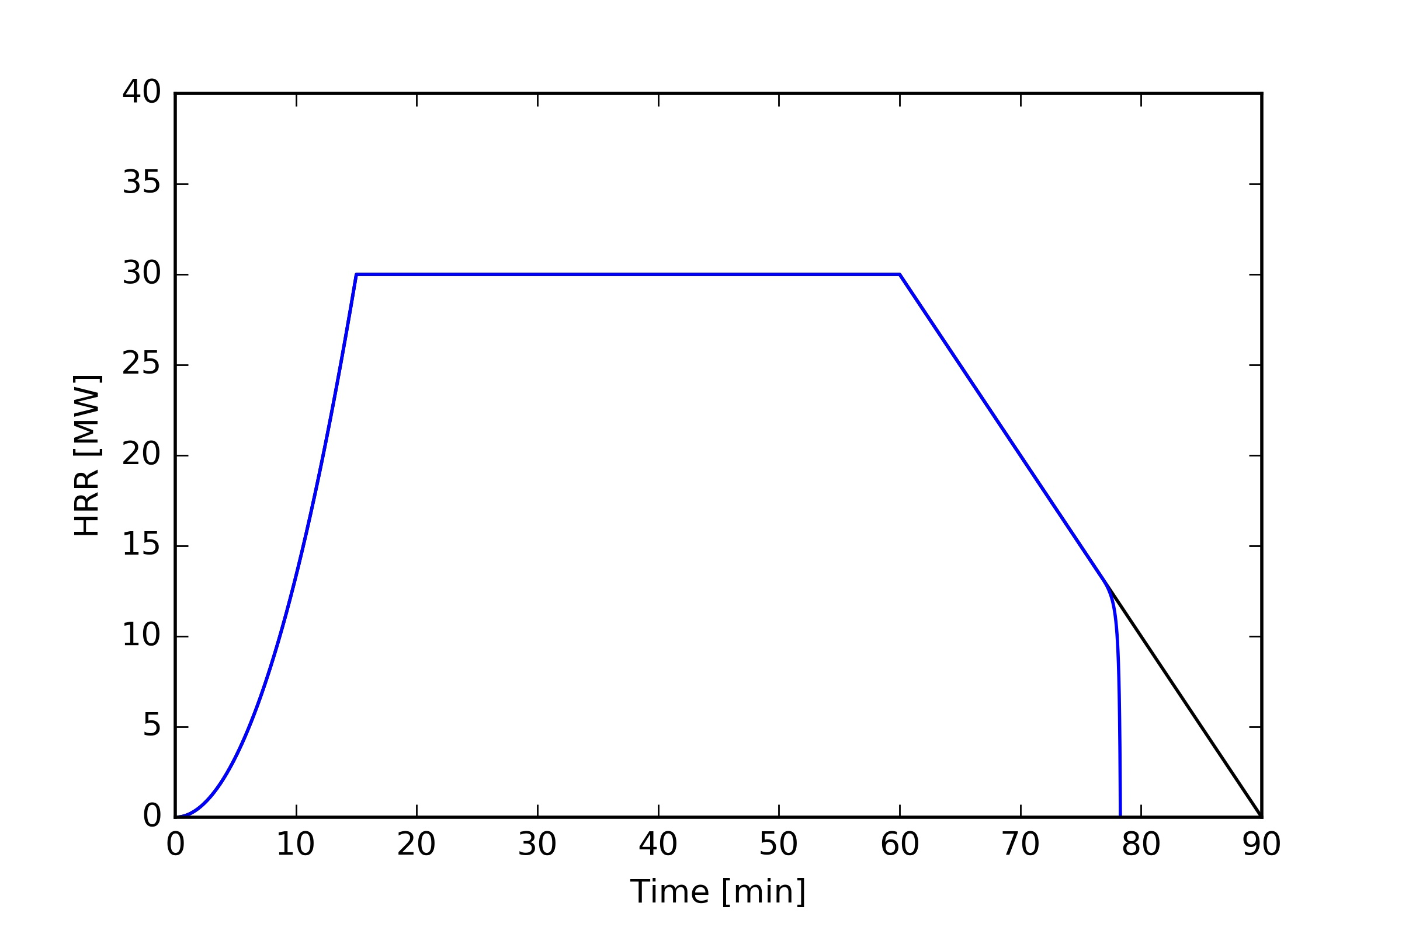
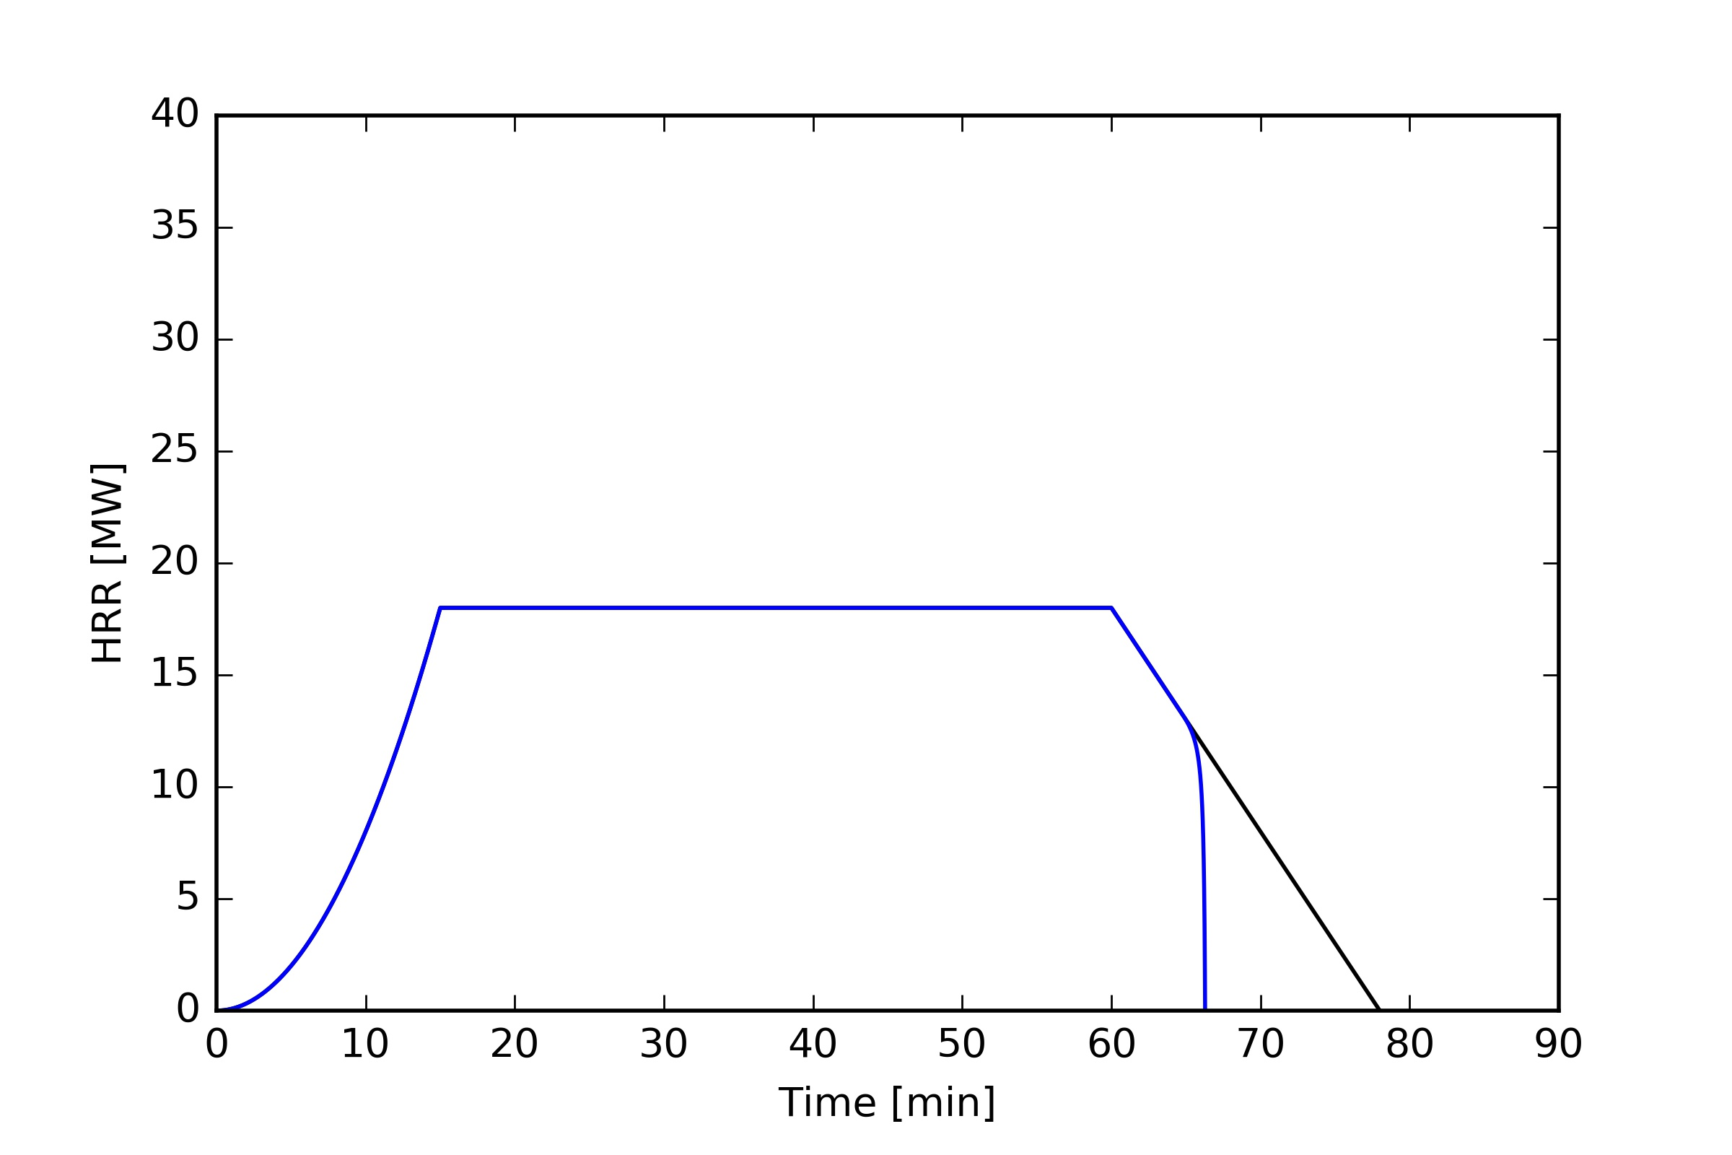
Trial Design benchmark
SCENARIO
DESIGN FIRE
FIRE RESPONSE
FIRE BRIGADE
TRIAL DESIGN
#1
SCENARIO
DESIGN FIRE
FIRE RESPONSE
FIRE BRIGADE
TRIAL DESIGN
#2
ROBOT

Slide 11
Trial Design benchmark
CDF
CDF
1
1
90%
90%
35m
time
36GJ
50GJ
energy release
75m
TRIAL DESIGN #1
TRIAL DESIGN #2
TRIAL DESIGN #1
TRIAL DESIGN #2
For 90% of the cases, fire extinction is achieved within 75’ and a 36GJ energy release in TD#1 versus 35’ and 50GJ in TD#2.

Slide 12
Model architecture
t_{extinguish}
t_{response}
Detection
Turnout
Travel
Access
Manual
firefighting
t_{detection}
t_{tournout}
t_{travel}
t_{access}
t_{knockdown}
Sprinkler activation
Sprinkler action
Robot travel
Robot
action
time
fire ignition
fire detected
robot attack
crews at surface
crews seat of fire
fire extinguished
sprinkler triggered
crews dispatched

Slide 13
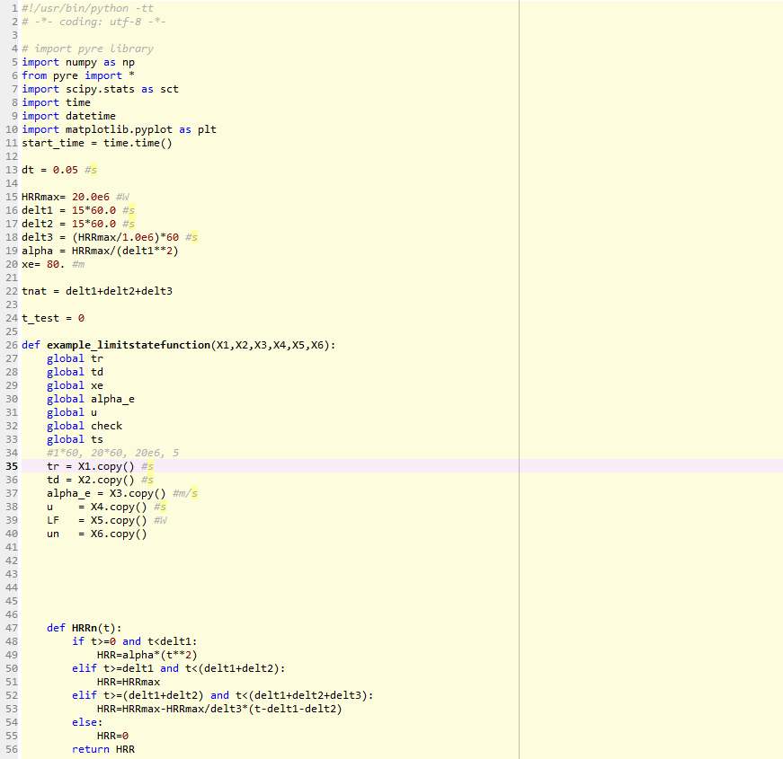
Model architecture
  Monte-Carlo method to build histograms and CDFs (LatinHypercube sampling with preservation of correlation matrix)
All submodels into a Python script
Multiple (1000) simulations/run
Time steps t=0.05s

Slide 14

Detection
Turnout
Travel
Access
Manual
firefighting
Fire Detection Distribution ~2%
From fire ignition to fire notification
Standard gamma distribution model
Calibration with CERN fire detection system specifications
Potential implementation of a fully developed probabilistic model by Joglar et al. Fire Technology (2005)
PDF
t
$$\overline{t}$$
Gamma distribution

Slide 15
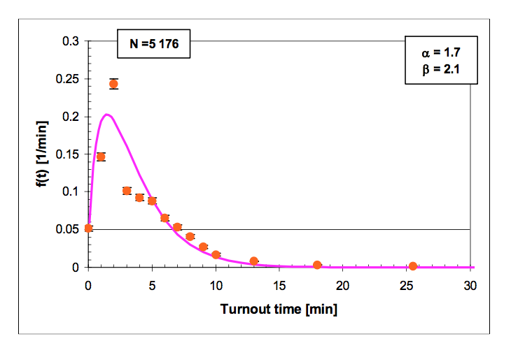
Detection
Turnout
Travel
Access
Manual
firefighting
Turnout Distribution ~4%
From fire notification to crews leaving station
Standard gamma distribution model - Tillander, K. VTT (2004)
Calibration with CERN Fire Brigade estimates, additional data aquisition needed

Slide 16
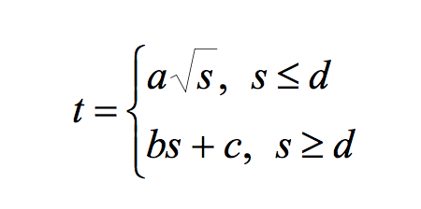
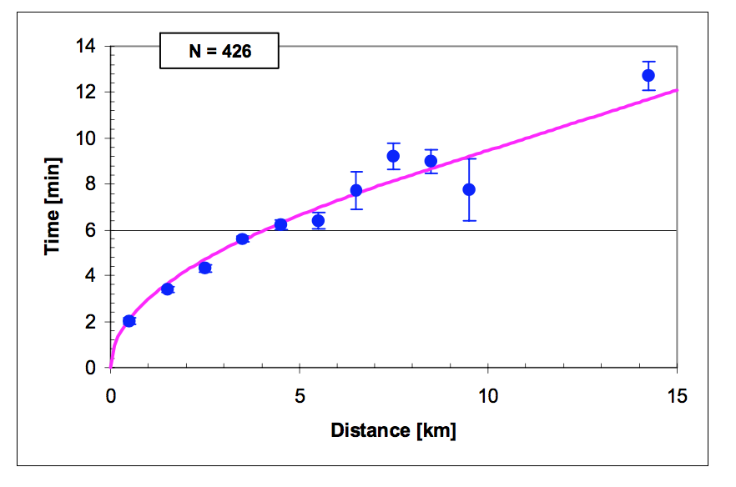
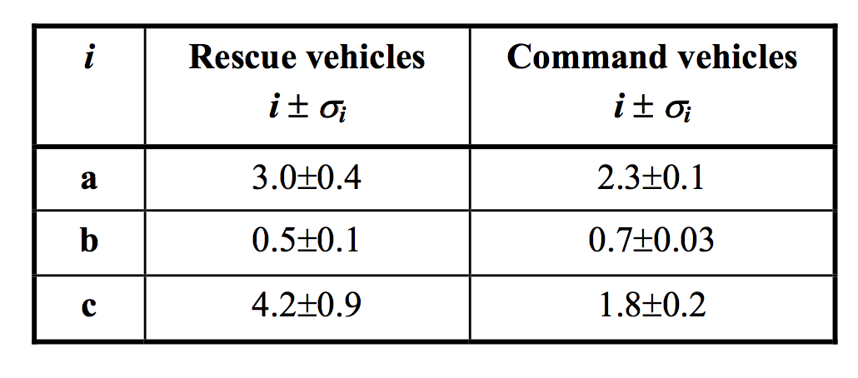
Detection
Turnout
Travel
Access
Manual
firefighting
Travel Submodel ~25%
From crews leaving station to access building
Tested travel model for NYC – Kolesar et al. (1975)
Found fit and adjusted with statistical data in Finland - Tillander, K. VTT (2004)
t is travel time
d is distance
a, b ,c are model parameters
Statistical uncertainties for a, b, and c

Slide 17
Detection
Turnout
Travel
Access
Manual
firefighting
Access Submodel ~25-50%
From access building to seat of the fire
Access point in surface
Seat of the fire

Slide 18
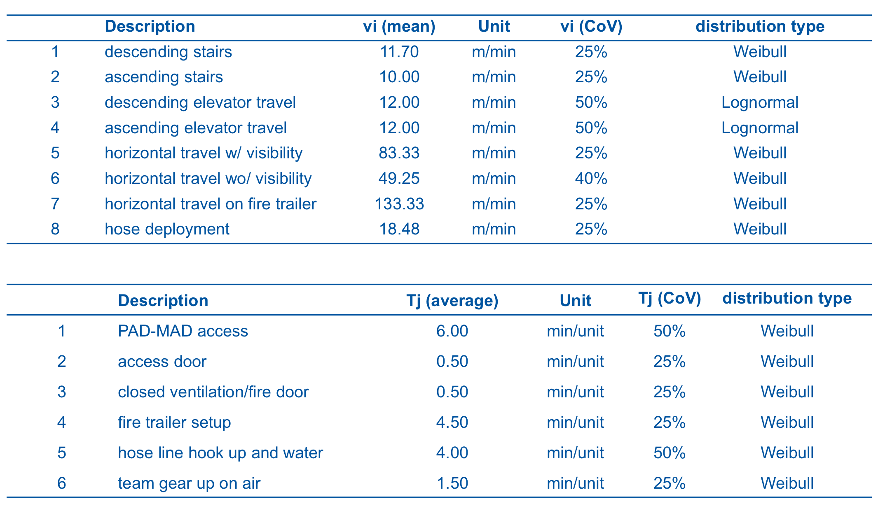
Detection
Turnout
Travel
Access
Manual
firefighting
Access Submodel ~25-50%
From access building to seat of the fire
Travel speed and obstacle bypass time model
Adjusted with data from CERN Fire Brigade drills
All parameters (14) introduced as probabilistic variables
Good performance, but limited sample
Additional CERN Fire Brigade drills foreseen

Slide 19
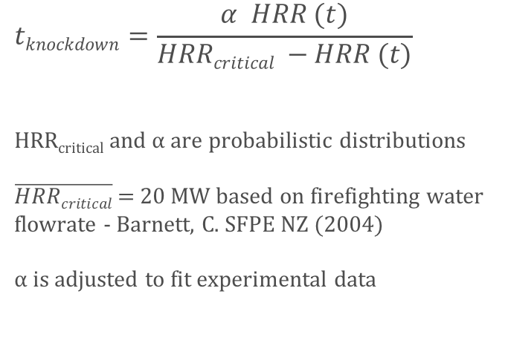
Detection
Turnout
Travel
Access
Manual
firefighting
Manual firefighting Submodel ~2-50%
From seat of the fire to fire knockdown
Proposed model is HRR dependent
Includes defensive approaches when HRR > HRR_{critical}
$$tknockdown=\frac{α HRR (t)}{HRRcritical −HRR (t)}$$
HRR_{critical} and $α$ are probabilistic distributions
$\overline{HRRcritical}$ = 20 MW based on firefighting water flowrate - Barnett, C. SFPE NZ (2004)
$α$ is adjusted to fit experimental data
HRR_{critical}
time
HRR

Slide 20
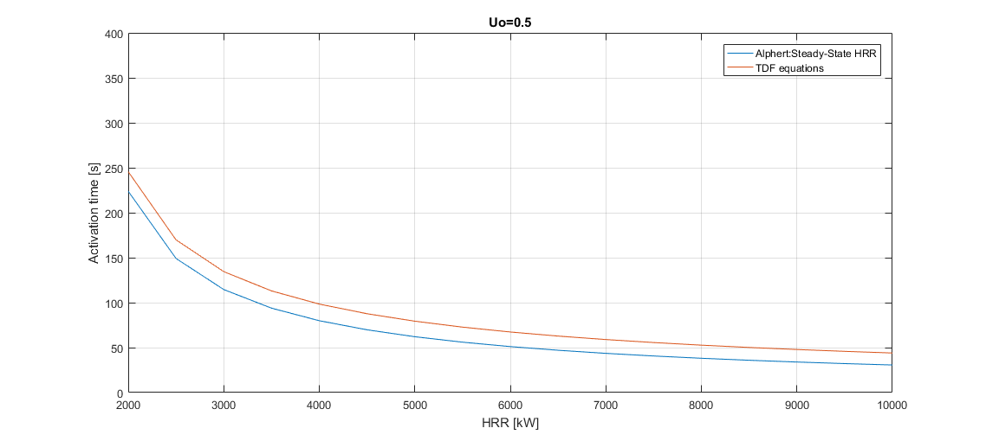
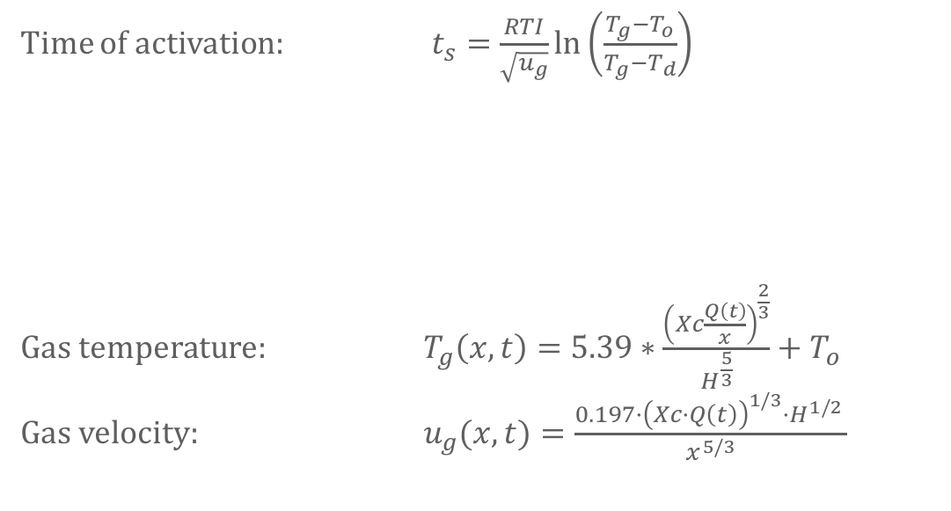
Sprinkler activation
Sprinkler action
Sprinkler activation
Time of activation t_{s} computed every time step using Alpert’s correlations and assuming quasi-static fire.
Time of activation: $t_{s}=\frac{RTI}{\sqrt{u_{g}}}\text{ln}\left(\frac{T_{g}−T_{o}}{T_{g}−T_{d}}\right)$
Gas temperature: $T_{g}\left(x,t\right)=5.39∗\frac{{\left(Xc\frac{Q\left(t\right)}{x}\right)}^{\frac{2}{3}}}{H^{\frac{5}{3}}}+T_{o}$
Gas velocity: $u_{g}(x,t)=\frac{0.197·{\left(Xc·Q\left(t\right)\right)}^{1/3}·H^{1/2 }}{x^{5/3}}$
Notes:
Where:
RTI is the Response Time Index RTI to be provided by supplier but a value of 90 can be taken
$T_{d}$is the design temperature to activate the sprinkler (68ºC),
$T_{o}$ is ambient temperature
and the gas velocity ($u_{g}$) and its temperature ($T_{g}$) are calculated according to the $Xc=2/3$ is the convective part of the fire
$x$ is the longitudinal distance from the sprinkler head to the fire (assumed 1.5m)
$H$ is the height to the fire (assumed 3m)
The orange line in the plot is the activation time for different HRR considering TUNNEL equations.. however, I don't implemented them 'cause we have to considere a ventilation value... and I didn't want to input this... orange is calculated with U=0.5m/s

Slide 21
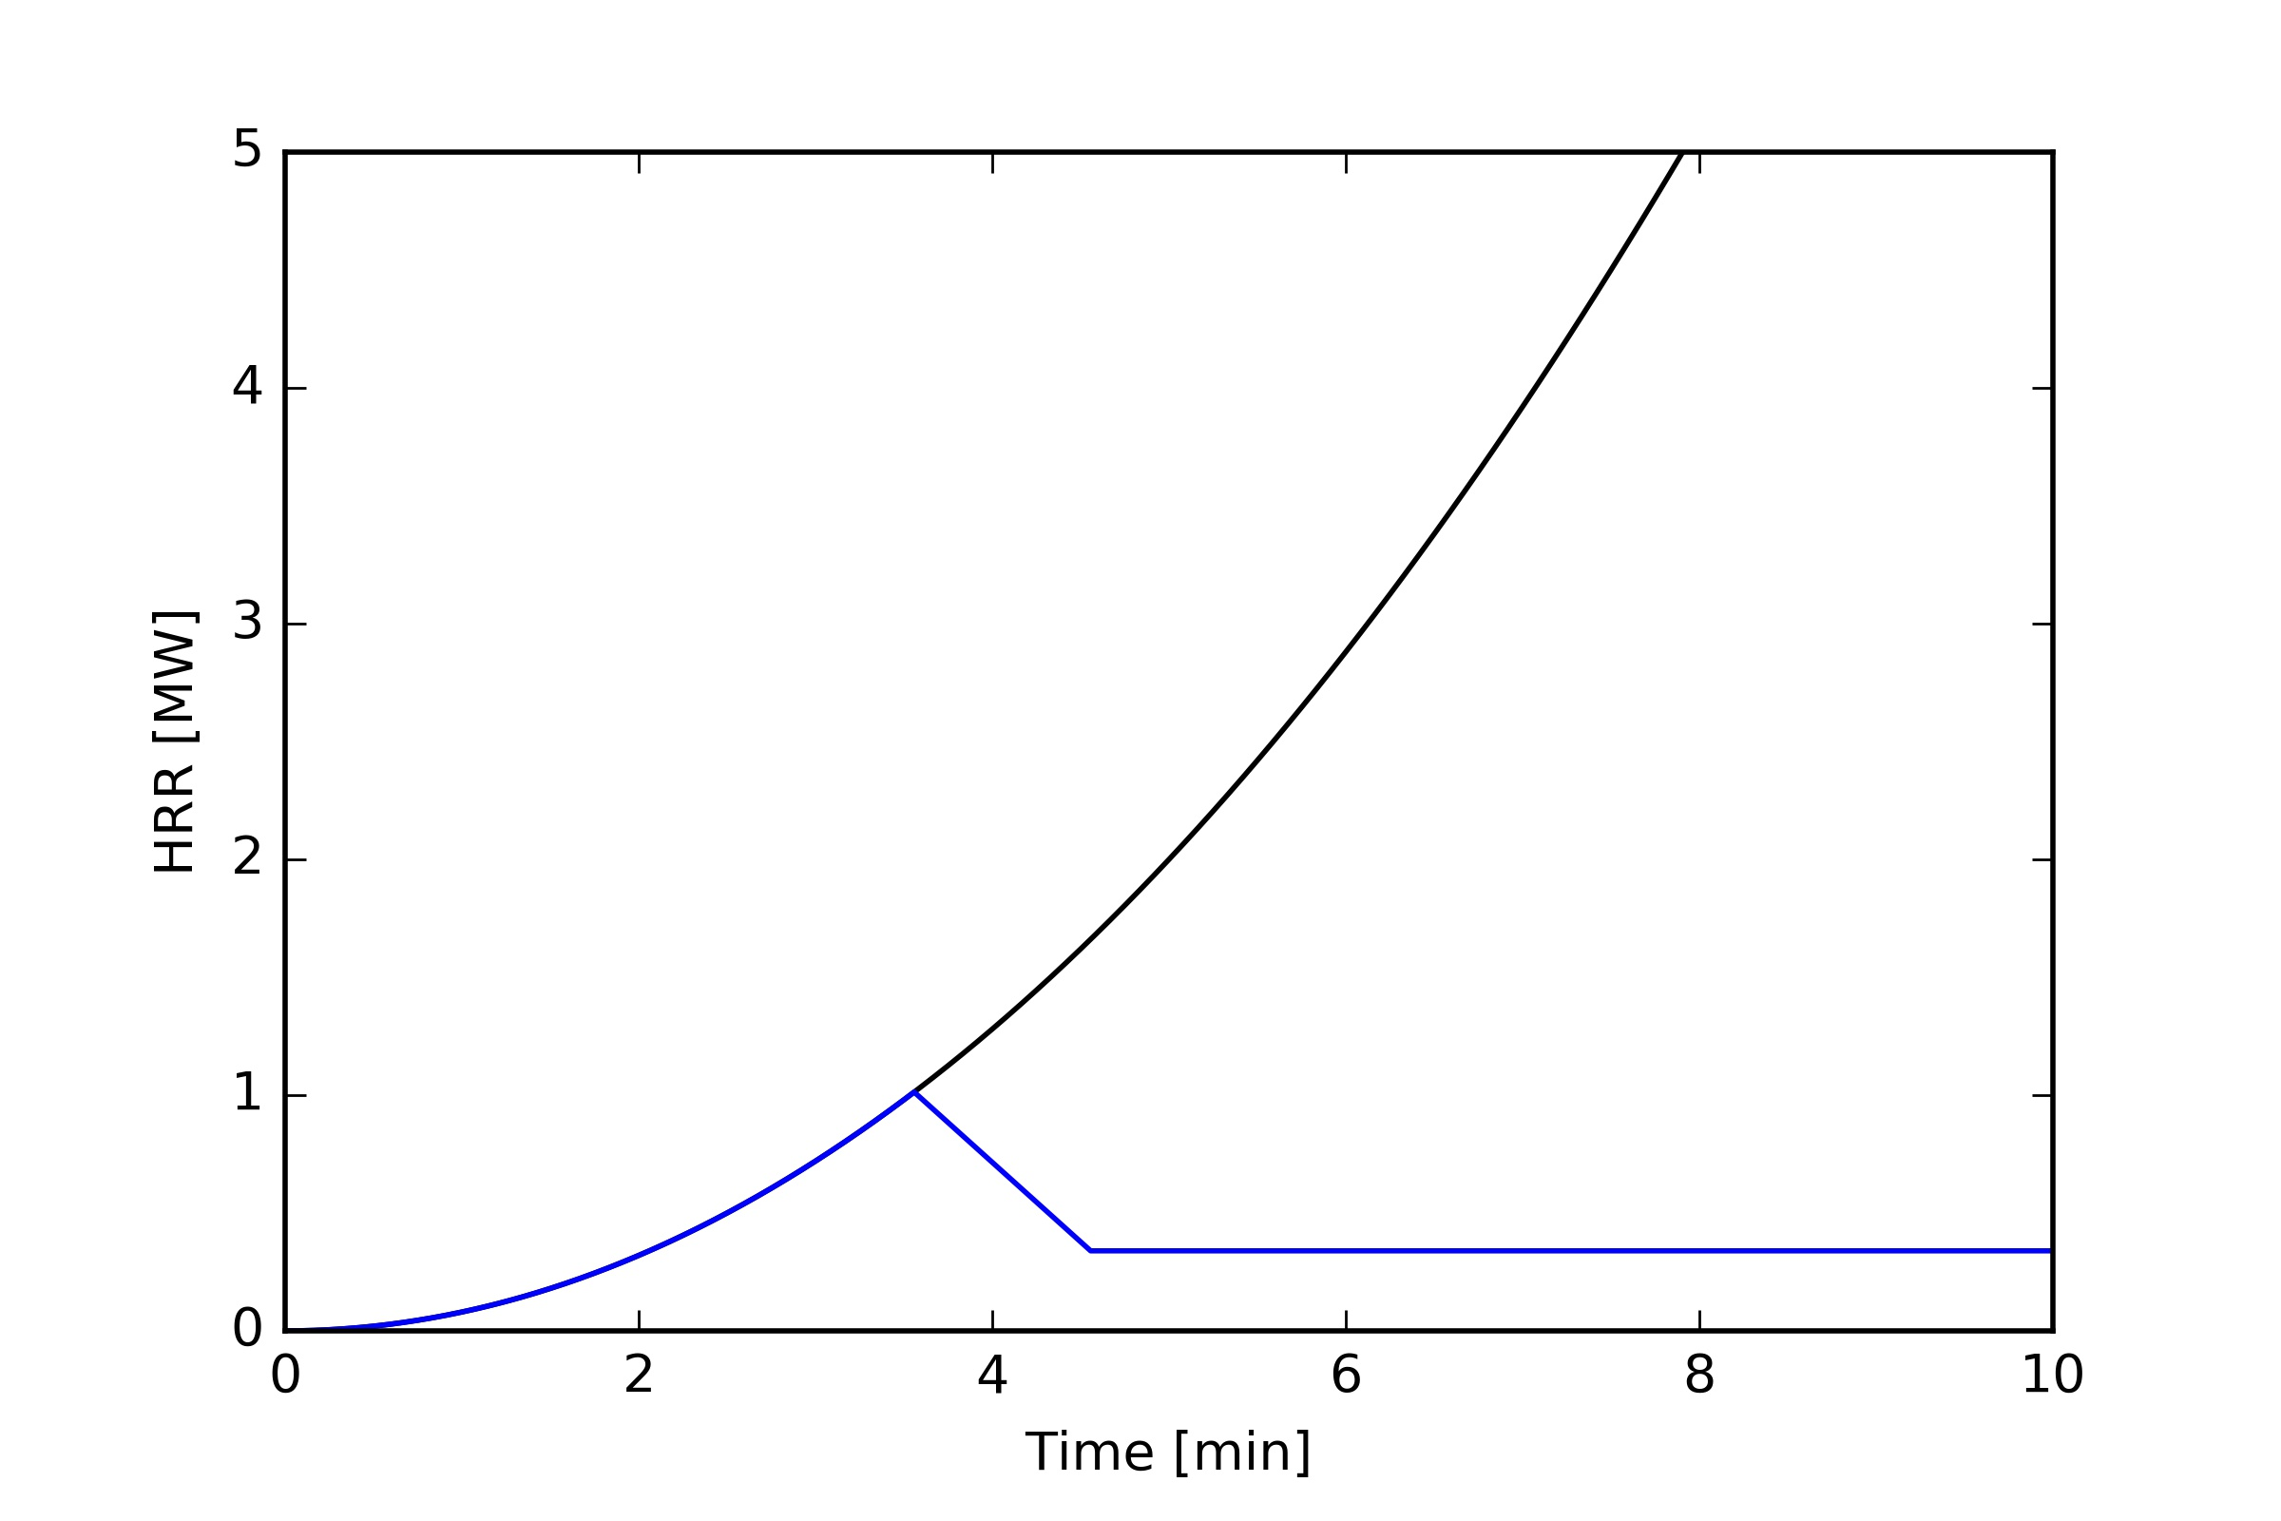
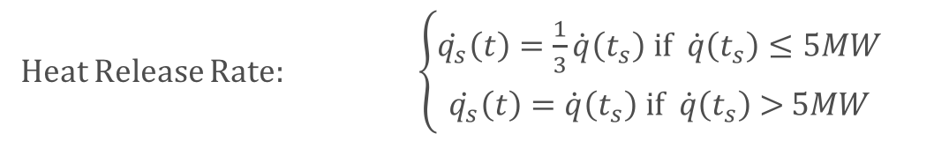
Sprinkler activation
Sprinkler action
Sprinkler action
As proposed in the Swedish construction code – §3.3.5 BBRAD
Heat Release Rate: $\left\{\begin{aligned}\dot{q_{s}}\left(t\right)=\frac{1}{3}\dot{q}\left(t_{s}\right) \text{if} \dot{q}\left(t_{s}\right)≤5MW \\ \dot{q_{s}}\left(t\right)=\dot{q}\left(t_{s}\right) \text{if} \dot{q}\left(t_{s}\right) \text{>} 5MW\end{aligned}\right.$
Notes:
If $\dot{q}\left(t_{s}\right)=\dot{q_{s}}<5MW$ $\left\{\begin{matrix}\dot{q_{s}}\left(t\right)=\dot{q_{s}}−\left(\frac{\dot{q_{s}}−\frac{\dot{q_{s}}}{3}}{60}\right)·t=\dot{q_{s}}−\frac{\dot{q_{s}}}{90}·t → for t≤t_{s}+60s \\ \dot{q_{s}}\left(t\right)=\frac{\dot{q_{s}}}{3} → for t>t_{s}+60s\end{matrix}\right\}$
If $\dot{q}\left(t_{s}\right)=\dot{q_{s}}>5MW$ $\dot{q_{s}}\left(t\right)=\dot{q_{s}}$
Where:
$\dot{q_{s}}$ is the HRR at sprinkler activation time t_{s}

Slide 22
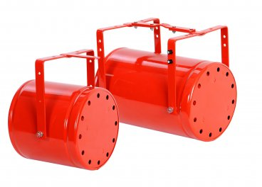
Robot travel
Robot
action
Firefighting robot
Multiple aerosol generators (K based)
Non-toxic, electronic safe

Slide 23
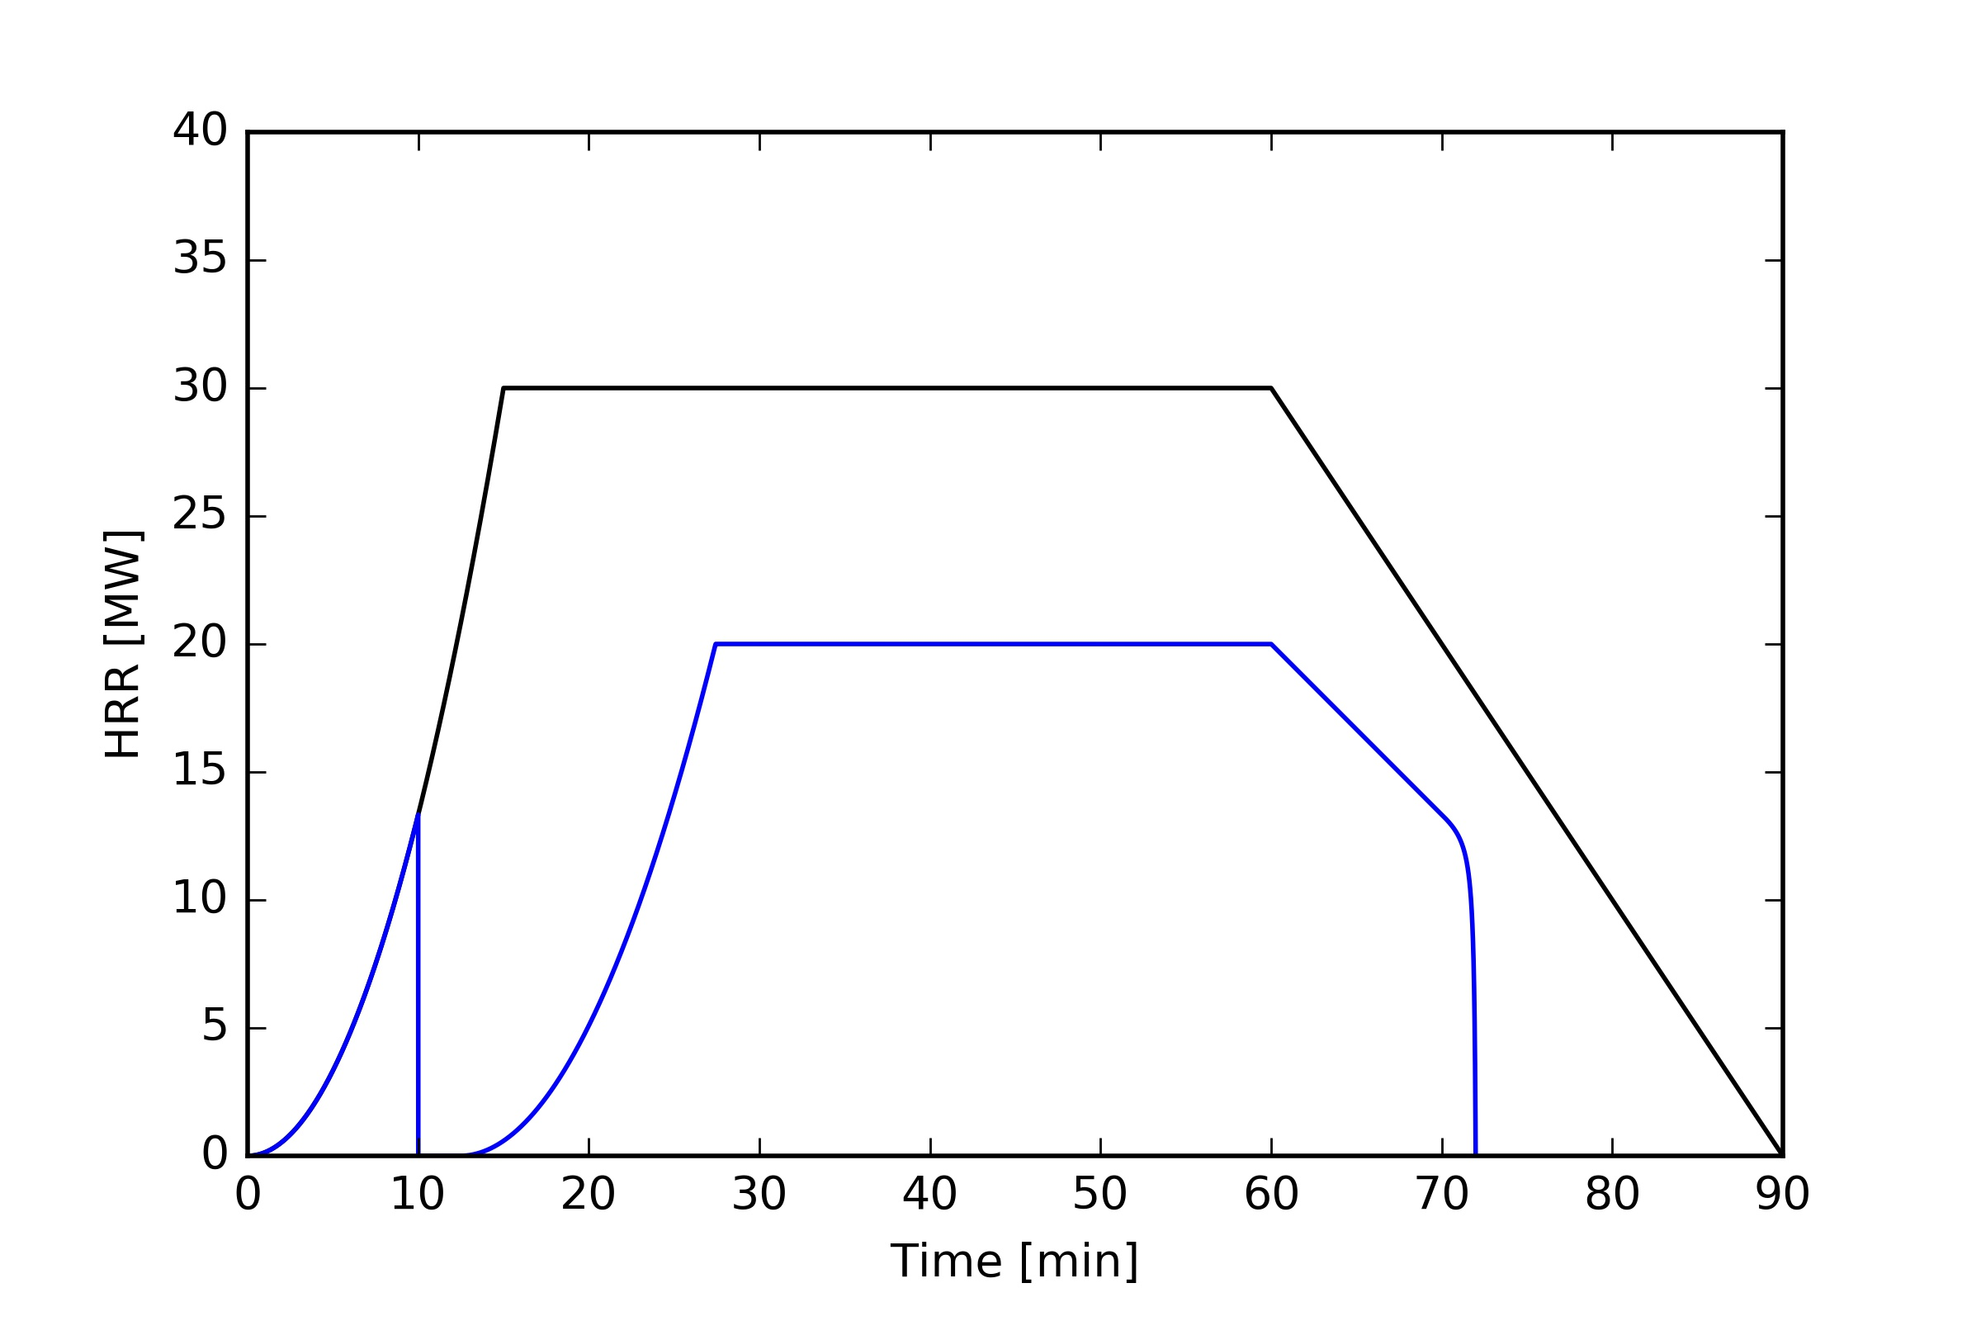
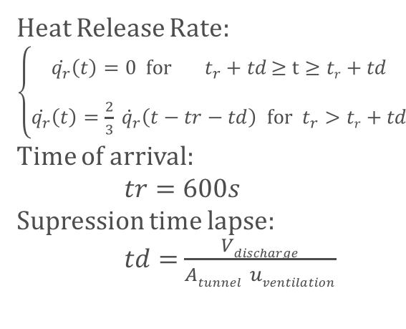
Robot travel
Robot
action
Firefighting robot
Multiple aerosol generators (K based)
Non-toxic, electronic safe
Achieves total supression for limited time, then fire rekindles with a reduced growth rate assuming a ventilation speed.
Heat Release Rate: $\left\{\begin{aligned}\begin{aligned} \\ \dot{q_{r}}\left(t\right)=\text{0 }\text{for} { t}_{r}+td \text{≥} \text{t}≥tr+td\end{aligned} \\ \\ \dot{q_{r}}\left(t\right)=\frac{2}{3}\dot{{ q}_{r}}\left(t−tr−td\right) \text{for} { t}_{r}>tr+td\end{aligned}\right.$
Time of arrival:
$tr=600s$
Supression time lapse:
$td=$ $\frac{Vdischarge}{Atunnel uventilation}$

Slide 24
Trials – Scenario
AWAKE – TSG4
Access point in surface
EXAMPLE FOR BB4 to fire in TSG4 (AWAKE)
Quantity | Description | vi / Tj | Unit | Time (min)
58.5 | descending stairs | 11.70 | m/min | 5.00
0 | ascending stairs | 10.00 | m/min | 0.00
0 | descending elevator travel | 12.00 | m/min | 0.00
0 | ascending elevator travel | 12.00 | m/min | 0.00
0 | horizontal travel w/ visibility | 83.33 | m/min | 0.00
0 | horizontal travel wo/ visibility | 49.25 | m/min | 0.00
800 | horizontal travel on fire trailer | 133.33 | m/min | 6.00
80 | hose deployment | 18.48 | m/min | 4.33
1 | PAD-MAD access | 6.00 | min/unit | 6.00
1 | access door | 0.50 | min/unit | 0.50
3 | closed ventilation/fire door | 0.50 | min/unit | 1.50
1 | fire trailer setup | 4.50 | min/unit | 4.50
1 | hose line hook up and water | 4.00 | min/unit | 4.00
1 | team gear up on air | 1.50 | min/unit | 1.50
Seat of the fire

Slide 25
Trials – Design fires
# | HRRmax [MW] | delt1 [min] | delt2 [min]
1 | 30 | 15 | 45
2 | 18 | 15 | 45
3 | 5 | 15 | 45

Slide 26
Trials – Fire response
# | RESOURCES
FF | FIRE BRIGADE (*)
FF+TIM | FIRE BRIGADE (*) ROBOT
FF+2TIM | FIRE BRIGADE (*) 2 * ROBOT
FF+SPKL | FIRE BRIGADE (*) SPRINKLER
(*) Standard CERN FB response (7 firefighter + 1 crew commander + 1 officer)

Slide 27
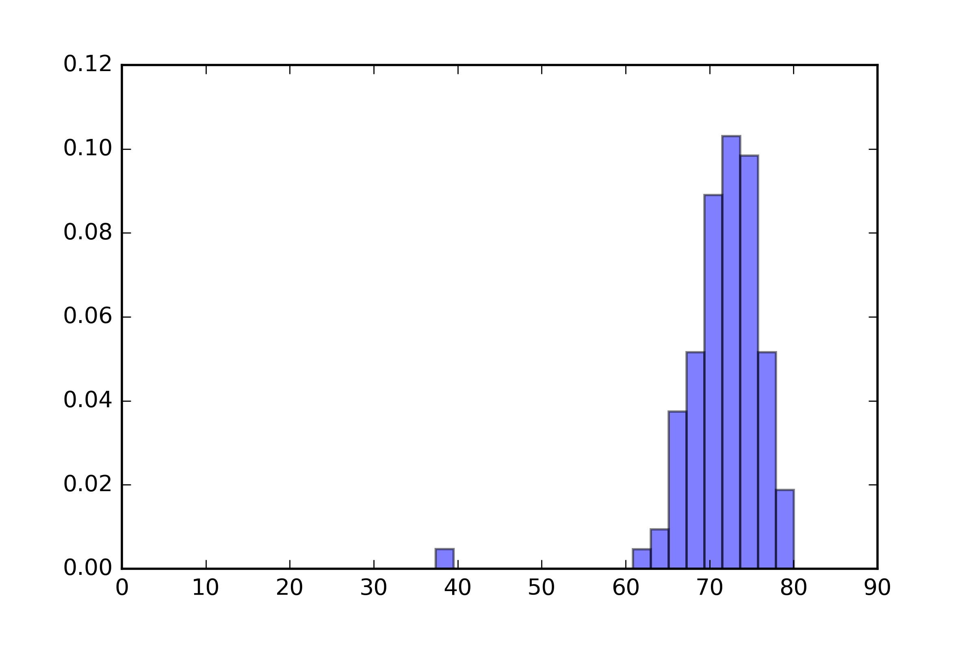
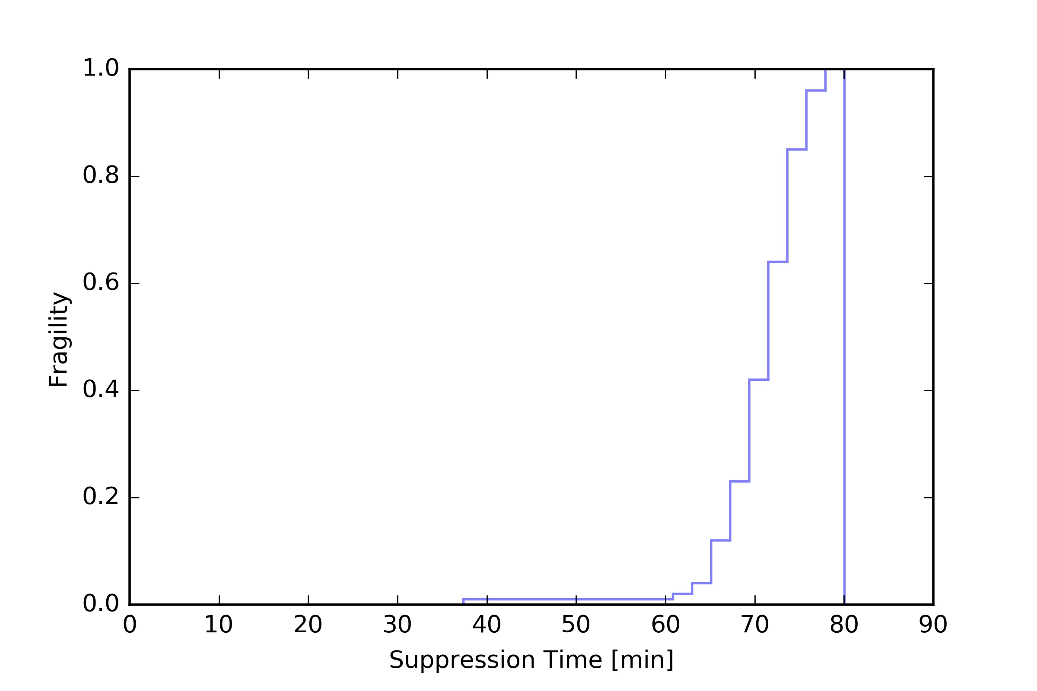
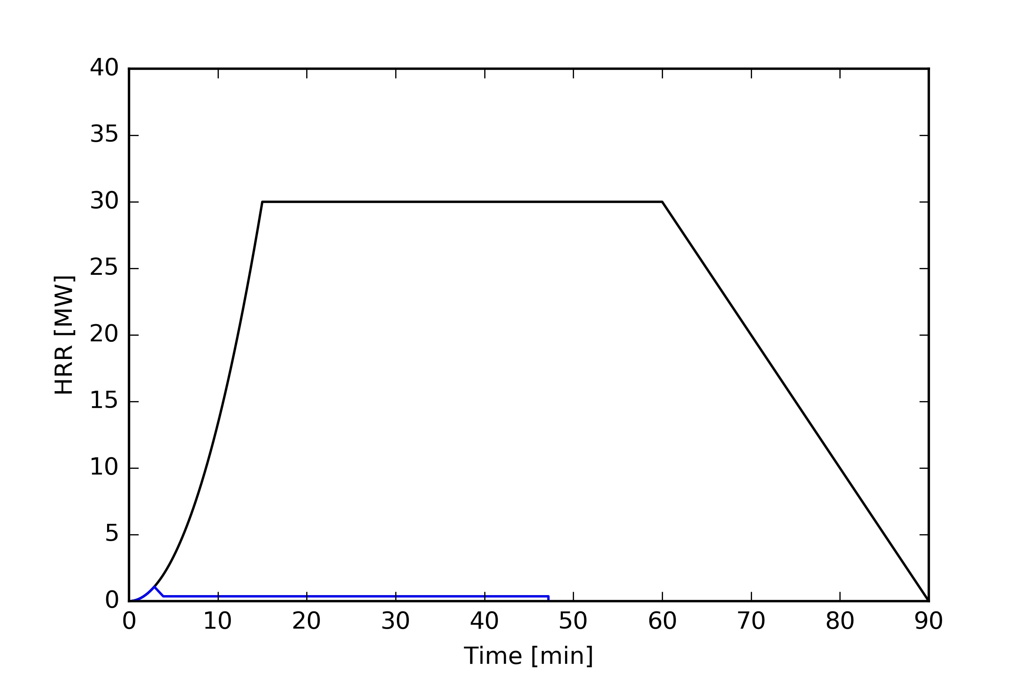
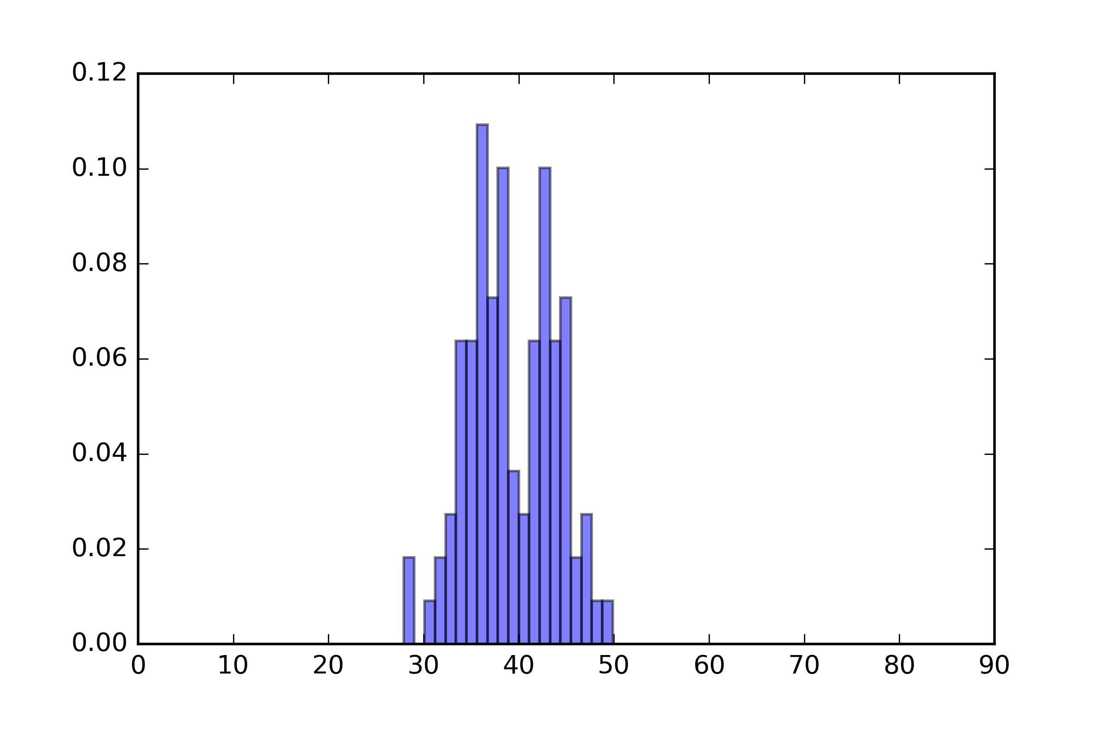
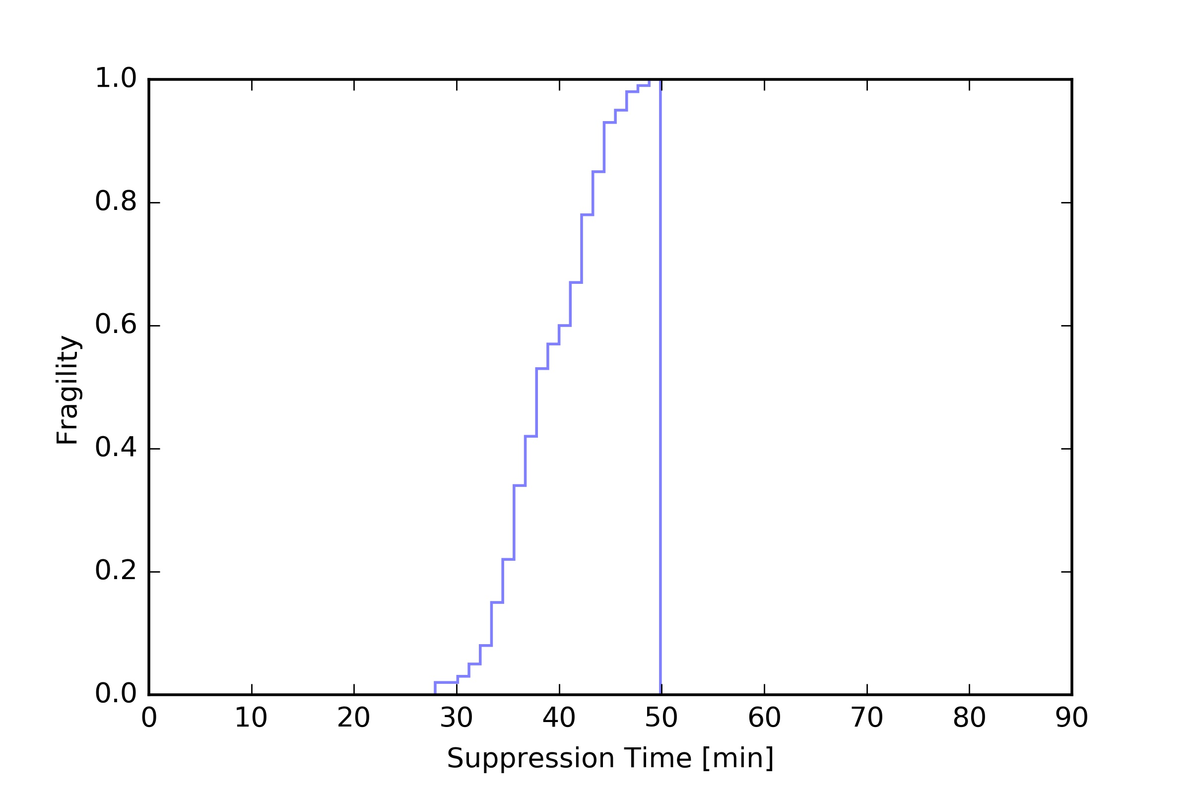
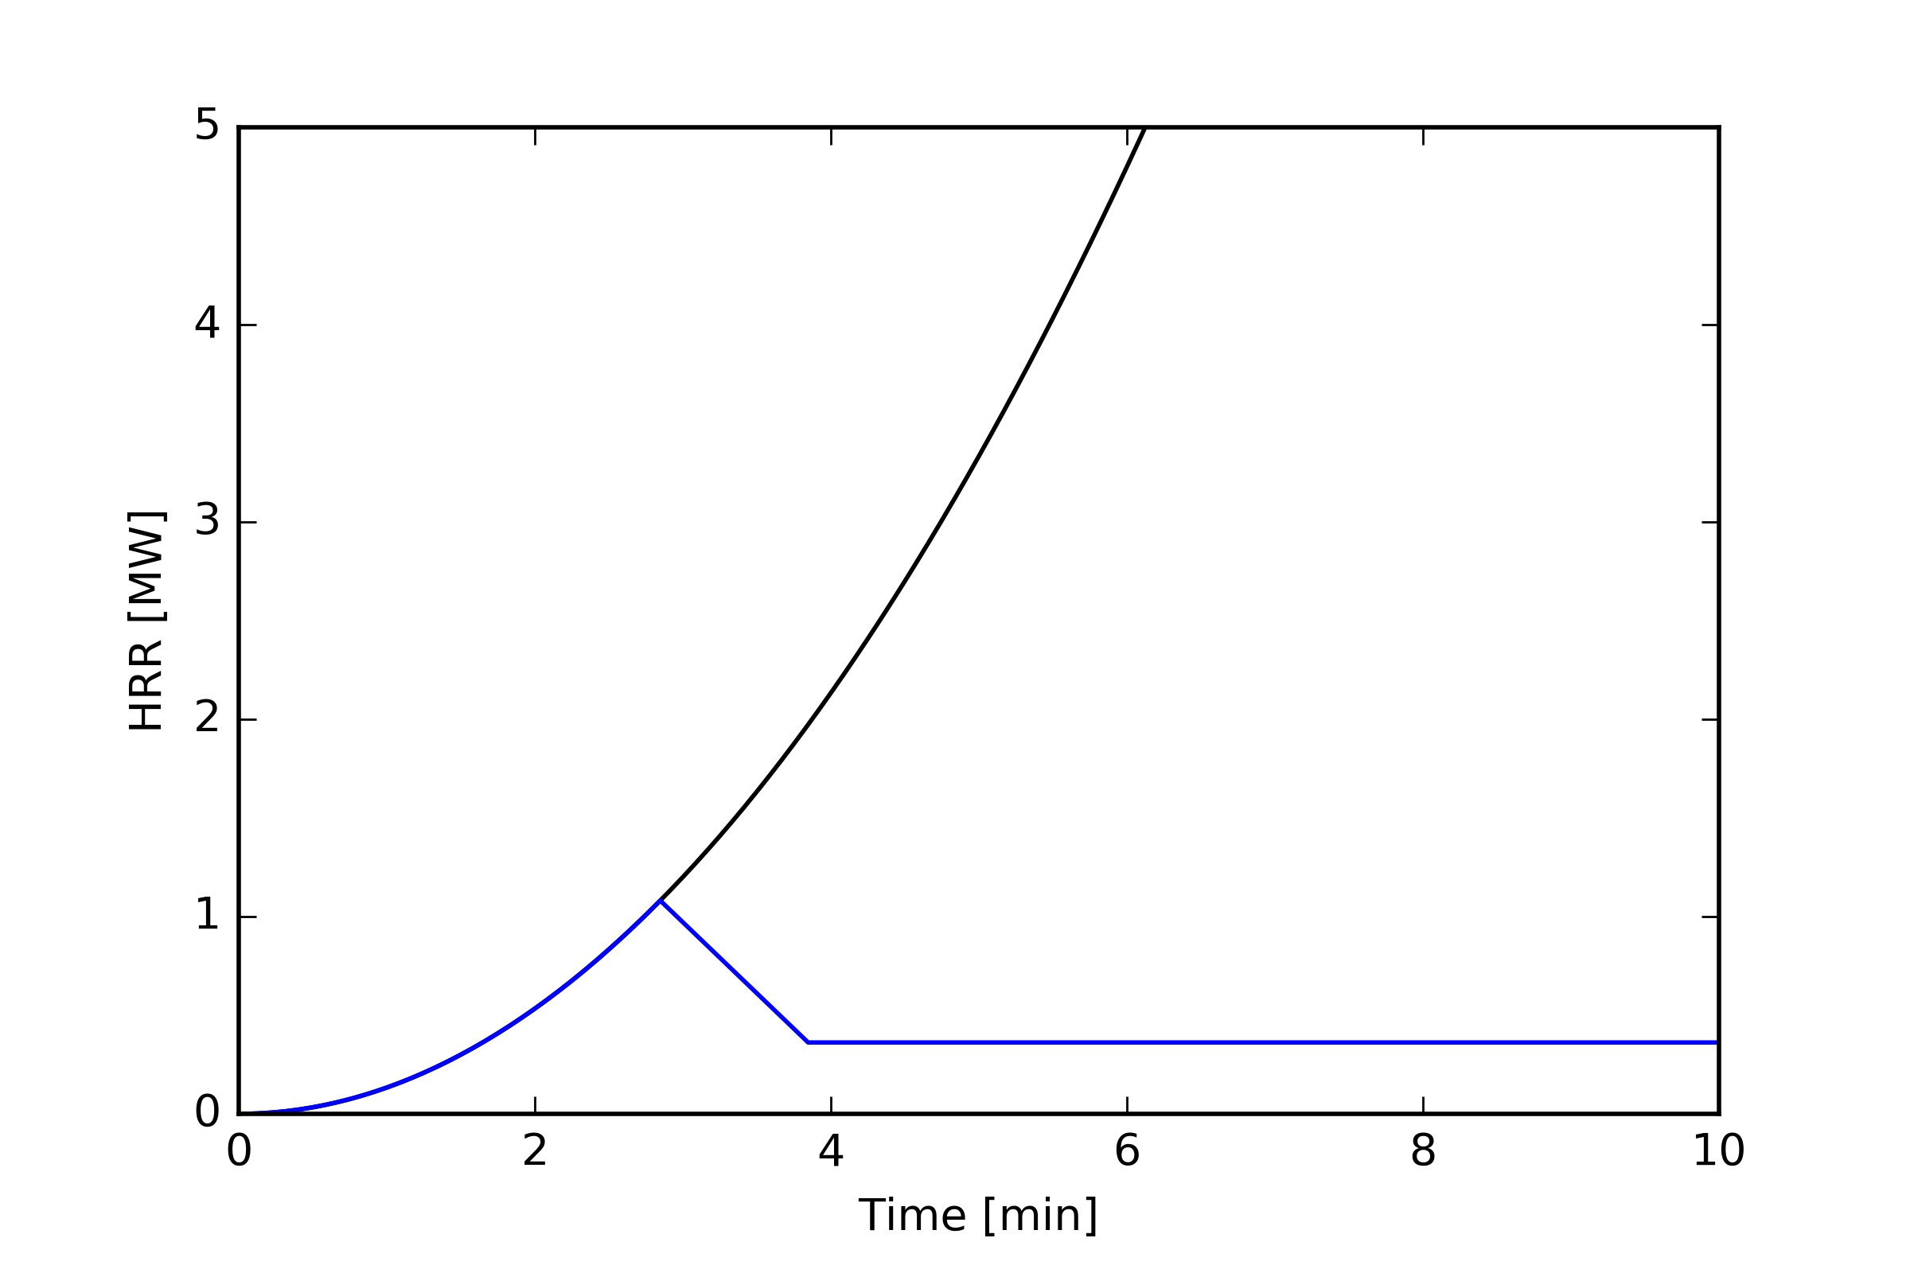
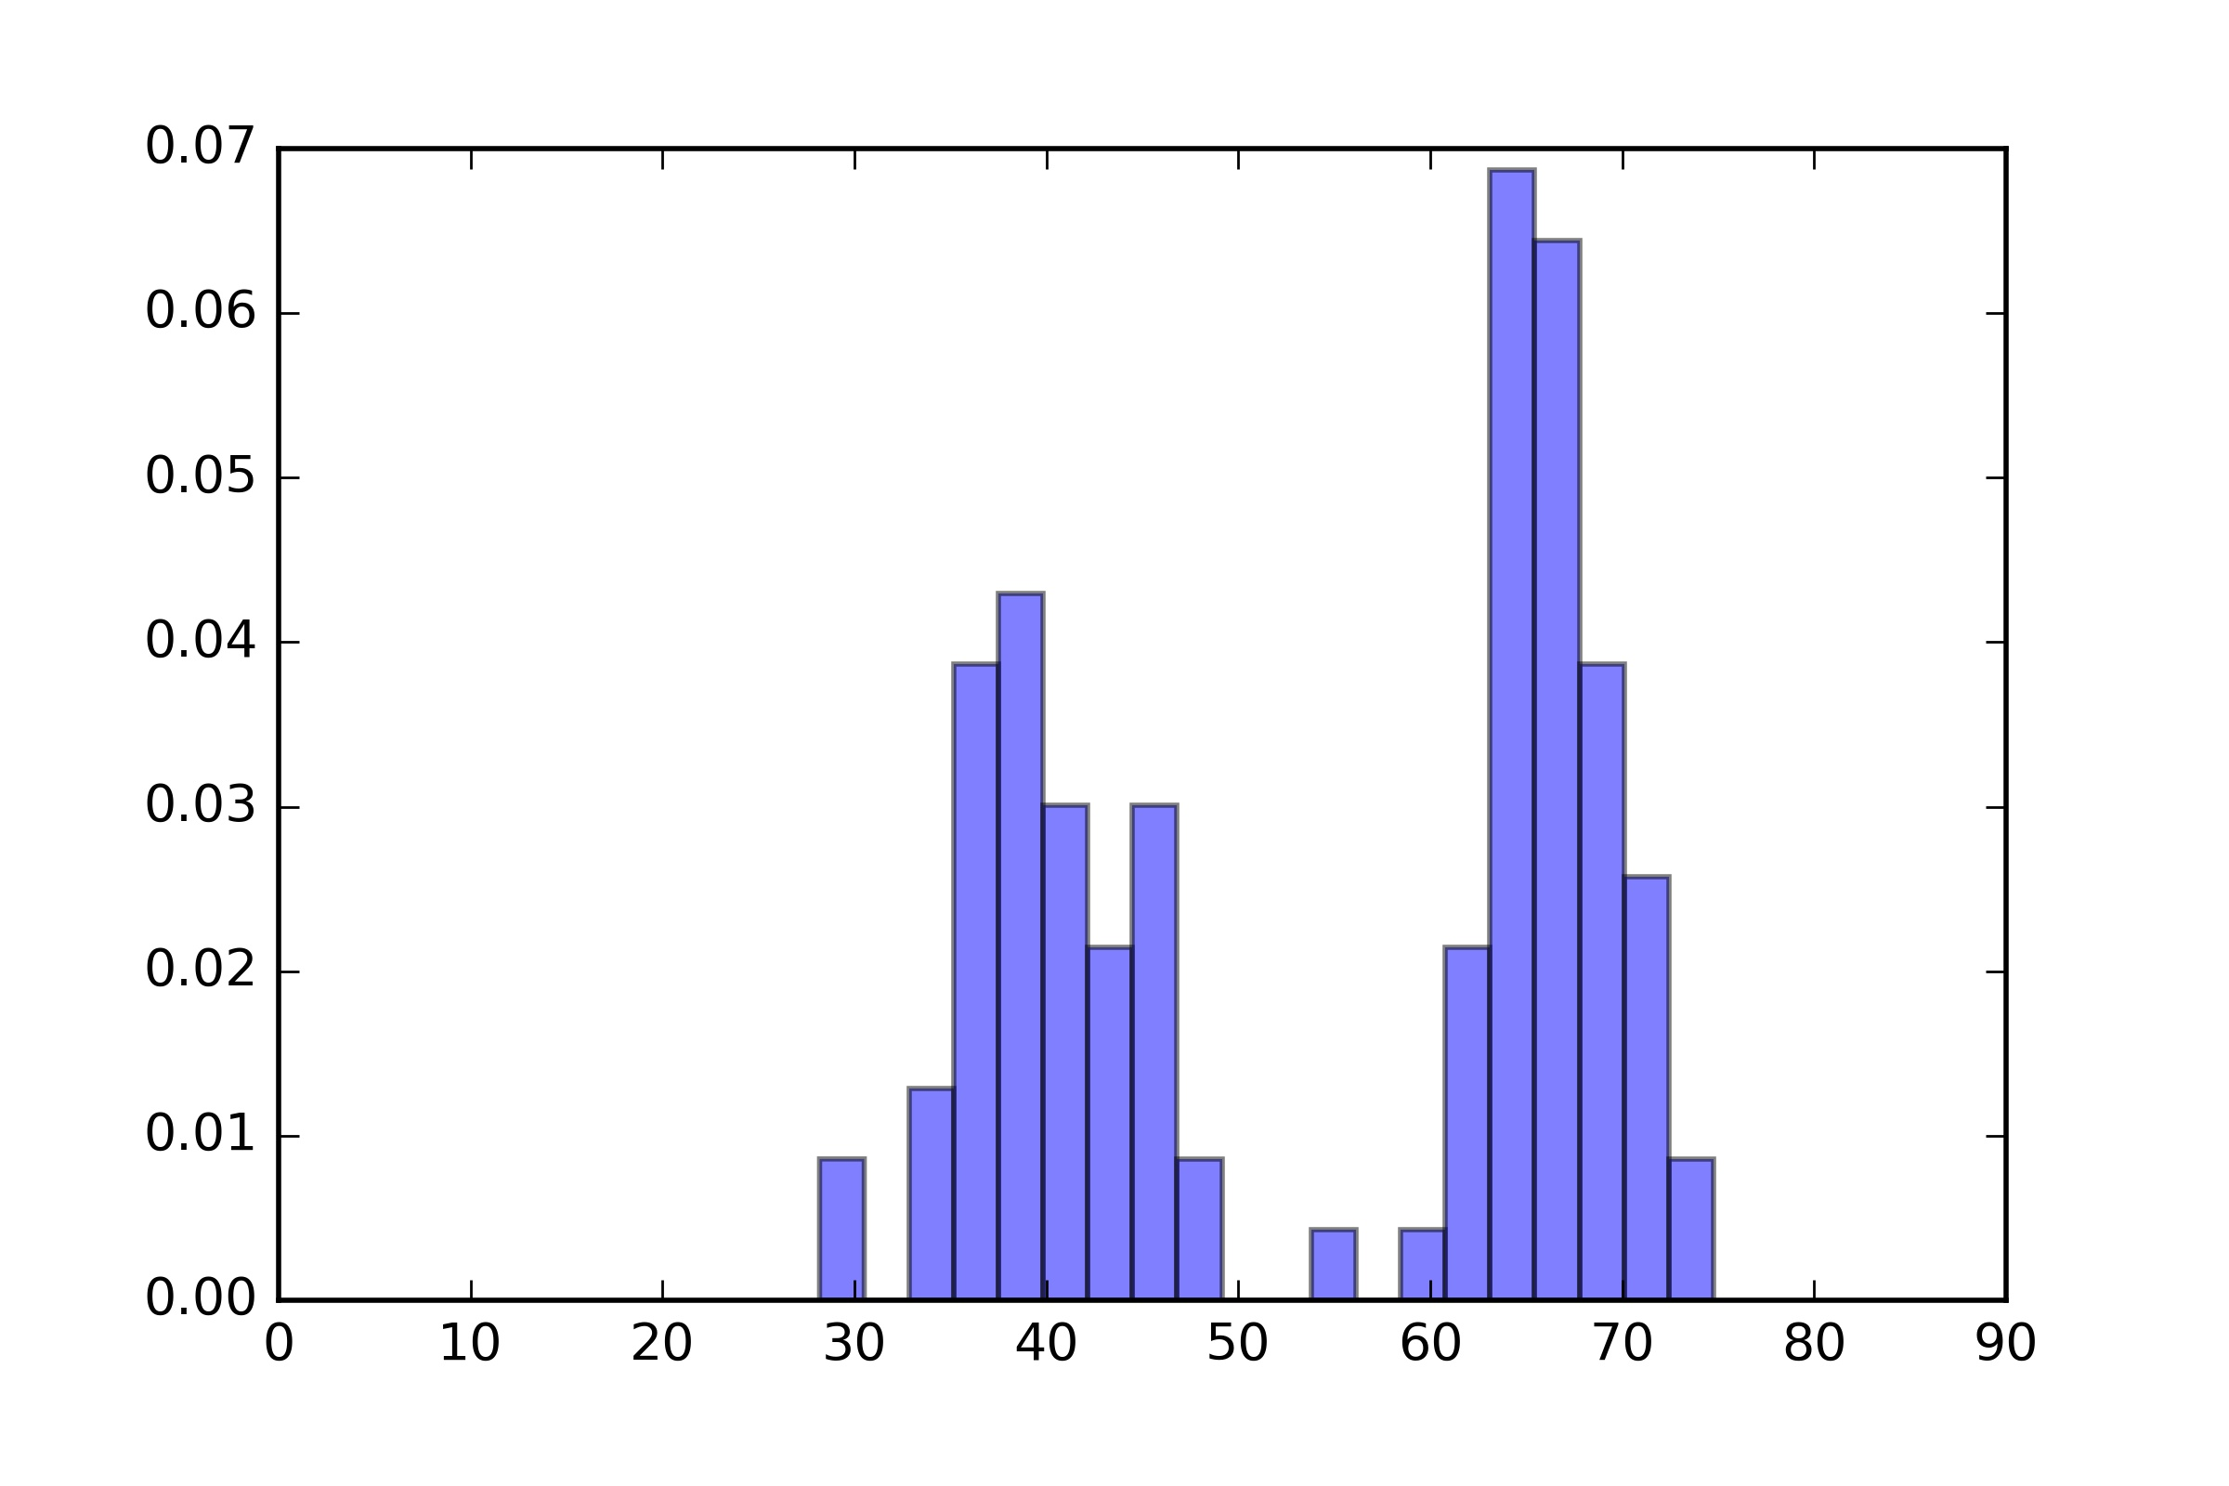
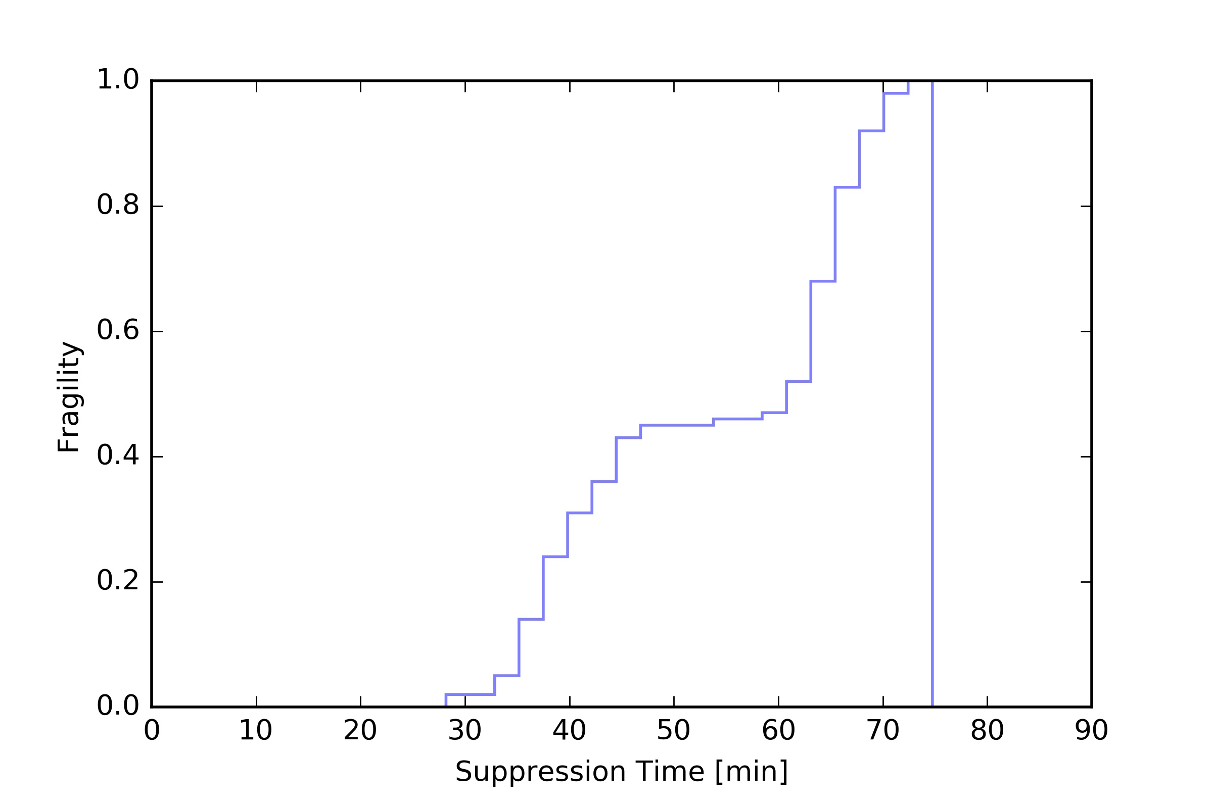
Time to extinguish fire t_{extinguish}
Case #1 - Design fire 30MW
FB
75m
@90%
44m
@90%
FB
SPRINKLER
FB
ROBOT
68m
@90%

Slide 28
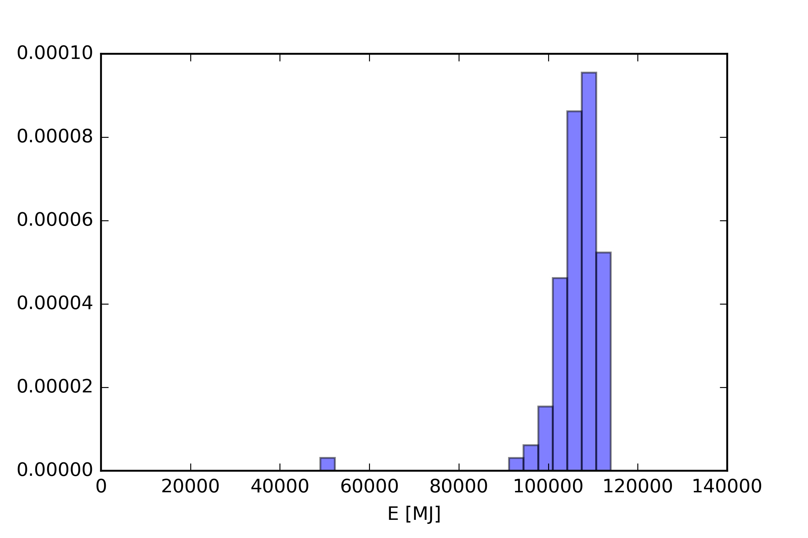
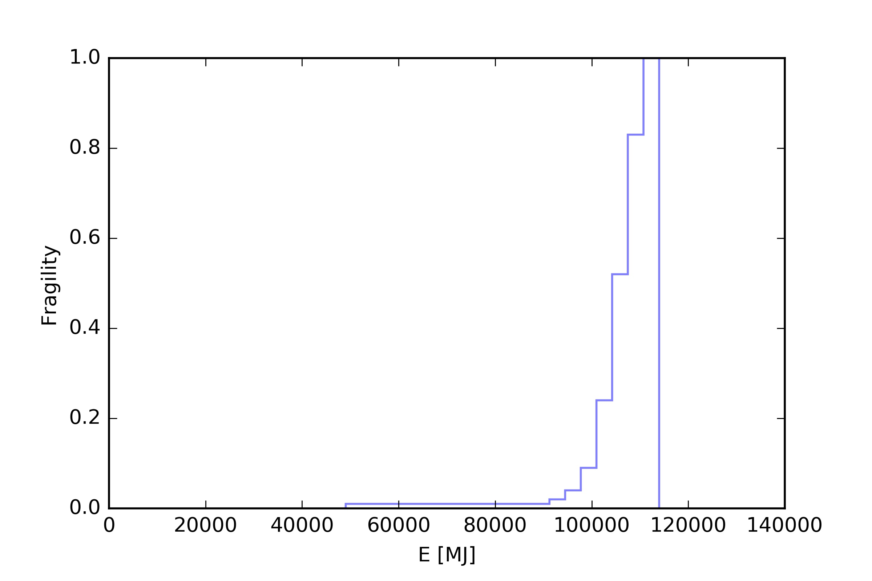
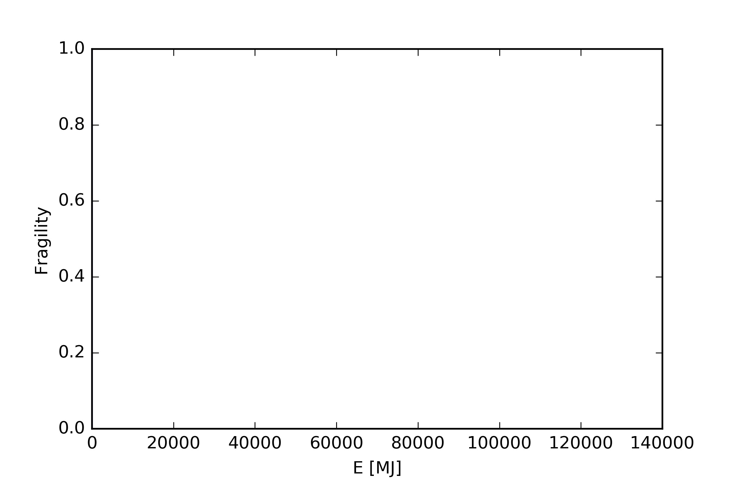
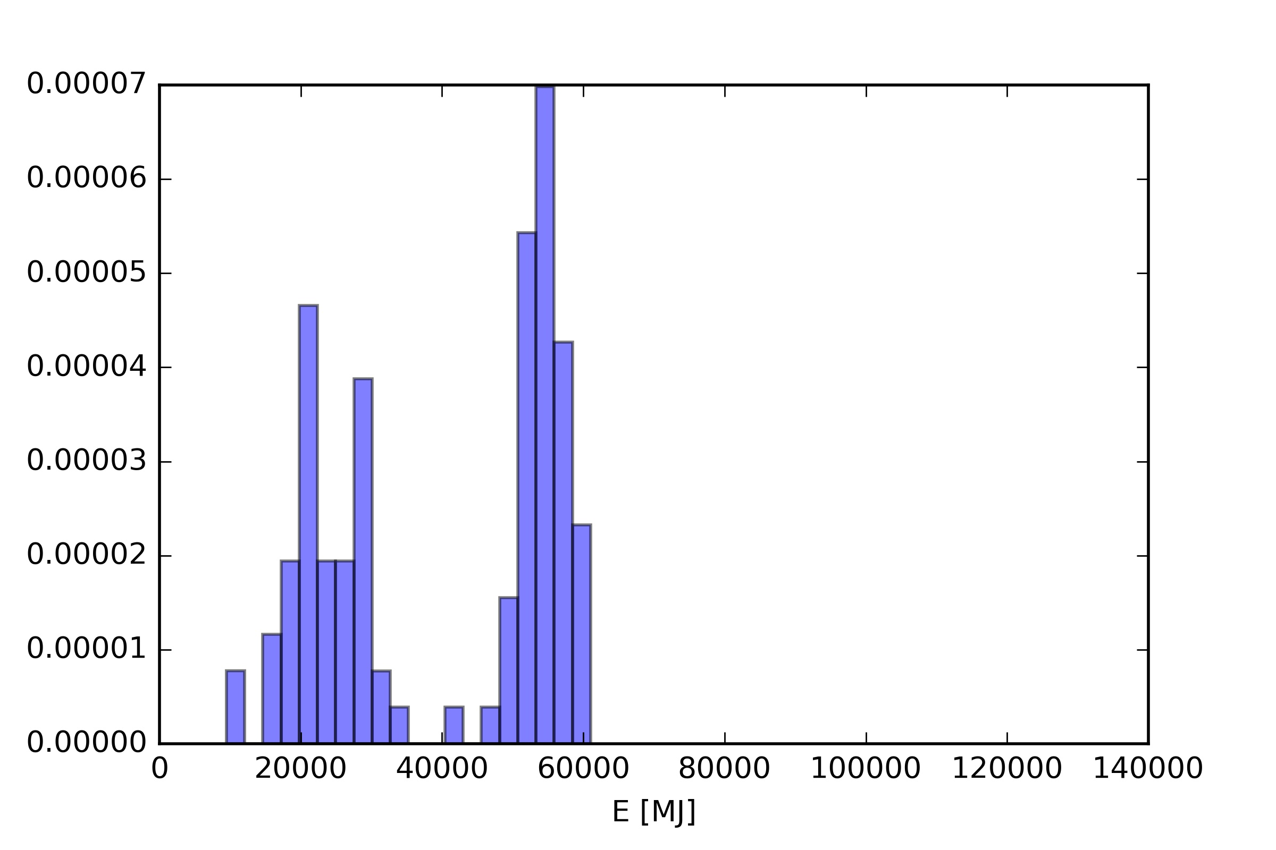
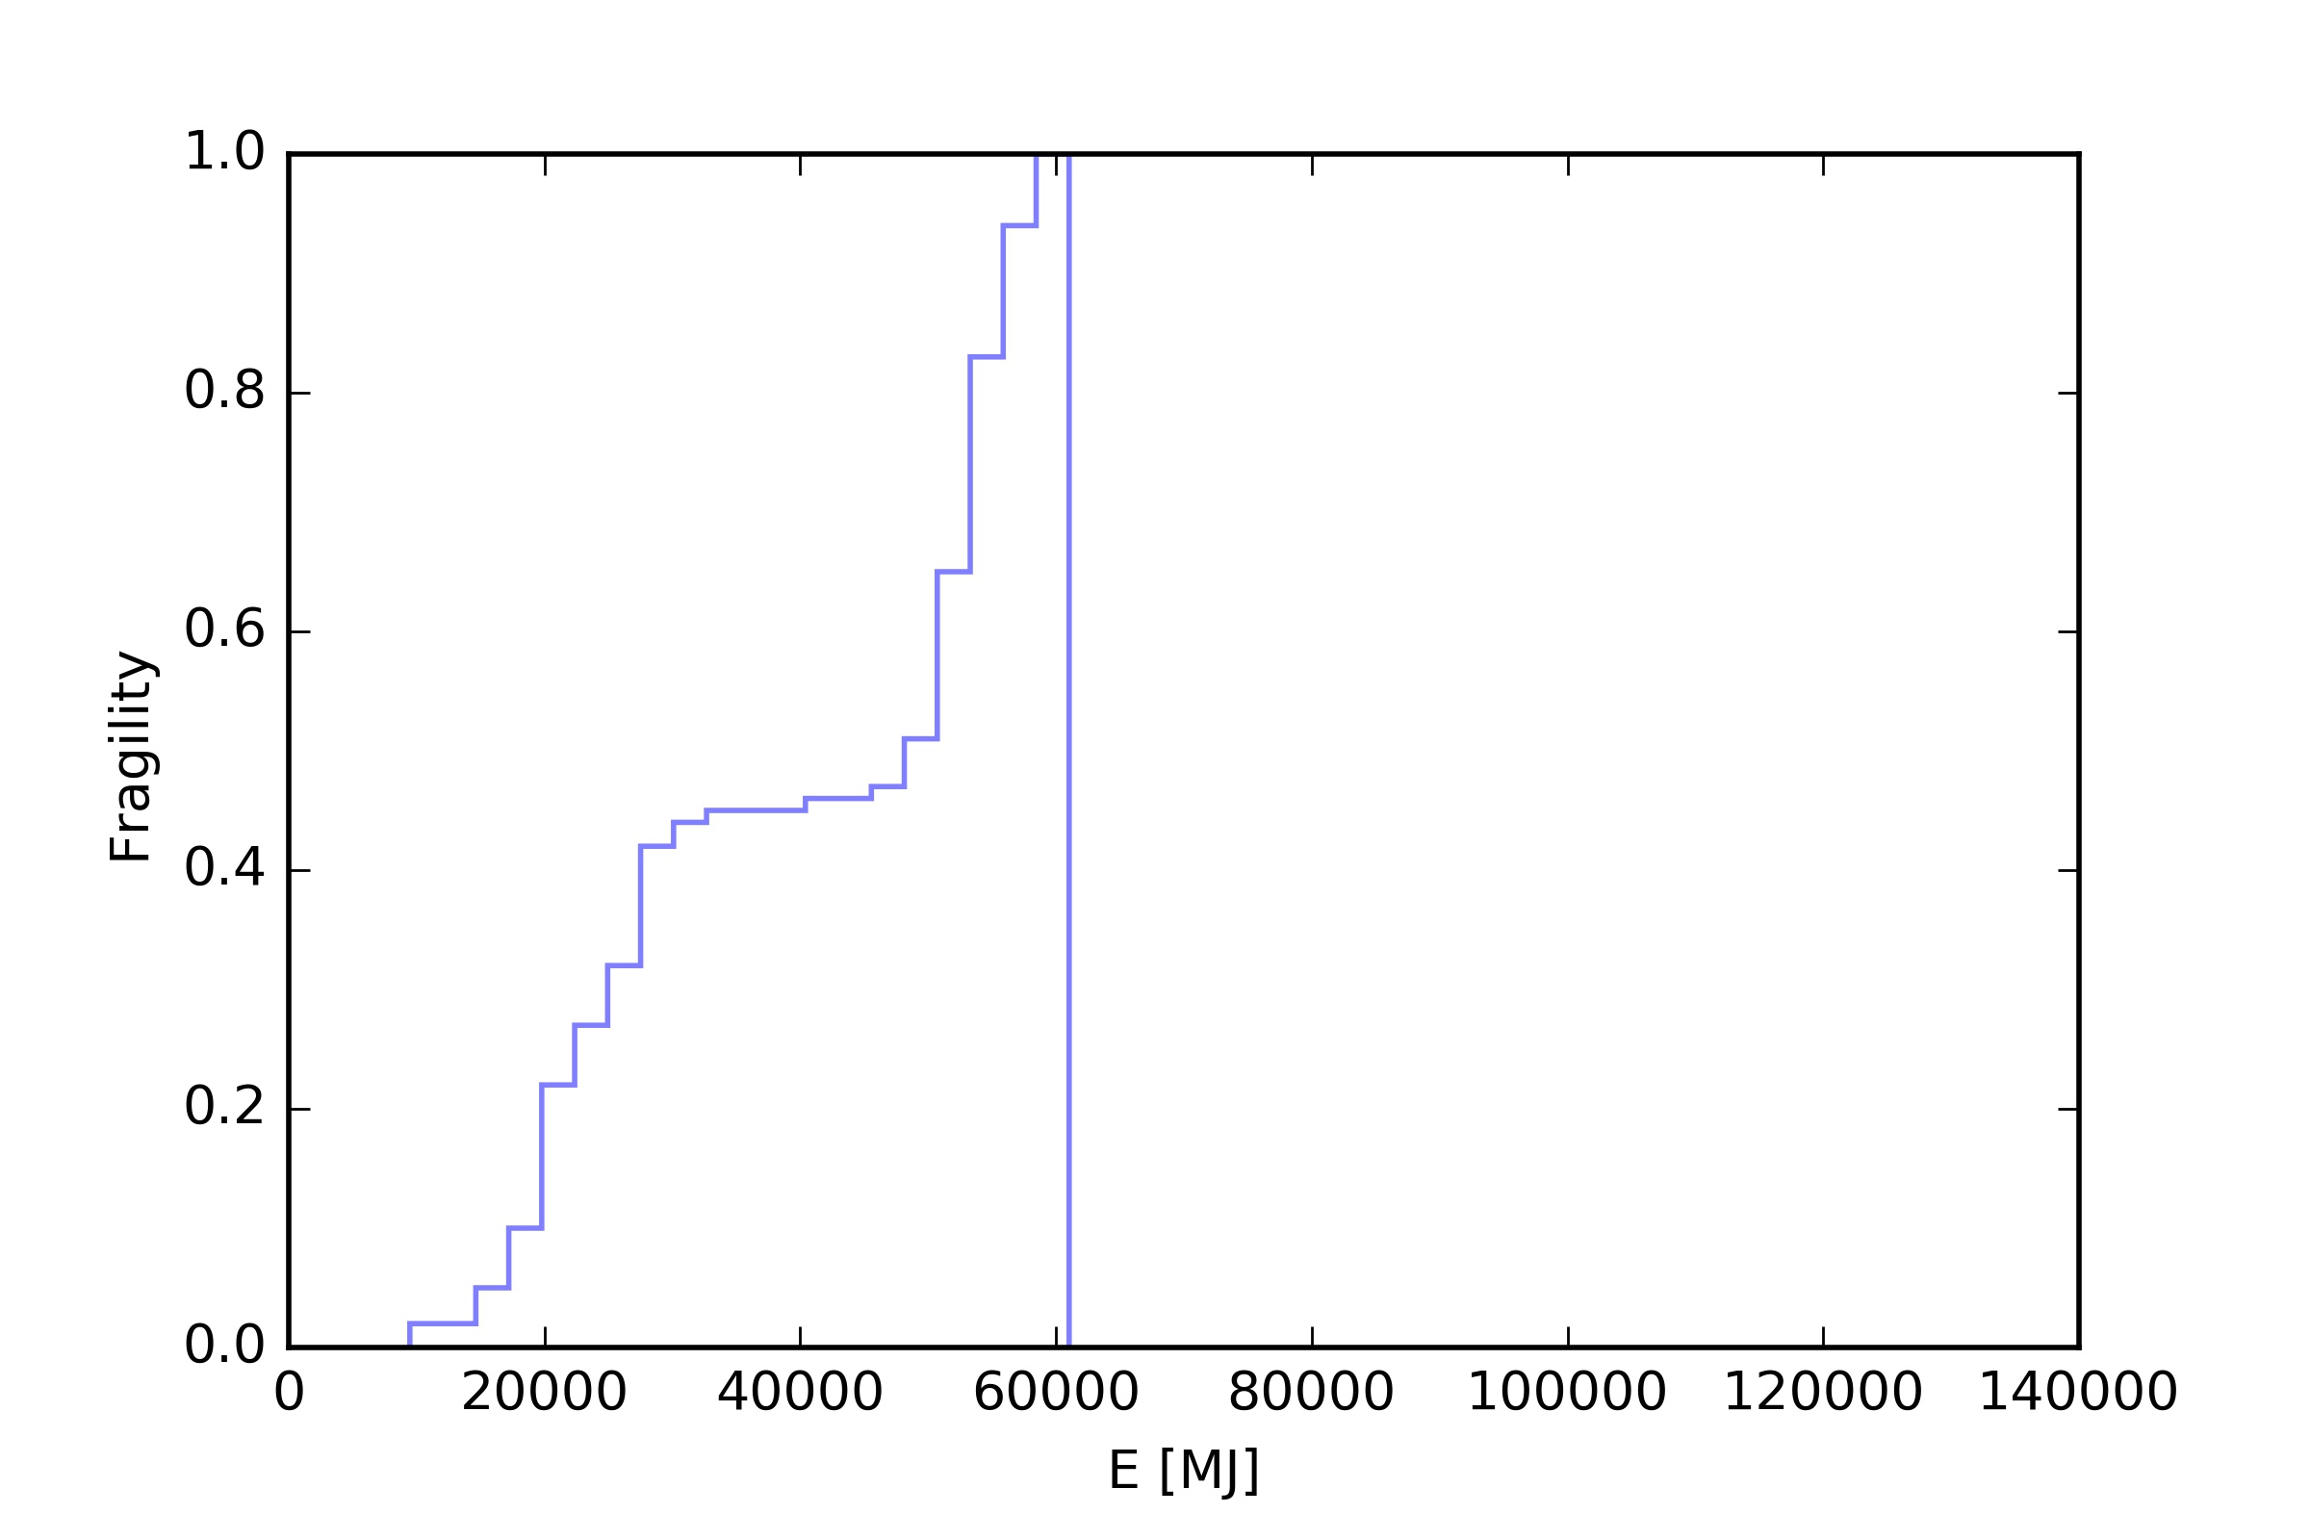
Total energy release E_{total}
Case #1 - Design fire 30MW
FB
115GJ@90%
1GJ
@90%
FB
SPRINKLER
FB
ROBOT
55GJ
@90%

Slide 29
Roadmap
Submodel for Fire Brigade block
Two seats of the fire (cable trays)
Validation (full and individual models)
    Additional data (access model)
    Manual firefighting model Suppression model

