Slide 2

Explosion Analysis and Assessment of Capacitor Banks in Technical Buildings
International Technical Safety Forum
ITSF 2017
September 18-22, 2017
TRIUMF, Vancouver Canada
Marco Andreini, Steve Hutchins, Jonathan Gulley, Saverio La Mendola (CERN, HSE-SEE-XP)
Fulvio Boattini (CERN, TE-EPC-HPC)
Francesco Chillè (FCSolutionS, Milan, Italy)
Angelo Fracchia (HVCC, Massalengo, Italy)

Slide 3
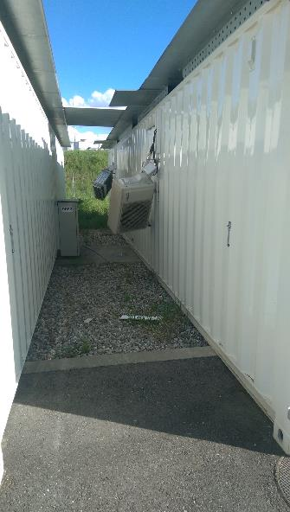
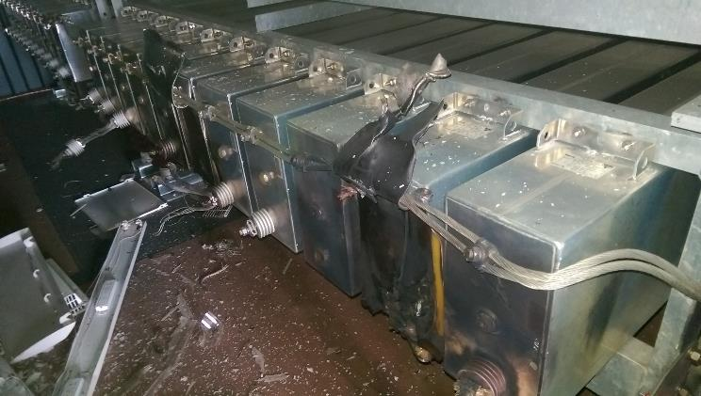
Preliminary Conclusions
Ante fact: POPS recommissioning of the faulted DC1 converter
After an intervention of corrective maintenance, POPS (Power for the PS) was restarted in normal mode but, later on, the DSP1 capacitor bank failed in short circuit.
Short circuited capacitors
The fault has been initiated by a short circuit in one or two capacitor units;
Technical explanation not found yet. Difficult to think it was a coincidence;

Slide 4
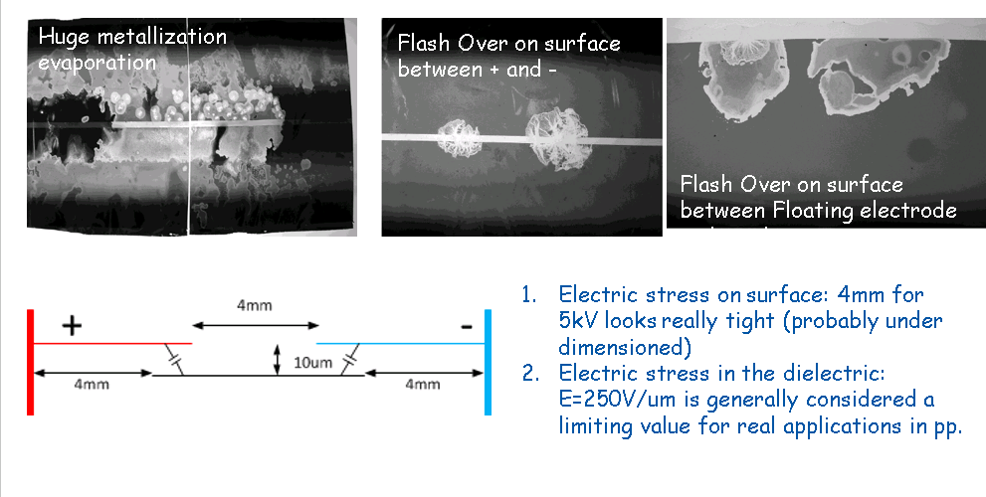
Preliminary Conclusions
Explosion probably due to premature ageing of the POPS storage capacitors

Slide 5
Activities under the supervision and with the support of HSE-SEE-XP
Explosion analysis and safety assessment of the new capacitor banks for POPSB to be installed at Building 245
Explosion analysis and safety assessment of the new capacitor banks for POPS to be installed in new containers
Design strategy adopted with TE department: acting on the preventing and mitigating interventions / monitoring system remains the same.

Slide 6
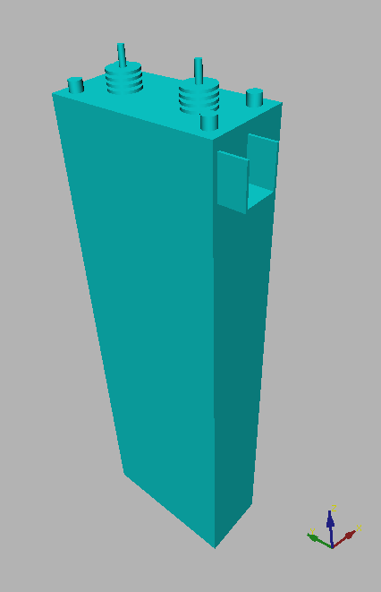
Accident Scenario
Explosion accidents can occur in consequence of electric faults in oil insulated electrical components.

Slide 7

Accident Scenario
Gaseous pyrolysis products
Explosion accidents can occur in consequence of electric faults in oil insulated electrical components.
An electric arc inside the component causes the pyrolysis of part of the oil ...
Pyrolysis reaction
Electric arc

Slide 8


Accident Scenario
Gaseous pyrolysis products
When the internal pressure reaches the withstand capability of the enclosure, a primary explosion scenario takes place: the enclosure fails, violently releasing the oil and gaseous products herein contained.
oil

Slide 9
Accident Scenario
oil mist
When the internal pressure reaches the withstand capability of the enclosure, a primary explosion scenario takes place: the enclosure fails, violently releasing the oil and gaseous products herein contained.
Part of the oil jet is turned into oil mist and forms an explosive atmosphere together with the gaseous pyrolysis products.
The liquid phase oil forms a pool...
liquid oil pool

Slide 10
Accident Scenario
Secondary Explosion scenario
Two subsequent fault scenarios can take place, if an ignition source is available:
secondary explosion scenario
pool fire scenario
Pool fire scenario

Slide 11
Methodological approach
external
effects
modelling enclosure
structural response
geometry data (concrete and rebars)
electric system characteristic data
enclosure characteristic data
geometry data
flammable amount and composition
turbulence field
internal
effects
pressure field
flame front
arc energy
modelling
electrical
fault
modelling
primary
explosion
modelling
secondary
explosion
modelling
structural
response
operation conditions
fault location
arc duration
pyrolysis reaction duration
oil mist amount
cloud position
ignition position
ignition delay
venting layout
configuration of doors&panels
material data
boundary conditions
other loads
load combinations

Slide 12
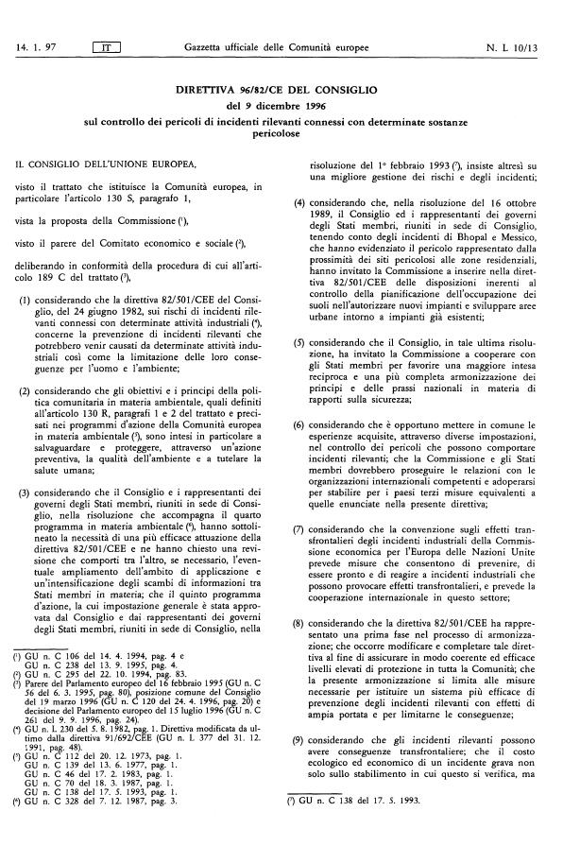

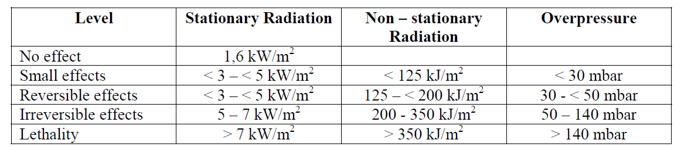
Checking external and structural effects
Definition of admissible threshold values
External Effects: Seveso directives
Structural Effects:
Building 245: Serviceability Limit State (SLS) - The material shall not present any irreversible damage
Containers: Ultimate Limit State (ULS) – The materials shall not achieve the rupture threshold

Slide 13
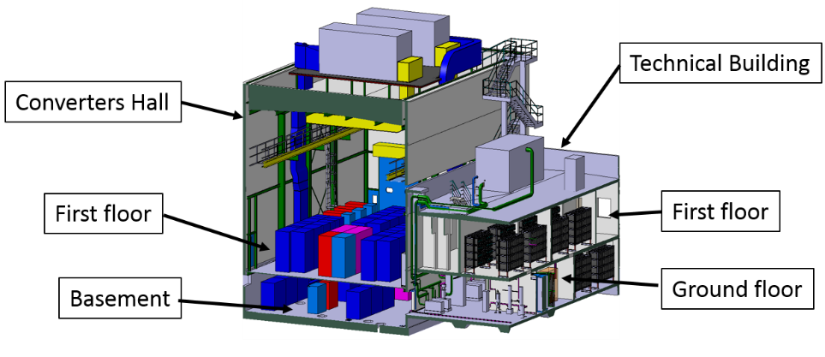
Building 245 – POPS-B
Building 245 is foreseen to house the new Main Power Supply of the PS Booster accelerator ring, in the frame of the 2 GeV energy increase requested by the LHC Injectors Upgrade (LIU) program.
This building is made of two parts:
Converters Hall - two story steel building 14.20 x 20.90 x 15 m
Technical building - two story concrete building 9.6 x 19.55 x 7.85 m

Slide 14
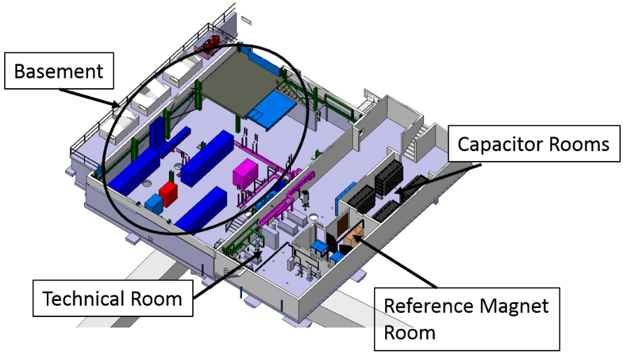
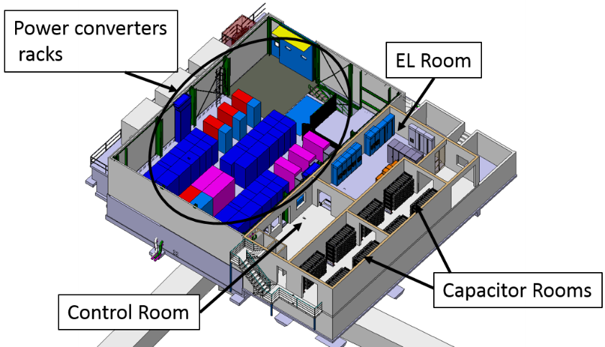
Building 245 – POPS-B
The Technical Building is divided in the following main rooms listed by floor:
Ground floor
Technical Room (S-402) with the pumping station equipment and the electrical cabinets needed for its operation;
One room for capacitor banks (S-401);
Reference Magnet room (S-403) with magnetic field measuring equipment (a magnet and some electronics).
First floor
Two rooms for capacitor banks (R-401 and R-403);
EL Room (R-004) with electric switchgears and UPS systems.

Slide 15
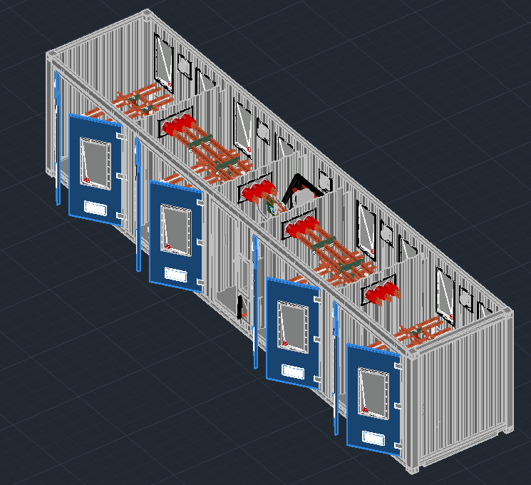
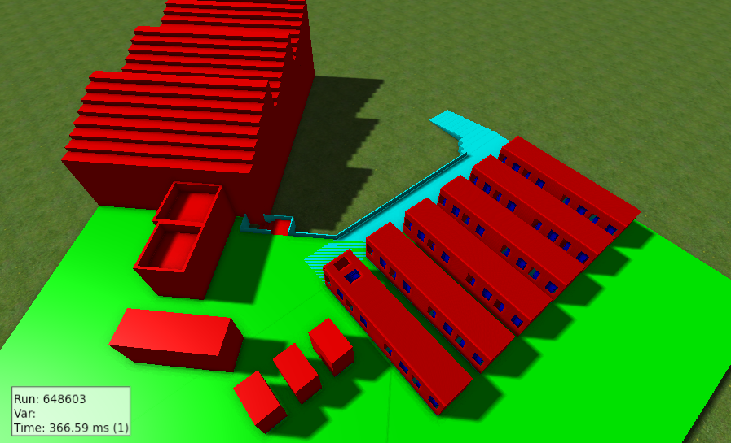
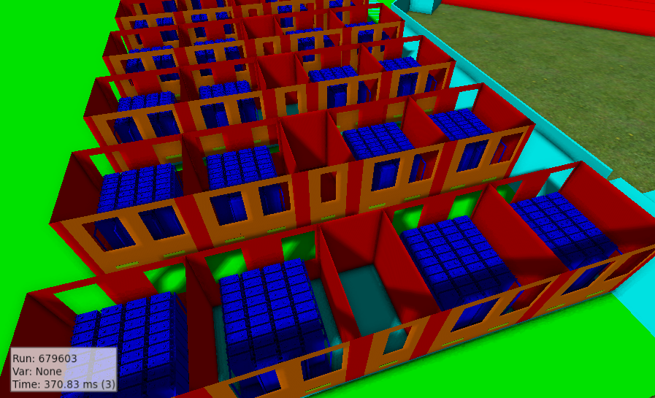
New Containers - POPS

Slide 16
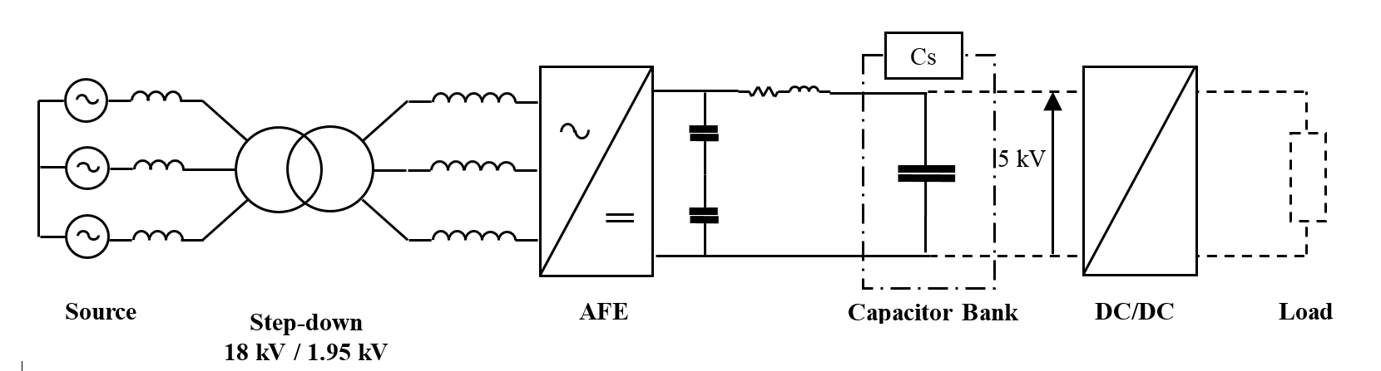
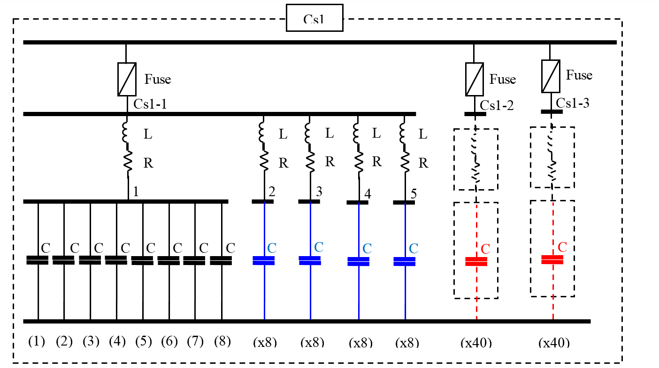
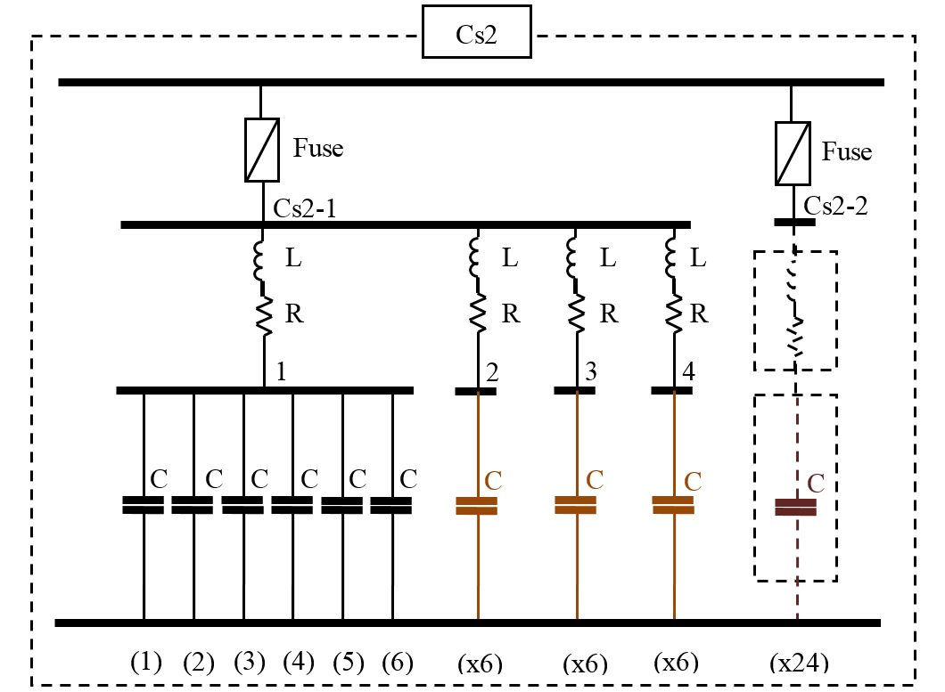
Characterization of the electrical fault
The power supply is composed by a step-down three phase transformer, an Active Front End (AFE) converter with associated filtering elements, one storage capacitor bank and one DCDC converter supplying the load.
The capacitors of the bank (Cs) are arranged in two sub-groups, Cs1 and Cs2 electrically connected in parallel.

Slide 17
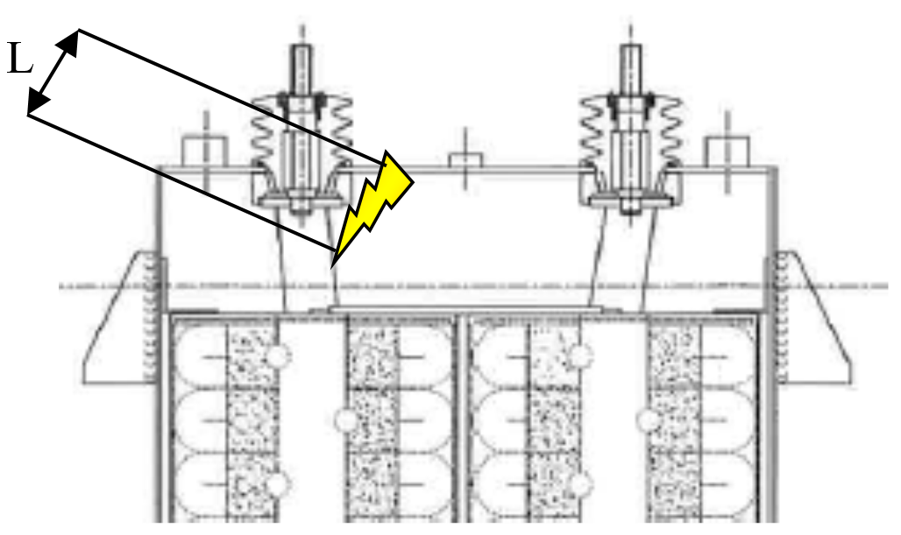
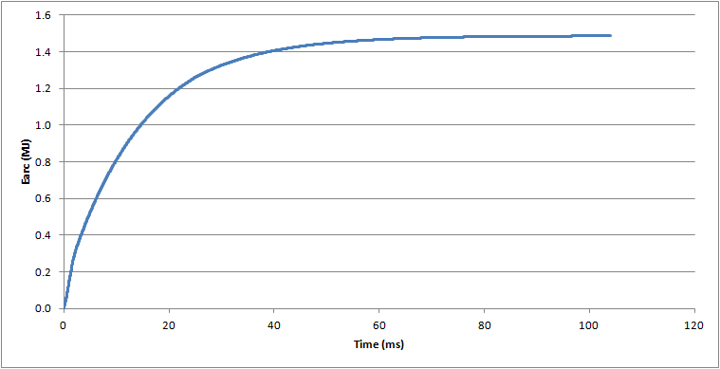
Characterization of the electrical fault
A line model has been developed in order to simulate the behaviour of the capacitor bank under fault conditions. Current transient has been calculated.
The arc voltage is depending on the arc length.
A representative arc length based on internal geometry of the component is adopted.
Finally the cumulated arc energy transient curve is obtained.

Slide 18
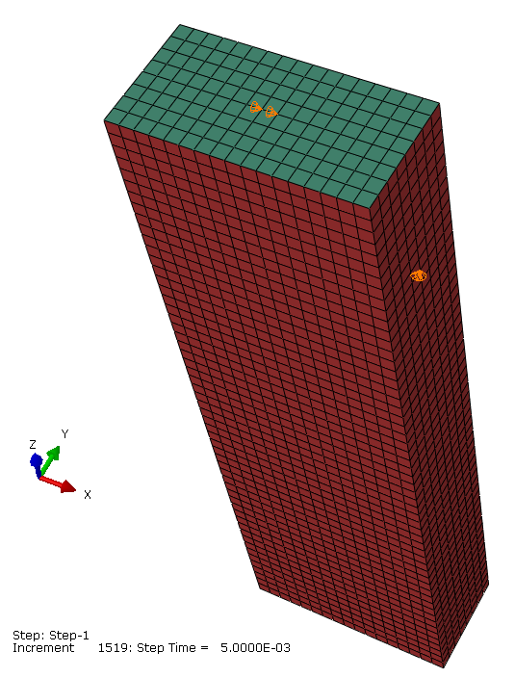
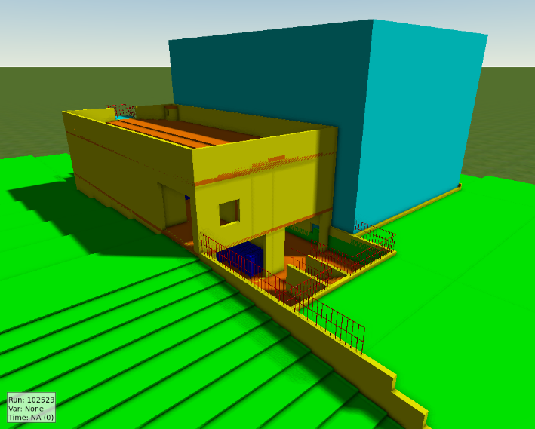
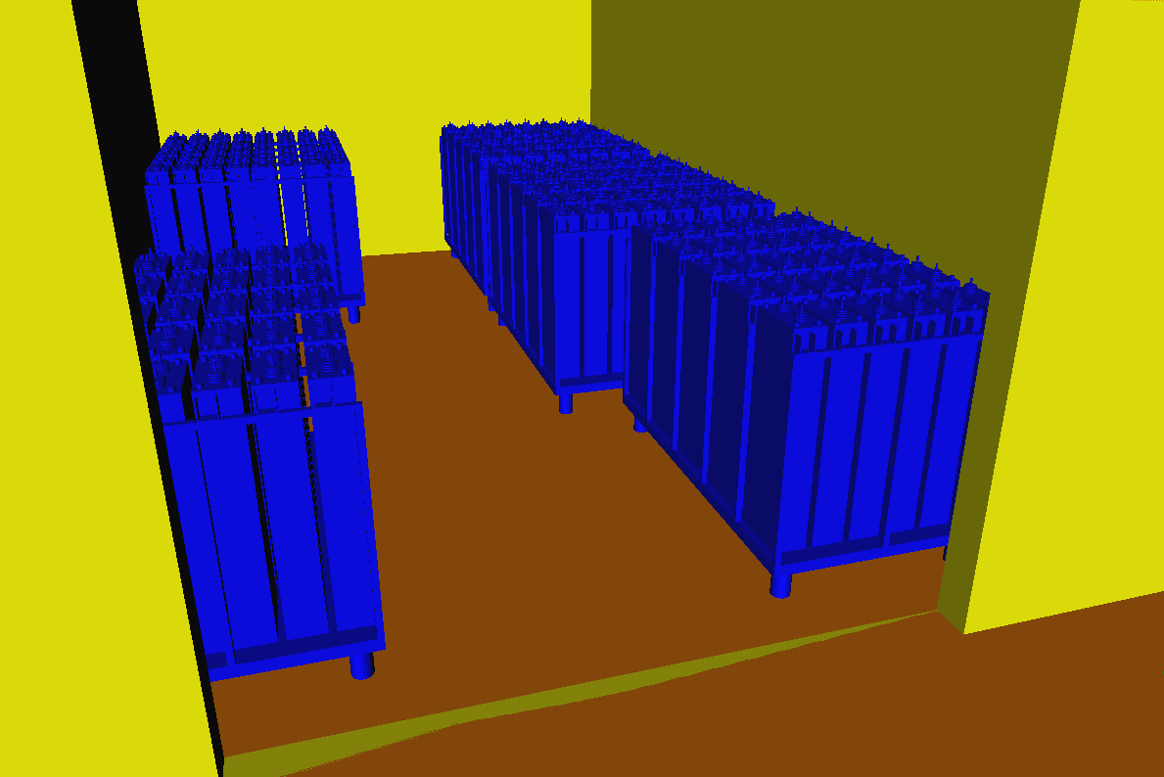
Modelling the primary and the secondary explosions

Slide 19
Modelling the primary and the secondary explosions
  Considered Parameters:
  faulted cell position
  geometry (doors and venting areas configuration)
  primary explosion modelling approach («well mixed»/ «burst»)
  gas cloud position
  ignition position (well mixed) / ignition delay (burst)
  oil mist amount
3
4
5
2
1

Slide 20
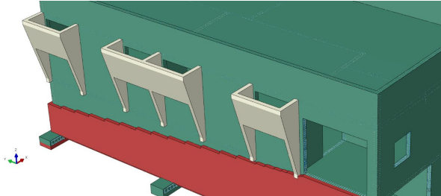
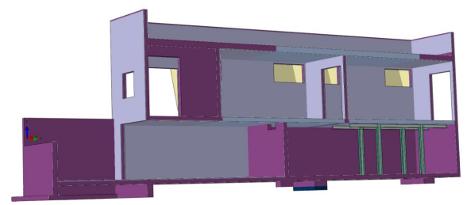
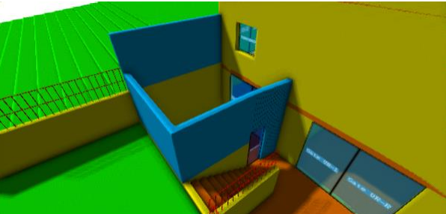
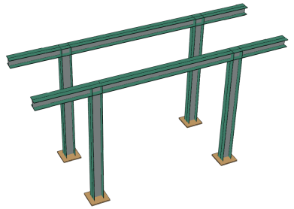
B 245 - Retrofitting strategy
  Realize compartments: blast resisting doors
  Additional venting areas and reinforced concrete barriers
  Structural stiffnesses and reinforcements

Slide 21
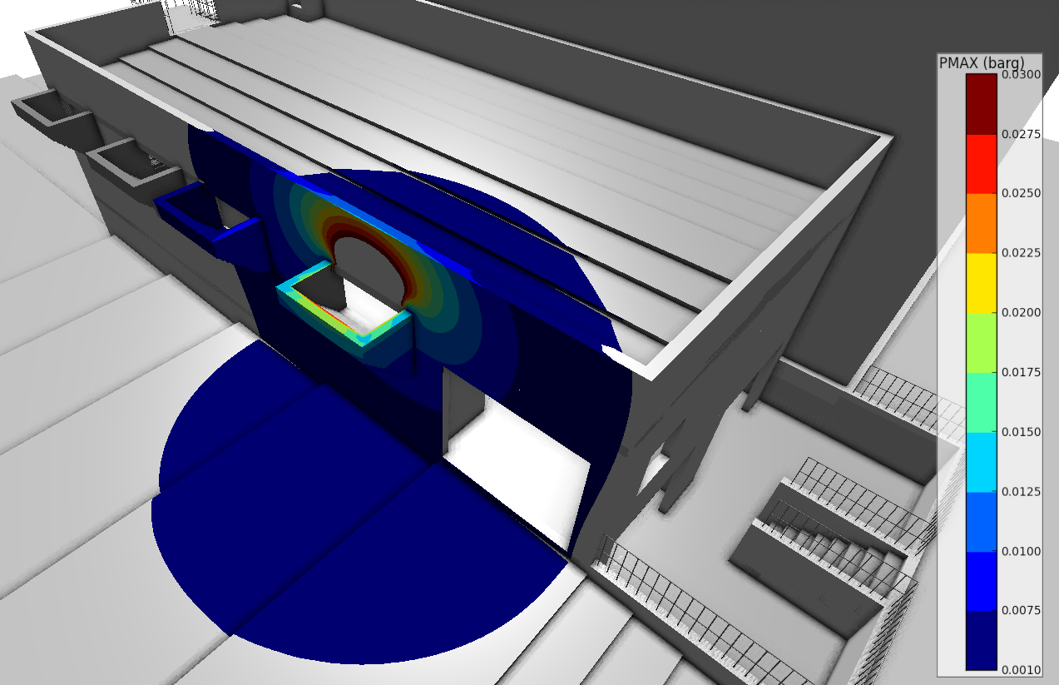
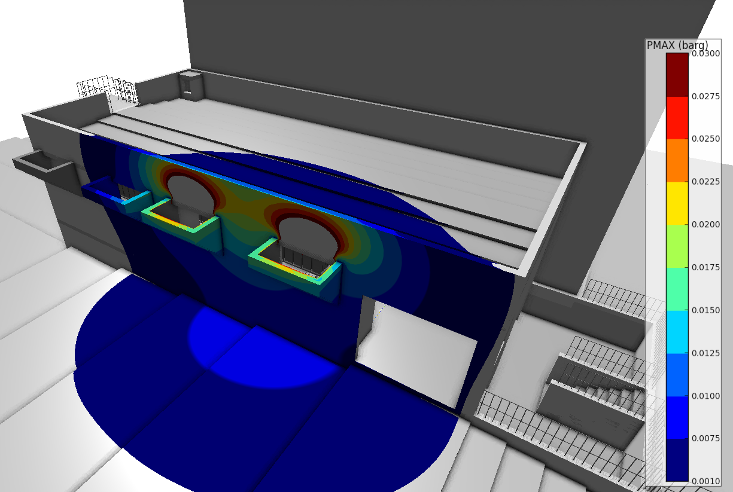
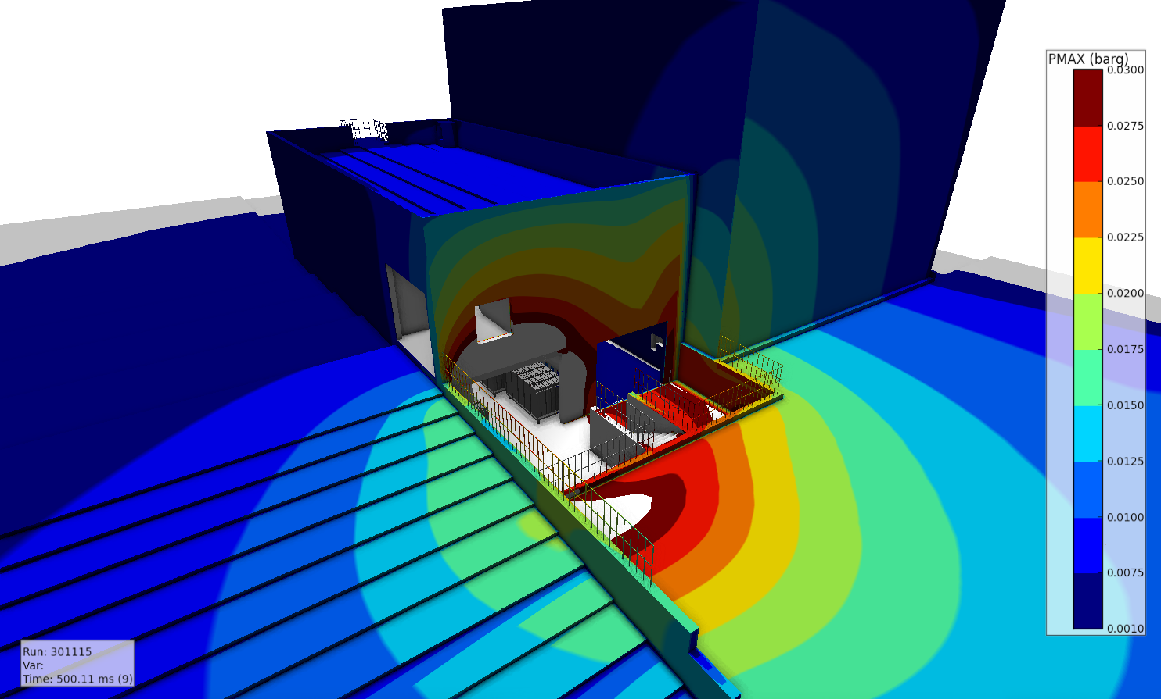
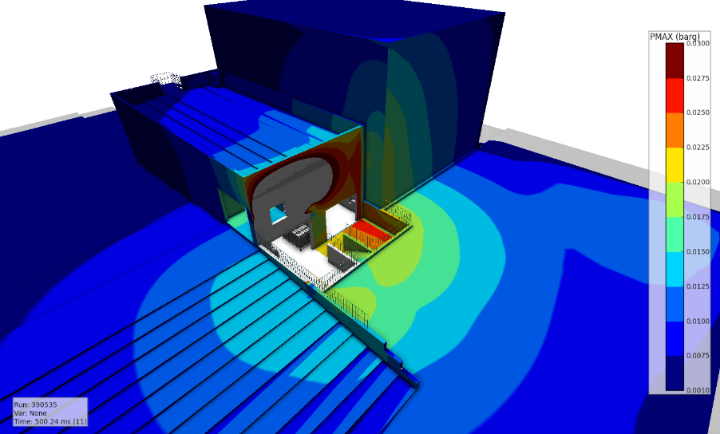
B245: External pressure
First floor: 1 venting area
First floor: 2 venting areas
Ground floor without barriers
Ground floor with barriers

Slide 22
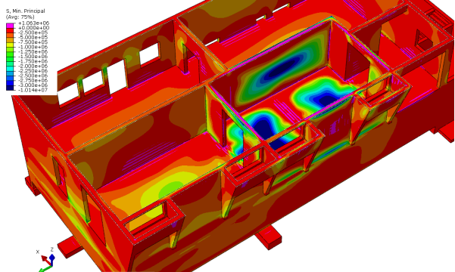
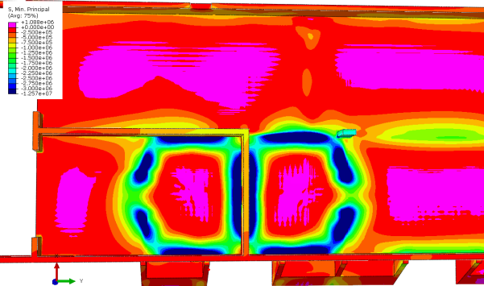
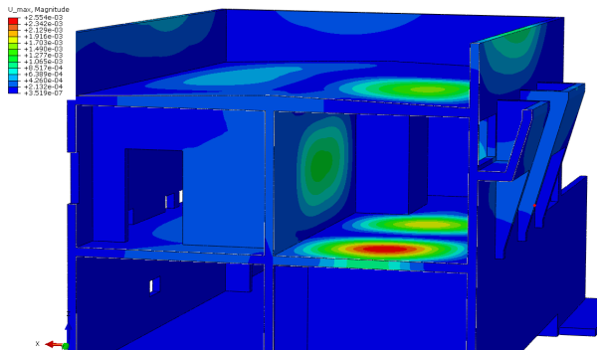
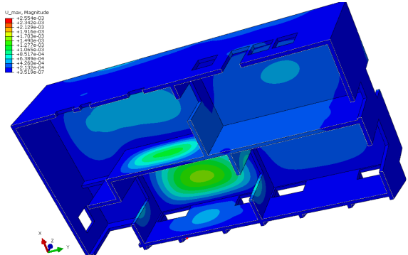
B245: Structural Members – Internal Stress / Displacement

Slide 23
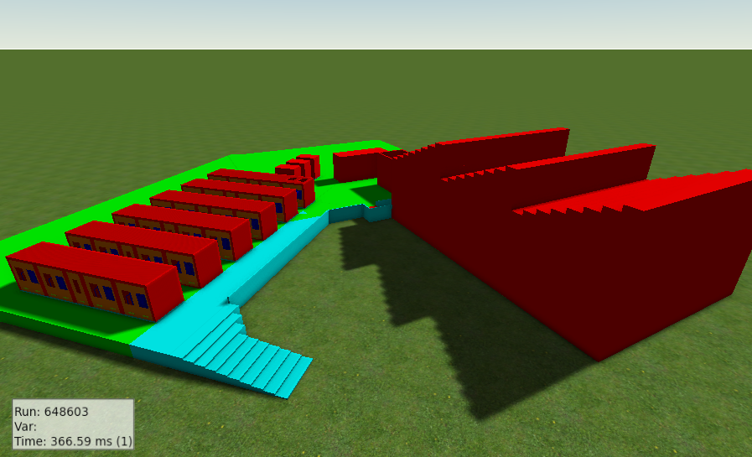
New Containers Design
  Realize compartments
  Additional venting areas and steel barriers
Proposal under discussion

Slide 24
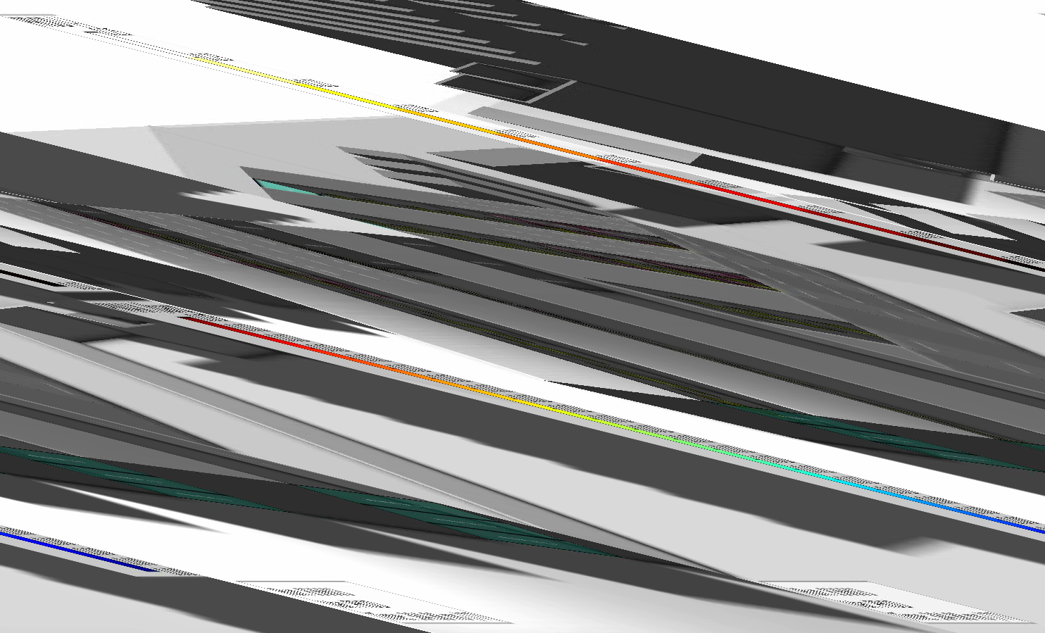
New containers: External pressure

Slide 25
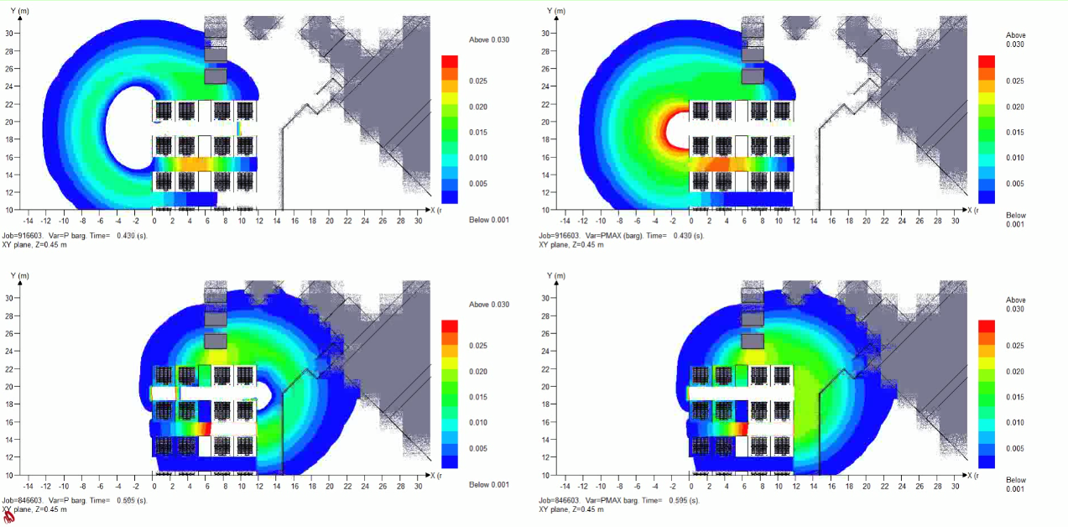
New containers: External pressure
Blast resisting barriers

Slide 26
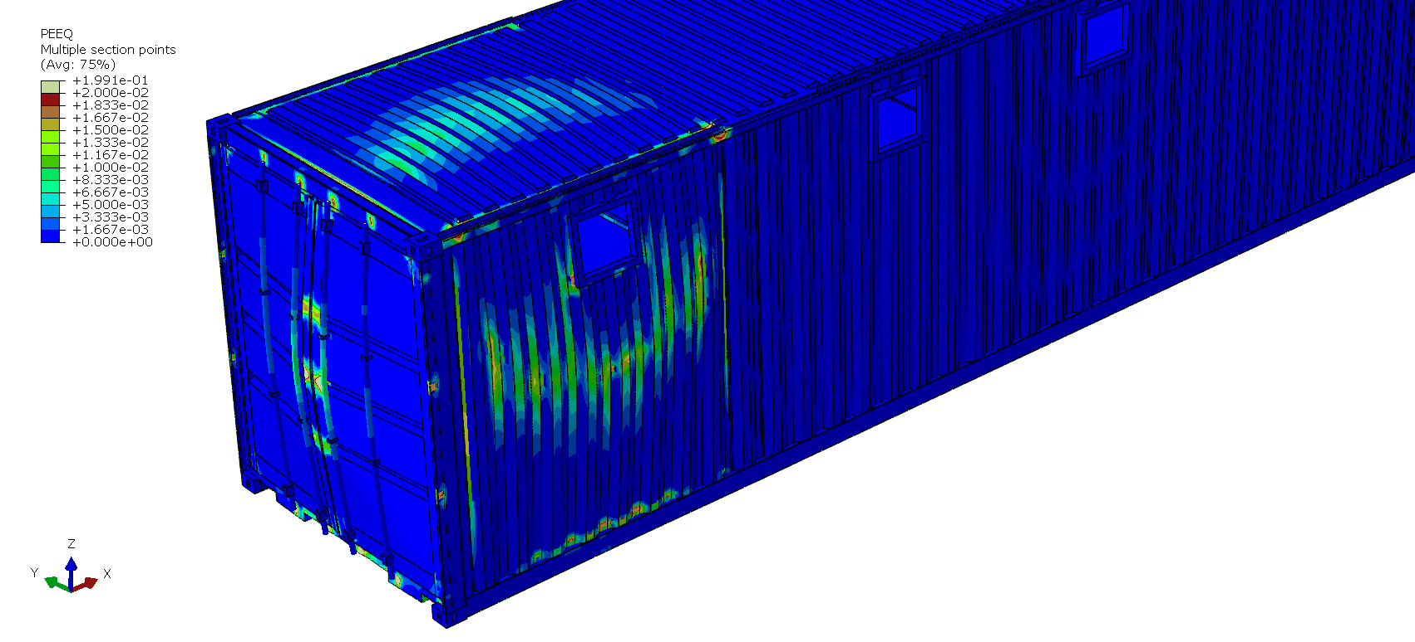
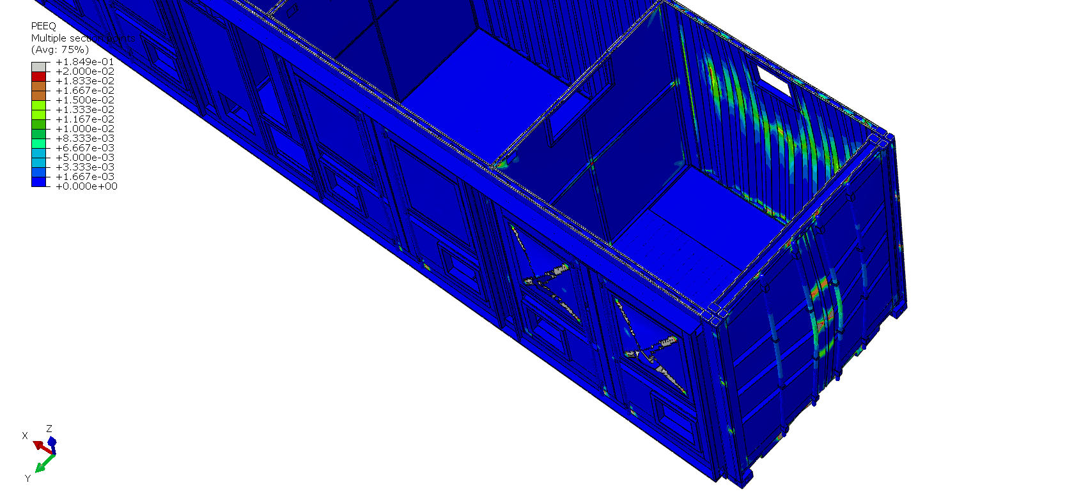
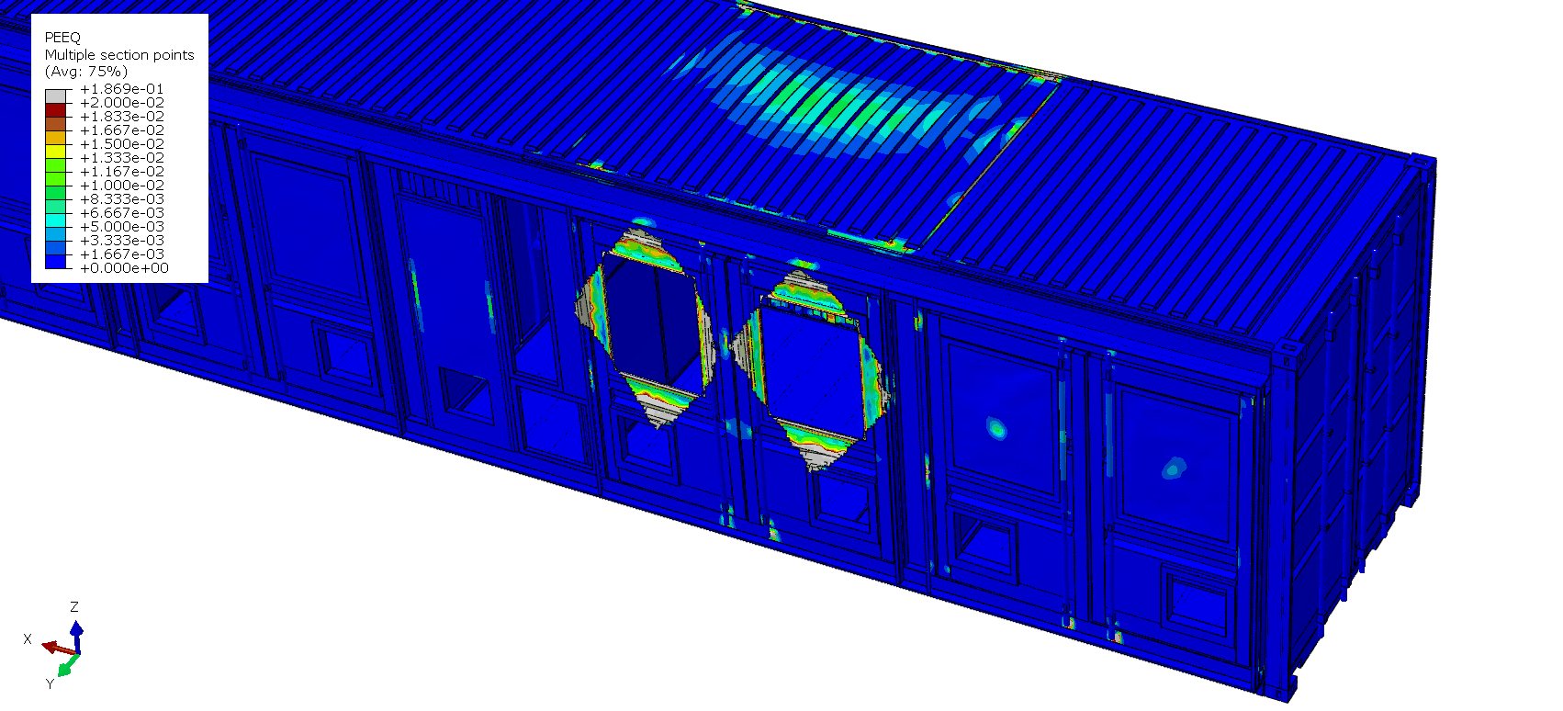
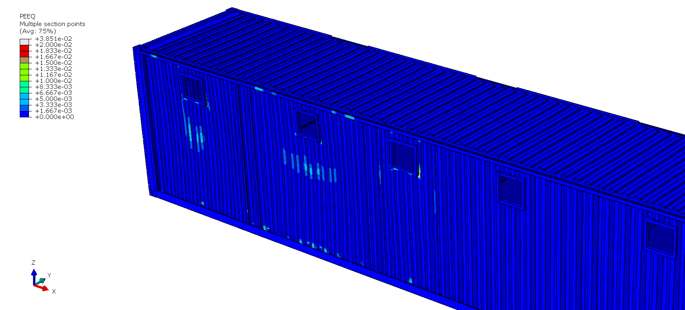
New containers : Structural Members – Plastic deformation

Slide 27
Conclusions
  Advanced CFD and FE analyses allowed to:
  characterize and compare different venting solutions for blast mitigation
  provide input (blast loads data) for subsequent structural assessment or design
  check solution admissibility with respect to external and structural effects
  select optimal solution
  Retrofitting intervention for B 245 are currently in production at SMB department
  Blast panels specifications for the containers have been defined
  A retrofitting strategy for the containers is under discussion (blast control panels or large exclusion zone)

