Slide 1
Increased Rigour & Discipline in TRIUMF’s Controlled Work Process
Anne Trudel
TRIUMF Chief Safety Officer
September 21, 2017

Slide 2
Controlled Work Process
Why is Change Needed?
Assess Current State
Opportunity for Improvement
Where we are & Where we’re going

Slide 3
Controlled Work Process
Work Permit System functions
  Work coordination
  Identification of hazards and mitigation
  Verification and readiness for beam delivery
  Configuration management
Stakeholder roles in WP process
  WP holder
    work proponent usually with service group
    specifies where, how and what work will be done
    Identifies hazards and mitigation and carries out pre-job briefing
    Enters End-of-job status information
  Radiation Protection Surveyor (radiological hazards)
  Facility Coordinator – reviews work and hazards
  Operations – issuer of permit
Notes:
This is our current state. The future state may evolve to slight difference in roles for operations.

Slide 4
Safe and Effective Operation
  Around 2600 work permits per year are opened and closed
    4 control rooms – 3 in Accelerator Division and 1 in Applied Technology
  Work is being done with only occasional incidents
  Our accelerators work at high efficiency, exceeding annual targets
  The overall radiation dose to workers is at an all-time low
  There are very few injuries and lost days
        …… On the surface everything looks pretty good

Slide 5

BUT…
Project delays for refurbishment due to lack of as-built drawings
Work stoppage or delay due to unknown configuration or lack of access to necessary information
Poor work coordination or undocumented configurations give rise to Hazardous Conditions
Near Misses
Live 480V, Lockout, Dose Exceedance
Issues with
Documentation
Roles and Responsibilities
Notes:
What fraction of one’s time is spent fighting fires?
How often is work stopped because one encountered something unexpected that was not part of the documented configuration?
Does one spend significant time clarifying information or searching for information that is required but is not readily available?

Slide 6
Near Misses
Near Miss - Non-Nuclear Energy Worker dose exceeded
  Procedures for recording dose not followed
  Worker training requirements not understood
  Worker not specifically listed on Work Permit
Near Miss - Electrical Incident – 408 V & Lockout
  Configuration not documented for the backup pump
  Configuration not managed consistently for work control
  Regulatory requirements for Lockout not met
Corrective Actions
  Institute Basic Radiation Protection Training for all staff
  Acknowledgement by workers on WP system
  Updated Training for staff on Work Permit
  ….

Slide 7
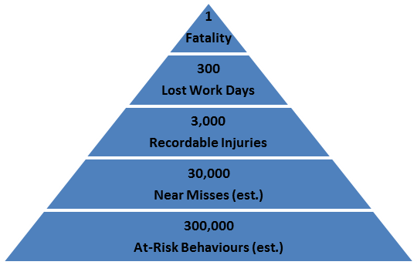
Limited results…..
Despite Corrective Actions still continue to have Non-Conformities regarding Controlled Work
  Near dose-exceedance for non-NEW – related to training status that had not been updated by supervisor when job change occurred
  Work scope insufficient to allow for accurate hazard assessment
  Even when acknowledging requirements, workers do not comply with the PPE specified
  Workers going ahead without an activated Work Permit
Management position
Important to address at risk behavior (Errors) to prevent more significant events
Generally address impediments to effective operation

Slide 8

Paradigm shift
Old paradigm:
Beam delivery supersedes everything
“Get it done”
New Paradigm:
Doing it right safely the first time is more important than just getting it done quickly
If it is not documented it does not exist

Slide 9
Current State of Work Permit Process
Currently the Description of Work in Work Permits is often insufficient to
  ensure that all hazards are identified and mitigated (Safety)
  all pertinent information for the work has been provided to the workers (Configuration)
  ensure verification of the work is being done
  establish a record of what was done
Work Permit Holders & Facility Coordinators cannot ensure that people can do the work safely
    Not compliant with our own procedures
    Not compliant with regulatory requirements
Regulatory Licence QMS requirements
  Work is carried out to the latest drawings specifications, approved instructions and procedures that identify specific items and activities
  Work conforms to approved drawings or specifications that define the conditions, methods, characteristics, acceptance criteria, and reporting and recording requirements
  Self checks, supervisor checks, and independent checks are performed for work

Slide 10
Elements Impacting Controlled Work
Work package
Plan, Pre-job briefing, Carry out, Verify
Update Configuration
Request
Work Permit
Work coordination
Hazard Identification and Mitigation
Configuration management
Verification
Work Types
Break-fix
Fault
Maintenance
Calibration & Inspection
Project task (SAS,PMOG)
Corrective action
Correction
Approval
(OPS, FC, RPG)
Group
Worker | Training Record
 | Job Description
 | Skill set
Group Manual | Calibration & Inspection
 | Procedures
 | Maintenance Records
Training Plan | JPMs
 | Training Courses
Latest drawings, specifications, approved instructions and procedures
Configuration
management
Buildings
Building coordinator
Rooms
Work Requests
Document & Record Management
Document Release
ECO
Facilities
Facility coordinator
Configuration
Hazards
Commitment List (PMOG)
Project Commitments
Operational Commitments
SAS
SAS Projects
SAS Tasks

Slide 11
Opportunity for improvement
Only if work is well defined and the configuration documented can we:
  assess all hazard and allow for proper mitigation
  assess impact on facility configuration
  ensure record of configuration changes
  ensure more than one person is able to fix it
  ensure knowledge (and safe work procedures) are not lost
Work is safer and more efficient
More time is spent on important things
Reduce the overload on key individuals
Notes:
Implementation focusses on meeting regulatory requirements for all work moving forward.
How we meet the requirements in the longer term will be addressed with upgrades to configuration management documentation for facilities and equipment.

Slide 12
Work permit Guidance
Work Type Examples
Troubleshooting
Fault (E-Fault#)
Maintenance
Calibration - Inspection
Install, modify, remove (ECO/WorkReq#)
Corrective action (CA#)
Other
Work Summary
State end goal
Work Conditions
Location
Pre-requisites or Special conditions
Operational risks
Time sensitivity
Verification details Self-check supervisor-check, independent verification
Radiological Hazards
Industrial Hazards
Start time/duration
End of Job Status
Job Status
Verification results, measurements, outcome
Present state Is device/syst operational? Is any change in performance expected?
Configuration Change Documents to update
Work Instructions
Released Procedure
Work sequence key steps
Reference specifications for work Drawings, design notes, comm. plans, equipment manuals
Machine /device /equipment
Unambiguous description
WP Guidance provides clear criteria for WP holders, Facility coordinators, and Operations to determine if information is sufficient to allow work to proceed

Slide 13
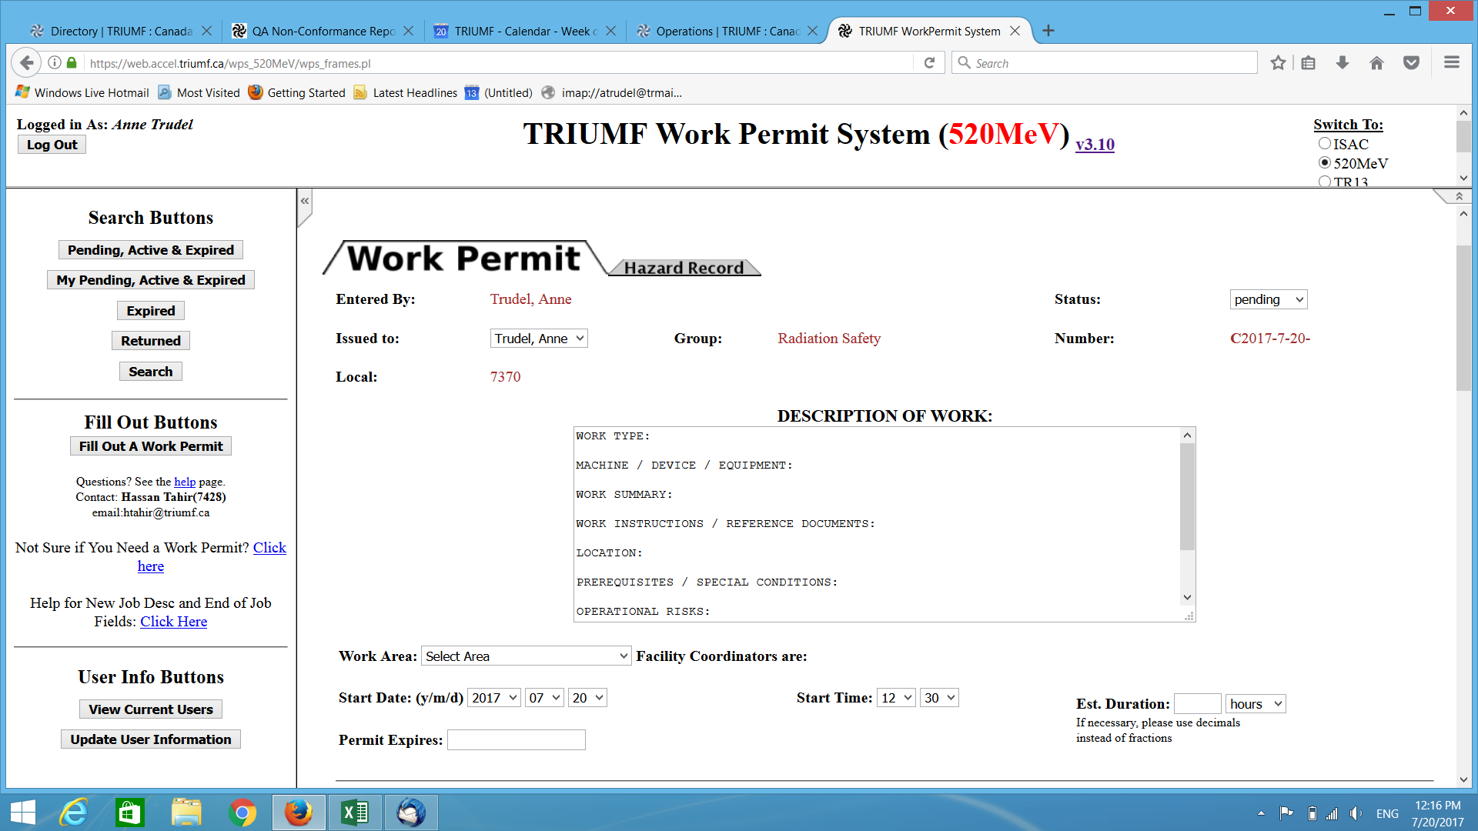
Notes:
Added fields for work type, summary, instructions, equipment and prerequisites.
Hazard Record has Radiological including waste, and industrial hazards and mitigation.
Other improvements will be made with hazard assessment drop-down menu and displaying training status for workers.

Slide 14
Work permit gate keepers
Facility Coordinators
  Check work description
  Review hazard assessment & augment if required (RP & OHS)
  Confirm verification details (independent verification state group responsible)
  Assess for conflict with other work that may exist
  Provide additional instructions
Operations
  Check Facility coordinator entry is complete
  Check status before issuing; have conditions changed
  Assess for conflict with other work
  Provide additional instructions

Slide 15

Continuous Improvement
Work Permit Improvement Team (Operations, Facility Coordinator, WP holder, EHS/QMS Advisor)
Amend Work Permit Training
Require use of Guidance
Revoke access for those without WP training update
Approve only Work Permits that have required information
Track no. of passes to successful approval
Identify possible improvements for Guidance
➔ Revise Guidance Document
Identify changes required documentation
  Facility Configuration, Group Training Plans, Group Manuals, Drawings, Maintenance Records, Calibration and Inspection Index
Town Hall Meeting to report on progress and solicit feedback
Weekly Audit of approved Work Permits
  Has required information been provided and is it complete?
  Review no. passes
Notes:
Monitor and iterate guidance with feedback from personnel. Communication is key for buy in and feedback.

Slide 16
Audit weekly to monitor status
Result summary
  Typical # WPs /week is 40-50 over 4 facilities
  Report on 5 per facility ( 15-20/week ≈40%) and track 1st/2nd pass rate and capture missing information
  Detailed review of one permit per facility per week for all information including document and reference checks
1St Pass Failures
Missing or confound Work type Work Summary, Work instruction.
Missing Industrial Hazard, Verification
Detailed Review
Stringent req. not met
Incomplete info
N/A needs to be used
Notes:
Monitoring is a key part of ensuring that the process is working and is being followed.
It also provides an opportunity to tweak and make improvements.
Monitor at weekly intervals until process is stable, and then less frequently.

Slide 17
Feedback & Benefits
Facility coordinators report there is less work following up with WP holders so permit approval process is more efficient
WP holders report that it takes longer to fill out WP
Short term
  Longer to find appropriate documentation (drawings, procedures) and complete hazard assessment
  Immediate benefit - improved work planning and safer work environment
  Long term benefit:
    Work is done more efficiently
    People have the tools, resources and knowledge to do their work
    Work done correctly the first time and less time wasted
    More time for creative tasks….
Doing it correctly and safely is more important than “getting it done” quickly

Slide 18
Error-proofing the System
Mistake proof key work systems, including non-standard work
Track, trend , and tackle daily process errors & failures
Use analysis of audit to identify process-based errors
Identify value added and eliminate non-value added
Learn and improve from mistakes
PROACTIVE
REACTIVE
Engage staff to capture and effectively fix daily errors

Slide 19
…. Ongoing work
Configuration Management tools
  Asset management system with configuration architecture
  Capture drawings in one system
  Capture procedures, specifications, design notes in one system
Develop cross-linked tools for Work Control
  Training database linked to WP
  Task Hazard Assessment & Procedures linked to WP
  Work Permit application with criteria and guidance information captured
  Equipment database
  Configuration changes uploaded at end of job
Task Hazard Assessment Guidance
  Take 5 Field Level Risk Assessment is printable for use and posting at job site
  Develop guidance with criteria to define when Subject Matter Expert review is required for higher level hazards

Slide 20
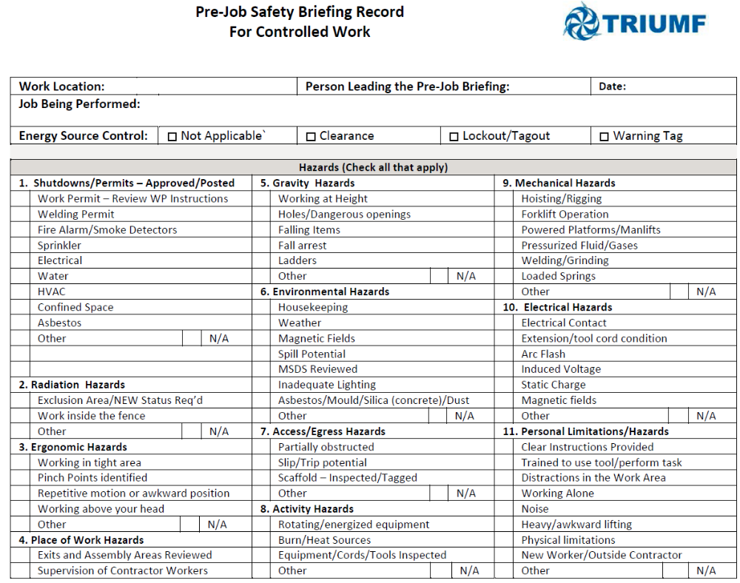
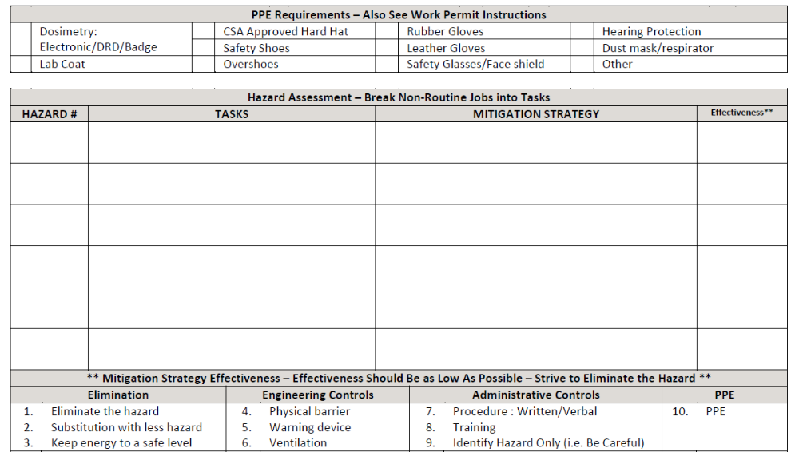
Take 5 – Field Level Risk Assessment
Notes:
Field level risk assessment based on oil & gas industry. An accelerator facility because of the distributed configuration is more akin to field work in the oil & gas industry than a factory floor setting.

Slide 21
Conclusions
Measured success achieved with improvements in controlled work by:
Assessing current state against requirements and defining a path towards an interim and final state
Having a small stakeholder group drive the needed changes
Engaging staff site-wide on rationale and proposed changes
Providing clear criteria to stakeholders to ensure success
Ongoing monitoring and communication with staff

Slide 22
Thank you!
Acknowledgements to R. Kruecken, J. Aoki, B. Laxdal, M. Marchetto, B. Richert, V. Toma, P. Jones, J. Drozdoff, J. Mildenberger, T. Sanghera

Slide 23
End State for Safe & Effective Operation
Facility Coordinators who are responsible for
  ensuring safe operation
  ensuring safe maintenance work
  delivering of outputs as planned
Equipment Owners / Service Groups who
  maintain facility equipment consistently under coordination of the Facility Coordinators
  have well documented
    work processes and maintenance plans in
      Group Manuals, released Procedures, Training Plans
      Asset Management System
    Project Plans for upgrades and larger projects (SAS, TSOP-15)
  Documented current configuration for equipment (drawings, released documents)
Work Permits and Work Requests that reference all pertinent information for the work to be done
Notes:
A project plan with all elements is being developed so that different components can be prioritized for roll out.

