Slide 1
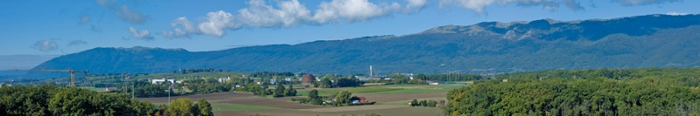
From LHC to HL-LHC – overview of the major environmental issues during civil-engineering and operation
M. Alessi, S. Kleiner, B. Leon, S. Schadegg & L. Wohlgemuth

Slide 2
Outline
Brief introduction to the project and affected sites
Local constraints
Issues during construction and operation

Slide 3
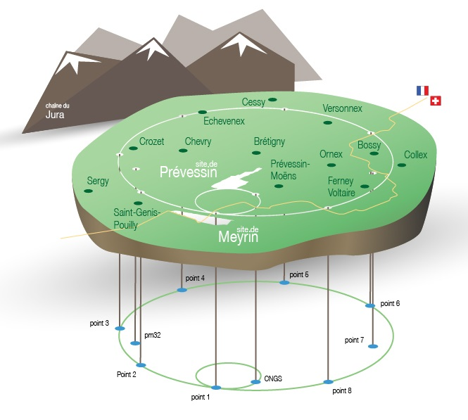
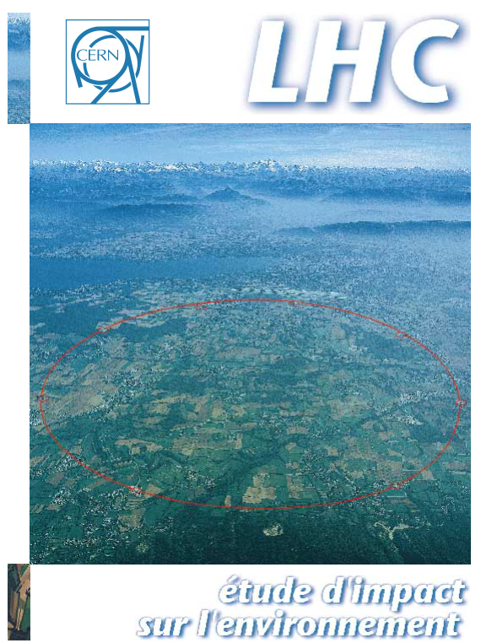
CERN and the LHC

Slide 4
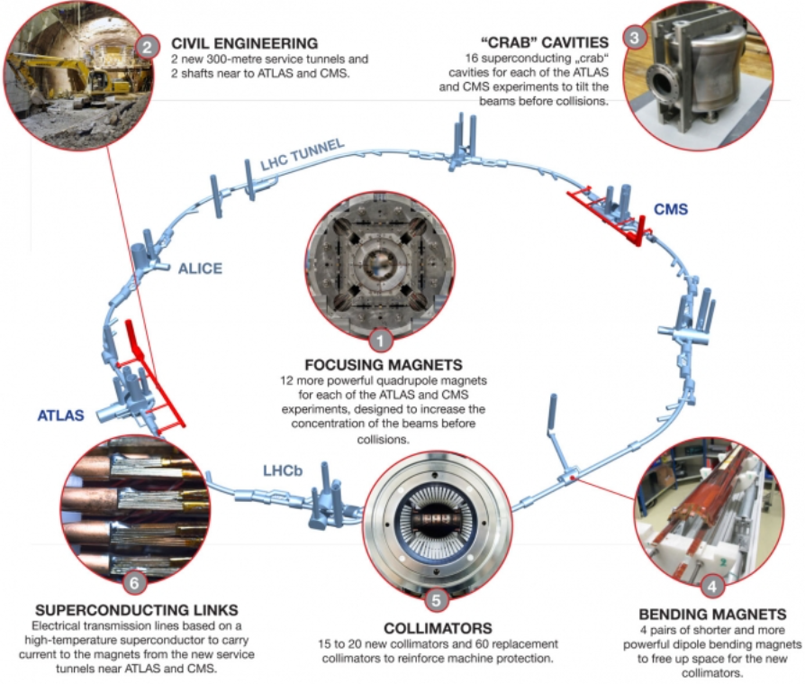
From LHC to HL-LHC

Slide 5
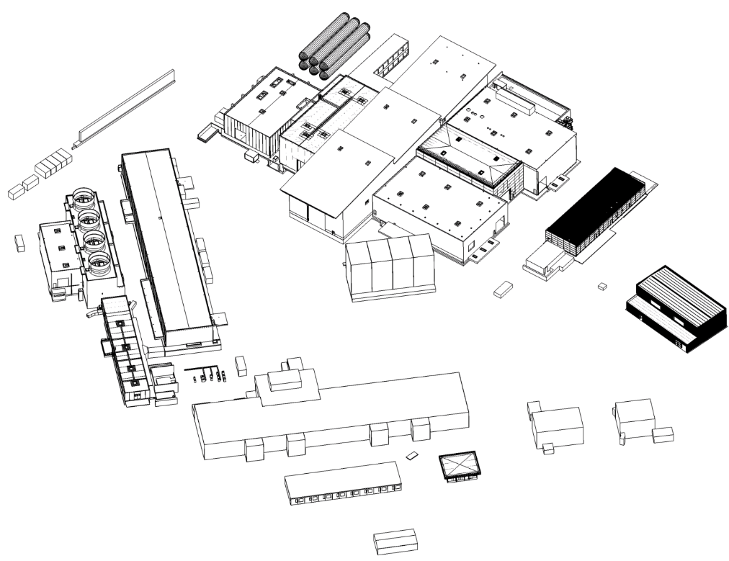
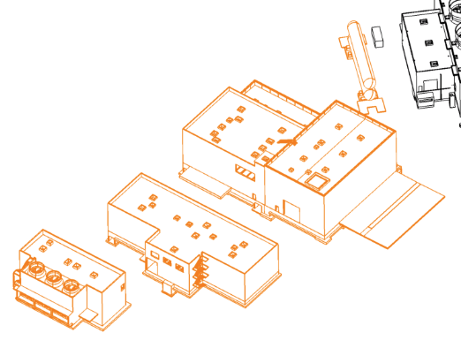
From LHC to HL-LHC
Point 1 (ATLAS) Switzerland
Surface Infrastructure
Courtesy of M. Poehler – September 2017

Slide 6
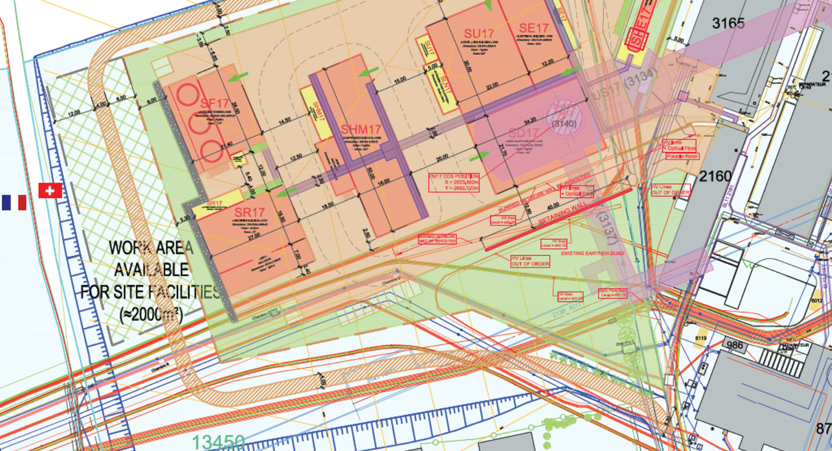
From LHC to HL-LHC
Point 1 (ATLAS)

Slide 7
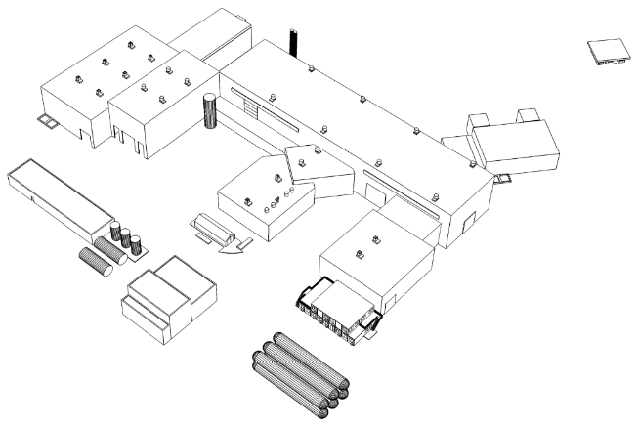
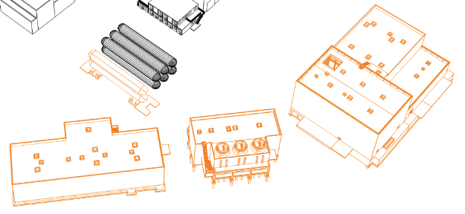
From LHC to HL-LHC
Point 5 (CMS) France
Surface Infrastructure
Courtesy of M. Poehler – September 2017

Slide 8
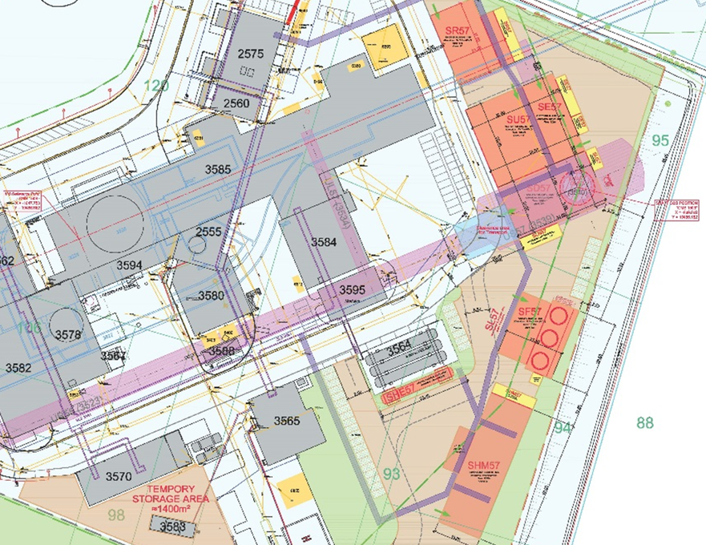
From LHC to HL-LHC
Point 5 (CMS)

Slide 9
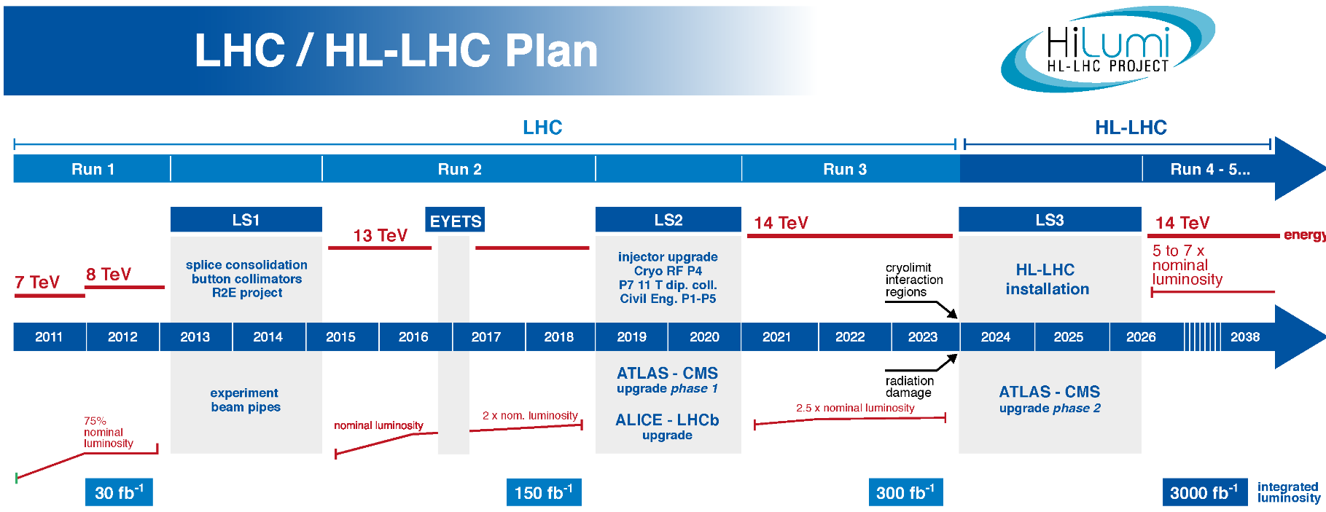
From LHC to HL-LHC

Slide 10
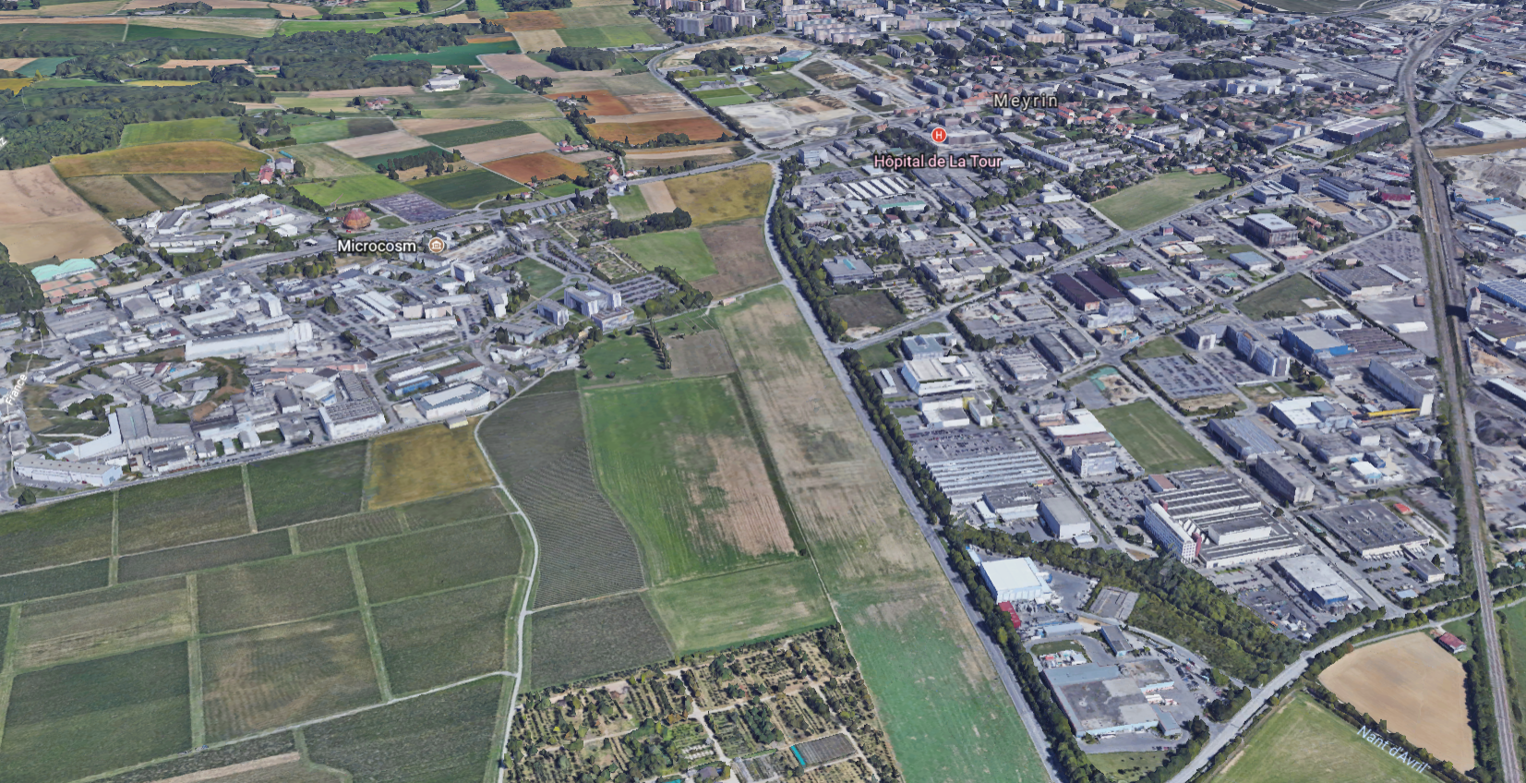
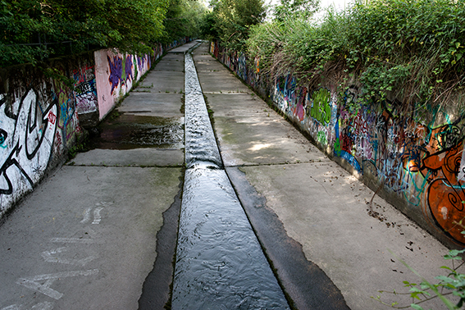
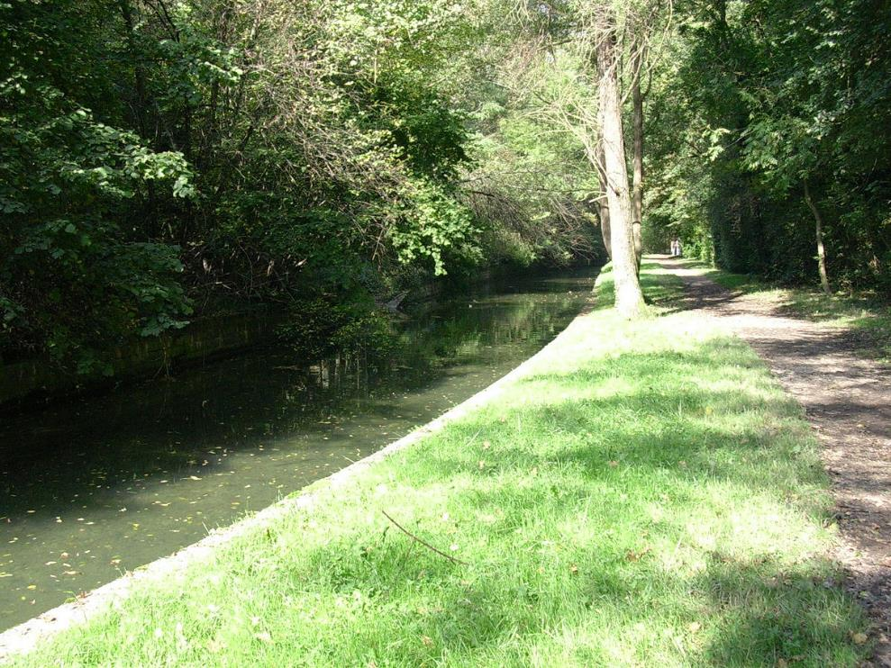
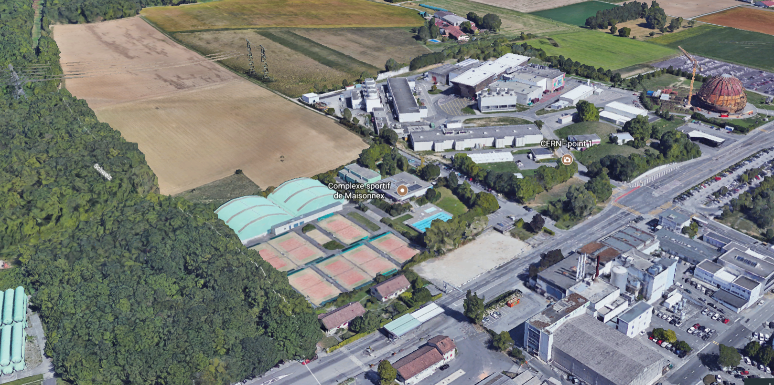
What are the local environmental constraints?
Point 1 – next to Meyrin site - Switzerland

Slide 11
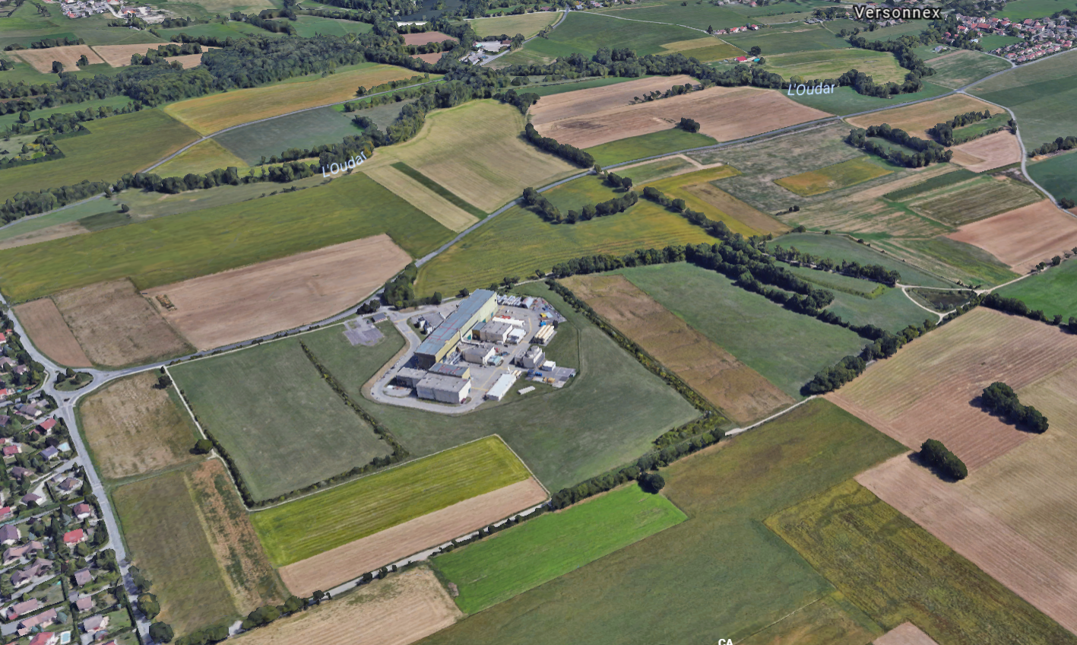
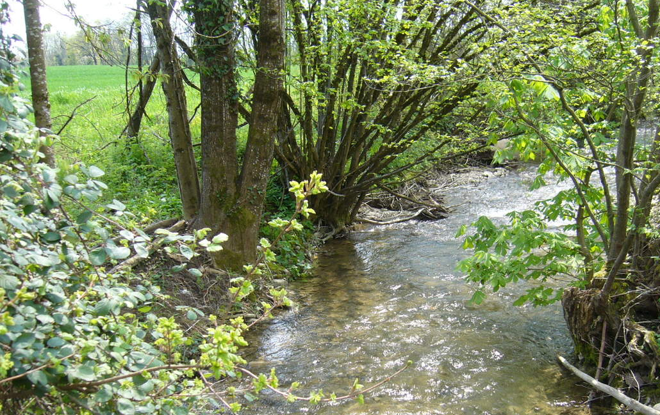
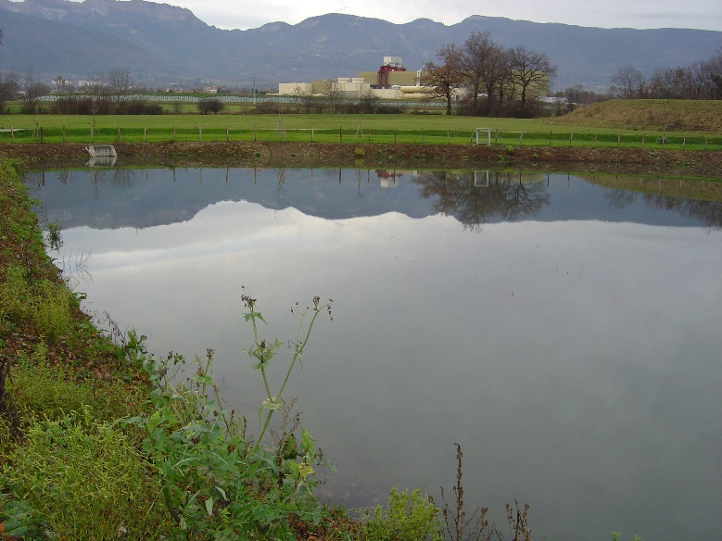
What are the local environmental constraints?
Point 5 – France

Slide 12


Environmental issues of concern ?
Two large civil-engineering worksites:
In total about 174’000 m³ of excavation material
Topsoil management
Dust
Emissions of fine particles
Water/Soil protection: significant concreting…
Effluent water
Storage/handling of oil/corrosive agents/solvents
Waste
Noise

Slide 13
Environmental issues of concern ?
Two large civil-engineering worksites:
Civil-engineering technical specifications were reviewed by the CERN HSE Unit – environmental requirements in France and in Switzerland applicable to the civil-engineering and to the design of surface buildings and linked infrastructure were included.
Planned Organization:
Environmental manager on each worksite – under the responsibility of the civil-engineering contractor;
Safety coordinator for each worksite – edits the Safety coordination plan that the civil-engineering contractor shall follow (incl. follow-up of environmental issues such as storage/handling of chemicals, waste, effluent water);
HSE Environment Services will periodically check effluent water and may carry out some visits on worksites with the Safety coordinator or CERN representative(s) of the worksites.

Slide 14
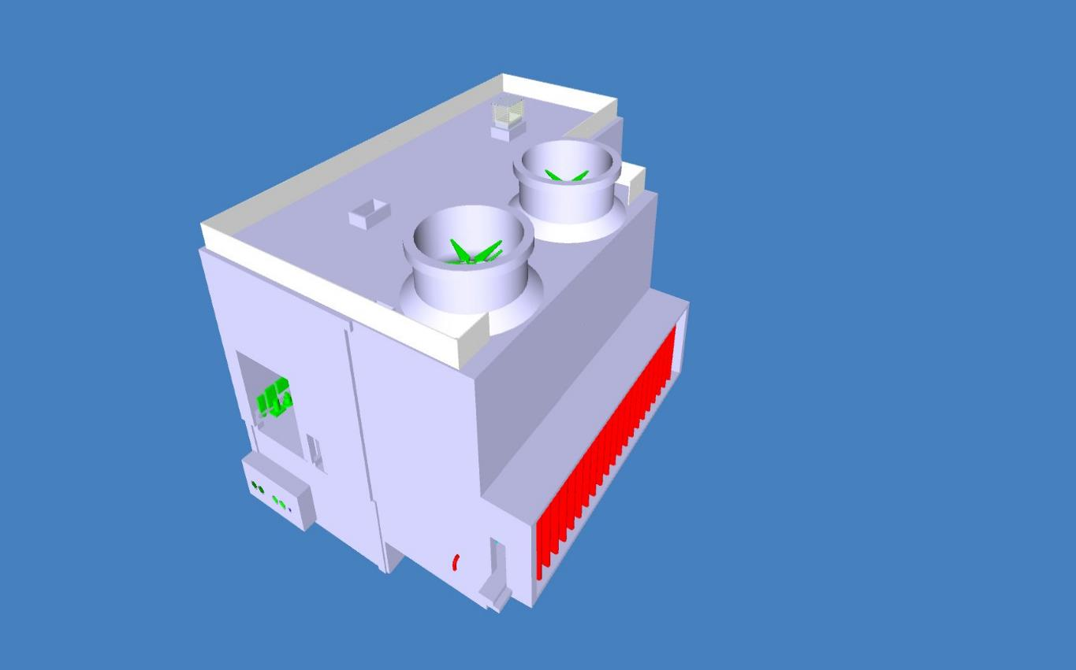
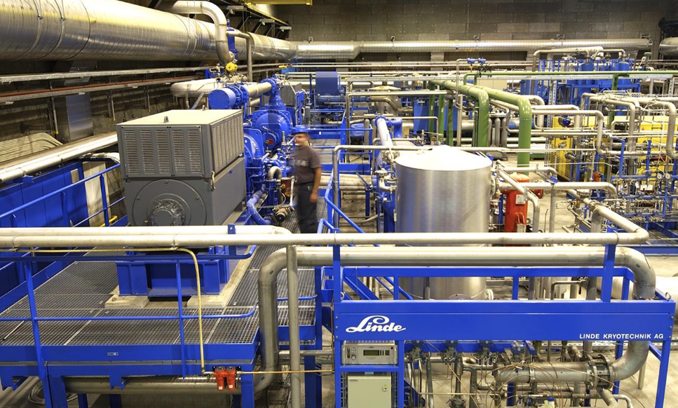
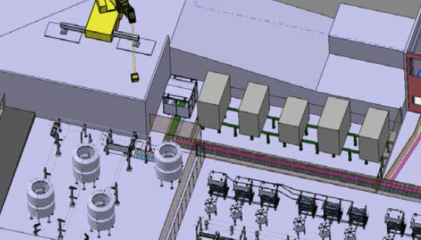
Environmental issues of concern ?
Operation of additional industrial infrastructure:
Cooling towers (3 x 5 MW on each site, incl. 1 tonne of chemicals, ~ 60’000 m³ effluent water discharged annually into Nant d’Avril)
Power supply equipment = oil transformers (20 tonnes on each site)
Helium compressors (4.9 tonnes of lubricant oil on each site)
Air conditioning units (tunnel – 0.6 tonnes of HFC on each site)
Notes:
Rejet annuel des tours dans Nant d’Avril environ 600 000 m3 – majorité du LHC
15 tonnes de produits de traitement d’eau au total aujourd’hui sur les sites LHC (annuellement, 23 tonnes injectées)
Breox 52 tonnes today on LHC
Oil 930 tonnes today on LHC
HFC sur le LHC au total 14 tonnes pour HVAC

Slide 15
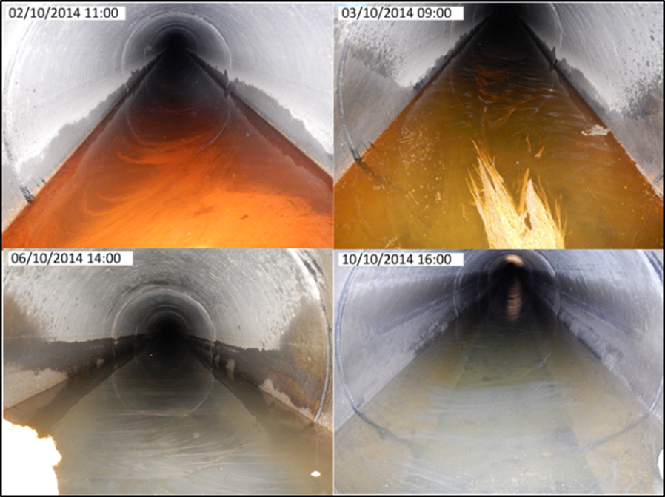
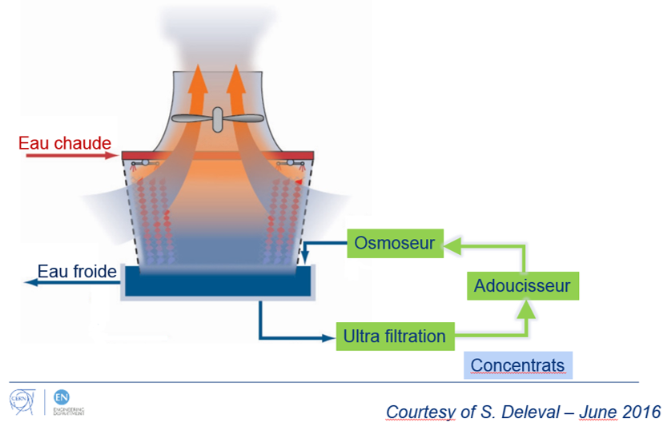
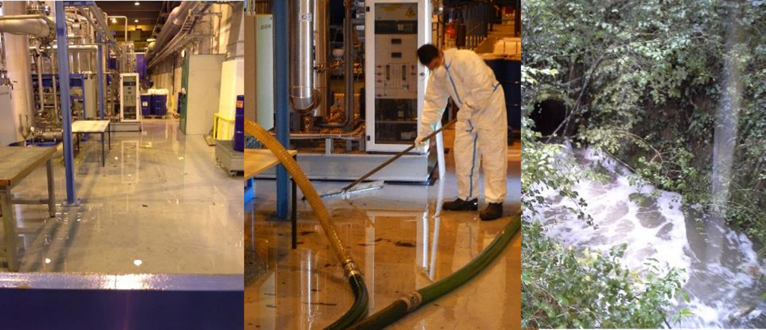
Environmental issues of concern ?
Operation of additional industrial infrastructure:
Cooling towers
On-going studies to reduce by 80% the effluent water + discharge into public sewage water plant
Power supply equipment &
Helium compressors
Special care to on-site oil/Breox retention
Air conditioning unit
Qualified personnel + emission register

Slide 16
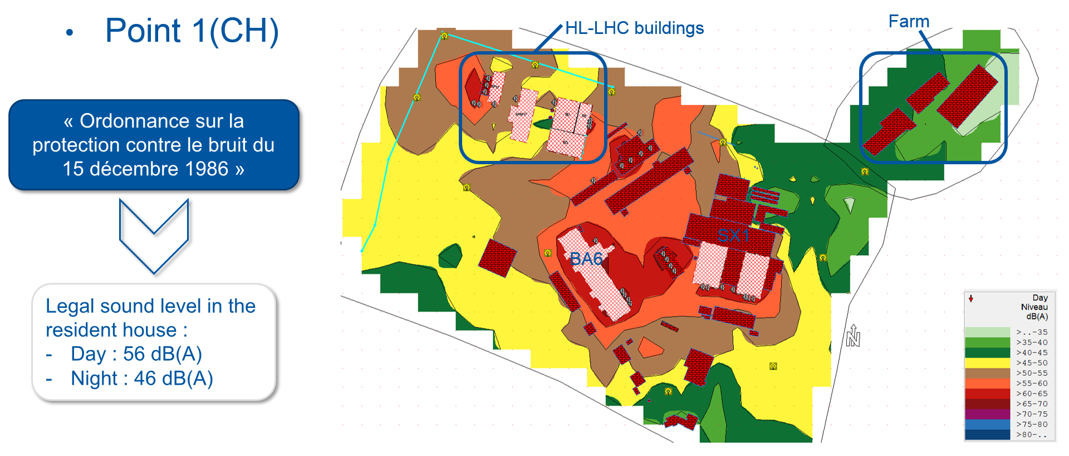
Environmental issues of concern ?
Operation of additional industrial infrastructure:
Noise in the environment (preliminary results)

Slide 17
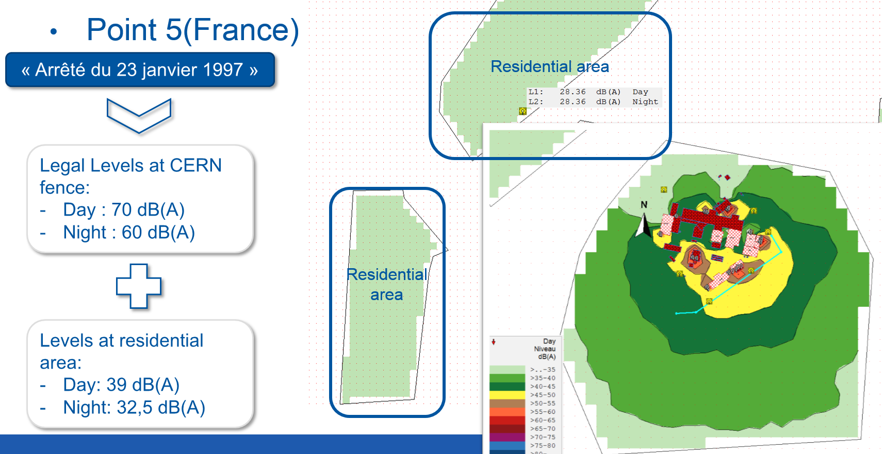
Environmental issues of concern ?
Operation of additional industrial infrastructure:
Noise in the environment = no expected change (preliminary results)

Slide 18
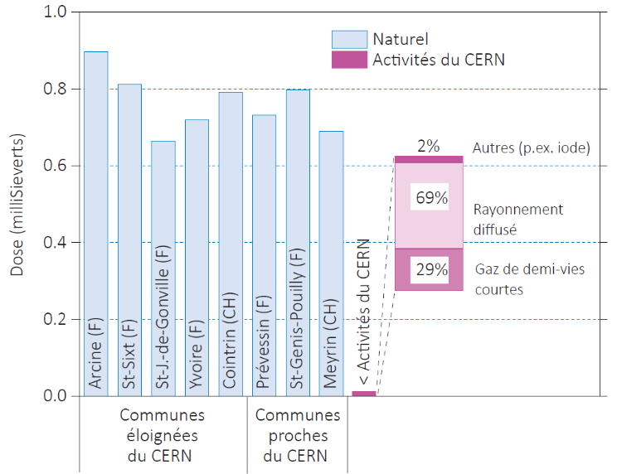
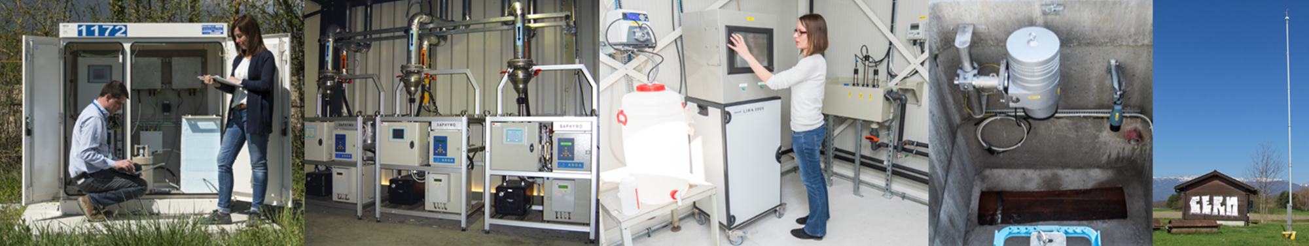
Environmental issues of concern ?
Operation of HL-LHC – ionizing radiation
At point 1 and point 5, the annual dose received by members of the public is expected to stay < 1µSv.

Slide 19
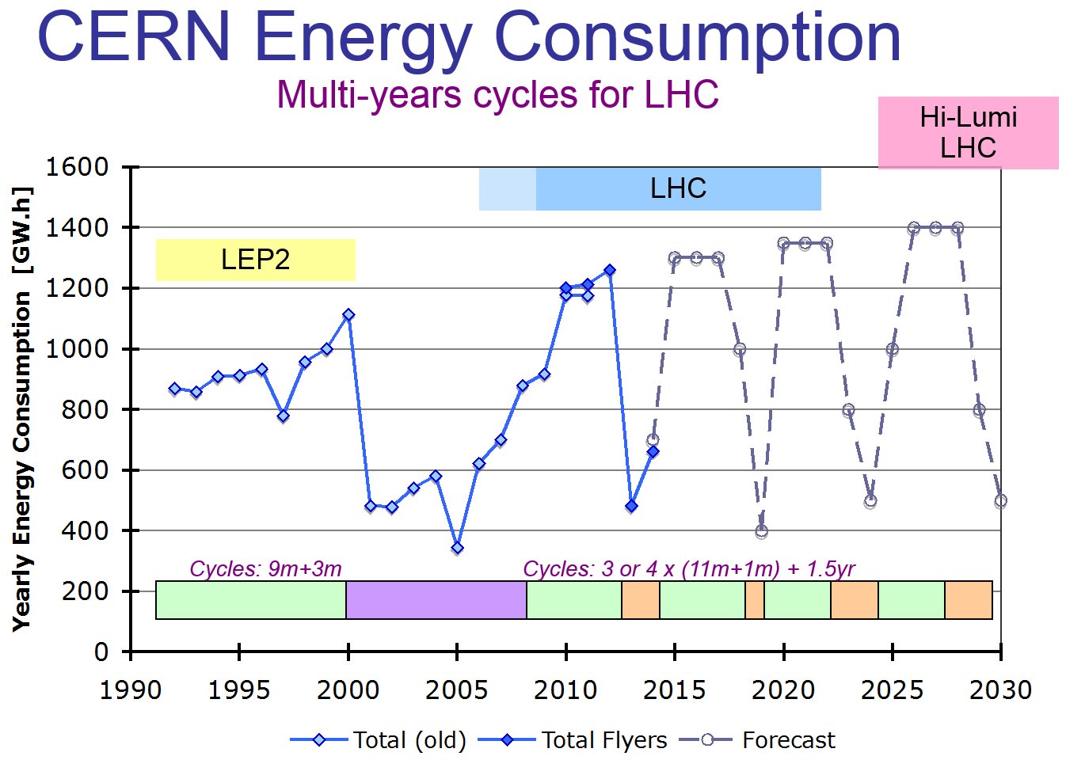
Environmental issues of concern ?
Operation of HL-LHC – electricity consumption = + 15%
Courtesy of S. Claudet – September 2017

Slide 20
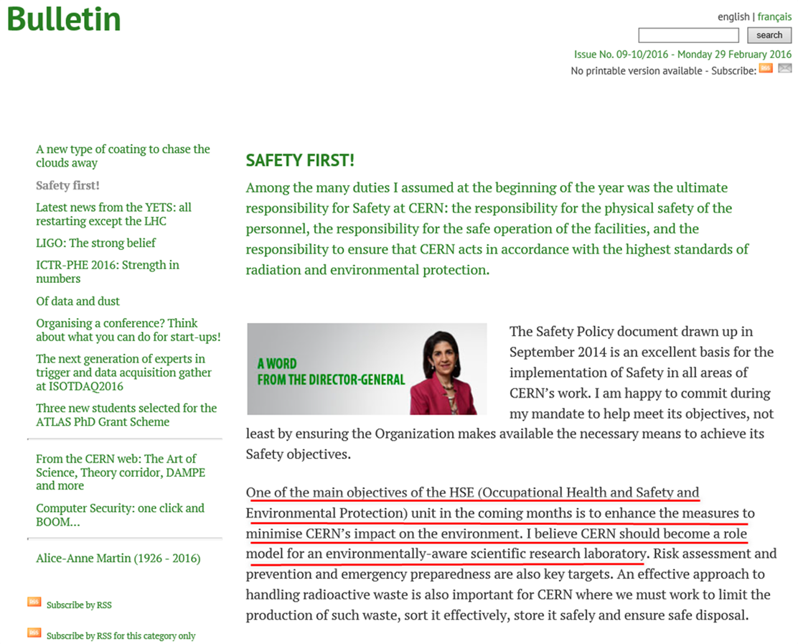
Conclusion
Challenging years ahead !

