Slide 1
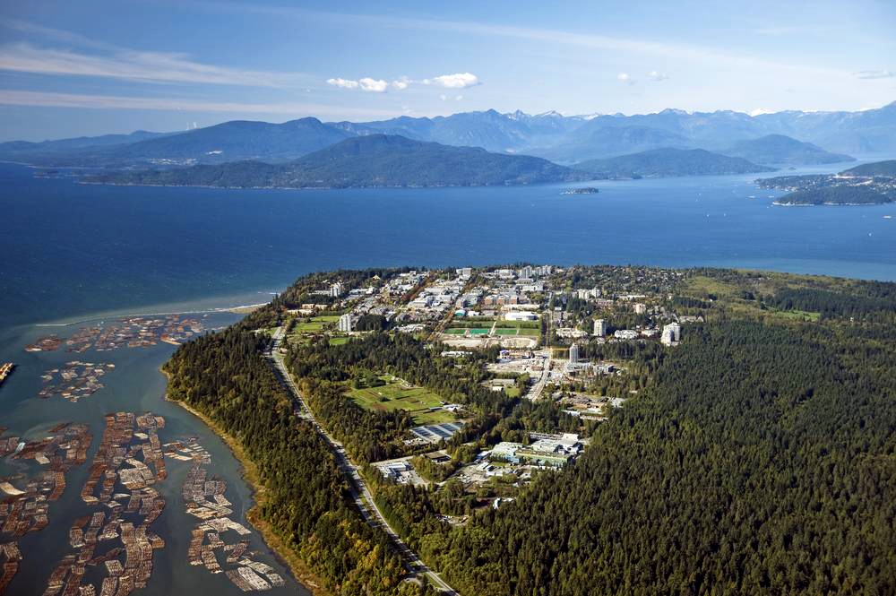
Calo4pQVAE: Progress and updates
DTRC-NRC
Mar 28 2024

Slide 2
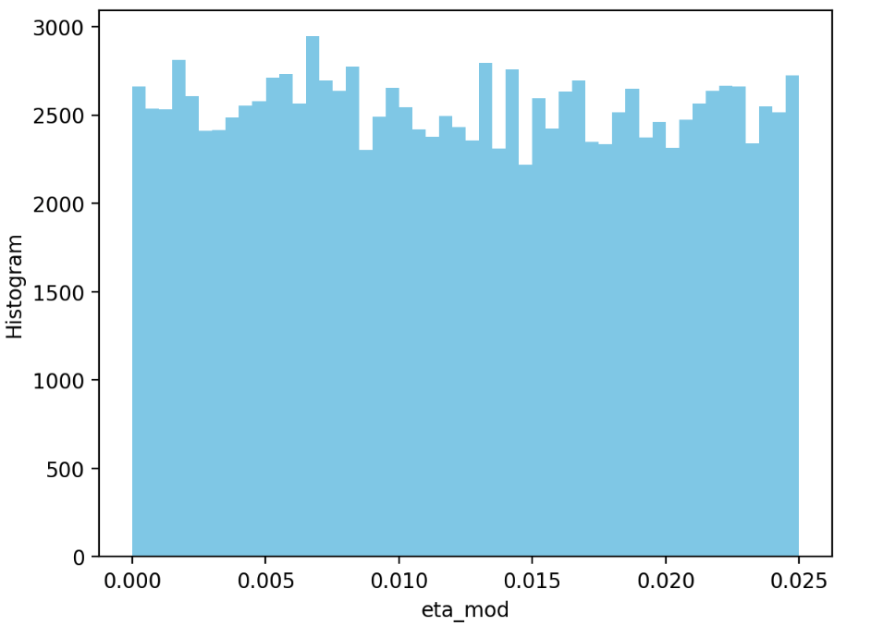
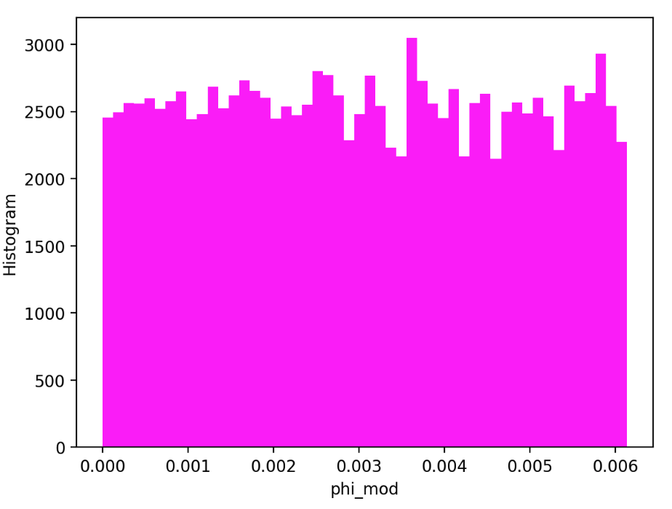
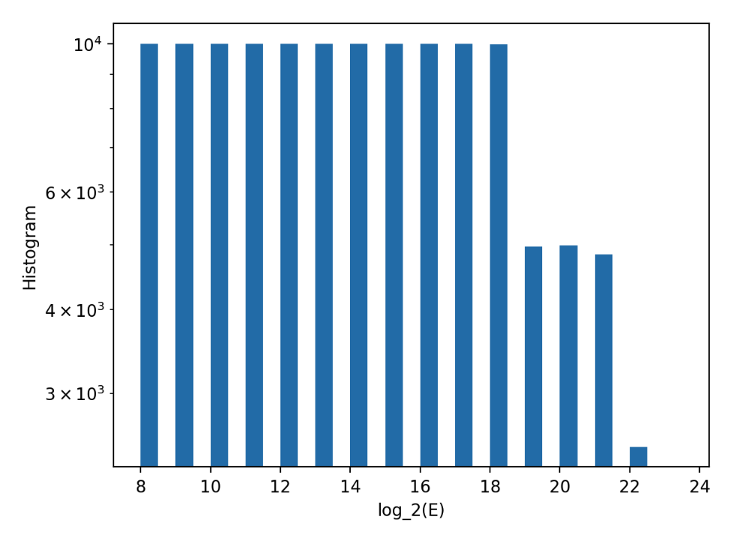
More on ATLAS dataset

Slide 3
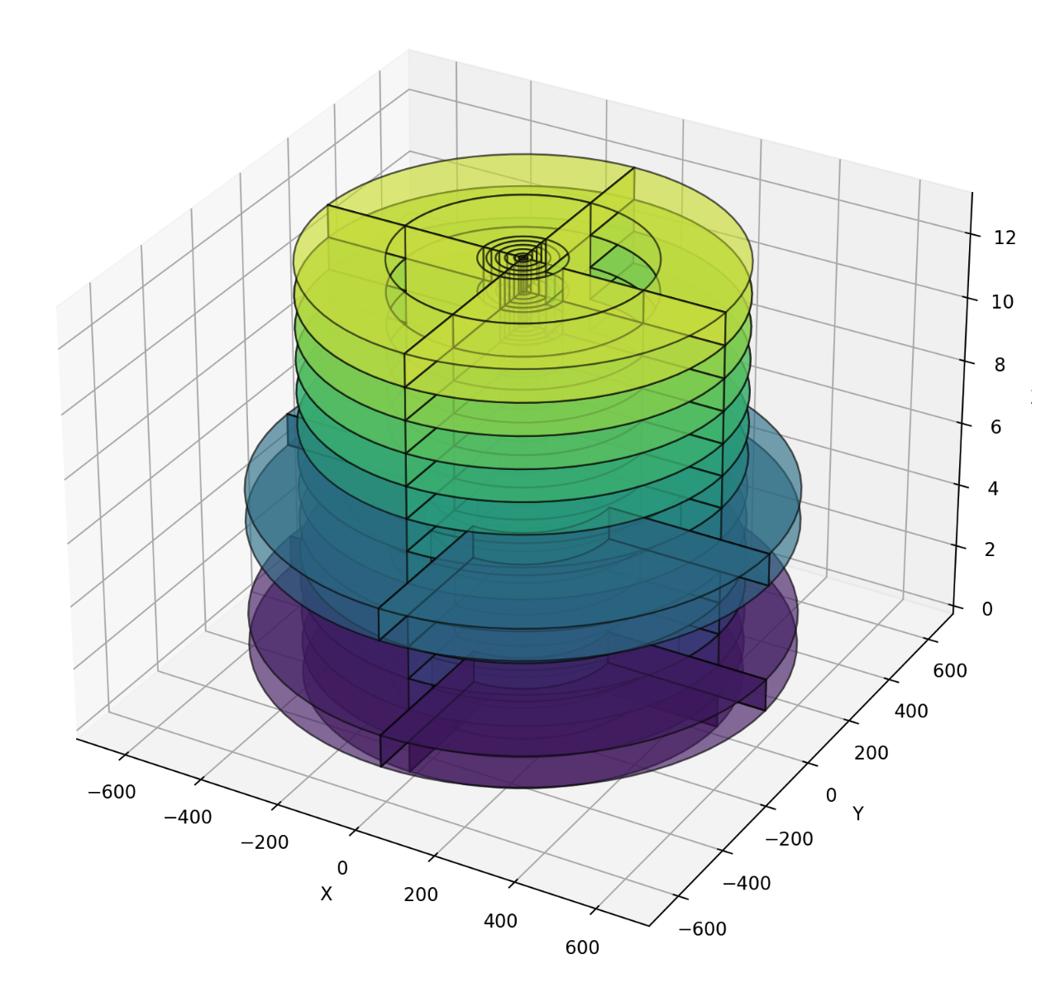
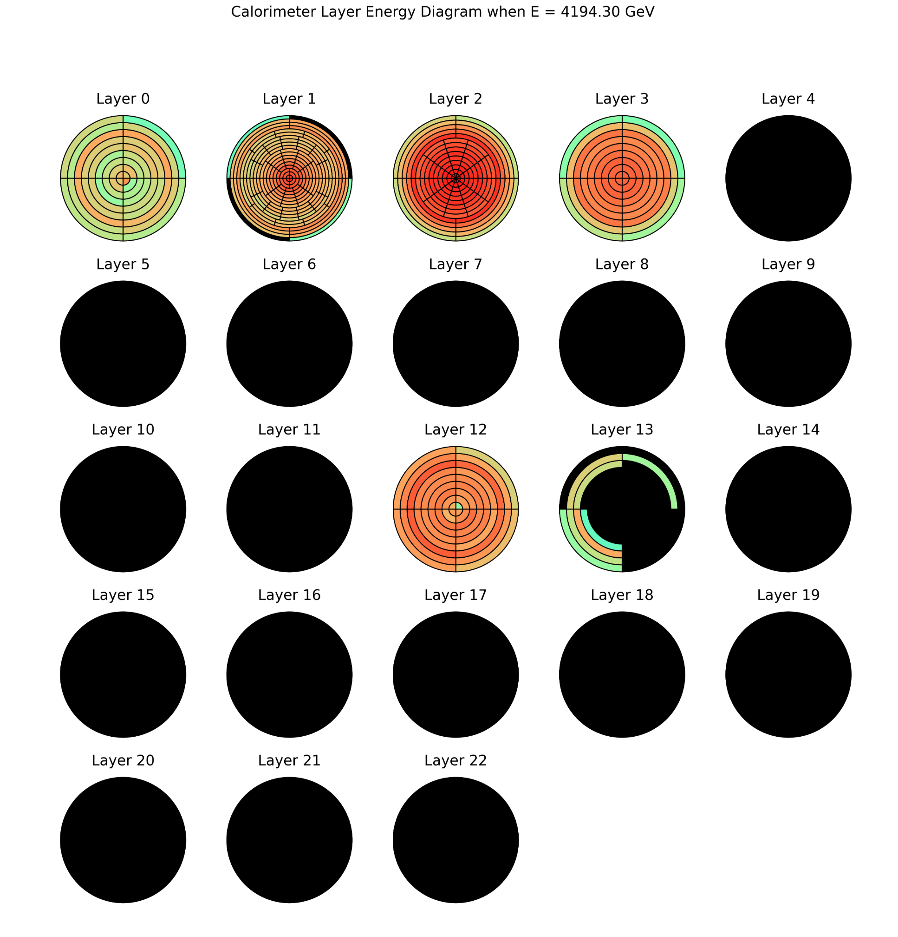
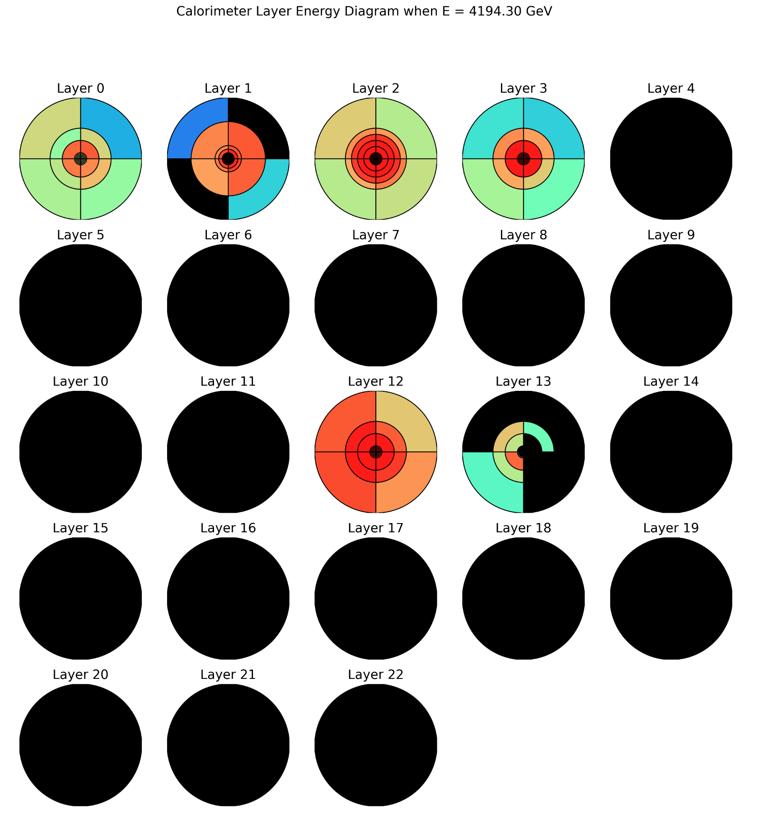
More on ATLAS dataset

Slide 4
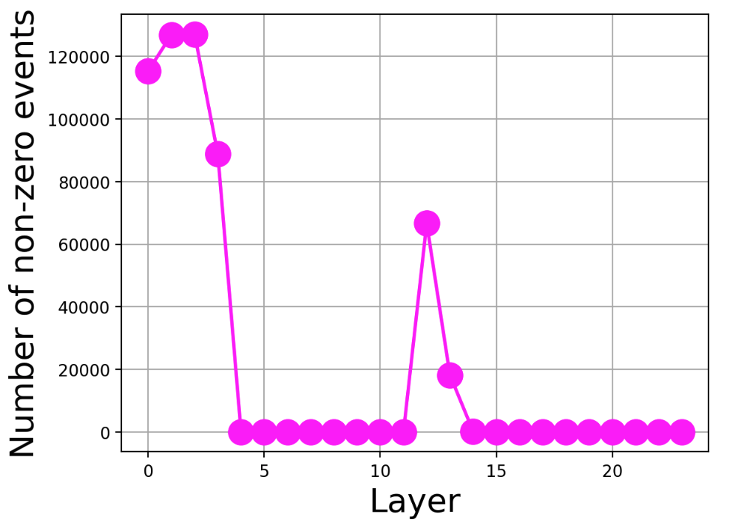
More on ATLAS dataset
Sum of voxels in layer 0 to 3=346
Sum of voxels in layer [0,1,2,3,12,13]=418

Slide 5
More on ATLAS dataset
Small number of voxels compared to dataset 2. Our framework should be able to manage this size.
The main issue is the discrete energy spectrum. Should we expect this spectrum as something recurrent when working with ATLAS?

