Slide 1
Physics with (Accelerated) Charge Bred Ions at TRIUMF
Greg Hackman
Physical Sciences
2019-06-10:08:35:00

Slide 2
Outline
There are compelling nuclear physics questions that can be addressed with accelerated heavy-ion radioactive beams
TRIUMF-ISAC has accelerators and detectors for answering these questions.
Beam requirements include purity, which can be measured and addressed by various means.

Slide 3
Science Motivation for ISAC/ISAC-II Charge-Bred and Accelerated Beams
Generally given by two “big questions”:
  What is the unified standard model of nuclear structure?
  What is the origin of matter in the universe?
Most national or international academy reviews have maybe ten “big science” questions and two of them use similar phrasing
More specific questions:
  What is the most fundamental and most appropriate description of nucleon-nucleon(-nucleon) interactions?
  How do shape transitions and shape coexistence occur?
    Macrostructure: what *is* the shape?
    Microstructure: How do individual nuclei drive the shape? (orbitals)
  What are the reaction rates that contribute to stellar evolution and production of elements by rapid proton capture?

Slide 4
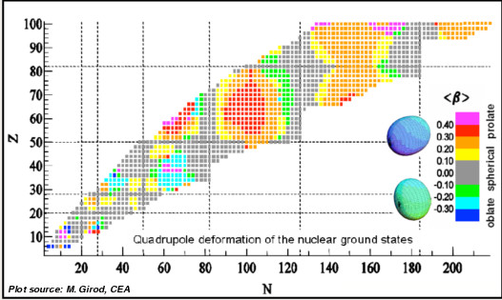
Science Motivation for ISAC/ISAC-II Charge-Bred and Accelerated Beams
Nuclear chart: neutron number on horizontal, proton number on vertical
Lines: “magic numbers” from shell model
Predicted ground-state shapes
Grey areas: spherical
Colours: rubgy-ball shaped (purple) to curling-rock-shaped (blue)
Particularly noteworthy: sharp shape change around ⁹⁶Kr, ⁹⁸Sr, ¹⁰⁰Zr
The challenge: connect the fundamental N-N(-N) interaction to the microstructure (shell model) to the macrostructure (shape coexistence)
Z ~ 40 & N ~ 60

Slide 5
Science Motivation for ISAC/ISAC-II Charge-Bred and Accelerated Beams: Shape Coexistence
By definition, shape coexistence is several states with same quantum numbers at nearly the same energies with different shapes
Left: calculation that *assumes* a bunch of parametrized shapes and calculates relative binding energies
  Macroscopic charged drop plus microscopic shell model parts
Two deformed states of zero spin and positive parity predicted within 2 MeV of ground state
Questions: Do these states exist? Are they pure or mixed?

Slide 6
Experimental techniques and equipment: Reaction mechanisms
There are plenty of types of processes that can access this physics
  Focus on ones with radioactive accelerated beams
Identifying shape & coexistence macrostructure: Coulomb excitation & gamma spectroscopy
  Near-miss electric repulsion: 3‑5 fm compared to nuclear radius ~ 3‐8 fm
  Kinetic energy transferred into internal excitation (not just repulsion)
  De-excitation measured by counting gamma rays etc.
Microstructure: Transfer reactions
  Transfer a nucleon to or from the beam
  Reaction rate and angular distribution can be related to single-particle wave functions in a nuclear shell model
Stellar evolution: direct measurement of reaction rate of radioactive beam impinging on proton(-rich) target
Fundamental N-N(-N…) interactions: all of the above plus elastic scattering

Slide 7
ISAC-I and ISAC-II Accelerator and Experimental Facilities

Slide 8
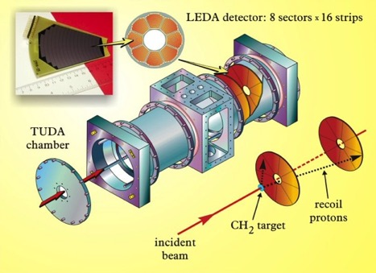
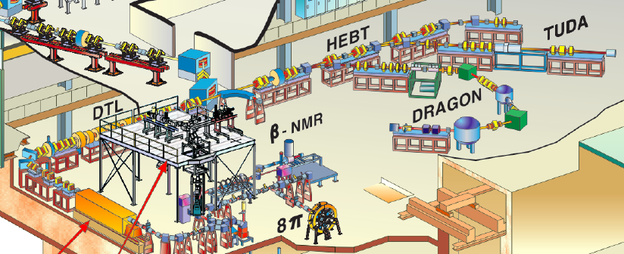
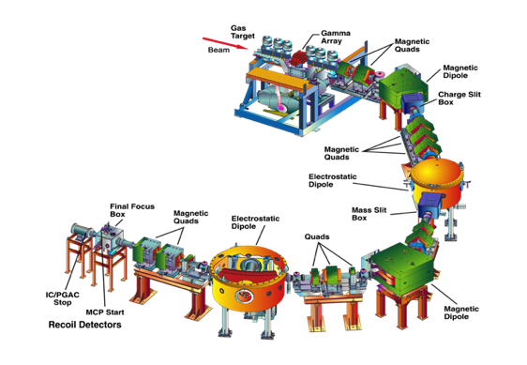
ISAC experimental areas
Experimental techniques and equipment: ISAC-I Facilities
TUDA
Astrophysical charged particle reactions
DRAGON
Astrophysical capture reactions

Slide 9
Example astrophysics: DRAGON experiment
Measurement of ³⁸K(p,gamma)³⁹Ca reaction
Calcium appears to be overabundant in nova ejecta
DRAGON measurement reduced uncertainty coming from nuclear physics
Points to other reactions or observation bias
Slides from Chris Ruiz, TRIUMF

Slide 10

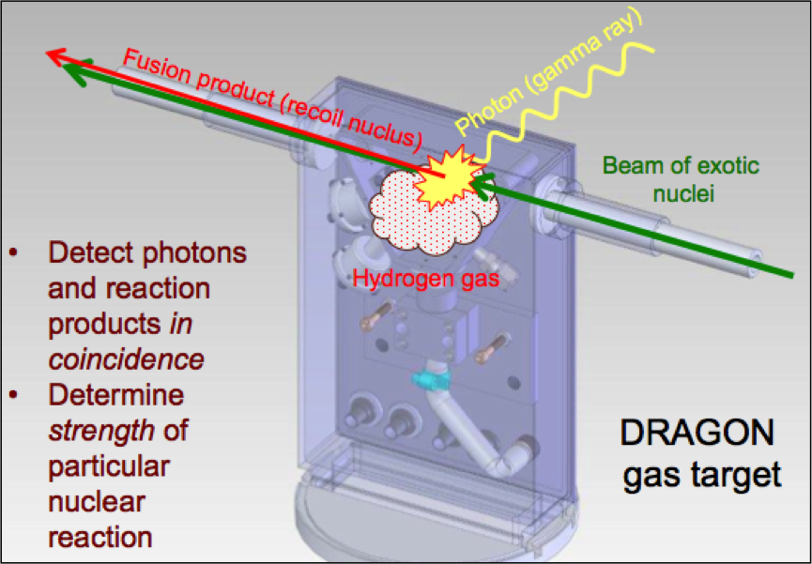

Let’s take a closer look at DRAGON:
Windowless gas target
BGO γ-detection array
MEME mass separator
Recoil detection system
What we measure for a resonant radiative capture reaction (narrow):
#reactions per incident ion

Slide 11
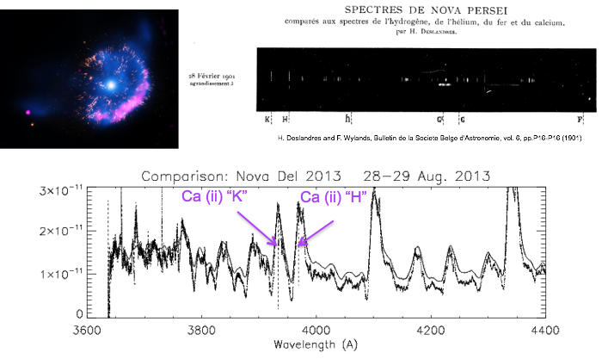
Example nuclear astrophysics experiment: ³⁸K(p,γ)³⁹Ca → K,Ar,Ca abundances in novae
An example of a proton-capture astrophysics experiment
Ca abundances from highly-ionized Ca lines in nova ejecta
Significant overabundances
High uncertainties in models calculating rates
Dominated by uncertainties in ³⁸K(p,γ)³⁹Ca reaction rate

Slide 12
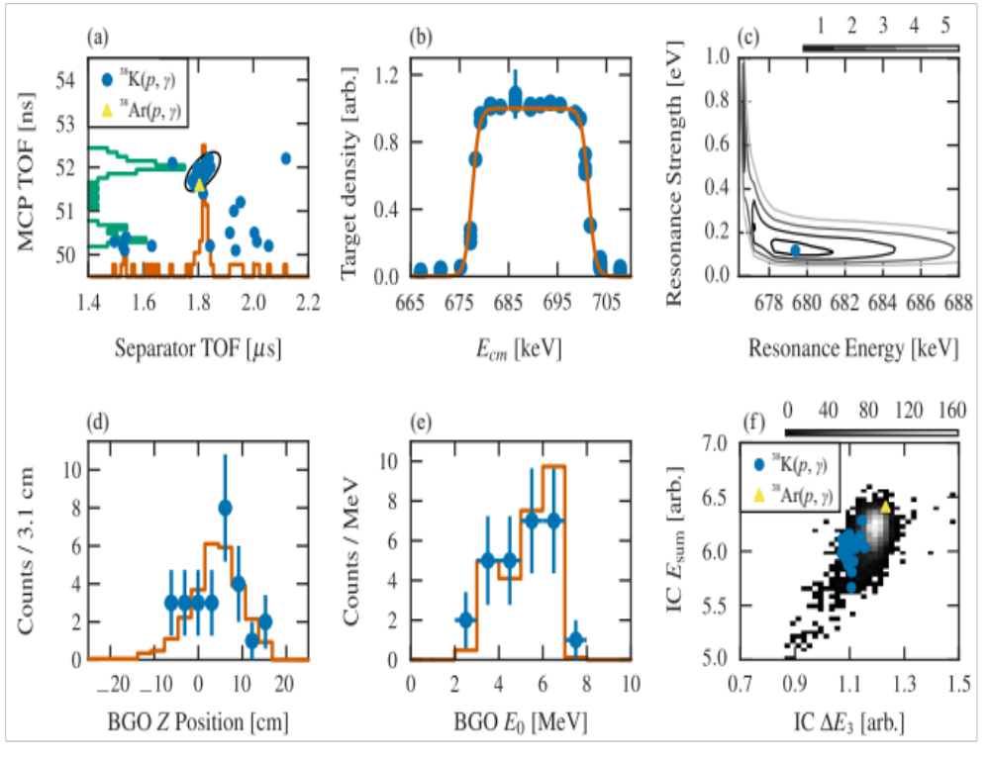
³⁸K experiment
Collaboration with University of Surrey
³⁸K beam from ISAC TiC → Charge Bred to 7+ in ECR
Beam intensity: 2x10⁷ s⁻¹ on target
  → Initial intensity ~1x10¹⁰ s⁻¹
Note very low statistics
G. Christian, G. Lotay, C. Ruiz et al., Physical Review C, Volume 97, Issue 2, id.025802 (2018)
G. Lotay, G. Christian, C. Ruiz et al., Physical Review Letters, Volume 116, Issue 13, id.132701 (2016)

Slide 13
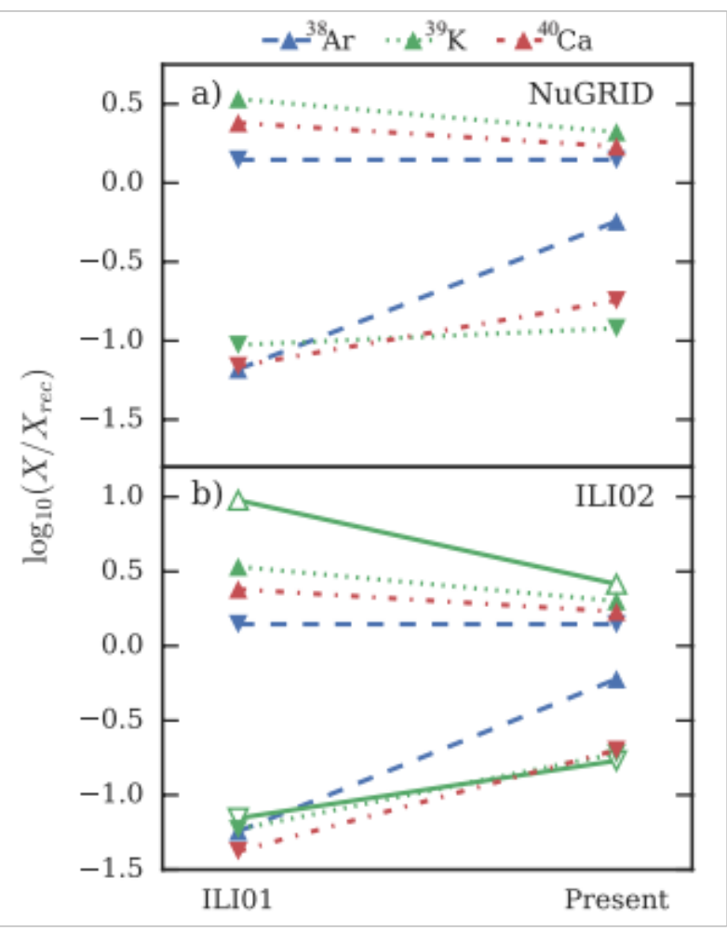
³⁸K experiment
Upper limits on 386 and 515 keV resonances, and positive measurement of 689 keV resonance → determine reaction rate at nova temperatures
Reaction rate uncertainty reduced from 10⁴ to 40
Reduce uncertainty in ³⁸Ar, ³⁹K and ⁴⁰Ca abundances from 25, 136, 57, to 2, 18, 9, respectively (in Iliadis’02 interpolation)
NuGrid 1.3M⦿ O-Ne model gives slightly different, but overall consistent numbers
Conclusion: ³⁸K(p,𝛾)³⁹Ca by itself does not allow room for Ar, K, Ca overproduction in models sufficient to explain observed anomalies. Either other reactions in region (unlikely?), or observational effects?
G. Christian, G. Lotay, C. Ruiz et al., Physical Review C, Volume 97, Issue 2, id.025802 (2018)
G. Lotay, G. Christian, C. Ruiz et al., Physical Review Letters, Volume 116, Issue 13, id.132701 (2016)

Slide 14
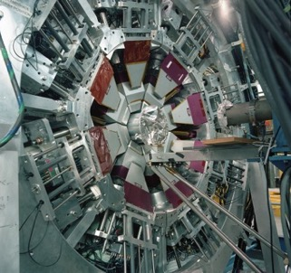
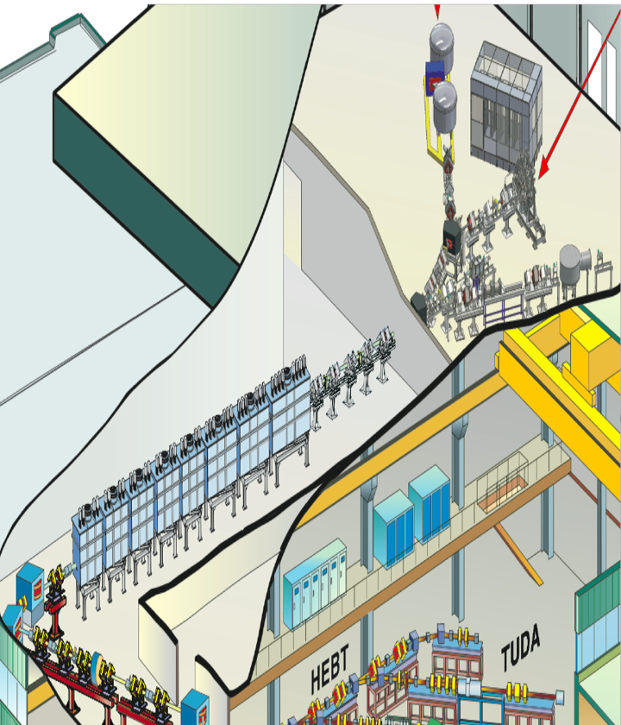
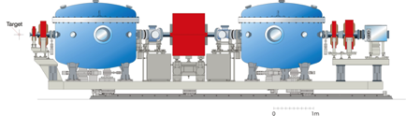
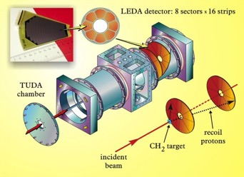
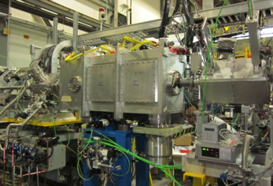
ISAC-II experimental facilities
TIGRESS + auxiliary detectors
HPGe ɣ-ray spectrometer
in-beam spectroscopy of
nuclear reactions
EMMA Mass analyzer for nuclear reactions
TUDA
Scattering array
for direct reactions
IRIS
Solid hydrogen target for direct nuclear reactions

Slide 15
Example fundamental interaction physics: IRIS example
IRIS physics example: ¹⁰C(p,p)¹⁰C elastic scattering
Points to importance of three-nucleon interactions

Slide 16
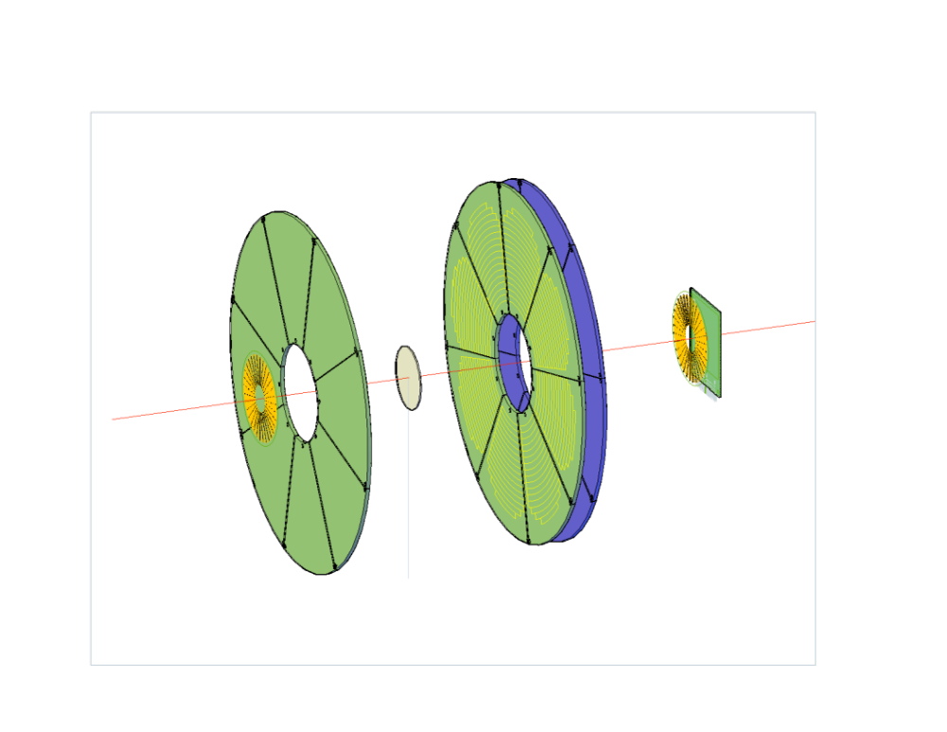
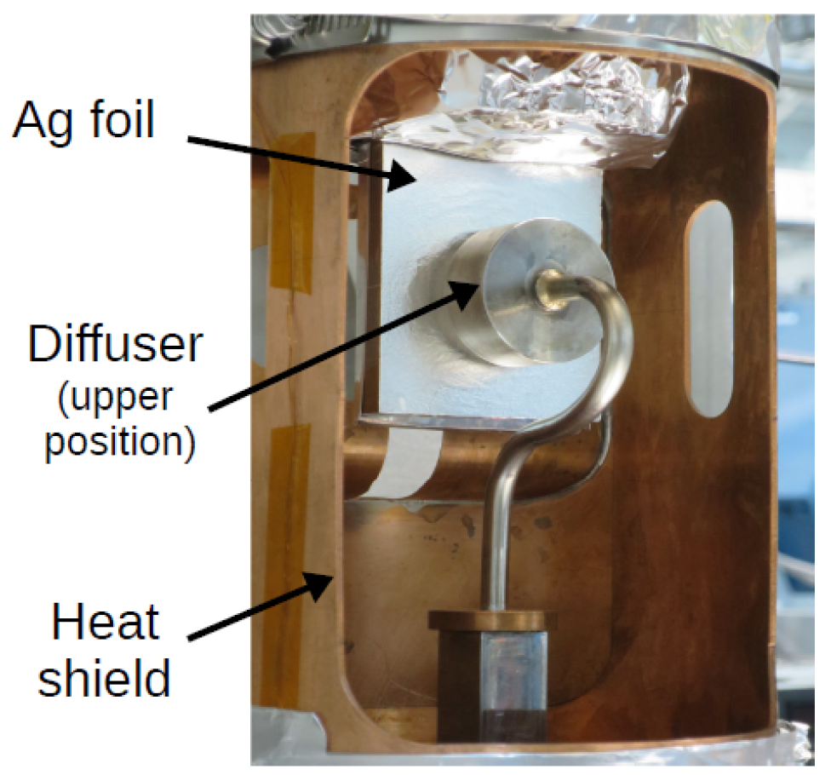
Let’s take a closer look at IRIS
p
Beam passes through ionization chamber (IC)
Frozen hydrogen/deuterium target
  Cu cold head with Ag foil down to 4 K
  gas sprayed onto silver backing
  Diffuser on linear actuator to move in and out of beam line
  Typical target thicknesses of ~50–100 µm
High angular-resolution Si detectors, some backed with CsI(Tl) scintillator for high energy particles
Downstream Si detectors for beam and beam-like reaction products
Images from David Walters, TRIUMF/SMU
H₂
Down-stream Si
Beam
Ionization Chamber
Si
Si – CsI(Tl)
Notes:
93Kr produced with proton beam on UO₂ target

Slide 17
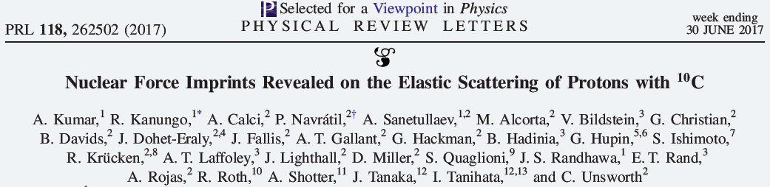
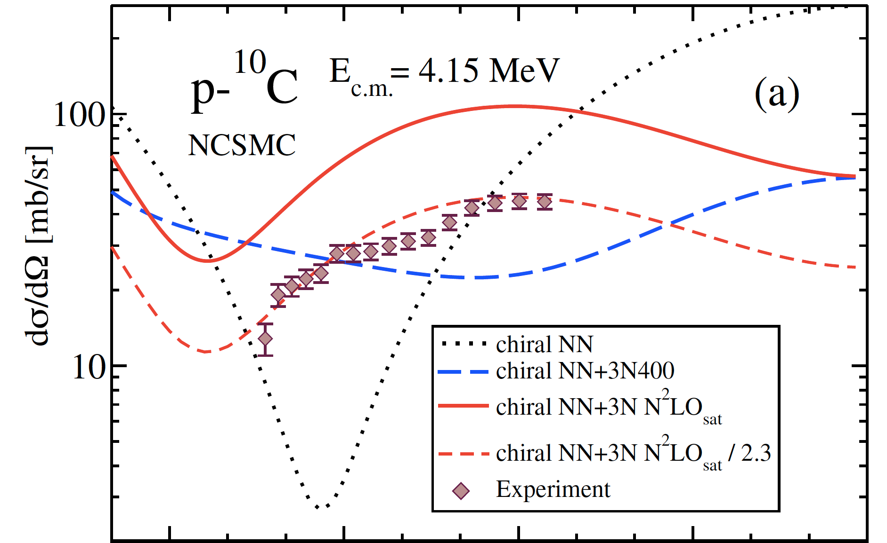
TRIUMF Experiment and Theory Result
Nuclear Force Imprints Revealed
on Eleastic Scattering of Protons with ¹⁰C
Led by Prof. R. Kanungo, Saint Mary’s University
IRIS charged particle spectrometer
Windowless solid hydrogen target
¹⁰C beam, 4.54 MeV/u from TRIUMF-ISAC-II
Theory from TRIUMF
Ab Initio with modern two- and three-nucleon forces
NN alone very wrong – overpredicts fringe contrast
NN and 3N derived separately: interference pattern wrong
Amplitude & shape of scattering interference pattern depends on nuclear force
NN and 3N fit simultaneously : shape correct but fails to reproduce magnitude
Scattering angle

Slide 18
Example shape coexistence macro- and micro-strucutre: TIGRESS example
TIGRESS experiment: ⁹⁵Sr(d,p)⁹⁶Sr and ⁹⁵Sr(d,t)⁹⁴Sr
Material from Reiner Kruecken and Soumendu Bhattacharjee

Slide 19
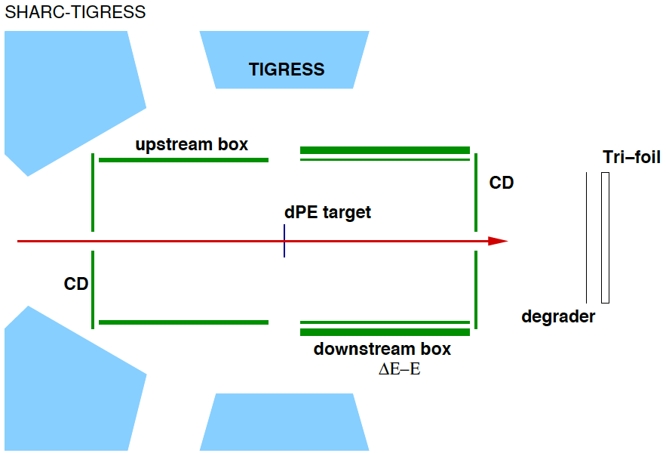
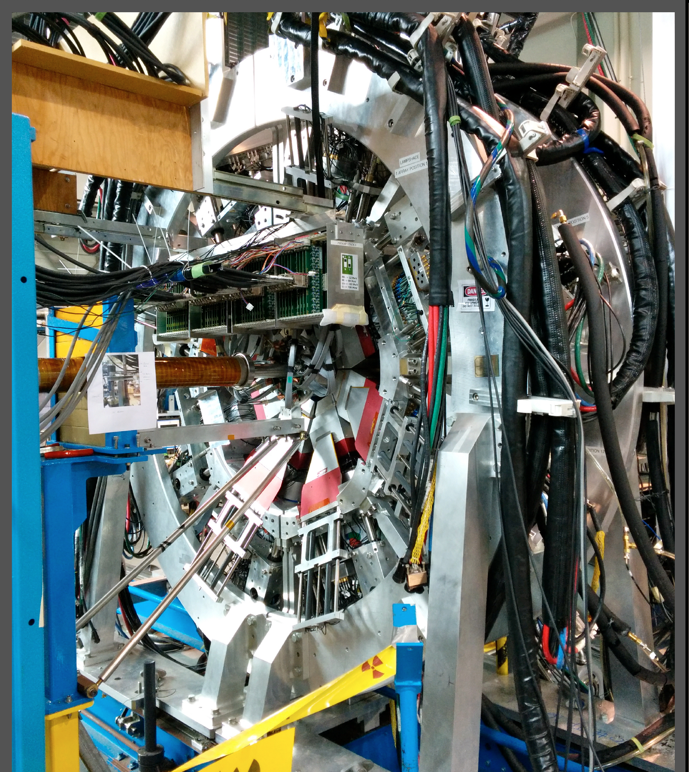
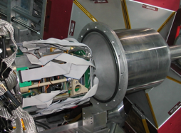
Experiment: d(⁹⁵Sr,p/t)^{96/94}Sr @ E_{lab} = 5.5 MeV/A
Experiment was carried out at the TRIUMF-ISAC II rare isotope facility
TIGRESS: 12 to 16 HPGe clover detectors with optional escape suppressors
SHARC: one of several auxilliary detectors for TIGRESS
Scattered light particle energy & direction measured by high granularity Si detectors to determine wave function composition
Gamma rays detected in TIGRESS to tag which excited states are populated

Slide 20
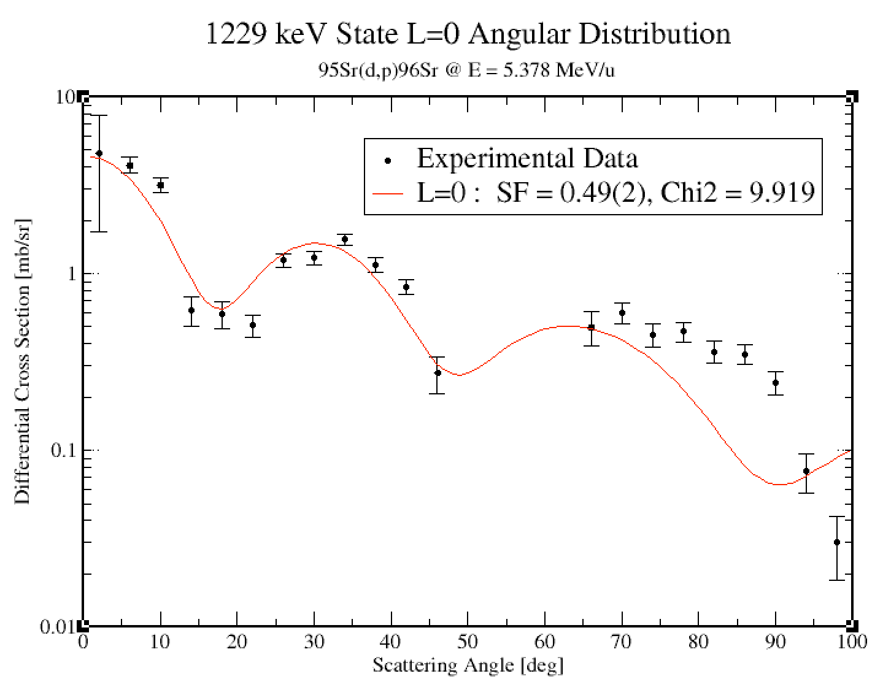
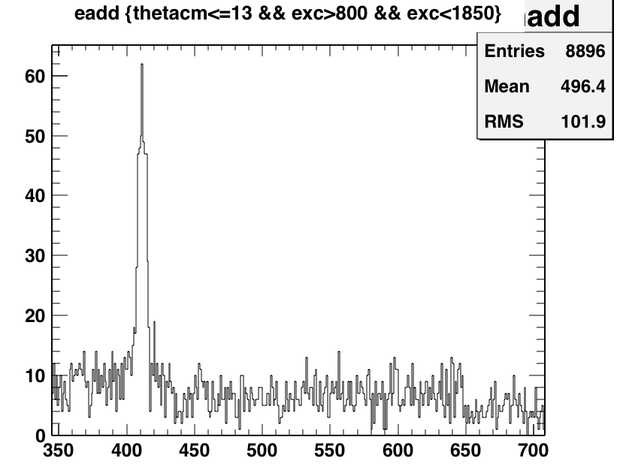
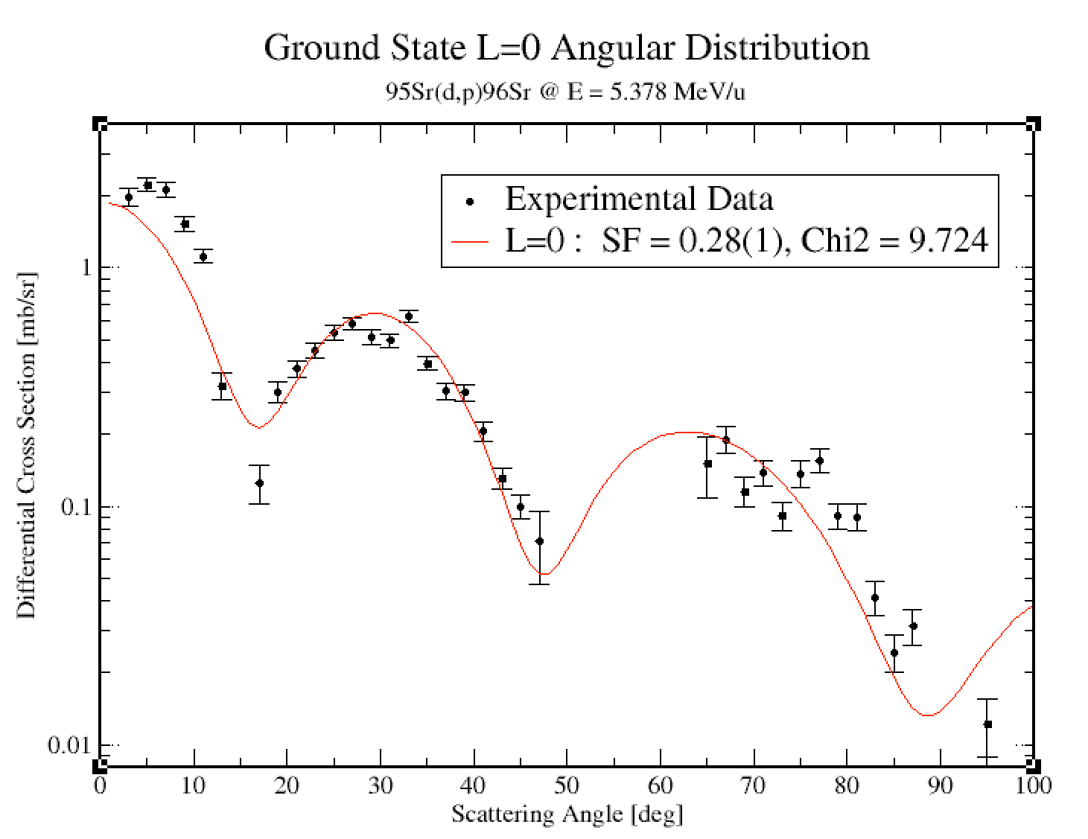
Shape coexisting states in ⁹⁶Sr
Gamma spectrum gated on protons at forward cm angles in excitation energy range 800-1850 keV
0₃⁺
τ=6ns
1465
0₂⁺
1229
414
650
414
2₁⁺
815
815
650
0₁⁺
0 keV
Strong population of 0₁⁺ and 0₂⁺
0₃⁺ only weakly populated (~5-10% of 0₂⁺)
Cruz et al, Physics Letters B 786 94 - 99 (2018)

Slide 21
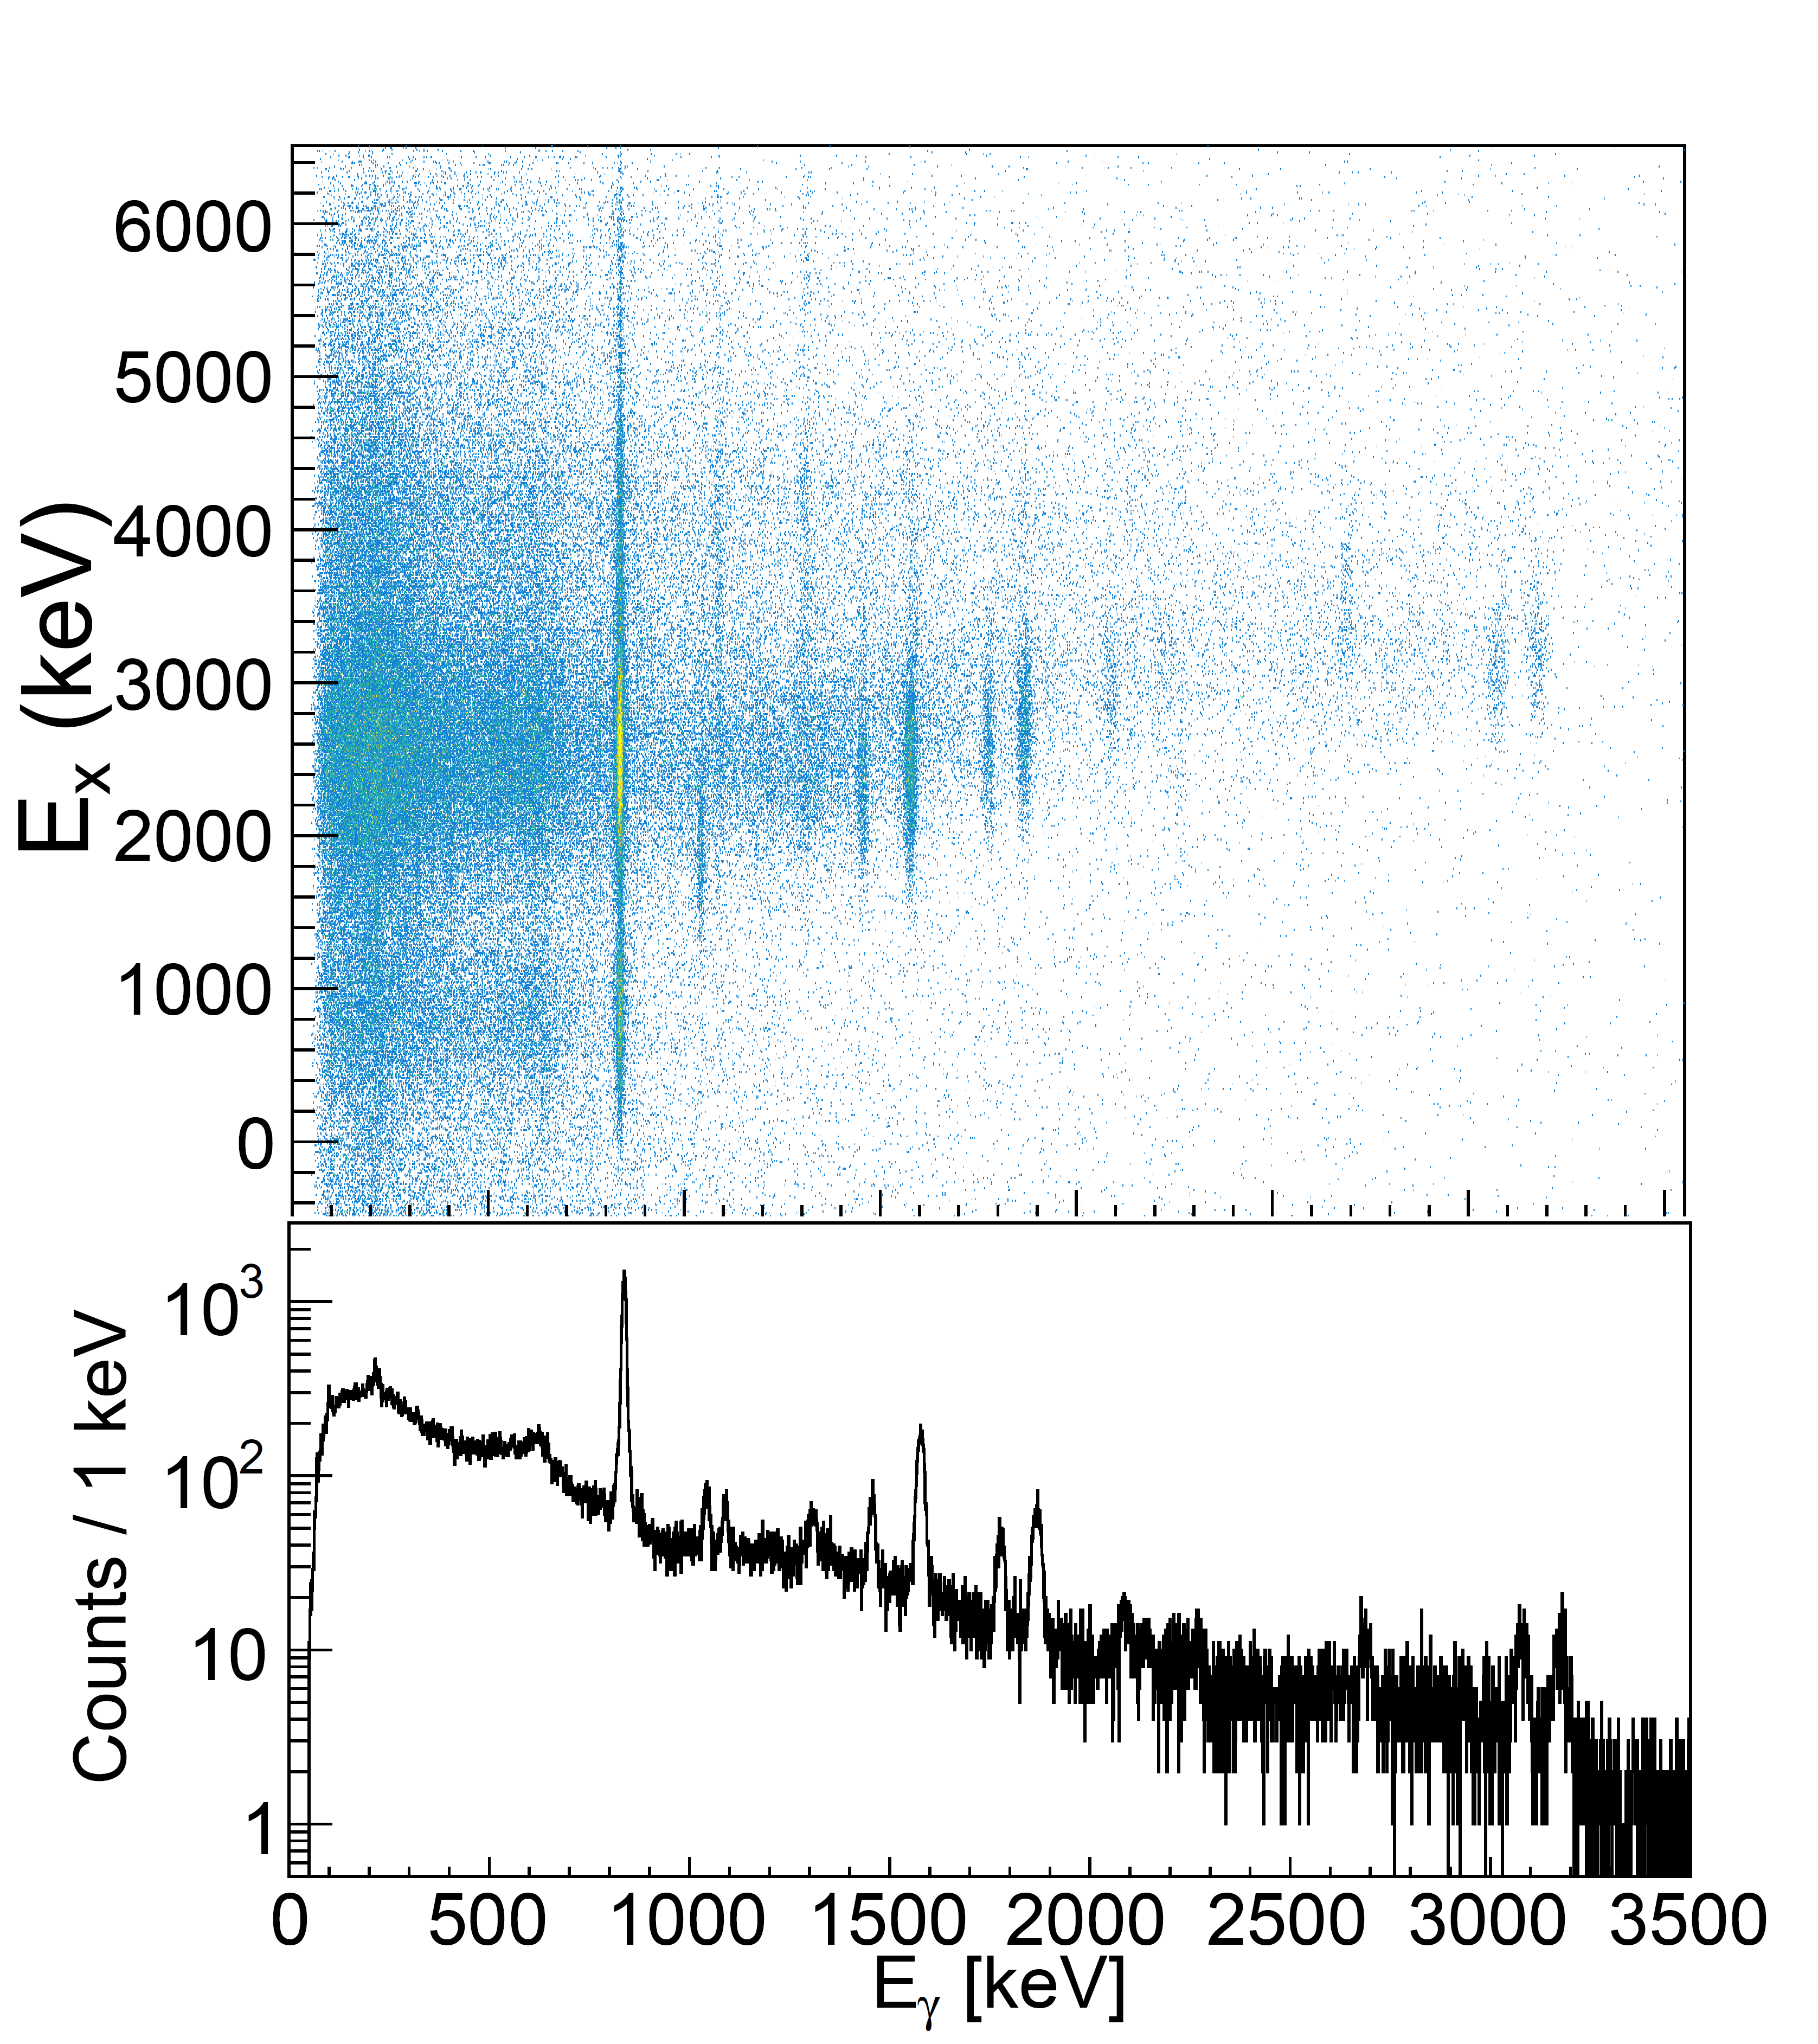
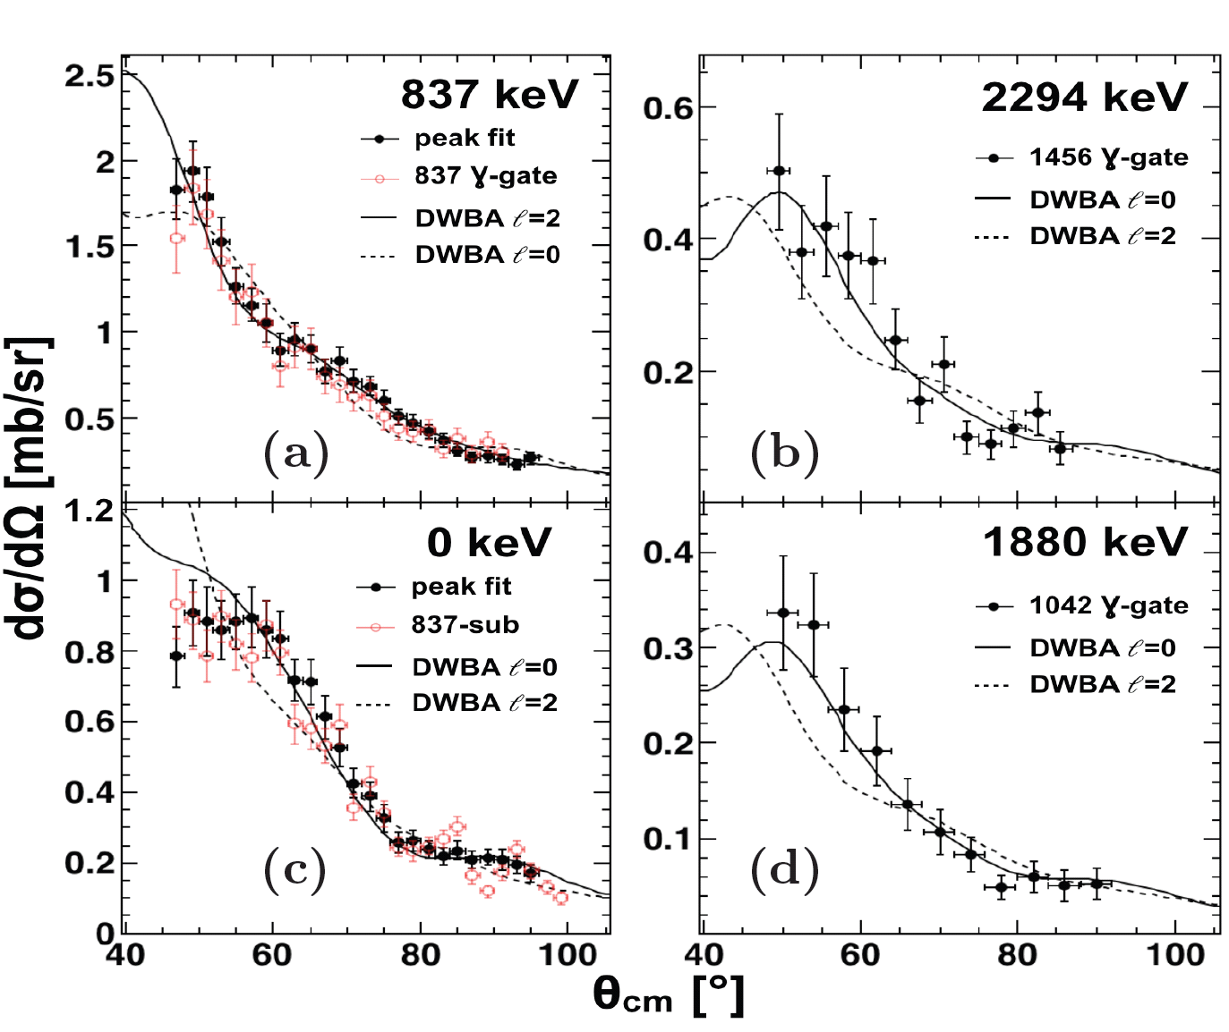
New shape coexisting states in ⁹⁴Sr
Several new states found in (d,t) reaction channel
Gamma decay and angular distributions are evidence two of them are 0+ states
E_{x} = E_{γ}
837
1577
1042*
1456*
1089
1868
1309
1777
3175*
2685*
3077
Bhattacharjee et al, draft in progress

Slide 22
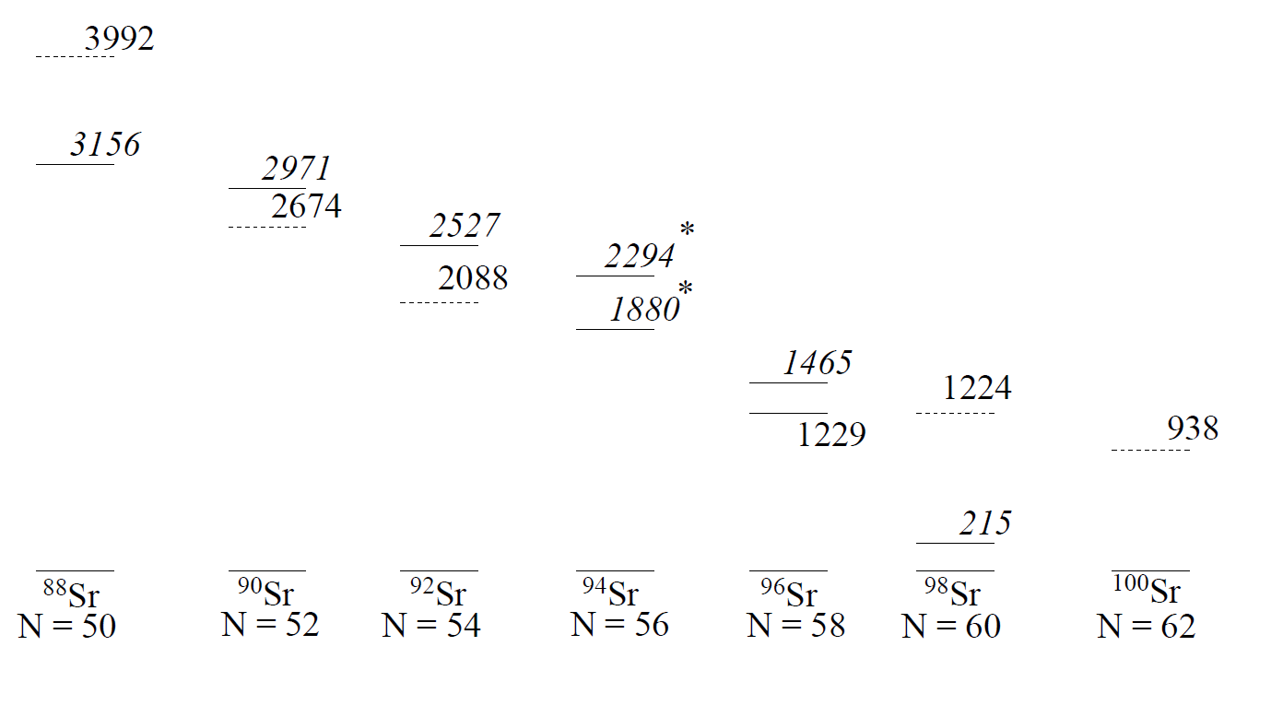
Energy systematics of shape-coexisting 0+ states
Our results: two new states, and new wave function measurements
N>58: ground states pure deformed, excited states mostly
N<60: ground states pure spherical, excited states admixtures of prolate and spherical shapes

Slide 23
Beam requirements
Beam requirements vary wildly from from one experiment to another
Don’t take numbers in following slides as formal specifications
I’ll try to emphasize what happens to experiments when they aren’t met

Slide 24
Beam requirements: species
Beam species: well … everything.
  Nuclear physics depends on proton & neutron number just as atomic physics depends on number of electrons (think periodic table)
  All elements are produced in stellar environments
  Shape coexistence occurs throughout nuclear chart
  Interesting astrophysics & structure at limits of existence
Consequences of not getting everything:
  Missed physics opportunities
  Specific elements & neutron numbers exhibit specific behavior, especially transitions as they change
    Counterpoint: use what you have
  Specific isotopes may have especially large impact on stellar evolution
  Less “exotic” (neutron number) often interpreted as lower impact

Slide 25
Beam requirements: energies
Beam energies: 0.15-15 MeV/u
  Generally need higher energies for higher Z, heavier beams
  Proton capture: <2.2 MeV/u
  Coulomb excitation: 1.5‑5.5 MeV/u
  Transfer reactions: 4.5-15 MeV/u
Consequences of not meeting this:
  Missed physics opportunities
  Some experiments can’t be done

Slide 26
Beam requirements: intensity
Beam intensities: >1000 /s on target
  Depends on physics goals
  Counting statistics depends on:
    Beam intensity
    Reaction target thickness
    Time -- “One paper per week"
    Detector efficiency
  In addition, experiments are affected by detector resolving power
    Energy & direction of outgoing particles
    Higher resolution can give higher peak-to-background – better measurement with fewer total counts
Consequences of lower beam rates
Poorer data
  Detectors already at or near best achievable sensitivity
  Thick reaction targets compromise resolving power
    Multiple scattering of outgoing particles, uncertainty in reaction depth
      Active targets get around this but have limited scope
Long beam times limit # of experiments, annoys other users

Slide 27
Beam requirements: Beam spot at focus
Beam focal properties
  (I know I’m not using proper ion optics terminology)
  Beam spots ~ 1 to 3 mm FWHM
  Transverse divergence ~ 1 to 3 degrees FWHM
Consequences of missing requirement
non-optimal experiments
  If beam spot too wide or divergent, cannot take full advantage of directional sensitivity of detectors
  Very tight beam spot can melt targets

Slide 28
Beam requirements: Energy spread, accuracy, precision
Energy spread: ~1% to 0.1%
  Depends on experiment
Delivered energy precision: varies
  Physics often is a slow function of beam energy
  If delivered energy not precisely the requested energy – rarely a problem
MEASURED energy accuracy and precision: 1% to 0.1%
  Especially for narrow resonances in astrophysics experiments
STABILITY of beam energy with time: same as measured
Consequences of not meeting these
  Unreliable data
    Poorly measured energy can lead to wrong answers for resonances
      First DRAGON experiment showed that previous measurements were wrong! ISAC-I energy accuracy is fantastic
    Unstable energies or broad energy spreads compromise sensitivity, complicate analyses

Slide 29
Beam requirements: Time structure I: Time width of a single pulse
Timing spread: ~ 1-3 ns
  Physics of interest happens within beam pulse
  Backgrounds esp. decay of scattered & stopped radioactive ions are problematic
  Measuring phase of RF at time of some detection discriminates in-beam physics from out-of-beam backgrounds
    Can also give us physics
Consequences if not met:
  Poorer quality data
  Higher background rates

Slide 30
Time structure II: Number of ions per bunch
Ions per bunch: small enough for <<1 reaction per bunch
  Pulsed sources with small duty cycle are problematic
    Throw out ions
    Or compress them
      Increases number of ions per acceleration bucket but without increasing total number of ions on target
Consequences of missing this requirement:
  Higher random background rate
  Most of our detector systems can’t distinguish multiple reactions per accelerator bunch
  Such events get thrown out
  At some point beam becomes unusable

Slide 31
Purity
Beam purity: varies
  Isobaric impurities inevitable with RIBs
    ISOL mass separators aren’t perfect, decay products happen
  In accelerated beams, near A/q analogues must be avoided
    Residual gases, Support gases, or erosion in ion sources and charge breeders
Isobaric impurities from production & decay are just a facts of life. We accept it and deal with it.
However: backgrounds introduced e.g. from charge breeders must be controlled
Consequences:
Impure beams could render experiments impossible
  Contaminant background swamps signal
  High current damages detectors

Slide 32
Why do we need charge breeding? To get beams with A>30.
First linac in ISAC chain: fixed-velocity RFQ
Must inject ions at 2.04 MeV/u
For singly-charged ions, need 2A kV on terminal
Maximum A: 29 for singly-charged ion
For higher A need charge greater than 1
At ISAC: now: use an ECR as a charge breeder
Inject q=1+, boost charge as needed, extract, inject into RFQ
Advantage: effectively a DC beam aside from linac RF structure
Disadvantage: beam contaminated with contributions from support gas, plasma erosion of internal components
Future: CANREB EBIS
Same idea used at CERN REX-ISOLDE, ANL CARIBU
Advantage: fundamentally cleaner system
Disadvantage: pulse mode operation

Slide 33
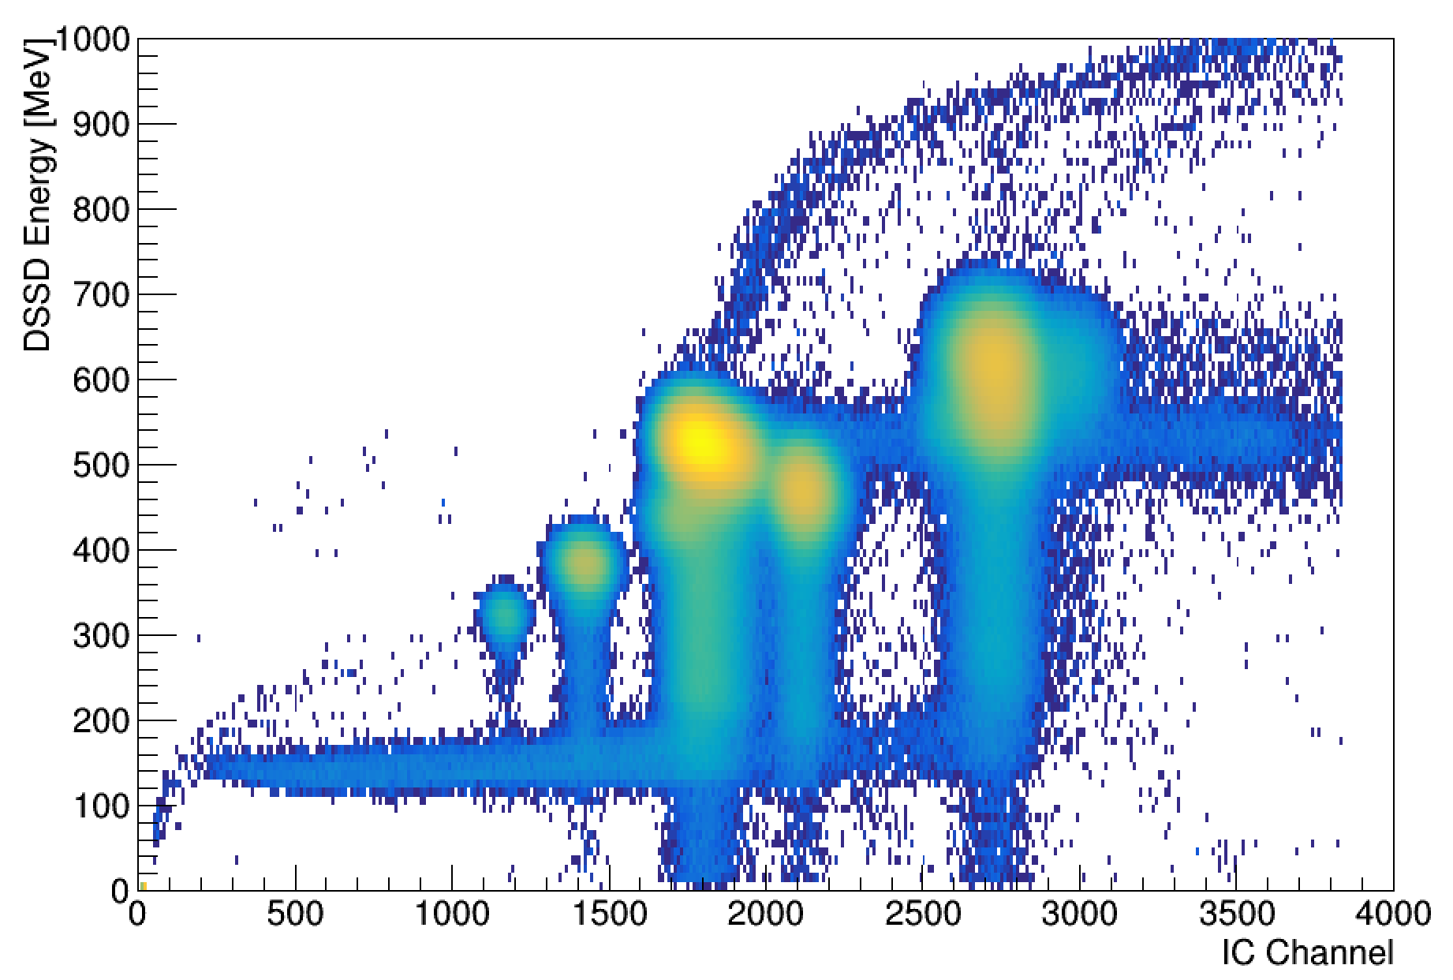
Diagnosing beam composition with IRIS
p
IC and downstream Si together can be used to identify
Example: ⁹³Kr beam delivered last year
Three strongest components: stable isobar ⁹³Nb, stable A/q near-analogue ¹¹⁸Sn
H₂
Down-stream Si
Beam
Ionization Chamber
Si
Si – CsI(Tl)
⁹³Nb
⁹³Kr
¹¹⁸Sn
Ion Chamber energy
Downstream S3 energy
Notes:
93Kr produced with proton beam on UO₂ target

Slide 34
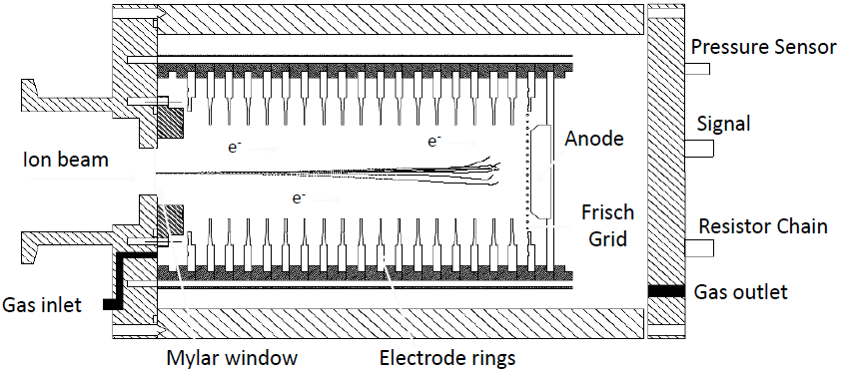
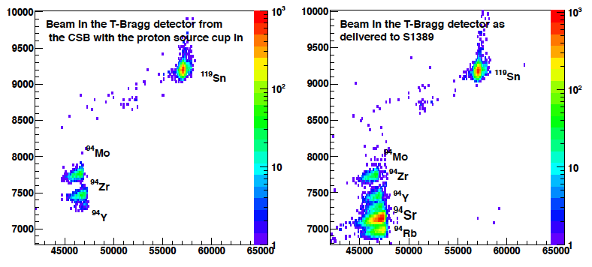
Diagnosing beam composition: Tbragg
Cylindrical chamber with axial drift
P-8 gas ~700 mbar
(Ar/CH4 92:08, non-flammable, non-toxic)
Digitization of Anode Signal
Pulse shape analysis
➔ “ΔE” and “E” values
Weinzierl, Diploma TU Munich
Nobbs, MSc, Univ. Surrey / TRIUMF
Accelerator chain set up for A/q = 6.260 for ⁹⁴Sr¹⁵⁺
Stable contaminants: Isobars, and ¹¹⁹Sn¹⁹⁺ A/q=6.258
With A=94 RIB from ISAC injected
⁹⁵ISAC yield: ~ 2•10⁸ pps
⁹⁴Sr on-target yield: ~3•10⁴ pps
Part of same campaign as Sr(d,p/t) results
¹¹⁹Sn
¹¹⁹Sn
⁹⁴Mo
New
A=94:
Y
Sr
Rb
⁹⁴Zr

Slide 35
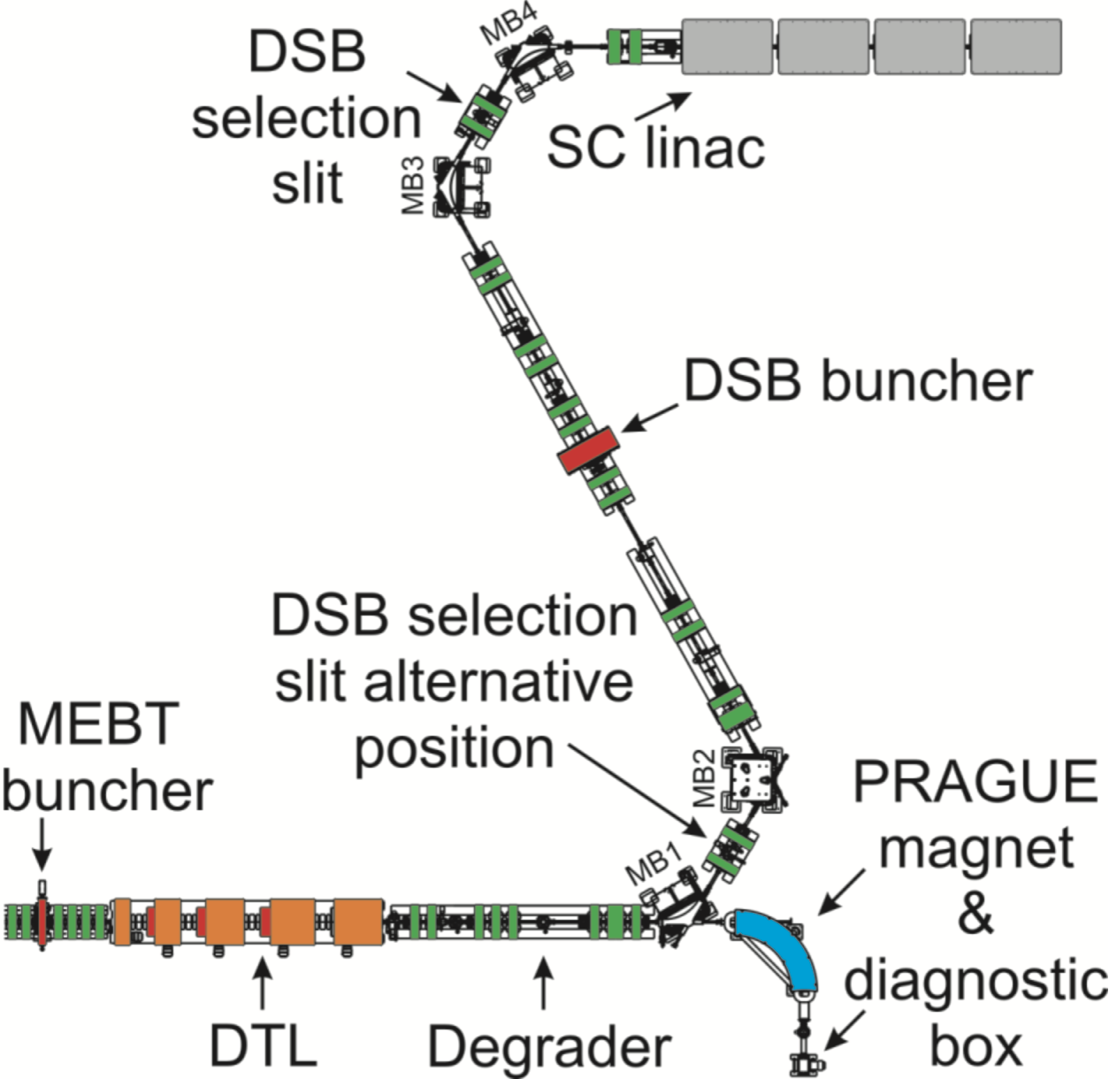
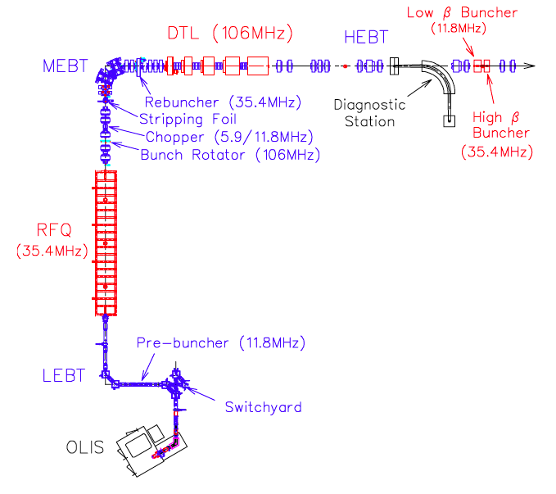
Eliminating contaminants and improving beam purity
F
D2
Three steps of filtration
Time-of-flight from prebuncher A to RFQ B to match RFQ phase accpetance
  resolving power of 1000
(optional) Stripper foil at C, Z² energy loss: beams momentum-dispersed at slits at bending magnets D1 & D2
  Resolving power ~300
Time-of-flight from DSB buncher E to superconducting linac F by phase adjustment
  Resolving power of 800
E
D1
C
B
A

Slide 36
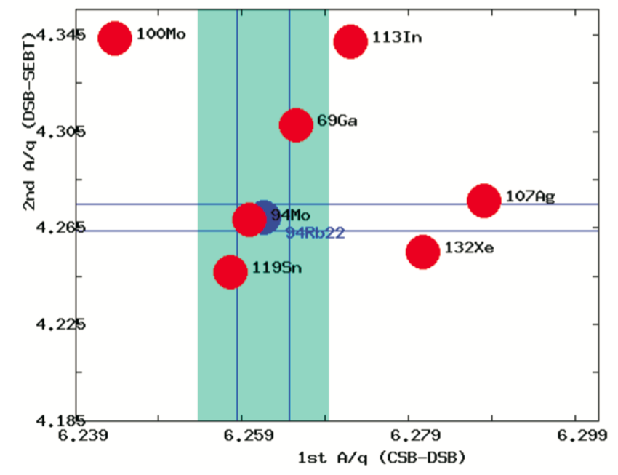
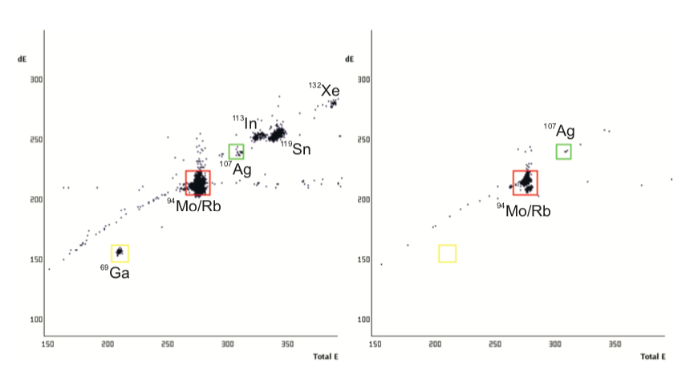
Eliminating contaminants and improving beam purity
Charge state from CSB and after stripper foil are free parameters
Web tools developed to predict optimal settings, design experiment
Graph: ⁹⁴Rb at 15+ out of CSB, 22+ after stripper foil
Bottom plots: phasing (left), then full phasing and dispersion stripping (right).
Other mitigations:
  Aluminum liner in ECR – done
  CANREB EBIS – future

Slide 37
Summary
There are compelling nuclear physics questions that can be addressed with accelerated heavy-ion radioactive beams, in particular on astrophysics and nuclear shapes and shape coexistence
TRIUMF-ISAC has an accelerator complex, including a charge state breeder, capable of reaching the beam energies needed, and the fleet of experimental tools needed, for answering these questions.
Beam requirements include purity, which can be measured and addressed by various means.

Slide 38




Thank you
Merci
www.triumf.ca
Follow us @TRIUMFLab

Slide 39
Thank you
Merci
www.triumf.ca
Follow us @TRIUMFLab

Slide 40
Thank you
Merci
www.triumf.ca
Follow us @TRIUMFLab

Slide 41
Thank you
Merci
www.triumf.ca
Follow us @TRIUMFLab

Slide 42
Thank you
Merci
www.triumf.ca
Follow us @TRIUMFLab

