Slide 1
CANREB Quadrupole Buncher: simulations and status update
Mathieu Cavenaile
NACB 2019 Workshop, June 10th, 2019

Slide 2
Introduction
Rare Isotope Beams (RIB)
  Required to investigate nuclear reactions and exotic nuclear structures
  Difficult to produce and maintain
  Need fast production, high intensity and high purity
  Post acceleration for experiments: high charge states required
CANREB
  CANadian Rare isotope facility with Electron Beam ion source
  Objectives: RIB with:
      intensity up to 100 pA
      high purity
      high charge states (A/q < 7 for ISAC post acceleration chain)

Slide 3
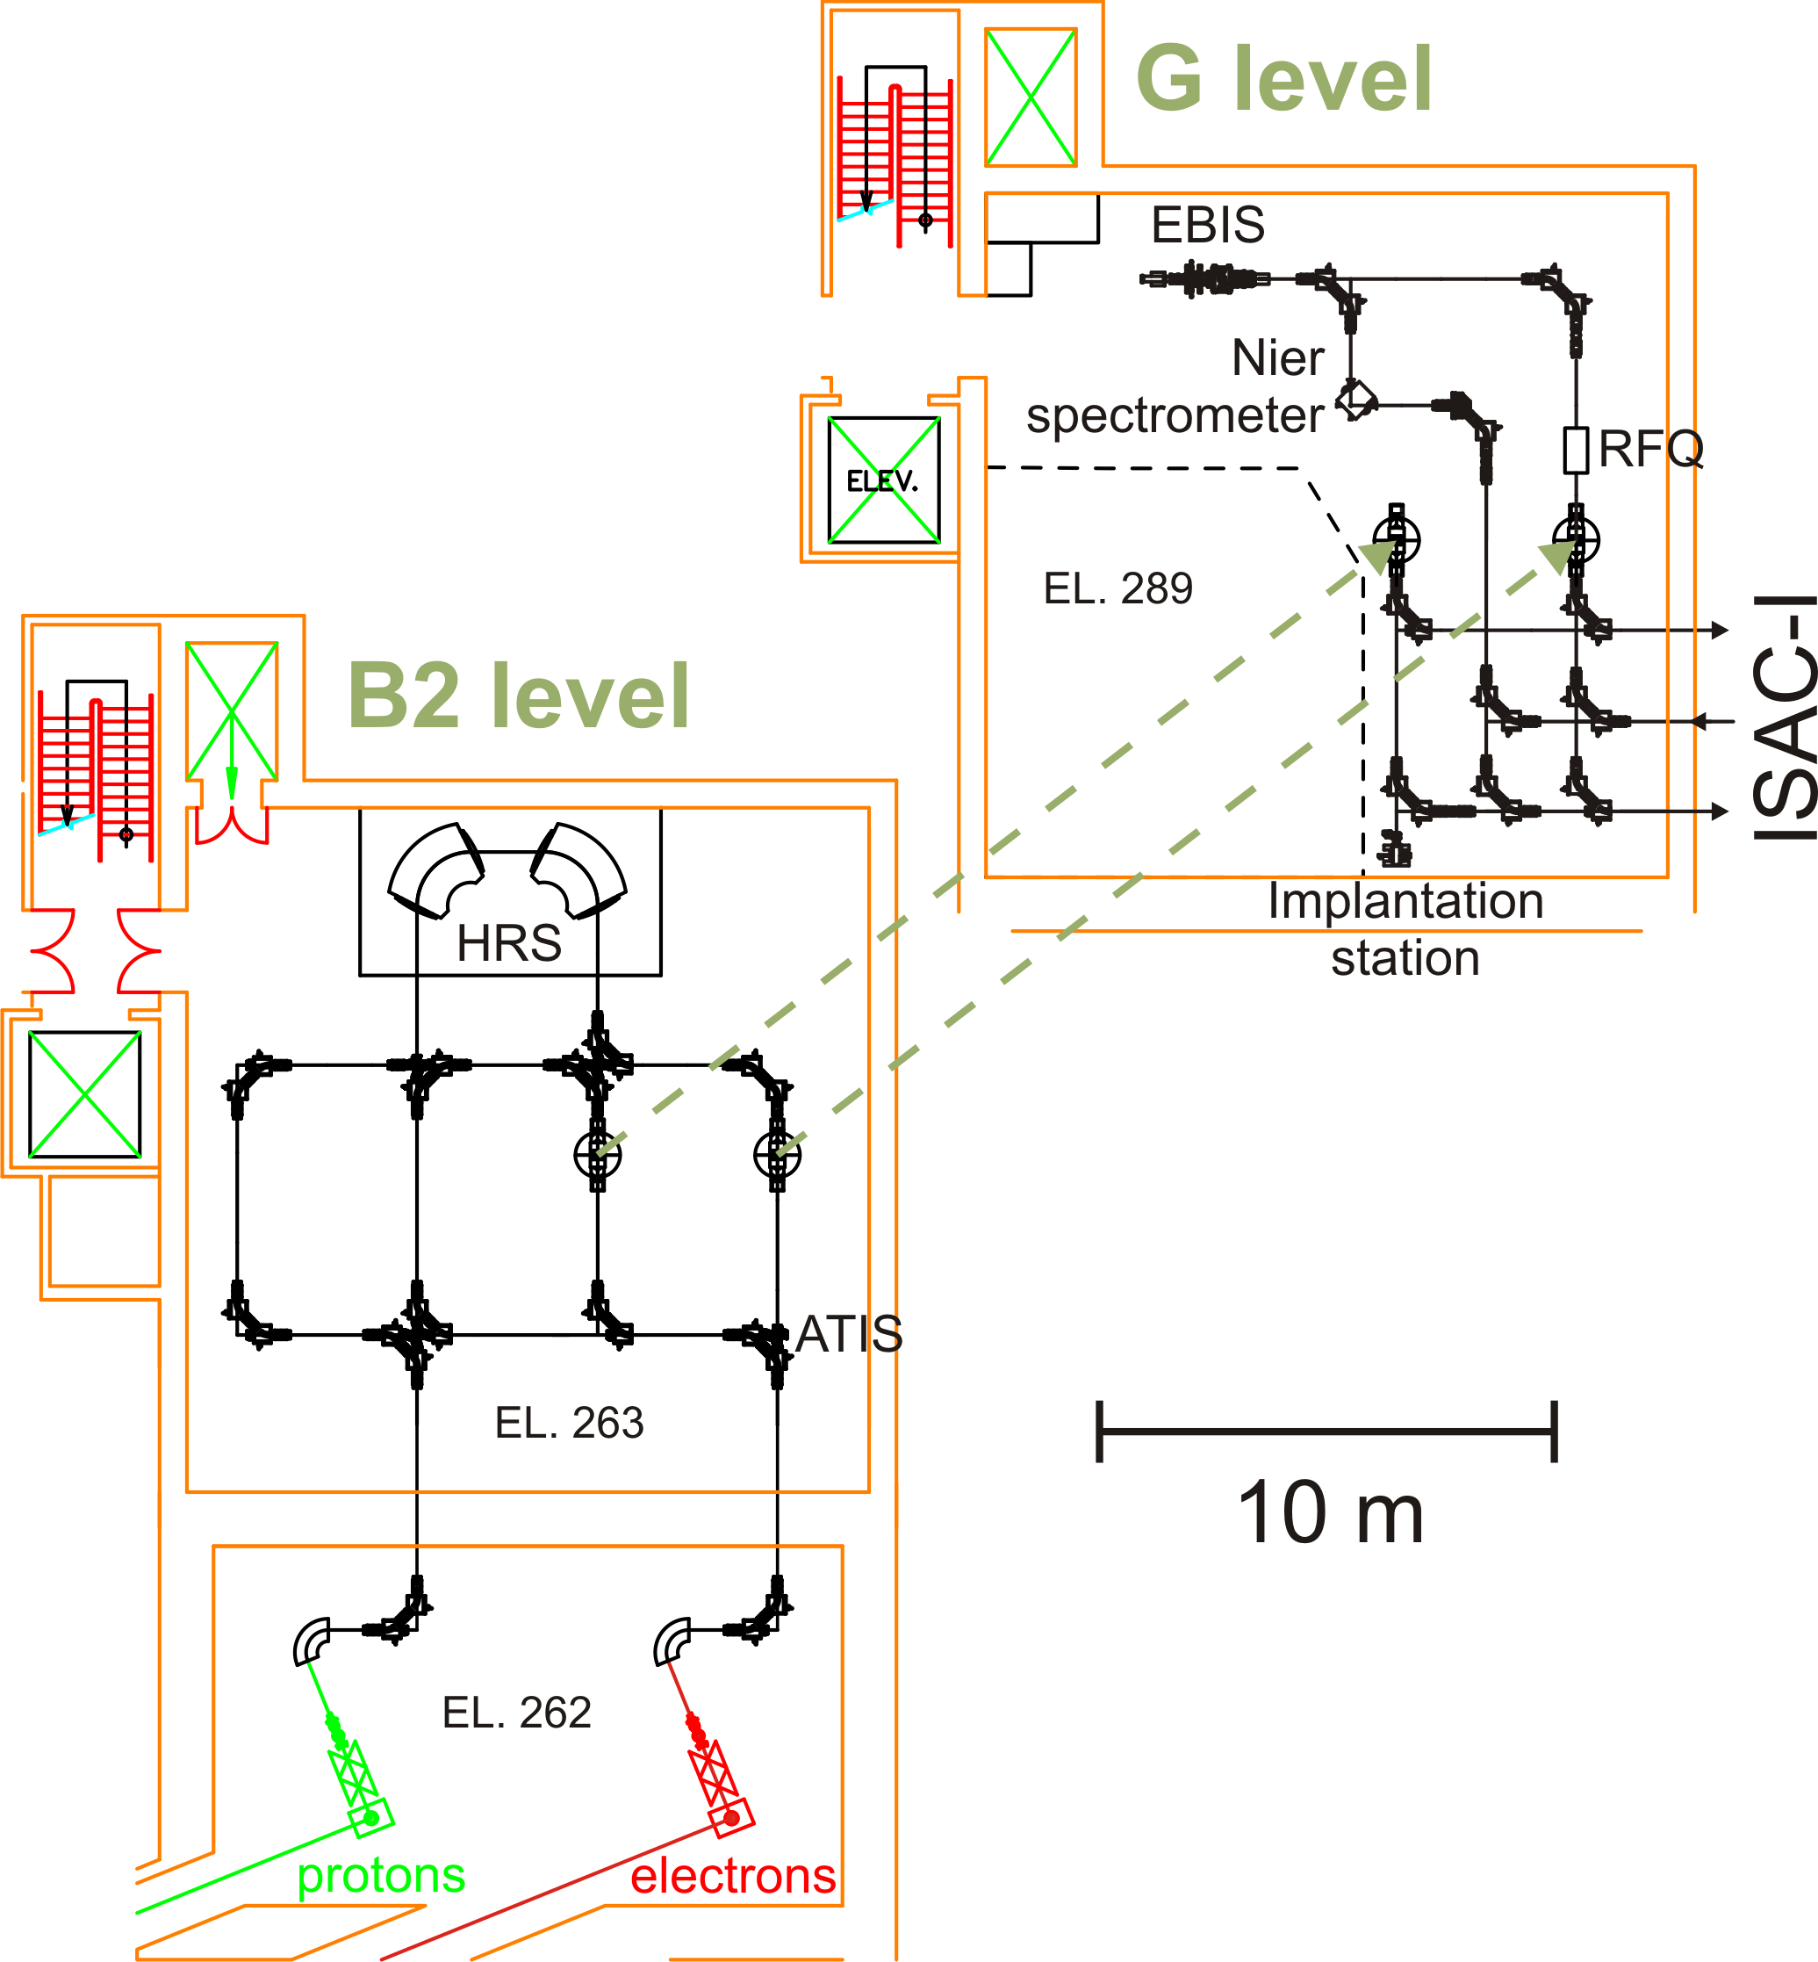
CANREB Overview
CANadian Rare isotope facility with Electron Beam ion source
High Resolution mass Separator (HRS)
ARIEL Radiofrequency Quadrupole Buncher (ARQB)
Pulsed Drift Tube (PDT)
Electron Beam Ion Source (EBIS) charge state breeder
Nier spectrometer
PDT
test ion source

Slide 4
CANREB schedule
Commissioning underway using ARIEL Test Ion Source and TRIUMF’s OffLine Ion Source
Stable beams (Cs, Rb) tests ongoing
First radioactive beam scheduled for September 2019 (Rb isotopes)

Slide 5
Outline
Introduction and CANREB overview
RFQ: principle and design
Simulations
Measurements and results
Conclusions and perspectives

Slide 6
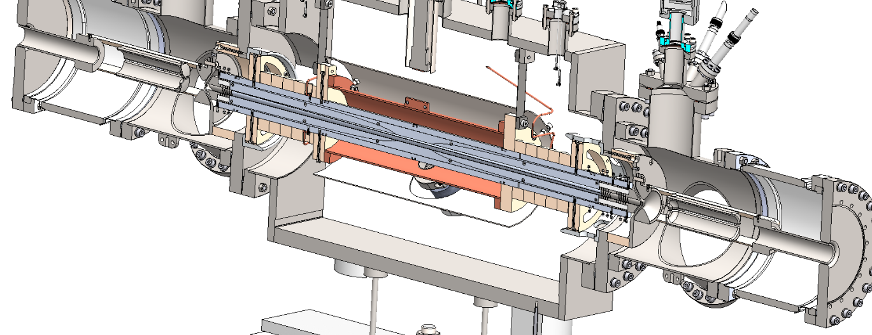
RFQ: principle and design
SolidWorks view of the inside of the ARQB

Slide 7
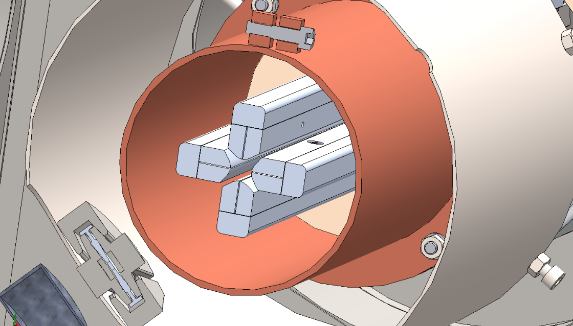
RFQ principle
Radiofrequency quadrupole: cooling and bunching of singly charges ion beams
Quadrupole: 4 rods for transverse confinement
DC voltage to drive the ions
Buffer gas for cooling
Trapping electrode for bunching
Placed on a isolated deck at (up to) 60 kV
SolidWorks view of the rods

Slide 8
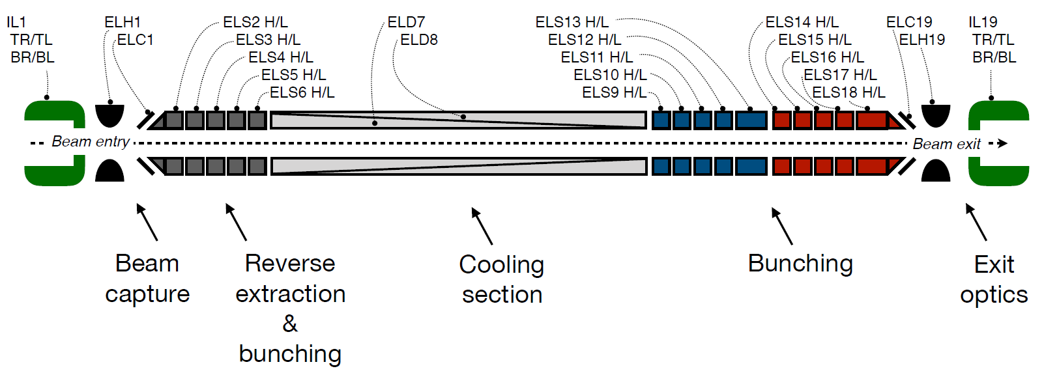
RFQ sections

Slide 9
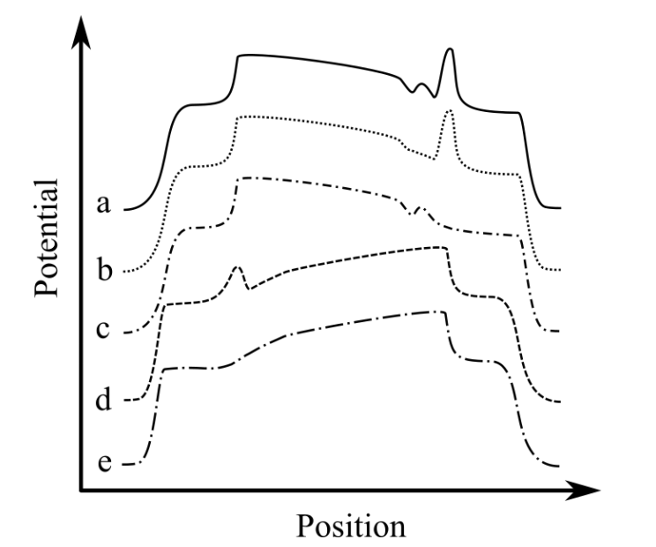
Bunch extraction potential
RFQ Trap potential
Trapping electrodes at high potential to accumulate ions (a)
Switch to low potential to release bunch (b,c)
Reverse extraction also possible (d,e)

Slide 10
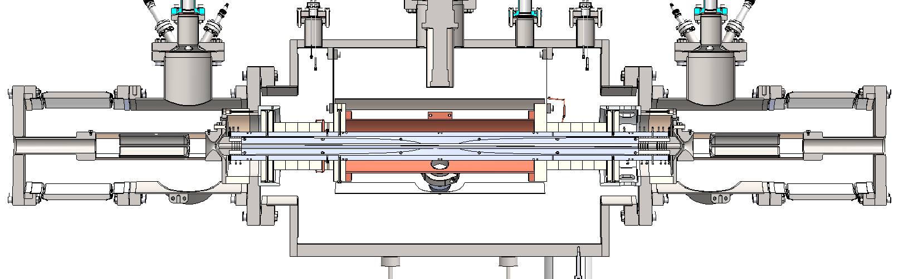
SolidWorks model
Beam entry
Beam exit
Beam capture
Cooling section
Bunching section

Slide 11
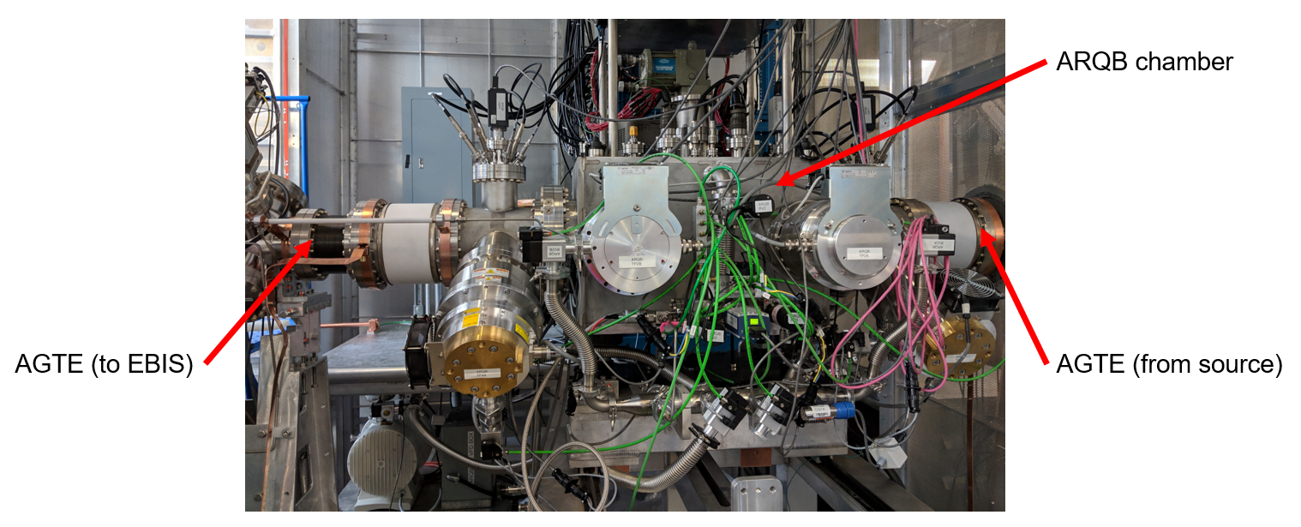
RFQ overview
RFQ chamber

Slide 12
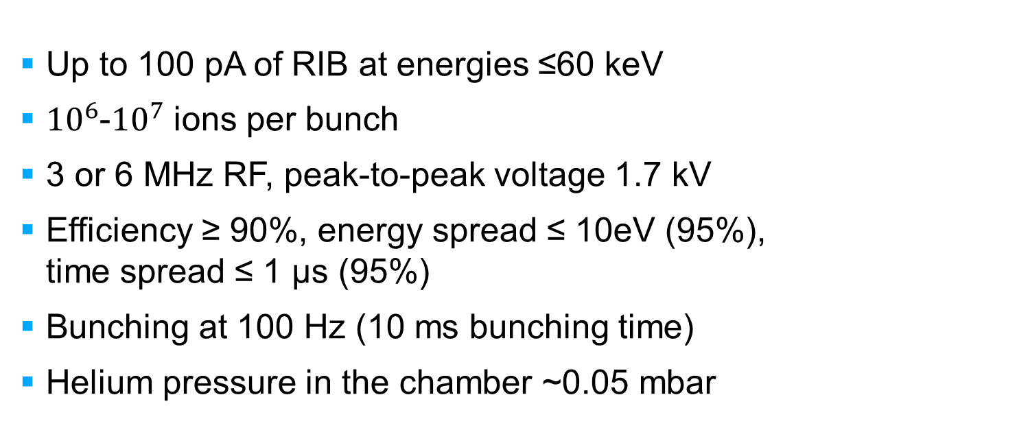
Design characteristics
Up to 100 pA of RIB at energies ≤60 keV
${10}^{6}$-${10}^{7}$ ions per bunch
3 or 6 MHz RF, peak-to-peak voltage 1.7 kV
Efficiency ≥ 90%, energy spread ≤ 10eV (95%), time spread ≤ 1 µs (95%)
Bunching at 100 Hz (10 ms bunching time)
Helium pressure in the chamber ~0.05 mbar

Slide 13
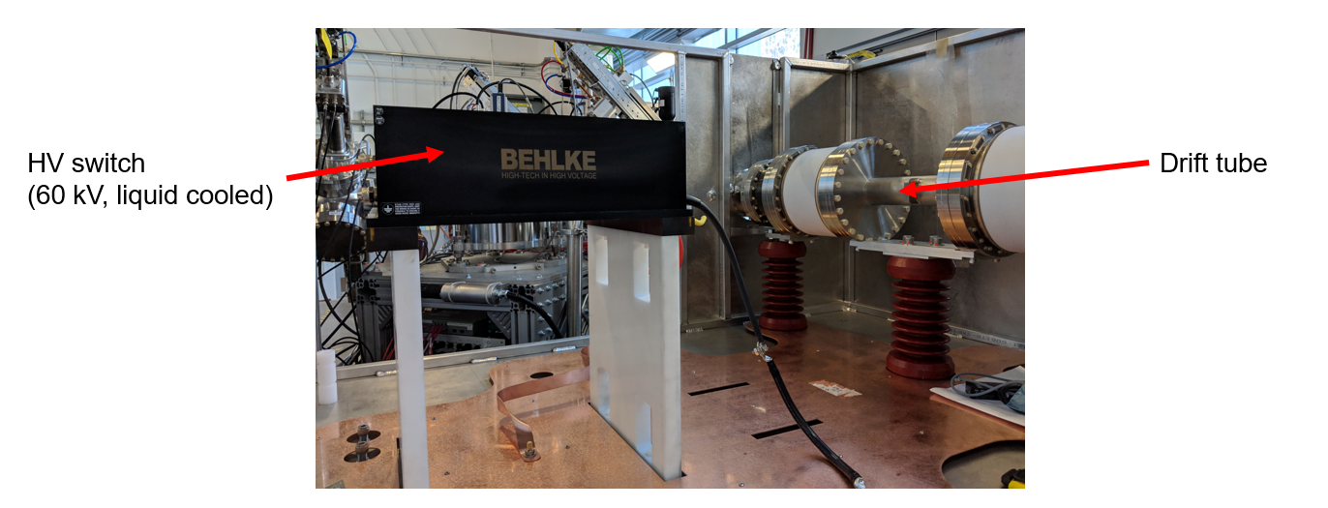
Pulsed drift tube
Beam back at max energy after going through the RFQ
Energy matching done by the PDT
Switch from 48 kV to ground at
100 Hz
CANREB PDT
48 kV switch
Drift tube

Slide 14
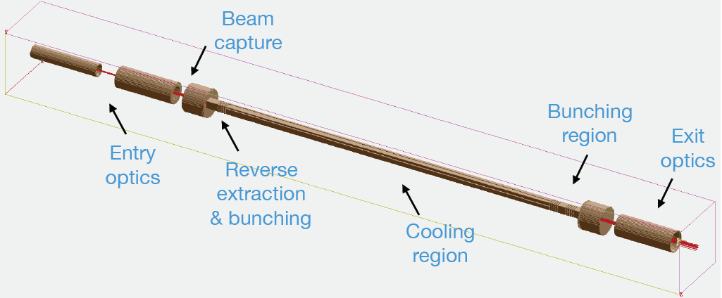
Simulations
SIMION Model of the ARQB

Slide 15
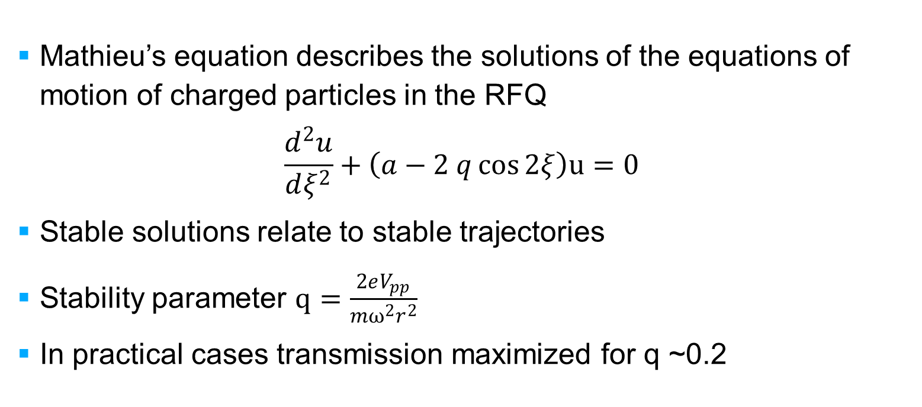
RFQ: Theory
Mathieu’s equation describes the solutions of the equations of motion of charged particles in the RFQ
$$\frac{d^{2}u}{dξ^{2}}+\left(a−2 q\cos{2ξ}\right)u=0$$
Stable solutions relate to stable trajectories
Stability parameter $q=\frac{2eV_{pp}}{mω^{2}r^{2}}$
In practical cases transmission maximized for q ~0.2

Slide 16
Simulations overview
Goals:
  Evaluate optimal operation parameters
  Evaluate device acceptance
  Measure beam characteristics after RFQ
SIMION: particle tracking software
Calculate charged particles trajectories in potentials defined by the user
RFQ SIMION model

Slide 17
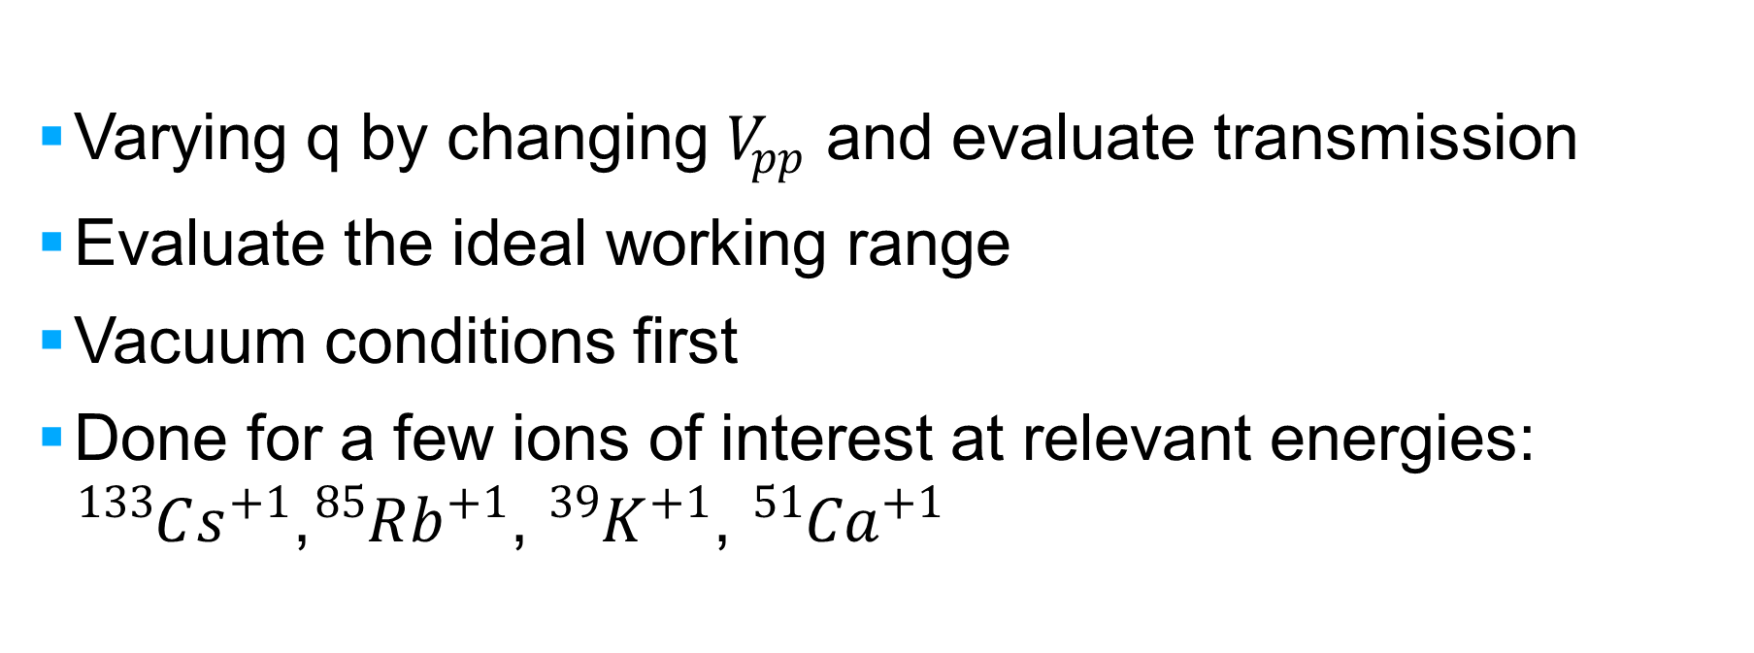
Q scans
Varying q by changing $V_{pp}$ and evaluate transmission
Evaluate the ideal working range
Vacuum conditions first
Done for a few ions of interest at relevant energies: ${}_{ }^{133}{Cs^{+1}}$,${}_{ }^{85}{Rb^{+1}}$, ${{}_{ }^{39}K}^{+1}$, ${{}_{ }^{51}{Ca}}^{+1}$

Slide 18
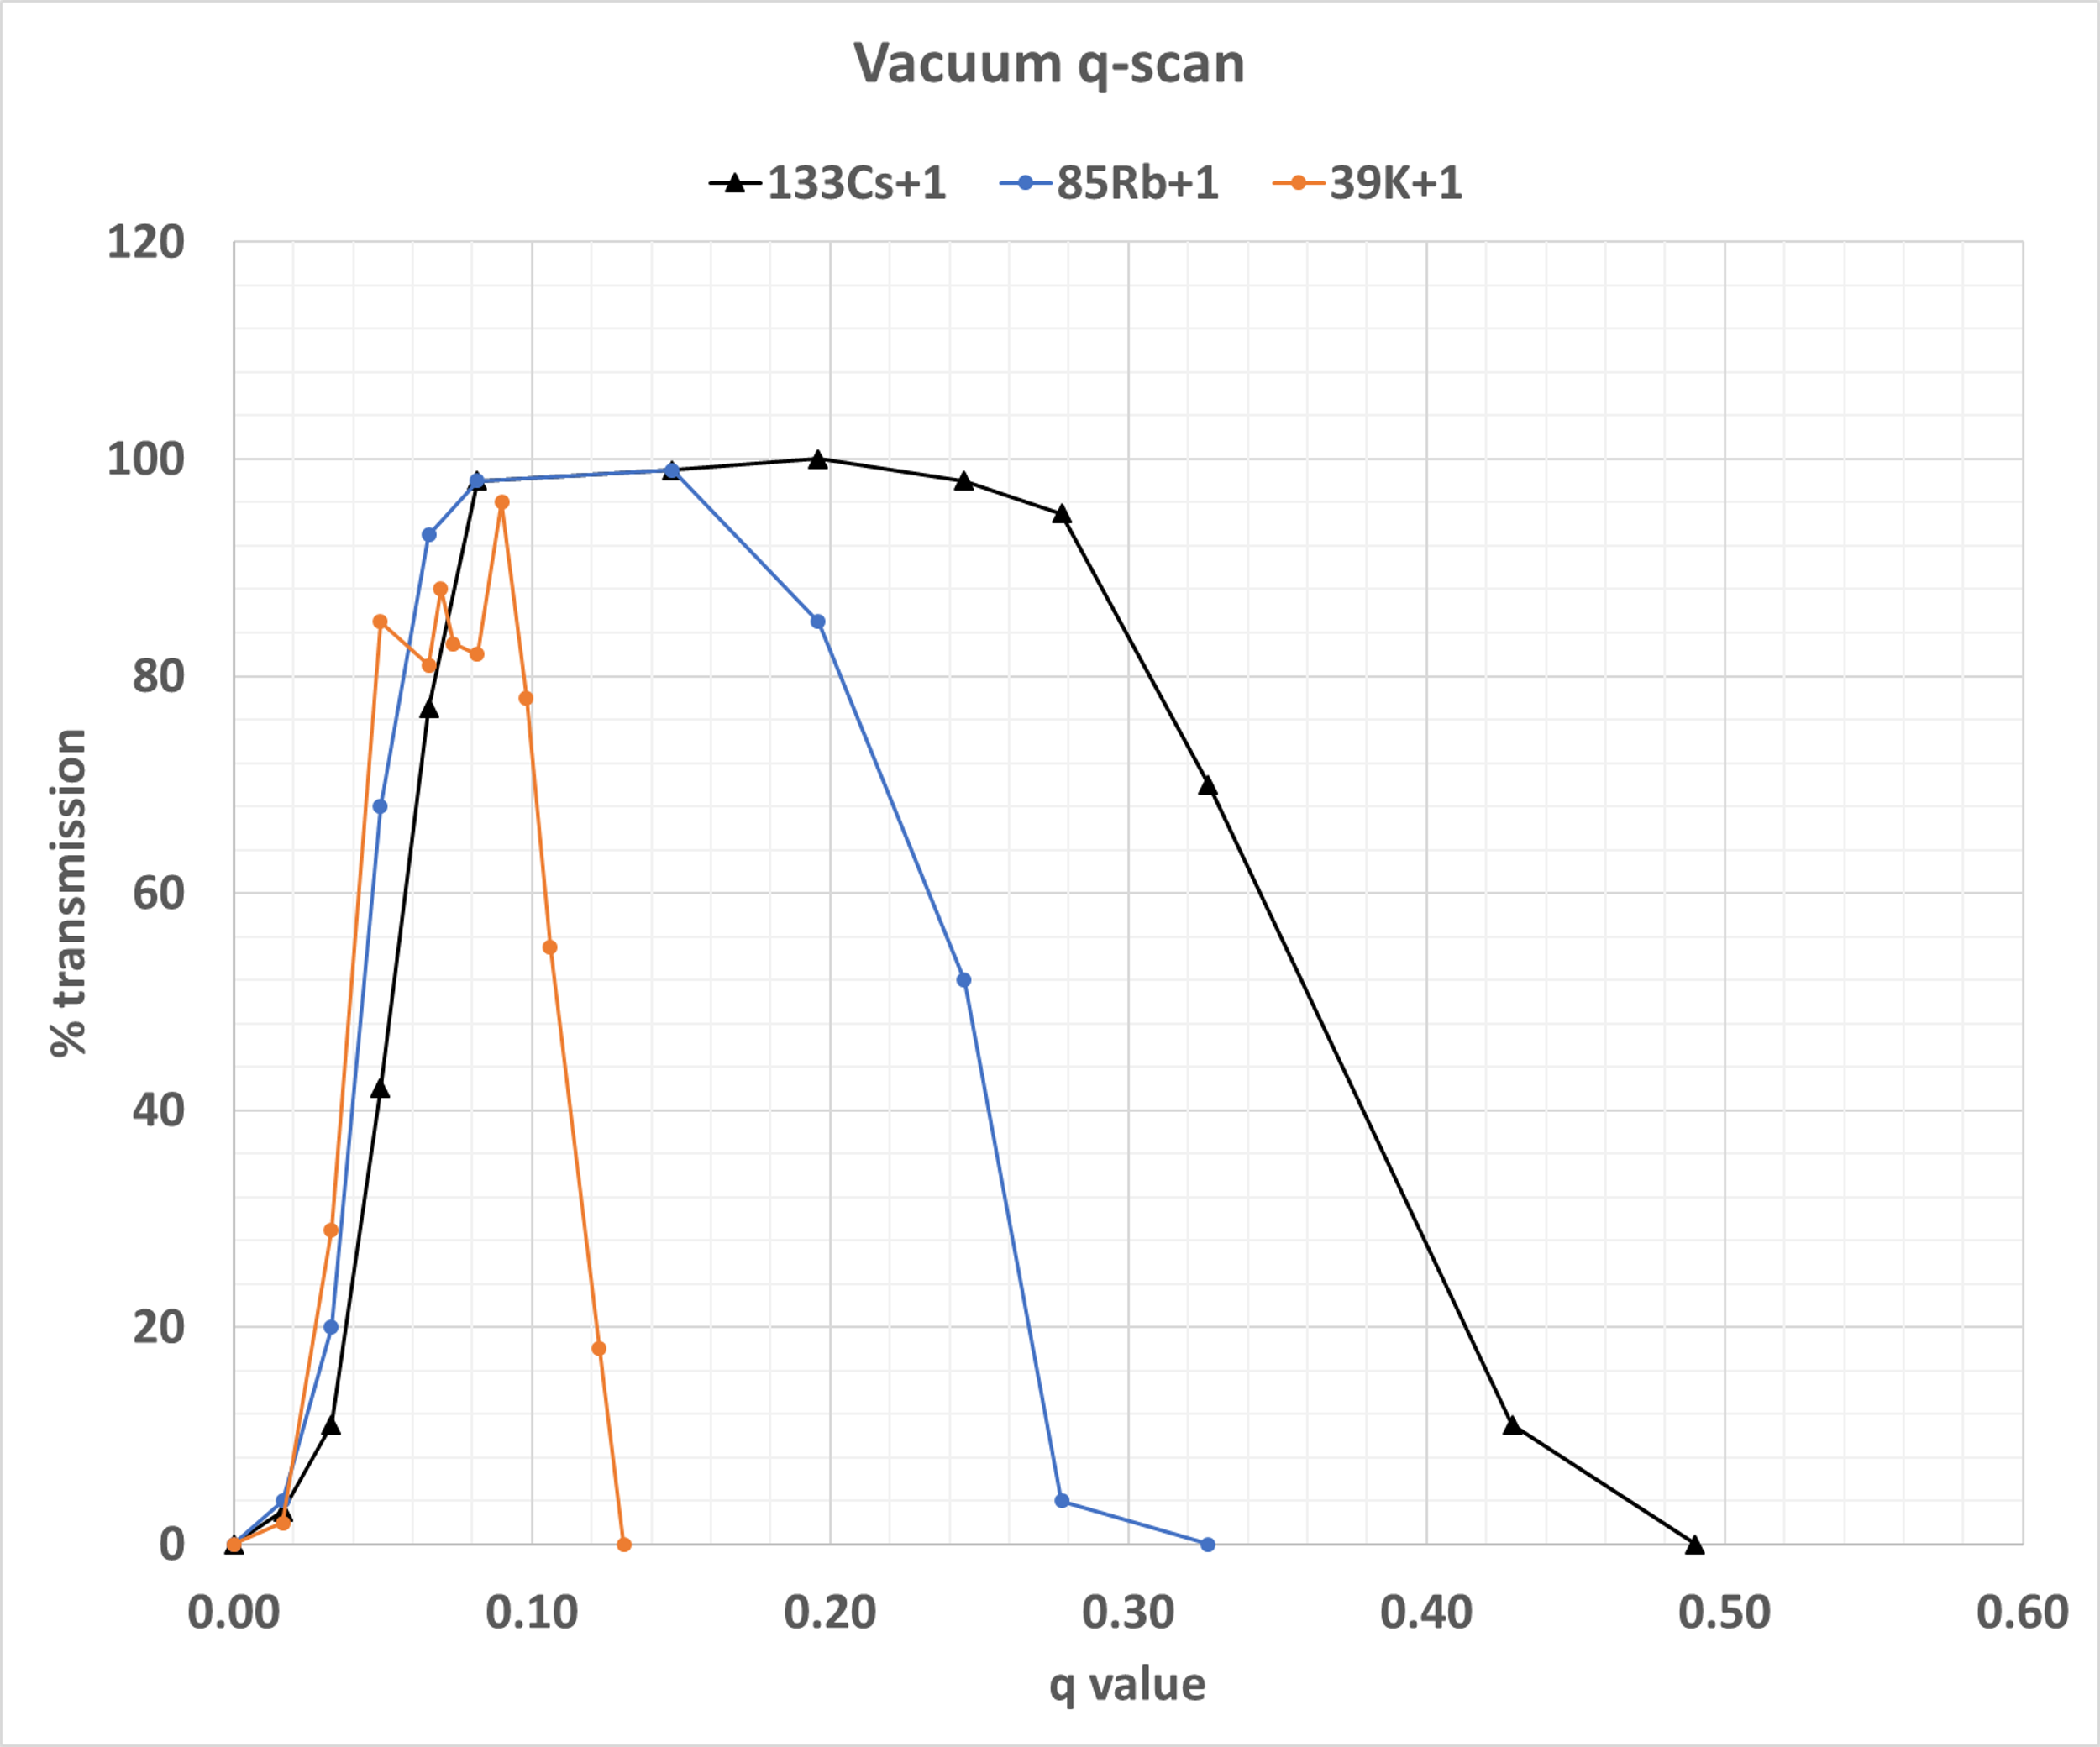
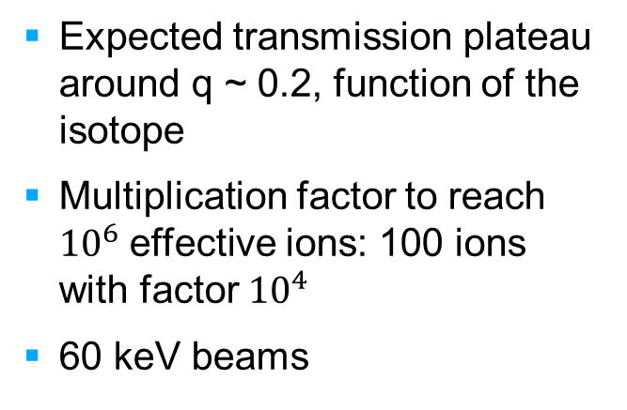
Q scans (2)
Expected transmission plateau around q ~ 0.2, function of the isotope
Multiplication factor to reach ${10}^{6}$effective ions: 100 ions with factor ${10}^{4}$
60 keV beams

Slide 19
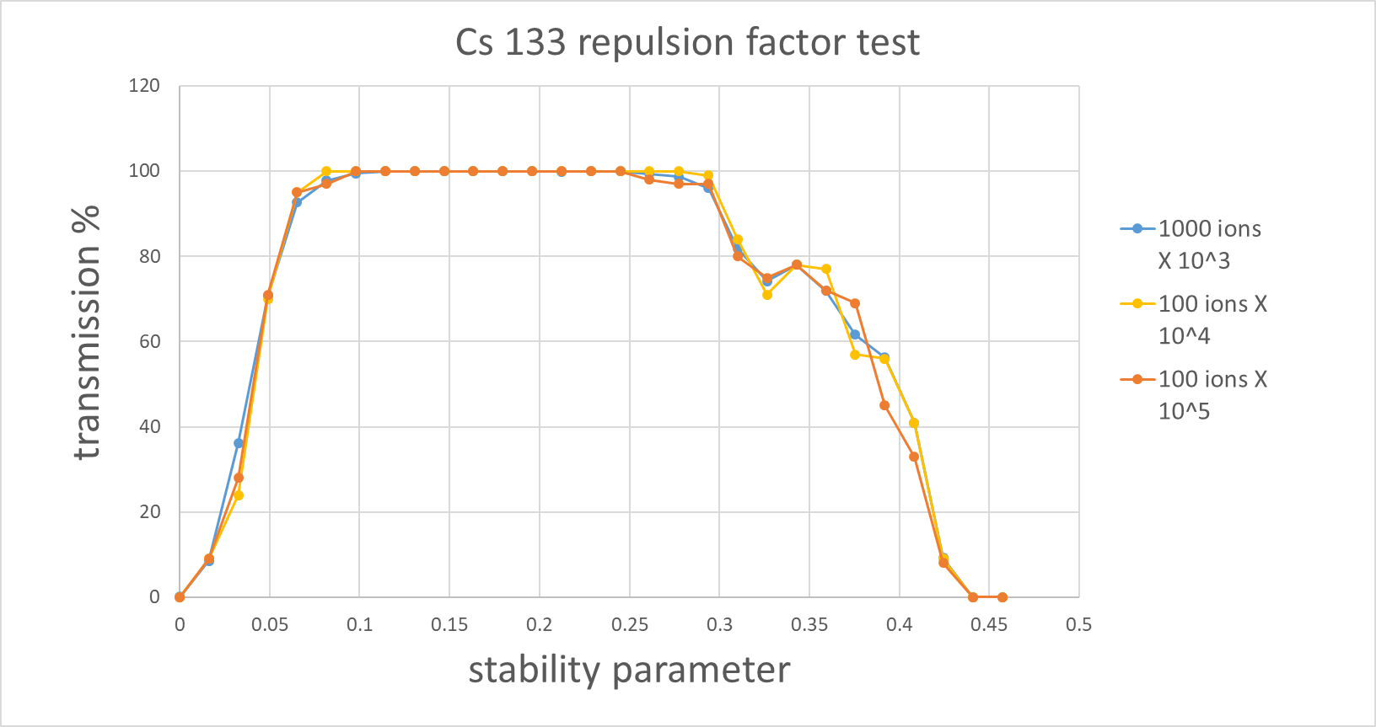
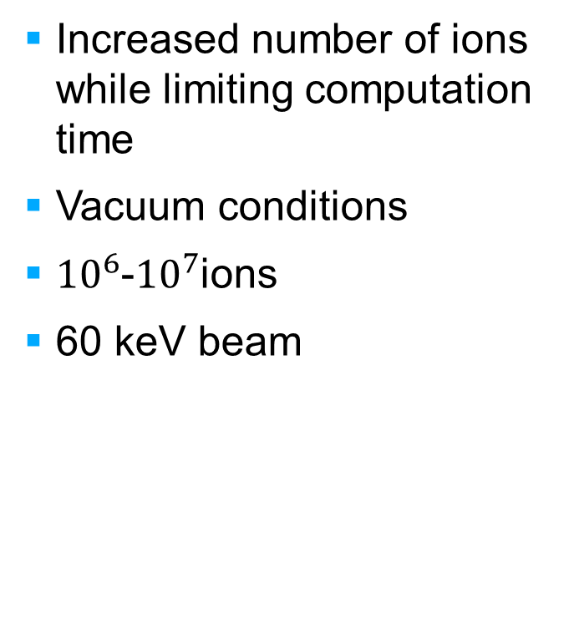
Multiplication factor
Increased number of ions while limiting computation time
Vacuum conditions
${10}^{6}$-${10}^{7}$ions
60 keV beam

Slide 20
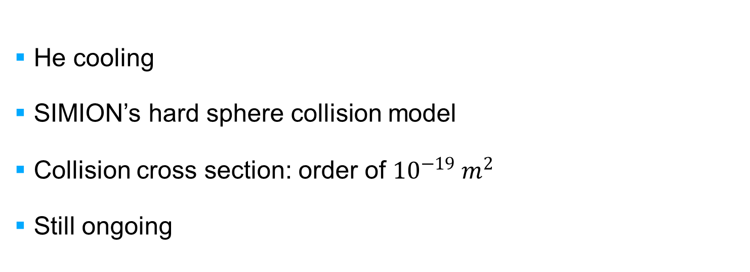
Simulations with cooling
He cooling
SIMION’s hard sphere collision model
Collision cross section: order of ${10}^{−19} m^{2}$
Still ongoing
Beam entry
Beam exit
Cooling simulations example, gas collisions in blue

Slide 21
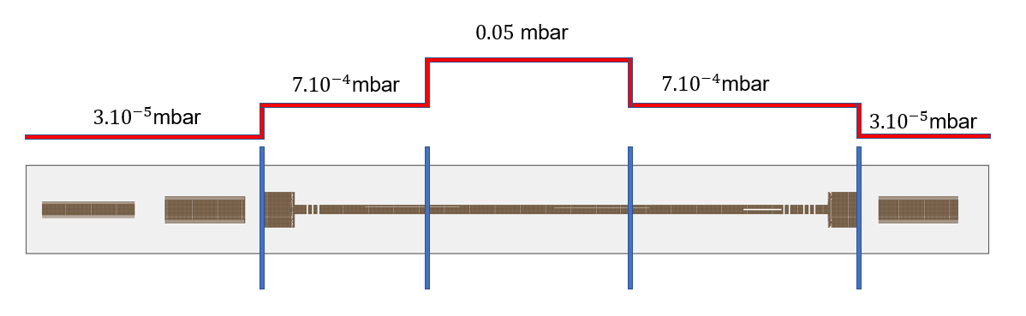
Buffer pressure profile
Beam entry
Beam exit
Step pressure profile
Pressure factor: multiplication factor applied to all pressures

Slide 22
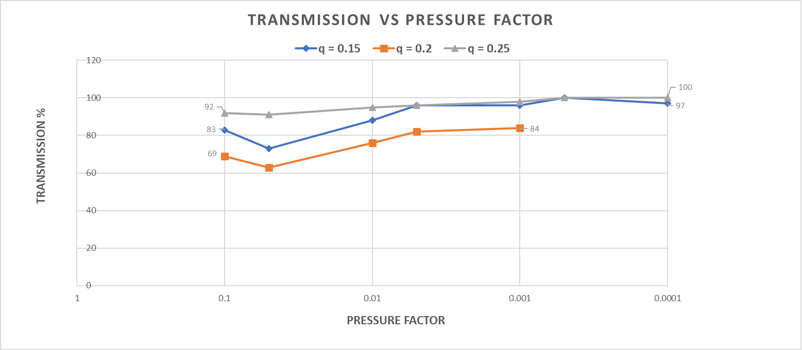
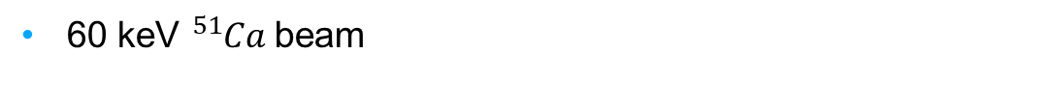
Transmission and pressure factor
60 keV ${}_{ }^{51}{Ca}$ beam

Slide 23
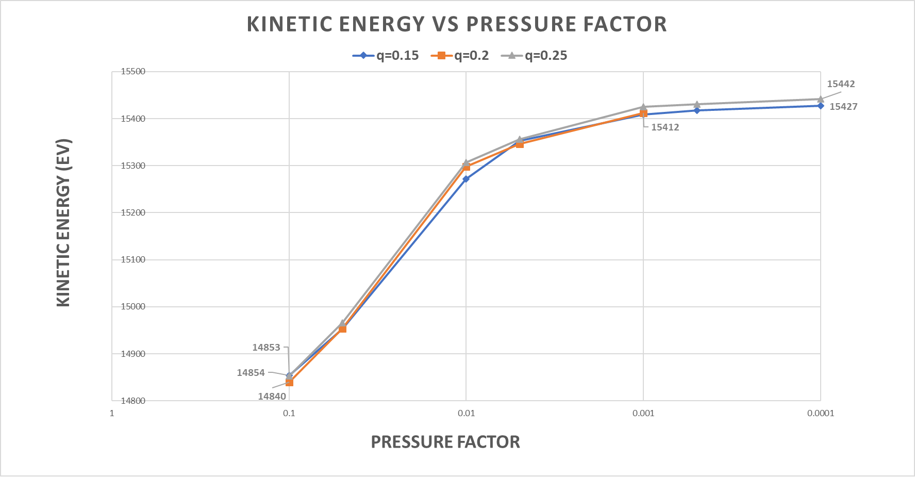
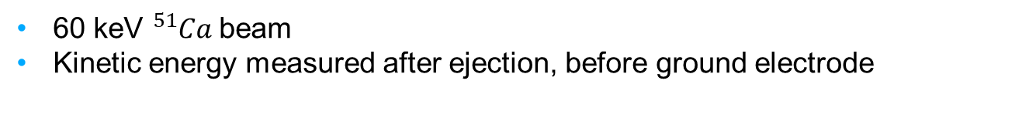
Kinetic energy and pressure factor
60 keV ${}_{ }^{51}{Ca}$ beam
Kinetic energy measured after ejection, before ground electrode

Slide 24
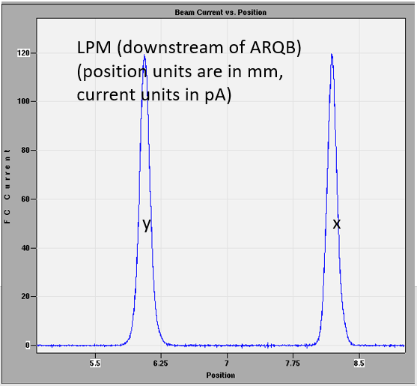
Measurements results and status
Measured beam profile

Slide 25
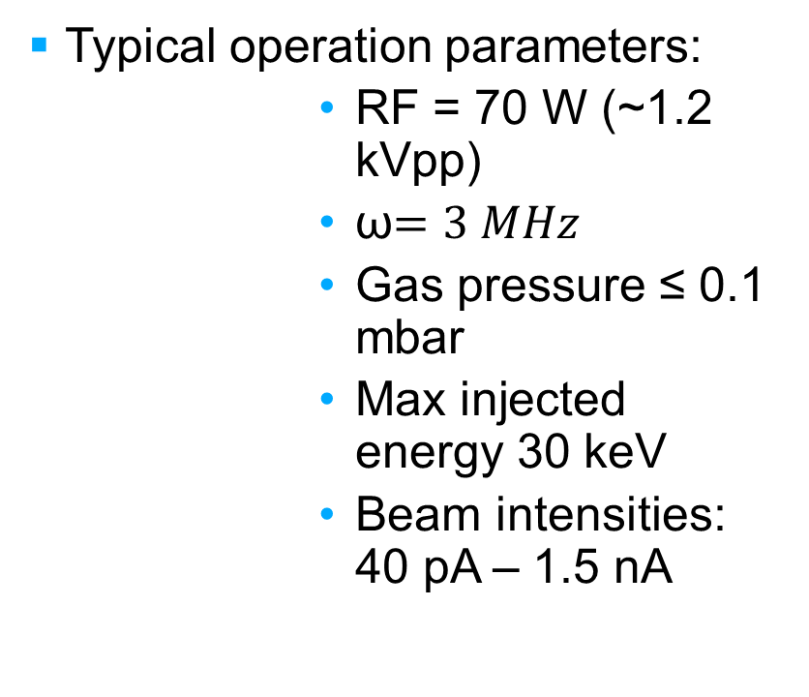
Operation parameters
Typical operation parameters:
        RF = 70 W (~1.2 kVpp)
        ω$=3 MHz$
        Gas pressure ≤ 0.1 mbar
        Max injected energy 30 keV
        Beam intensities: 40 pA – 1.5 nA
Measurement results
    DC transmission >90%
    Bunched transmission
        ~50% (>1 nA)
        >90% (< 300 pA)
    Bunched width: 1 µs (FWHM), 2 µs (95%) (nominal 1 µs)

Slide 26
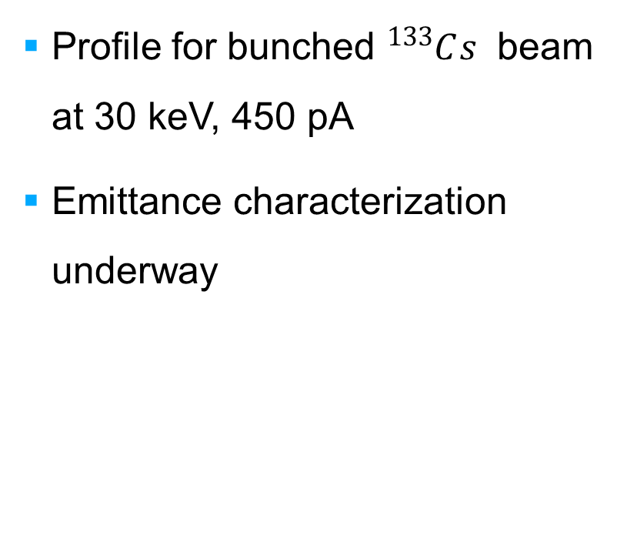
Beam profile
Y and X profiles of the bunched beam
Profile for bunched ${}_{ }^{133}{Cs^{ }}$ beam at 30 keV, 450 pA
Emittance characterization underway

Slide 27
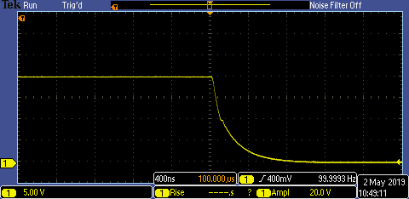
Pulsed Drift Tube
Switched between 48 kV and ground at 100 Hz
~450 ns rise/fall time
No sparking, stable output, regulated temperature
100% transmission of 30 keV beam with PDT@18 kV (no switching)
Fall of the potential in the PDT after switch

Slide 28
Conclusions and perspectives: simulations
Simulations of the CANREB RFQ well underway, with preliminary results and clear objectives
Perspectives and next steps:
    Measure device acceptance in term of angular and energy spread
    Energy and emittance measurement downstream
    More realistic pressure profile from COMSOL Multiphysics package

Slide 29
Commissioning results and next steps
Ongoing commissioning phase
Testing results similar to expected nominal operation
Next steps:
    Systematic characterization of bunched beam
    Optimize parameters for beam delivery: trapping potentials, RF voltage, beam intensity
    Confirm PDT energy matching capabilities

Slide 30
CANREB commissioning team
Christopher Charles, Brad Schultz, Friedhelm Ames, Rituparna Kanungo, Leigh Graham, Marco Marchetto, Suresh Saminathan, Mike Rowe, Matt Pearson, Andrea Teigelhöfer, Tiffany Angus, Justin Lewis, Keerthi Jayamanna, Eric McGlashan, Owen Lailey, Zachary Hockenbery, Geoff Hodgson, Matt Kettle, Anthony Ip, Derek Orth, Marco Lovera, Brian Minato, Tomislav Hruskovec, John Chow, Adrian Watt, Mathew Brownell, Paul Dirksen, John Langrish, David Wager, Julie Cho, Ray Mendoza, Gelo Remon, …
and many more from all TRIUMF services groups

Slide 31




Thank you
Merci
www.triumf.ca
Follow us @TRIUMFLab

